Slide 2
Today we'll discuss:
What is Channel Conflict?
Why is it important to have a "clean channel"?
How can Channel Conflict happen?
How to fix and manage challenges

Slide 3
What is Channel Conflict?
Setting the stage
Defining terms
Who are the players?
What is at stake?
Channel conflict is when brands lose control of brand & product ownership in the retail ecommerce landscape.
Brands
Retail eCommerce partners: Amazon, Walmart, Target for example
Agencies
Distributors
Unauthorized 3P sellers
Revenue (lost Buy Box)
Brand ownership
Profitability
Consumer safety
Brand integrity
Platform fees and penalties
What is Channel Conflict
Why is it important to have a "clean channel"
How can Channel Conflict happen
How to fix and manage challenges
Notes:
What is Channel Conflict
Why is it important to have a "clean channel"
How can Channel Conflict happen
How to fix and manage challenges

Slide 4
Why is it important to get it right?
Setting the stage
Short-term business impact
Long-term business impact
Average Sales Price (ASP) erosion
Lost revenue
Lost Buy Box
Buy box suppression for SC brands
Ineligibility challenges for advertising and merch programs
Questionable product in marketplace
Amazon AVN conversations become focused on additional funding and accrual asks
Difficult to get future cost increases accepted
Channel pricing impacts
Content and brand-messaging challenges
It will cost the brand more to fix and manage over the long term

Slide 5
How does this happen?
Setting the stage
Loose Distribution Model that fuels 3P Sellers
Misalignment of omni-channel & retail initiatives
Loose language in distribution contracts can lead to product getting in the hands of rogue 3P sellers
Price promotions exclusive to one retailer that cuts price on PDP will get picked up by the entire channel
Misaligned omni channel price promotions
Price promotions over 30% have the potential to fuel 3P sellers to resell at lower ASP
Promotions that cut price on PDP

Slide 6
What can we do about it?

Slide 7
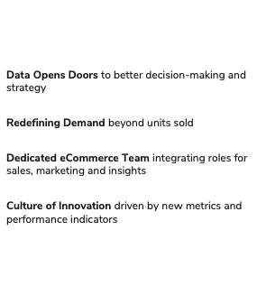
Build Internal Alignment
Now what?
Thought leadership drives change
Before we implement a solve, we need to understand what is controllable, build an all-encompassing strategy, and secure buy-in across the organization
Thought leadership
Notes:
What Internal Conversations need to occur to align for success
eCommerce business owners need to align with Retail sales channel business owners
Price promotions
Distribution contract language
Leadership should be made aware how serious the impact is so everyone works together to solve (majority of times, retail and ecom teams butt heads on this topic)
Consumer safety
Impact to revenue
Ownership of brand presence on Amazon
Profitability will be impacted if rules of engagement are not followed which impact the entire org
-------
Proof of concept
Nothing is immediate, but you have to build a path to being a core part of company growth strategy
-------
Reading through the fix and manage section, here’s a recap of what we have done over the past couple years to address this issue:
Cleaned up distribution to reduce channel conflict
Instituted national promotions vs one-off channel-specific
Better understand the profitability considerations for 3P to reduce arbitrage – so 30% is probably a good threshold, but we also consider potential shipping costs using the Amazon FBA calculator

Slide 8
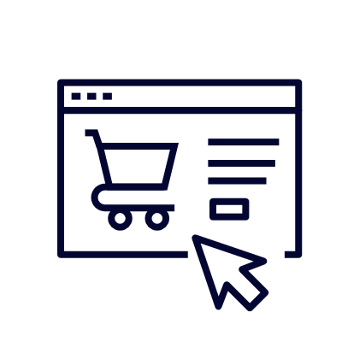
External Playbook
Now what?
Utilize Brand Registry Programs
Brands are masters of their own destiny
Minimize Distributor Leaks
National Promotion Roadmap
Retail platforms put the onus on the brands to manage but must understand and build around the rules of engagement to be successful
Content Ownership & Control
Advertising for Relevance
Notes:
Brand Registry 🡪 Brand Integrity
Project Zero
Transparency
IP Accelerator
MAP
Distributor Best Practices 🡪 Loose Distribution
Set rules and mandate process around who can purchase your products
B&M only
Non-B&M with written permission only

Slide 9
Retailer Best Practices
Now what?
Effective promotion management to limit channel conflict
✓
X
Do…
Don’t…
Implement MAP or iMAP and ENFORCE
Align B&M and retail ecommerce price promotions
Keep everyday price promotions below arbitrage threshold (consider 3P commissions, FBA costs, etc)
Put redemption limits on coupons
Leverage tools to help eliminate unauthorized 3P sellers
Ad-hoc price discounts (ideally use coupon, coupon code or in cart)
Allow retailers to cut price on PDP without brand permission
For CPG brands, run frequent OIs with distributors without strict boundaries for non-B&M customers
Silo your org and make decisions in vacuums
Notes:
Retailer Best Practices
Do not allow retailers cut price on site, price promotions should be reflected via coupon, coupon code or in cart
Align B&M and retail ecommerce price promotions
Put redemption limits on coupons
Keep everyday price promotions below 30% (CPG, need to confirm for CE and fashion)
DO:
Take a macro view of the business

Slide 10
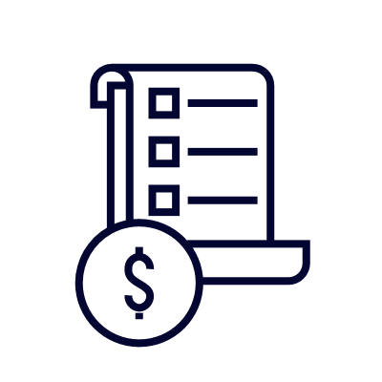
Strategic recommendations for 2021…
Continued eCommerce Thought Leadership
Customer-Centric, Data-Driven Approach to Digital Shelf
Supply Chain Innovations – Be Agile!
Content Optimization and Syndication
Strengthen Agency Partnerships
Notes:
As for what’s next for Panasonic this year:
Content syndication
Supply chain innovations
Legal action (potentially using a company like Vorys)

Slide 11
Thank you!

