Slide 2
Retail Media growth
Did you know?
Retail Media Spending
76%
of brand marketers now agree…
+29.8%
in 2021 YoY
“Growth of our business depends on retail media advertising.”
eMarketer

Slide 3
But what is the impact of our retail media spend?
full
V

Slide 4
“THE KNOWN”
THE TIP OF THE ICEBERG
Media Value
Online Sales

Slide 5
“THE KNOWN”
THE TIP OF THE ICEBERG
Media Value
Online Sales
“THE LESS KNOWN”
Partner Value
Offline Sales
Repeat Rate
Social Validation
Digital Visibility
Offline Placement
CPA Efficiency

Slide 6
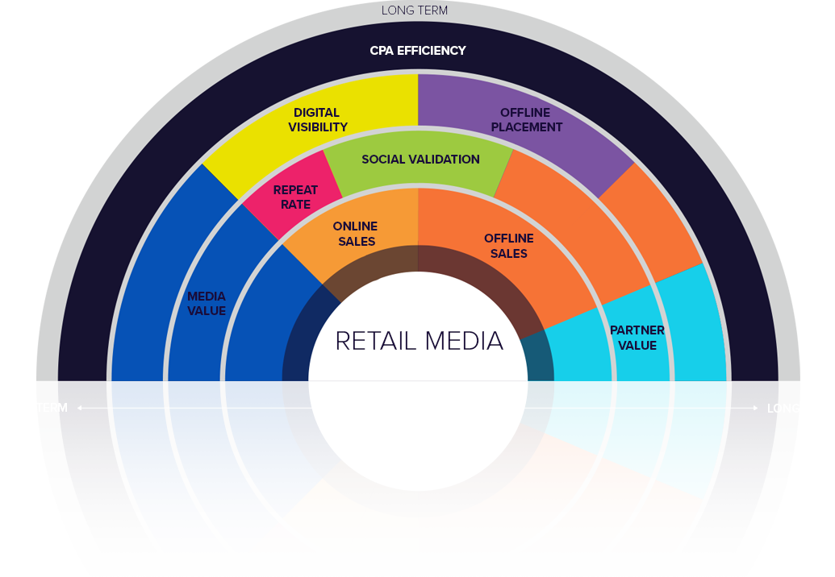
Retail Media IMPACT
A framework for more productive brand media planning and evaluation

Slide 7
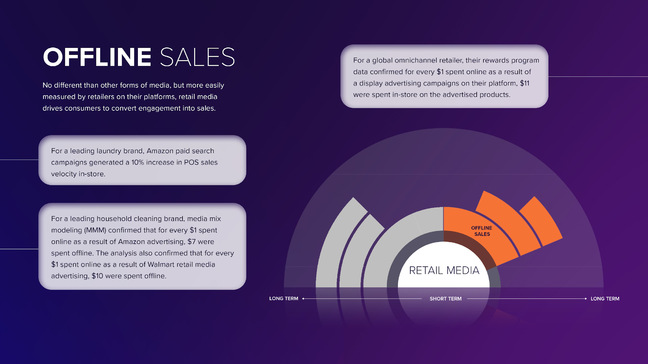
Offline Sales

Slide 8
Digital Visibility

Slide 9
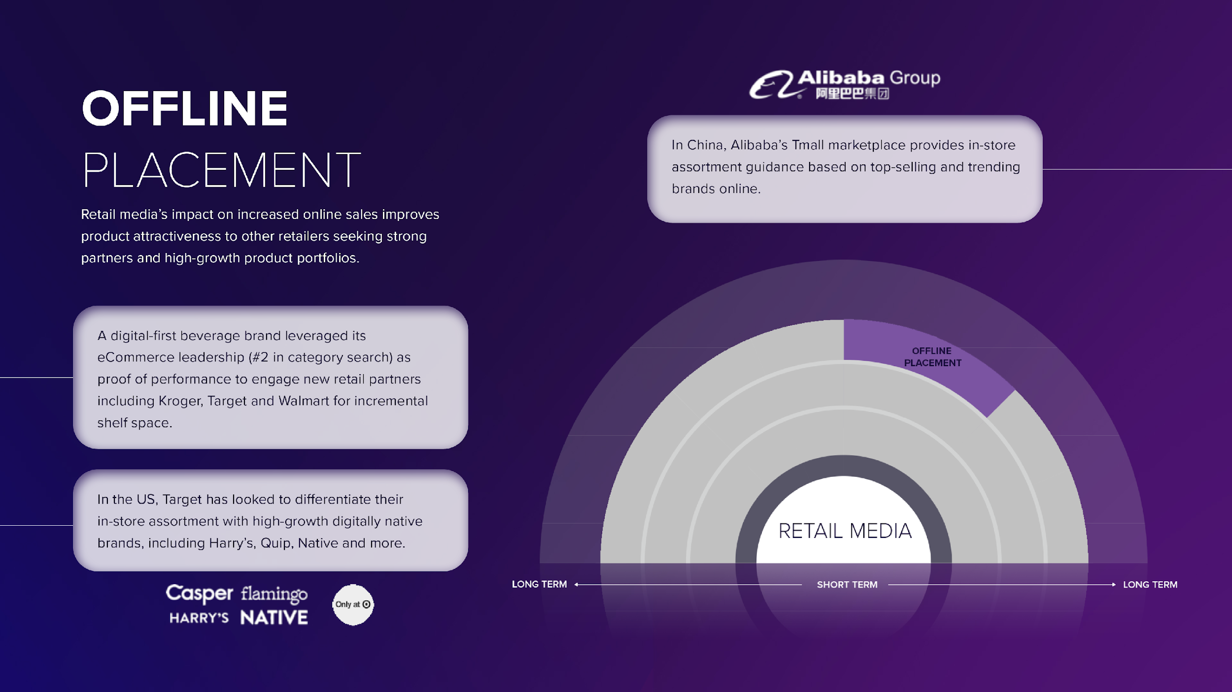
Offline Placement

Slide 10
CPA Efficiency

Slide 11
Retail Media IMPACT
A framework for more productive brand media planning and evaluation

Slide 12
Andrew Pearl VP Strategy and Insight EMEA
Annabelle Gough eBusiness Data & Insights Manager
Chris Perry
Chief Learning Officer
Thank you!

