Slide 1
Colgate-Palmolive

Slide 2
A lot changed in 2020...
“You might know exactly what the organization needs to know and do, but sometimes anything challenging the status quo is not very easily adopted. When this is the case, the most effective way from point A to B might not be a straight line. There is merit in understanding that you may not go the shortest path but take a circuitous route because eventually, you will make everyone a believer.”
— Surabhi Pokhriyal Head of Global Digital Commerce, Colgate-Palmolive

Slide 3
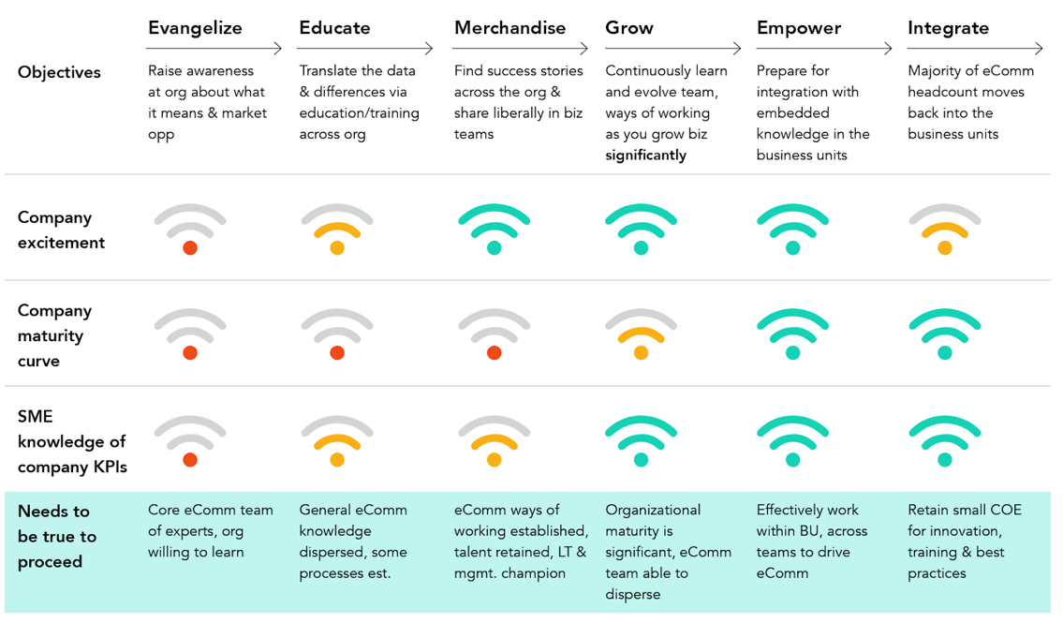
High-performance eComm teams develop through stages

Slide 4
As organizations mature, there are three prevailing organizational structures
INCREASING MATURITY
1
The embedded team
2
The side-car
3
The integrated team
C-Suite
C-Suite
C-Suite
eComm team
eComm COE

