Slide 1
Transportation Provider Orientation

Slide 2
Topics We Will Cover
Who is Hamaspik?
Who and where we serve
Transportation network management
Authorizations (orders)
Accepting or rejecting trips
Billing (claims) for services
Expectations and miscellaneous notes
Key contacts

Slide 3
Who is Hamaspik?
New York State Hamaspik Association Inc. (NYSHA) is a statewide non-profit organization representing a network of member agencies that provide essential health and human services for people in need and their families.
Hamaspik means “provider” in Hebrew.
A New York State-based health plan serving government programs (Medicaid and Medicare) under contract to NYS Dept. of Health and CMS (federal)
Local…based in Rockland County
Health plan employees are from and based all over our service area, including Long Island, NYC, Westchester, Mid-Hudson Valley, and Capital Region

Slide 4
Who and Where We Serve
Hamaspik Choice MLTC plan serves 6 mid-Hudson Valley counties (Dutchess, Orange, Putnam, Rockland, Sullivan & Ulster). Members must have Medicaid and need community-based long-term care services.
Hamaspik Medicare Select Medicare Advantage D-SNP plan; covers Medicare services excludes non-emergency transportation (ambulance service that is medically necessary) and serves 19 counties from Nassau County on Long Island up to Albany (including NYC and Westchester). Members must have Medicare and Medicaid.
Hamaspik Medicare Choice Medicaid Advantage Plus (MAP) plan serves 13 counties from Nassau county to mid-Hudson Valley (includes non-emergency transportation). Members must have Medicare and Medicaid and be in need of community-based long-term care services.

Slide 5
Transportation Network Management
AMBULETTE
WHAT IS COVERED?
MAP & MLTC
Non-emergency transportation to/from health care related services
Prior authorization is required.
Medicaid rules apply.
LIVERY

Slide 6
Transportation Network Management
WHAT IS COVERED?
DSNP
Emergency transport - prior authorization is not required.
Non-emergency transport- must be reviewed first by a Utilization Management Nurse and prior authorization is required.

Slide 7
Transportation Network Management
Transportation Unit receives calls from members and schedules trips with contracted providers.
Members are advised that transportation must be ordered 48 hours in advance and (but there are exceptions)

Slide 8
Authorizations (Orders)
How are they issued?
Depending on provider preference indicated at initial set-up:
Secure E-mail
Fax
What’s Included:
Member name
From address
To address
Date and time
Procedure code
Authorization #
Trip Indications:
1-one way, 2-round trip, 3-three legged trips

Slide 9
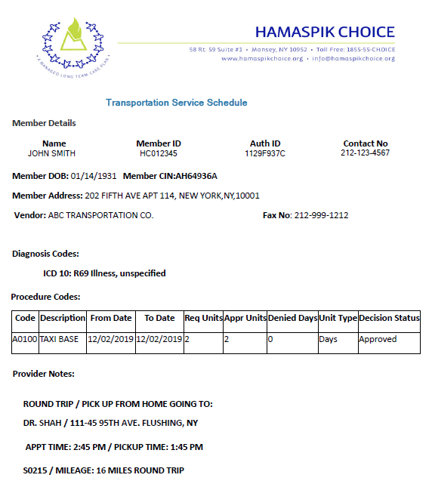
Sample Authorization Form

Slide 10
Accepting or Rejecting Trips
Accepting or Rejecting:
Email or fax response to acknowledge same day as receipt.
Hamaspik staff will call to confirm the day before.
Best practice: Transportation provider should confirm the trip with the member (client) the day before.
No shows: Call Hamaspik Transportation Unit right away if member cancels at the door or does not answer.
Return trips: Member should contact the provider directly.

Slide 11
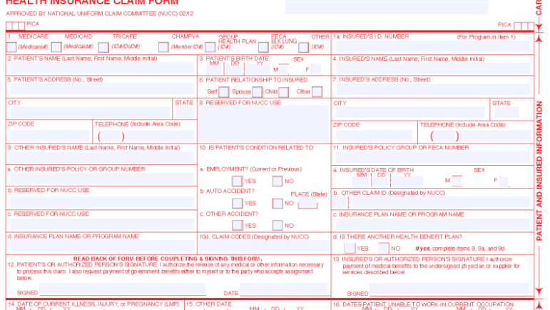
Billing / Claims for Services
Electronic claims (same elements as CMS-1500 claim form) thru Change Healthcare clearinghouse. Hamaspik’s payer ID is: 47738
Paper claims on CMS-1500 to:
Hamaspik, Inc.
Attn: Claims Dept.
58 Route 59, Suite 1
Monsey, NY 10952
Claim info should match the authorization and must include the authorization number
Refer to Provider Manual on Hamaspik website for more details: www.Hamaspik.com

Slide 12
Billing / Claims for Services
Refer to your contract for length of submission for claims.
Payment for clean claims made within NYS requirements
Electronic claims = 30 days
Paper claims = 45 days
Payment via electronic deposit into provider account preferred (providers need to complete & submit ACH form)

Slide 13
Expectations and Miscellaneous Notes
Require member to sign voucher or log, or during pandemic may have the driver make a record of the trip.
Member complaints are investigated by Hamaspik’s Compliance Dept. and prompt response from providers is essential.
Audits. Hamaspik’s Compliance Dept. conducts random audits of all provider types. When requested, providers must be able to furnish proof of providing a service to members.
Provider performance data is considered as part of the credentialing process.
Provider Manual can be found at www.hamaspik.com

Slide 14
Hamaspik Key Contacts
Transportation Unit
Tel :(855) 552-4642, option 3
Fax No. 845-503-1998
Email: Transportation@hamaspikchoice.org
Provider Relations Dept.
Tel. No. (845) 503-0907 or (855) 552-4642
Email: ProviderRelations@hamaspikchoice.org
Claims:
Tel. No (845)503-0578 or (855) 552-4642
Email: Claims@hamaspikchoice.org
24-Hour Emergency Line: (855) 552-4643
Mailing address:
Hamaspik, Inc.
58 Route 59, Suite 1
Monsey, NY 10952

Slide 15
Questions?
We look forward to working with you!

