Slide 1
Conversion
GMV
Business Intelligence
Customer Engagement
Live
Chat
Ecommerce
Data Analytics
SOT
We Love Commerce
Opportunities for Ecommerce in South East Asia
18 September 2020
E-logistics
Digital Marketing
Seller
Centre

Slide 2
Introduction
Leading E-Commerce Enabler in SEA*
Founded End
2014
CAGR FY2015-2018
340%
End-To-End Services
Brand Partners
>300
No Of Employees
>150
Business
Development
Marketing
Solution
Supply Chain
Management
Customer
Engagement
Data
Analytics
Listed On SGX Catalist 08 Aug 2018
Fastest Growing Ecommerce Start Up In Singapore &
One Of The Fastest Growing In SEA (2011-2017) by Frost & Sullivan
Ranked 4th Fastest Growing Company
in Asia-Pacific in 2020 by Financial Times
SG, MY, PH, TH, VN, INDO (6)
HQ in SG
* Frost & Sullivan 2018

Slide 3
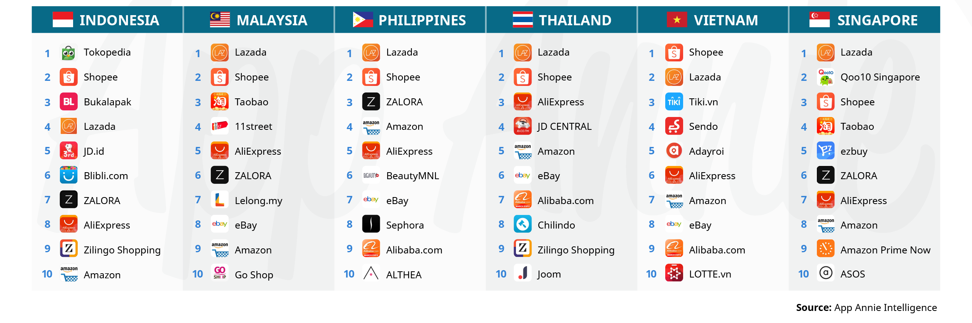
SEA Ecommerce Landscape
2 Dominating Regional Marketplaces – Lazada (Alibaba) and Shopee (SEA)
1 Key Fashion Marketplace – Zalora (in 4 markets)
Local Marketplaces are extremely active in Vietnam and Indonesia
Key Challenges: 6 languages in 6 major SEA countries + 6 different laws and regulations

Slide 4
SEA Ecommerce Value Chain
Business
Advisory
Onboarding & Training
Channel
Management
Account
Management
Content
Development
Solution Introduction
Ideas & Opportunities
Terms & Agreement
Onboarding
Vendor Creation
Training by Synagie
Product Listing
Assortment & Pricing
Channel Tools Optimization
Business Plan
Promotion Planning
Campaign Planning
Product Detail Page
On-site Merchandising
Content Marketing
Brands & Businesses
Consumers
Our End-to-End Solution
Dashboard
Big Data
Business Intelligence
Customer Enquiry
Customer Engagement
Reviews & Ratings
B2B & B2C Delivery
Cross Border Drop-shipping
Importation & Freight
Inbound / Inventory
Pick & Pack / Outbound
Value Added Services
Performance Marketing
Community Engagement
Integrated Marketing
Business
Analytics
Customer Engagement
Delivery &
Fulfilment
Logistics & Warehousing
Marketing Solution

Slide 5
Our 5 Key Pillars
ENABLE
INTEGRATE
SIMPLIFY
INFLUENCE
STRATEGIZE
Customer Business
Development
(CBD)
Strategic Marketing
Solution
(SMS)
Supply Chain
Operation
(SCO)
Customer Engagement
Solution
(CES)
Business Analytics
Solution
(BAS)
Channel Management
Creative Management
Warehousing
Customer
Support
Metrics
Dashboard
Account
Planning
Content
Marketing
Logistics & Fulfilment
Personal
Shopper
Data
Analytics
Business
Planning
Performance Marketing
Professional
Service
Business
Intelligence
Supply Chain

Slide 6
>300 MNC Brands Partners
Dominating Premium Beauty Category in SEA and Expanding to Premium Fashion
Luxury Beauty
Personal Care
Healthcare
Fashion
SME
many more..

Slide 7
Our Ecosystem & Networks
Ecosystem Partners
Warehousing
Fulfilment
Marketing Solution
Business & Brands Partners
Platforms
Customer Engagement
Account / Channel Management
Business Analytics
Consumers
The Synagie Ecosystem & Networks

Slide 8
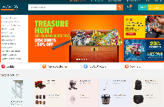
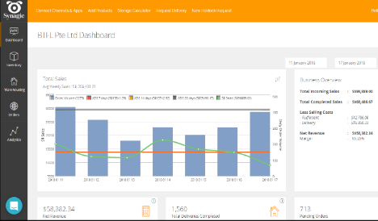
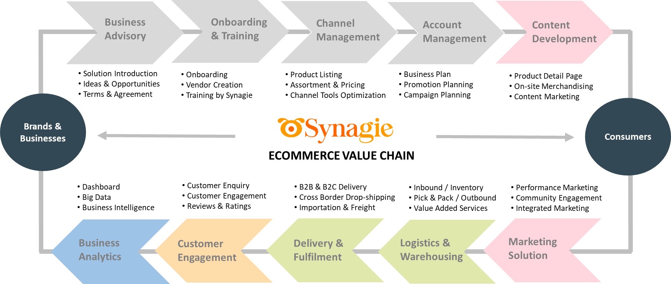
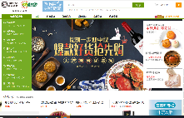
One Platform to All Channels
Local Marketplaces
Brand.com
Cross Border Marketplaces
Omni Channels
Cloud Platform Powered
By AI & Big Data
End-to-End Services
All Channels

Slide 9
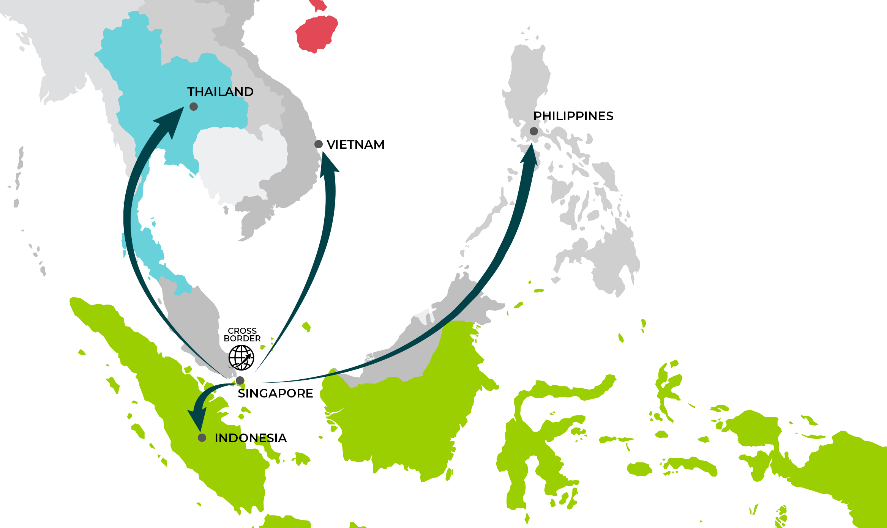
South East Asia the Gateway for Cross border
Cross border via SEA
The Fastest way to sell online in SEA
Pick & Pack in your country and deliver to the customer door step of 6 of the SEA countries. Inventory is only stored in 1 instead of 6 locations
Product Registration not required* (Faster, Simpler and Easier)

Slide 10
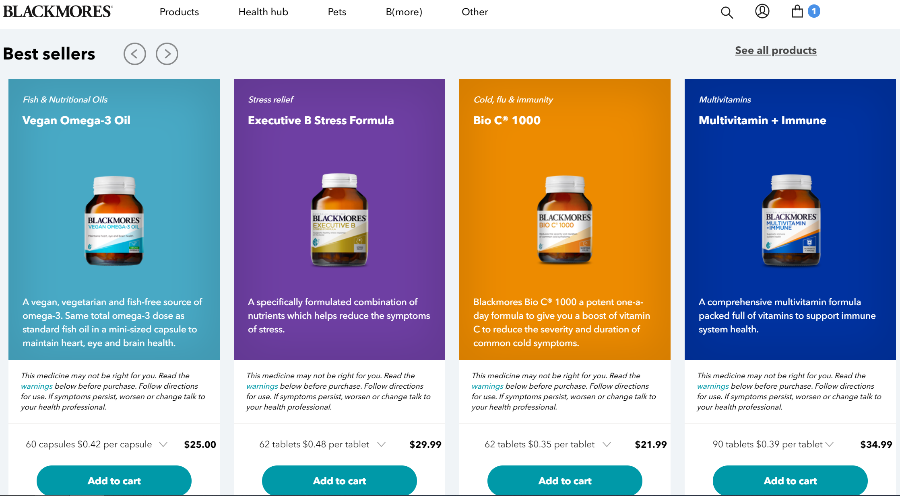
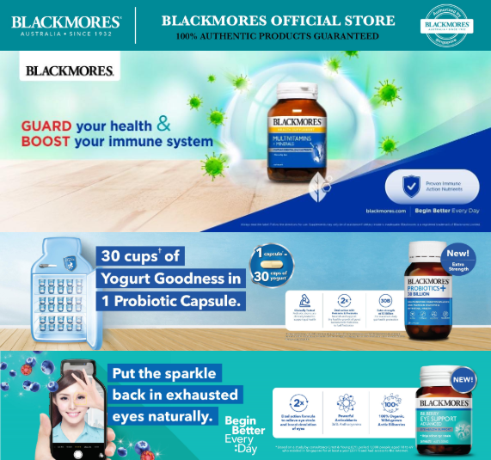
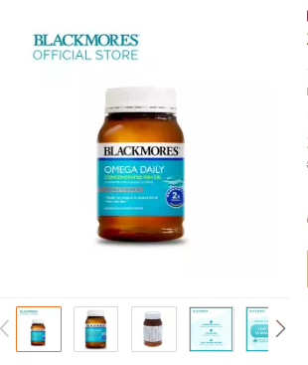
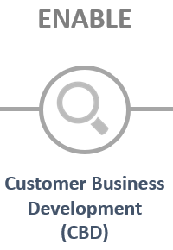
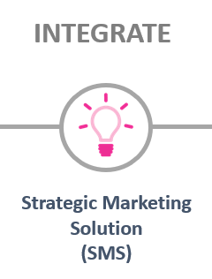
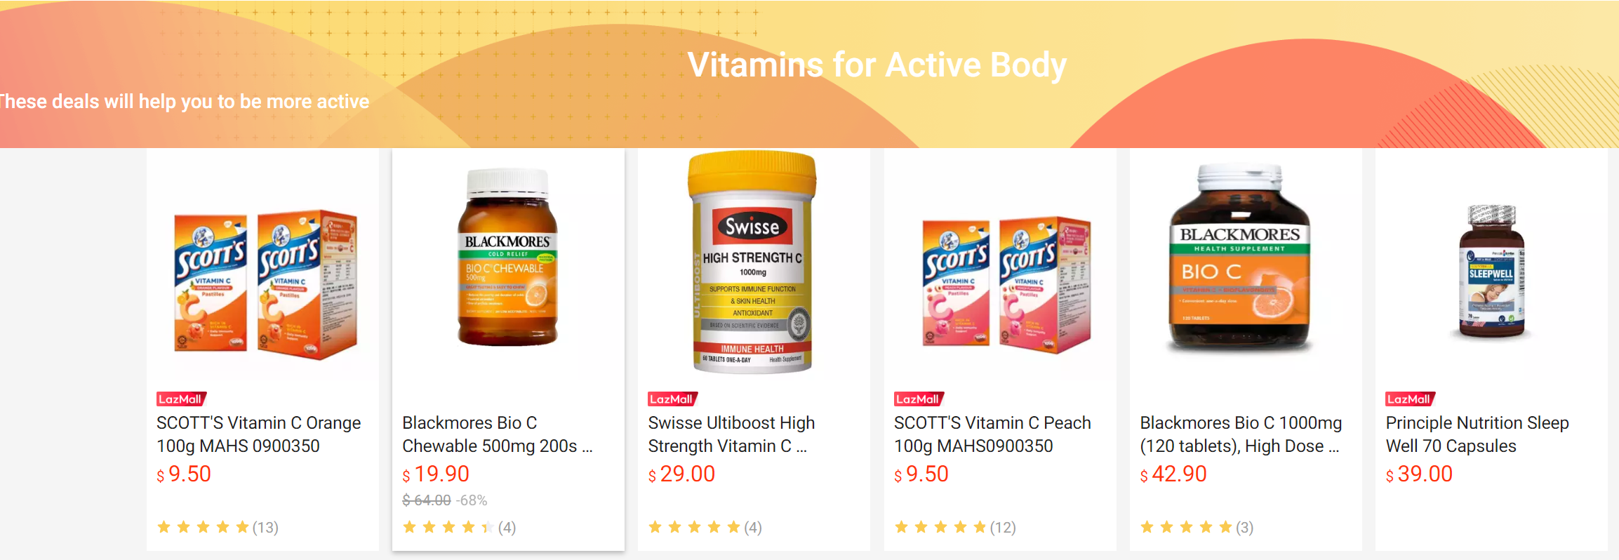
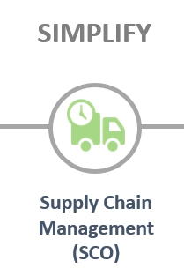
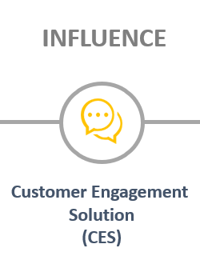
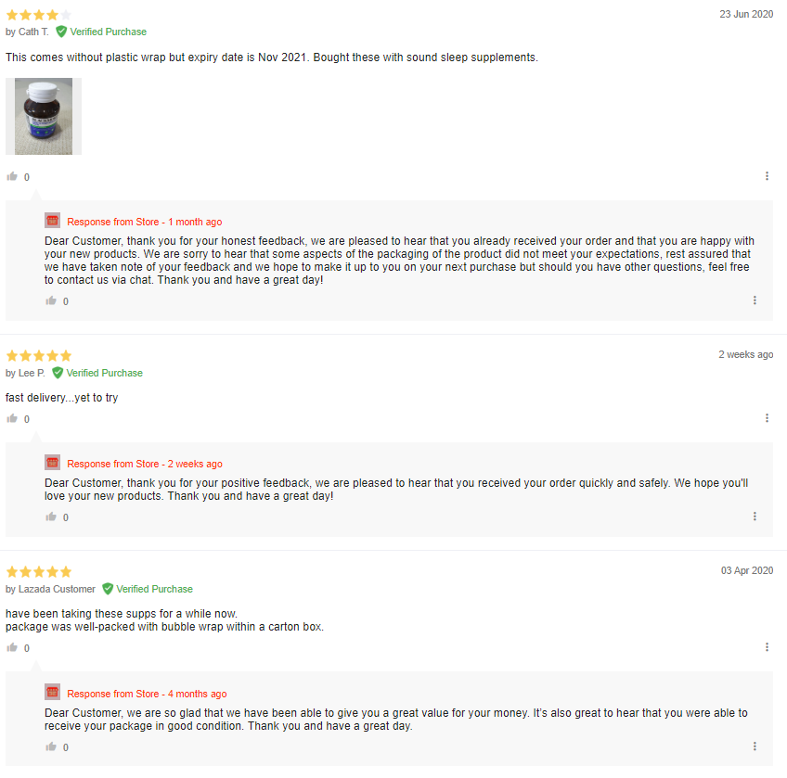
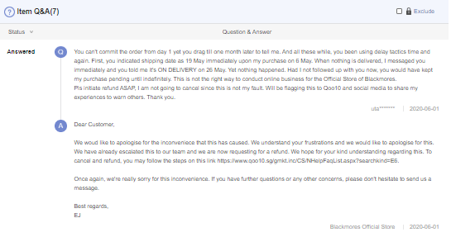
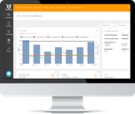
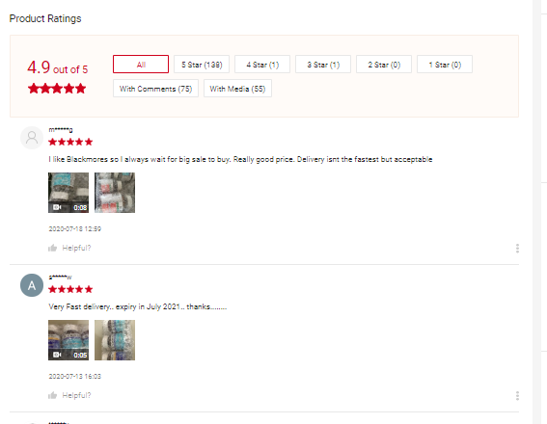
Case Study -
1
2
Blackmores official stores are listed on all major online marketplaces + Blackmores.com (Cross Border)
Creative / Design of onsite merchandising. Photo Taking, Marketing Solution ie sponsored Search, Livestreaming etc.
3
4
1 Stock pile to distribute all local B2C marketplaces + blackmores.com via cross border fulfilment
Real-time order processing, inventory and delivery status
24/7 Live Chat service, response to product review, and giving voucher to shopper via CEM tools

Slide 11
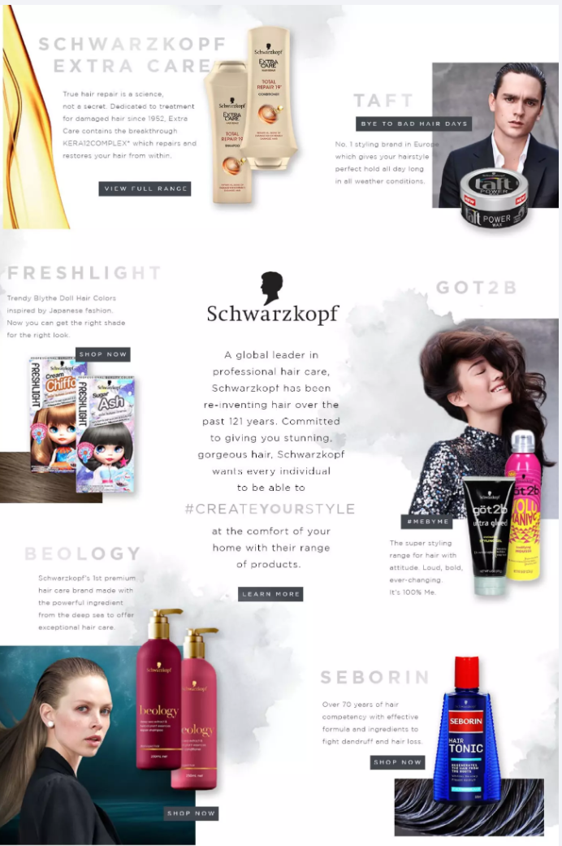
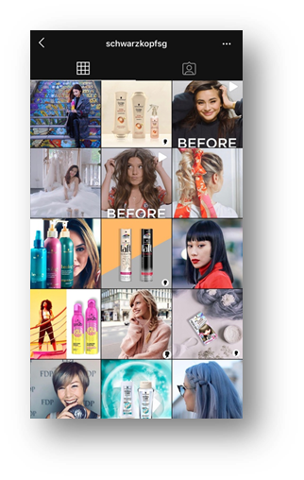
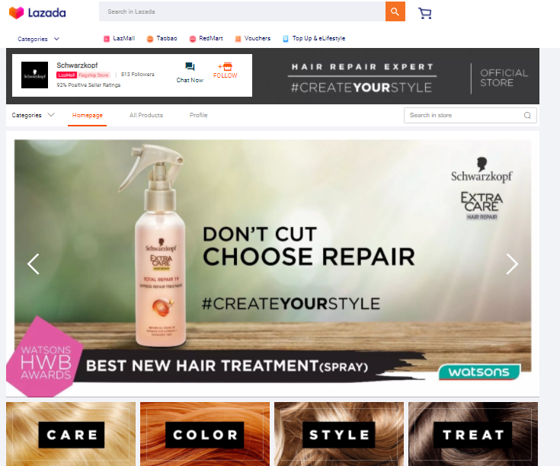
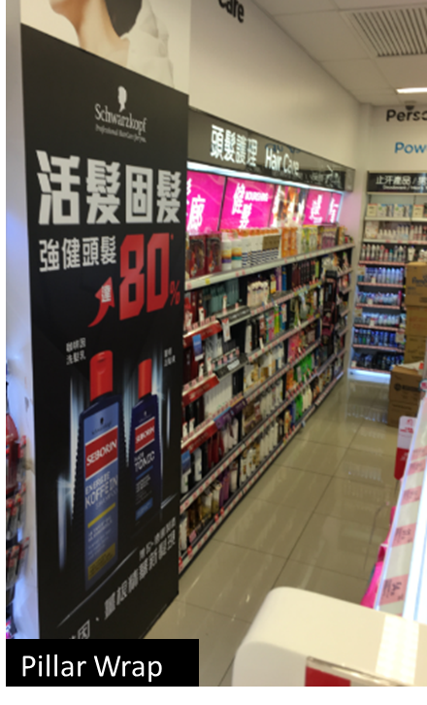
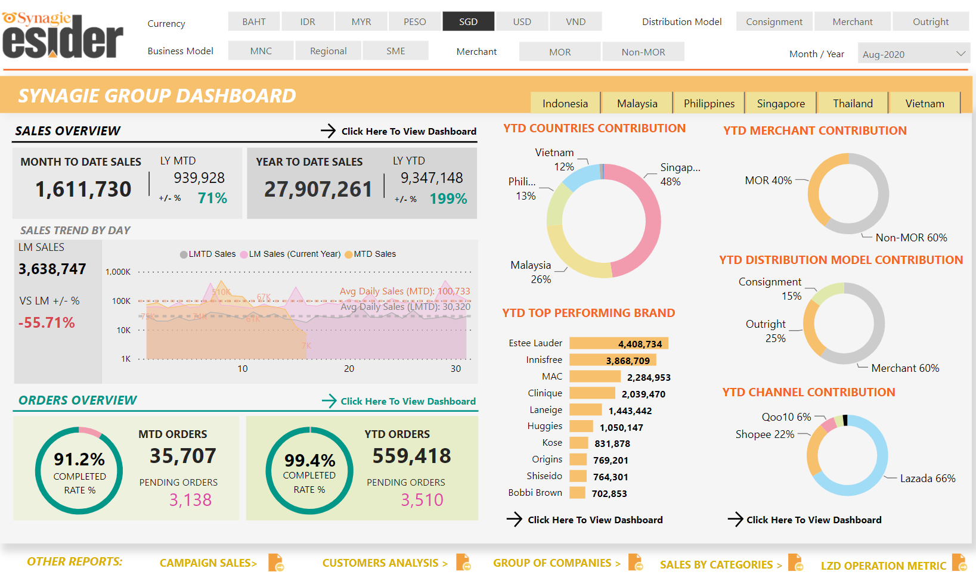
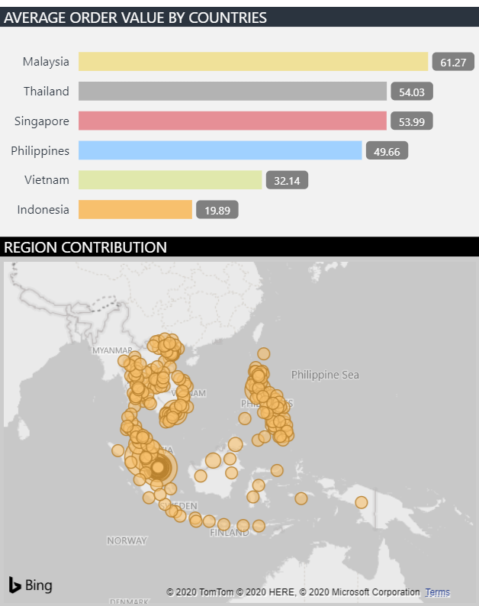
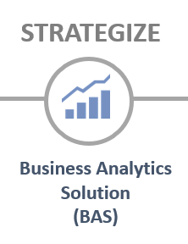
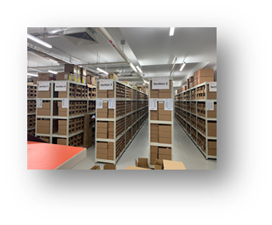
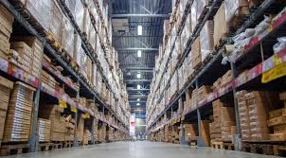
Case Study – Henkel / Schwarzkopf
1
2
Schwarzkopf official stores are listed on all major Online Marketplaces + Offline Retailers
Creative / Design of onsite merchandising. POSM for offline display. Integrated Digital Marketing Solution
3
5
Product Registration & Importation, Centralised Warehouse for online and offline, Fulfilment for B2B and B2C
Real time Dashboard, Business Review, Data Analytics, Campaign Post Mortem, Category Insight, etc

Slide 12
Conversion
GMV
Business Intelligence
Customer Engagement
Live
Chat
Ecommerce
Data Analytics
SOT
We Love Commerce
Thank you
E-logistics
Digital Marketing
Seller
Centre
Contact Us

