Slide 1
6th edition
Welcome & Aims
Notes:
For use with with APLS ANZ 6e Manual 2017

Slide 2
Notes:
We acknowledge the traditional owners of the land on which we meet – the <INSERT> people of the <insert> Nation. We recognise their continuing connection to land, waters and culture. We pay our respects to their Elders, past, present and emerging. Together we re-state our shared commitment to advancing Aboriginal and Torres Strait Islander health and education as core business of APLS.

Slide 3
PLS f2f Program
To consolidate the knowledge necessary for effective treatment and stabilisation of children with life threatening emergencies
To teach the practical procedures necessary for effective management of childhood emergencies
To test the acquisition of these skills

Slide 4
PLS f2f Program
Notes:
Activity: Ask the candidates to find the other members of their “coloured” group, sit together and take a few minutes to get to know each other.
Faculty briefly introduces themselves and states who they are mentoring. This includes the course coordinator who takes this opportunity to address any housekeeping.
Then ask everyone to briefly introduce themselves – consider asking what they would have done if they were not in their current profession.

Slide 5
Pre-course
Pre-course Online Learning
Manual
Notes:
Pre-course online learning designed to draw out the clinical priorities of the APLS manual

Slide 6
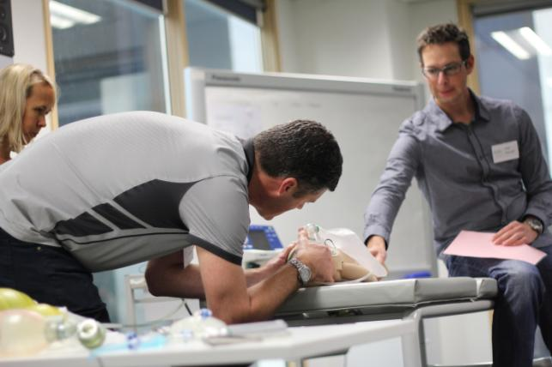
f2f Content
Practical
Skill Stations – (tested)
Discussions
Scenarios
Notes:
Over the next 3 days we will further consolidate this theory, learn the skills required to put this theory into practice
Low fidelity scenarios, designed to consolidate learning.
More time is allocated to practicing structured approach in different clinical scenarios, followed by debriefing (12 mins scenario/ 8 mins group discussion of learning from the case)
Acknowledge stress of ‘performing’ in front of peers
Need candidates to ‘suspend belief’ to maximise the benefits from this form of learning.
Candidates will be expected to:
Prepare for the case
Examine the manikin (to elicit clinical cues from instructor)
Guide the roles of their assistants (other members of their colour group)
Maintain responsibility for team member actions.

Slide 7
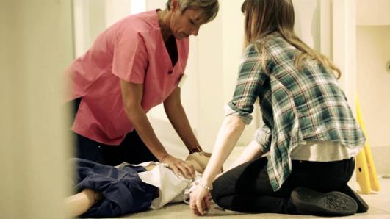
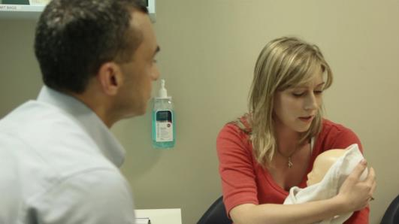
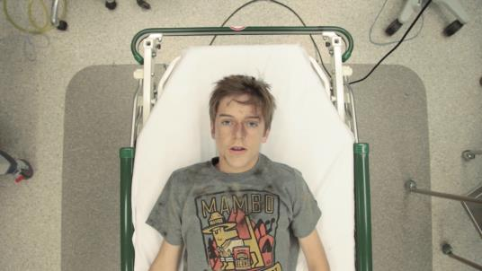
f2f Format
Life Support
Serious Illness
Serious Injury

Slide 8
Expectations
You & Faculty
Prepared
read the manual
pre-course online learning
Attend all sessions on time
Support your faculty & fellow candidates
Enjoy yourself

Slide 9
Educational Support
Mentoring
Critiquing
Feedback
Notes:
The content of this is actually a good prompt

Slide 10
Post course support
Access to website
APLS online learning for one month following completion of the f2f program
APLS app & algorithms
Feedback of experiences
Notes:
APLS feedback can be emailed to feedback@apls.org.au, or via the hard copy feedback forms.

Slide 11
?

