Slide 1
Generic Instructor Course
Notes:
Instructor Course for all ALSG courses:
Australian courses Incl:
ALS
APLS/PLS
MOET

Slide 2
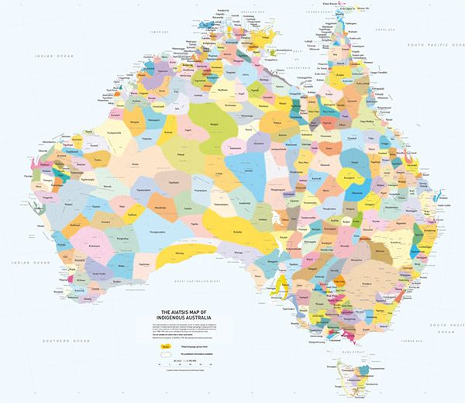
We acknowledge the Traditional Custodians of Country throughout Australia and recognise their continuing connection to land, water and community.
We pay our respect to Aboriginal and Torres Strait Islander people and to Elders past, present and emerging.

Slide 3
Learning outcomes
Systematic approach to teaching
Practical application in different teaching modes
Feedback - instructors & small group
Notes:
6 colours for 24 candidates (Delete according to how many candidate groups)

Slide 4
Mentor group rooms
Notes:
Colour groups
Nest – colour group home room
Mentor groups – bands

Slide 5
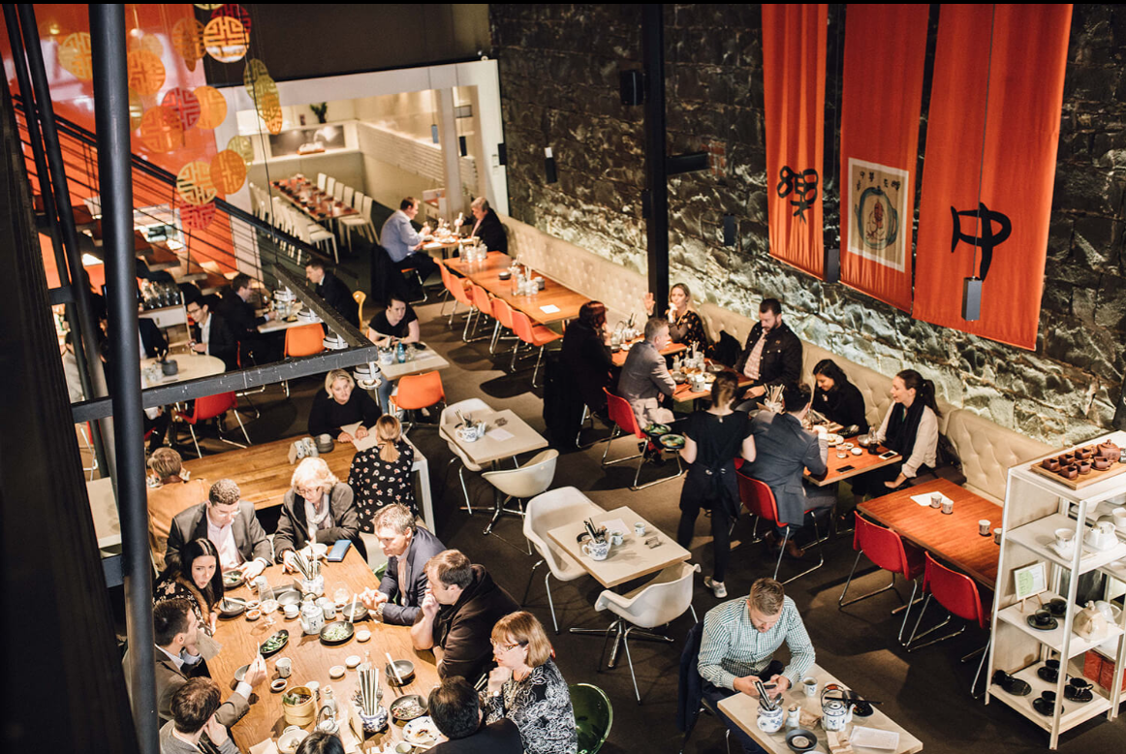
Introductions
Peer Learning model
2 mins –
Introduce the person next to you
One piece of information not on their CV
Dinner tonight!
Notes:
Quicker we know each other – the better prepared we are to learn from each other
Animation for Dinner & picture of Henry & the Fox – Adapt this slide to context and if dinner appropriate

Slide 6
Format
Day 1 and 2
Plenary
Demonstration
Your practice session
Day 3
Repeat practice sessions
Simulations
Role playing
Realistic
Notes:
Formative assessment on Day 1 & 2 applied on Day 3

Slide 7
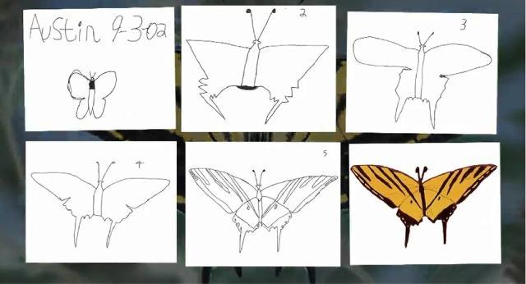
Support and Formative Assessment
Mentors
Peers
Verbal feedback
Feedback forms
Notes:
Formative feedback from 11 people – discuss with mentors if you feel like you are getting mixed messages
The continuity and consistency of the ALSG courses is due to credible instructors and maintenance of course program structures
- Using the GIC structured approach to learning/ in the short timeframes does not always fit everyone’s style of teaching.
Austin’s butterfly – Image here to reinforce 6 minute video sent to candidates 1 week prior to course. https://www.youtube.com/watch?v=hqh1MRWZjms
Animation for picture of the suit not fitting

Slide 8
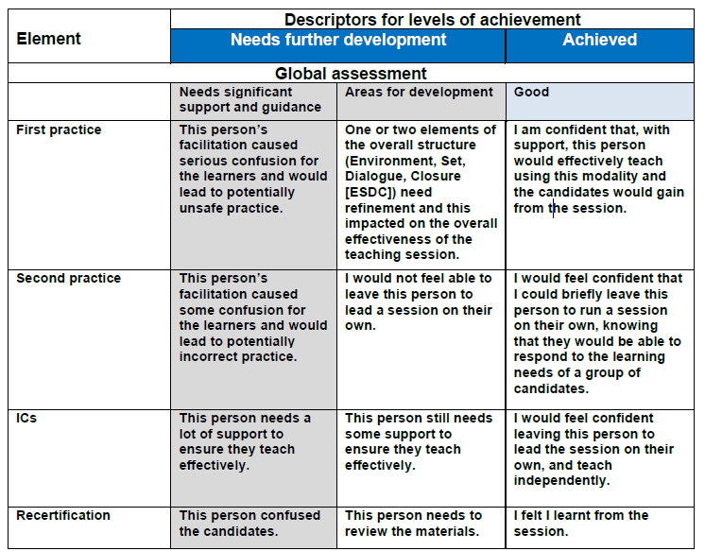
Notes:
Faculty will submit feedback online so you can access and review.
Formative feedback from 11 people – discuss with mentors if you feel like you are getting mixed messages
The continuity and consistency of the ALSG courses is due to credible instructors and maintenance of course program structures
- Using the GIC structured approach to learning/ in the short timeframes does not always fit everyone’s style of teaching.
Animation for picture of the suit not fitting

Slide 9
‘Performance’
You may feel:
Challenged
Uncomfortable
Embarrassed
We want you to feel safe to have a go
We’re all here to support each other and to learn from one other
Notes:
Clinicians put performance pressure on themselves

Slide 10
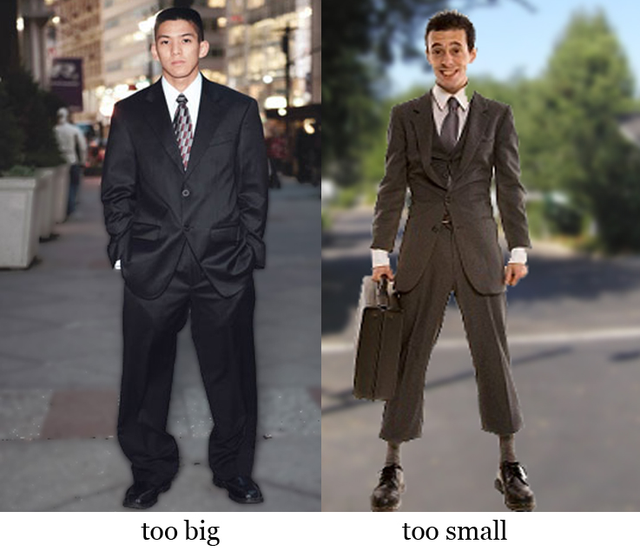
Support & Formative Assessment
Self-reflection
Mentors
Peers
Verbal feedback
Feedback forms
Notes:
Animation for picture of the suit not fitting
Course is designed to manage diversity of learners - multidisciplinary, multi-specialist, short focussed sessions with defined objectives and materials.
OK if ALSG – style courses are not your thing/not reflective of you as a teacher in other context

Slide 11
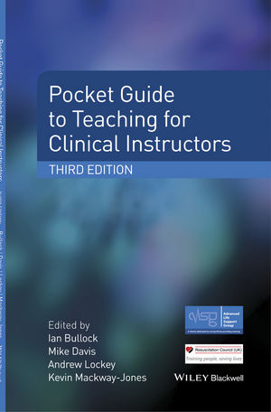
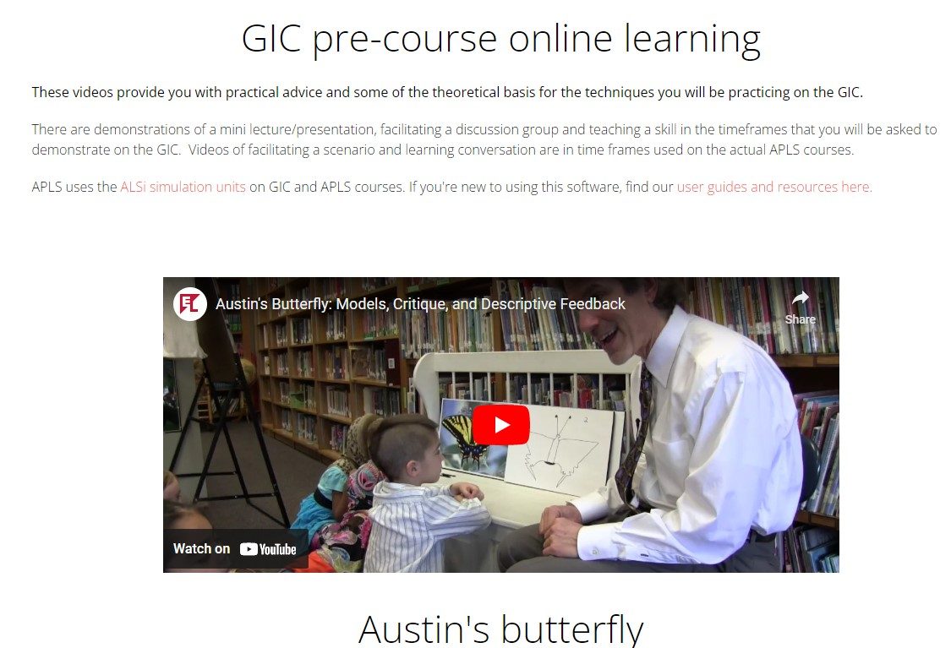
Expectations
Read the GIC ‘manual’
Watched the online videos
Prepared for all your practice sessions
Attend sessions on time
Support each other
Enjoy yourselves !

Slide 12
?

