Slide 1
Teaching using Simulated Scenarios

Slide 2
Simulation / Scenarios
Correct use of simulation equipment
Understand the aims of simulation
Facilitating learning during & following simulation
Awareness of the roles involved
Notes:
Advice candidates to use time at afternoon tea to be comfortable with ALSi

Slide 3
Simulation
Simulation has been developed to provide a highly valid replication of the clinical environment
(Bradley & Postlethwaite, 2003)
Structural fidelity is not as important as functional fidelity; as high fidelity equipment can be a distraction
(Norman et al 2012)
Notes:
Bradley, P., & Postlethwaite, K. (2003). Setting up a clinical skills learning facility. Medical Education, 37, 6-13.
Norman, G., Dore, K., & Grierson, L. (2012). The minimal relationship between simulation fidelity and transfer of learning. Med Educ, 46(7), 636-647.

Slide 4
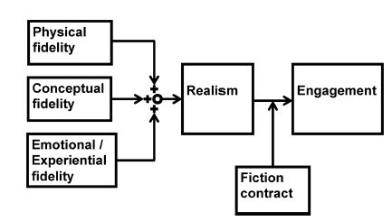
Simulation
Notes:
A model of fidelity, realism & educational engagement in simulation.
Engagement that moves people to the edge of their knowledge to expose what they know/can do in a ‘situated’ environment.
Image can be drawn on whiteboard & practical aspects of Environment /Set/Dialogue and Closure – elicited from the group.
Diagram is from this article
Nanji, K. C., Baca, K., & Raemer, D. B. (2013). The effect of an olfactory and visual cue on realism and engagement in a health care simulation experience. Simulation In Healthcare: Journal Of The Society For Simulation In Healthcare, 8(3), 143-147. doi:10.1097/SIH.0b013e31827d27f9

Slide 5
Psychological Safety
Notes:
Harvard Business School: Amy Edmondson
Simulations put candidates in a situation where they are accountable. Balance is needed to keep them psychologically safe
Some anxiety reflects emotional realism of clinical scenarios.
Some simulations (aviation/military) are designed to mimic the anxiety zone to ‘test’ functioning in this environment - not aim of APLS!.
Rudolph, J. W. (2014). Establishing a safe container for learning in simulation: the role of the presimulation briefing. Simulation in Healthcare, 9(6), 339.

Slide 6
Aims
Allows safe repetitive practice
Improves task performance
Helps promote independent competence
Increases personal confidence
Notes:
In APLS context

Slide 7
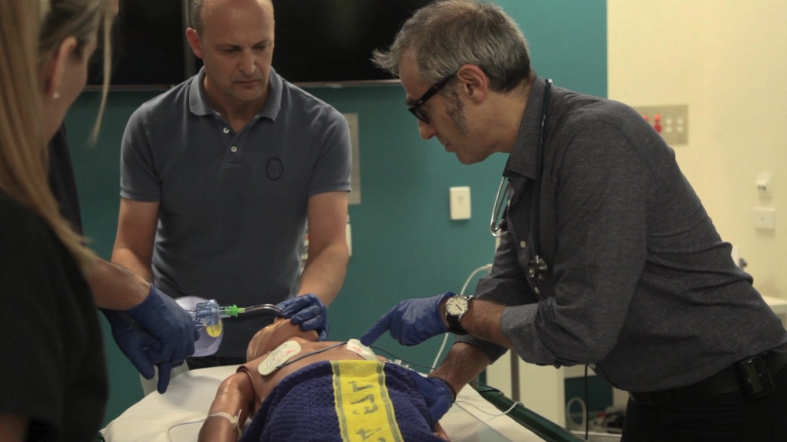
Aims of simulation
If integrated into training at appropriate times it increases the relevance and motivation to learn

Slide 8
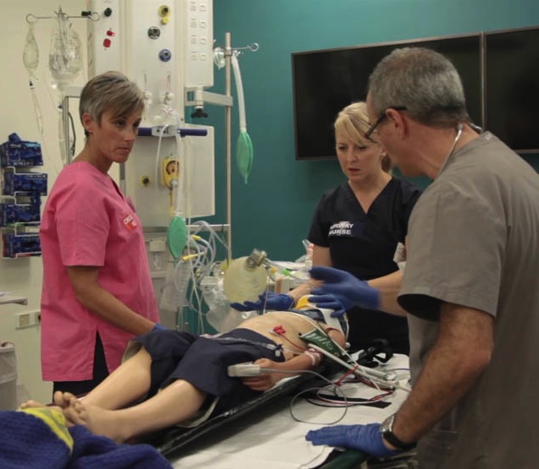
Outcomes of simulation
Improve teamwork
Increase confidence by building on the complexity of simulations
Encourage critical thinking
Standardised experience ensures core knowledge / skills for everyone
Notes:
Improve teamwork
Increase confidence by building on the complexity of simulations
Encourage critical thinking
Standardised experience ensures core knowledge / skills for everyone

Slide 9
Situated learning
Simulations can be adjusted to allow for different professions and levels of experience
High fidelity
Increases relevance (realism)
Increases motivation
Reduces stress
Notes:
We increase the relevance and motivation by ‘situating’ scenarios in the candidate’s usual workplace.
- usual resources may be limited because of competing demands…...
Candidates participate in their usual role
- “take care of the patients with the skills you have (this may include newly taught skills on the course)”

Slide 10
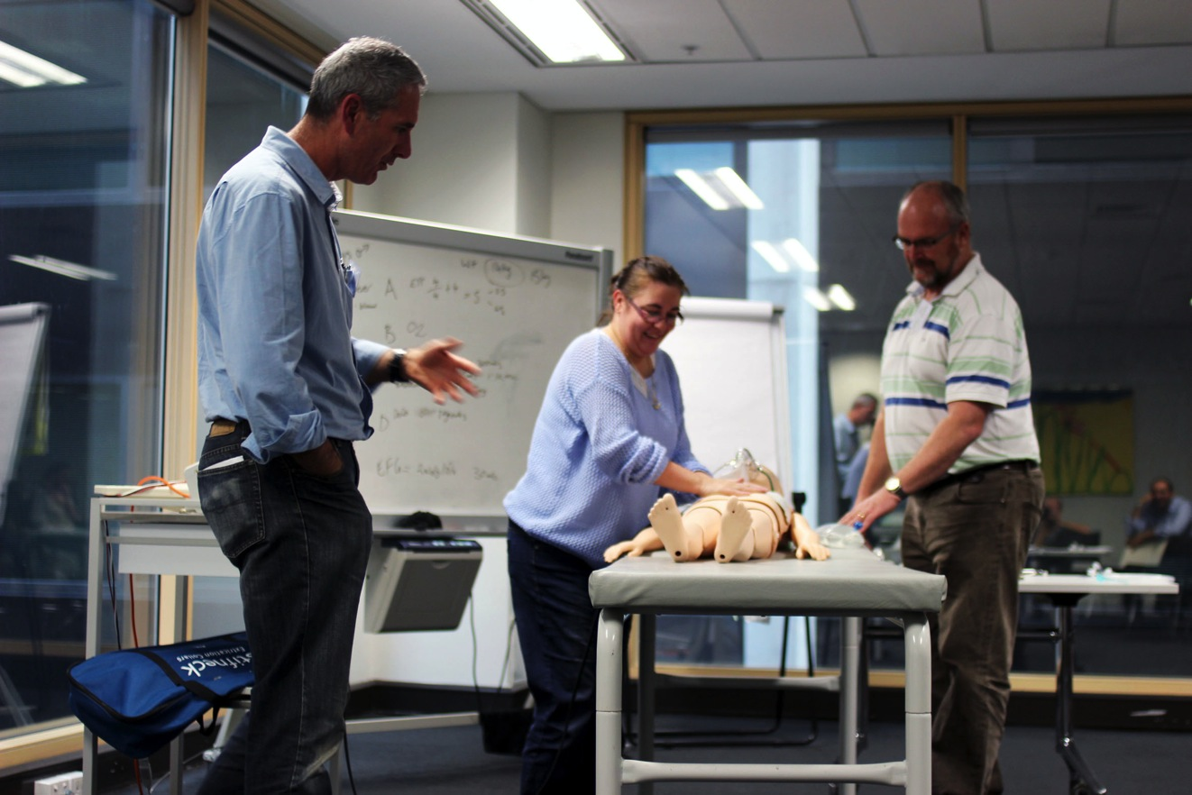
Facilitating simulation

Slide 11
Facilitating simulation
In pairs consider the following questions:
How is a simulation experienced from the candidate’s point of view?
What might a simulation be like from the instructor’s point of view?
Notes:
Ask them to answer the first question in pairs and detail their own experience to each other. Then get the key words back e.g. stressful etc
2nd question as a whole group, this is speculative for them, follow up questions such as what makes you say that to get them thinking deeper.

Slide 12
Focused learning
Psychomotor
Affective
Cognitive
Human factors
Notes:
As a facilitator - be clear on why you are using this form of teaching/ what the focus is for the candidate.
Mostly – bringing it all together – however some simulations have particular focus.
Knowledge (numeracy, application and understanding)
Skills
Attitudes
Human factors (communication, situational awareness, recall when stressed)

Slide 13
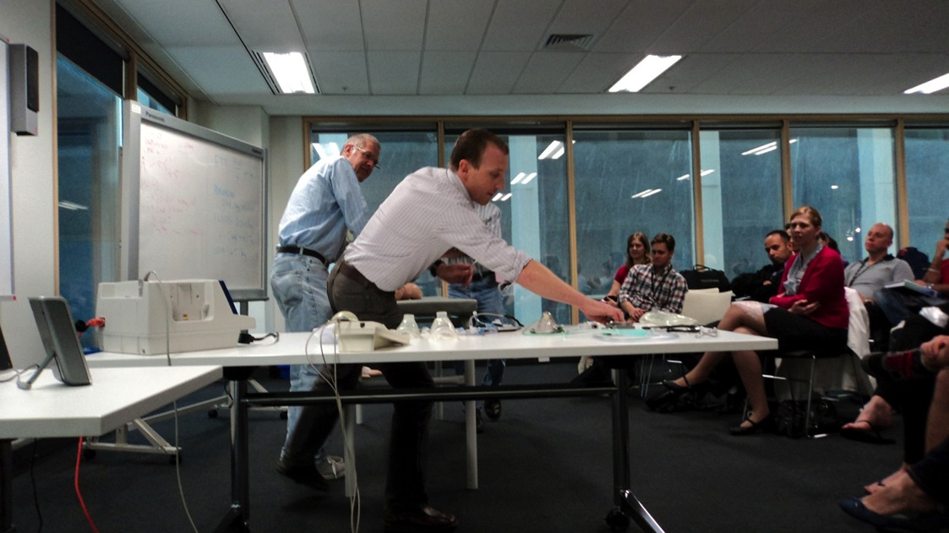
Structured Approach
Set (includes Environment)
Dialogue
Closure

Slide 14
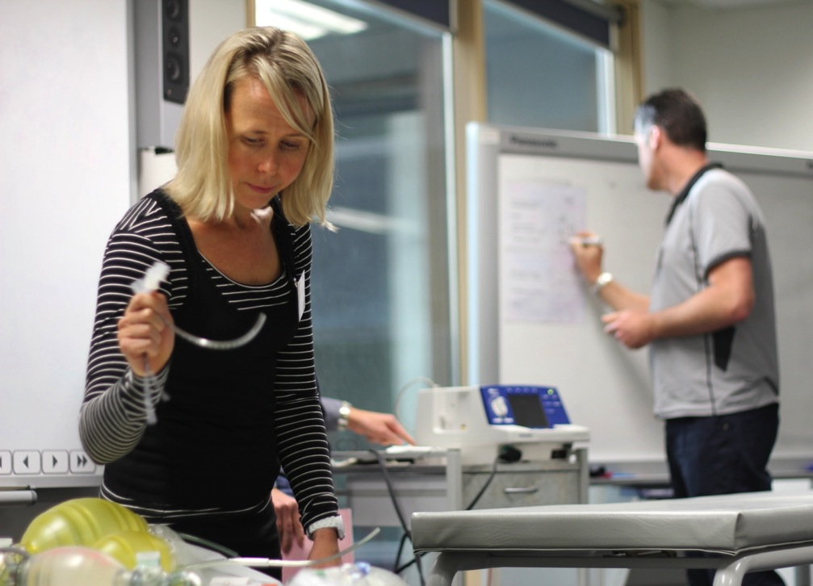
Environment & Set
Heat and light
Equipment
including safety
Layout
sight lines
distractions
Briefing assistants
Notes:
Set up the event for the practice candidate and the group

Slide 15
Dialogue
Outline the simulation and inform
Listen and respond
Minimise stress for the candidate
Encourage a systematic approach
Enable achievement of key treatment points within the time limits

Slide 16
Optimising equipment
Know the mannikin and its functions
Provide candidate with clinical information which is not available from the mannikin
Ensure safety with potentially dangerous equipment throughout
Make a decision about equipment which is not available
Notes:
Could talk about taking time to get to know equip, locating who is the person who can help you (people always like to help) and on this course if you’re not clear come and find one of us.
Perhaps ask them what decision they would make about equip that’s not there and get there reasons for their responses.

Slide 17
Dialogue
When should we stop a simulation?
In which situations are you clear that you should halt a simulation?
In which situations is the decision less clear-cut?
Notes:
Safety
Time
Very stressed candidate

Slide 18
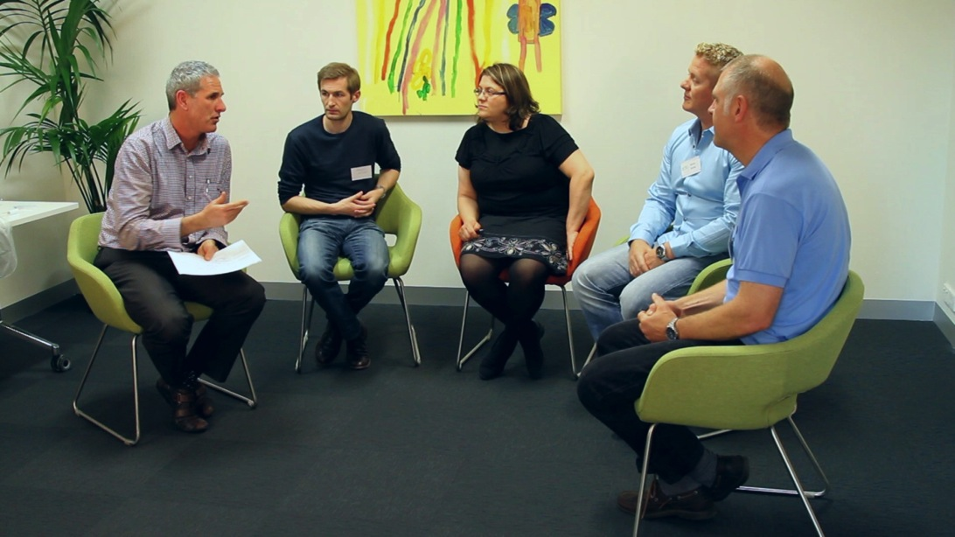
Feedback
Feedback is an important component of simulation and is part of the dialogue for the benefit of all group members
Involve:
Candidate
Assistants
Rest of group
Notes:
This will be role modelled in demonstration & subsequent session will have specific focus on the learning conversation
Notice positioning of candidates and facilitator in the image.

Slide 19
Closure
Brings the group away from the simulation
Include:
questions
summary
termination

Slide 20
?

Slide 21
Summary
the correct use of simulation equipment
an understanding of the aims of simulation
an awareness of how to facilitate learning during simulation
further understanding of feedback
an awareness of the roles involved

