Slide 1
Facilitating Discussions & Group Dynamics
Notes:
10:30

Slide 2
Learning outcomes
Strategies for optimising learning in discussions
Apply environment, set, dialogue, closure to large and small group discussions
Strategies for managing group interactions
Notes:
Have INTRO written on white board
Use for this session
Interest: challenge to facilitate larger groups and let go of control. Primary AIM is for candidate synthesis/application of knowledge. Facilitator just need to organise the activities, monitor the time, promote discussion and fill in the gaps when the group can’t answer
Name: they already know you – but you can add something to give credibility to why you are facilitating this session
Timing: good habit to let them know structure and how long things will take (~ 20 mins of group work, 7 min demonstration of small group discussion, followed by debrief. Let them know how you will stop their discussions (clap/sing/ raise your hand etc)
Range/Roles: extension of above. Ie: 6 groups of 4 and one spokesperson. Activity designed for you to draw on your own experiences/knowledge from reading and share strategies. Then you will facilitate of the group will share ideas
Outputs/Objectives – paraphrase what is on the slide in view of what you’ve said in your INTRO - point out that it is on the AV so that there are visual prompts – for visual learners!
Environment – ask group to reflect on how you’ve set up the room and what that does to the dynamics

Slide 3
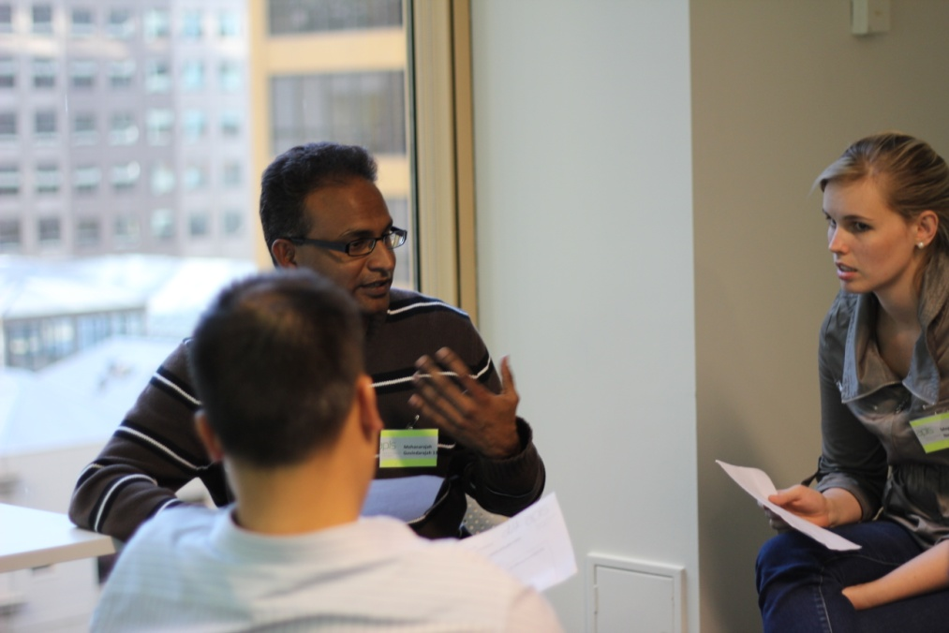
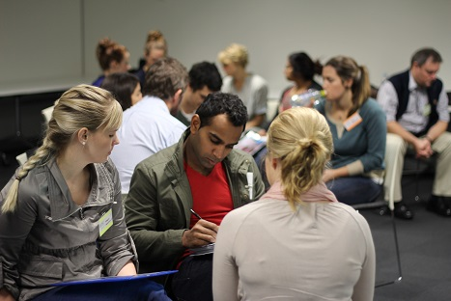
Challenges for you?
Notes:
Share is pairs
2 mins for this activity: Describe how being part of a group impacted on your learning?
2 mins to share
10:35

Slide 4
Learning outcomes
Provide guidance for sessions

Slide 5
The role of the facilitator
Anticipating learning needs
Maintaining control through well-phrased questions
Anticipate discussion
Timing
Notes:
About their recall and synthesis of knowledge – you are only there to fill the gaps!
What is the normal ph range? - is after “knowledge” – level 1 of the cognitive hierarchy
What does a ph of 7.3 tell you? is looking for “application” – a level 3 question.
When are breaths given in Paediatric BLS?
Given there are no RCTs to support this – why is it done?

Slide 7
Group Behaviours Activity
Groups of 5-6
5 mins discussion
Nominate a spokesperson to share answers with the whole group
Notes:
10:40
Visual prompts to help keep them all on track
Facilitator - Note: level of noise of groups ‘at work’ – activity questions require more than recall of facts/feelings & body language of groups ‘engaged’.

Slide 8
Group Behaviours Activity
Activity 1
Aggressive: I’m OK You’re NOT OK
Passive: I’m NOT Ok You’re OK
Passive Aggressive: I’m NOT OK You’re NOT OK
Assertive: I’m OK You’re OK
Notes:
Thomas A Harris 1969
From the ideas of Eric Berne MD, creator of Transactional Analysis and author of Games People Play
(slide hidden as not enough time for both activities)

Slide 9
Notes:
1045
Animated slide
Use of visuals to promote engagement.
Use of micro summaries
Shy – fear of social judgement.
Being corrected – for some is ridicule because their response is shame (internal self-judgment)
Brain freeze

Slide 10
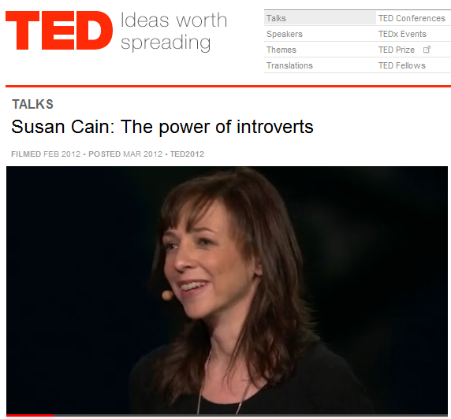
Notes:
Those whose learning preference is for thoughtful contemplation.
- Options: discuss in pairs
- Give ‘air’/ give them space

Slide 11
Notes:
Behaviour is language

Slide 12
Strategies for large groups
INTRO
Group selection & size
Audio visuals
Feedback control

Slide 14
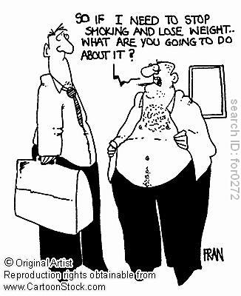
Notes:
Avoiding work/dependency
Asking for confirmation about the nature of the task
Seeking clarification
Checking for affirmation (from you and other group members)

Slide 15
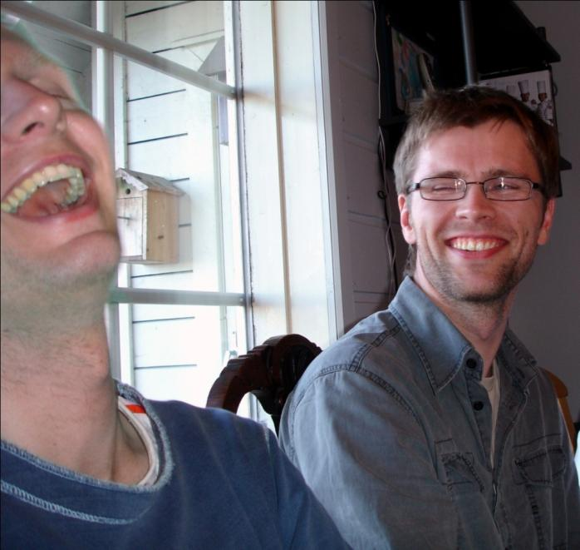
Talking off task
Telling jokes
Describing work status/practices
Notes:
Avoiding work - fight

Slide 16
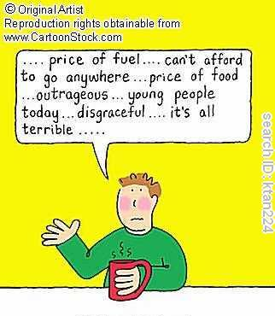
Complaining about:
the task
the environment
the programme
the facilitator

Slide 17
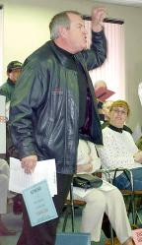
Giving way to dominant members
Off task fascination
Argumentative behaviour
Personal attacks on another group member
Notes:
Avoiding work: ba pairing

Slide 18
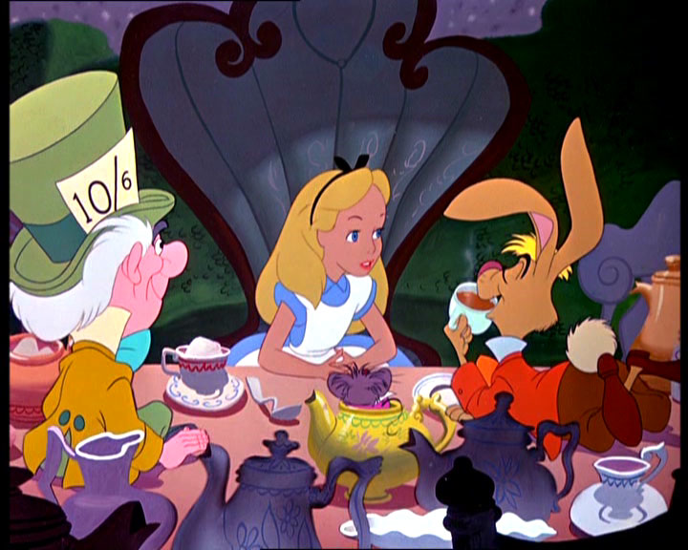
What are we afraid of?
“If you only spoke when
you were spoken to, and
the other person always
waited for you to begin,
you see nobody would
ever say anything,” said
Alice.
Notes:
What we are afraid of is silence
Anything else you are afraid of?

Slide 19
Facilitating a Discussion
Environment
Set
Strategic
Dialogue
preplanning questions/activities
focus on learner recall and application of knowledge
Closure
Incorporate the groups’ input
Notes:
1025 – watch this demonstration – noticing E/S/D/C
What cues were you taking from the group that let you know they were engaged? Or the group appeared very active in discussion, what was going on for you?
How did that impact on your choice of questions?
2 questions from the group – describe a behaviour you witnessed

Slide 20
Mentoring on APLS courses
Notes:
My name is xxxx and welcome to our group discussion this morning on Mentoring.
over the next 5-6 minutes – discuss how the mentor can support learners on APLS courses
Can I just get you to quickly tell me your name again and your experience with mentoring?

Slide 21
Mentoring Key teaching objectives
On completion of this workshop candidates should be able:
To identify some key mentoring strategies to support learners on APLS courses

Slide 22
Mentoring
Case
Your mentee is a specialist clinician, who has 8 years more experience than you.
On Day 1 they failed the Defibrillation test twice for not saying stand clear (1st) visual look to see bed was clear (2nd).
In the faculty meeting, the other faculty reported that they appeared cross. When reason for failing was explained they quipped that …
“It is the staff’s responsibility to watch what is going on and move away from the bed”
Notes:
Discussion points:
How do you quickly build a mentor/mentee relationship - Meet early to clarify roles/purpose of mentor on course & find out why they came on course
How would you have that follow-up conversation?

Slide 23
Mentoring
Notes:
This is an optional slide for graphic or points if you want to include - suggested opening lines/tips
“ I heard that testing didn’t go as planned”…
“PAUSE” – give them time to respond…
“what works best for you when you need to remember something in other settings”

Slide 24
Mentoring Workshop
Q&A

Slide 25
Mentoring Workshop Summary
Build relationship early in course
Explain your role and follow up with regular ‘check-in’
Listen to their perspective and how they want support
Notes:
In Summary………we have shared strategies for mentoring and its importance in the APLS setting
Thank you for your contributions.
We will close the workshop here and you will break into your own groups again to practice facilitating your own workshops.

Slide 26
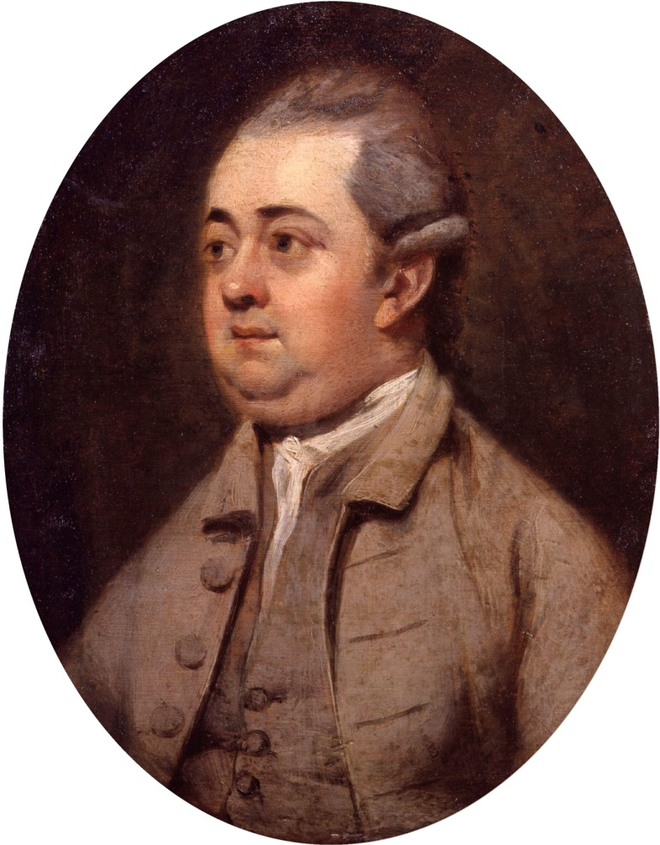
What are we afraid of?
Conversation enhances the understanding but solitude is the school of genius.
Edward Gibbon
Notes:
What we are afraid of is silence
- recall change in sound of room when group activity required thinking beyond recall of facts/feelings/thoughts.
Edward Gibbon (1737-05-08 [or 1737-04-27, O.S.] - 1794-01-16) was arguably the most important historian since the time of the ancient Roman Tacitus. Gibbon's magnum opus, The History of the Decline and Fall of the Roman Empire, published between 1776 and 1788, is a groundbreaking work of early modern erudition, the broad influence of which endures to this day
Anything else you are afraid of?

Slide 27
?

Slide 28
Facilitating Discussion
Environment - S/D/C applied to large and small discussions
Strategies for optimising synthesis & application to clinical setting
Group dynamics
Notes:
More challenges/opportunities to explore strategies will be presented during their own practice sessions.

