Slide 1
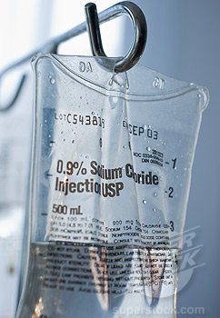
Fluid & Electrolytes
Notes:
Don’t forget to read the notes under the slides.
Updated for use with APLS ANZ 5e manual, March 2013 & pre-course online learning modules

Slide 2
Objectives
To understand normal fluid requirements in childhood
Discuss the assessment and management of the dehydrated child
Notes:
Equipment
Overhead projector/Screen/Computer
Aim for inter-group learning using expertise within the group.
Session Resources
4 cases as basis for candidate recall/application of knowledge for their clinical context.
1: Assessment/Mx of 5-10% dehydration without shock
2: 10% dehydration/↓Na⁺
3: > 10% dehydration/↑ Na⁺ with shock
4: no dehydration/SIADH
Resources on slides – consider use of whiteboard for reference data
Normal Fluid requirements (slide 9)
Clinical features (slide 10 & 11)
Deficit calculation (slide 12)
Dehydration algorithm (slide 13)

Slide 3
Case 1
Initial information
A 12m boy is referred by a GP with 4 days of intermittent vomiting and diarrhoea. 2 days ago, the GP, recorded his weight as 9.9Kg, and prescribed oral rehydration solution. Overnight, although vomiting improved, the watery diarrhoea has worsened.
Now he weighs 9.4Kg, respiratory rate is 30, pulse is 145, & BP 89/42. His eyes appear sunken, but capillary filling time is about 2 seconds. He is alert, but irritable. Temp is 37.2ºC
Notes:
Initial Information
Discuss assessment of dehydration
Failing / failed oral rehydration
Oliguria ?
Discuss management options
Calculate fluid prescription – deficit and maintenance +/- ongoing losses
What route ?
How much ?
What type ?
? Repeat electrolyte test?

Slide 4
Case 1
Further information
His mother says he vomited again on the way to hospital.
She is not sure when he last passed urine, due to diarrhoea
Urea, electrolytes, and glucose:
Na 139 mmol/L
K 3.6 mmol/L
Cl 102 mmol/L
Ur 6.1 mmol/L
Gluc 5.7 mmol/L
Notes:
Instructor Information
Diagnosis:
– 5-10% dehydrated – not shocked
Guide weight 10kg.
Deficit ~600ml
NG or IV fluid therapy
Electrolytes (if checked) are unremarkable

Slide 5
Case 2
Initial information
An 18 month old boy has a history of 5 days of diarrhoea and vomiting. He has a respiratory rate of 40, a pulse of 172, and an initial blood pressure of 80 systolic. Capillary refill time is about 4 seconds. He has a dry mouth and sunken eyes. His mother says he is thirsty but can’t keep anything down.
Further information
Urea, electrolyte, and glucose estimations show:
Na 130 mmol/L K 3.2 mmol/L
Cl 90 mmol/L Ur 8.5 mmol/L
Glu c 3.2 mmol/L
Notes:
Click to animate – information is displayed in stages.
Initial Information
Discuss the possibility of shock
Discuss management of mild to moderate hyponatraemia
Further Information
Discuss management
Instructor Information
Diagnosis:
10% dehydrated.
Hyponatraemic
Guide weight 10kg.
Deficit 1000ml
Fluid bolus, then reassess. Replace deficit and maintenance with isotonic fluid with potassium added. Recheck electrolytes soon after commencing.

Slide 6
Case 3
Initial information
A 3 month old baby who has had diarrhoea and vomiting for 4 days is brought into hospital. His respiratory rate is 40, pulse 150, and capillary refill time 3 seconds. He is pale.
Further information
Urea, electrolyte, and glucose estimations show:
Na 164 mmol/L K 4.3 mmol/L
Cl 115 mmol/L Ur 13.9 mmol/L
Gluc 4.2 mmol/L
Notes:
Click to animate.
Initial Information
Discuss assessment of dehydration
Further Information
Discuss management
Instructor Information
Diagnosis:
>10% dehydrated. Hypernatraemic.
Guide weight 5kg.
Deficit 500ml +
Treat shock then aim for slow lowering of sodium at a rate of no more than 0.5mmol/hr, monitoring electrolytes frequently.

Slide 7
Case 4
Initial information
A 4 year old boy who is recovering from chicken pox, is brought into the Emergency Department having a convulsion. This started 10 minutes before. He is not febrile.
Further information
His respiratory rate is 16, pulse 120, and capillary refill time 1 second. Glucose stick test is in the normal range. His mother says he has not been going to the toilet as often as usual.
Na 120 mmol/L K 3.8 mmol/L
Cl 85 mmol/L Ur 3.2 mmol/L
Gl 7 mmol/L
Notes:
Initial Information
Discuss initial assessment
Further Information
Discuss assessment of dehydration
Further Information
Discuss management
Instructor Information
Diagnosis:
0% dehydrated. SIADH
Guide weight 16kg. Deficit 0ml.
Treat seizures with 4ml/kg of 3% NaCl. Following cessation of seizures, aim to raise the serum sodium slowly (no more than 8mmol/day). Monitor electrolytes frequently.

Slide 8
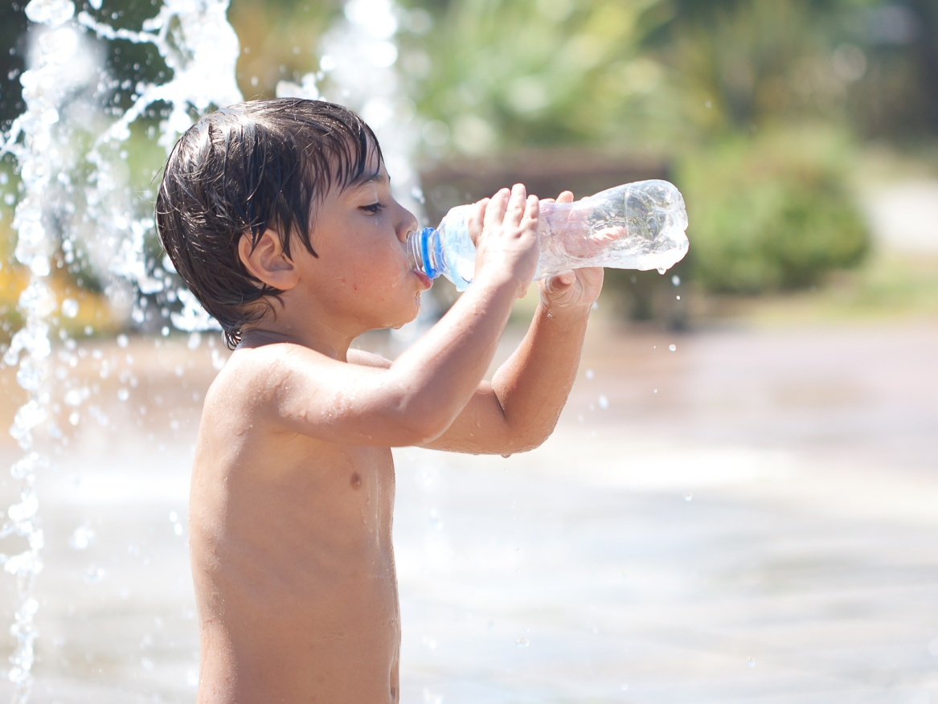
Concepts
Notes:
Shock occurs as result of rapid loss of 20 mL/kg from the intravascular space. If the intravascular volume is maintained, clinical dehydration is only evident after losses of >25 mL/kg of total body water.
The treatment of shock requires rapid administration of a bolus of intravascular fluid (start with 20ml/kg then reassess), with electrolyte content that approximates to plasma (eg. 0.9% saline).
The treatment of dehydration requires gradual replacement of fluids, with electrolyte content that relates to the electrolyte losses, or to the total body electrolyte content.
Damage from electrolyte abnormalities is related to either extreme levels, or rapid rates of change.
While the ideal composition of maintenance intravenous fluid is still debated, it should contain no less than 75mmol/L of sodium (0.45% saline).

Slide 9
Normal fluid requirements
Body Weight | Fluid requirement per day | Fluid requirement per hour
First 10kg | 100 mL/kg | 4 mL/kg
Second 10kg | 50 mL/kg | 2 mL/kg
Subsequent kg | 20 mL/kg | 1 mL/kg
Must be tailored to the needs of the specific child as actual requirements may be lower (eg. in the presence of CNS pathology / ADH secretion) or higher (eg. where diarrhoea is present).
Notes:
Instructor’s Notes
In many ill or injured children, these fluids may be inappropriate. Fluid therapy has to be adjusted to the needs of individual patients.
This table is in the manual. There is unlikely to be time to cover this in depth.

Slide 10
Clinical signs of dehydration
Signs/ Symptoms | Notes/Caveats
↓ urine output | Beware watery diarrhoea
Dry mouth | Mouth breathers may be dry, while fluid ingestion may moisten mouth
↓ skin turgor | Difficult to interpret in malnourished children. Particularly unreliable in overweight children and in hypernatraemic dehydration
Sunken anterior fontanelle | Only useful if fontanelle well patent, and in absence of disorders such as meningitis
Sunken eyes | Very difficult to asses, although mothers may give accurate assessment
Notes:
Instructor’s Notes
Weight is the only objective measure of acute fluid losses from the body.
All these clinical signs are individually unreliable. Generally accepted that the presence of increasing number of signs = increasing degrees of dehydration. As an a very approximate estimate:
- mild dehydration – few clinical signs
- moderate – a few more – at least three
- severe – likely to resemble shock

Slide 11
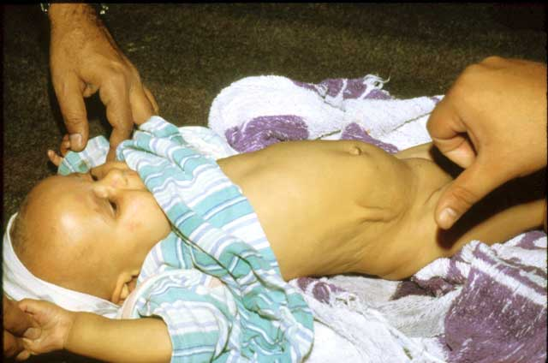
Notes:
Instructor’s Notes
Weight is the only objective measure of acute fluid losses from the body.
All these clinical signs are individually unreliable. Generally accepted that the presence of increasing number of signs = increasing degrees of dehydration. As an a very approximate estimate:
- mild dehydration – few clinical signs
- moderate – a few more – at least three
- severe – likely to resemble shock

Slide 12
Calculating deficit
Percentage dehydration x weight x 10
Percentage dehydration means:
the number of grams of fluid lost per 100 gm of body weight.
Percentage x 10 converts this volume into mL/kg

Slide 13
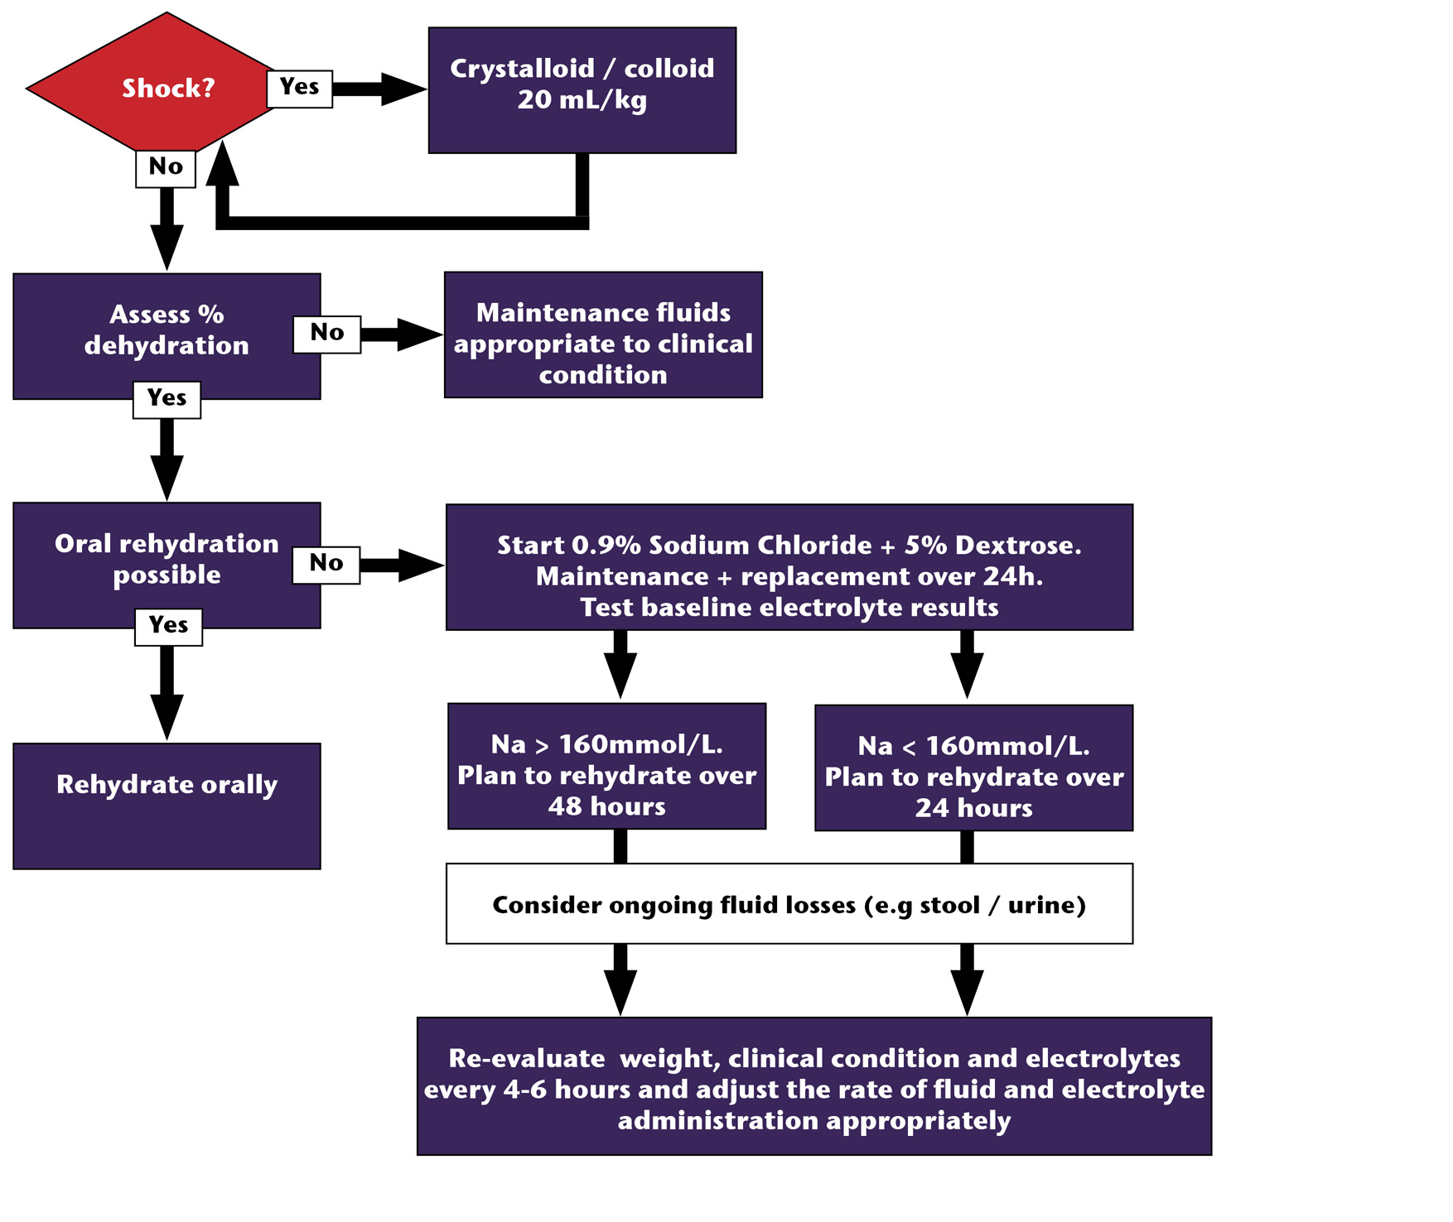
Dehydration
diagram
Notes:
Instructor Notes:
The key to management is appropriate re-evaluation.
In hypernatraemic dehydration:
If the weight of a dehydrated child is increasing appropriately (i.e. will be rehydrated over 24 hours) and the sodium is not decreasing at a rate of 1-2mmol/l/hr, then decrease the Na content of the fluids
If the weight is not increasing and the sodium is not decreasing, increase the rate of fluid administration
If the weight is increasing appropriately, and the sodium is decreasing at >2mmol/l/hr, then increase the sodium content of the fluid.
If the weight is increasing too rapidly and the sodium is decreasing too rapidly, decrease the rate of fluid administration

Slide 14
?

Slide 15
Summary
Normal fluid requirements in childhood
Assessment and management of the dehydrated child

