Slide 1
SHOOTING
Football

Slide 2
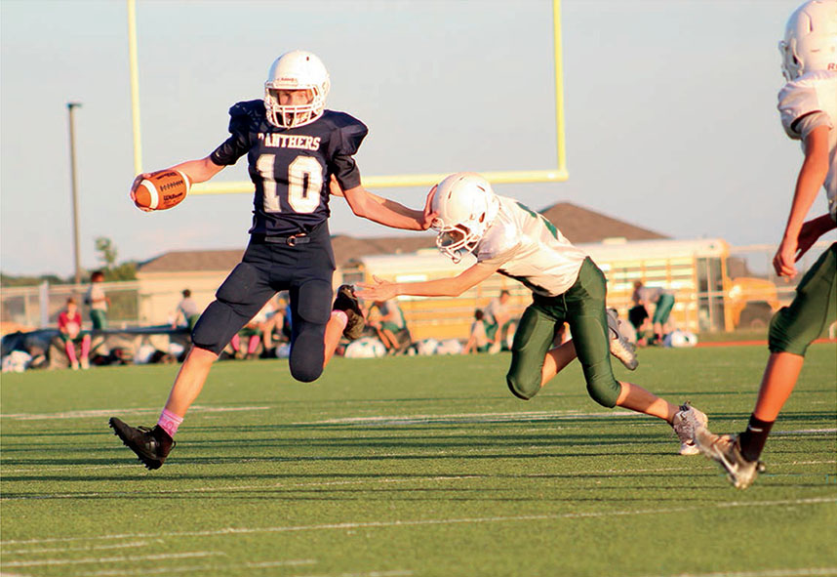
Shooting football tips
Tip #1:
Understand how the game is played. That allows you to anticipate the action and get the best shots.
Tip #2:
Get to the game early.
Stay until the last player leaves the field.
Tip #3:
More games means more chances to get a perfect shot. Use shots from several games on a spread.

Slide 3
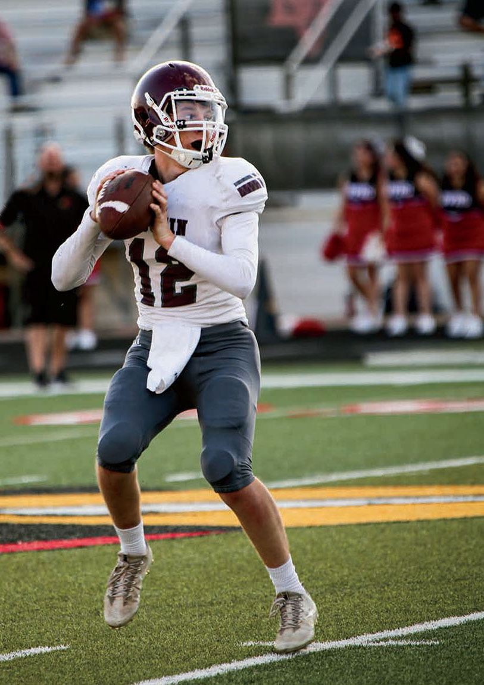
Tip #4:
Take advantage of different lighting to create varied effects in your shots.
Tip #5:
Shoot both offense and defense, home & away.
Tip #6:
Move up and down the field as play moves.

Slide 4
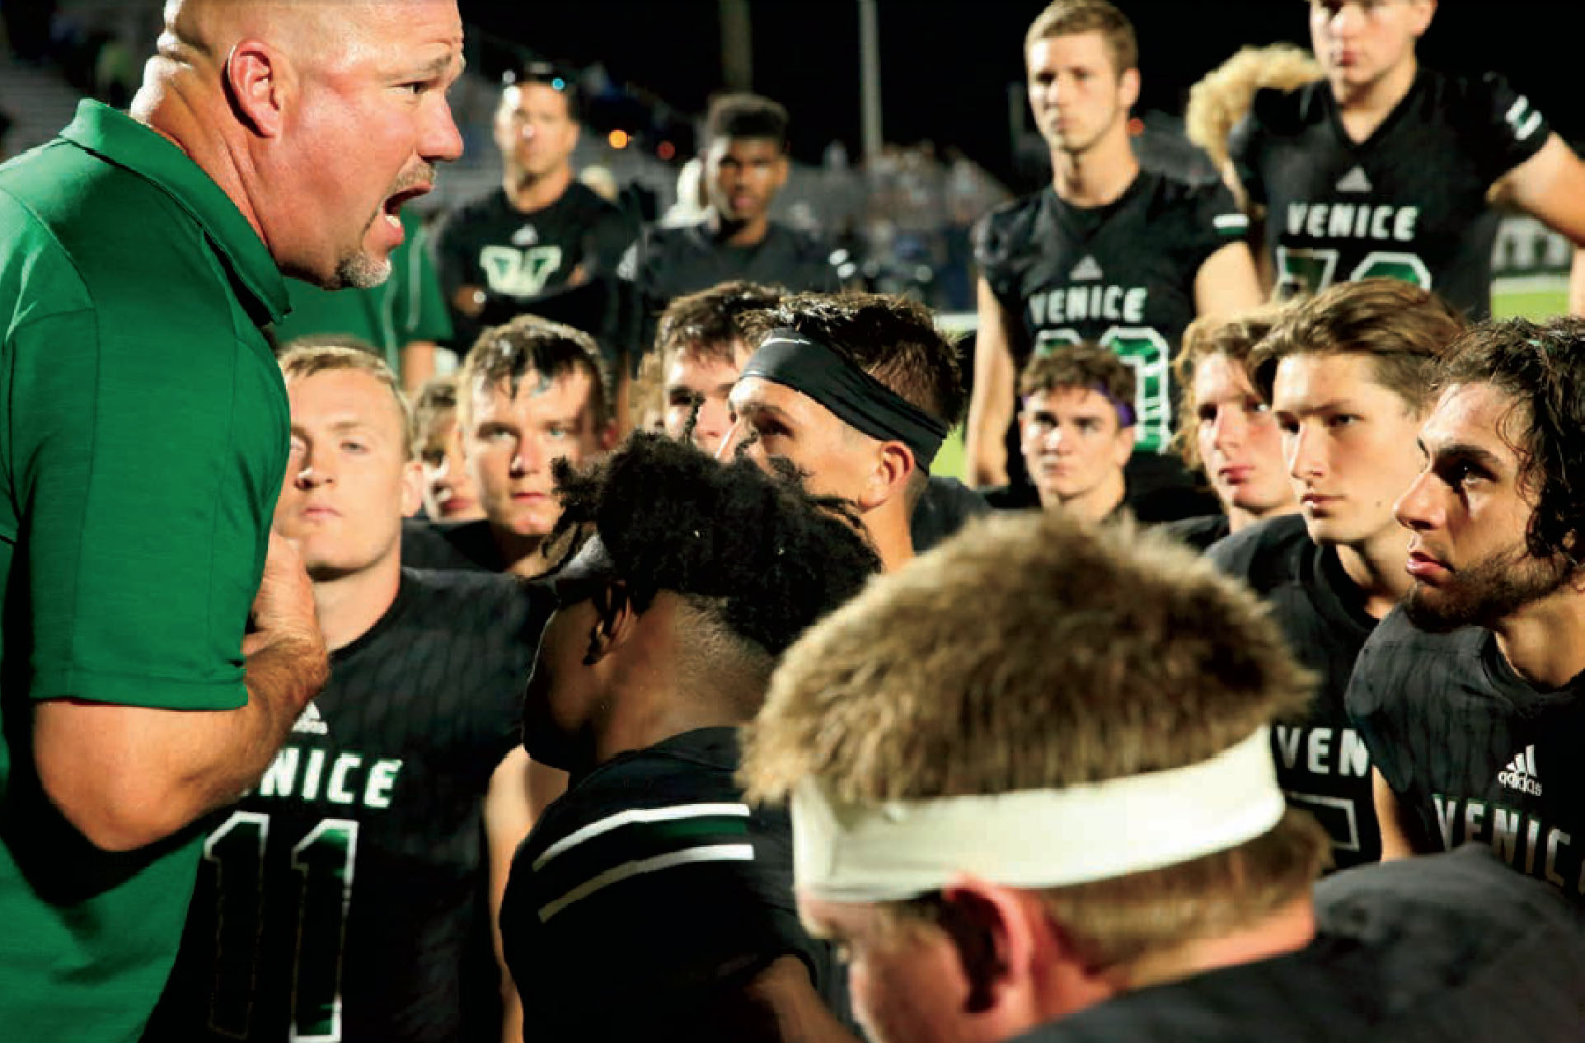
Tip #7:
Go to the opponent’s side of the field to shoot; your team will be in the background. At halftime, your school’s performers will be facing you.
Tip #8:
Invest in a 200mm/f2.8 lens for shooting night games.
Tip #9:
If you don’t have a long lens, wait for the play to come to you.

Slide 5
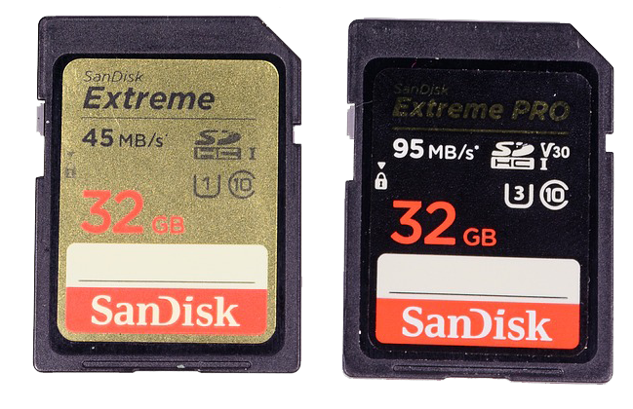
Tip #10:
Use manual focus and shutter priority settings. Choose a shutter speed of 250 or faster.
Tip #11:
Shoot the scoreboard after each score to have a record of the score &
frame reference for the plays.
Tip #12:
Take a back-up battery & extra media card.

Slide 6
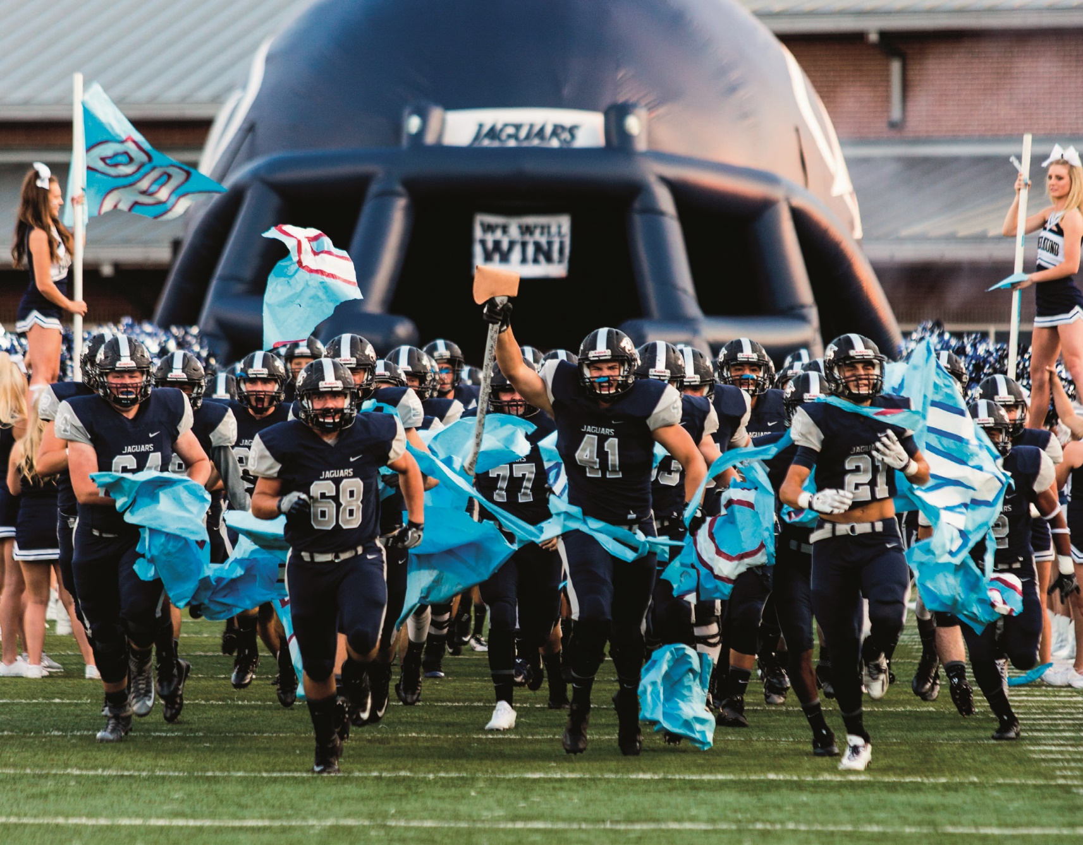

Slide 7
PHOTO COMPOSITION
Freezing action
Filling the frame
Framing
The photographer captures the players running onto the field through an inflatable helmet, which serves to frame the action.
Fans don’t get a chance to see this angle from the stands, so the photographer provides an unique perspective.
The cheerleaders holding flags complete the frame.

Slide 8
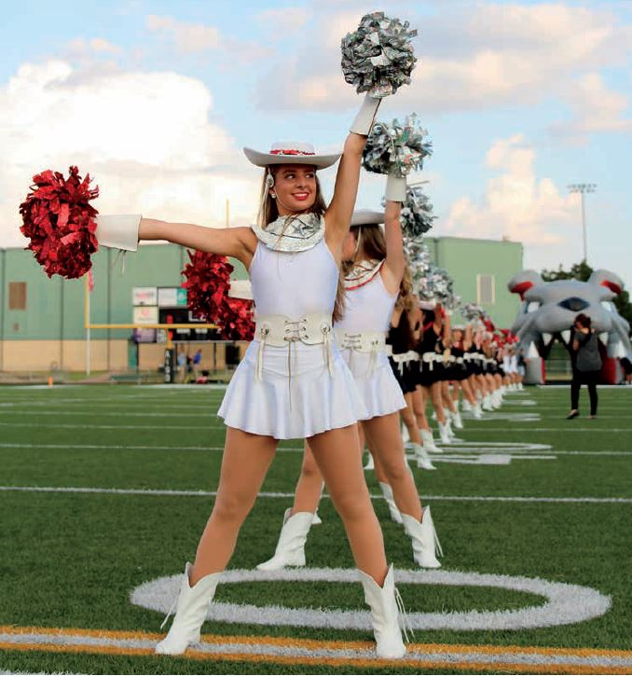

Slide 9
PHOTO
COMPOSITION
Leading Lines
Lighting
Pregame photos offer opportunities to capture dance teams, JROTC, mascots, cheerleaders, etc. as they prepare for the football team to join them on the field.

Slide 10
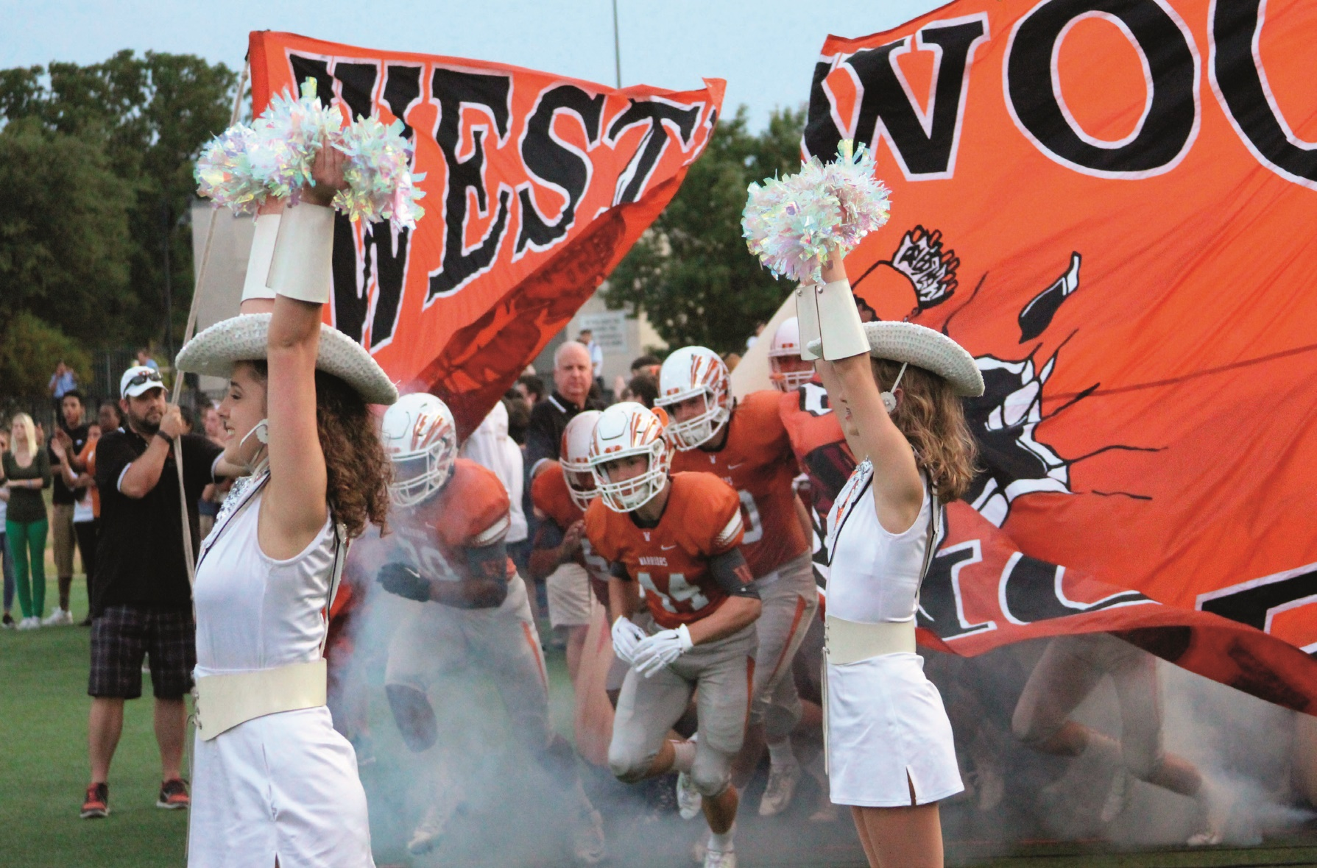

Slide 11
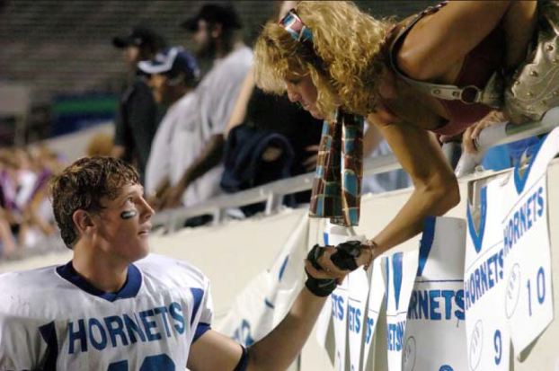
PHOTO COMPOSITION
Freezing action
Framing
Leading lines
A fast shutter speed freezes the action as the players burst through the banner and run through fog. The banner and cheerleaders form a frame and the angle of the shot, down the row of players, creates a leading line.

Slide 12
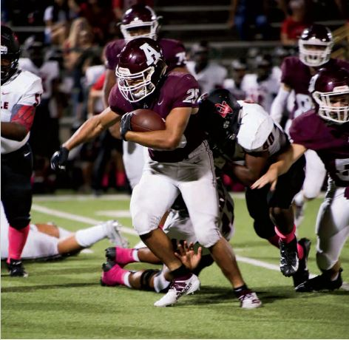

Slide 13
PHOTO COMPOSITION
Freezing action
Selective focus
Center of interest
The angle of this shot has a strong center of focus. Fast shutter speed freezes the action while a wide aperture blurs the background.

Slide 15
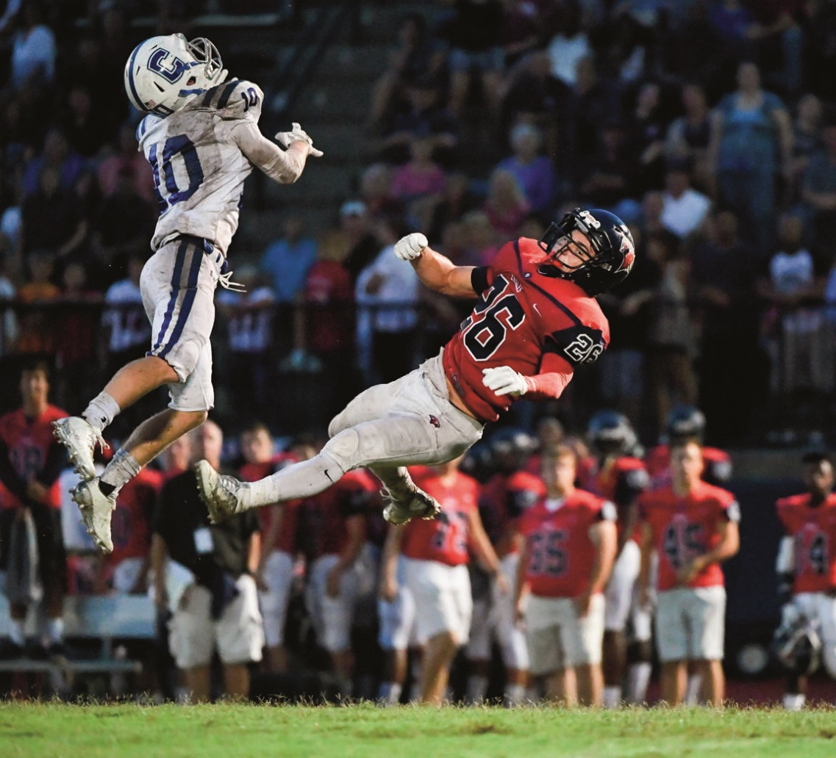
PHOTO
COMPOSITION
Freezing action
Selective focus
Captures the moment
Following the action pays off as the photographer captures players in mid-air with a fast shutter speed. A wide aperture limits the area in focus.

Slide 16
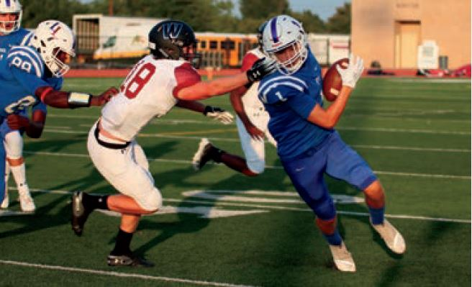

Slide 17
PHOTO
COMPOSITION
Freezing action
Capturing the moment
Shooting in daylight lets the photographer use a fast shutter speed to capture the play.

Slide 18
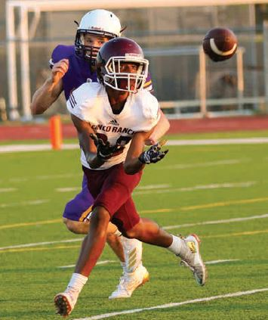

Slide 19
PHOTO COMPOSITION
Freezing action
Captures the moment
Don’t forget to cover afternoon JV and freshman games, which offer a chance to shoot with natural light, allowing faster shutter speeds. Here the photographer freezes action and keeps the ball in the photo.

Slide 20
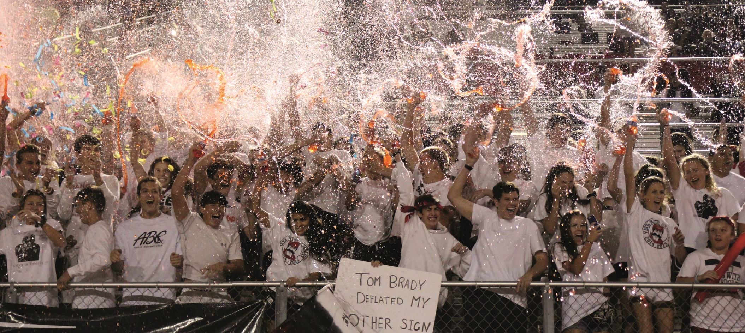

Slide 21
PHOTO
COMPOSITION
Fill the frame
Repetition
Center of interest
Remember to cover the stands. Here the photographer fills the frame with an enthusiastic group in the student section with the hand-lettered sign serving as a center of interest.

Slide 22
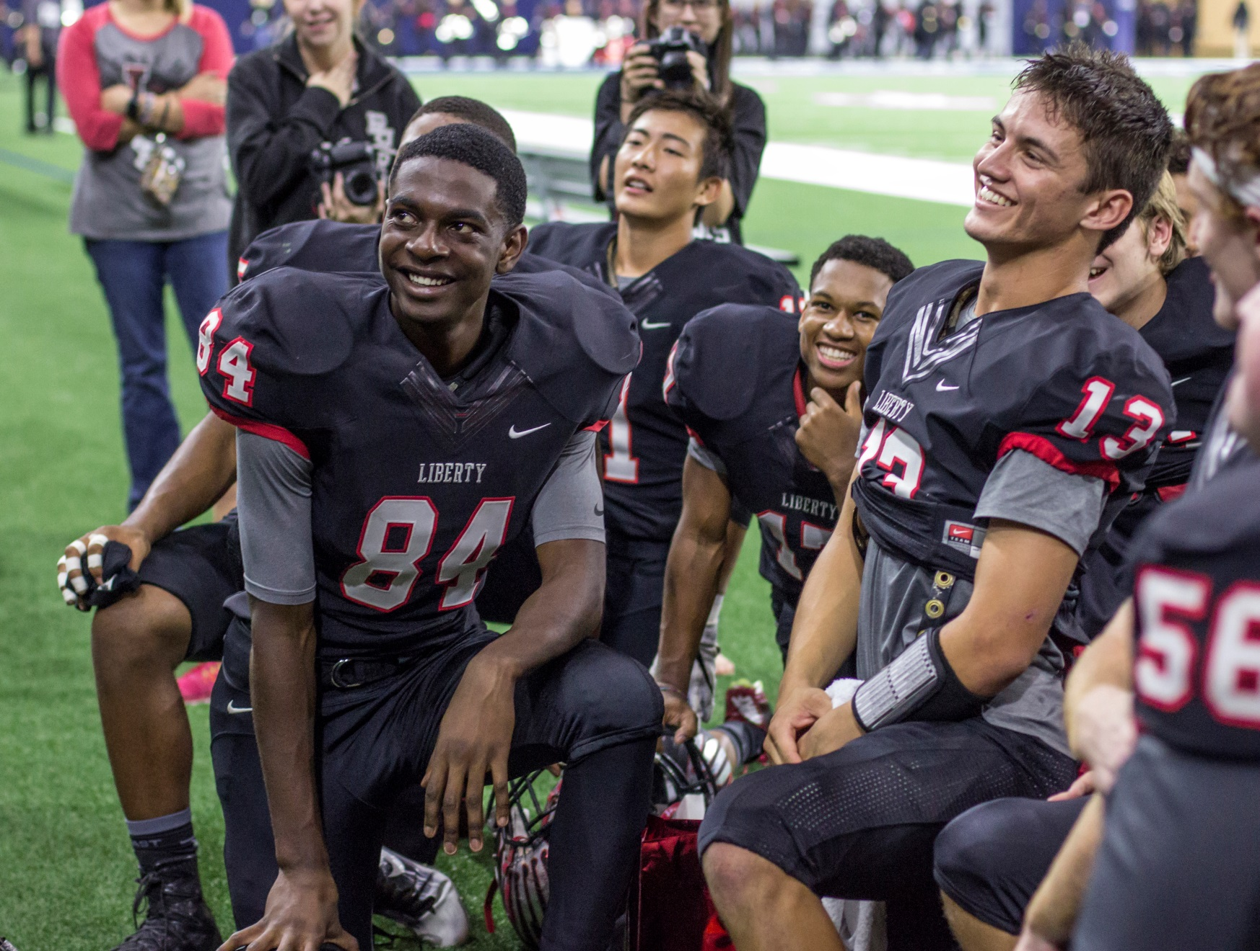

Slide 23
PHOTO COMPOSITION
Reaction shot
Emotion
Watch the sidelines for the story behind the story. The players’ reactions are as important as the action of the game.

Slide 24
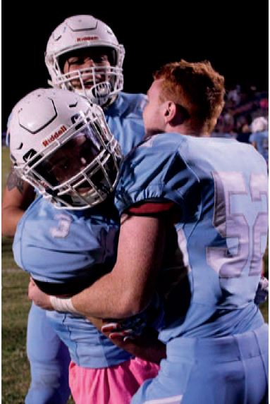

Slide 25
PHOTO COMPOSITION
Reaction shot
Emotion
Keep shooting even after the play ends and players return to the sidelines – they often continue celebrating a score or turnover with their teammates/coaches.

Slide 26
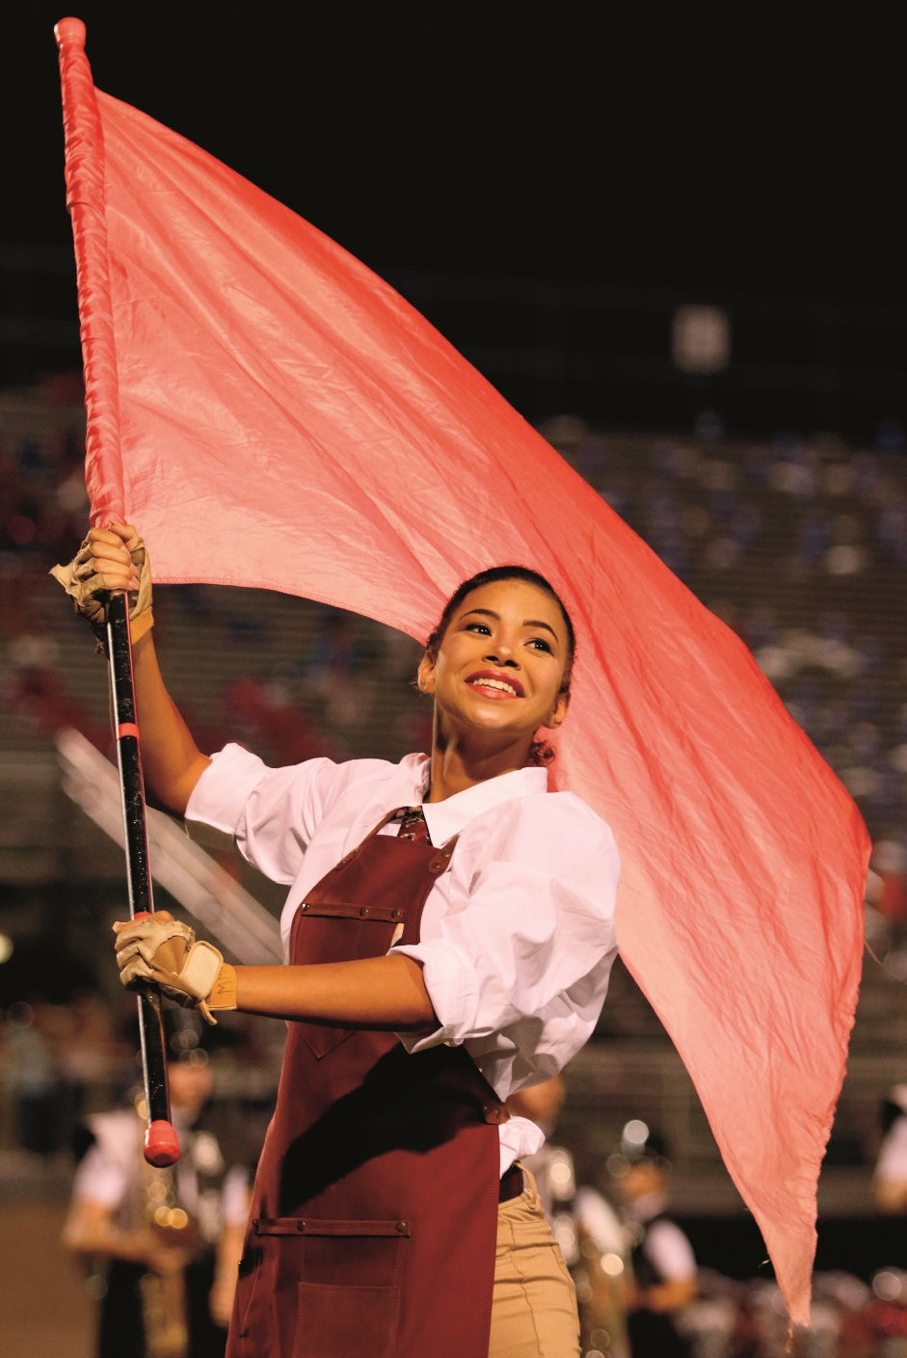

Slide 27
PHOTO
COMPOSITION
Worm’s eye view
Fill the frame
Framing
Emotion
The halftime show offers a variety of coverage opportunities. Here the color guard flag forms a vibrant frame for the performer, whose facial expression is clearly shown. The worm’s eye angle eliminates background distractions.

Slide 28
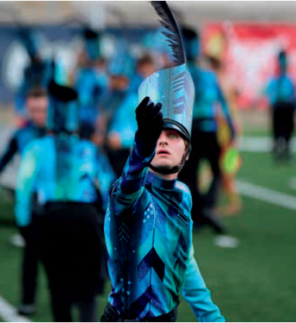

Slide 29
PHOTO
COMPOSITION
Depth of field
Lighting
Focus on individual
The half-time show offers a variety of coverage opportunities. The depth of field provides a strong center of focus and eliminates background distractions.

Slide 30
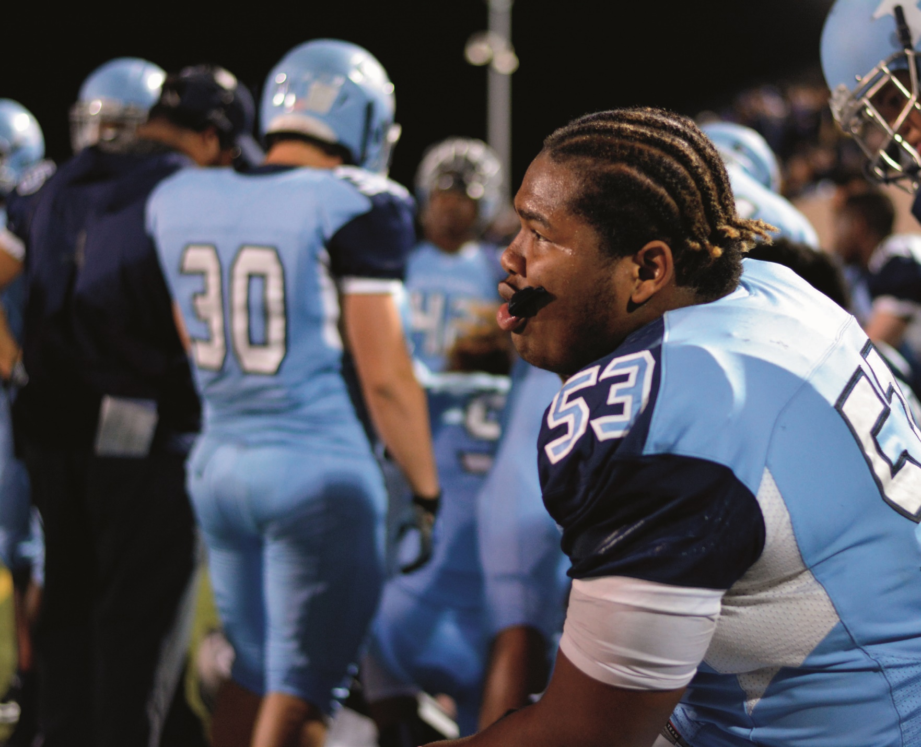

Slide 31
PHOTO COMPOSITION
Selective focus
Emotion
Rule of thirds
Staying until the end of the game pays off with emotional sideline shots like this. The photographer uses a wide aperture to focus on the emotion of the player in the foreground, blurring the background.

Slide 32
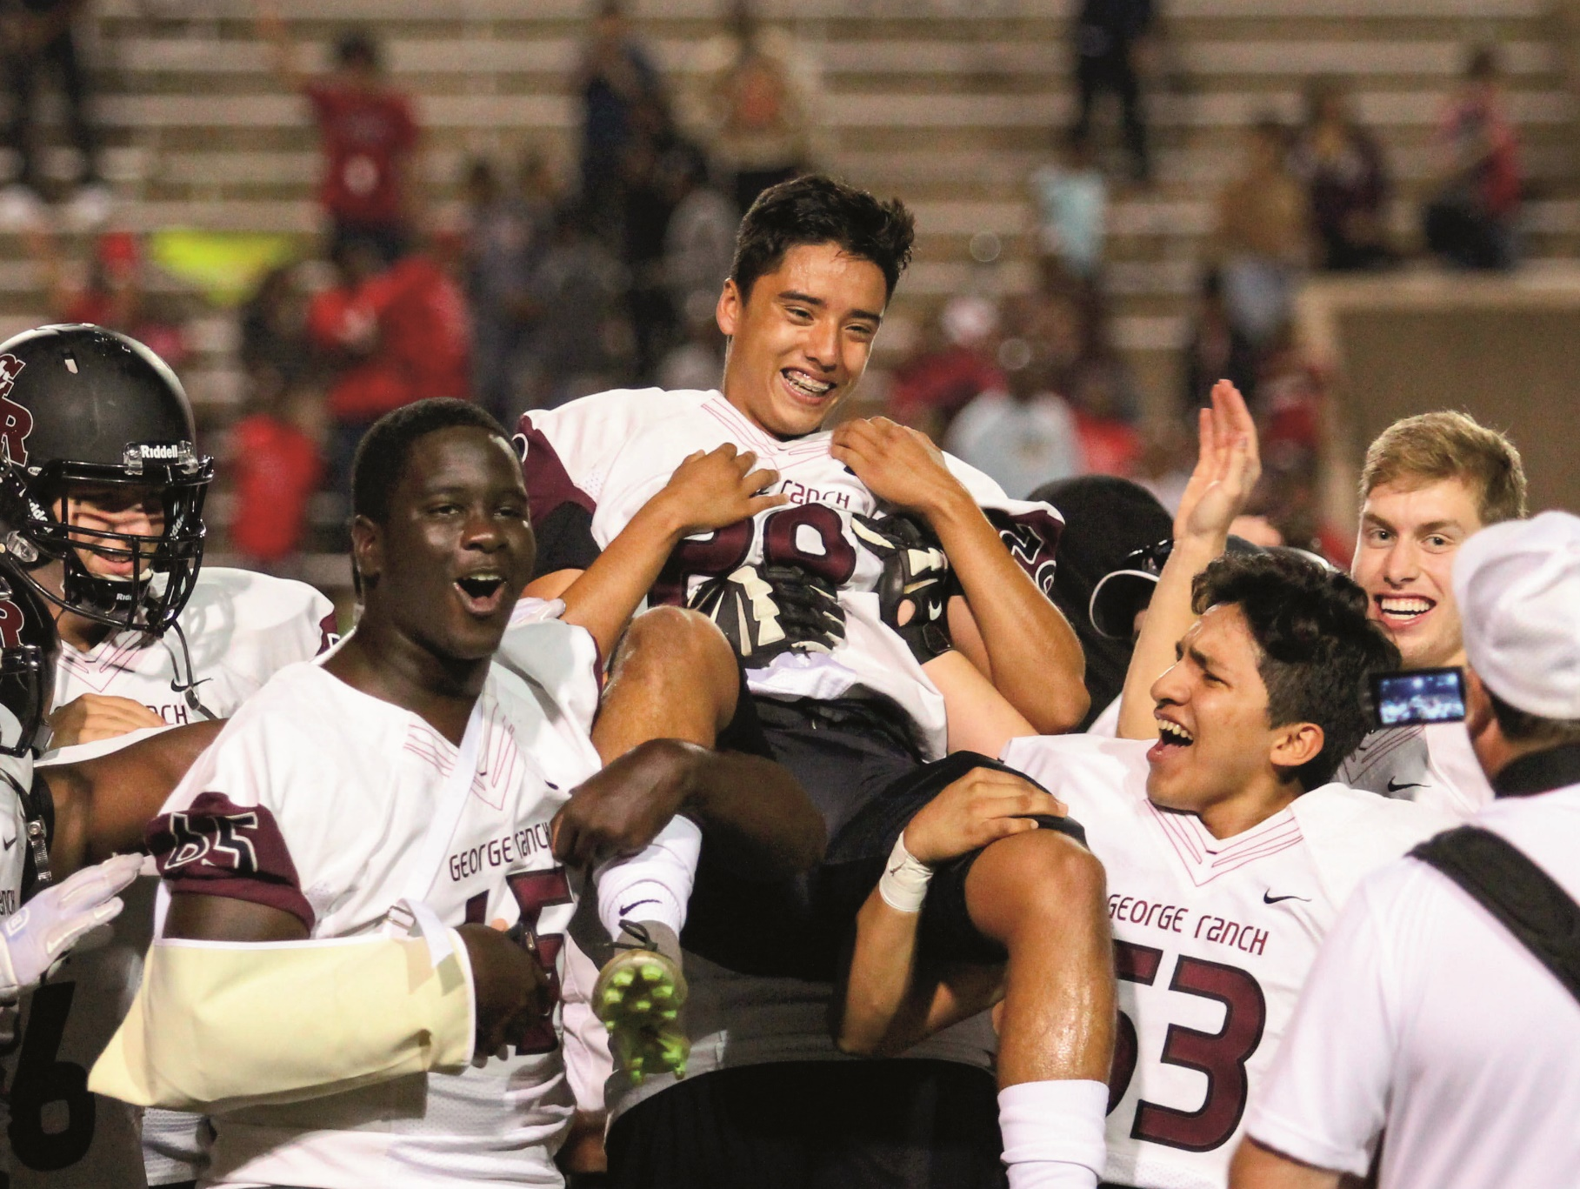

Slide 33
PHOTO
COMPOSITION
Filling the frame
Framing
Selective focus
Emotion
Teammates frame the central player in this celebratory shot. By moving in close, taking a slightly low angle and blurring the background with a wide aperture, the photographer tells the story through the looks on the players’ faces.

Slide 34
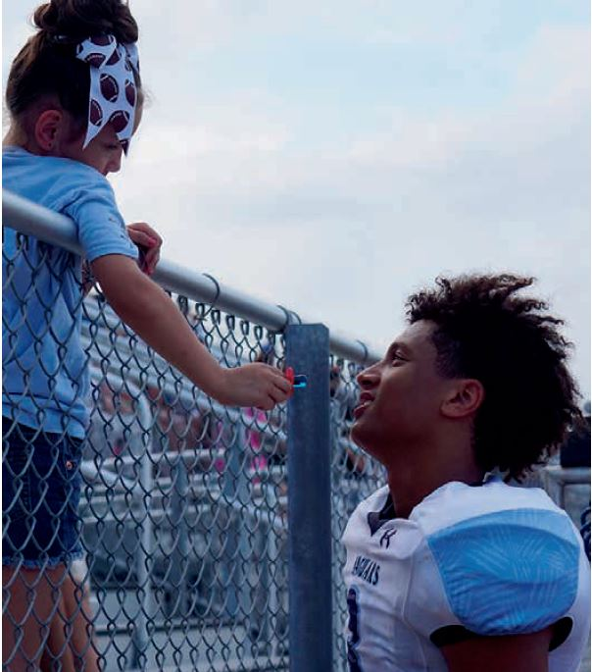

Slide 35
PHOTO
COMPOSITION
Framing
Emotion
Staying after the game gives photographers the opportunity to capture moments with siblings, parents and other fans as they interact with players.

