Slide 1
PHOTOGRAPHING
Academics

Slide 2
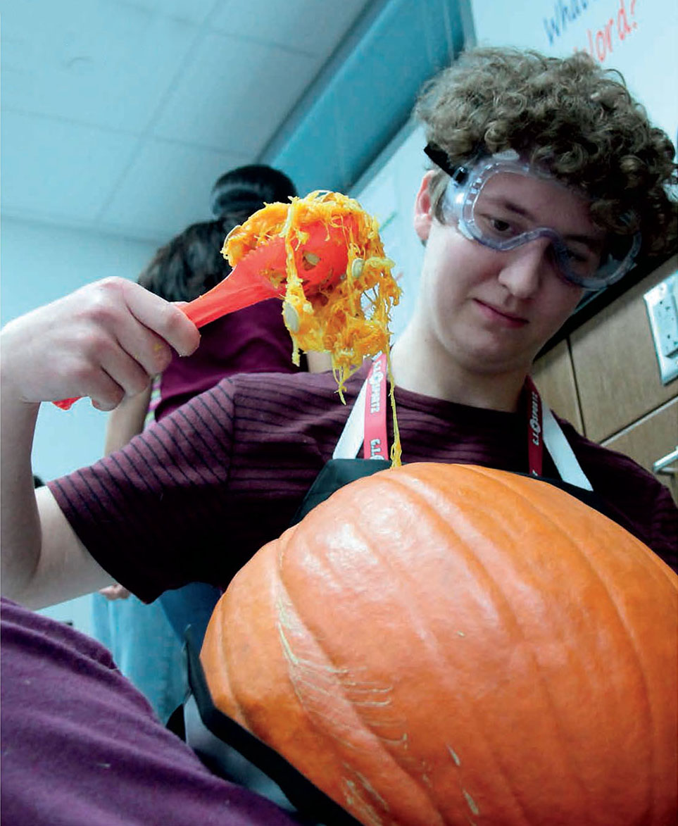
Tips for strong academics photos:
Shoot activities with involved students.
Find a unique angle.
Wait for the moment.
Shoot no less than 100 shots.
Ask teachers to alert the yearbook staff when special presentations or activities are planned.

Slide 3
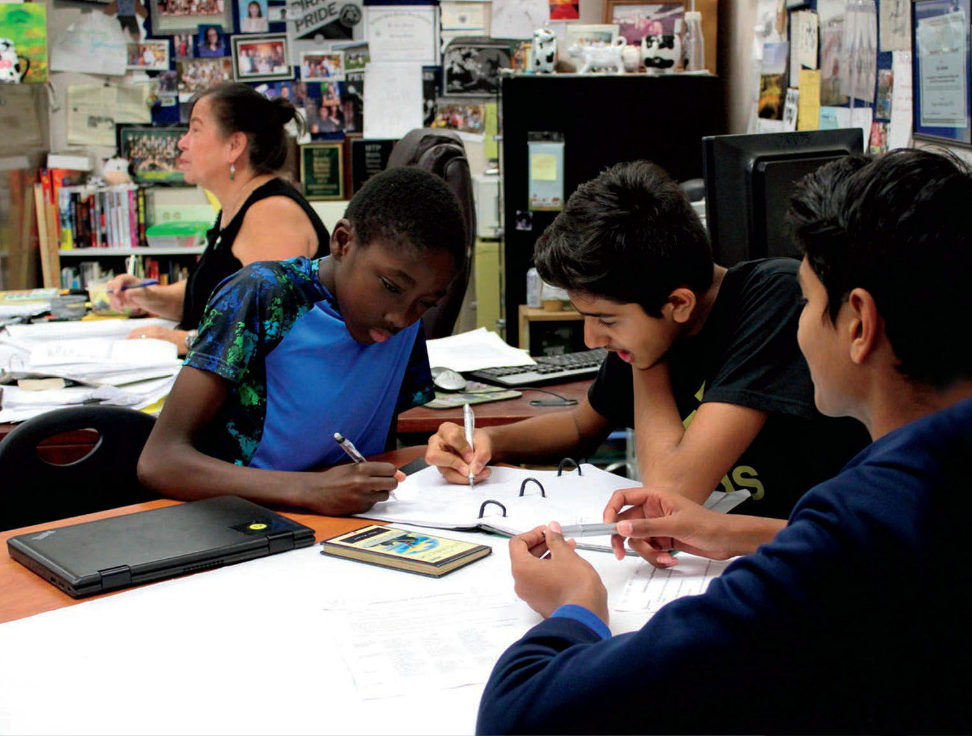
Tips for strong academics photos:
Avoid shooting toward windows. Outside light is too bright and will cause silhouettes.
Look for moments with one person, two people, three
people, small groups and large groups.

Slide 5
PHOTO COMPOSITION
Unique angle
Foreground framing
The photographer uses beakers and tubes to frame the subjects.
By shooting from slightly below the subjects, the photographer avoids the cluttered background and captures the students’ faces as well.
Avoid angles where you’ll be forced to shoot the top of someone’s head.

Slide 6
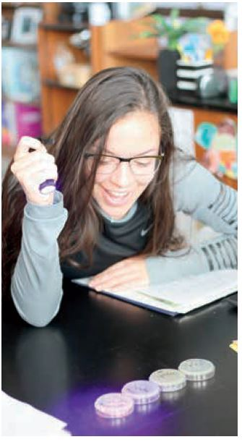

Slide 7
PHOTO COMPOSITION
Unique angle
Focal point
By angling from slightly above the subject, the photographer captures the scene with attention to the subject’s focus and the light she holds.
The photographer captured the object she’s illuminating to provide storytelling elements for captions.

Slide 8
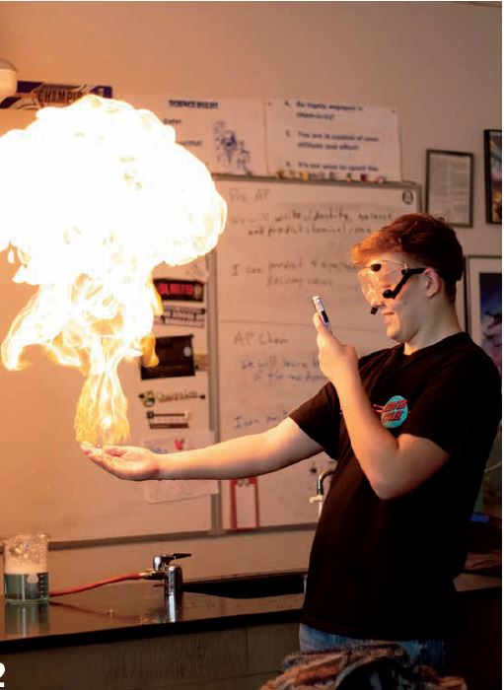

Slide 9
PHOTO COMPOSITION
Dramatic lighting
Captures emotion
Look for moments when students are interacting and learning.
The photographer caught the flame, the phone and the student’s face.

Slide 11
PHOTO COMPOSITION
Dramatic lighting
Fill the frame
Center of interest
Moving in close isolates the subject and shows facial expression.
Turning the flash off and adjusting the aperture is key capturing the glow of the flame.

Slide 12
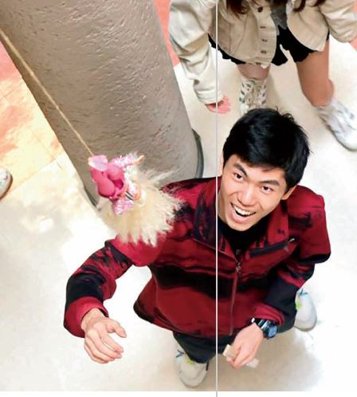

Slide 13
PHOTO COMPOSITION
Angle
Leading lines
Above angle draws the viewer to the focal point, adds interest
The doll on the string and the column behind the student lead the eye toward subject.

Slide 15
PHOTO COMPOSITION
Framing
Fill the frame
Wide angle shot
Career classes offer more opportunity for hands-on shots.
The wheel well frames the subject and the angle provides a clear view of both his face and the work he’s doing.

Slide 16
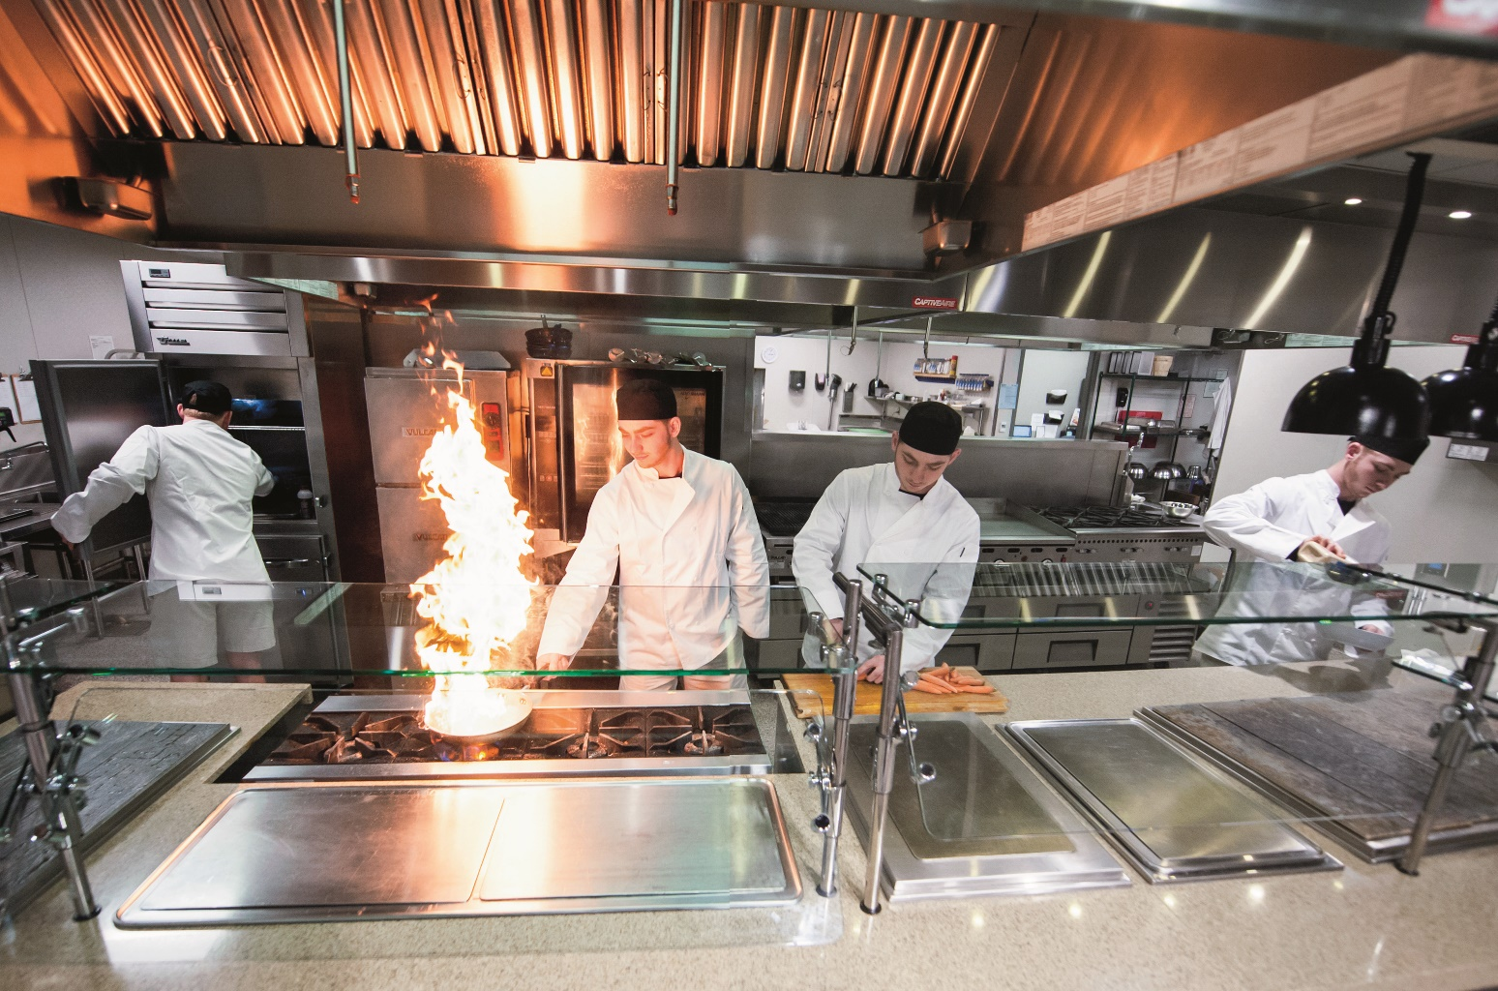

Slide 17

PHOTO COMPOSITION
Leading lines
Framing
Creative angle
Lines lead your eye to the student chefs at work. Kitchen equipment frames the action while the high angle gives a view of both the students and their environment. Reflective surfaces emphasize the flames.

Slide 18
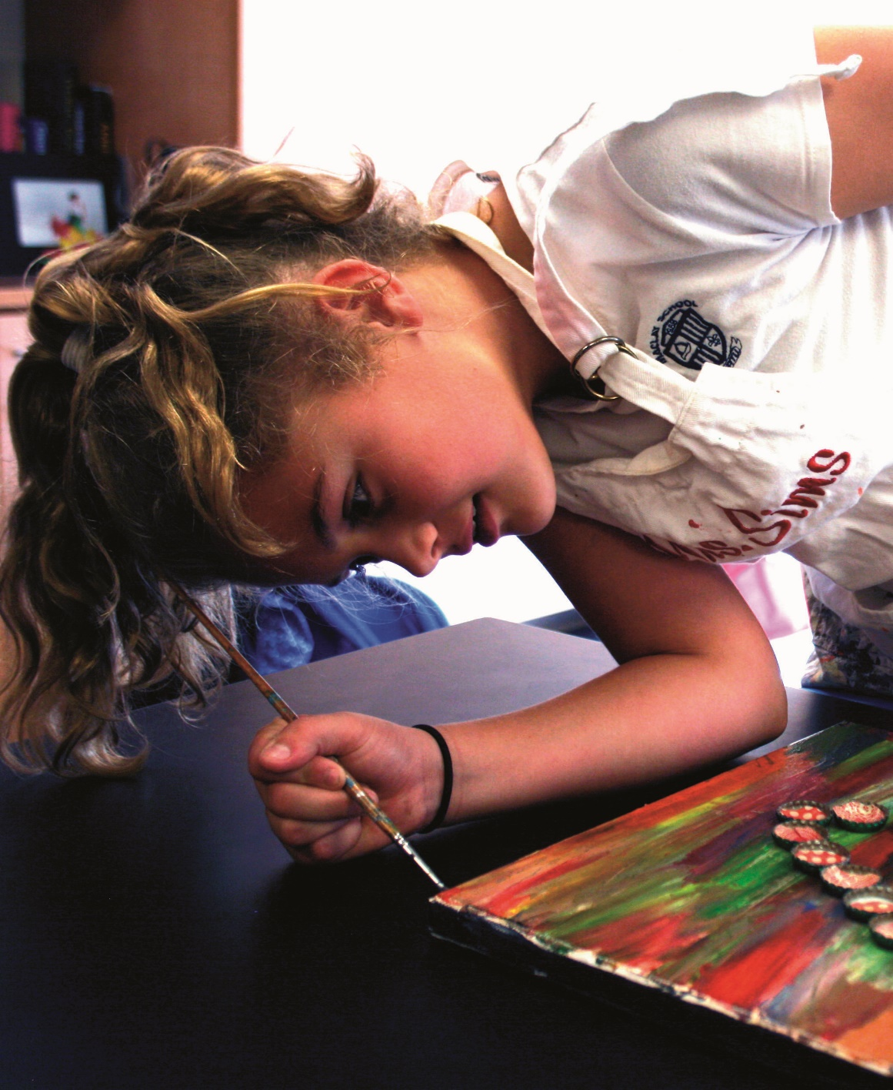

Slide 19

PHOTO COMPOSITION
Unique angle
Fill the frame
The photographer gets on the level of the artist to show both her face and the piece she’s painting.
A tight crop eliminates distraction from the center of interest.

Slide 20
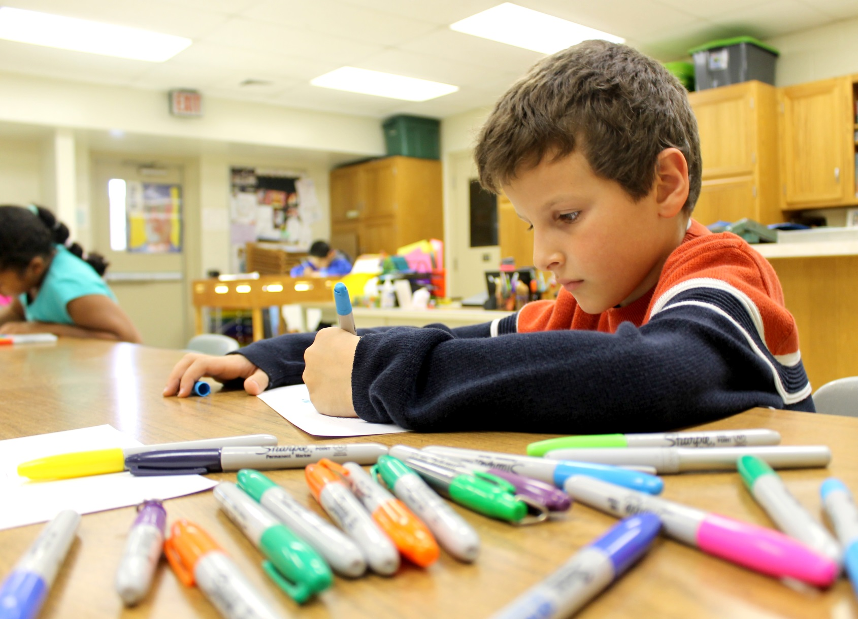

Slide 21

PHOTO COMPOSITION
Unique angle
Fill the frame
Leading lines
The low angle captures both the artist’s face and his multi-colored markers. The markers form a leading line through repetition, drawing the eye to the subject.

Slide 22
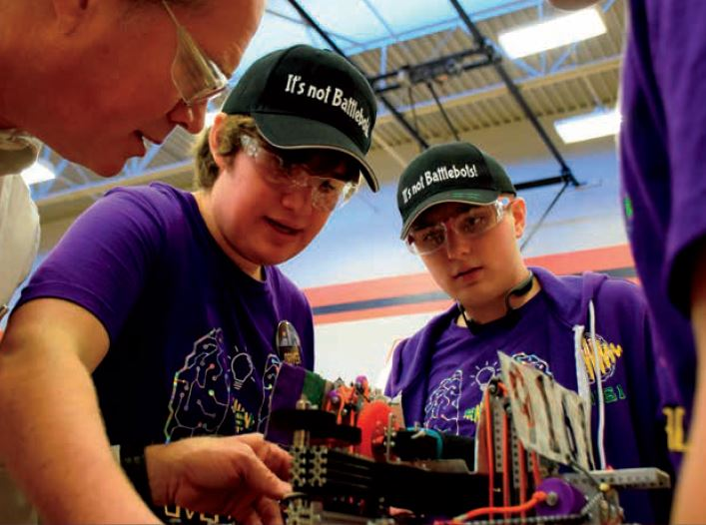

Slide 23
PHOTO COMPOSITION
Worm’s eye angle
Fill the frame
By shooting from a lower angle, the photographer captures the detail of this students’ project as well as the instructor. Tight cropping keeps the focus on the students and their project.

Slide 24
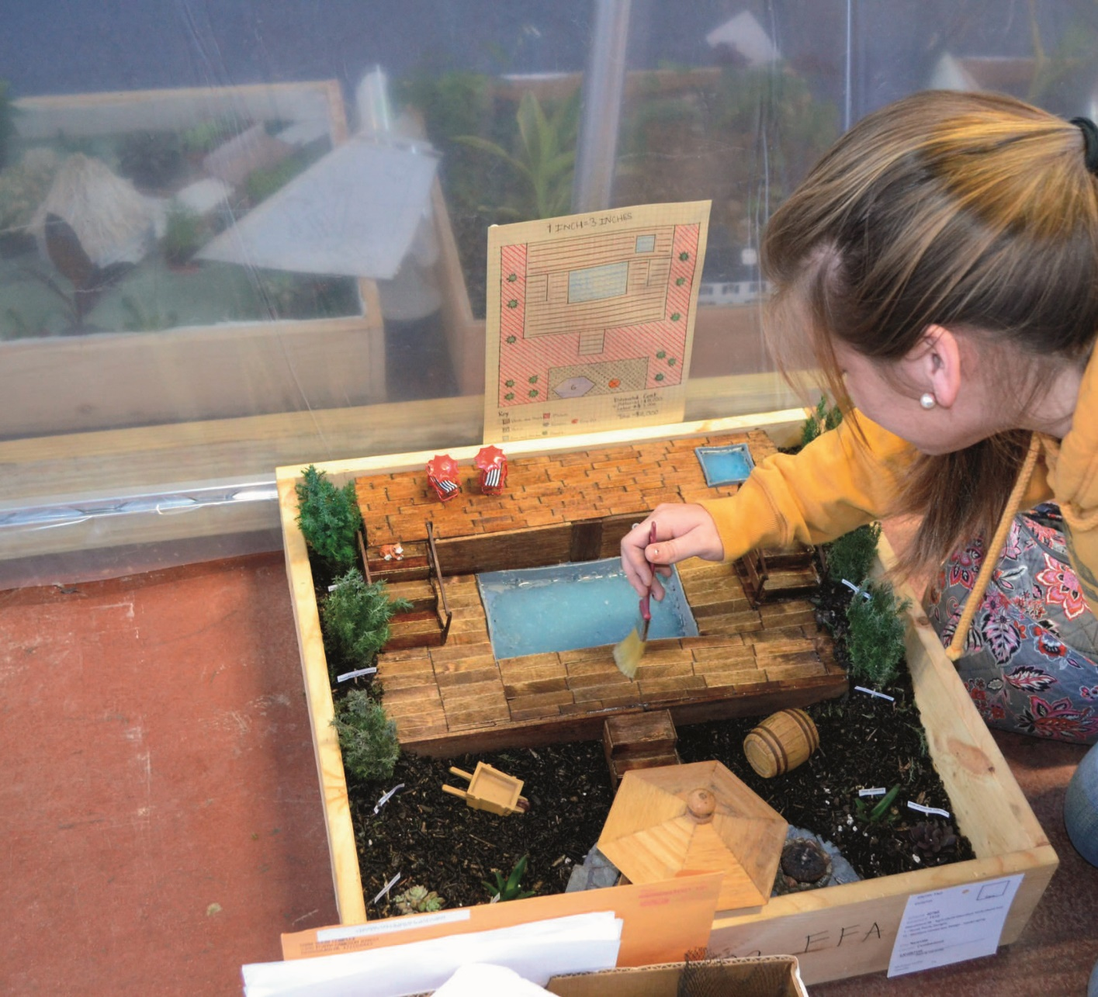

Slide 25

PHOTO COMPOSITION
Bird’s eye angle
Attention to background
Rule of thirds
By shooting from a higher angle, the photographer captures the detail of this student’s design project as well as others beyond the translucent plastic sheeting. The subject is placed to the top right, following the rule of thirds.

Slide 26
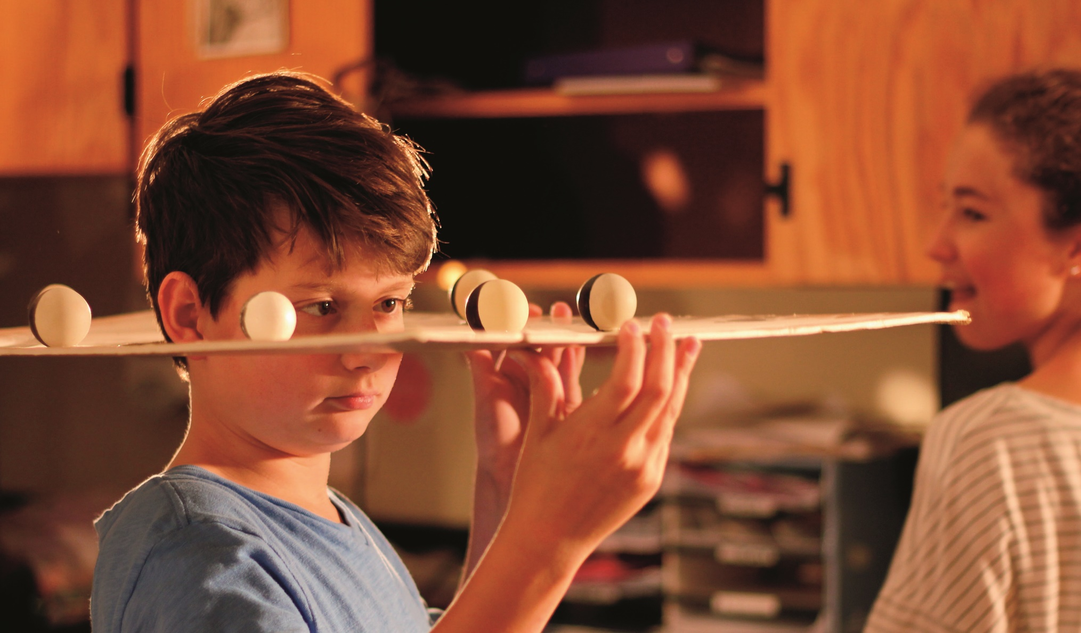

Slide 27

PHOTO COMPOSITION
Framing
Warm lighting
Filling the frame
A model showing phases of the moon acts as a frame for the subject. The photographer shoots from an angle to clearly show the facial expression and avoids using flash to show the warm lighting of the room.

Slide 28
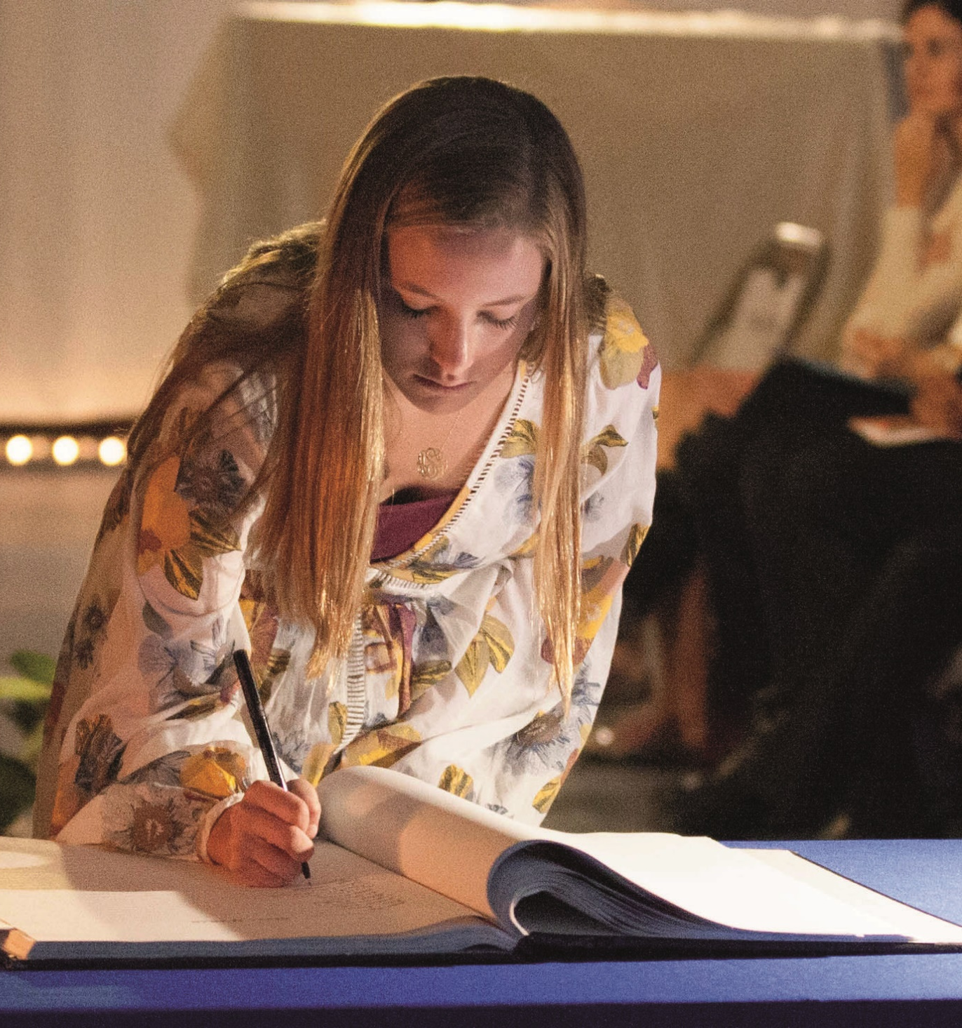

Slide 29

PHOTO COMPOSITION
Unique angle
Under lighting
Shallow depth of field
Shooting from slightly below the subject captures the facial expression and the glow of the under lighting. Using a wide aperture blurs the background to draw attention to the foreground.

Slide 30
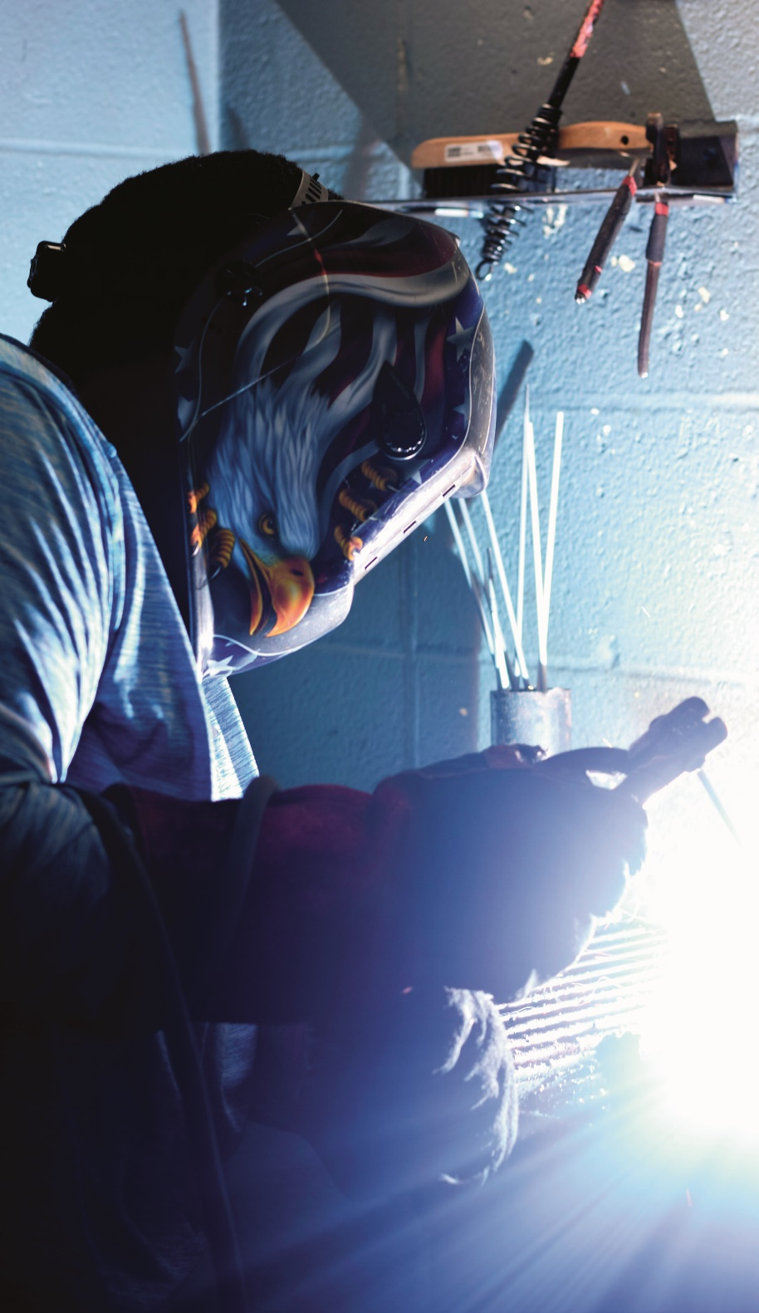

Slide 31

PHOTO COMPOSITION
Low angle
Fill the frame
Backlighting
The worm’s eye view allows the viewer to see the welder’s helmet and his hands as he works. Backlighting creates a partial silhouette.

