Slide 1
Typography

Slide 2
typography
Typography is the setting and printing of type.
It is the art of skillfully arranging and presenting type to gain attention.
Notes:
Typography is the art of skillfully arranging and presenting type to gain attention.

Slide 3
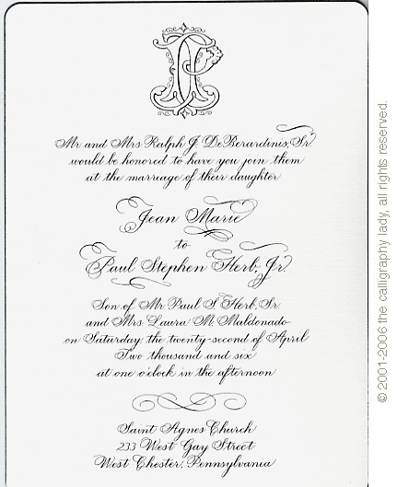

typography
Typography conveys a mood and message.
Have you ever seen a wedding invitation in
?
Notes:
Of course not, because that’s not the mood or message you’re trying to get across. Unless, it’s a Halloween or Thriller wedding.

Slide 4


typography
Type conveys meaning like voice inflection.
Notes:
Which one of these is more effective? The first is very small, quiet and feminine. The second is large, loud and bold. Even the color adds to the emphasis.

Slide 5
typography
Typography has a significant effect on:
Readability
Compelling design
Conveying a mood or message
Understanding the elements of typography will help you choose typefaces and improve design.

Slide 6
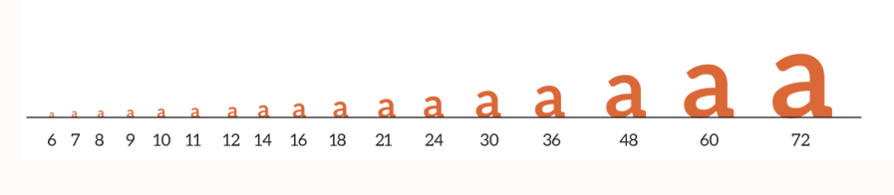
Type sizes
Type is measured in points
(12 points = 1 pica)
Notes:
Six picas in an inch. So, 72 point is one-inch tall.

Slide 7
Type sizes
72-point type (1 inch)
36-point type (1/2 inch)
18-point type (1/4 inch)
12-point type (1 pica tall)
9-point type (1/8 inch)
Notes:
This is actual size on a computer screen.
Six picas in an inch. So, 72 point is one-inch tall.

Slide 8
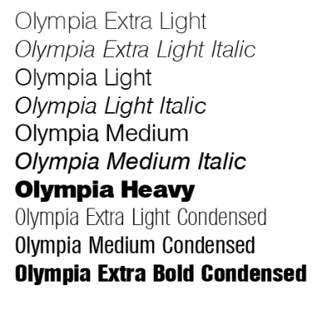
Type styles & weights
A typeface family provides a range of styles and weights.
Choosing a family is ideal for consistency in typography and contrast for design.
Notes:
A traditional family offers styles like regular, italic, bold. An extended family has additional variations like thin, black. Then there are super families with have condensed and extended versions of the typeface.

Slide 9
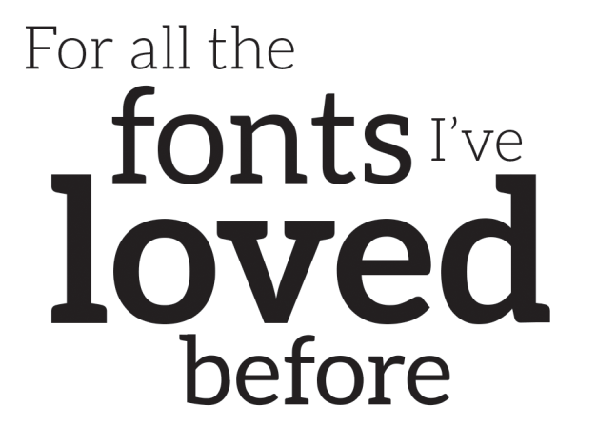
Type styles & weights
Light
Regular
Bold
The typeface Aleo, using three weights
Notes:
The type family “Aleo” with examples of light, regular and bold type.

Slide 10
Type readability
Leading is the space between lines of type.
Auto leading sets spacing, but you can manually adjust to create emphasis or save space.
Notes:
Pronounced “ledding” the term comes from the use of lead type with printing presses. Typesetters would add a 1-point line of lead between lines of text for readability.
Auto leading was set for reading on a computer.

Slide 11
Type readability
Kerning is the space between pairs of characters or glyphs.
Tracking is the space between letters in an entire block of text.
Notes:
Kerning only affects the space between two letters, so you can adjust each space differently. Tracking adjusts all spaces in a block of text equally. (Most people call them both kerning.)

Slide 12
Type readability
Alignment affects type readability.
Align left, also called ragged right, is the easiest to read.
Left justified aligns the left and right margins, but can cause awkward spacing in narrow text boxes.

Slide 13
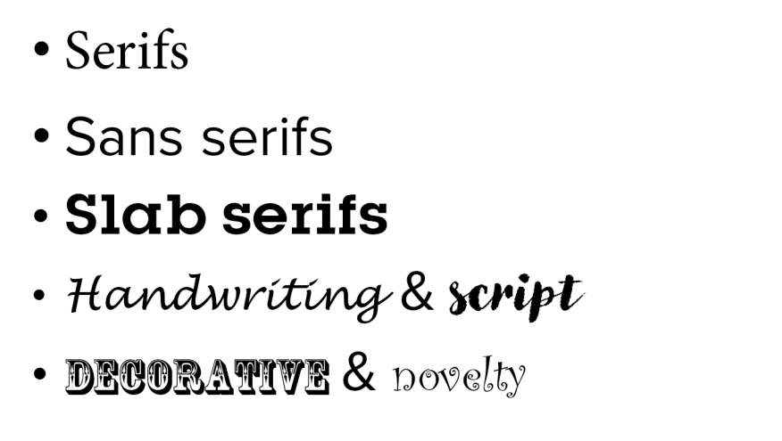
Type classifications

Slide 14
serifs
Feet at the end of the letters
The letters have thin and thick transitions
Some versions (like Old Style) have slanted serifs

Slide 15
serifs
Often used for body copy, headlines, captions
Easy to read
Serifs make each letter distinct

Slide 16
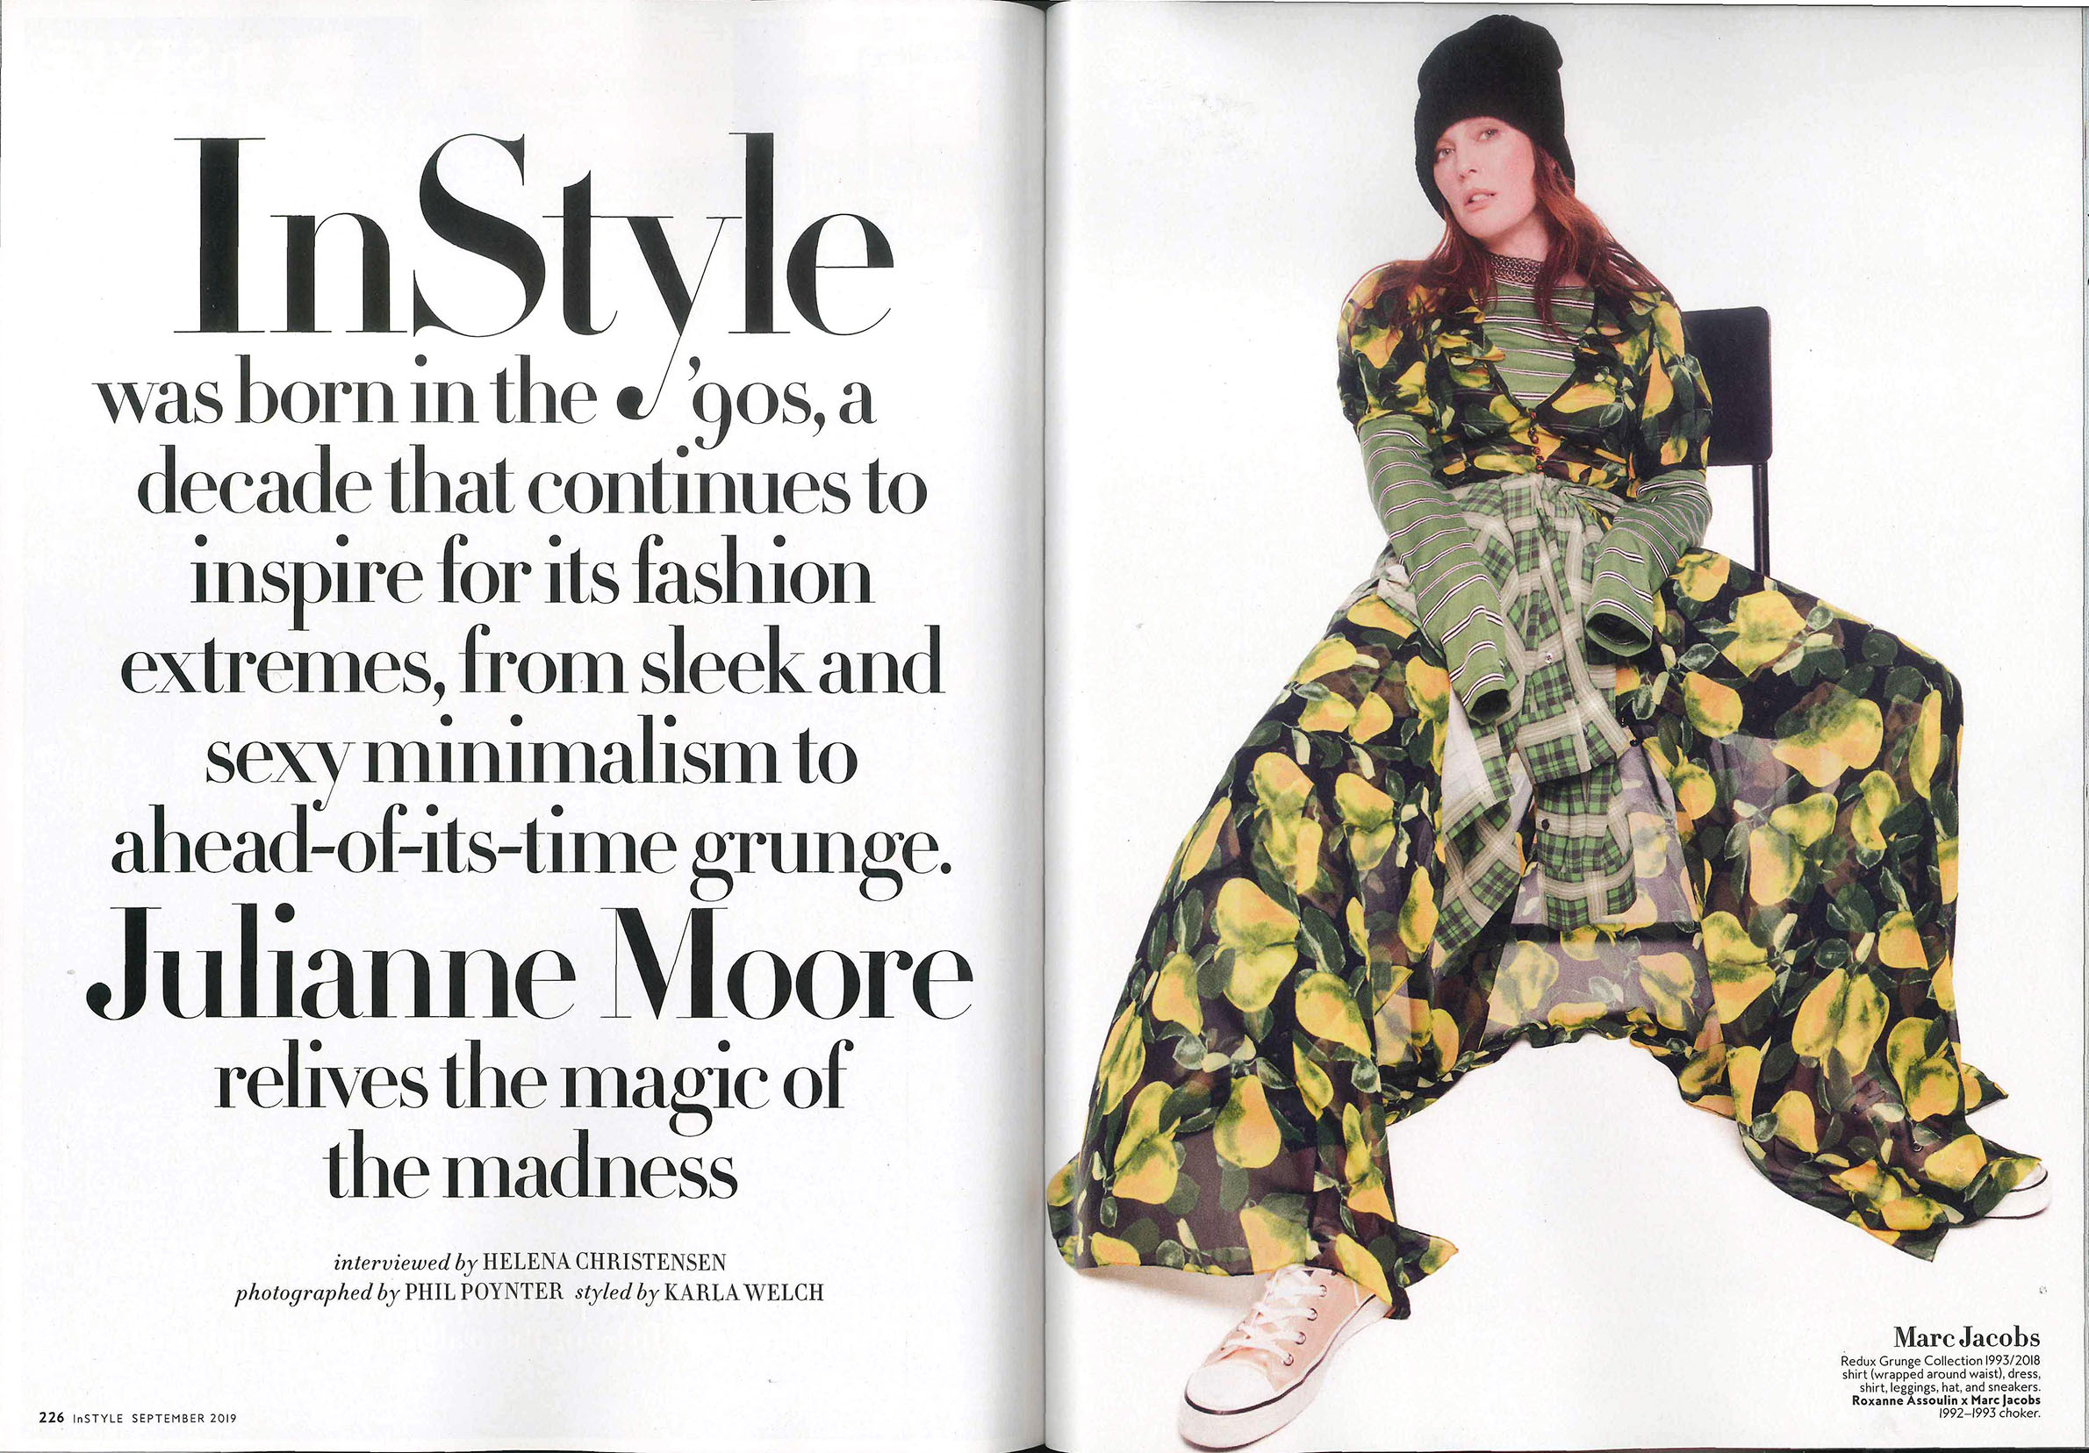

Slide 17
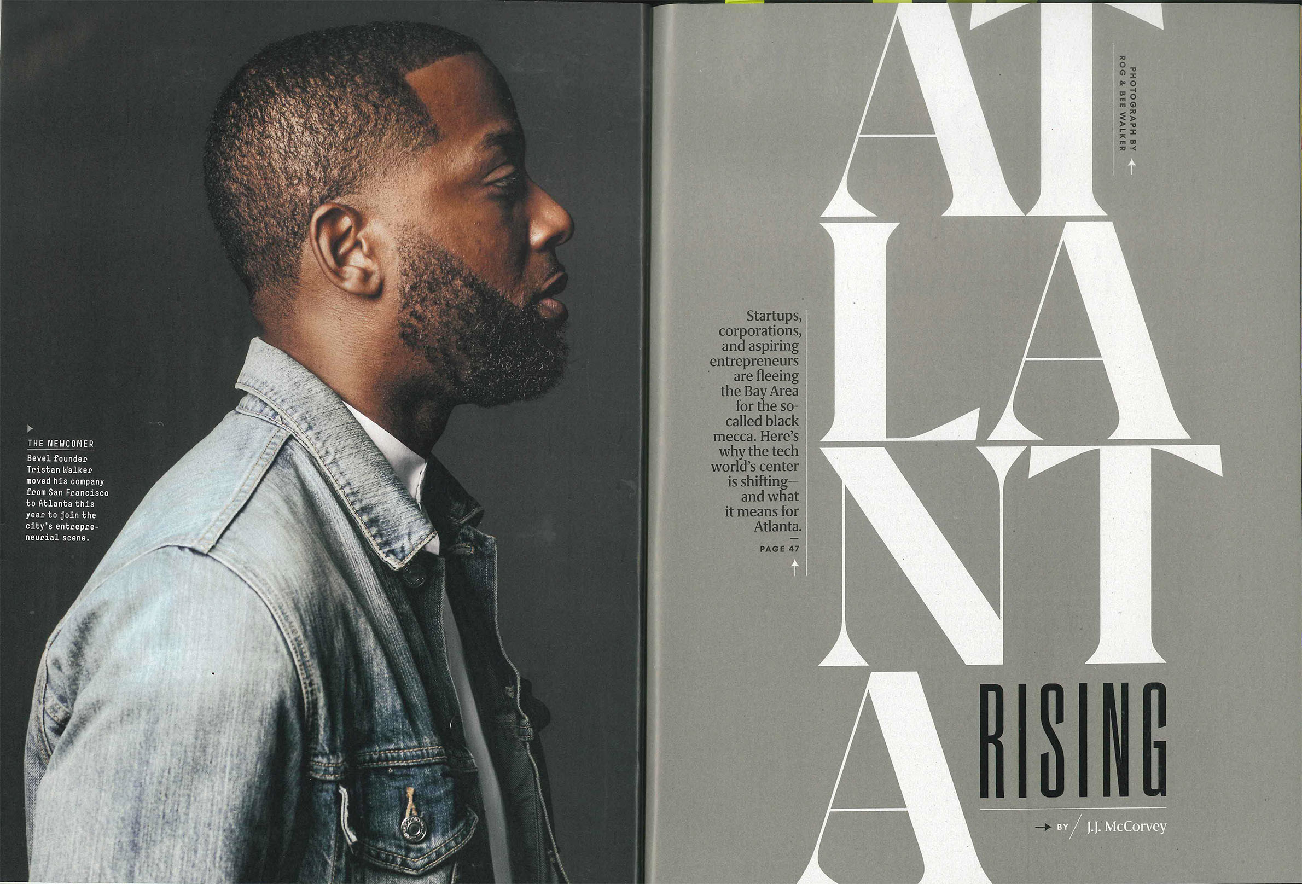

Slide 18
sans serifs
“Sans” means without. There are no feet (serifs) at the ends of the letters.
Usually monoweight – no visible thin or thick transitions in the strokes.

Slide 19
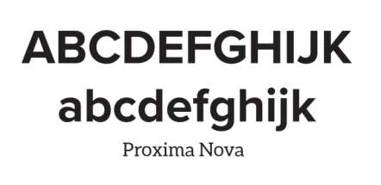
sans serifs
Smooth, clear appearance
Often used in headlines, sidebars, ads
Sometimes used for body copy

Slide 20
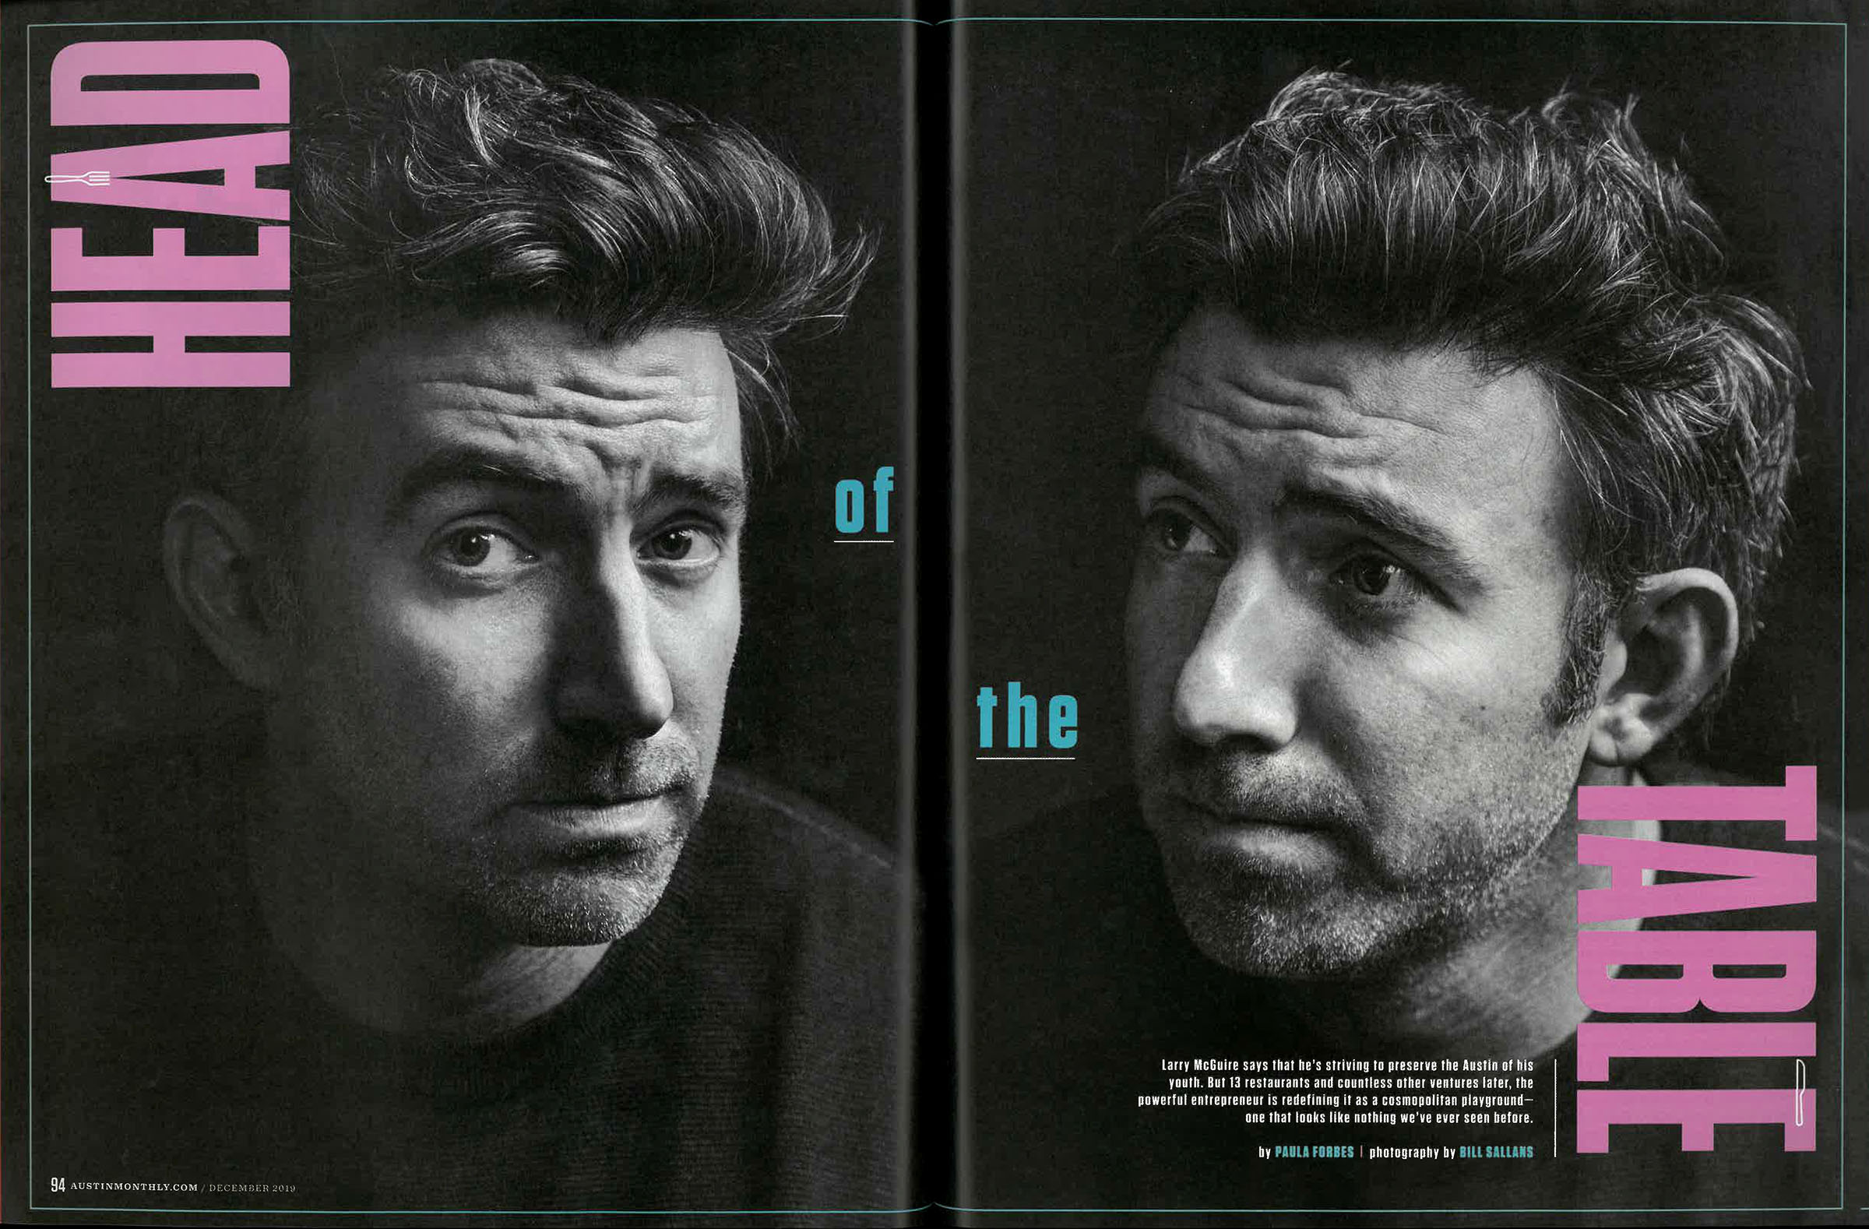

Slide 22
slab serifs
Slab serifs have a mixture of serif and sans serif characteristics.
The serifs are heavier and thicker in weight, usually rectangular in shape.
Notes:
Slab serifs have a mixture of serif and sans serif qualities/characteristics

Slide 23
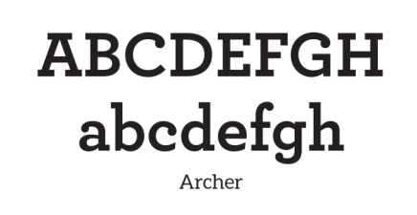
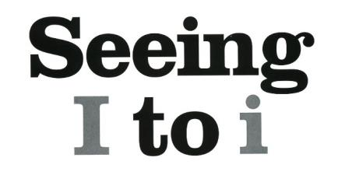
slab serifs
Slab serifs are monoweight – little to no thin or thick transitions
Often used for headlines & sidebars

Slide 24
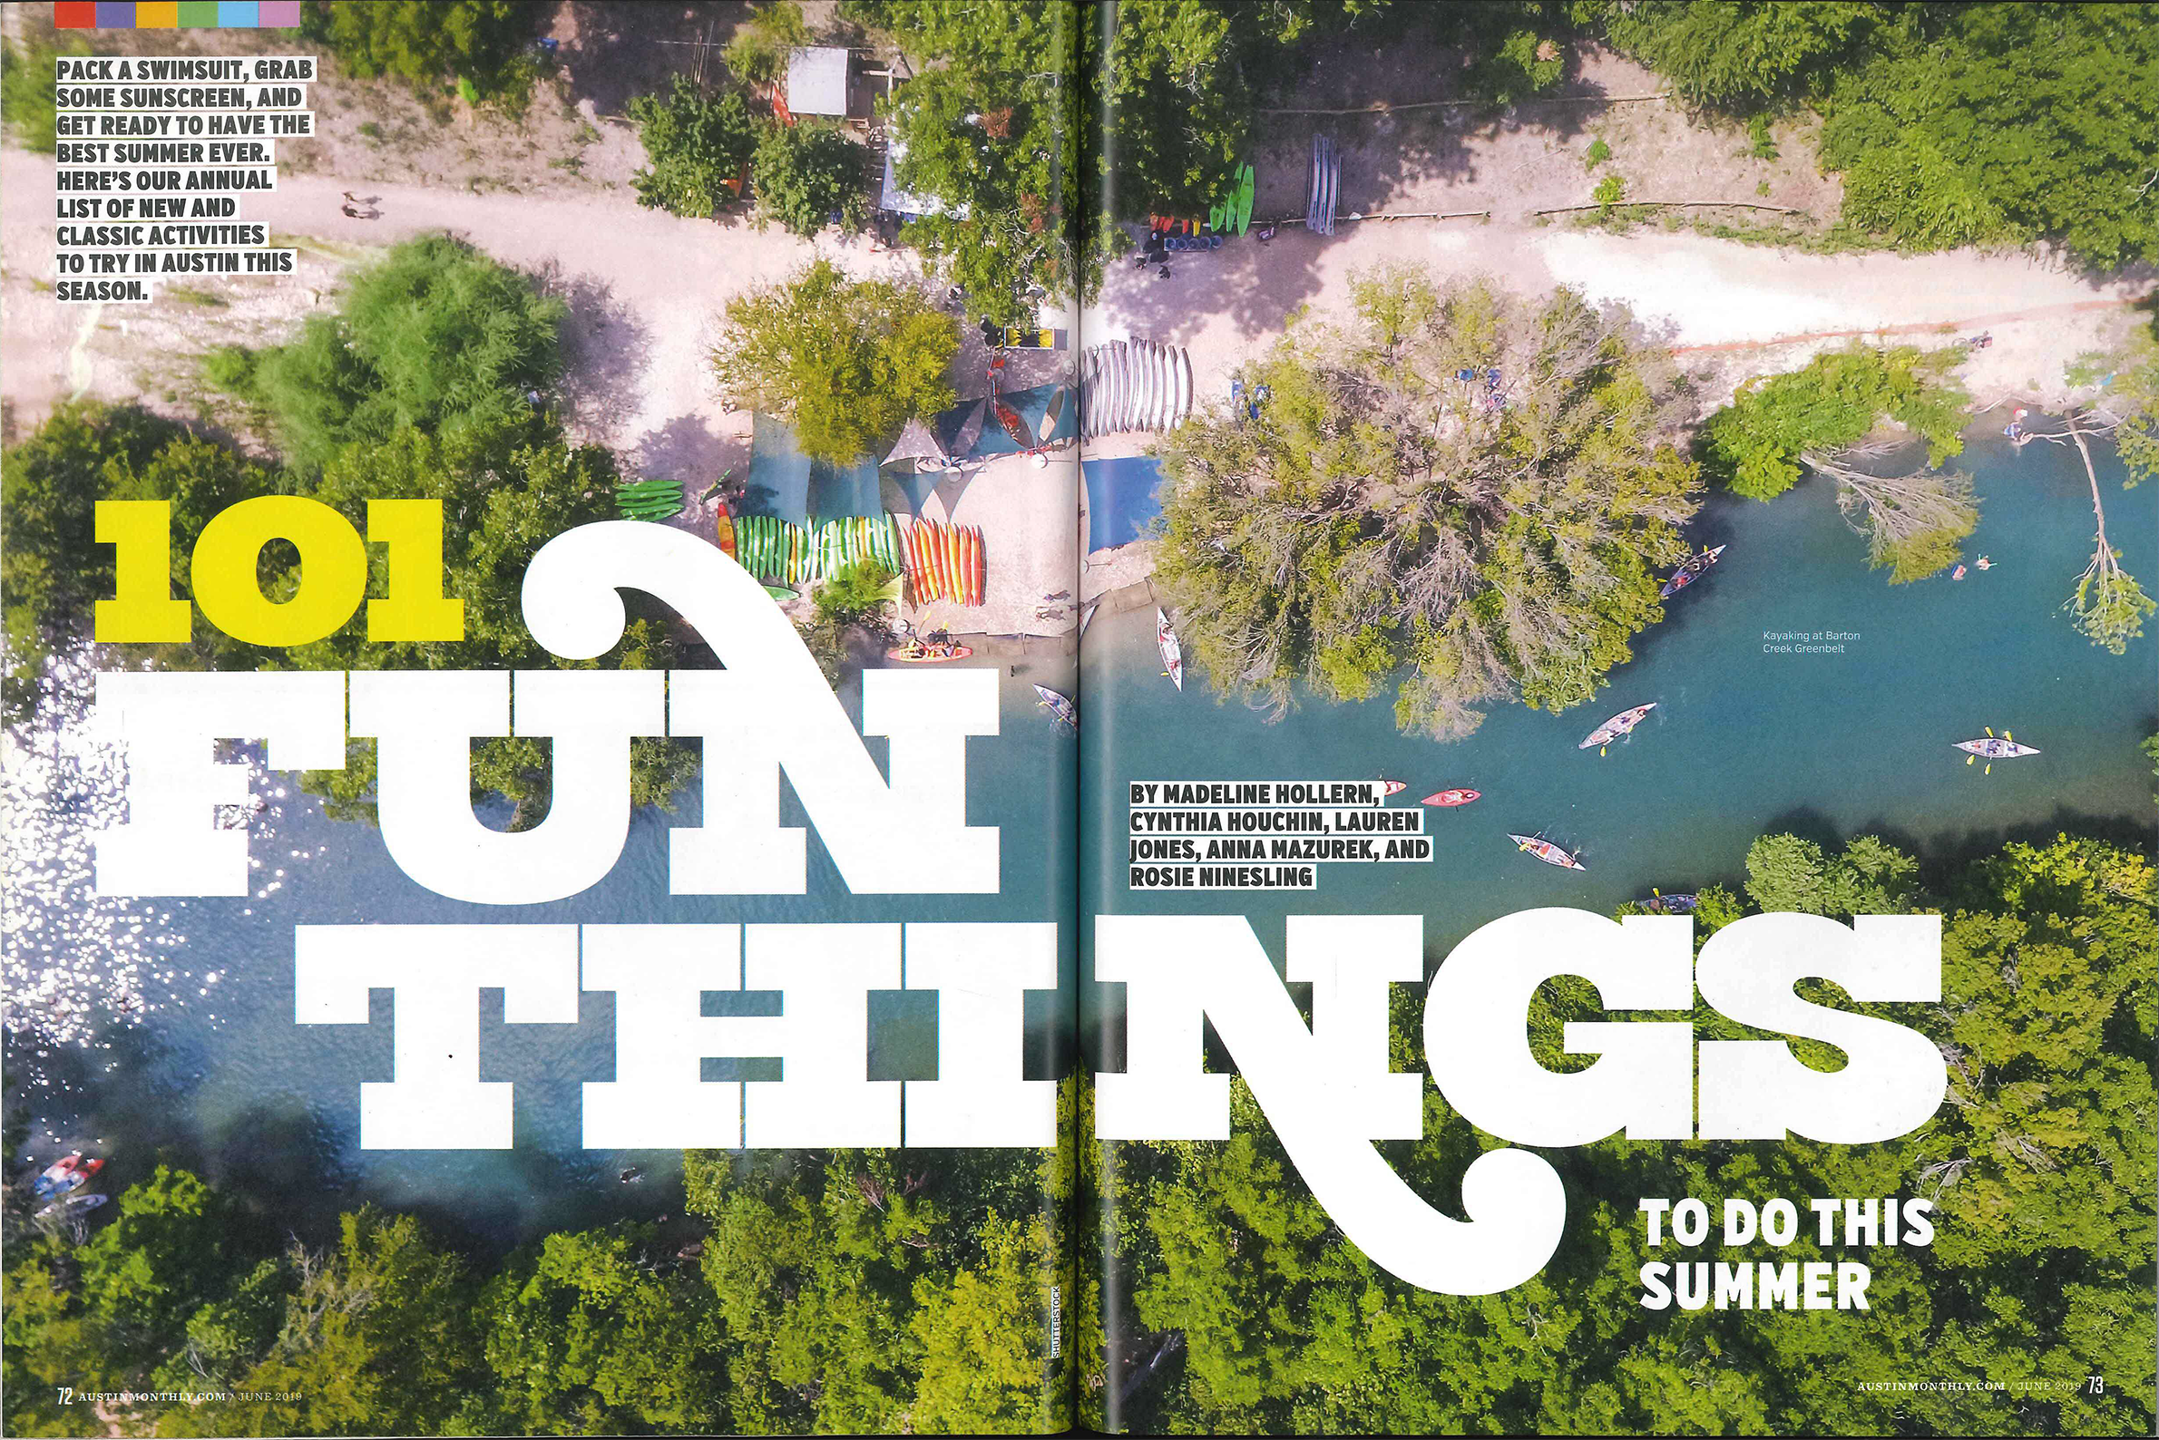

Slide 25
handwriting & script
Resembles handwriting, calligraphy or cursive writing
Has low readability

Slide 26
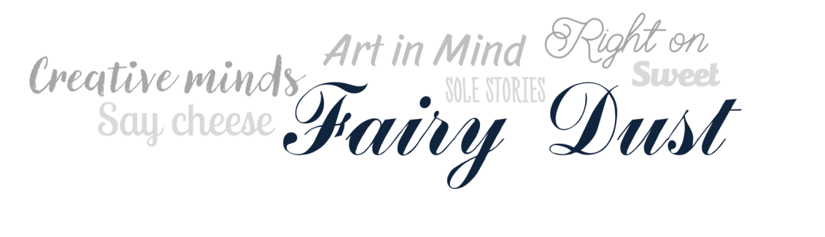
handwriting & script
Use sparingly, sprinkle into design as an accent.
Use in large sizes, with headlines.
Avoid using small or in body copy.
Notes:
Be careful with handwriting and script type that it doesn’t look too ”girly.” Often yearbook staffs are comprised mostly of girls so be careful that we’re catering to all of our audience.

Slide 27
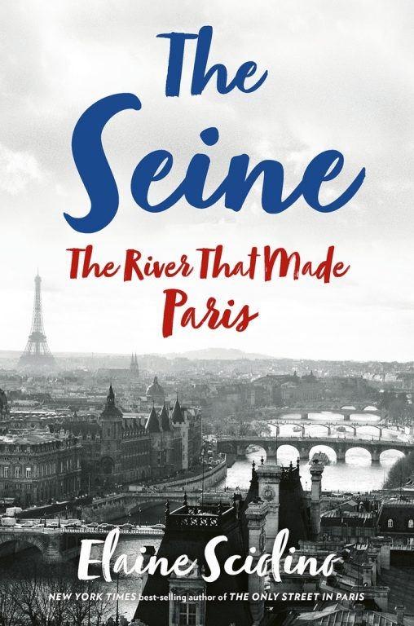

Slide 29

decorative & novelty
Decorative and novelty fonts are fun and distinctive.
They have an artistic flair with personality.

Slide 30

decorative & novelty
Use to accent or highlight certain words
Often used for headlines, not for body copy

Slide 31
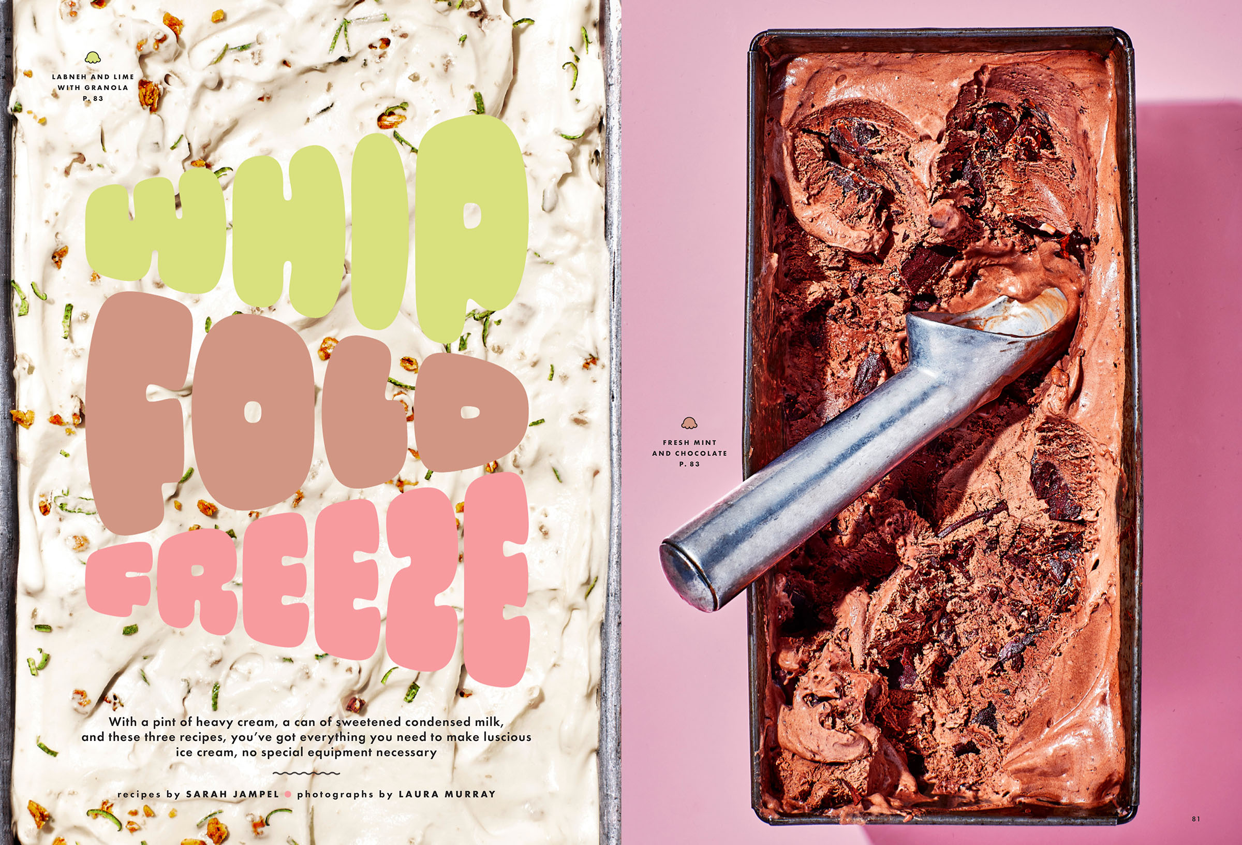

Slide 33
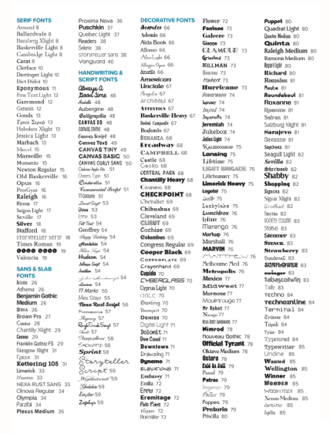
Type suggestions
Balfour offers more than 300 different typefaces and families.
With so many to choose from, how do you decide?
Notes:
The serif or sans serif typeface will do the bulk of the work.

Slide 34
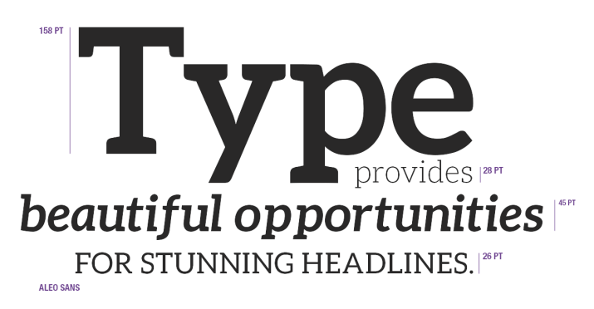
Type suggestions
Choose type for its readability, aesthetic appeal and visual extension of your theme.

Slide 35


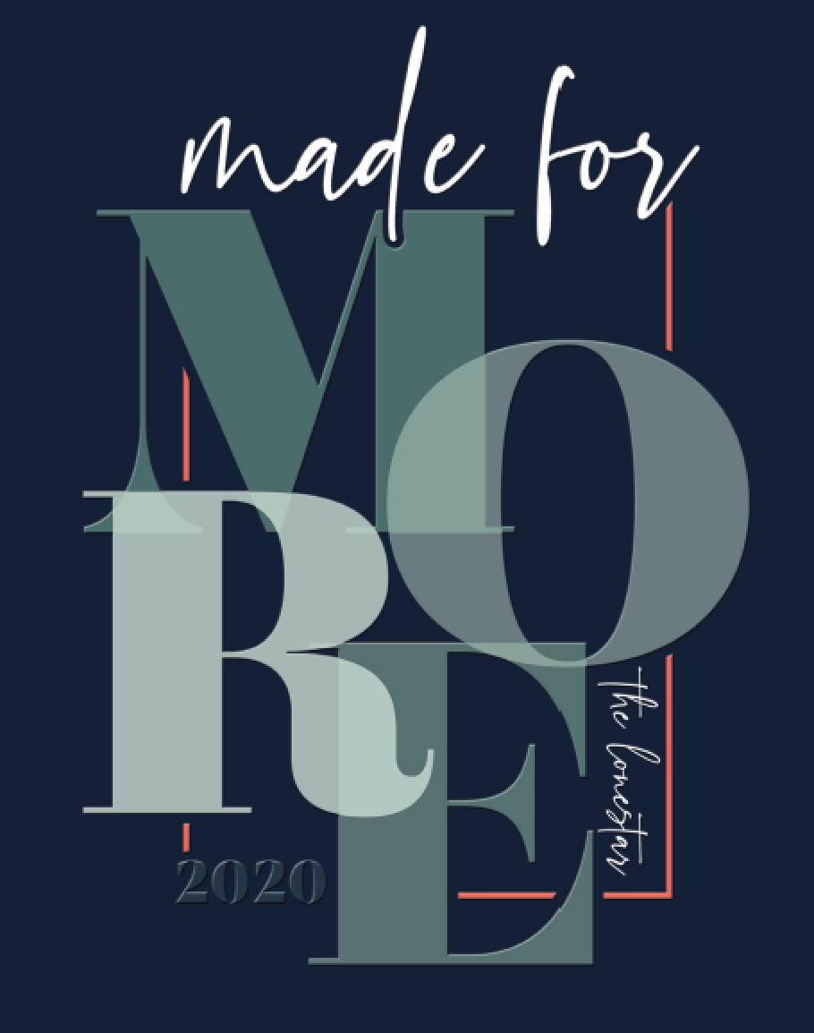


Theme logo typography
Notes:
“Something BIG” – Arlington HS
“What you make of it” – Rock Canyon HS
“Things we know for sure” – Minnetonka HS
“Made for more” – Vista Ridge HS
“Make it count” – Hendrickson HS

Slide 36
Theme typography
Choose a serif, sans or slab serif typeface with several weights to provide consistency and contrast.
Add another font or two for additional contrast or appeal.
Use decorative and handwriting fonts sparingly, for accents.
Notes:
The serif or sans serif typeface will do the bulk of the work.

Slide 37
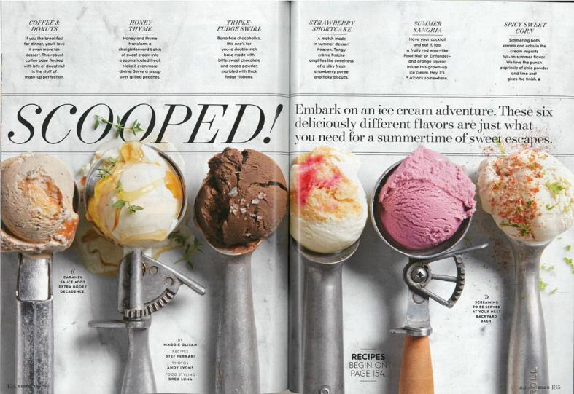
Modern serif typeface in italic
Modern serif typeface in regular
A bold sans serif to provide contrast
Notes:
See the modern serif in an italic weight for the main headline but the regular version for the secondary headline. Modern serifs have radically thin and thick strokes.

Slide 38
A modern serif used for all their section names
A sans serif in a bold weight in a repeated pattern to give a blur 3D effect
The same sans serif typeface, in regular and bold
A san serif font in bold

Slide 39
A sans serif in light
A modern serif
A sans serif in bold
A handwriting font
Notes:
.

Slide 40
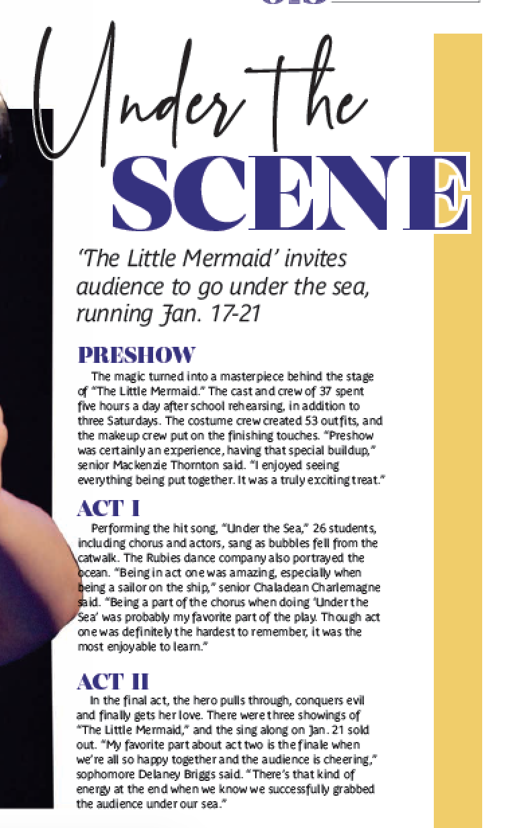


headlines
Headlines are the best way to display your typography and have fun with the look of your book.

Slide 41
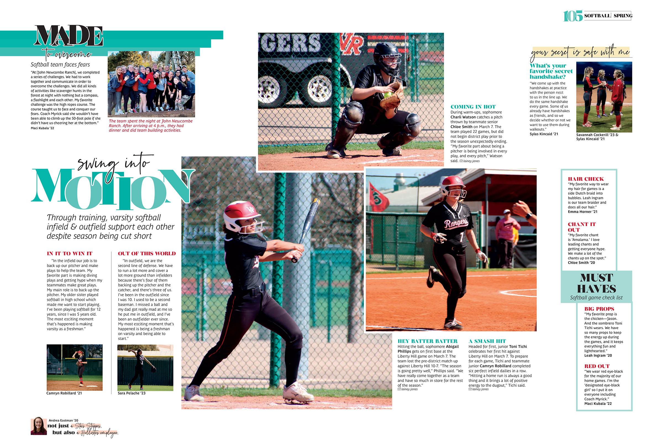
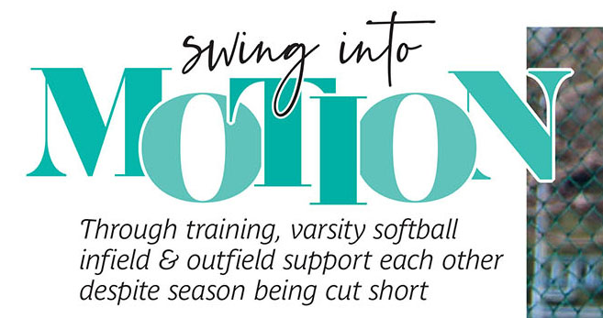
headlines

Slide 42
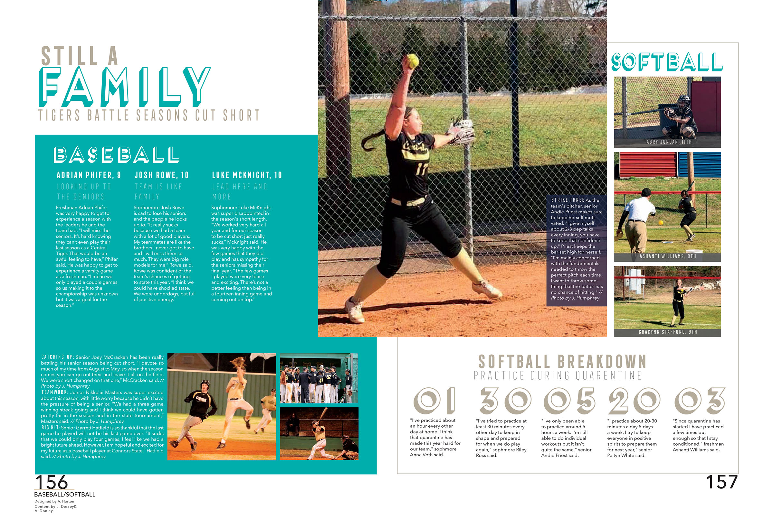

headlines

Slide 43
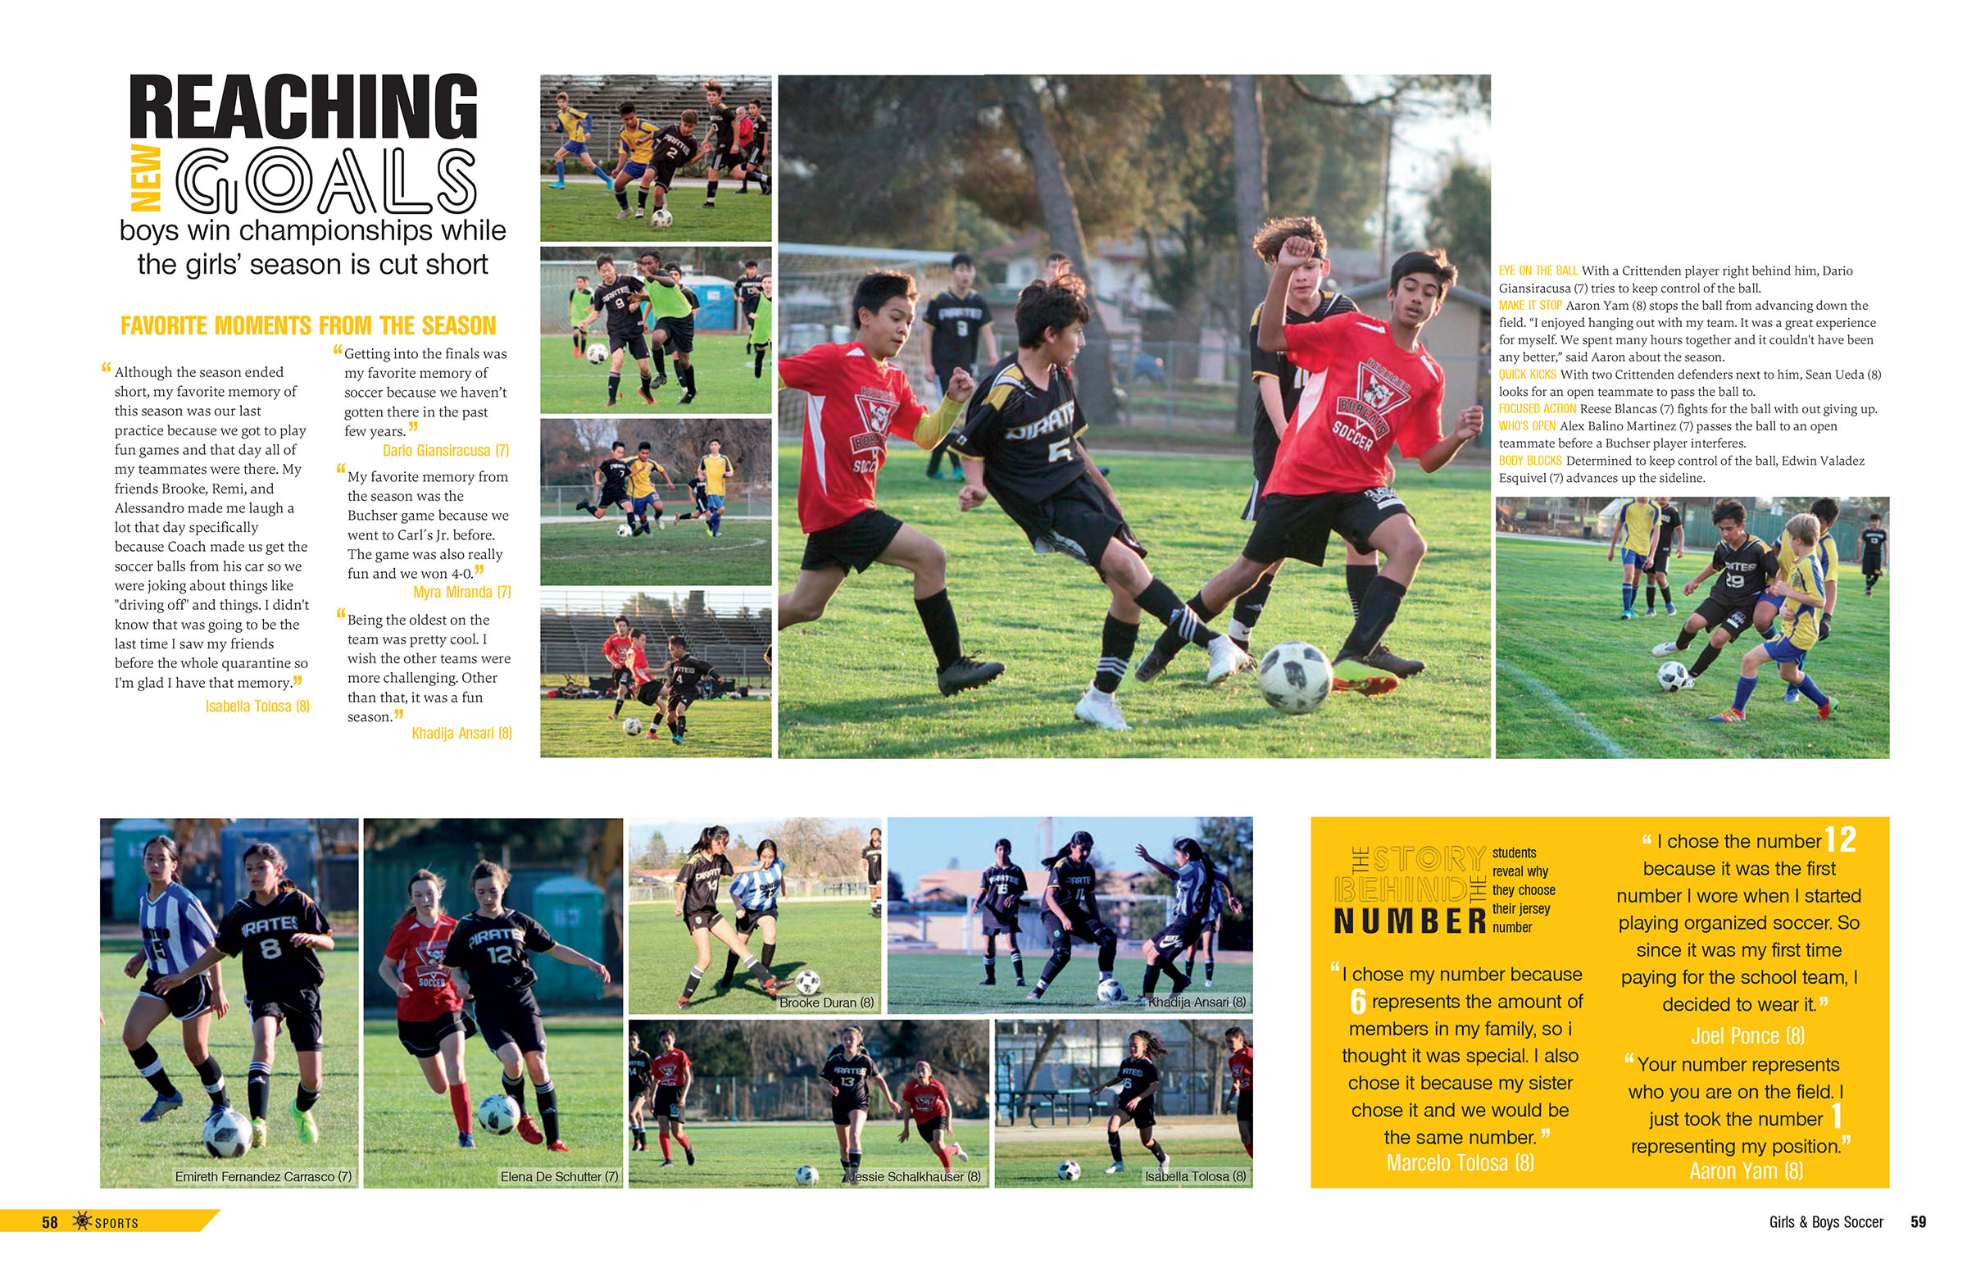
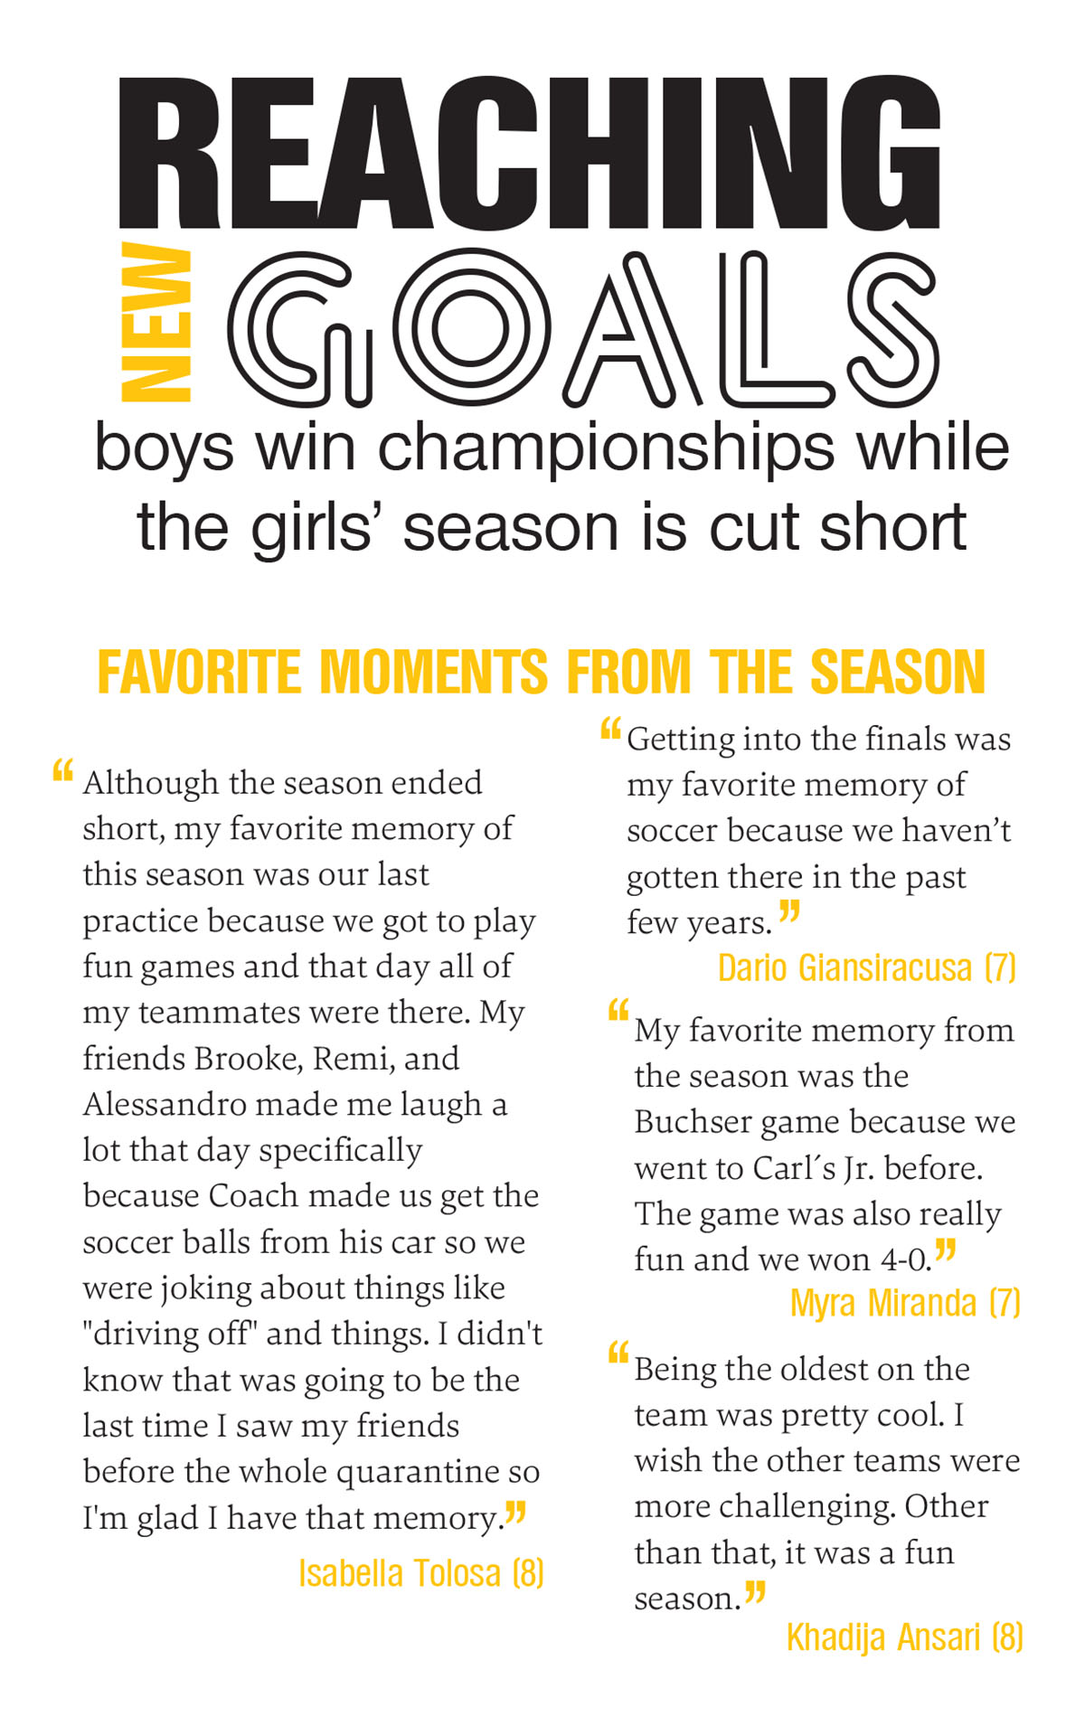
headlines

Slide 44
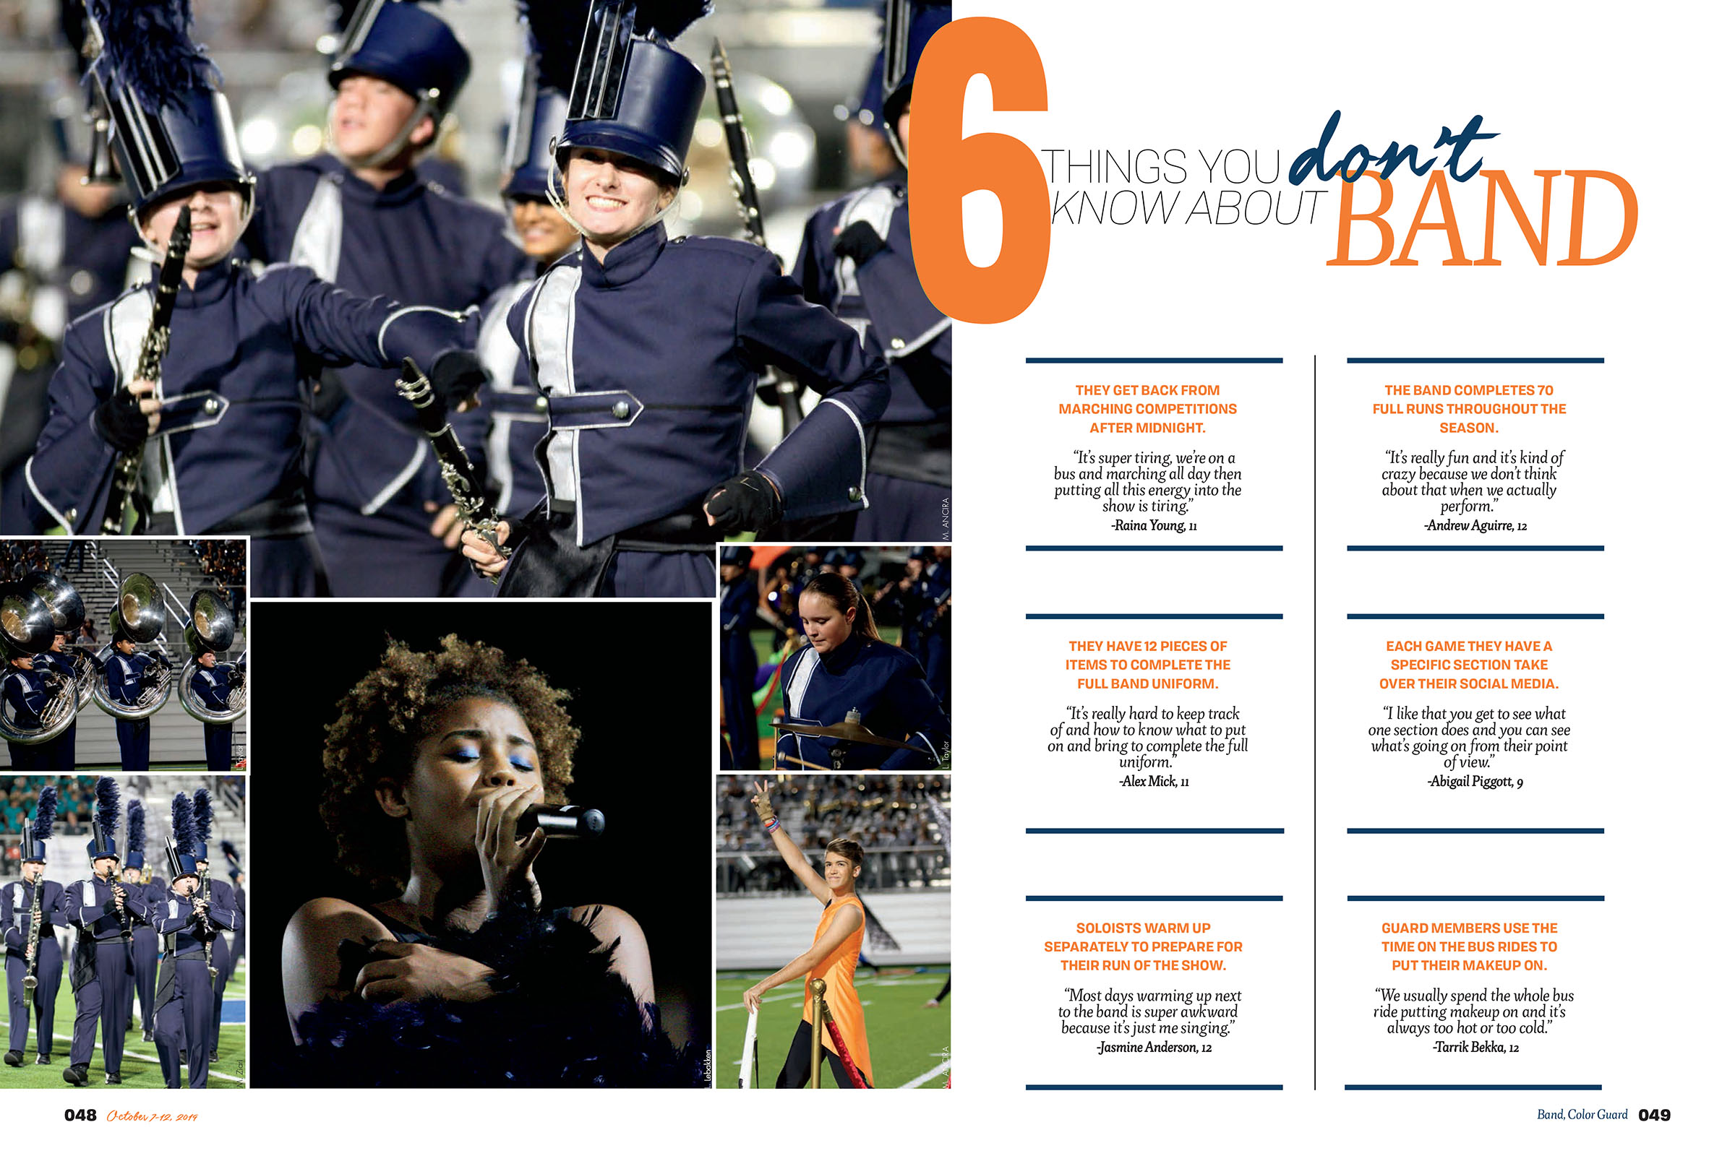
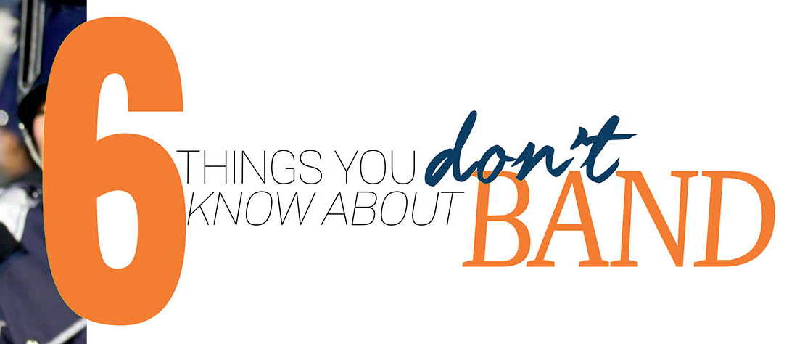
headlines

Slide 45
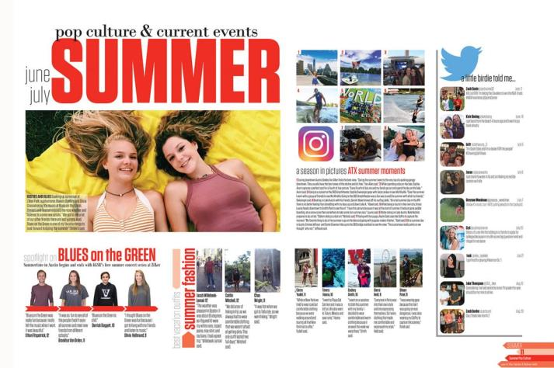
Type hierarchy
Establishing a hierarchy lets the reader know what element to look at first.

Slide 46
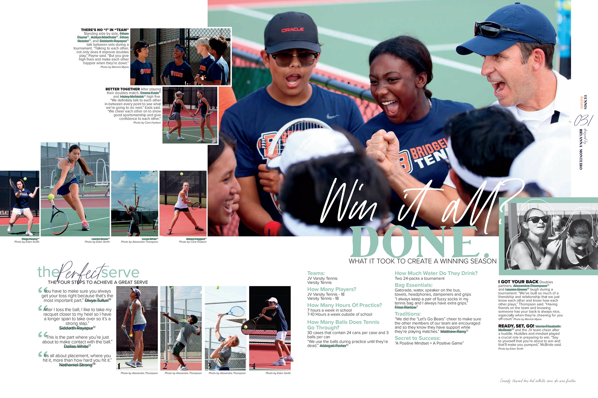
Type hierarchy
Main headlines should be sizably larger than smaller stories or sidebar headlines.
Secondary headlines should not compete with the main headline.

Slide 47
Type hierarchy
Type size suggestions:
PRIMARY HEADLINES
48 pt & higher
Light, Condensed, Book, Regular, Italic, Medium, Semibold or Bold
SECONDARY HEADLINES
15 to 22 pt
Light, Condensed, Book, Regular, Italic, Medium, Semibold or Bold
BODY COPY
9 to 10 pt
Book or Regular (add Italic or Bold for Q&As and quotes-only copy)
SECONDARY COVERAGE
7 to 9 pt
Light, Condensed, Book, Regular, Italic, Medium, Semibold or Bold
CAPTIONS
8 to 9 pt
Light, Condensed, Book, Regular, Italic (Run slightly smaller than copy)
PHOTO CREDITS
6 to 8 pt
Light, Condensed or Italic (Run slightly smaller than captions)

Slide 48
Type hierarchy
SECONDARY HEADLINE
15 to 24 pt
PRIMARY HEADLINE
48 pt & higher
BODY COPY
9 to 11 pt
CAPTIONS
8 to 10 pt
SECONDARY COVERAGE COPY
7 to 9 pt

Slide 49
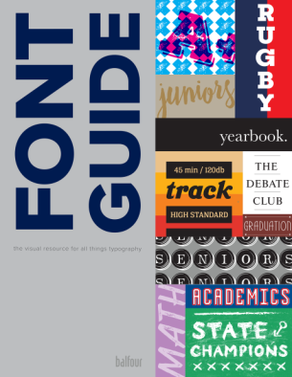
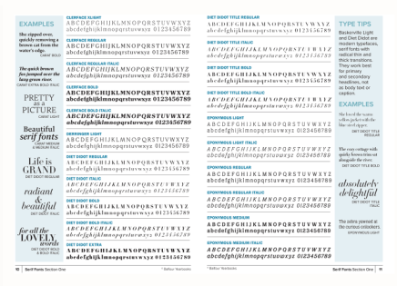
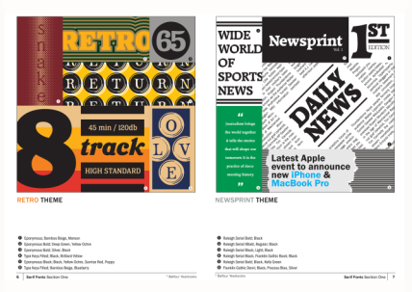
Type hierarchy
Our Font Guide can be a great resource for choosing fonts and learning more about typography.

