Slide 1
Theme
COPY

Slide 2
how to write
great
theme
copy

Slide 3
Choose the right
voice
and
tone
for your theme.

Slide 4
VOICE
Your “voice” is the way you “speak” on paper. It is how your words come across to the reader, and it will be different for every writer.
Voice depends on the style you choose—formal, informal, technical, chatty, poetic.
Voice depends on the words you choose to express this style—simple words, scientific words, slang words. It also depends on the connotation of the words you use.
Voice depends on the narrator (1st person, 2nd person, 3rd person, other).

Slide 5
1st PERSON
“One summer, along about 1904, my father rented a camp on a lake in Maine and took us all there for the month of August. We all got ringworm from some kittens and had to rub Pond's Extract on our arms and legs night and morning, and my father rolled over in a canoe with all his clothes on; but outside of that the vacation was a success and from then on none of us ever thought there was any place in the world like that lake in Maine.” –E.B. White, opening sentences of "Once More to the Lake," 1941

Slide 6
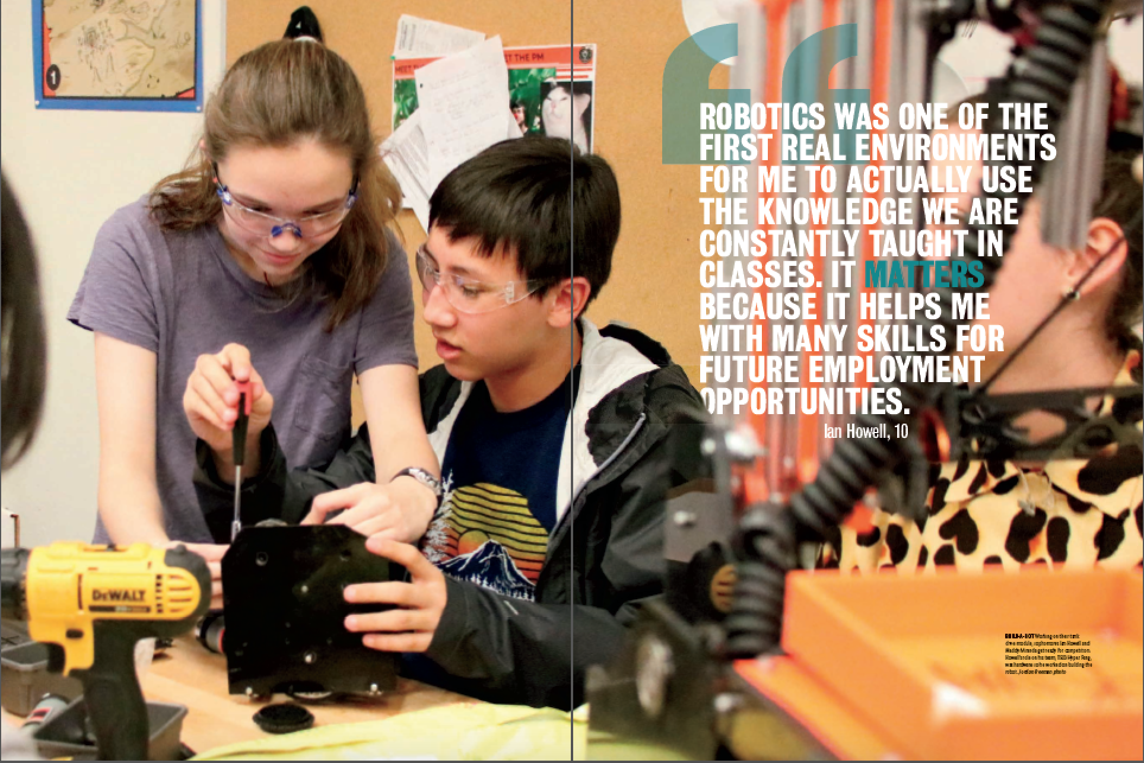
1st PERSON
Vandegrift HS “It matters”

Slide 7
1st PERSON plural
“Most of us on the boat were accomplished, and were sure we would make good wives. We knew how to cook and sew. We knew how to serve tea and arrange flowers and sit quietly on our flat wide feet for hours, saying absolutely nothing of substance at all.”
–Julie Otsuka, The Buddha in the Attic

Slide 8
1st PERSON plural
Leander HS “More than just”

Slide 9
2nd PERSON
"You have brains in your head. You have feet in your shoes. You can steer yourself any direction you choose. You’re on your own. And you know what you know. And YOU are the guy who’ll decide where to go." –Dr. Seuss, Oh, the Places You’ll Go! Random House, 1990)
“While standing in his parents kitchen, you tell your boyfriend you’re leaving. You’re not going to college. You’re not buying into the schedules, the credits, or the points. No standardized success for you.”
–Heather McElhatton, Pretty Little Mistakes

Slide 10
2nd PERSON
Foster HS “If you know, you know”

Slide 11
2nd PERSON
Foster HS “If you know, you know”

Slide 12
TRY 3rd PERSON (USED MOST OFTEN)
“They all remembered, or thought they remembered, how they had seen Snowball charging ahead of them at the Battle of the Cowshed, how he had rallied and encouraged them at every turn, and how he had not paused for an instant even when the pellets from Jones's gun had wounded his back.” –George Orwell, Animal Farm, 1945

Slide 13
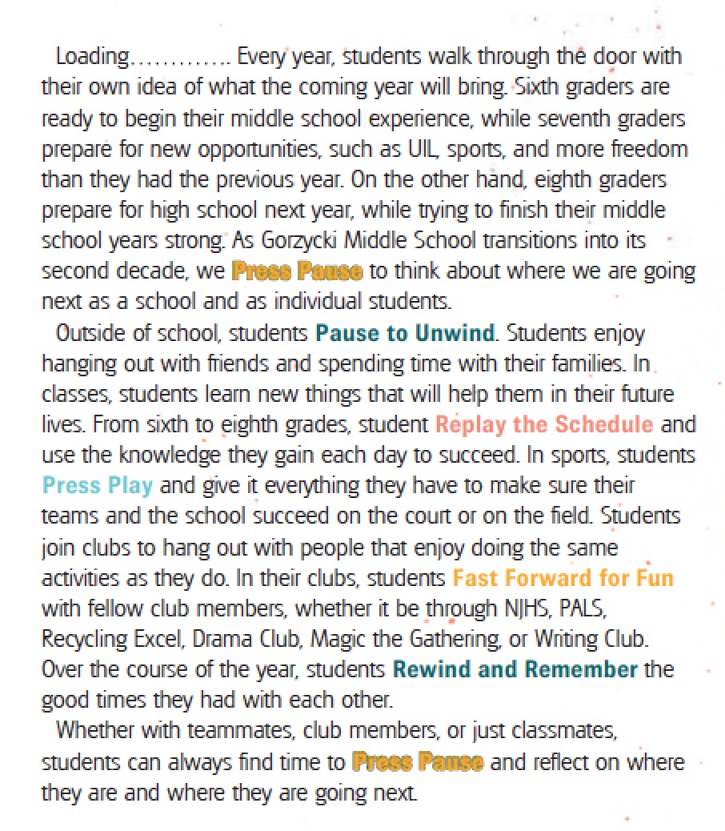
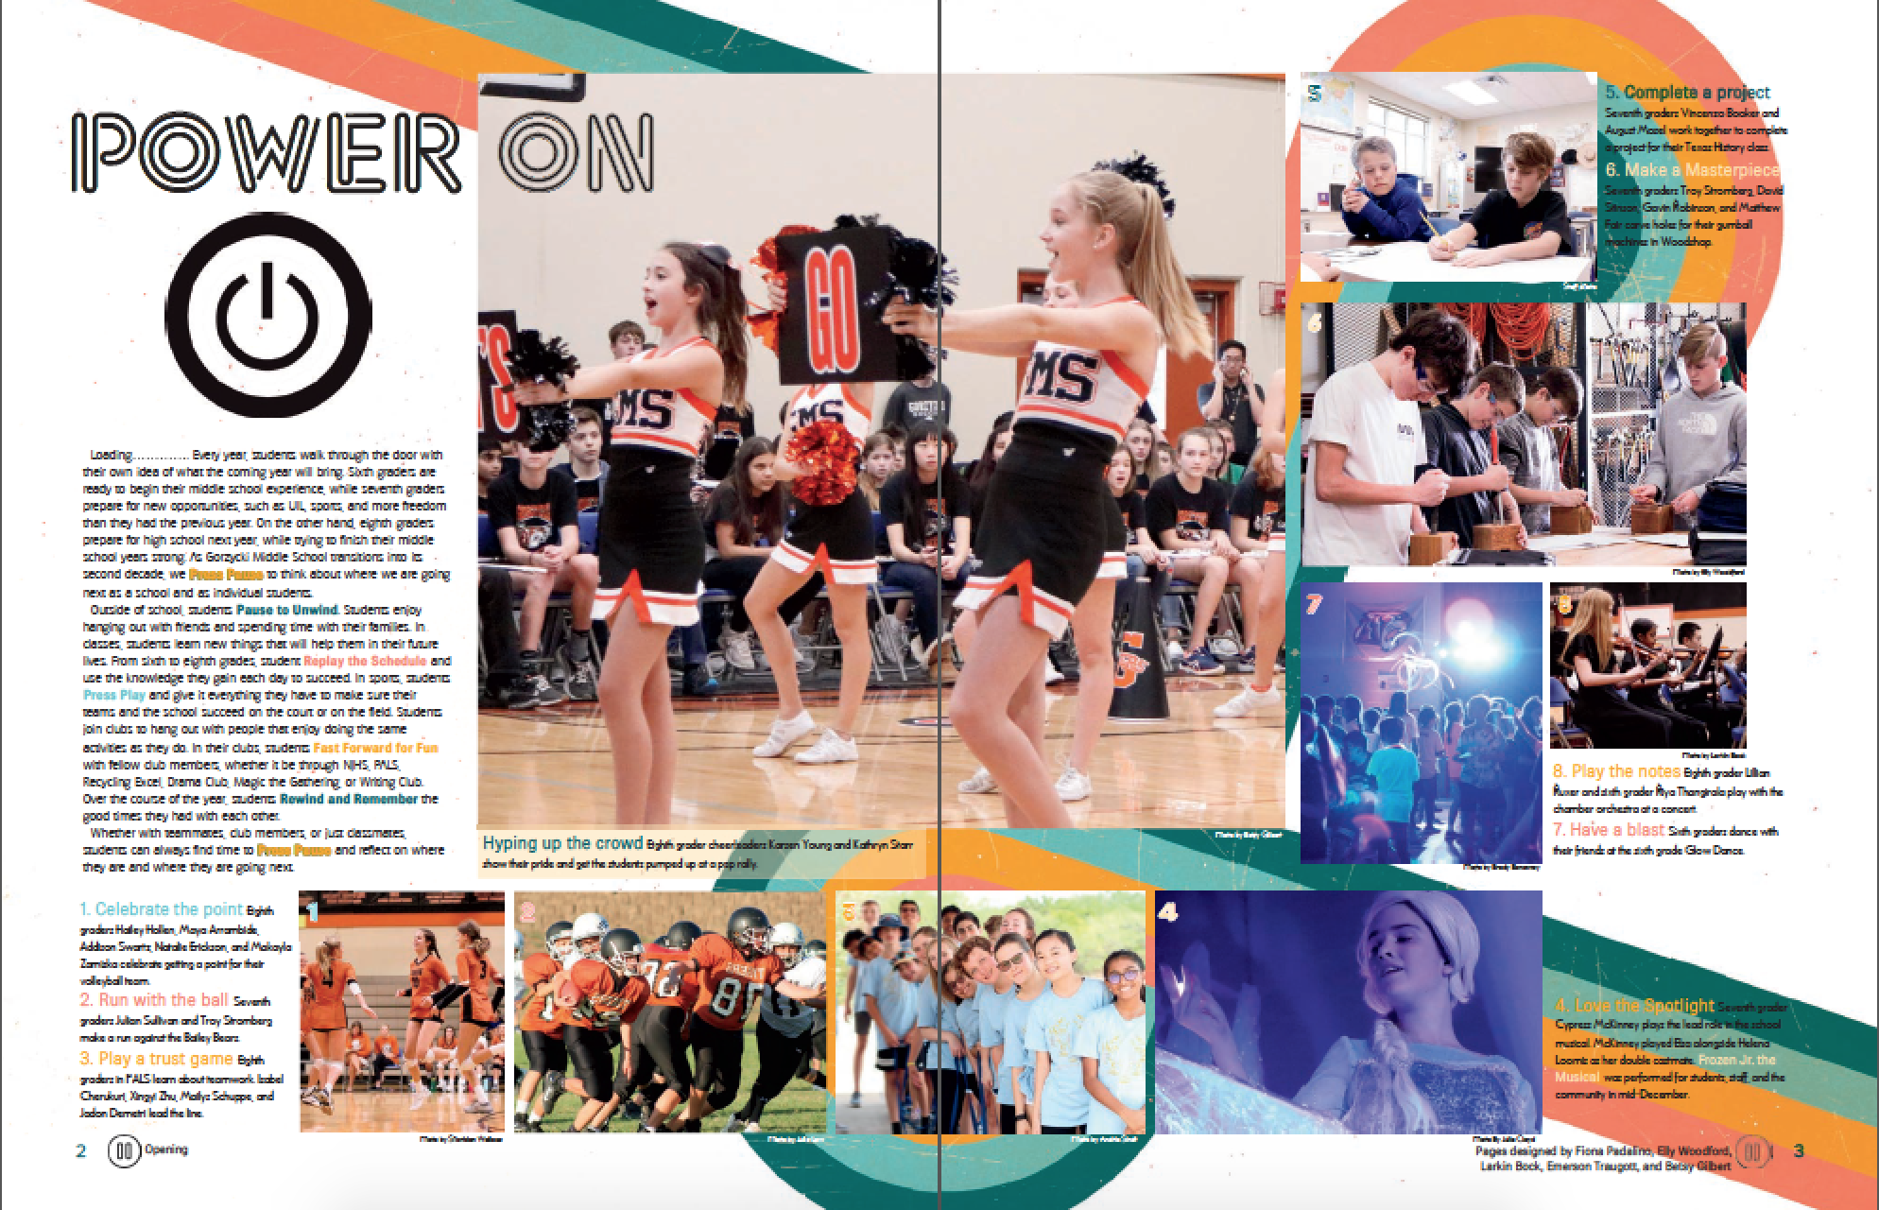
TRY 3rd PERSON
Gorzycki MS “Press Pause”

Slide 14
MIX IT UP (first and second person)
Santa Fe Trail MS ”Not what you expected”

Slide 15
TRY A CONVERSATIONAL TONE
Inglemoor HS “You deserve this”

Slide 16
BEGINNINGS & ENDINGS
BEGINNINGS hook the reader with the first sentence.
The 1st sentence MUST be unforgettably
relevant
useful
truthful
provocative
ENDINGS snap the theme shut.

Slide 17
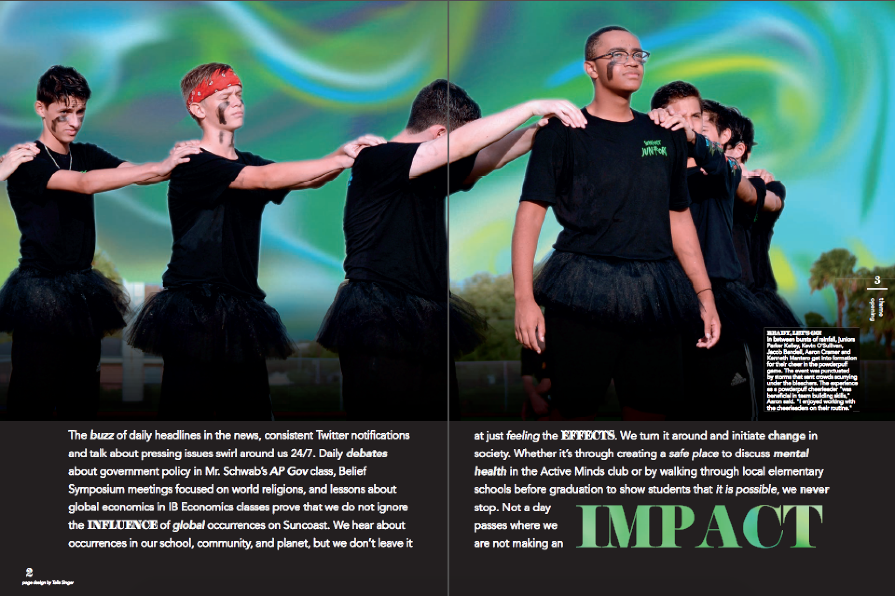
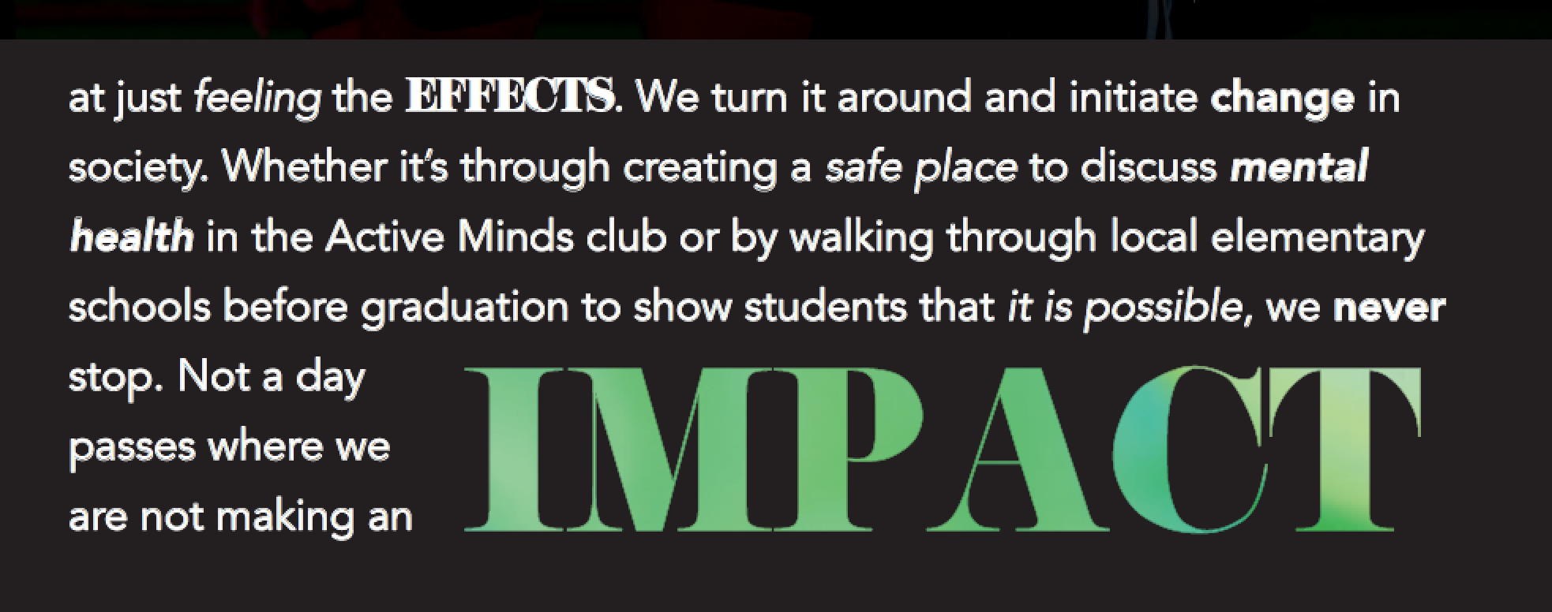
BEGINNINGS & ENDINGS
Suncoast HS “Impact”

Slide 18
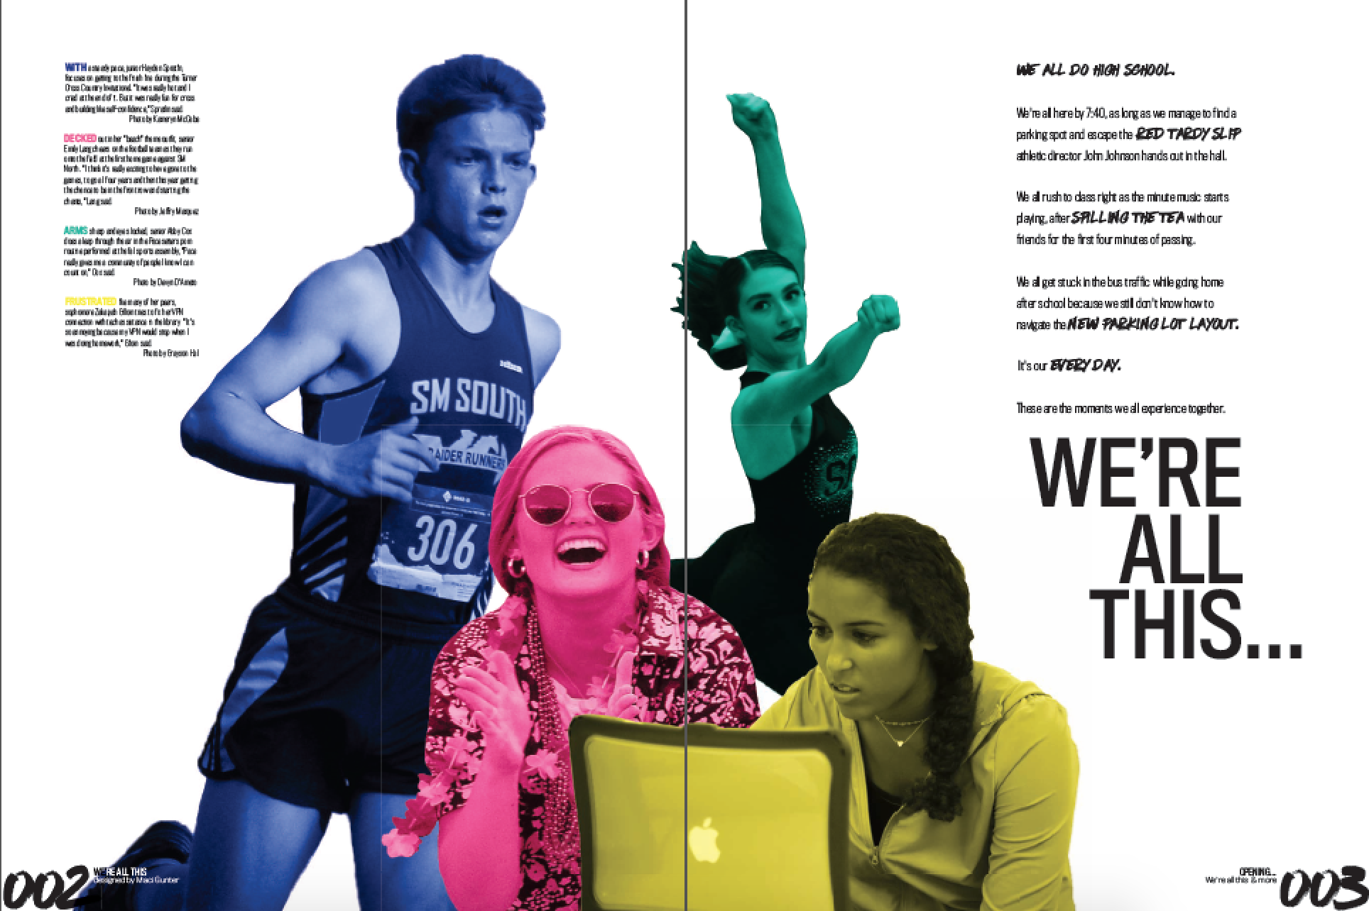
BEGINNINGS & ENDINGS
Shawnee Mission South HS “We’re all this & more”
Notes:
Hree Sides

Slide 19
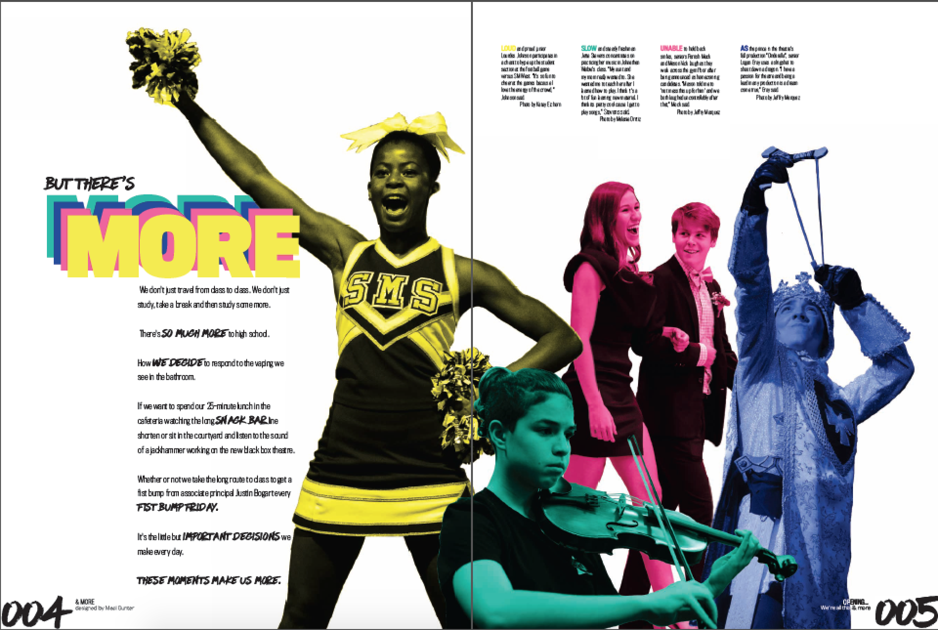
BEGINNINGS & ENDINGS
Shawnee Mission South HS “We’re all this & more”
Notes:
Hree Sides

Slide 20
FORMAT
The way you present the information is also important.
Be creative. Abandon the conventional.
Make every WORD, PHRASE & SENTENCE count.

Slide 21
FORMATS—CONSIDER LISTS
Henry's Variety Store
By John Updike
”Did children still marvel within as the holidays wheeled past in a slow pinwheel galaxy of altering candies, cards and artifacts, of back-to-school tablets, footballs, Halloween masks, pumpkins, turkeys, pine trees, tinsel, wrappings reindeer, Santas, and stars, and then the noisemakers and conical hats of New Year's celebration, and Valentines and cherries as the days of short February brightened, and then shamrocks, painted eggs, baseballs, flags and firecrackers? There were cases of such bygone candy as coconut strips striped like bacon and belts of licorice with punch-out animals and imitation watermelon slices and chewy gumdrop sombreros. I loved the orderliness with which these things for sale were all arranged. Stacked squarish things excited me—magazines, and Big Little Books tucked in, fat spines up, beneath the skinny paper-doll coloring books, and box-shaped art erasers with a faint silky powder on them almost like Turkish delight.”

Slide 22
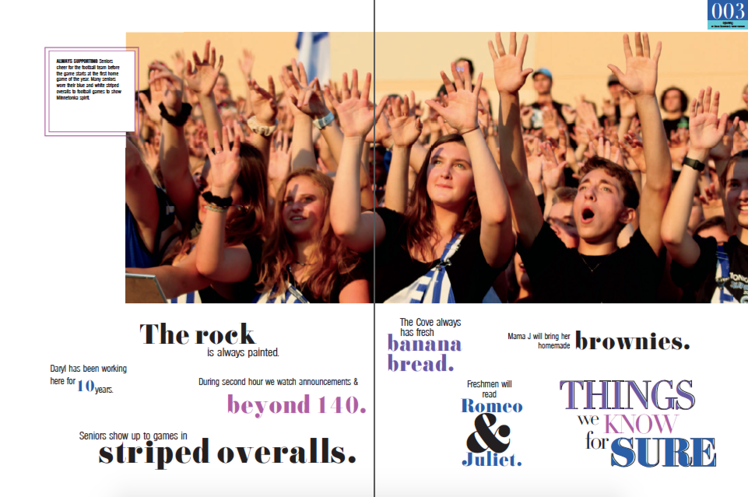
LIST
Minnetonka HS “Things we know for sure”

Slide 23
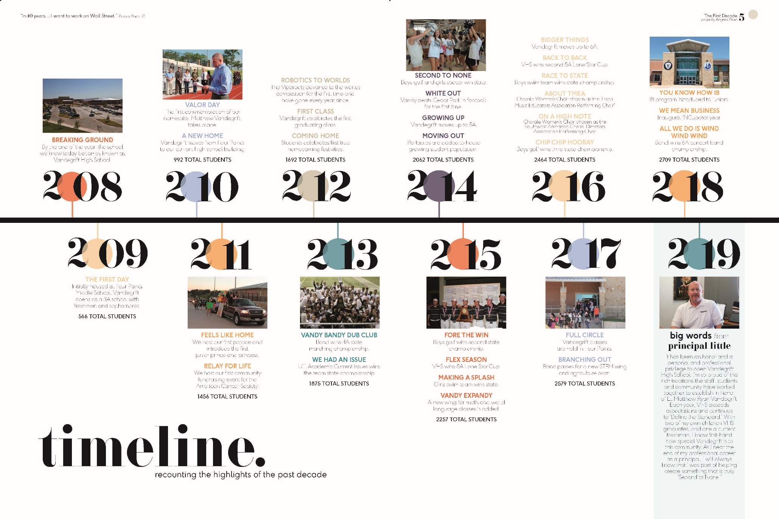
TIMELINE
Vandegrift High School “cerTEN”

Slide 24
NUMBERS
Hendrickson HS “Make it count”

Slide 25
NUMBERS
Episcopal School of Dallas “in addition to”

Slide 26
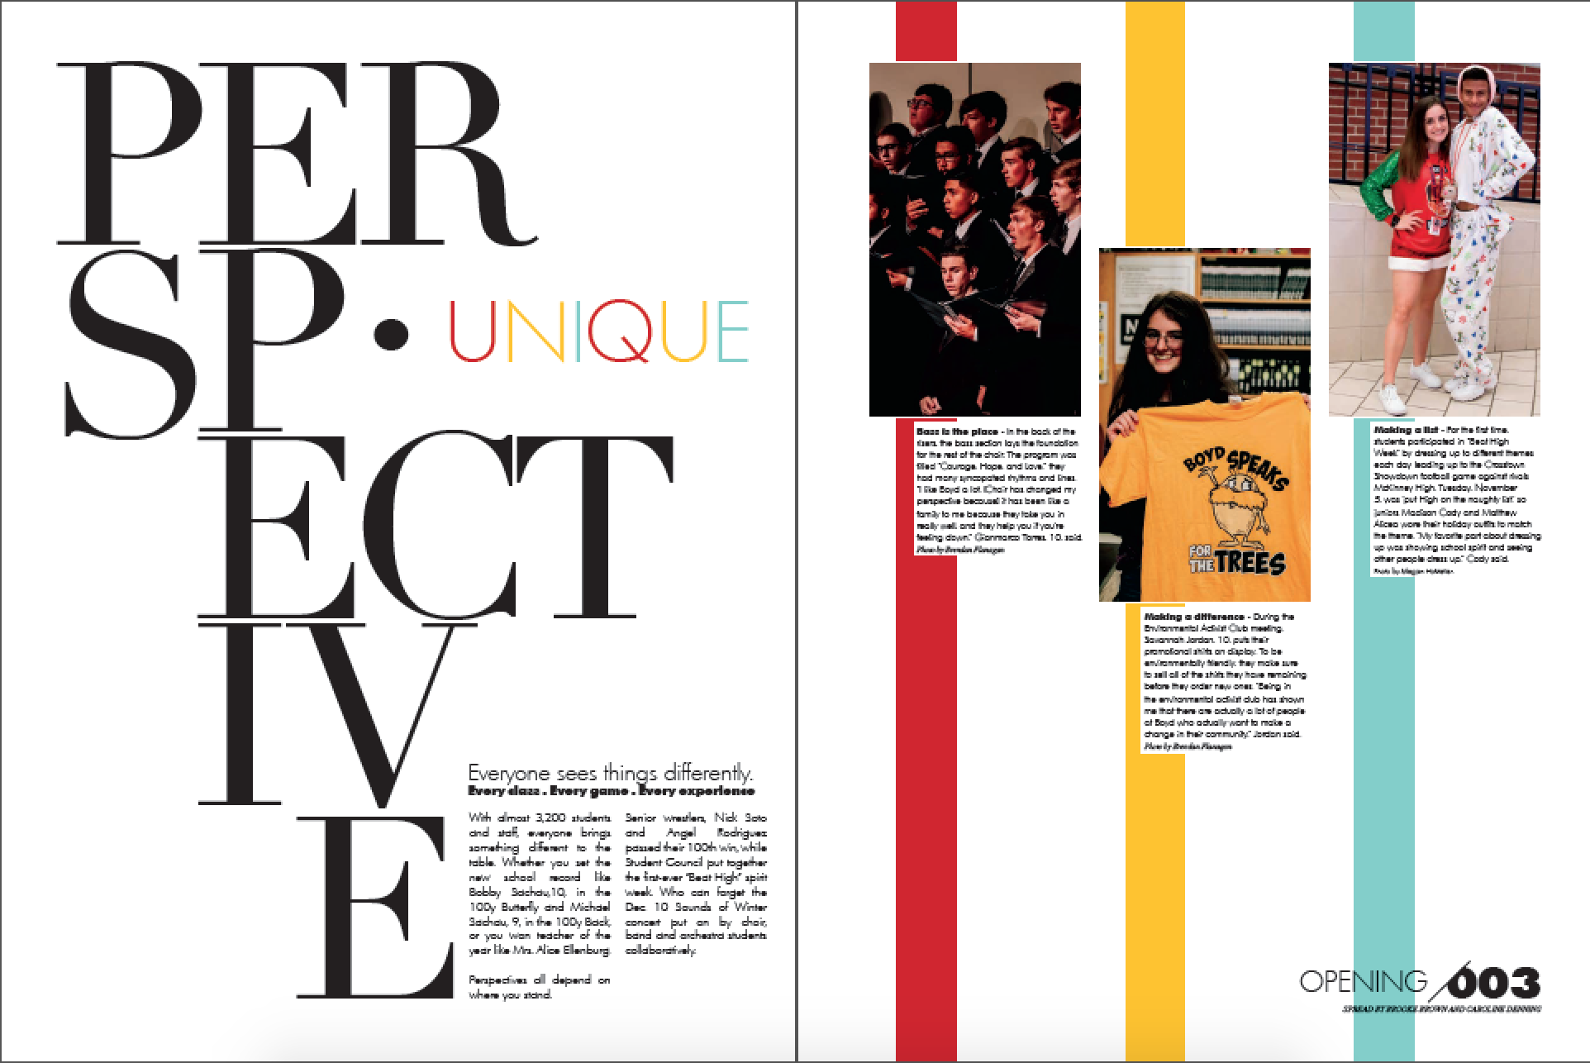
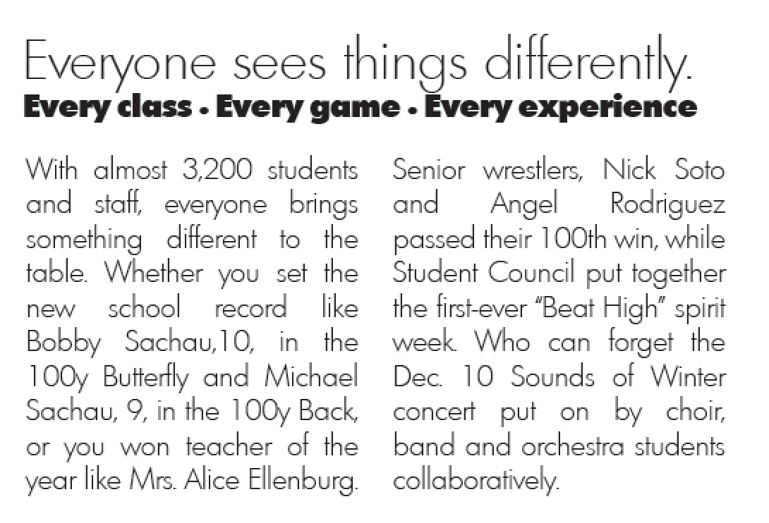
NAME DROPPER
McKinney Boyd HS “Perspective”

Slide 27
QUESTIONS
A.B. Maclay School “Wait…What?”

Slide 28
EXAMPLES
Thrall High School “Everything in Between”

Slide 29
REPETITION, IN OTHER WORDS
When used deliberately, REPETITION is an effective strategy for achieving EMPHASIS.

Slide 30
USE REPETITION
Remember the day I borrowed your brand new car, and I dented it? I thought you'd kill me, but you didn't. Remember the time I dragged you to the beach, and you said it would rain, and it did? I thought you'd say, "I told you so," but you didn't. Do you remember the time I flirted with all the guys to make you jealous and you were? I thought you'd leave me, but you didn't. Do you remember the time I spilled strawberry pie all over your car rug? I thought you'd hit me, but you didn't.

Slide 31
USE REPETITION
And remember the time I forgot to tell you that the dance was formal, and you showed up in jeans. I thought you'd drop me, but you didn't. Yes, there were lots of things you didn't do. But you put up with me, and you loved me, and you protected me. There were lots of things I wanted to make up to you when you returned from Vietnam.
But you didn't.
-Leo Buscaglia

Slide 32
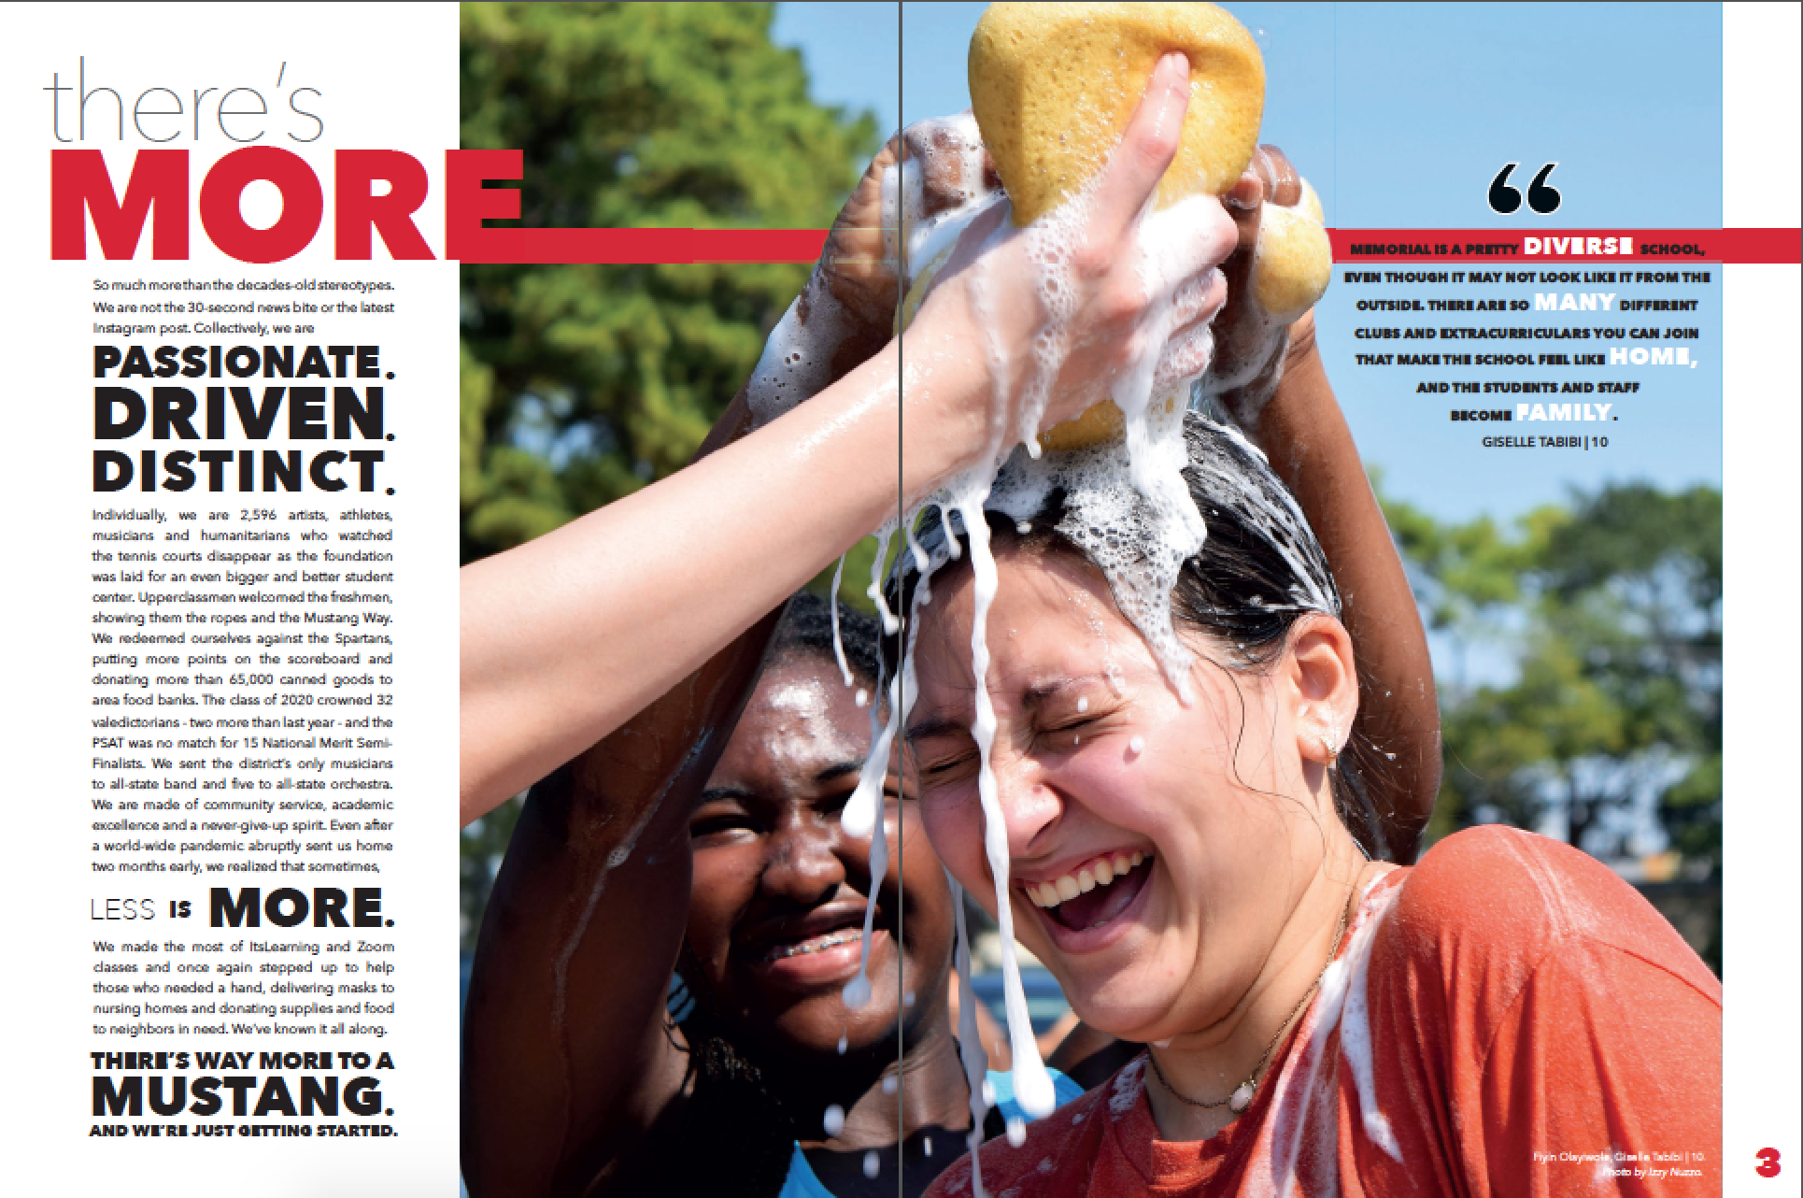
REPETITION, IN OTHER WORDS
Memorial HS ”There’s more”

Slide 33
REPETITION, IN OTHER WORDS
If you're a fan of Monty Python’s Flying Circus, you may recall how John Cleese used repetition beyond the point of absurdity in the Dead Parrot Sketch:
He's passed on! This parrot is no more! He has ceased to be! He's expired and gone to meet his maker! He's a stiff! Bereft of life, he rests in peace! If you hadn't nailed him to the perch he'd be pushing up the daisies! His metabolic processes are now history!
He's off the twig! He's kicked the bucket, he's shuffled off his mortal coil, run down the curtain and joined the bleedin' choir invisible! THIS IS AN EX-PARROT!

Slide 34
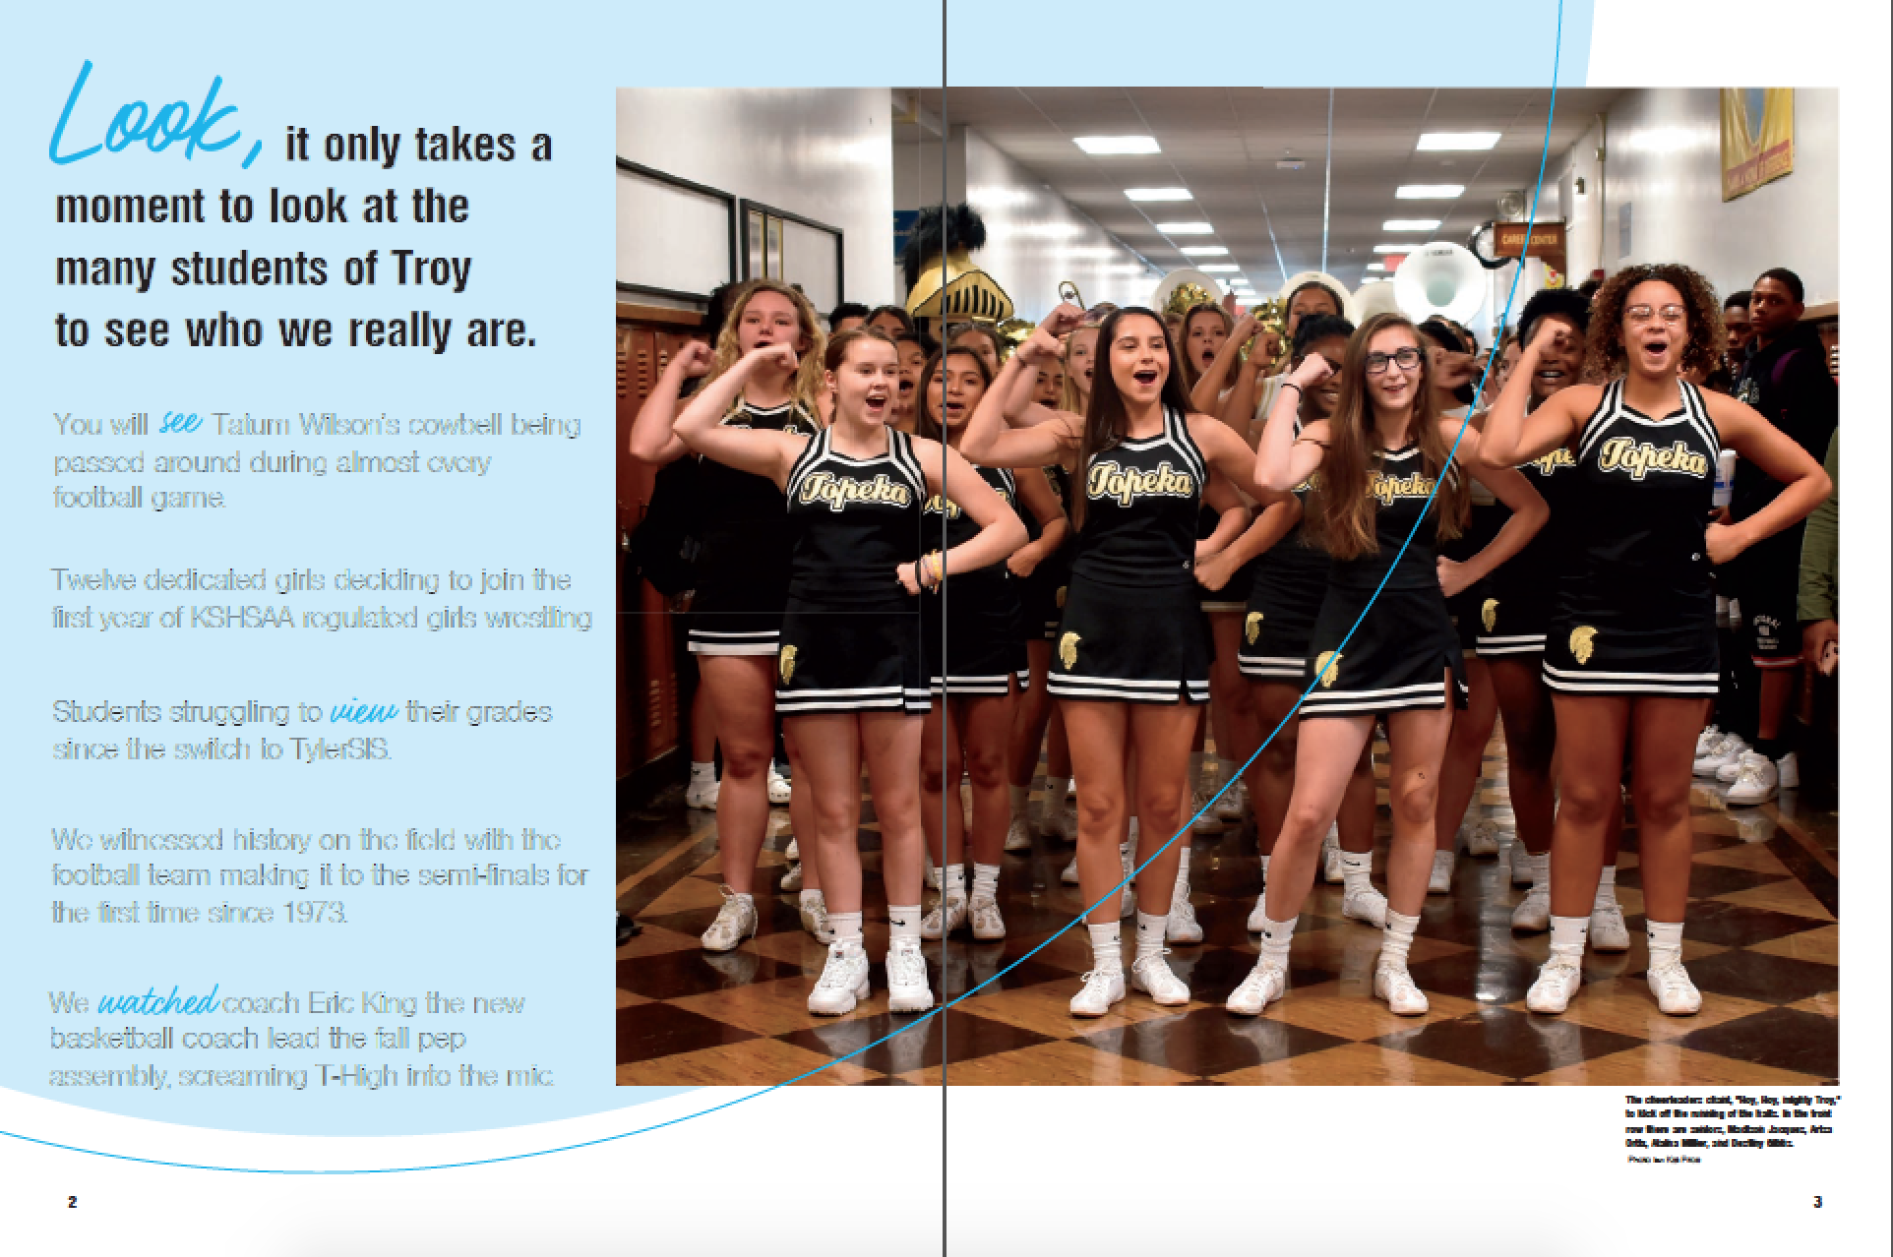
REPETITION with synonyms
Topeka HS “Look”

Slide 35
EXPERIMENT with writing in threes
Use prepositional phrases as in
"History will show that he walked away with _____with _____and with _____.”
or
"She walked down the _____through the _____ and across the _____."

Slide 36
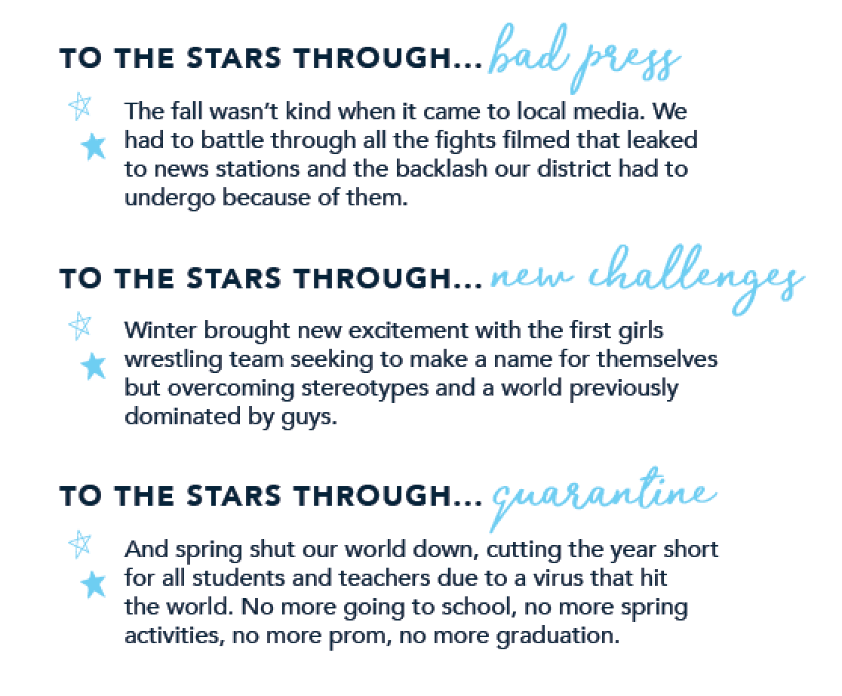
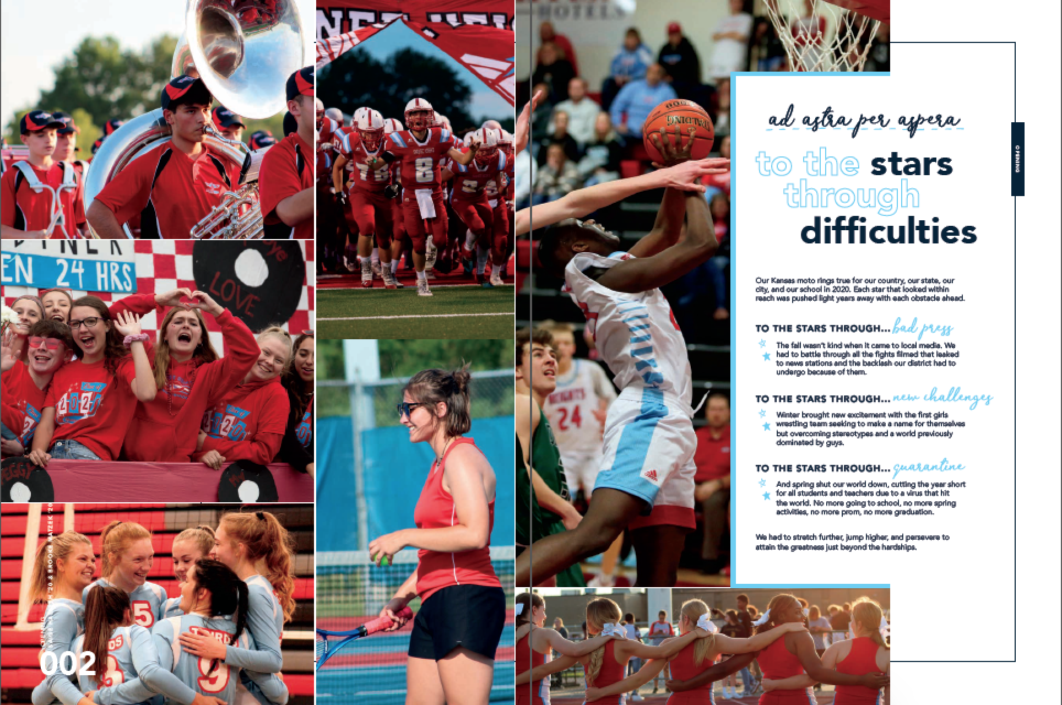
EXPERIMENT writing in threes
Shawnee Heights HS “ad astra per astra”

Slide 37
ANAPHORA
EXPERIMENT WITH
ANAPHORA is a literary and rhetorical device in which a word or group of words is repeated at the beginning of two or more successive clauses or sentences.
This technique adds EMPHASIS and UNITY to the piece.

Slide 38
ANAPHORA EXAMPLES
HOMER SIMPSON: I want to shake off the dust of this one-horse town. I want to explore the world. I want to watch TV in a different time zone. I want to visit strange, exotic malls. I’m sick of eating hoagies! I want a grinder, a sub, a foot-long hero! I want to live, Marge! Won’t you let me live? Won’t you, please? (The Simpsons)
WINSTON CHURCHILL: We shall not flag or fail. We shall go on to the end. We shall fight in France, we shall fight on the seas and oceans, we shall fight with growing confidence and growing strength in the air, we shall defend our island, whatever the cost may be, we shall fight on the beaches, we shall fight on the landing grounds, we shall fight in the fields and in the streets, we shall fight in the hills. We shall never surrender.

Slide 39
REPETITION using anaphora
Hendrickson High School “Beneath the Surface”

Slide 40
VARY THE LENGTH OF SENTENCES
This sentence has five words. This is five words, too. Five word sentences are fine. But several together become monotonous. Listen to what is happening. The writing is getting boring. The sound of it drones. It's like a stuck record. The ear demands some variety.

Slide 41
VARY THE LENGTH OF SENTENCES
Now listen. I vary the sentence length and I create music. Music. The writing sings. It has a pleasant rhythm, a lilt, a harmony. I use short sentences. And I use sentences of medium length. And sometimes when I am certain the reader is rested, I will engage him with a sentence of considerable length, a sentence that burns with energy and builds like a crescendo, the roll of the drums, the crash of the symbols, and sounds that say listen to this; it is important.
–Gary Provost on the Rhythms of Sentence Length

Slide 42
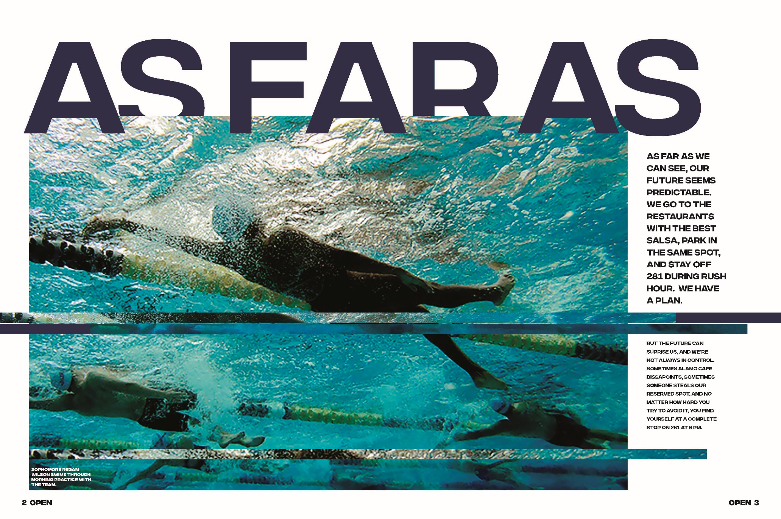
VARY THE LENGTH OF SENTENCES
Claudia Taylor Johnson High School “As Far as We Can See”

Slide 43
ABOVE ALL—BE SPECIFIC
The truth of your story lies in the details, particular items of information that support your theme concept.

Slide 44
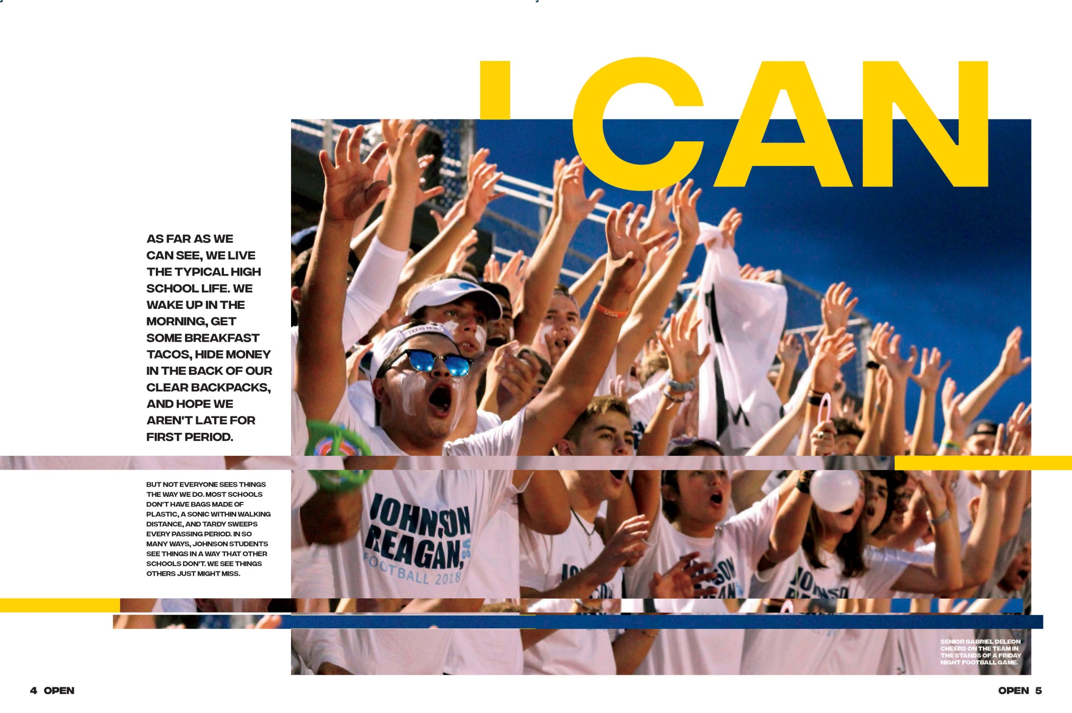
BE SPECIFIC (routines)
Claudia Taylor Johnson High School “As Far as We Can See”

Slide 45
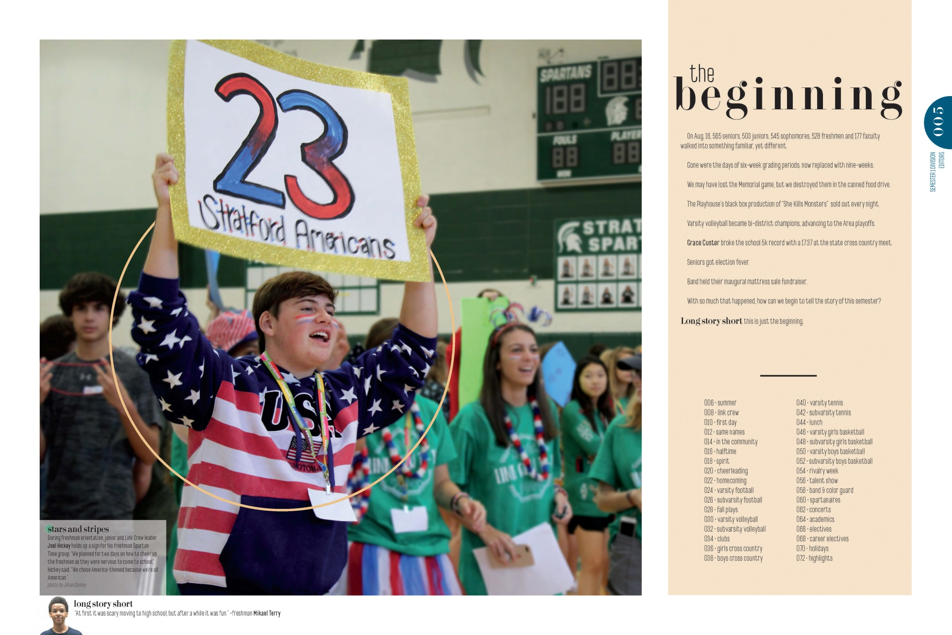
BE SPECIFIC (facts & figures)
Stratford High School “Long Story Short”

Slide 46
AWFUL THEME COPY
Our four years of high school provide many opportunities to set out in various directions. Bay High has established many programs so we may become familiar with different areas. However, we are also given other alternatives. Everyone tries at least one direction, wherever it may lead. By trying a particular direction, we are able to develop an interest which may in turn lead to another area of interest, and eventually direct us where we are destined to go. too philosophical
We may take part in many activities: music, athletics, jobs, clubs, school work, or just taking it easy. Many times these high school activities are group affairs, but actually we are individually pursuing our own personal interests. Most of us are not even near the end of our journey, and some of us have not yet begun. Difficulty in finding the place where we are headed should not discourage us. We will have to stop and do some serious thinking once in awhile when we have more than one path available; and we may follow only one. too philosophical
High school is just one of the legs in our journey to find out where we should be headed. At the end of the year, we will continue our search in other directions. Each one of us in his own way will explore the new dimensions discovered this year together. too philosophical
“How Often I saw Where I should be going,
Only By Setting Out For Somewhere Else”
INDEFINITE ADJECTIVES
NOT SPECIFIC
TOO PHILOSOPHICAL
NO ONE WILL READ IT!

Slide 47
MAKE IT BETTER
1. BE SPECIFIC
An indefinite adjective is used to describe a noun in a non-specific way.
The most common indefinite adjectives: any, each, few, many, much, most, several, some.
Include times, dates, events unique to the year, students’ stories, etc.
2. BE BRIEF
Avoid spreading good ideas over too many words. No one will read long copy.

Slide 48
MAKE IT BETTER
3. SIMPLIFY
Theme copy should not prove you own a thesaurus.
4. DON’T BURY THE THEME
Repeat. Reword. Repeat again. Don’t leave your reader guessing.
5. DON’T PREACH
Hop off your soap box. Guide your readers by relating student experiences specific to the year.

Slide 49
THEME COPY
Marries the message to the concept
Hooks the reader without explanation
Teases, piques, plays, parodies
Relates universal experiences, using specific relevant information

Slide 50
YOUR TURN
What is your theme’s tone?
What voice will work with the tone?
What format will you use?
Brainstorm. Write a 1st draft. Read it to staff members and have them offer suggestions.

