Slide 1
theme
DEVELOPMENT

Slide 2
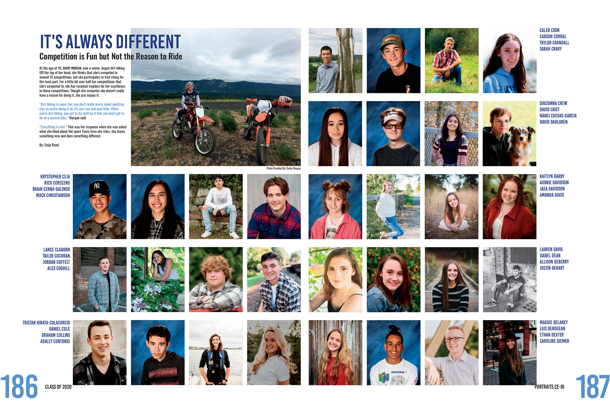
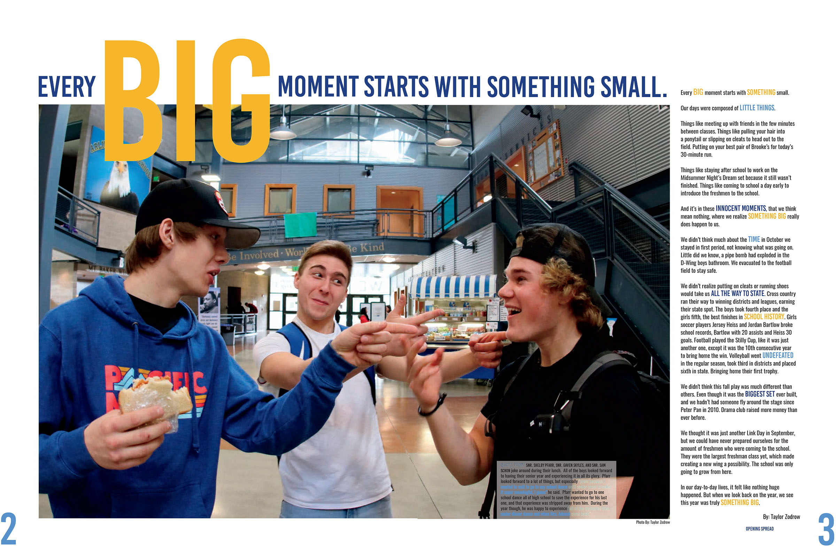
theme
The theme provides a unifying and defining device that runs through the book.

Slide 3
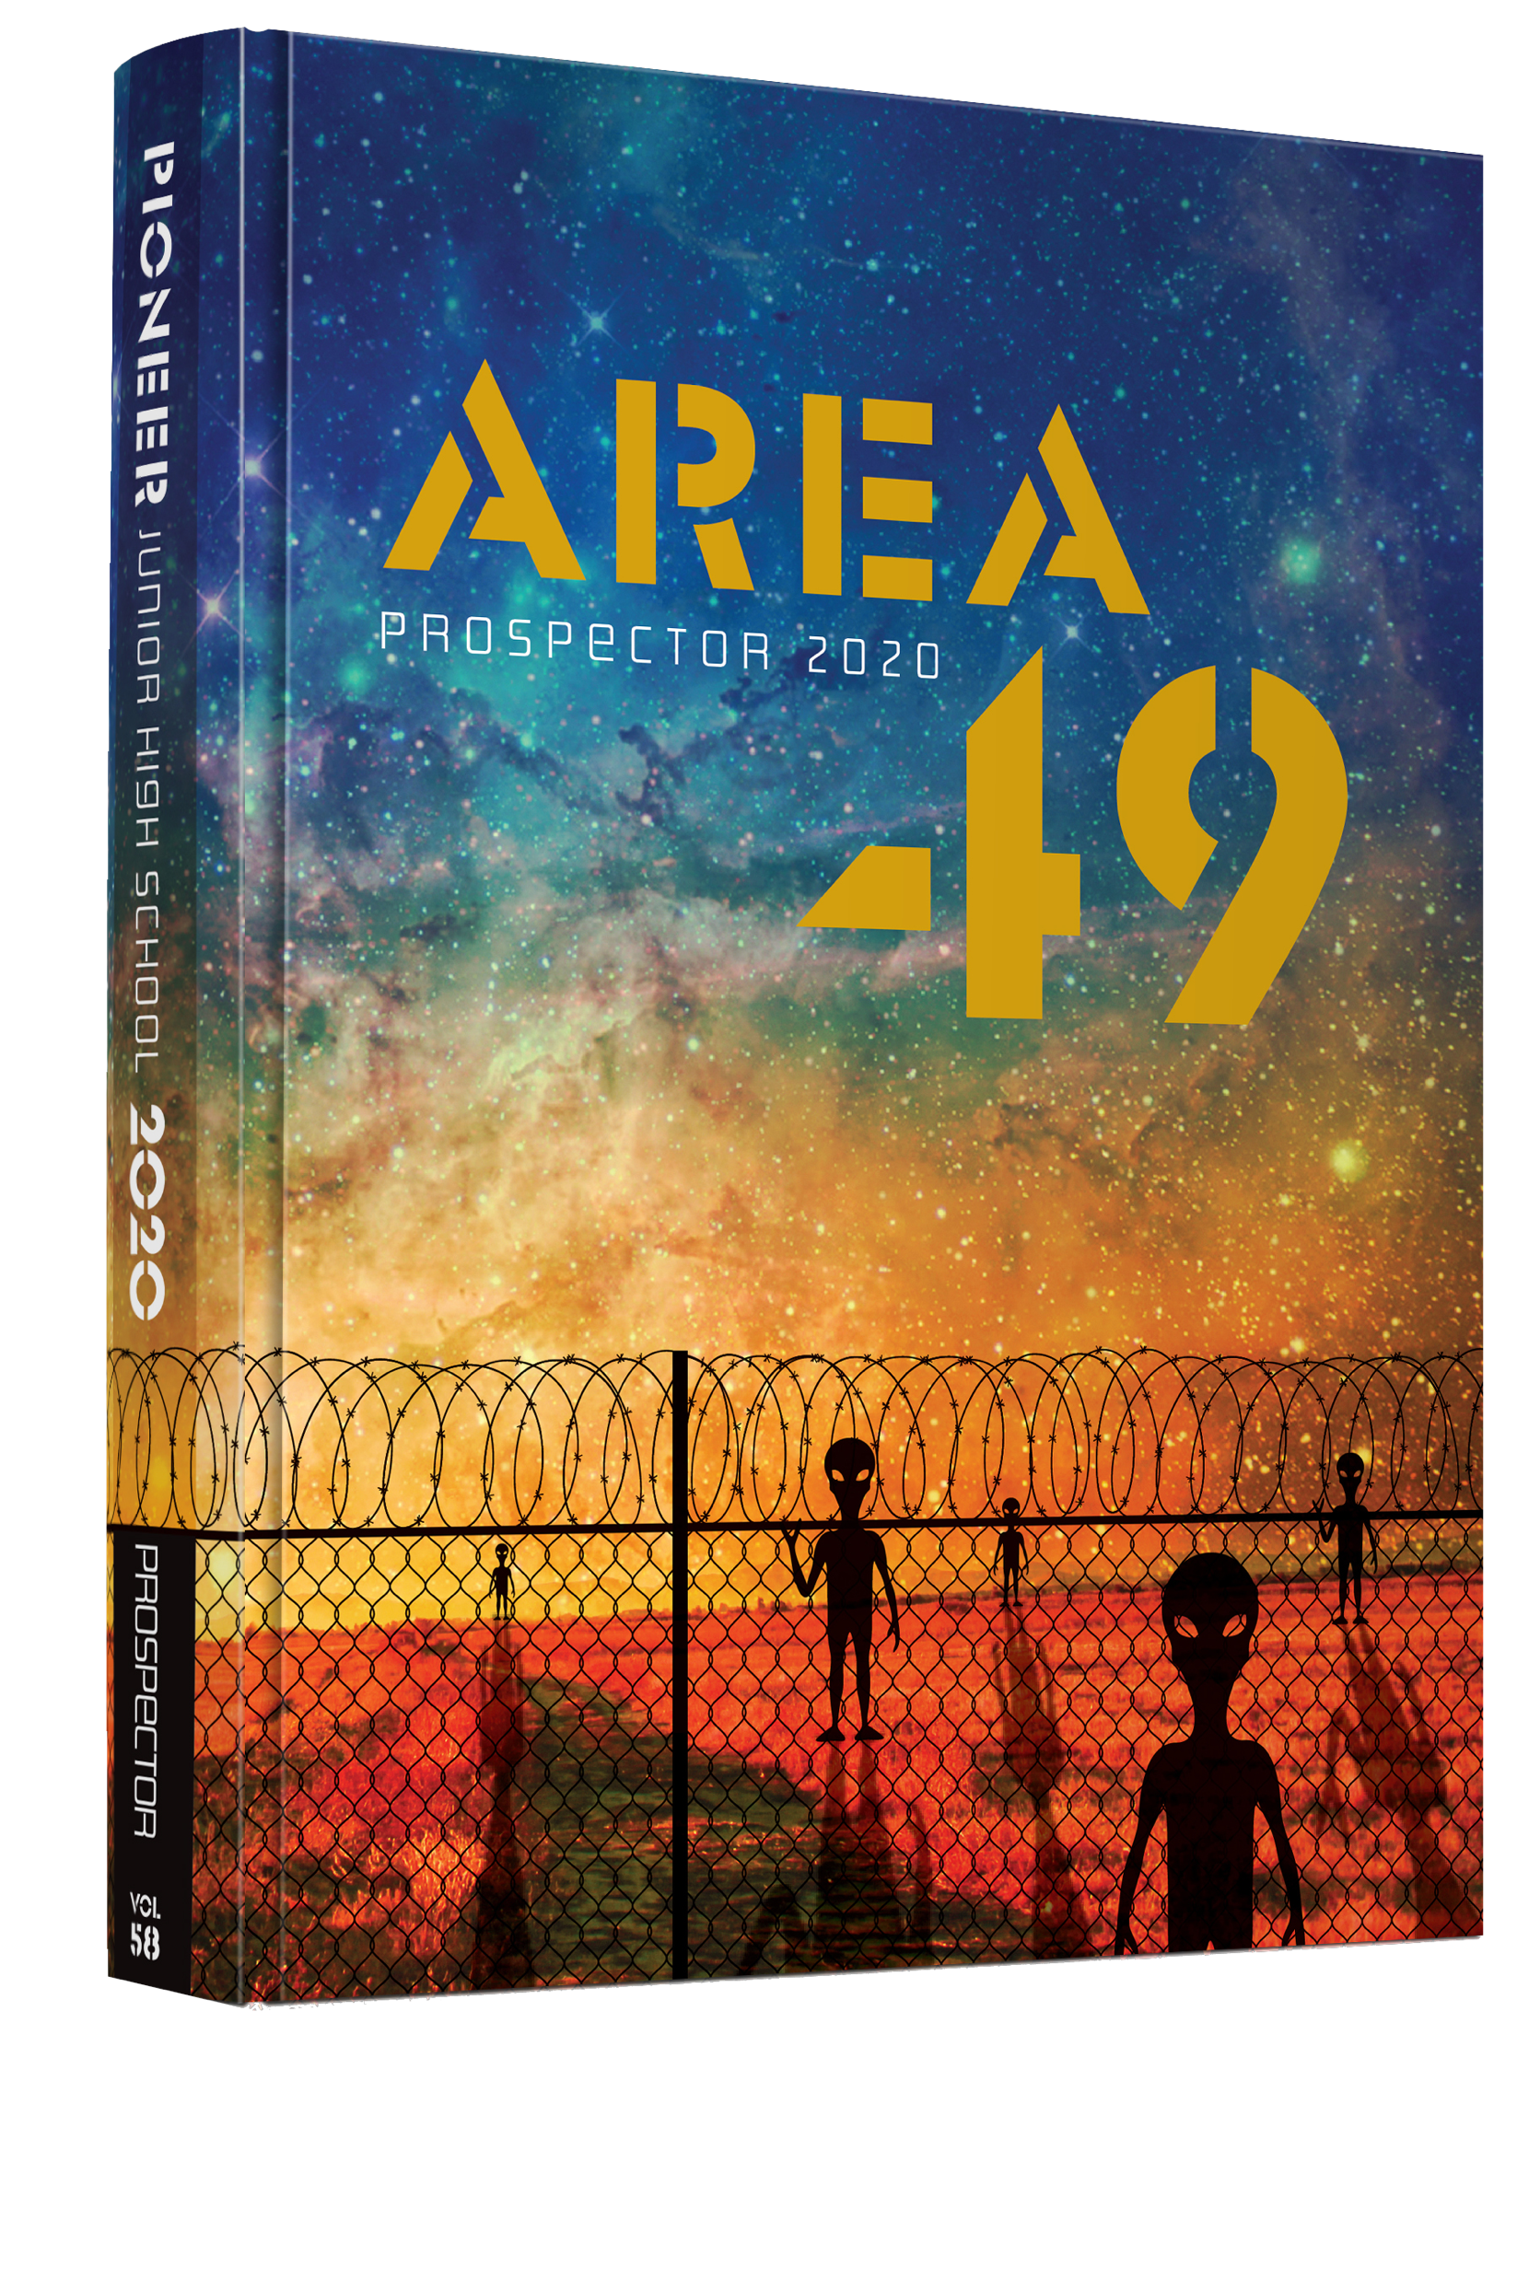
theme
It’s built around a word, phrase or concept.

Slide 4
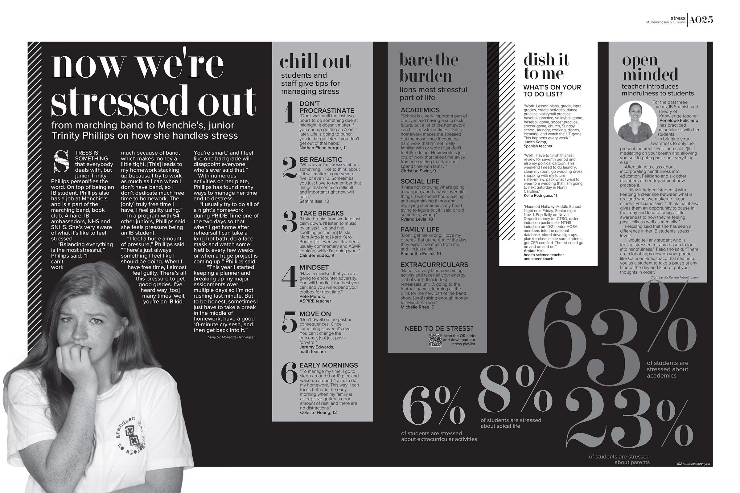
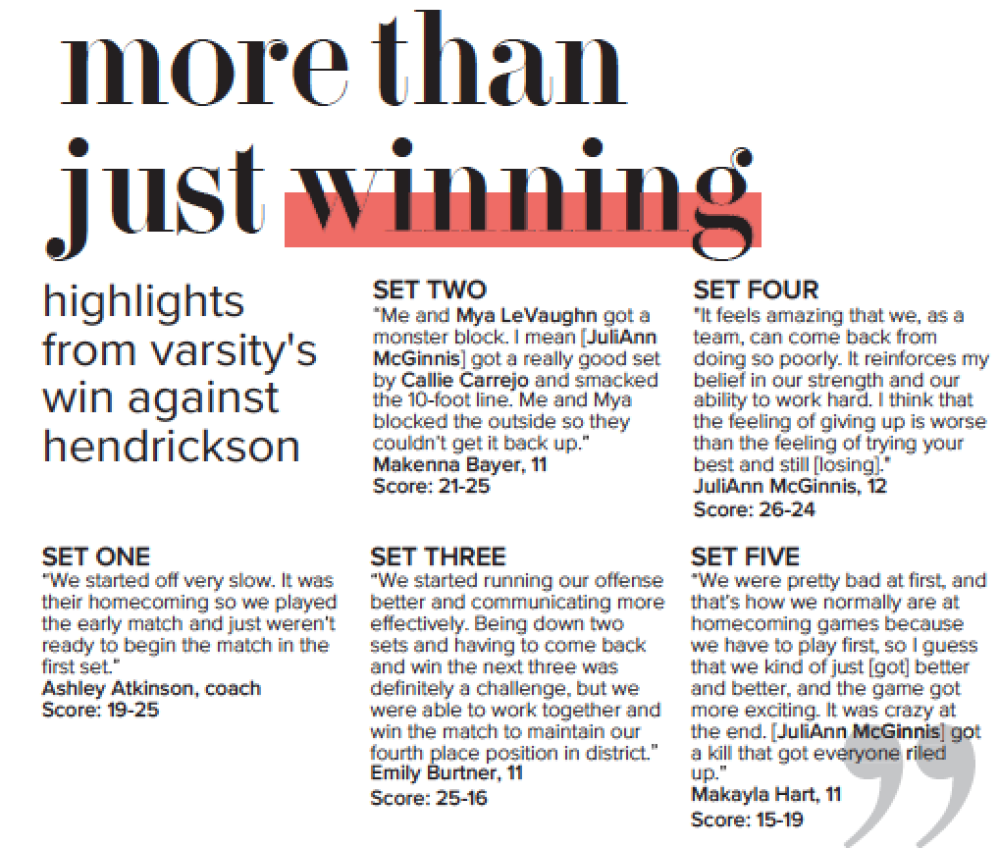
theme
It’s presented visually and verbally.

Slide 5
theme
It occupies theme-based pages – cover, endsheets, opening, closing and the division pages.
It should also extend to other sections – secondary coverage, headlines, group photos, ads & the index.

Slide 6
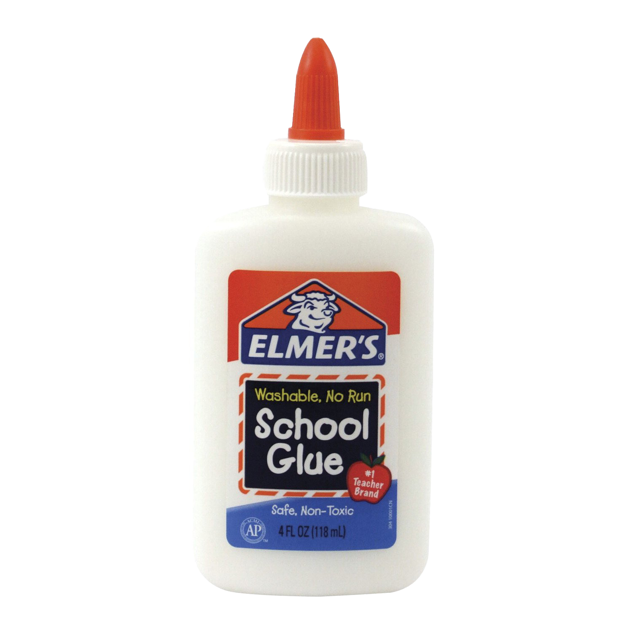
theme
The theme simplifies decisions about colors, fonts & design elements
Helps with consistency & design.
It’s the glue that holds the book together.

Slide 7
Let’s see it all put
together

Slide 8
Venice HS – cover

Slide 9
Venice HS – endsheets

Slide 10
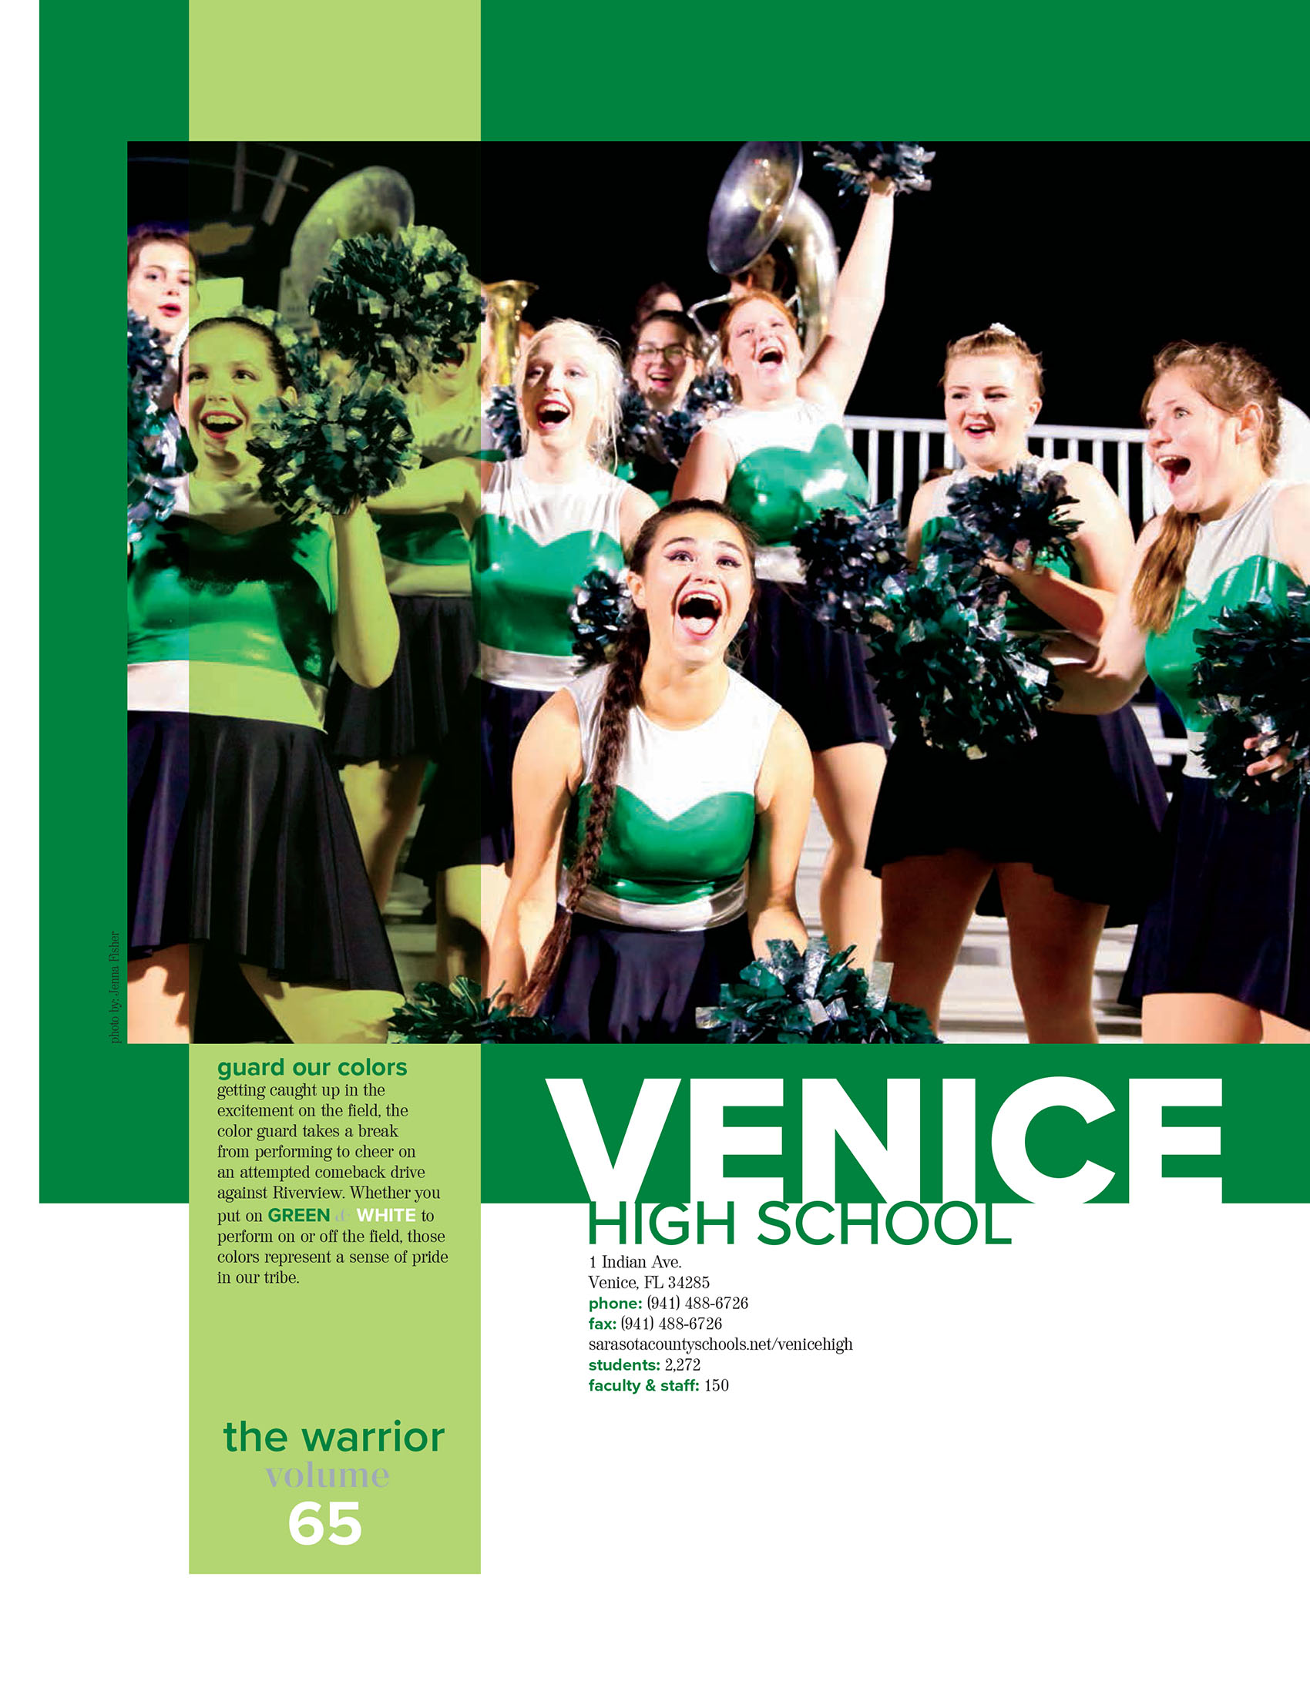
Venice HS– title page

Slide 11
Venice HS– opening

Slide 12
Venice HS – opening

Slide 13
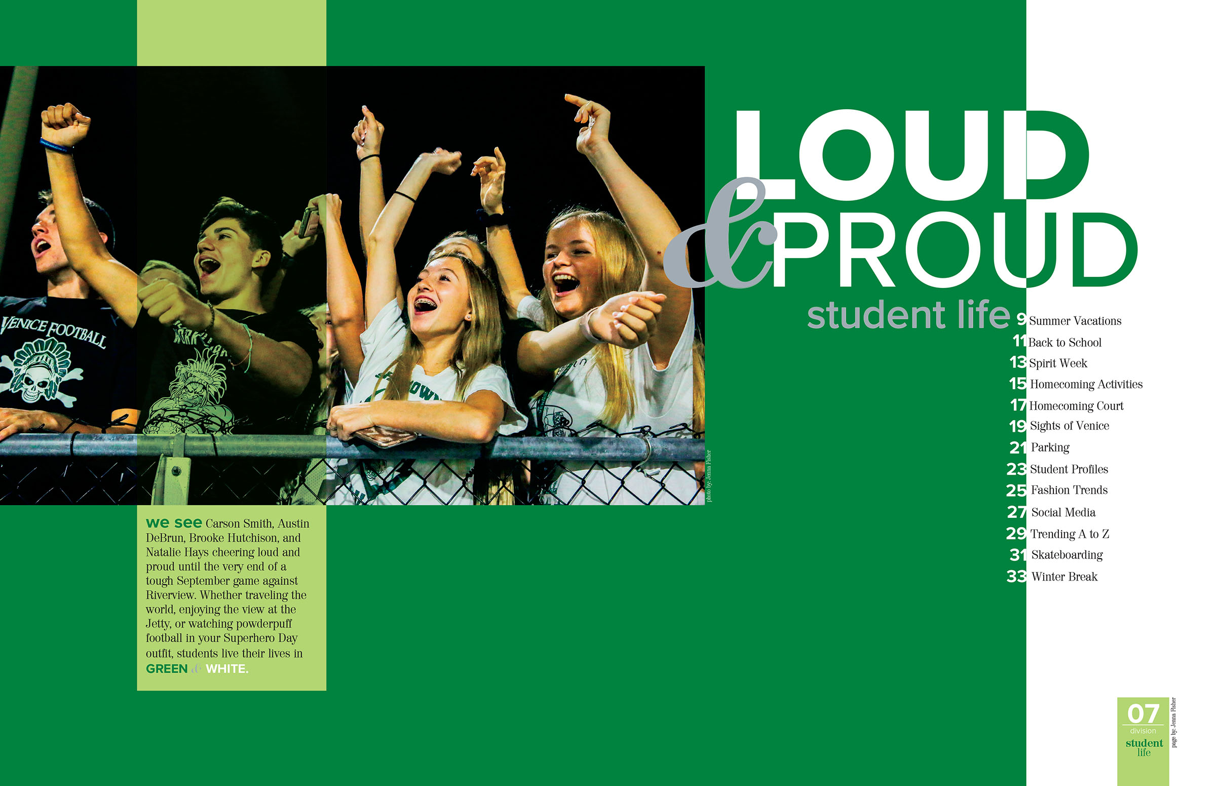
Venice HS– divider

Slide 14
Venice HS– student life coverage

Slide 15
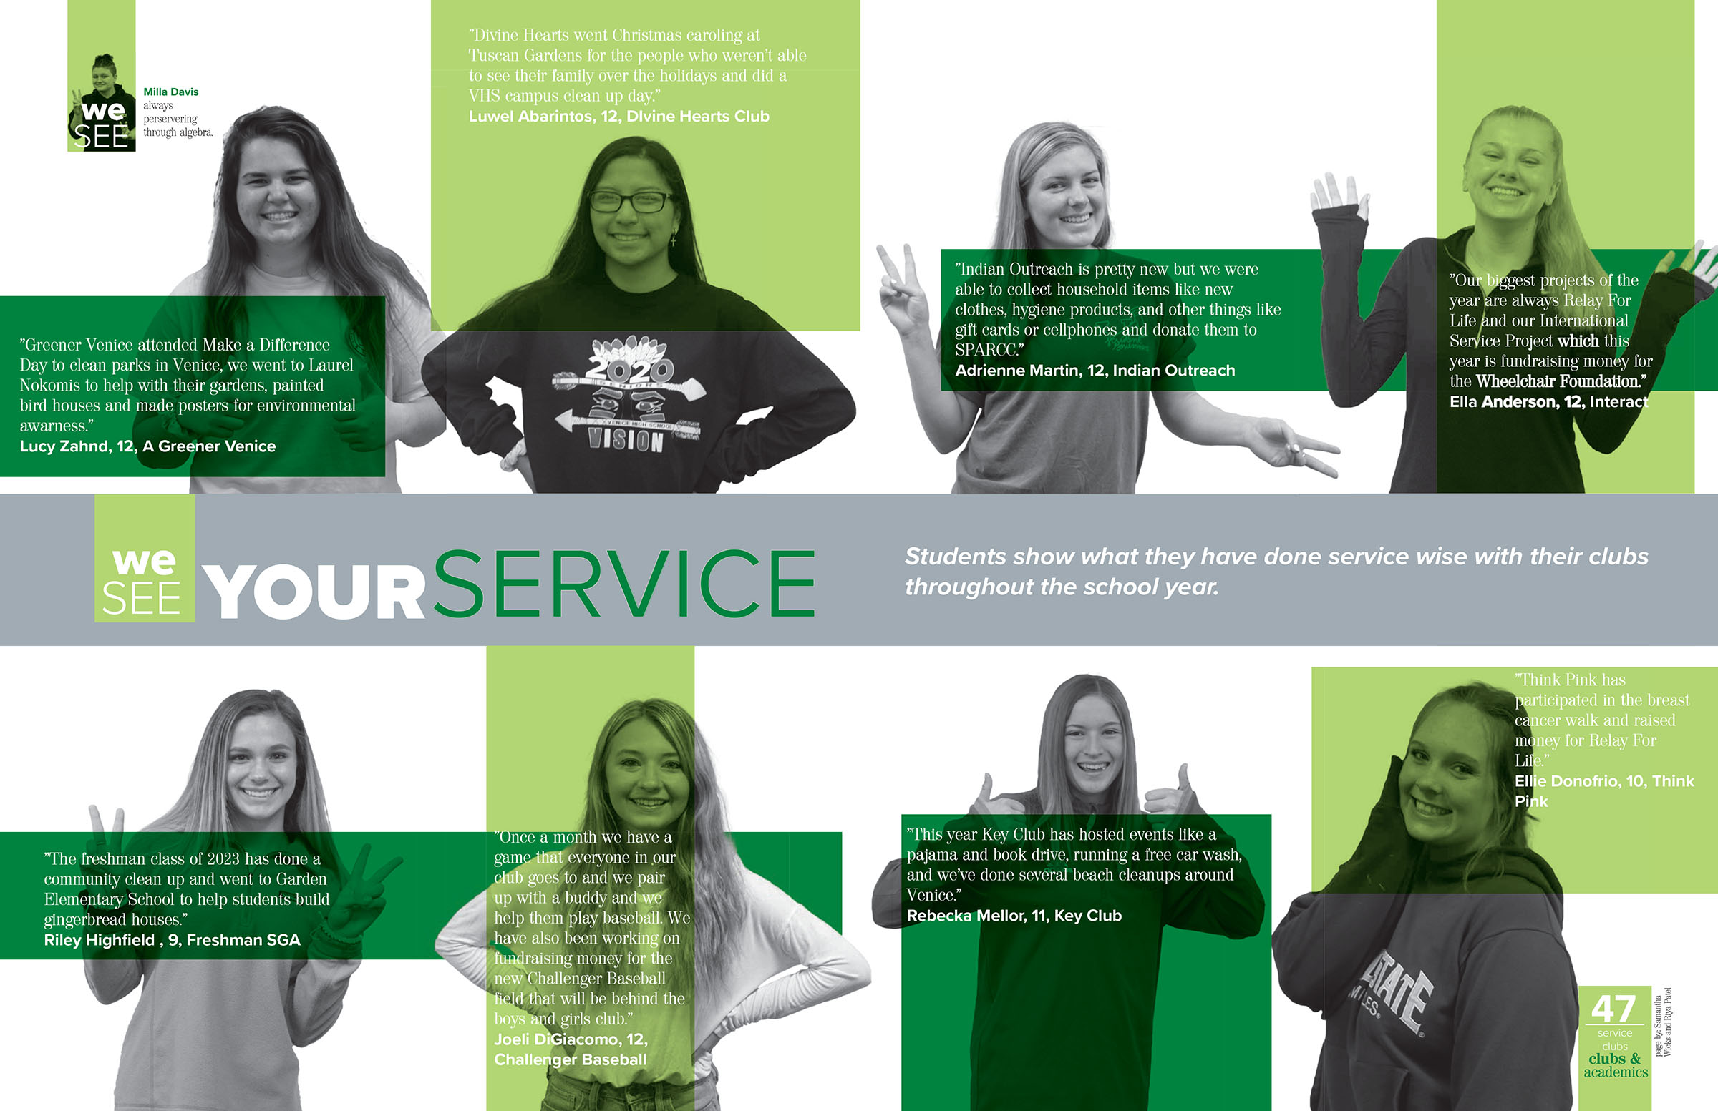
Venice HS– club coverage

Slide 16
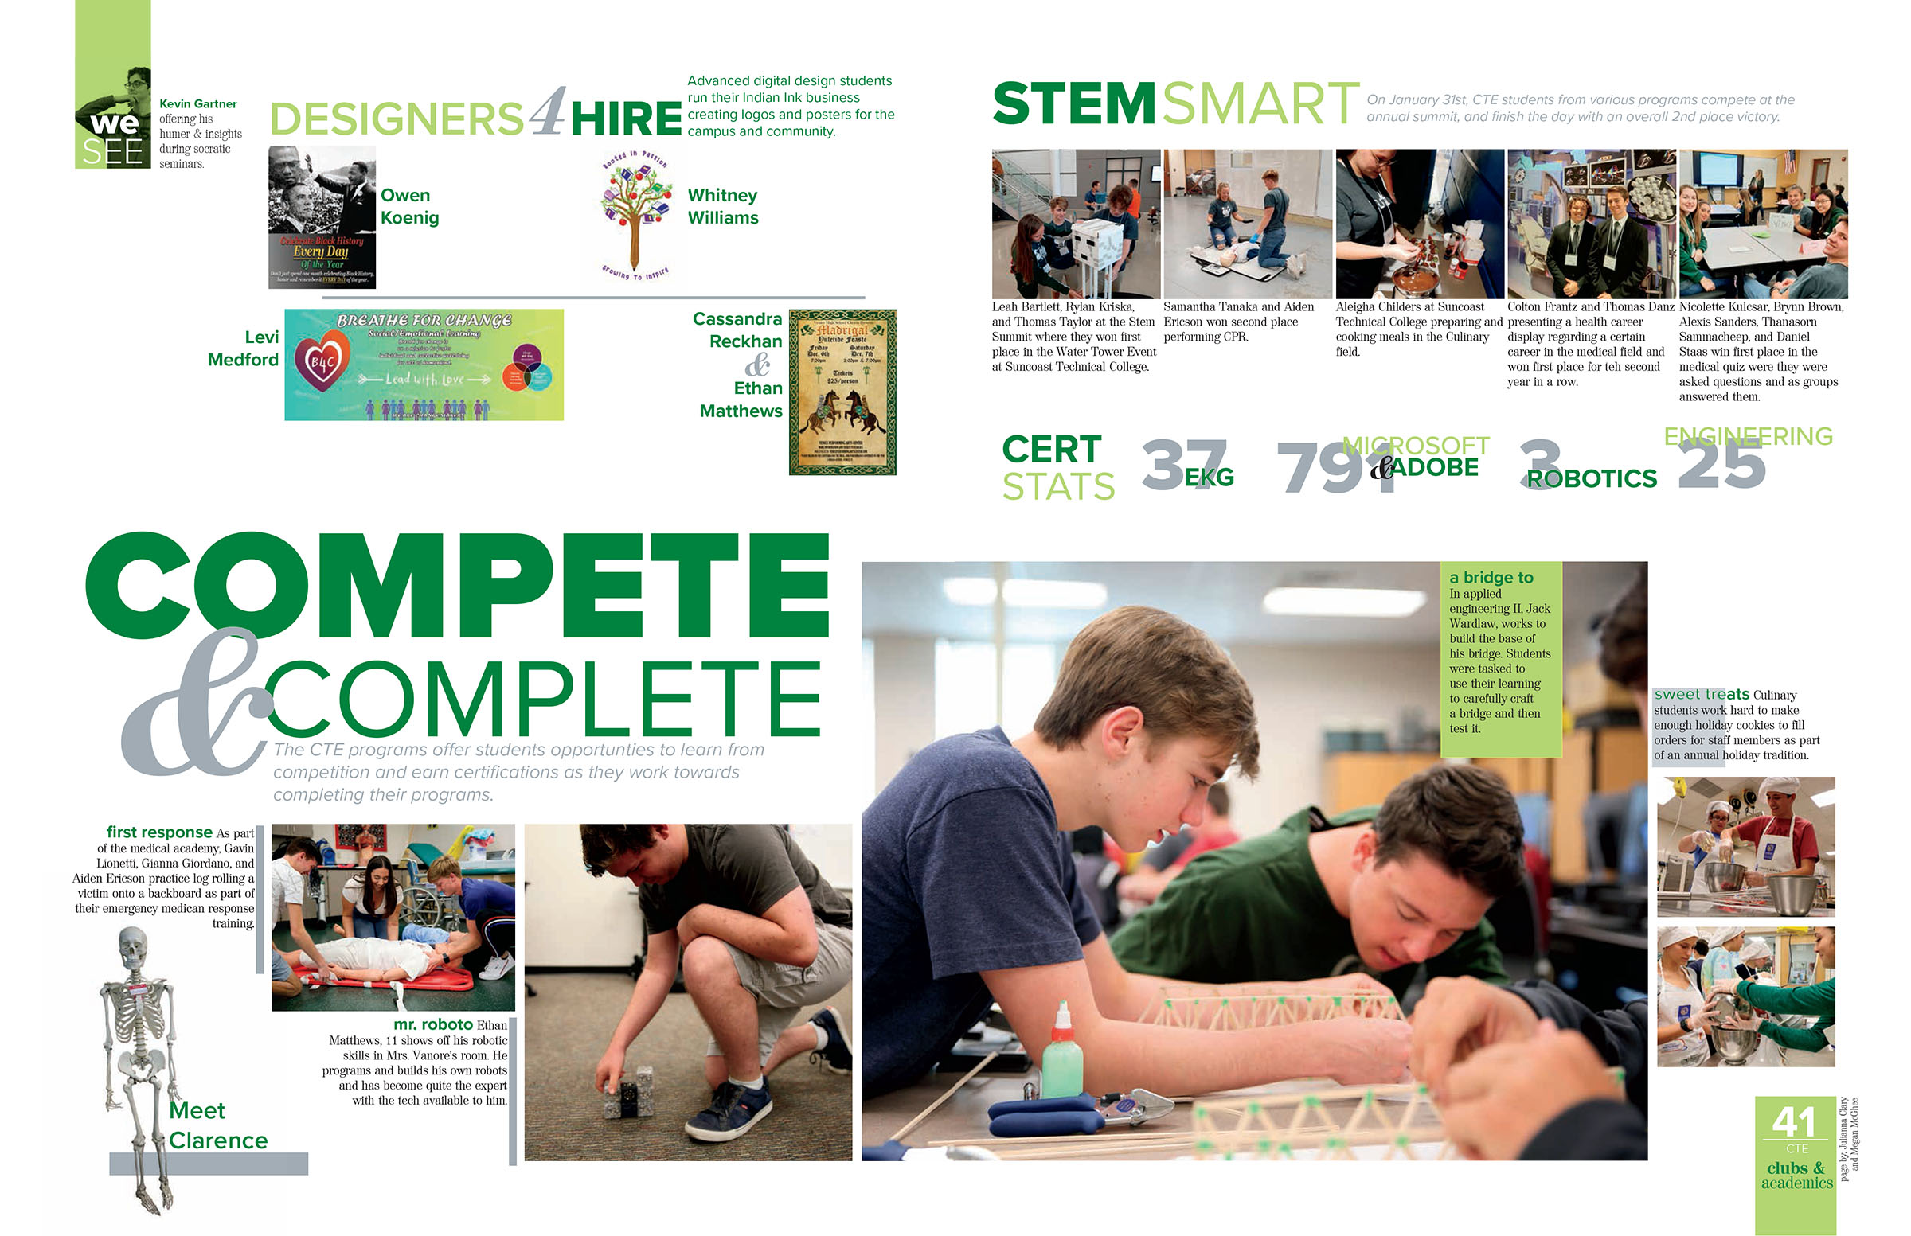
Venice HS – academic coverage

Slide 17
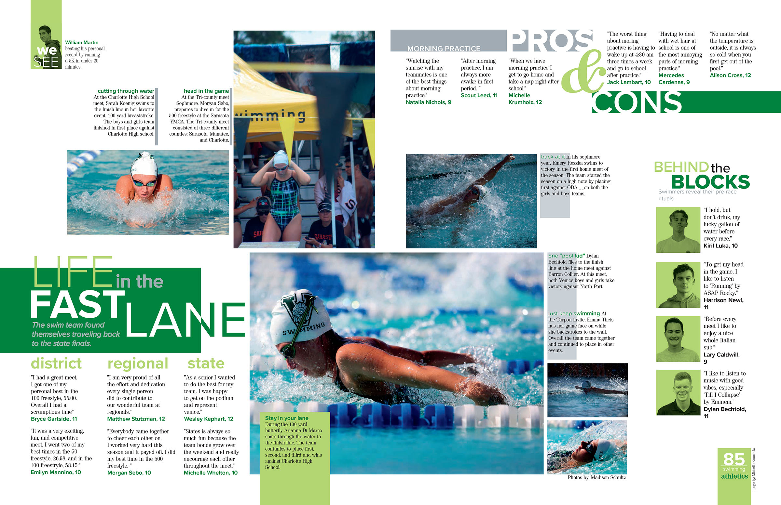
Venice HS – sports coverage

Slide 18
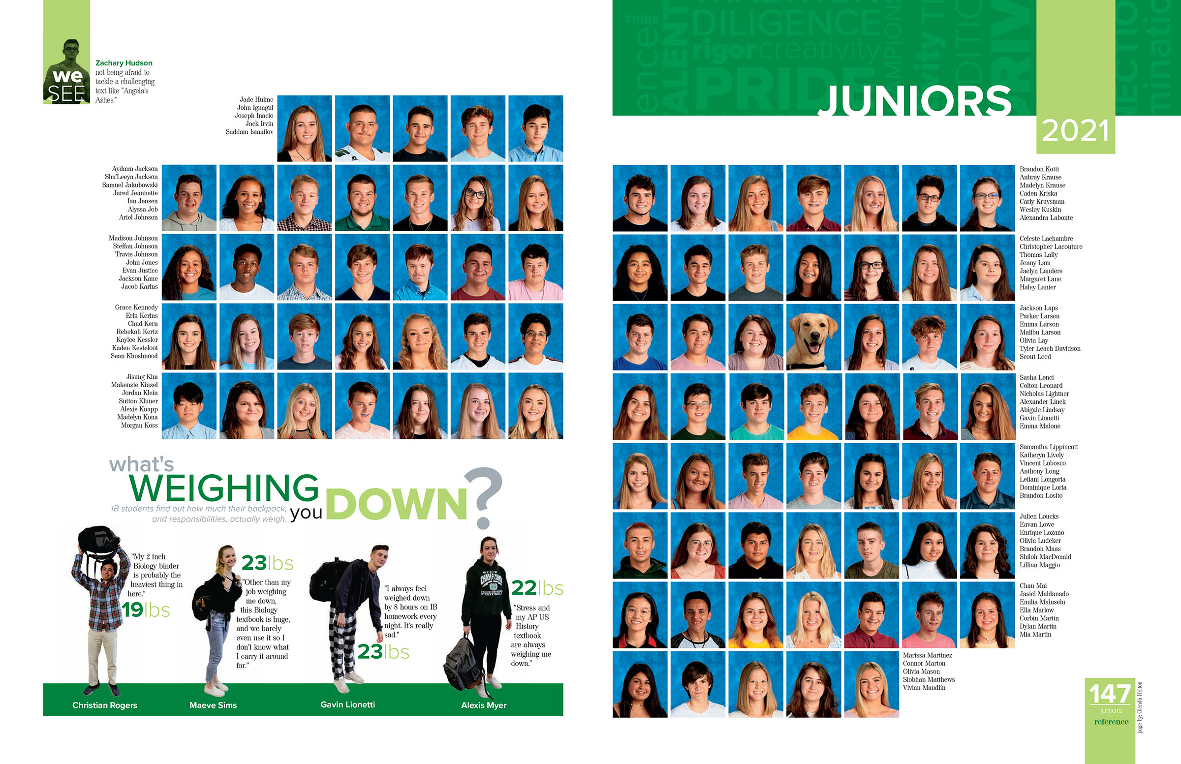
Venice HS – people coverage

Slide 19
Venice HS – theme coverage

Slide 20
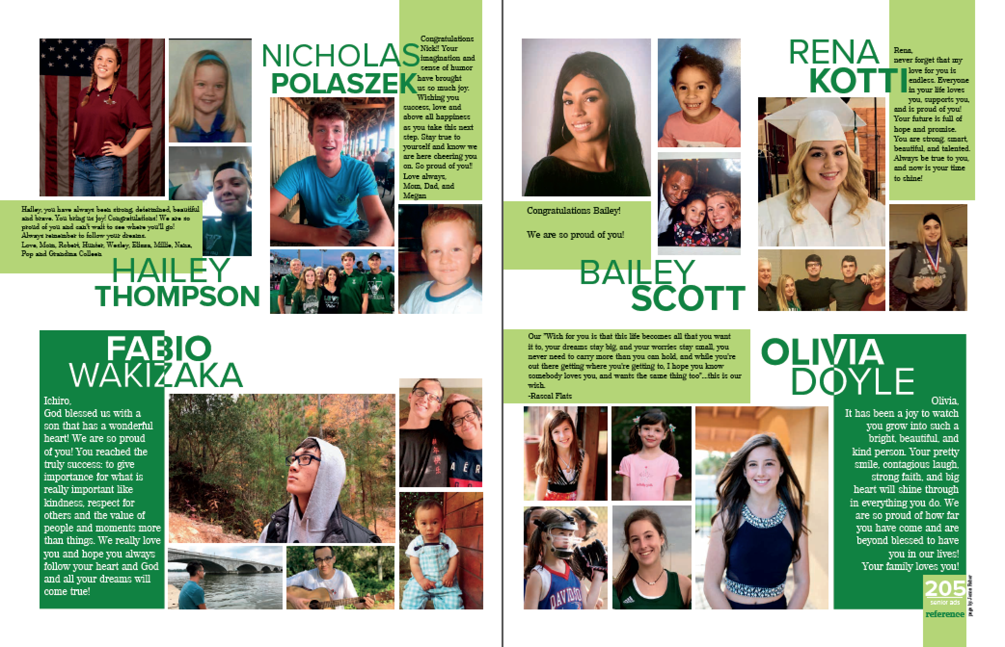
Venice HS– reference

Slide 21
Venice HS – theme closing

Slide 22
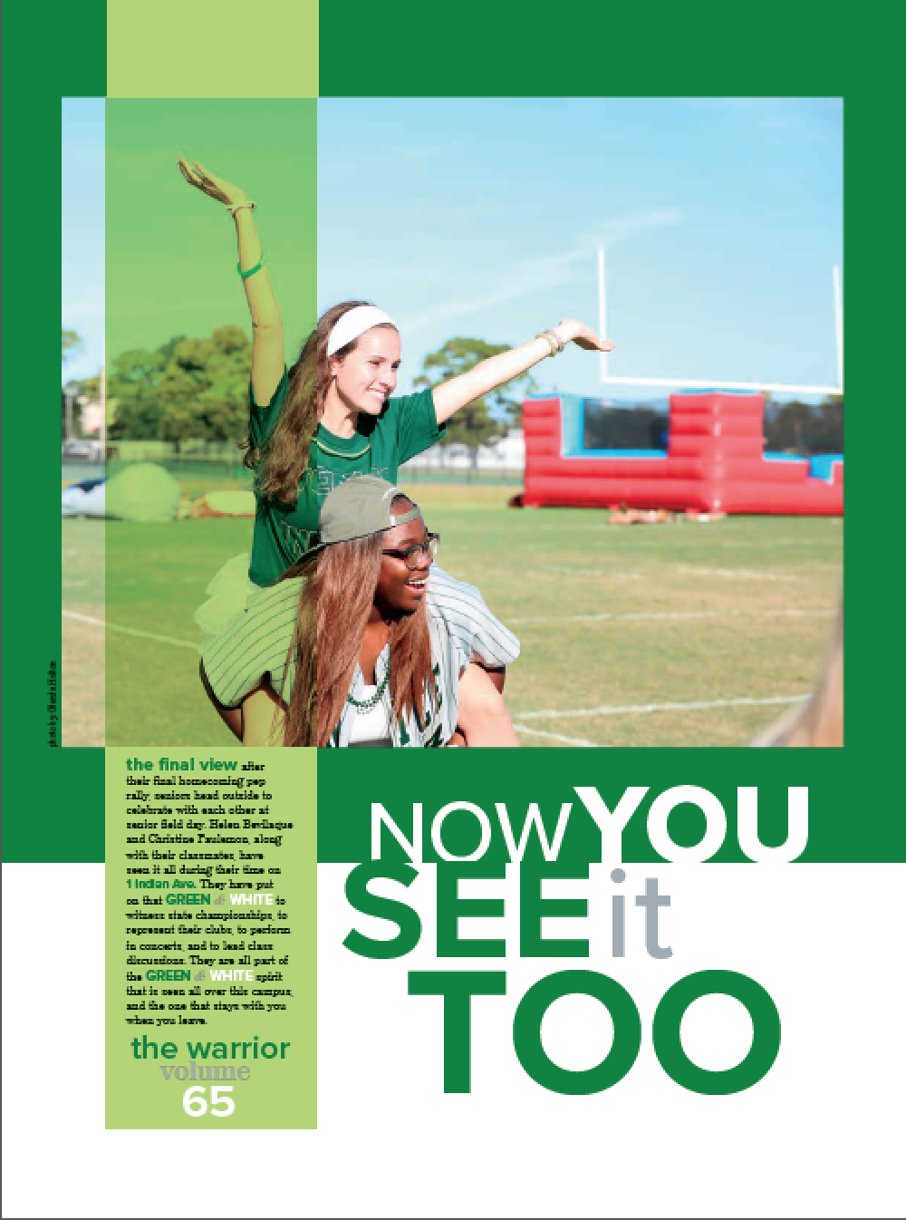
Venice HS – back page

Slide 23
Where do we
start
to develop the theme?
The COVER, of course.

Slide 24
Cover
The visual look of the book starts with the cover. It should include:
Theme word or phrase
Visual motifs – fonts, colors, lines, shapes & textures
Book name & year

Slide 25
Theme phrase
Green boxes – graphic element
UV varnish – word cloud in clear UV coat that shines when cover moves
Sans serif font in two weights
Book name & year
Venice HS – cover

Slide 26
Cover
The logo, simple and distinctive, should capture the essence of a theme’s message.
It should reflect the mood and tone of the theme.
A mash-up of an impactful theme and a logo-like presentation packs a one-two punch.

Slide 27
Cover logos

Slide 28
theme
Theme development should continue inside the book:
Theme pages: endsheets, opening, closing, division pages
Extended coverage: secondary coverage, headlines, group photos, ads & the index

Slide 29
theme
Theme development should continue inside the book:
Visually: typography, colors, lines, shapes
Verbally: headlines, secondary coverage/modules

Slide 30
create
visual
verbal
connections

Slide 31
What you make of it
Rock Canyon High School
Littleton, Colorado
Rock Canyon HS – cover
Notes:
What do you expect to see inside the book? Theme? Graphics? Colors? Fonts

Slide 32
Rock Canyon HS – endsheet
Notes:
What do you expect to see inside the book? Theme? Graphics? Colors? Fonts

Slide 33
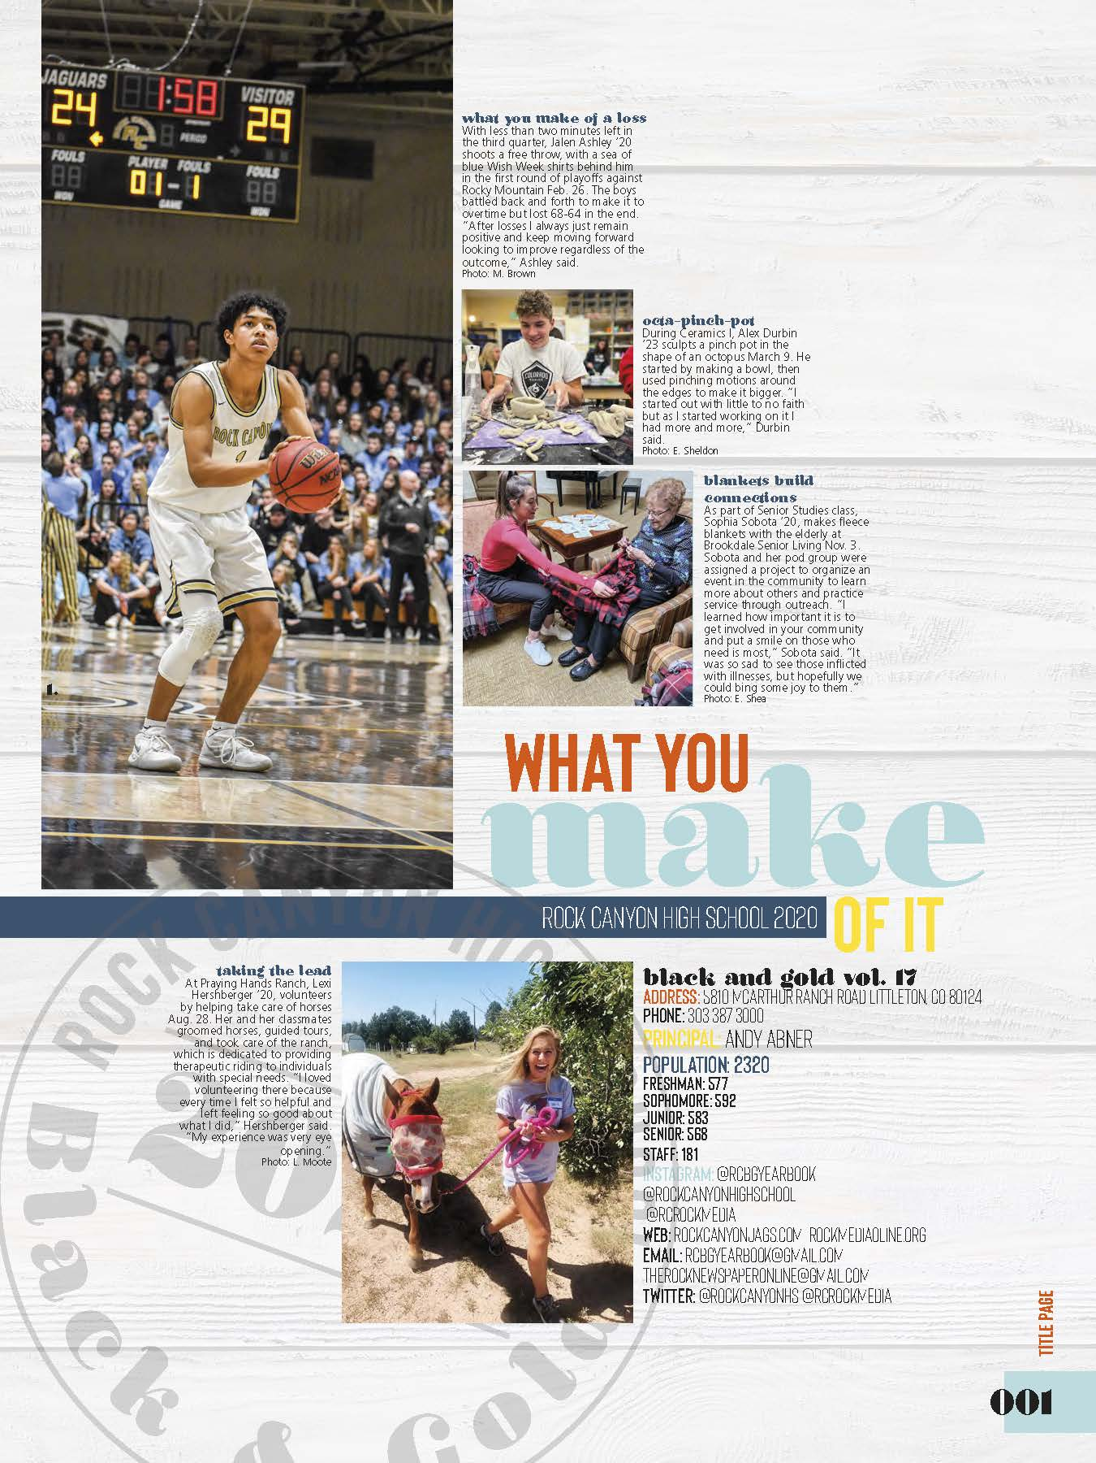
Rock Canyon HS – title page
Notes:
What do you expect to see inside the book? Theme? Graphics? Colors? Fonts

Slide 34
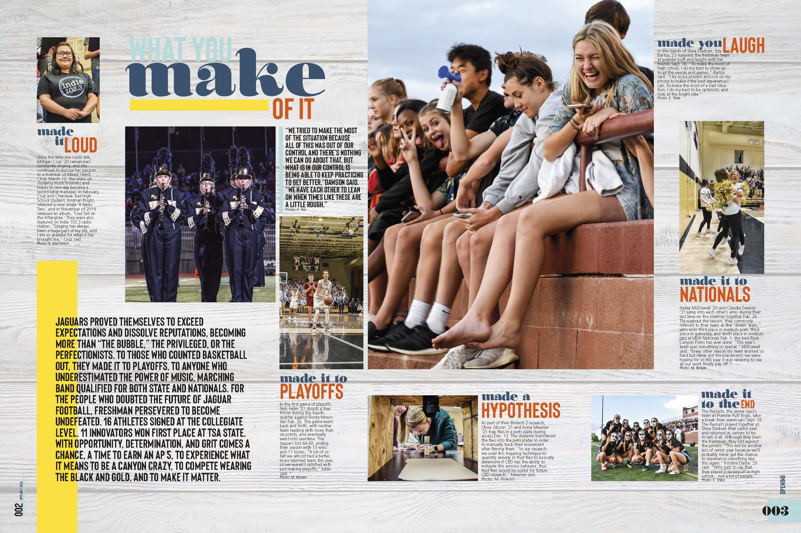
Rock Canyon HS – theme opening
Notes:
What do you expect to see inside the book? Theme? Graphics? Colors? Fonts

Slide 35
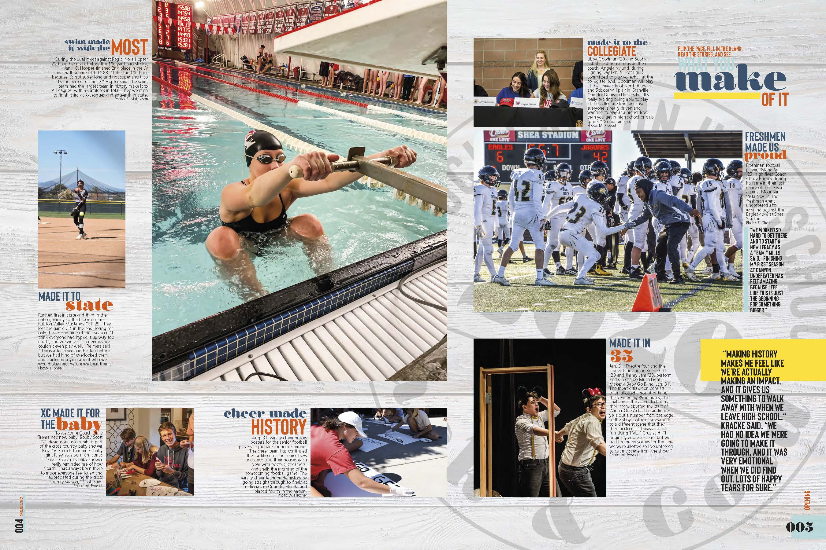
Rock Canyon HS – theme opening
Notes:
What do you expect to see inside the book? Theme? Graphics? Colors? Fonts

Slide 36
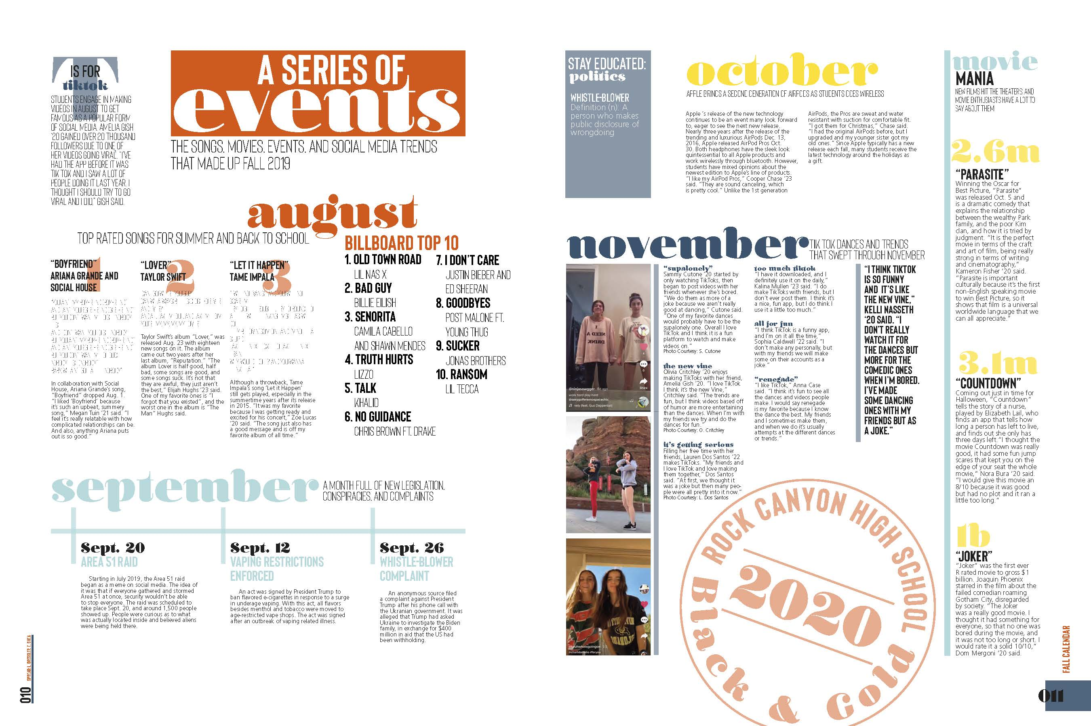
Rock Canyon HS – fall calendar/divider
Notes:
Notice how well theme is carried out—headlines, colors, graphics

Slide 37
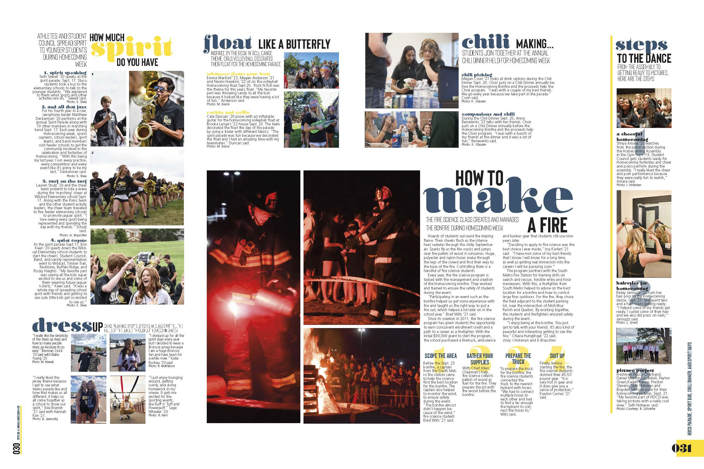
Rock Canyon HS – September events
Notes:
Notice how well theme is carried out—headlines, colors, graphics

Slide 38
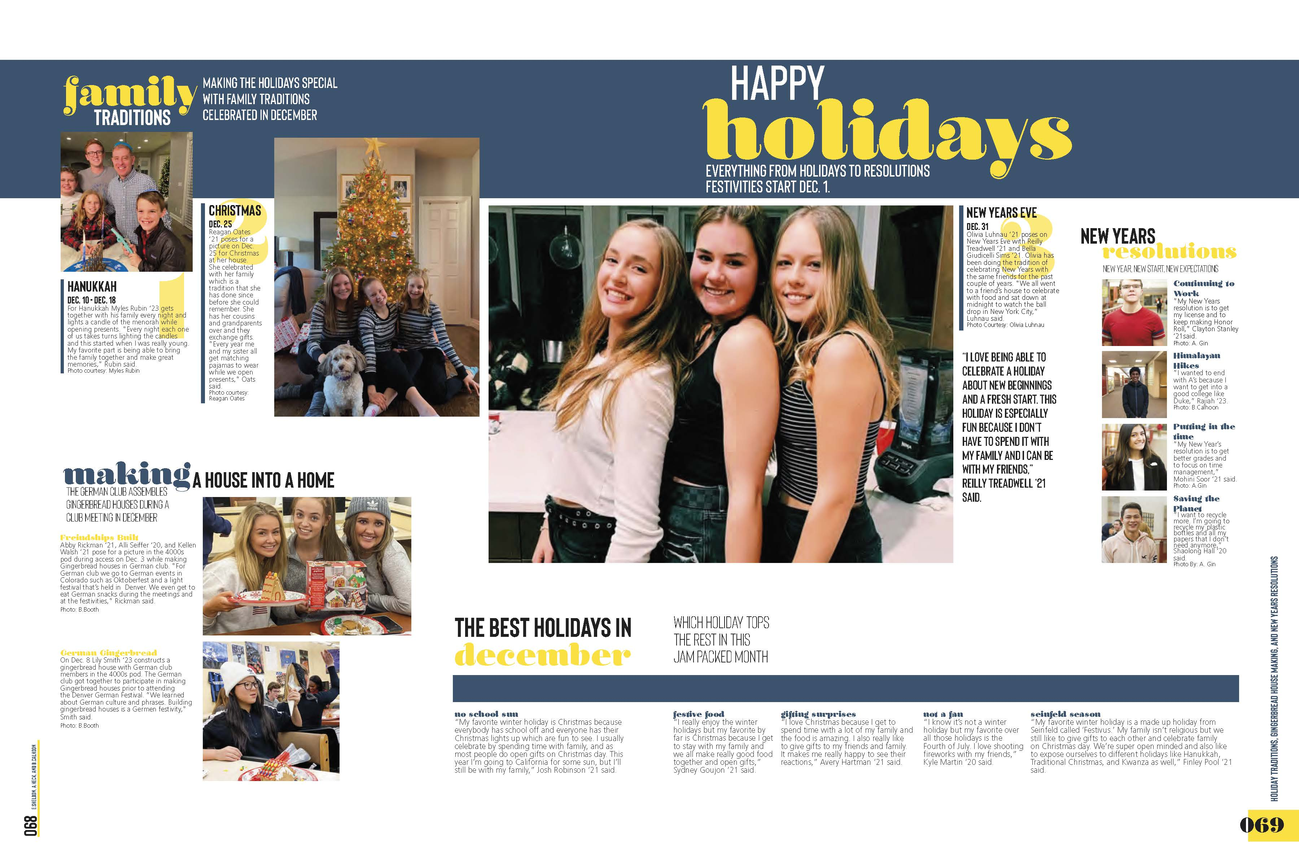
Rock Canyon HS – holidays

Slide 39
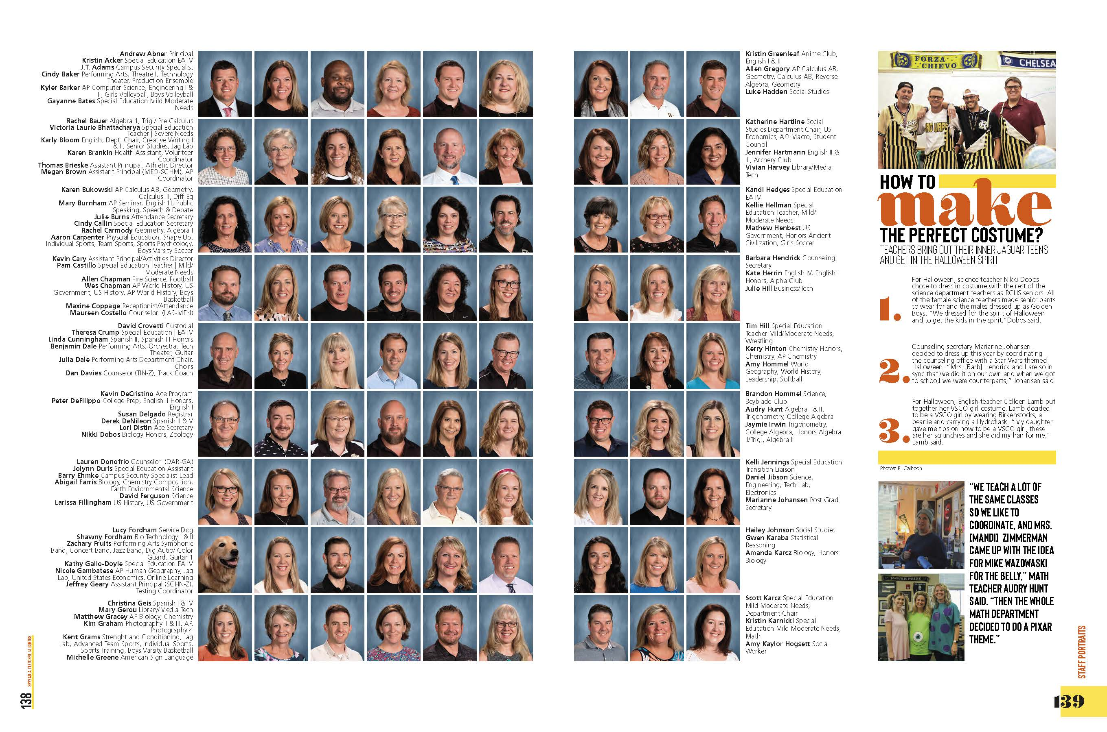
Rock Canyon HS – people coverage
Notes:
Notice how well theme is carried out—colors, graphics. Even though it’s verbally seen, it’s seen visually.

Slide 40
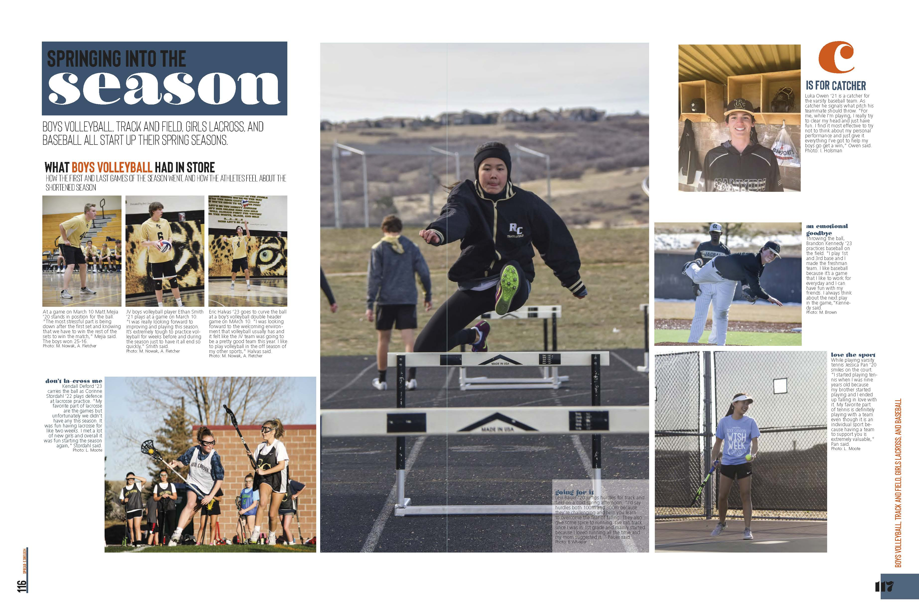
Rock Canyon HS – spring sports

Slide 41
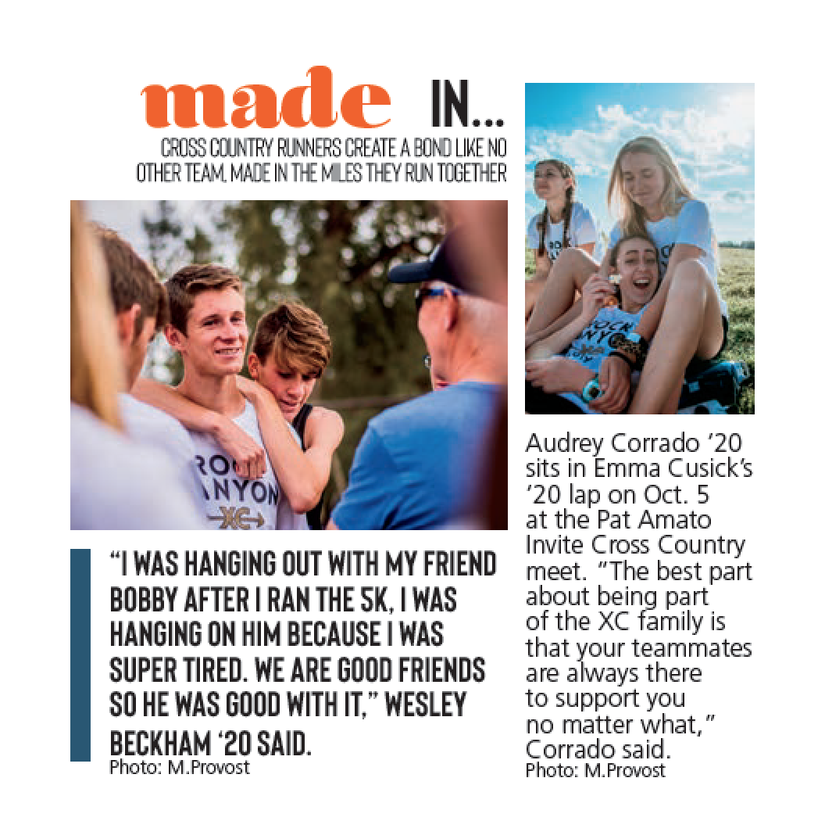
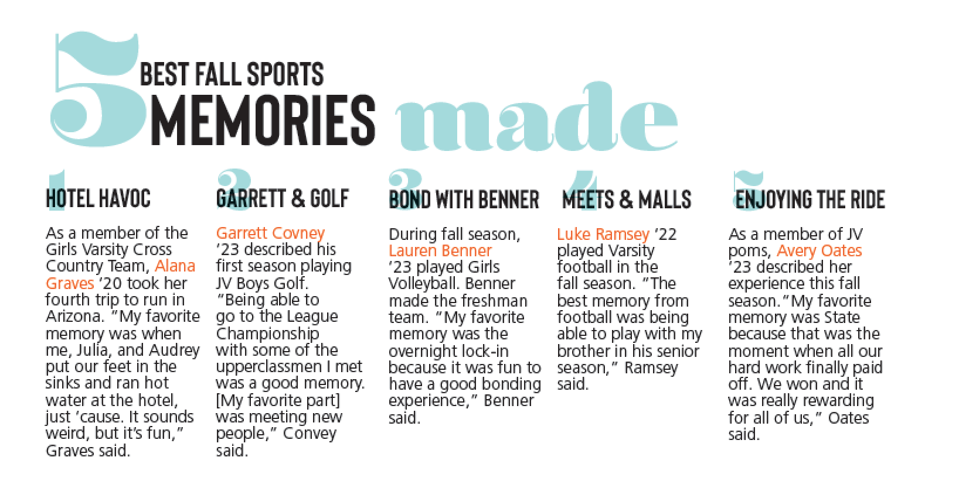
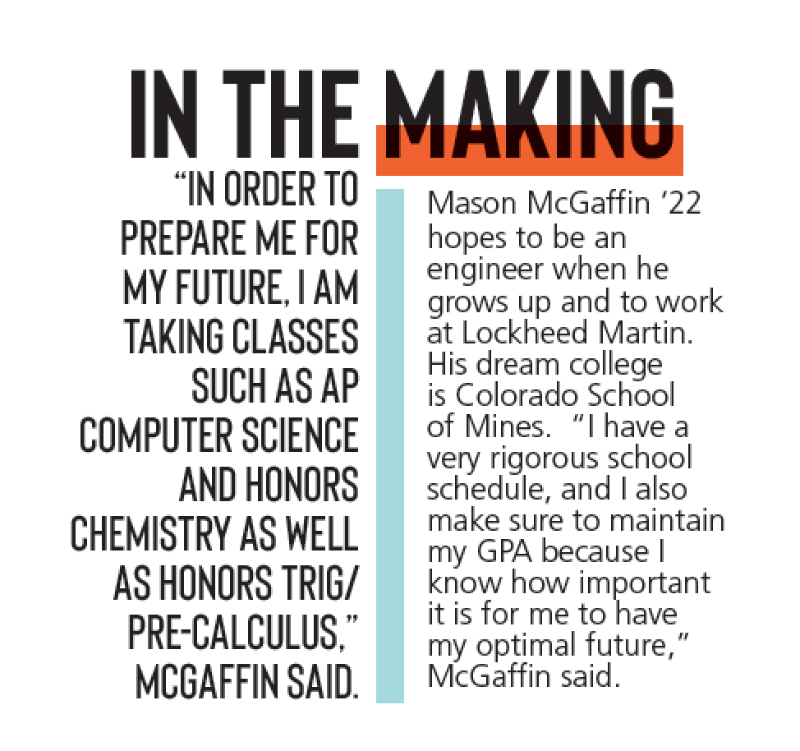
Rock Canyon HS – visual/verbal connections
Notes:
Closing wraps up book

Slide 42
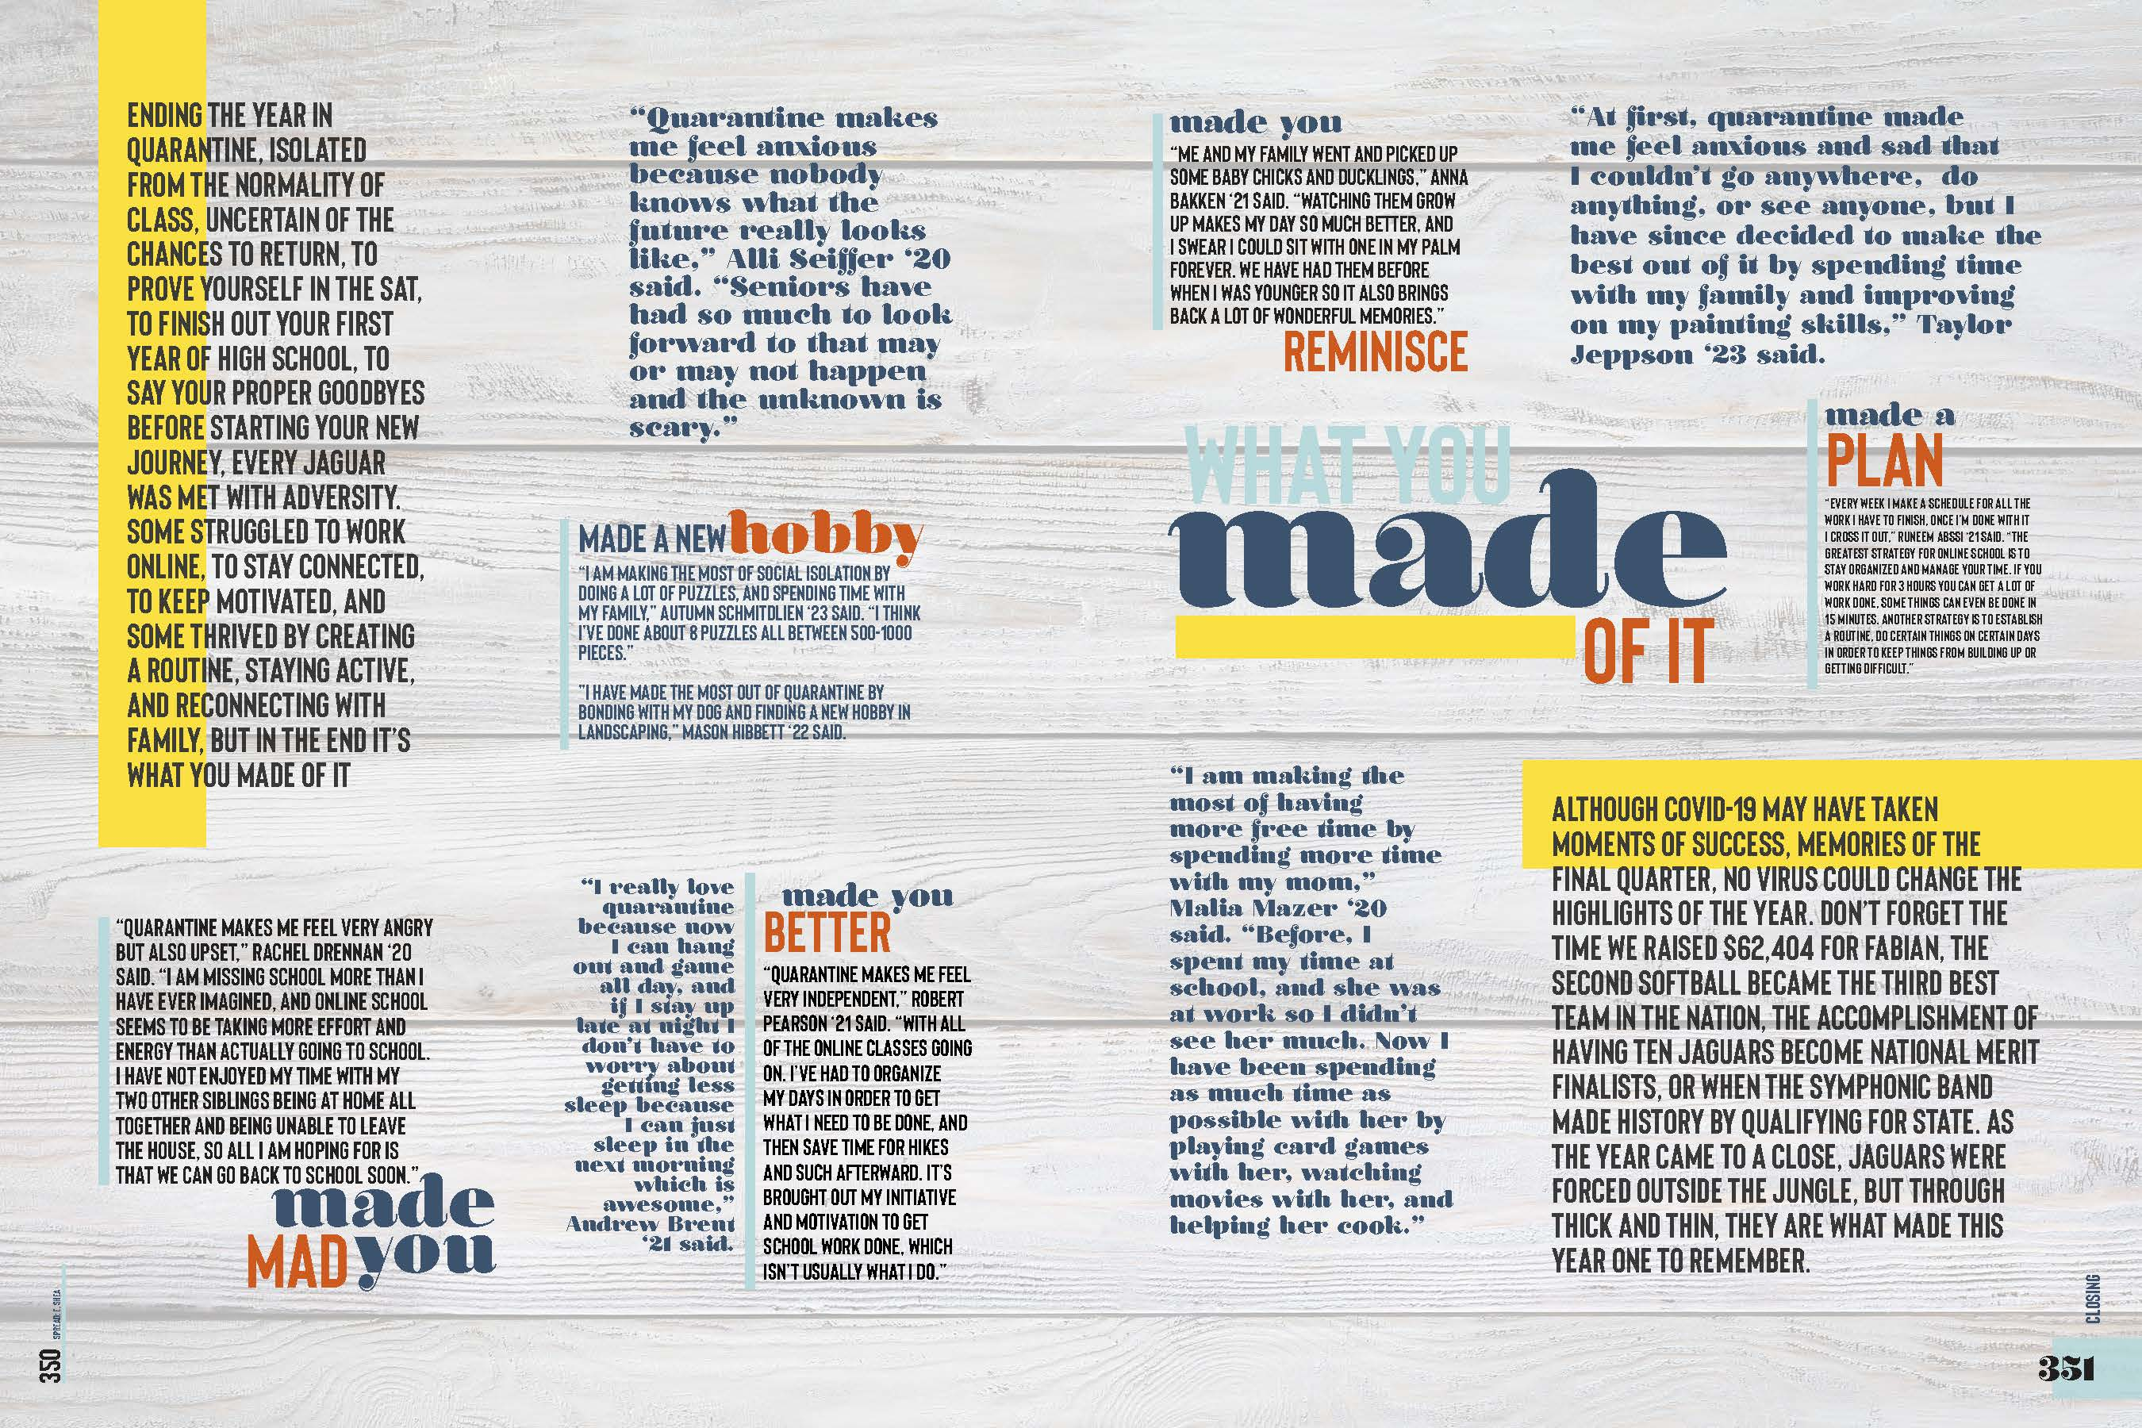
Rock Canyon HS – theme closing
Notes:
Closing wraps up book

Slide 43
Rock Canyon HS – back page
Notes:
Closing wraps up book

Slide 44
Let’s see a few more
examples.

Slide 45
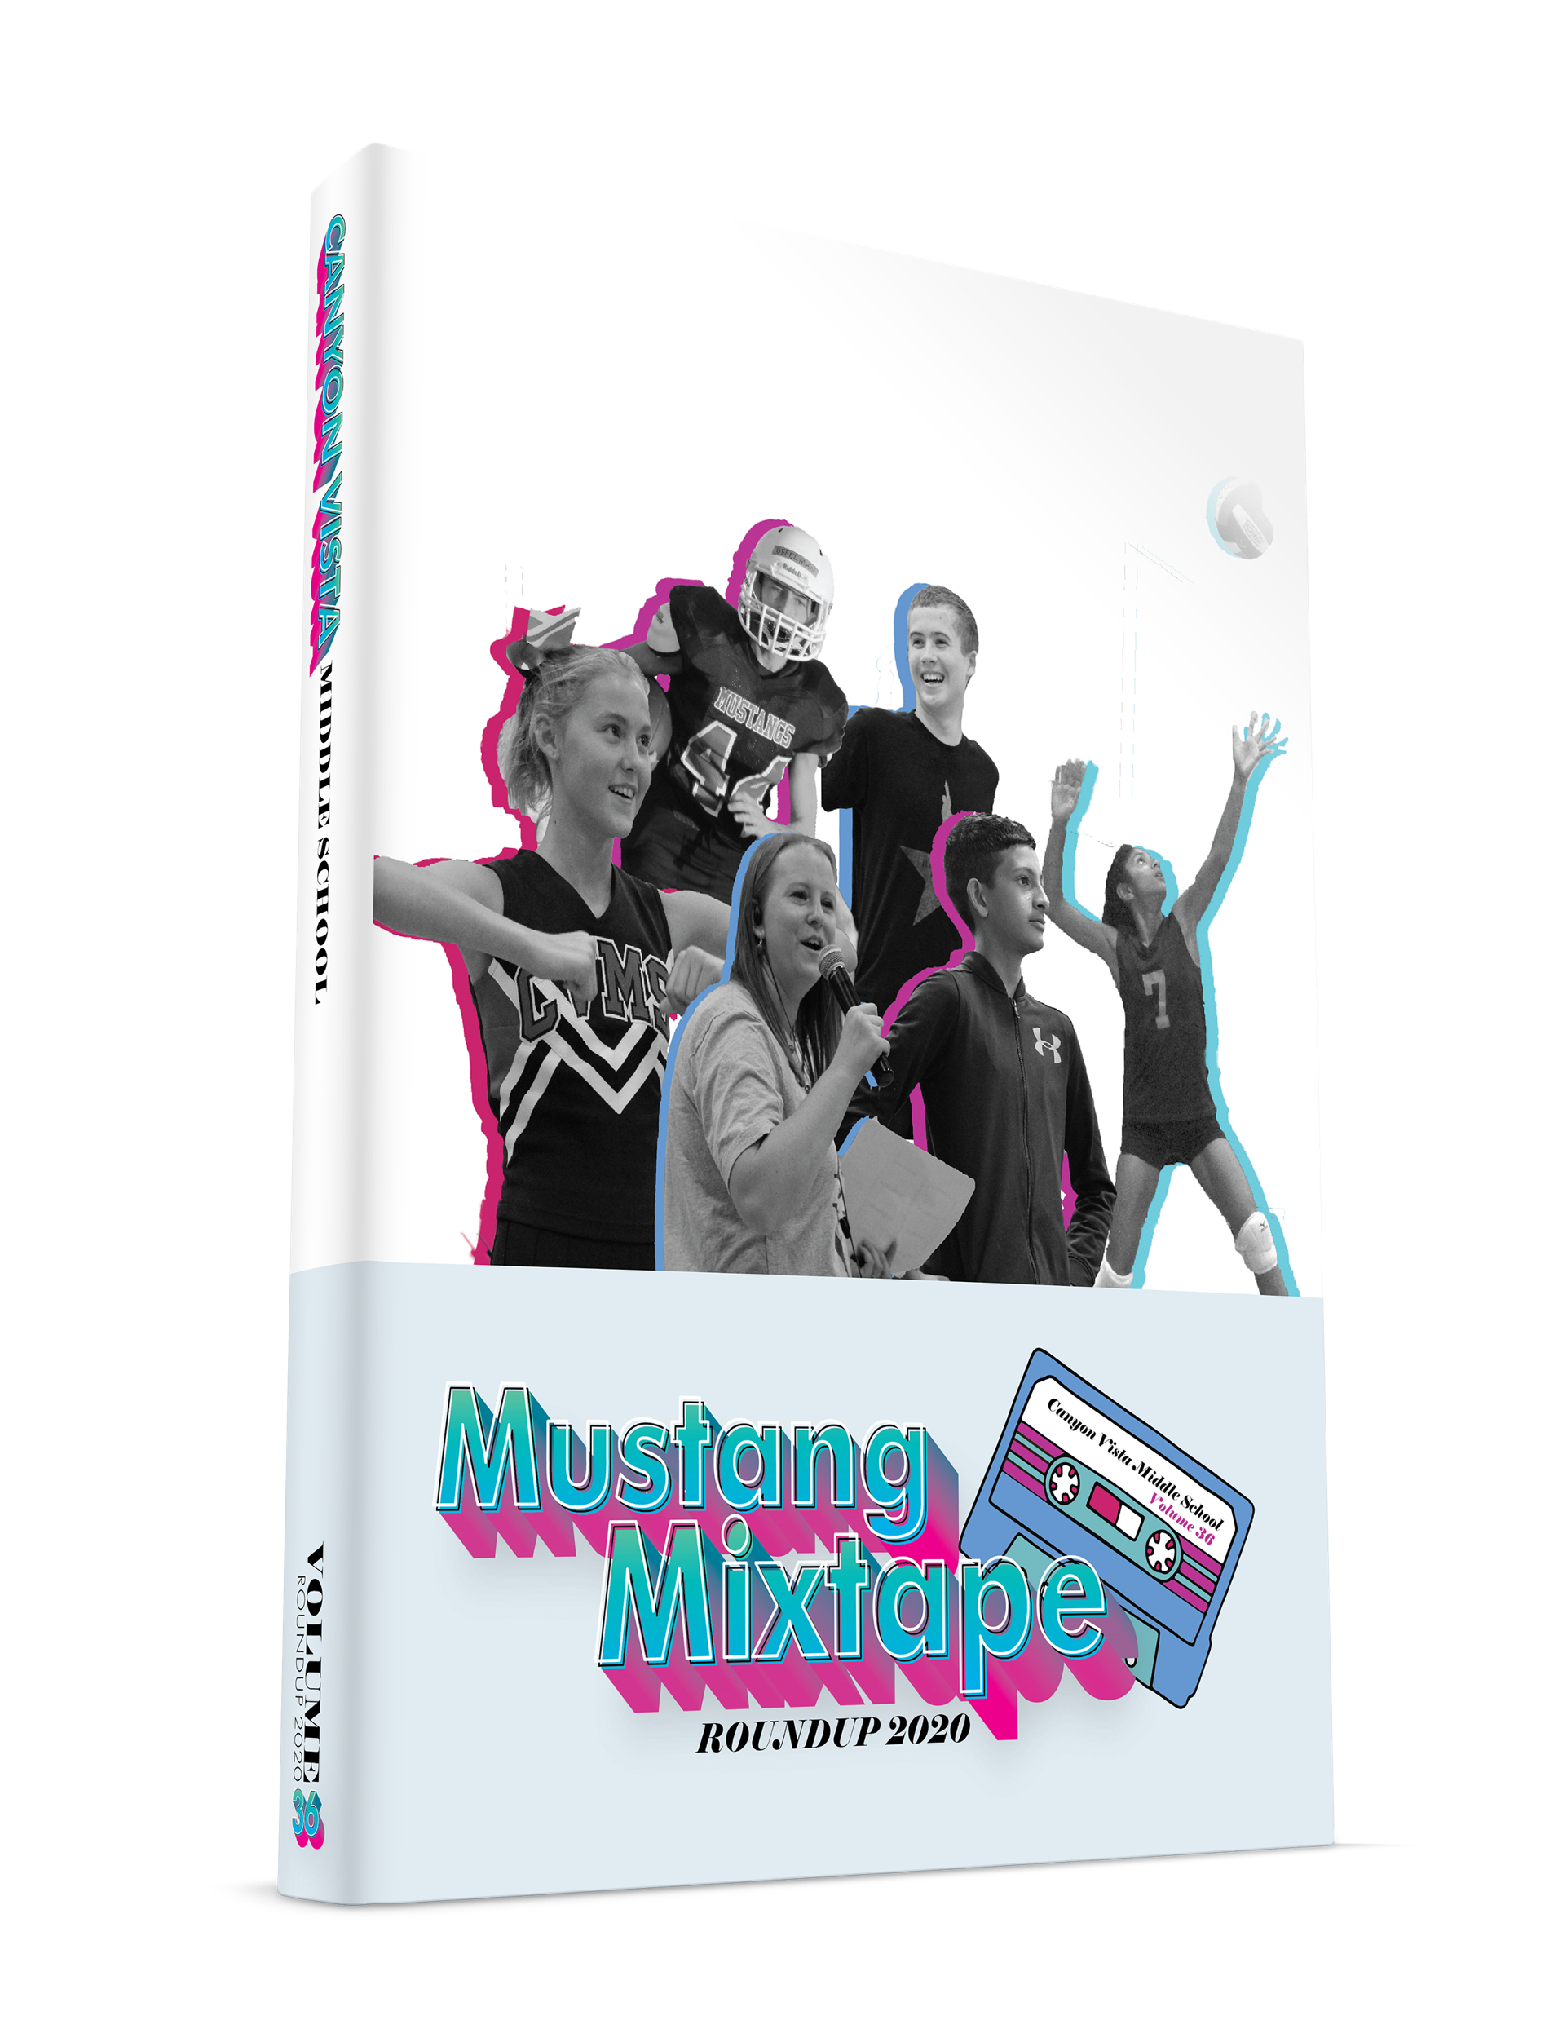
Mustang Mixtape
Canyon Vista Middle School
Austin, Texas
Canyon Vista MS – cover
Notes:
The cover gives you hints of what you’ll see inside the book. B&W cutouts with colored shadows, 3D text, doodles/graphics, music-related elements

Slide 46
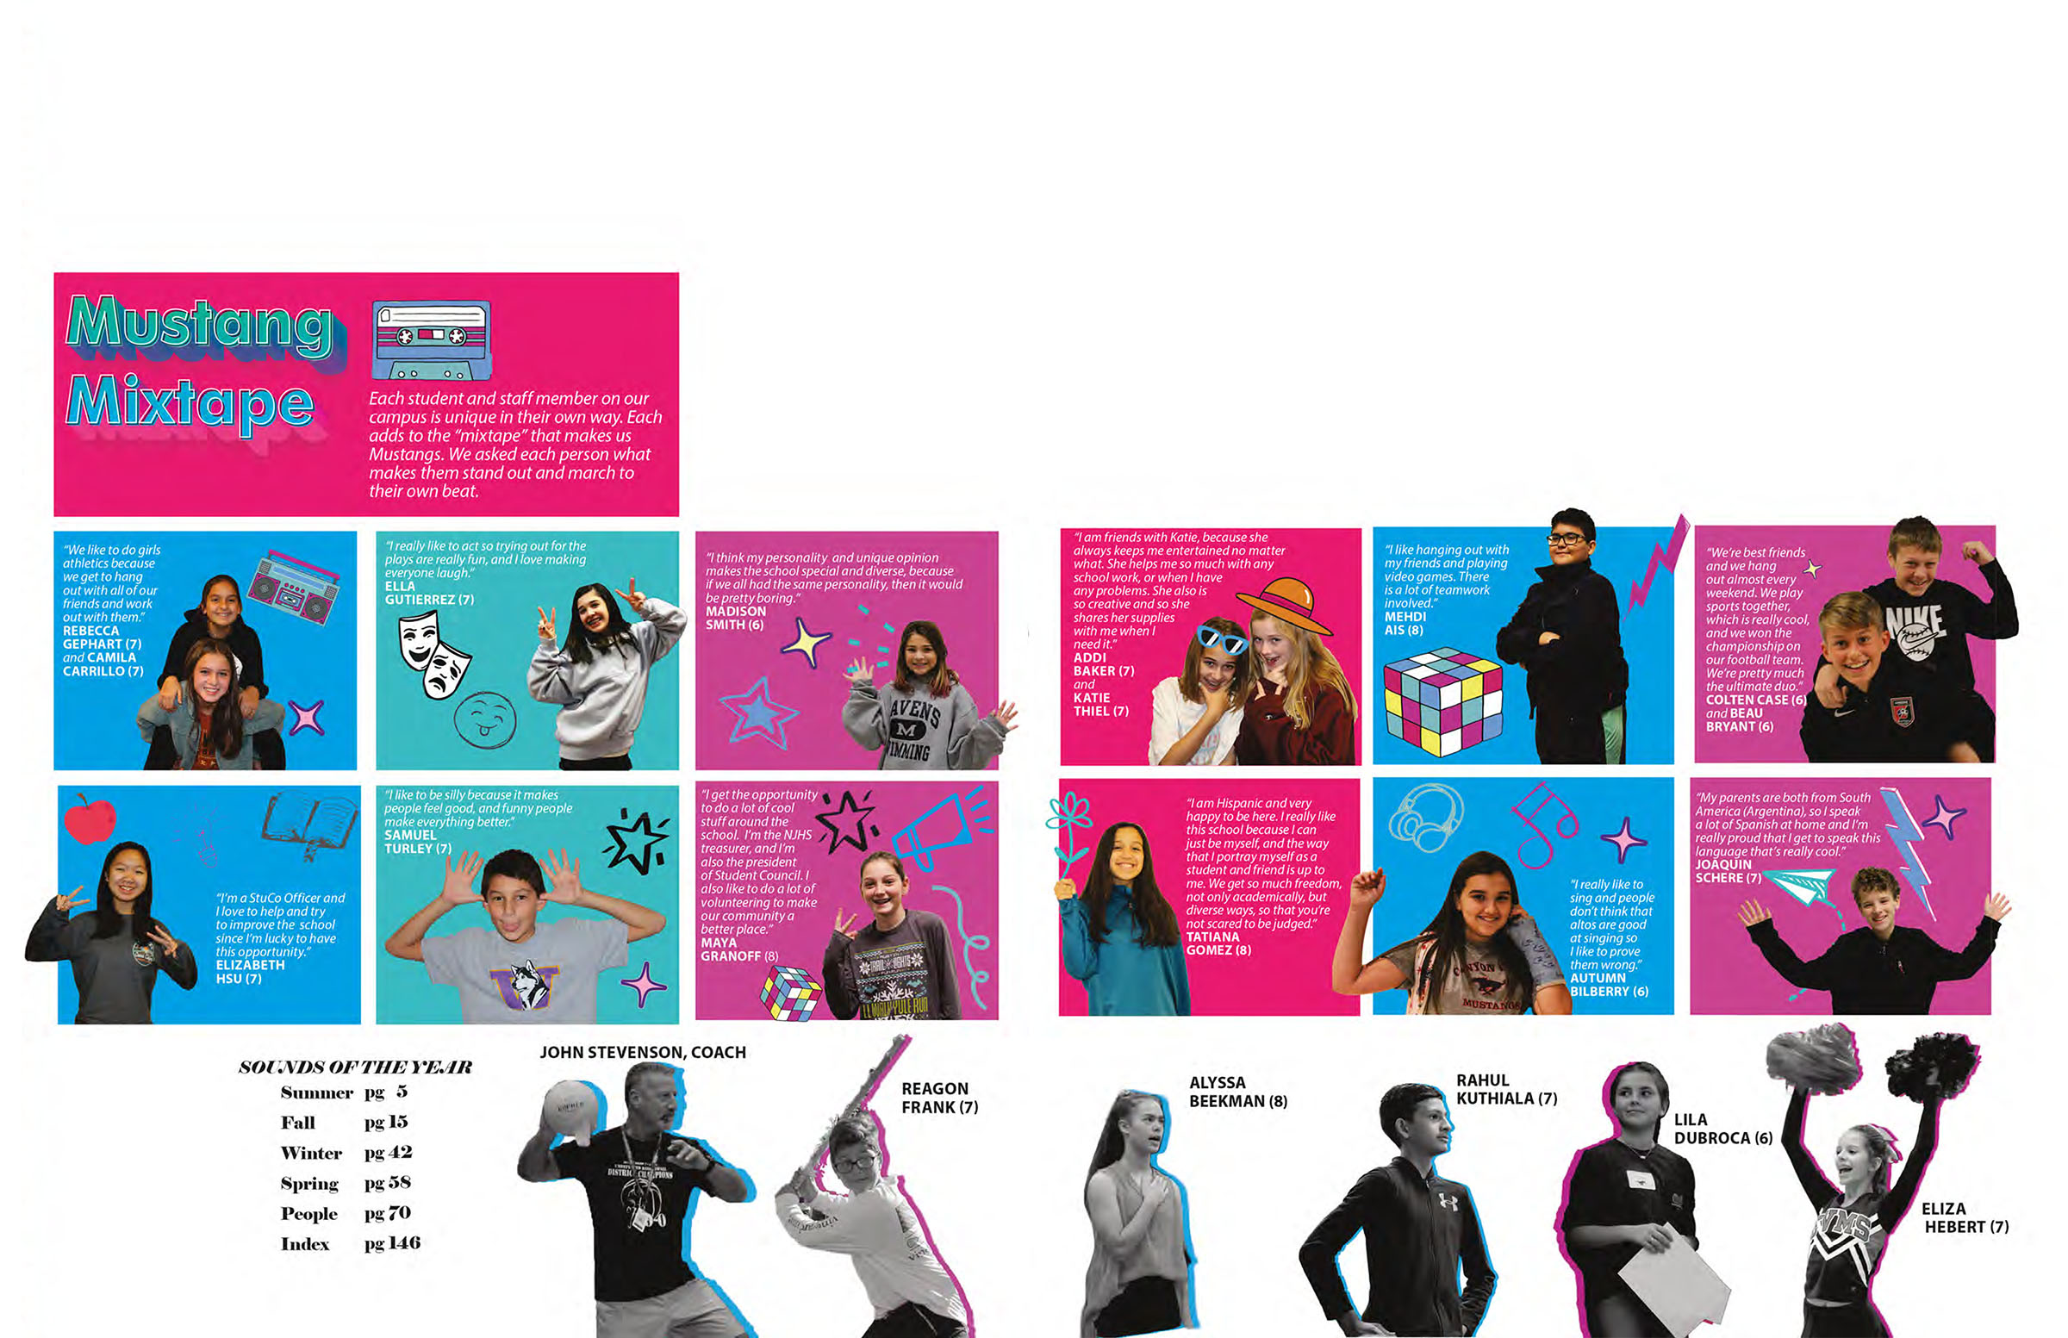
Canyon Vista MS – endsheets
Notes:
Notice how well theme is carried out—headlines, colors, graphics

Slide 47
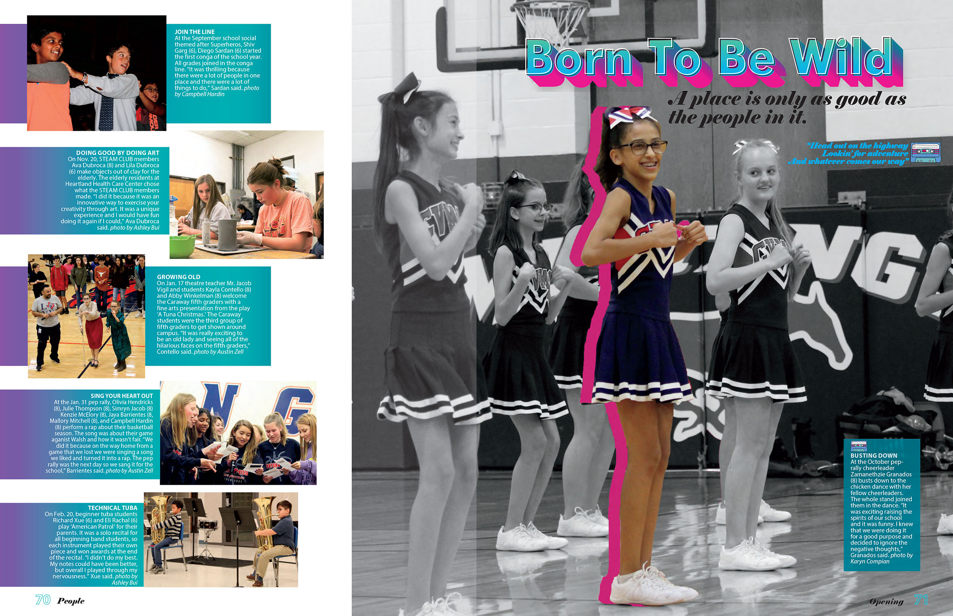
Canyon Vista MS – divider

Slide 48
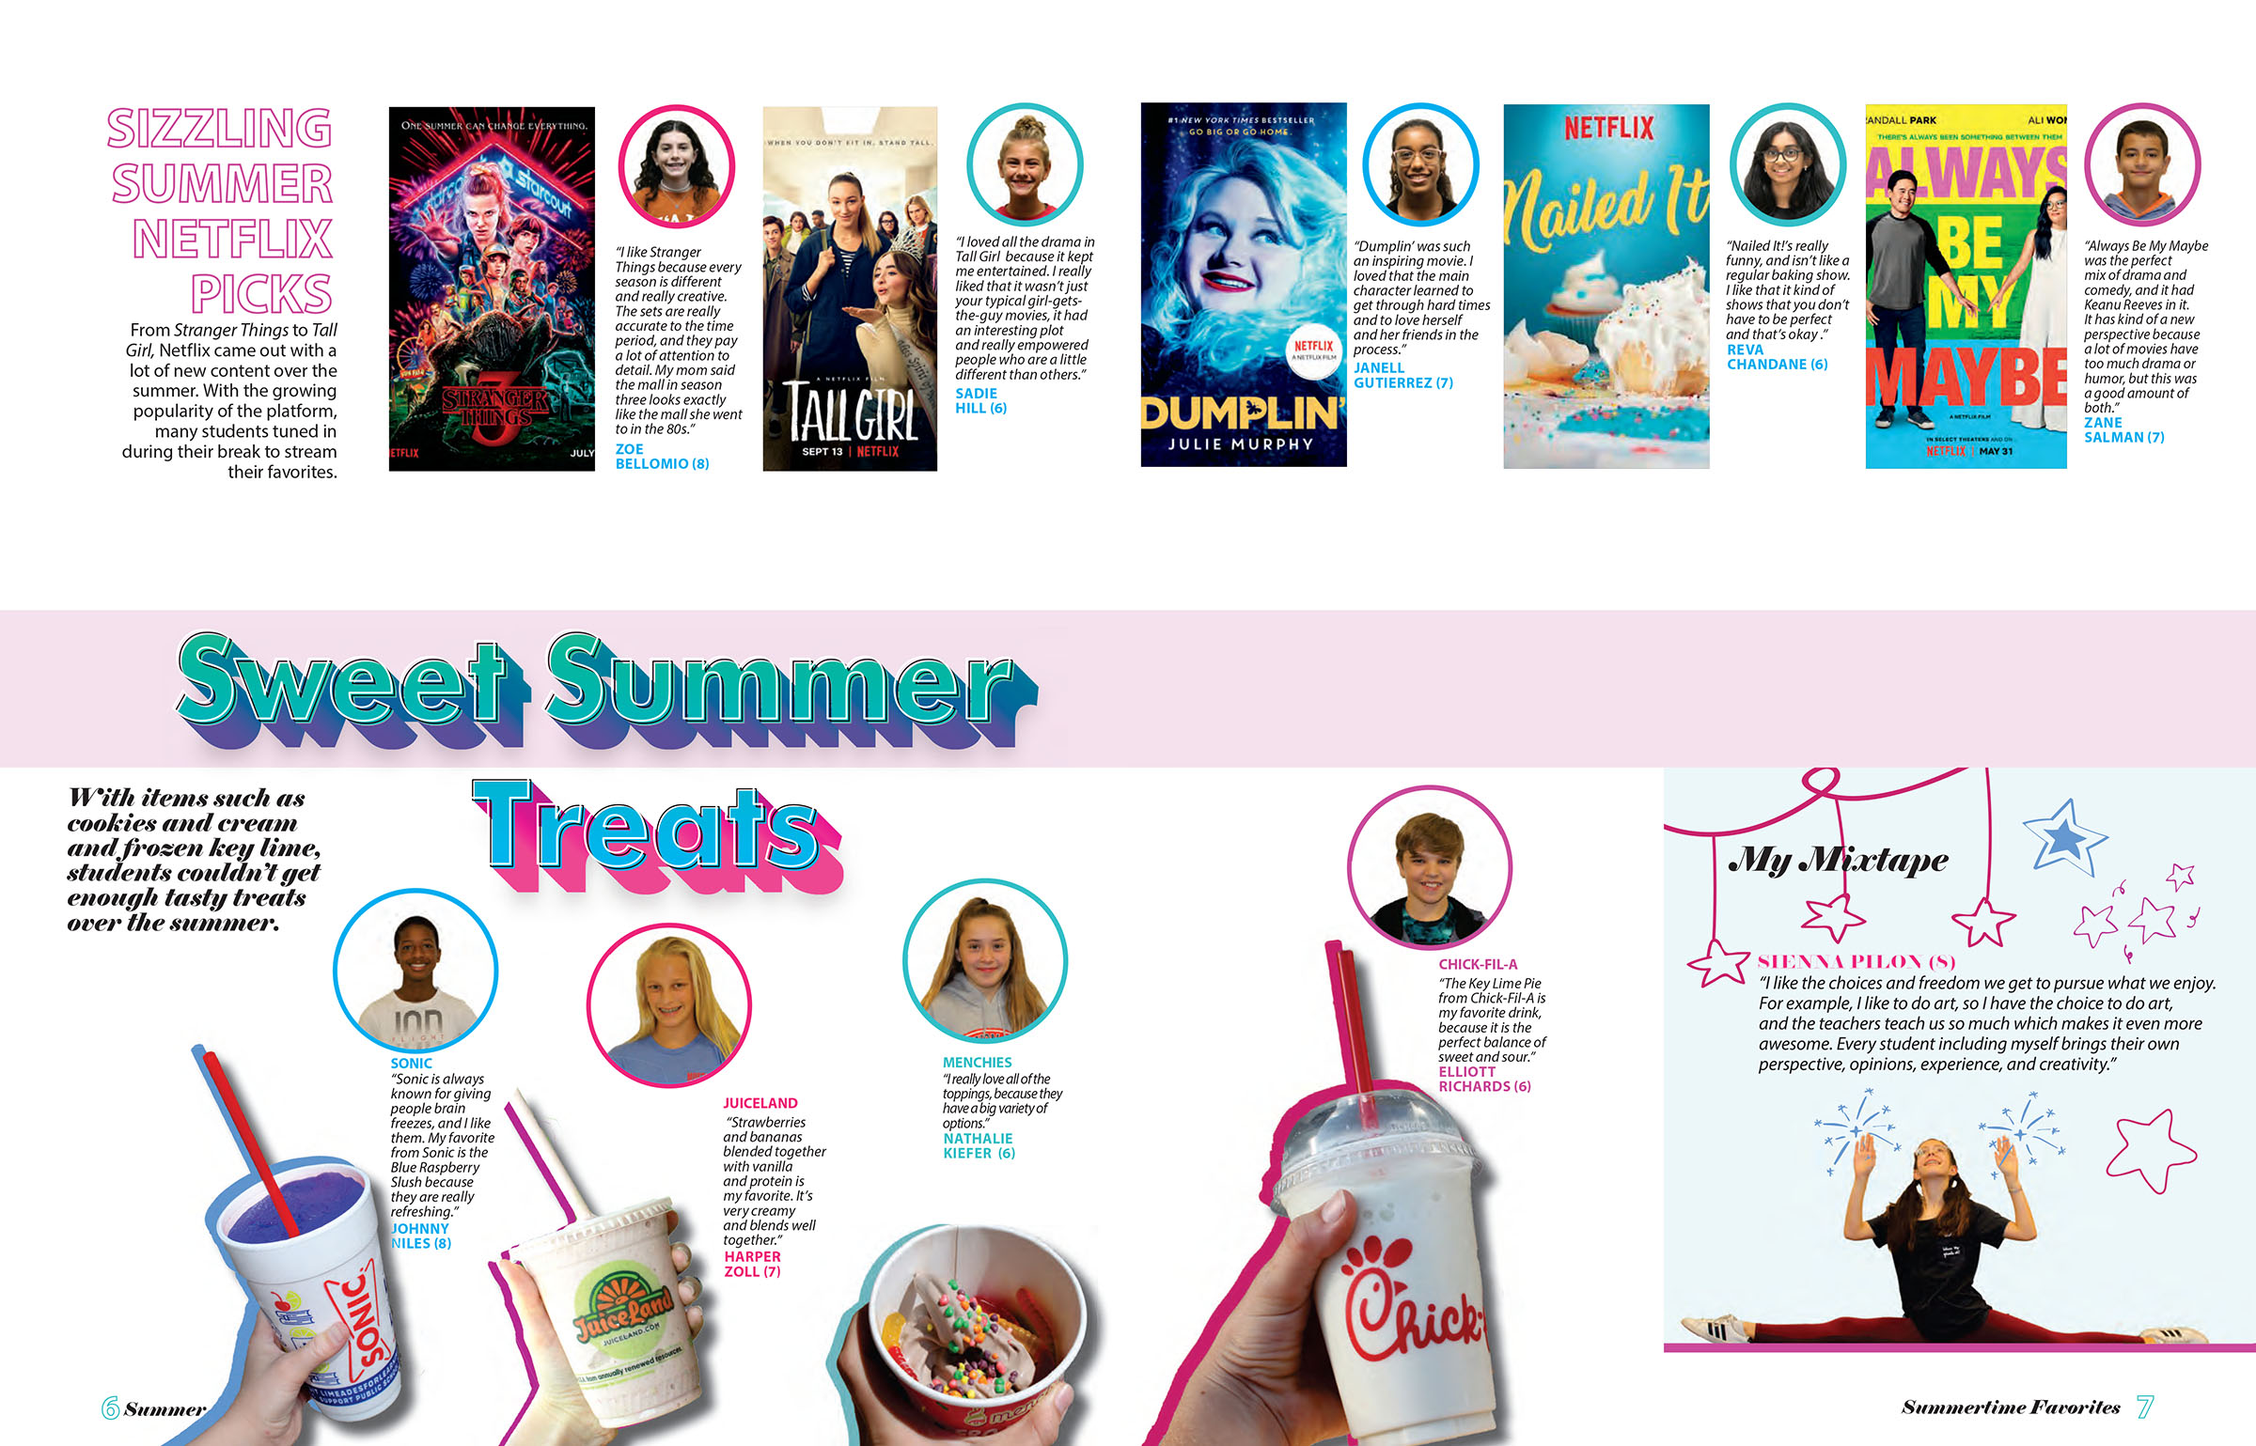
Canyon Vista MS – student life coverage

Slide 49
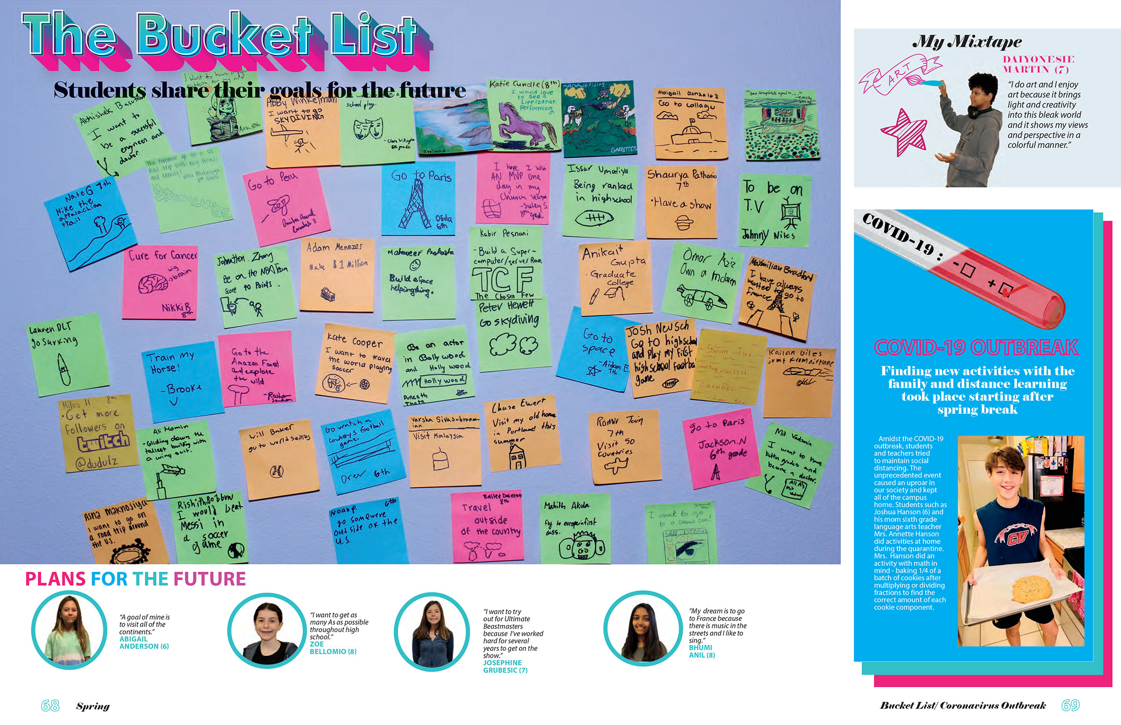
Canyon Vista MS – student life coverage

Slide 50
Canyon Vista MS – academics, first day

Slide 51
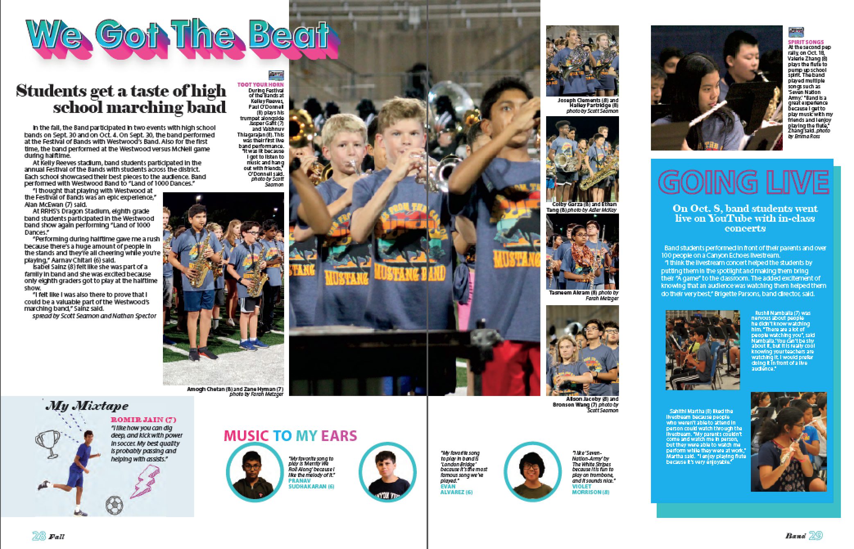
Canyon Vista MS – organizations coverage

Slide 52
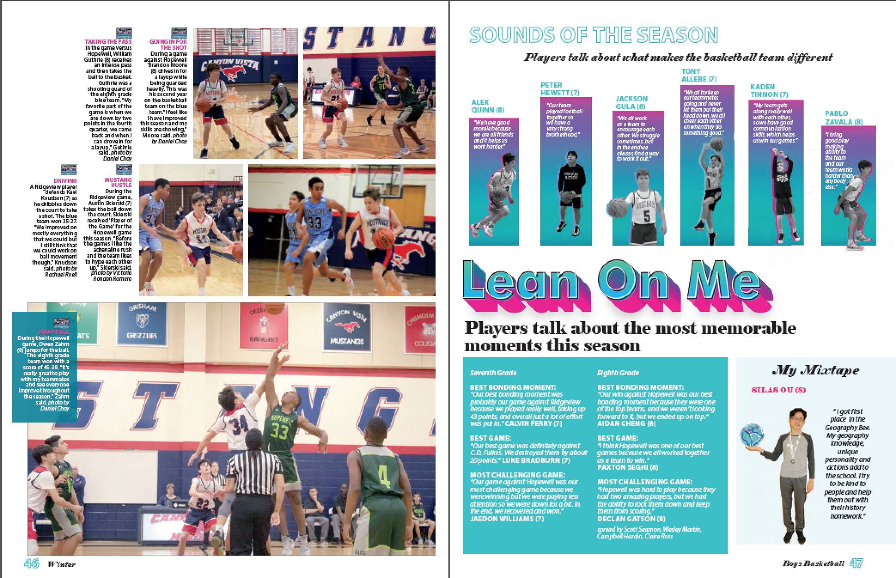
Canyon Vista MS – sports coverage

Slide 53
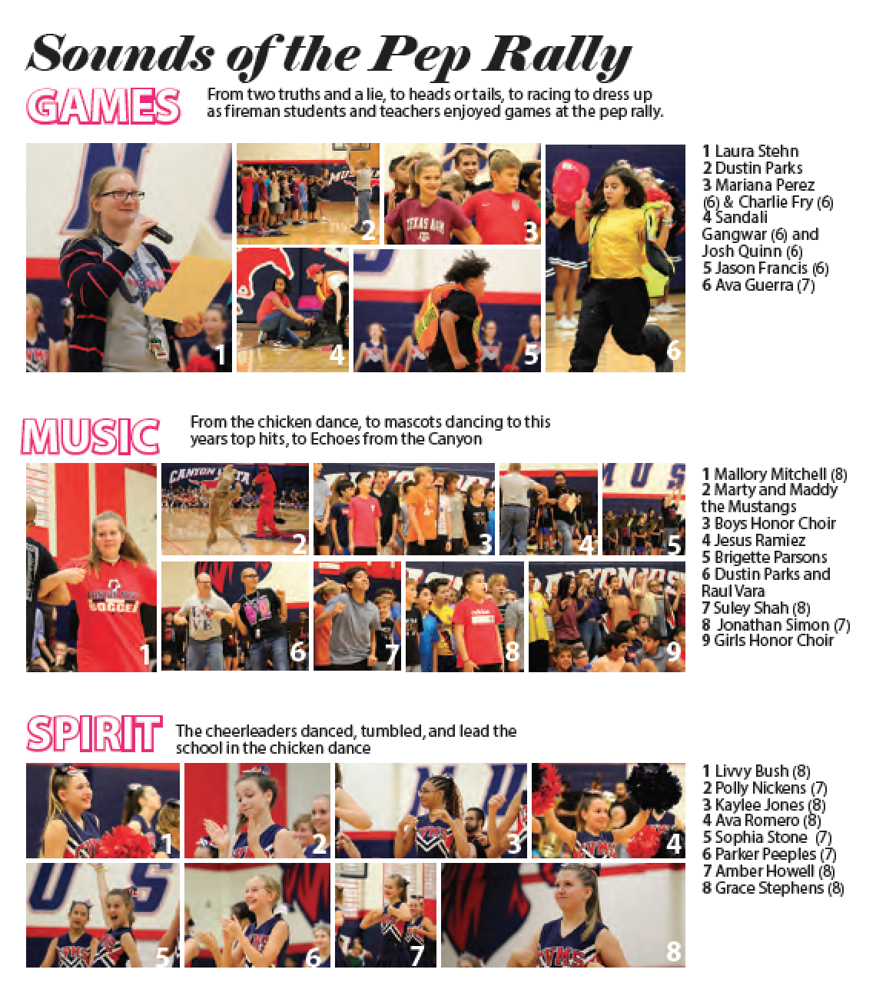
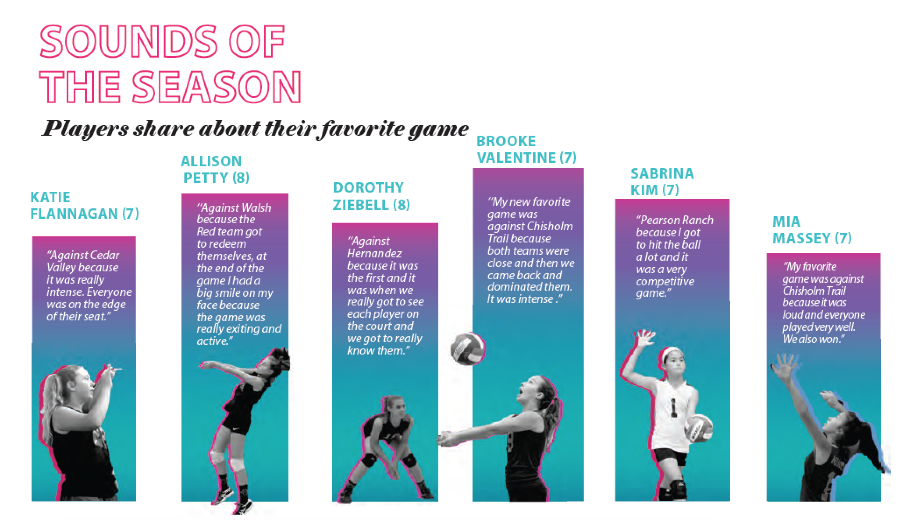
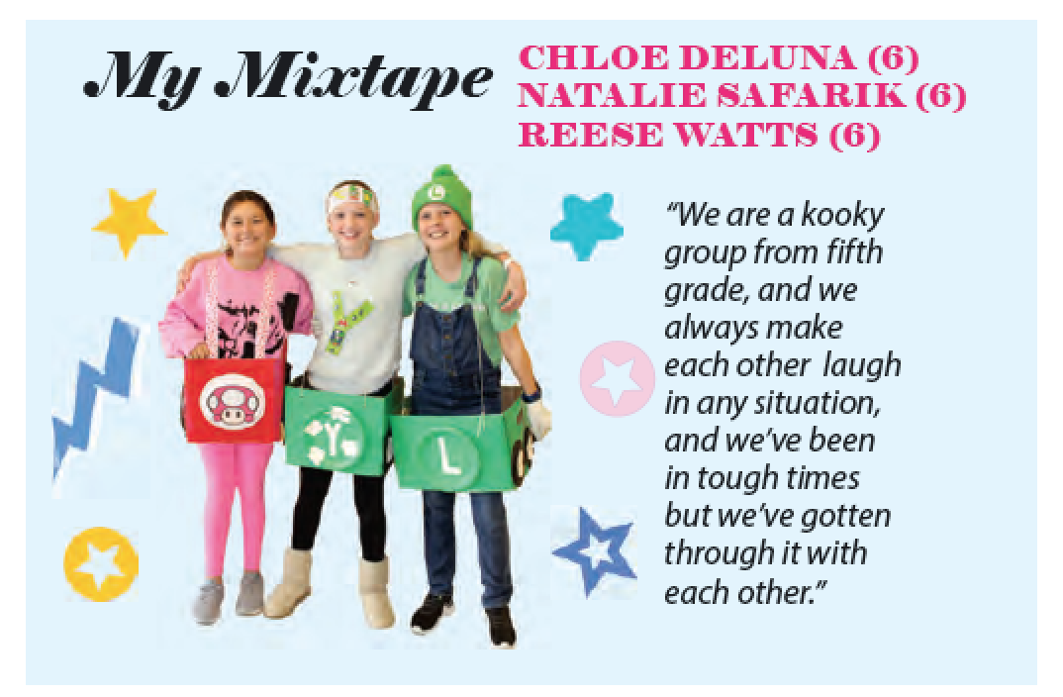
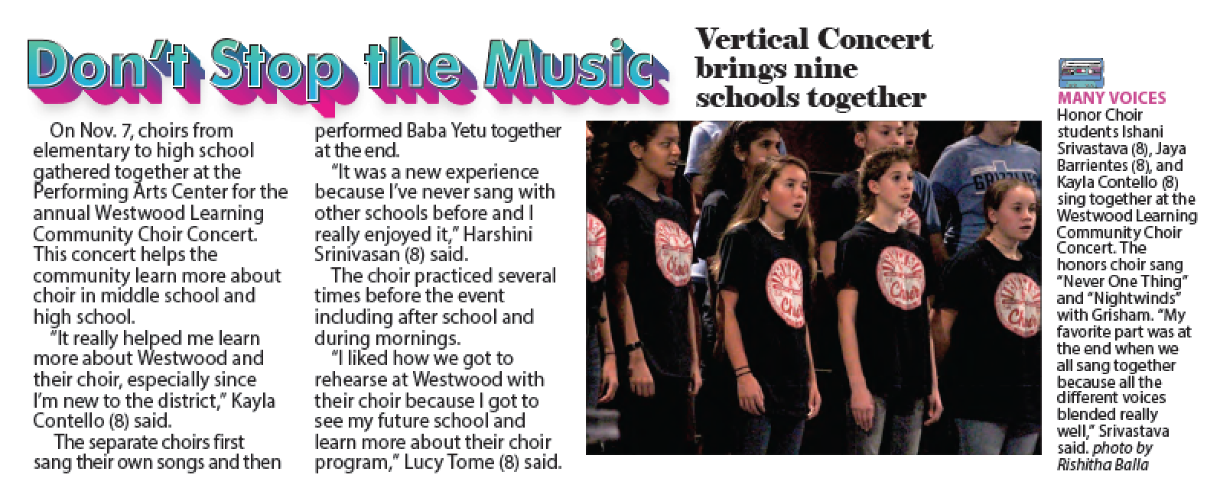
Canyon Vista MS – visual/verbal connections

Slide 54
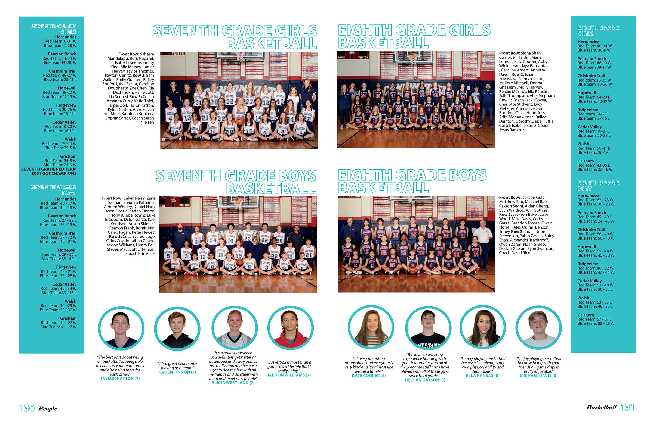
Canyon Vista MS – reference

Slide 55
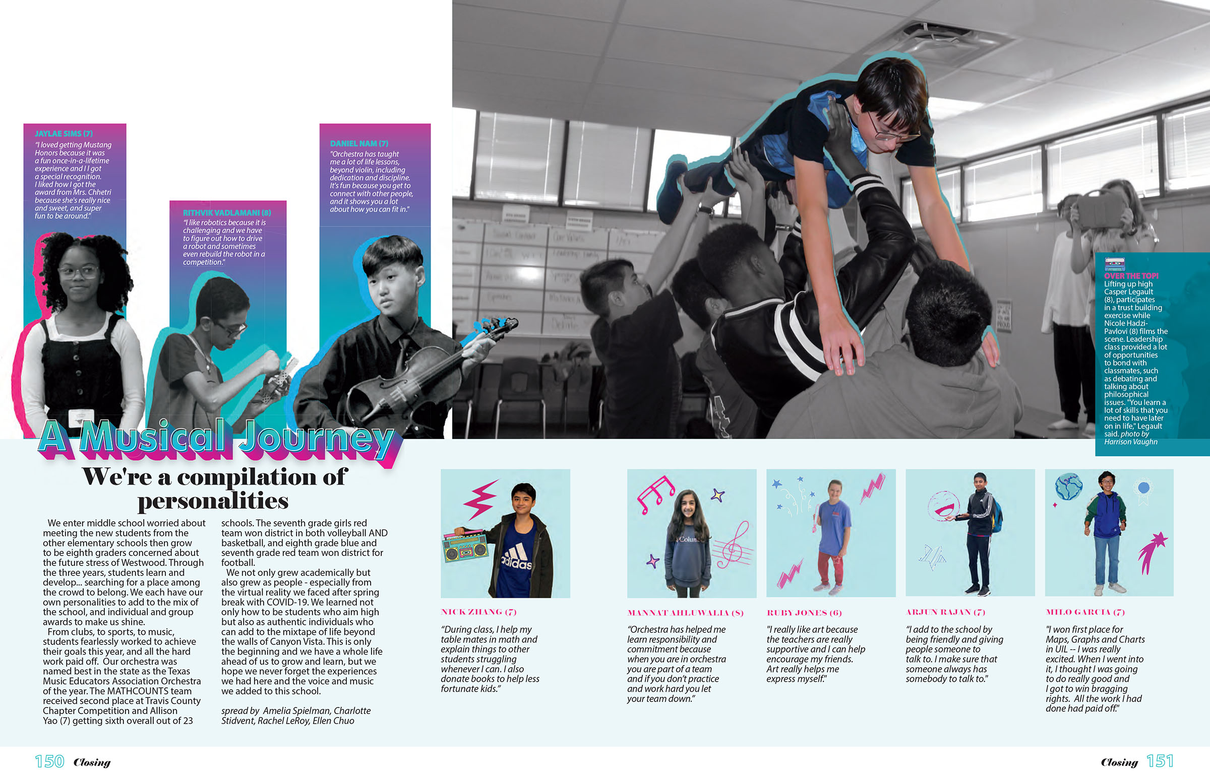
Canyon Vista MS – closing

Slide 56
Start with an
idea.

Slide 57
Develop it by answering a few
questions.

Slide 58
Theme questions
Why that theme?
What three words describe the tone/personality of the theme?
What is new/different/noteworthy this year? (becomes coverage ideas)
What are students talking about? (Trends, current events, school events—become coverage ideas)
Using the theme word or phrase, what phrases play off the theme verbally? (becomes headline & coverage ideas for modules)
What other phrases play off the theme without using the exact word or phrase? (becomes headline & coverage ideas for modules)

Slide 59
If you can’t answer these questions,
Try another idea.

Slide 60
Theme plan should include:
Theme phrase
Graphics
Color palette
Fonts
Verbal connections
Coverage connections

