Slide 1
DOWN TO THE
Detail

Slide 2
The details take you from good to
great!

Slide 3
INDEX

Slide 4
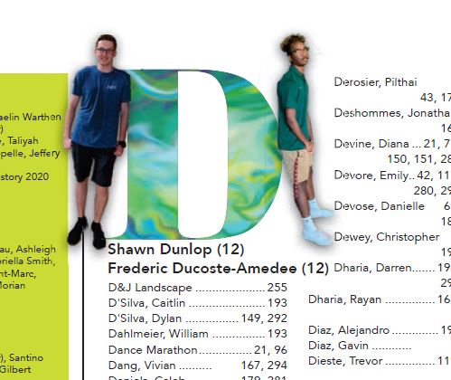
INDEX
Add images with index division letters to feature more students

Slide 5
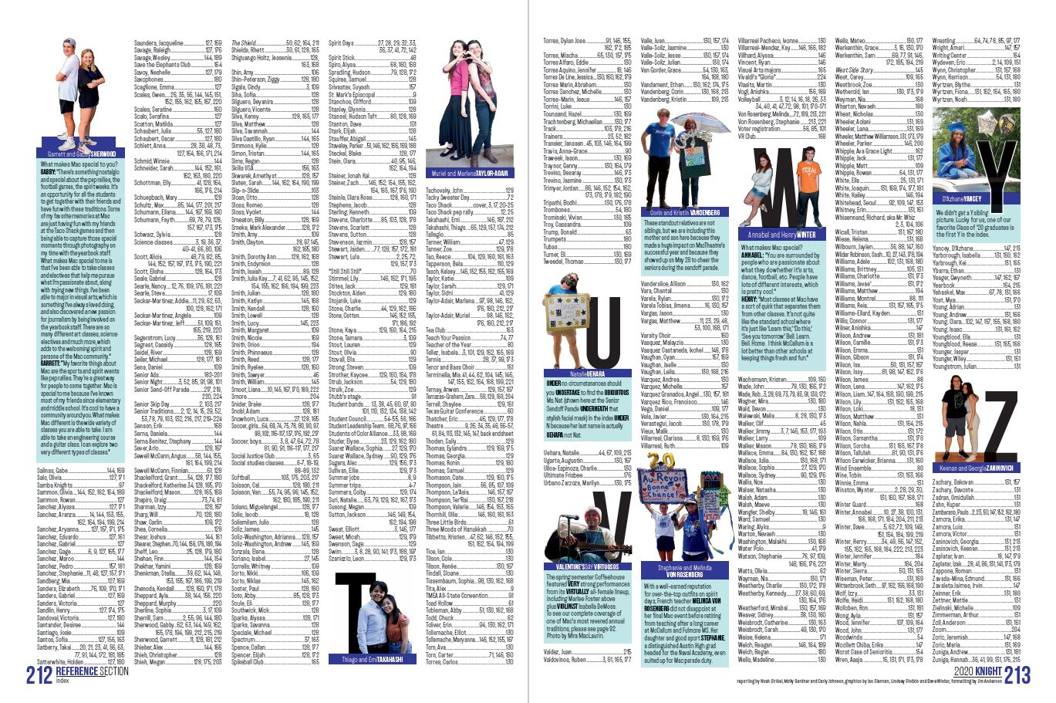
INDEX
Add images with index division letters to feature more students

Slide 6
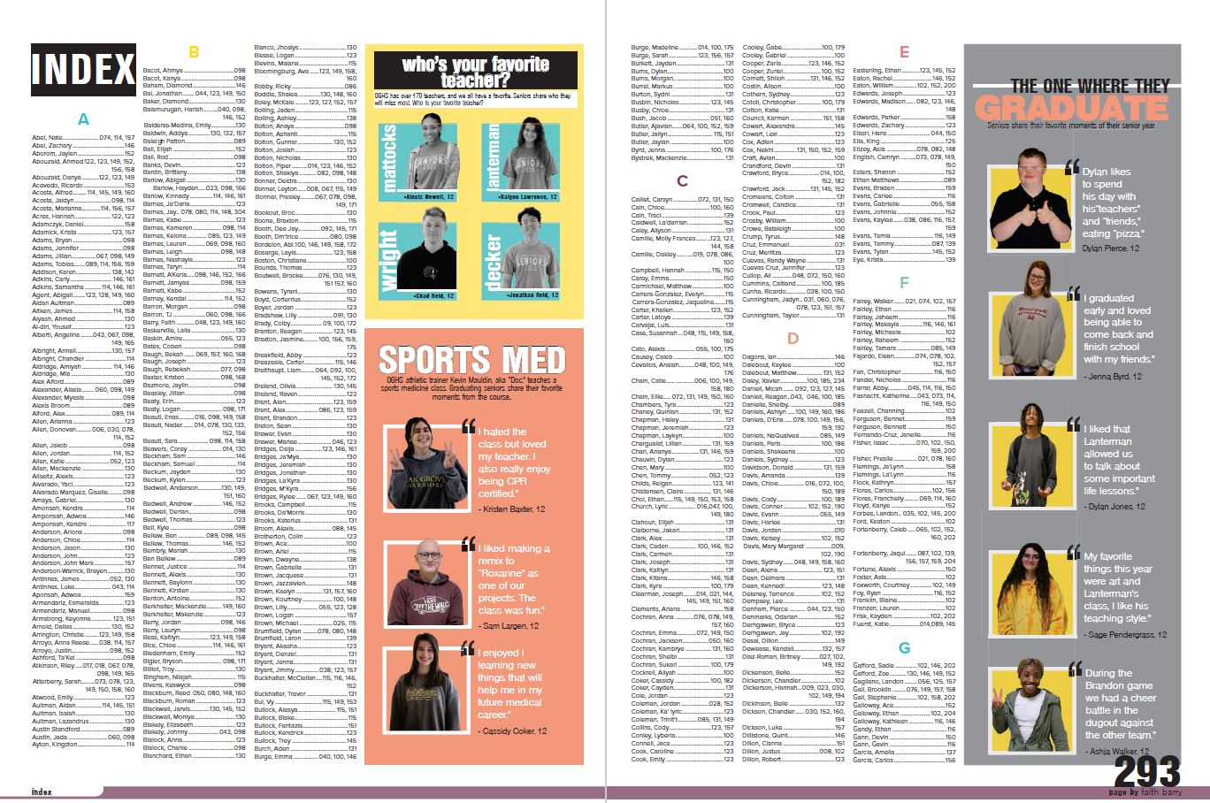
INDEX
Add secondary coverage modules for additional coverage

Slide 7
INDEX
Add secondary coverage modules for additional coverage

Slide 8
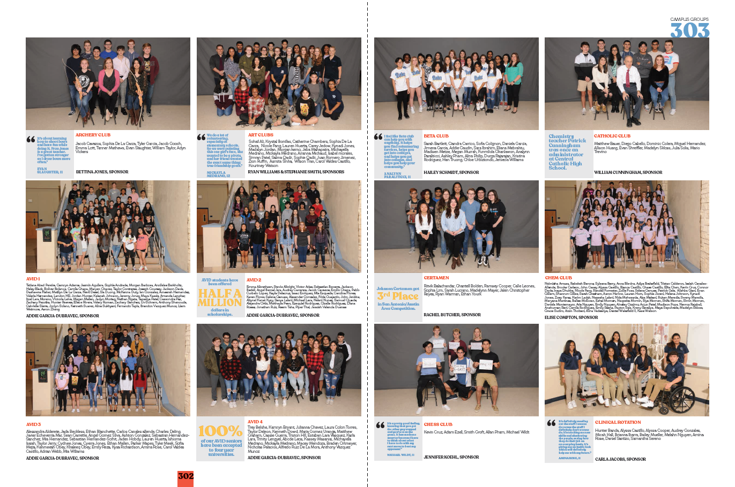
GROUP SHOTS

Slide 9
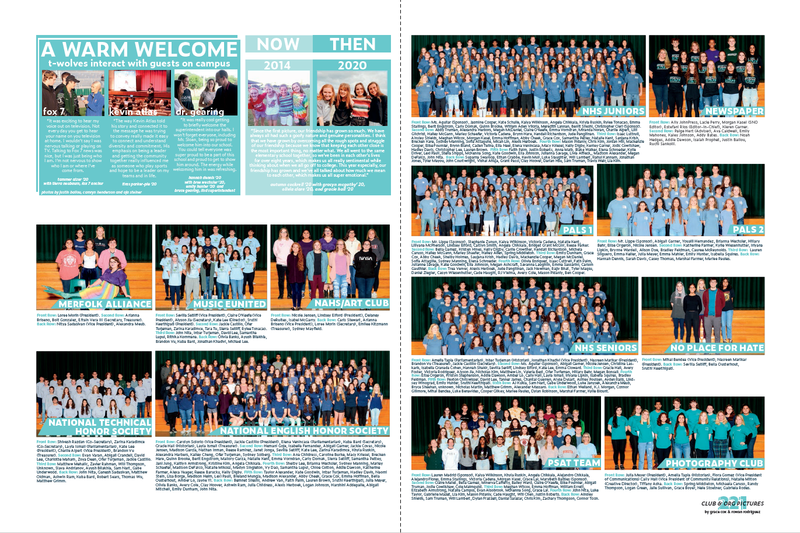
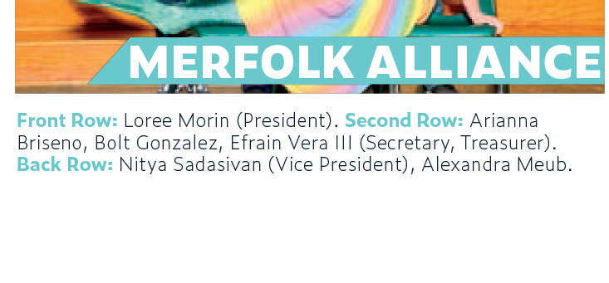
GROUP SHOTS
GROUP ident
ROW DESIGNATIONS

Slide 10
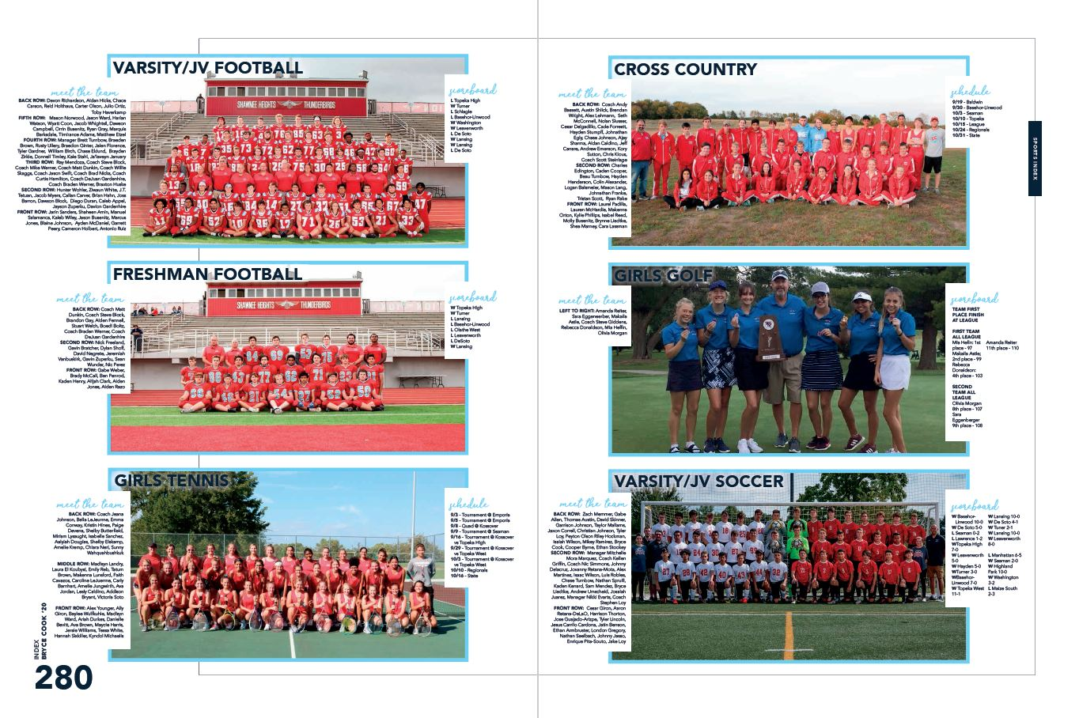
GROUP SHOTS

Slide 11
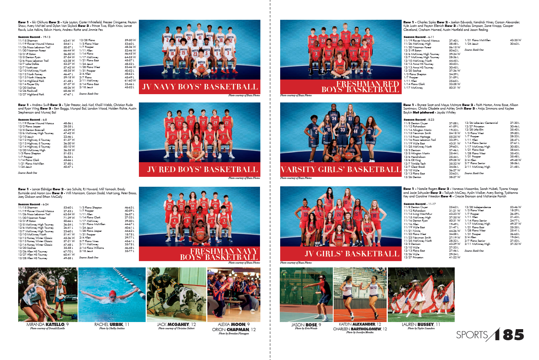
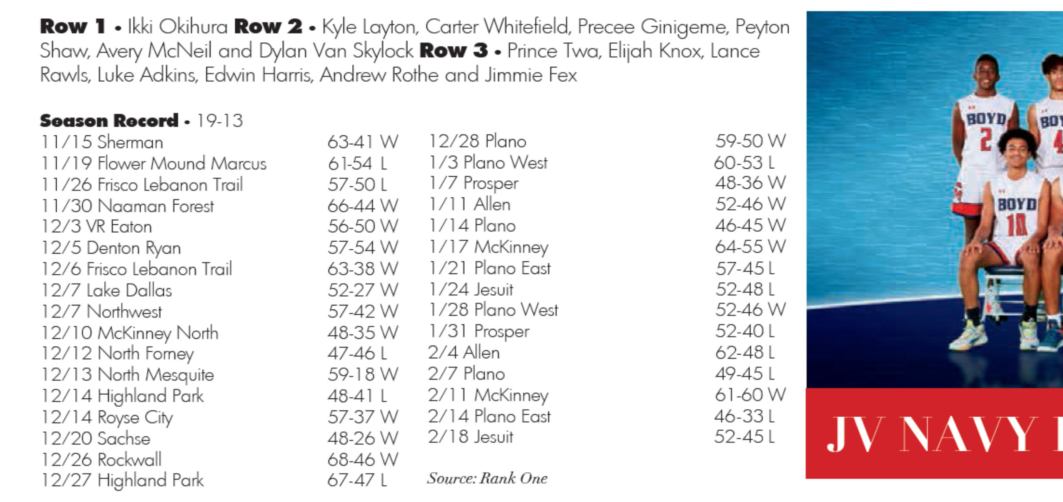
GROUP SHOTS & SCOREBOARDS
W/L after score
Winning score first
Redundant to say 53-60 L

Slide 12
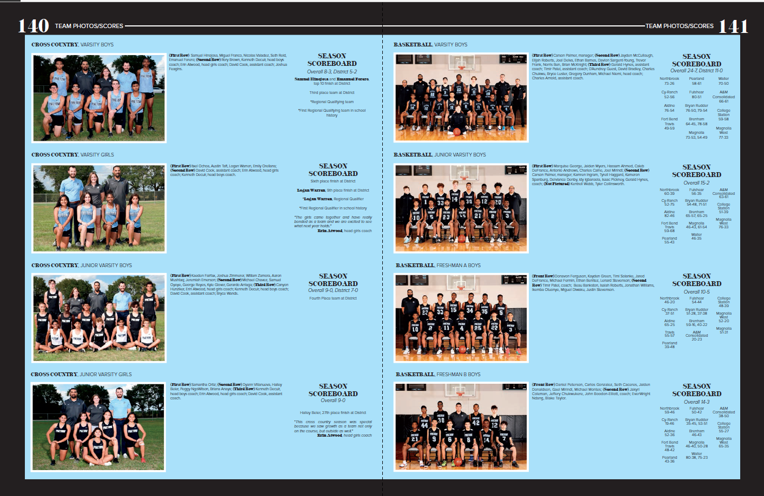
GROUP SHOTS & SCOREBOARDS

Slide 13
THE TABLE OF CONTENTS

Slide 14
THE TABLE OF CONTENTS

Slide 15
THE TABLE OF CONTENTS

Slide 16
THE TABLE OF CONTENTS

Slide 17
FOLIOS

Slide 18
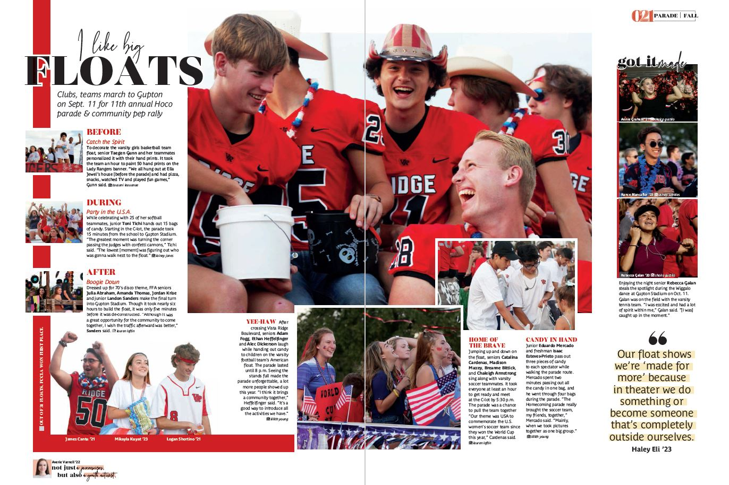
FOLIOS (top placement)

Slide 19
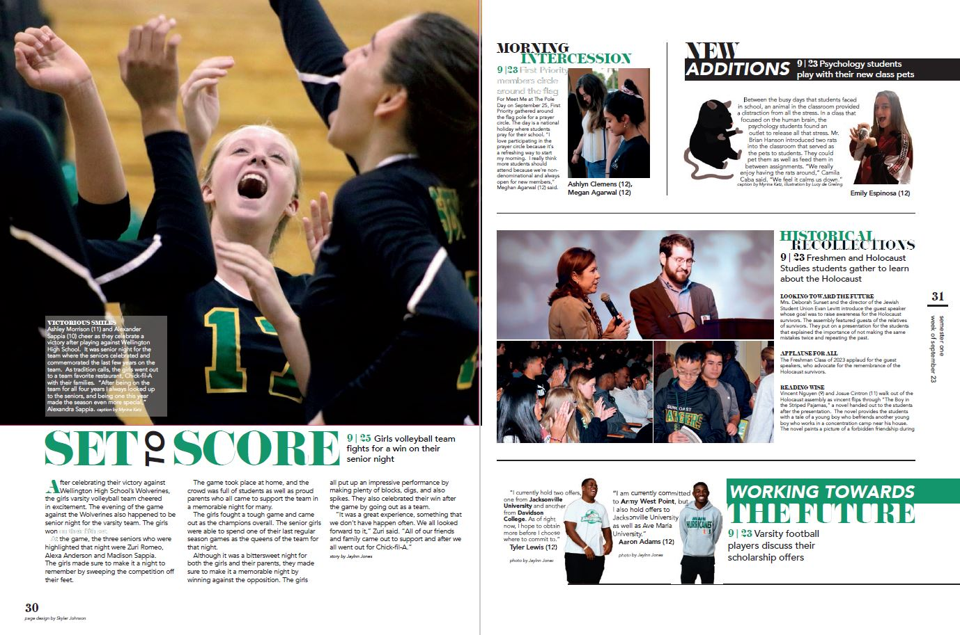
FOLIOS (side placement)

Slide 20
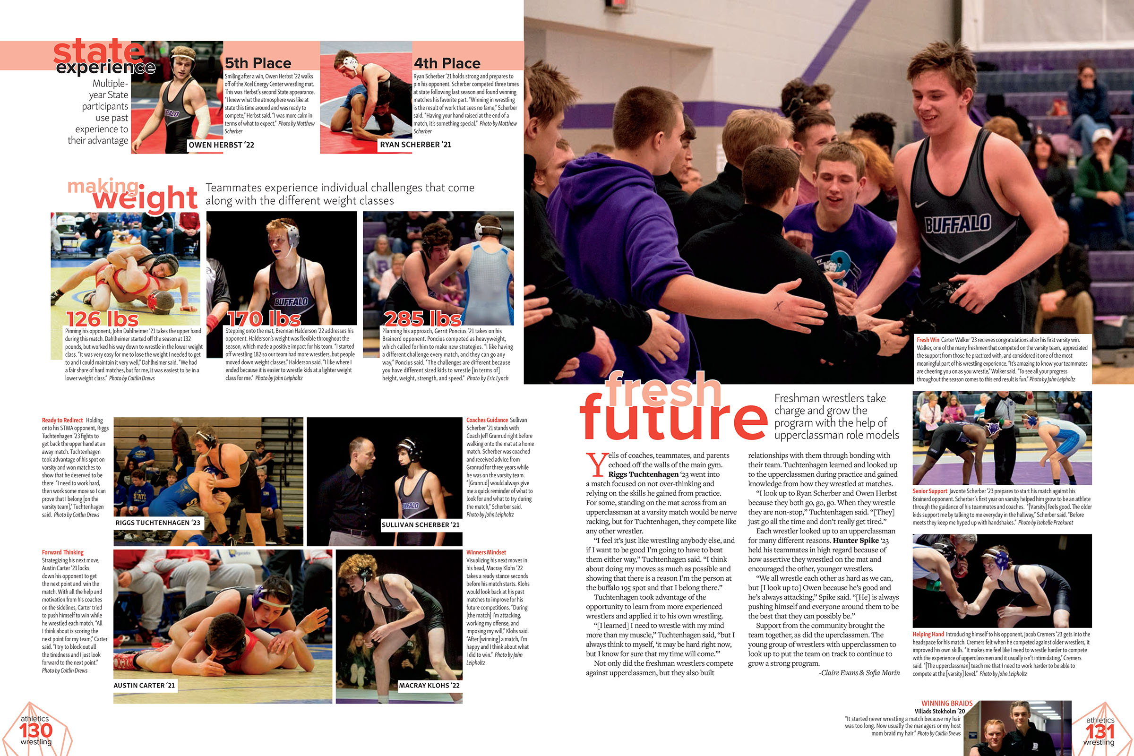
FOLIOS
bottom placement)

Slide 21
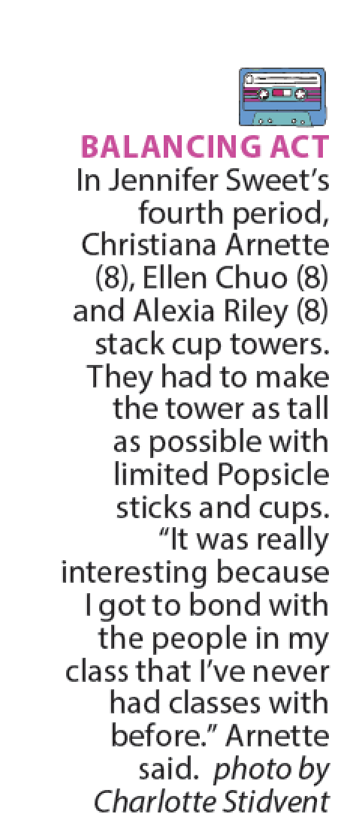
CAPTION DESIGN

Slide 22
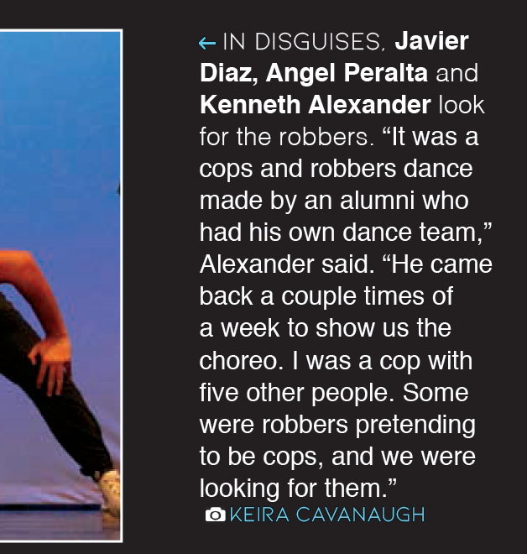
CAPTION DESIGN

Slide 23
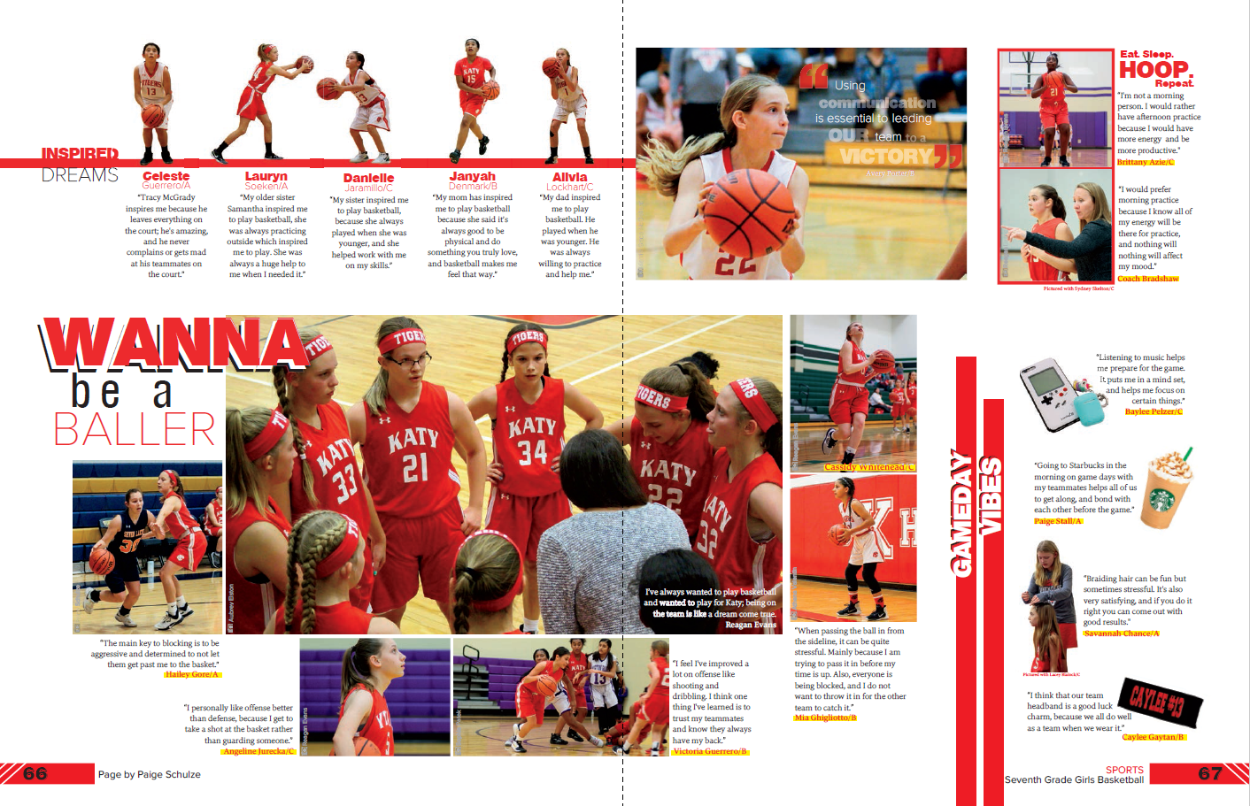
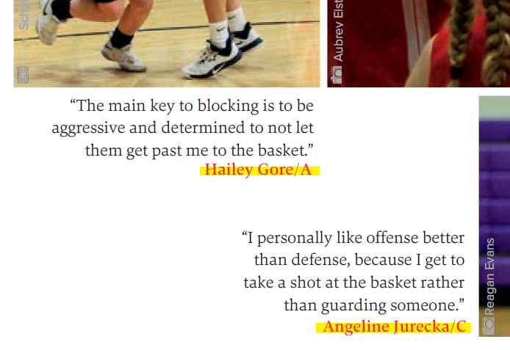
CAPTION DESIGN

Slide 24
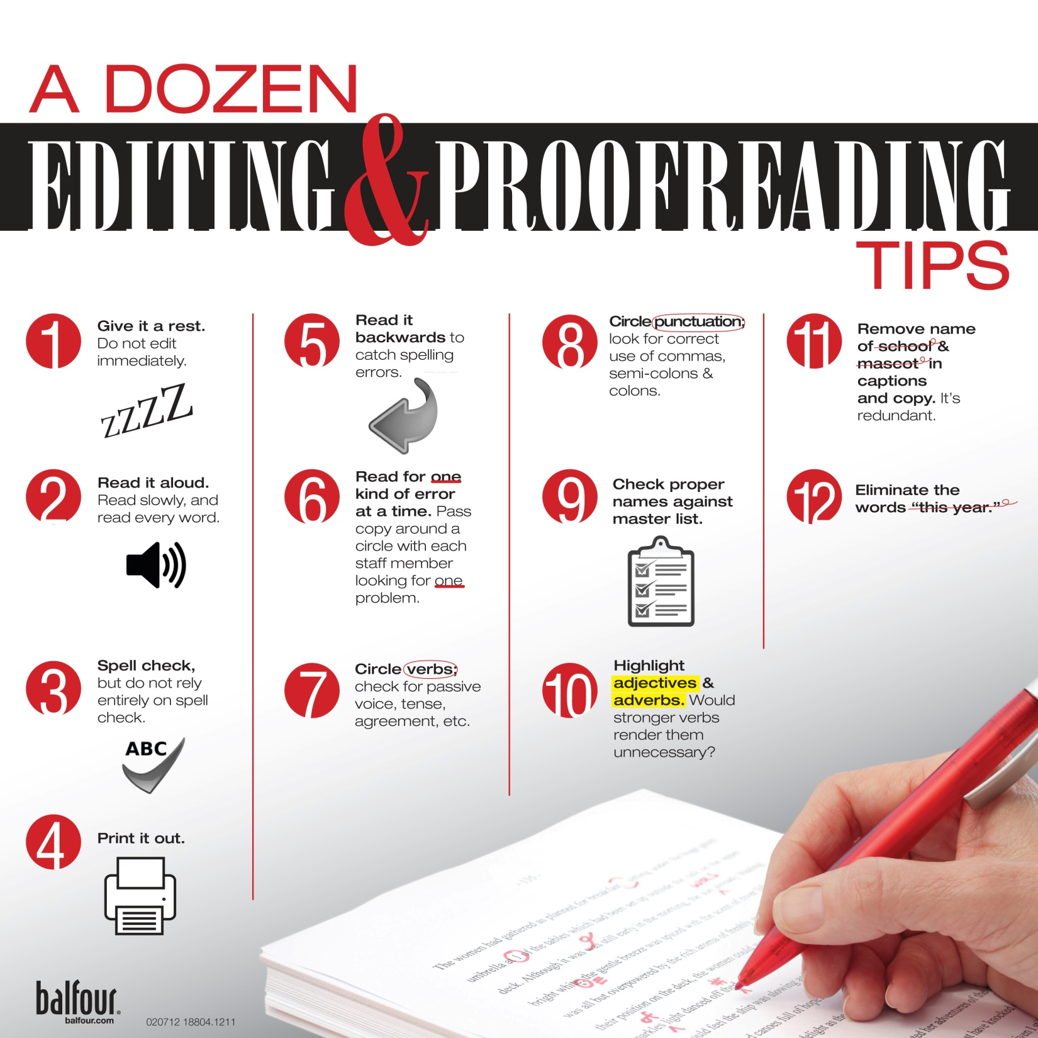
SPELLING, ESPECIALLY NAMES

Slide 25
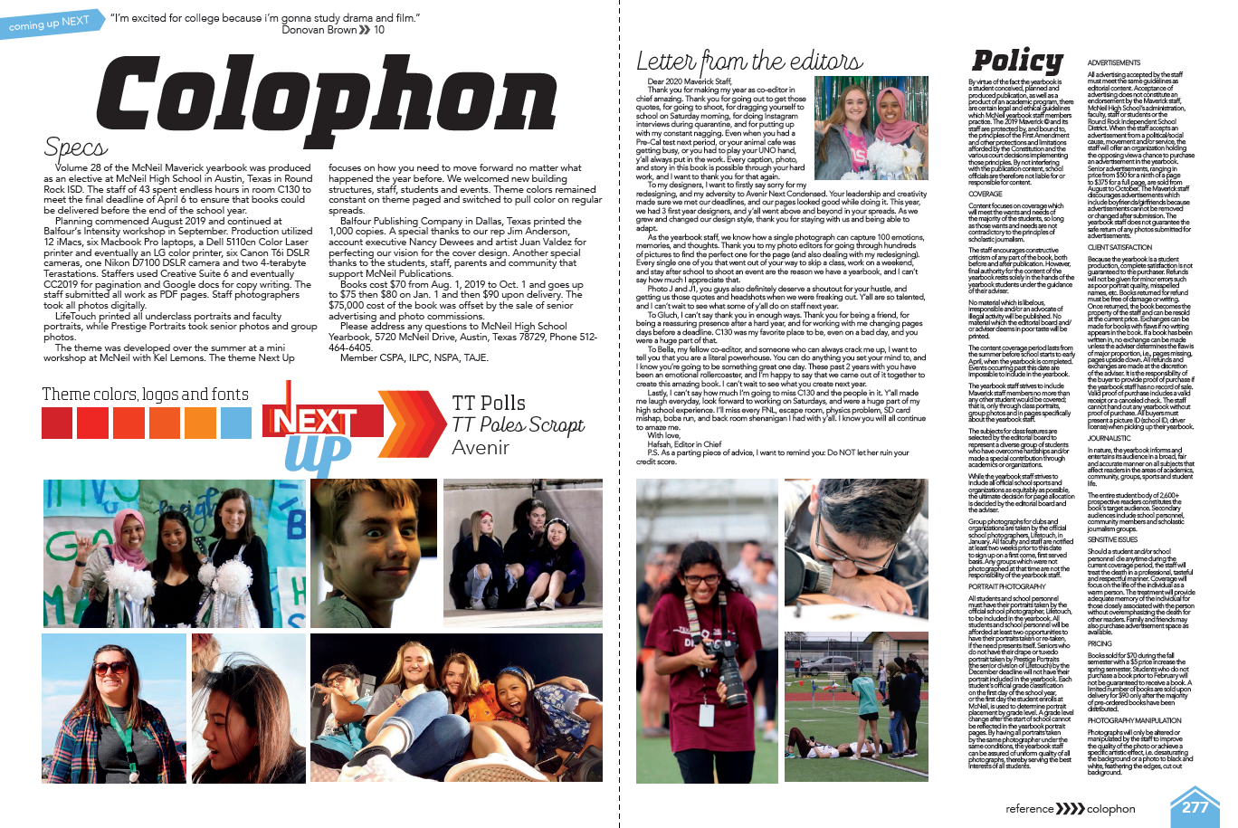
POLICIES

Slide 26
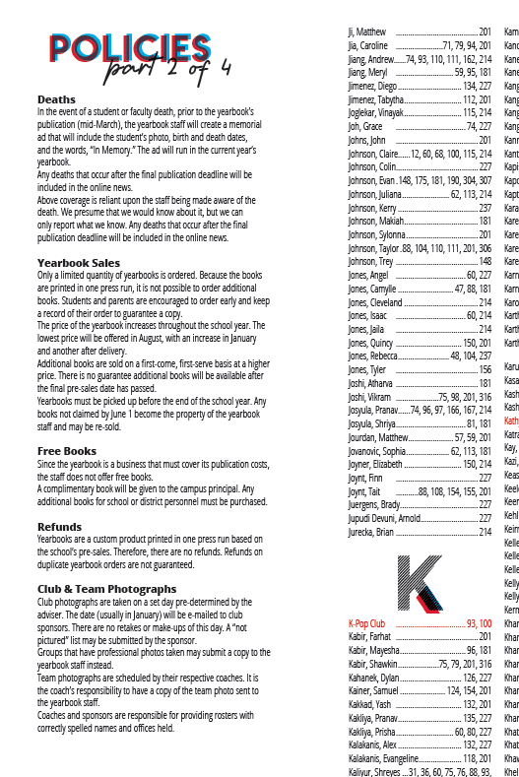
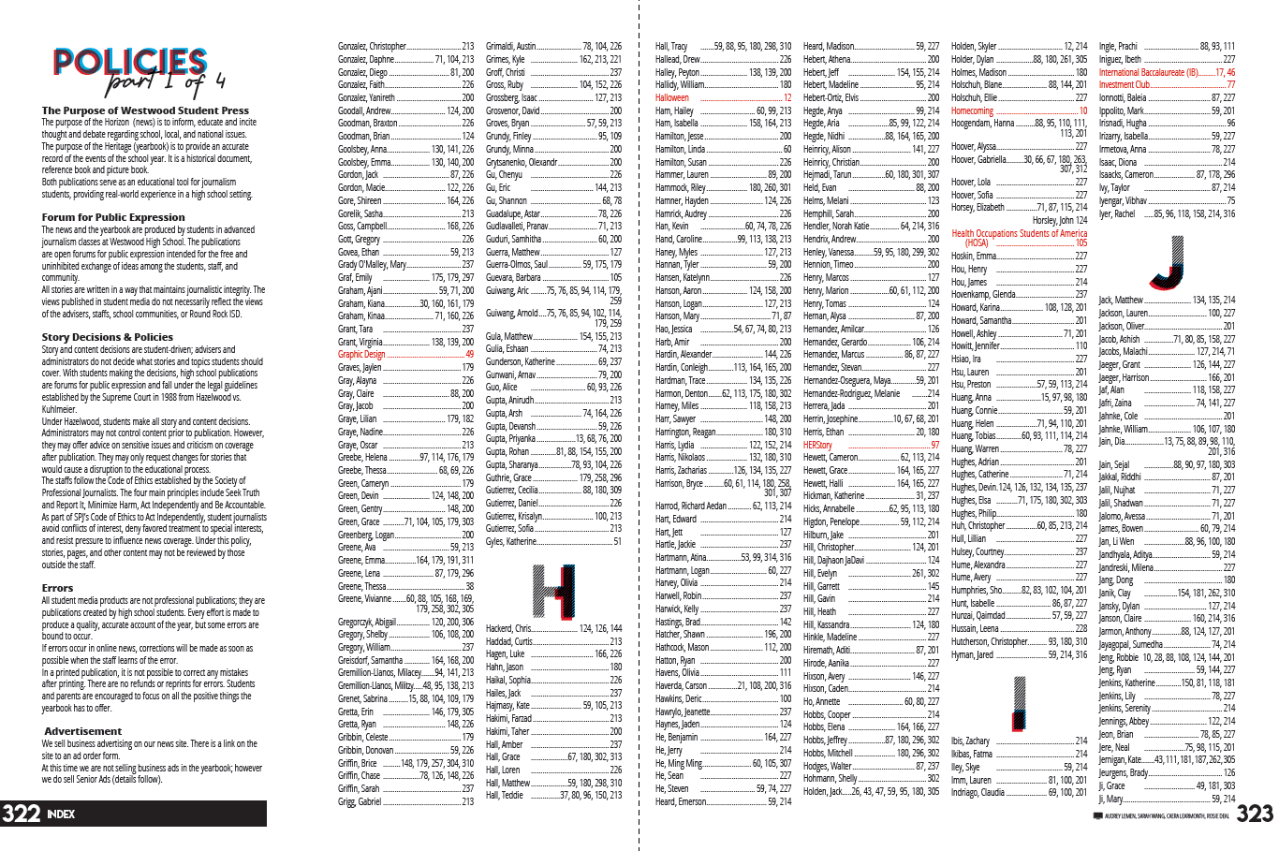
POLICIES

Slide 27
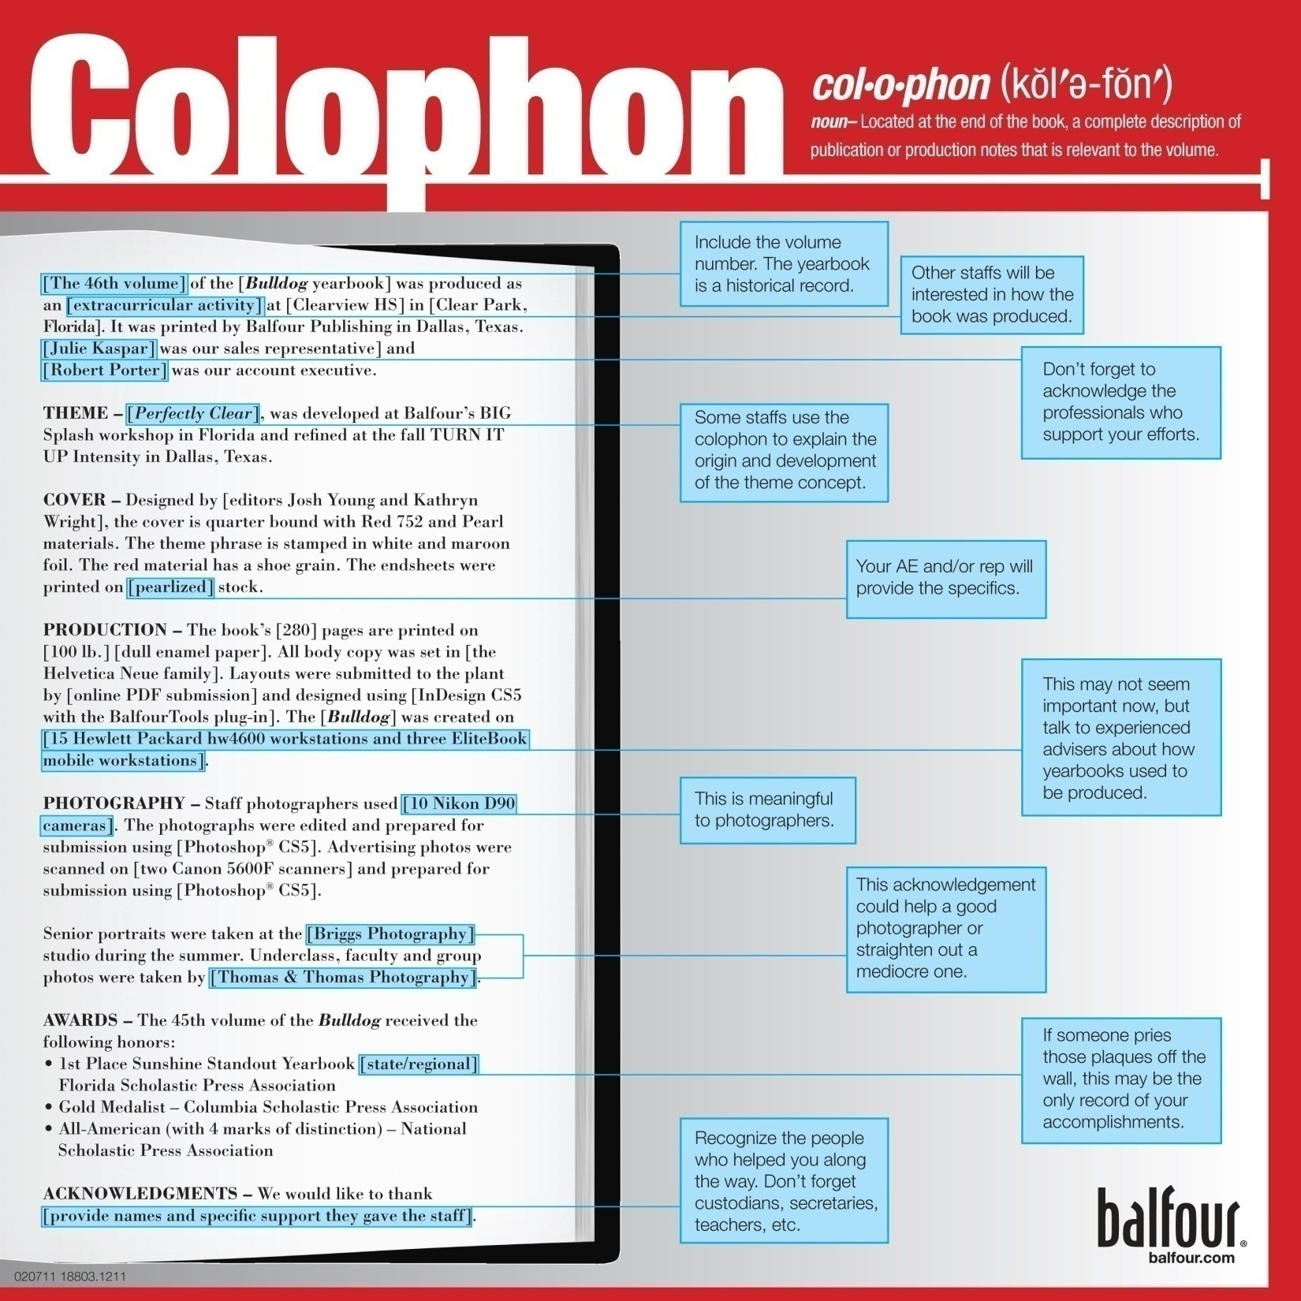
COLOPHON

Slide 28
COLOPHON

Slide 29
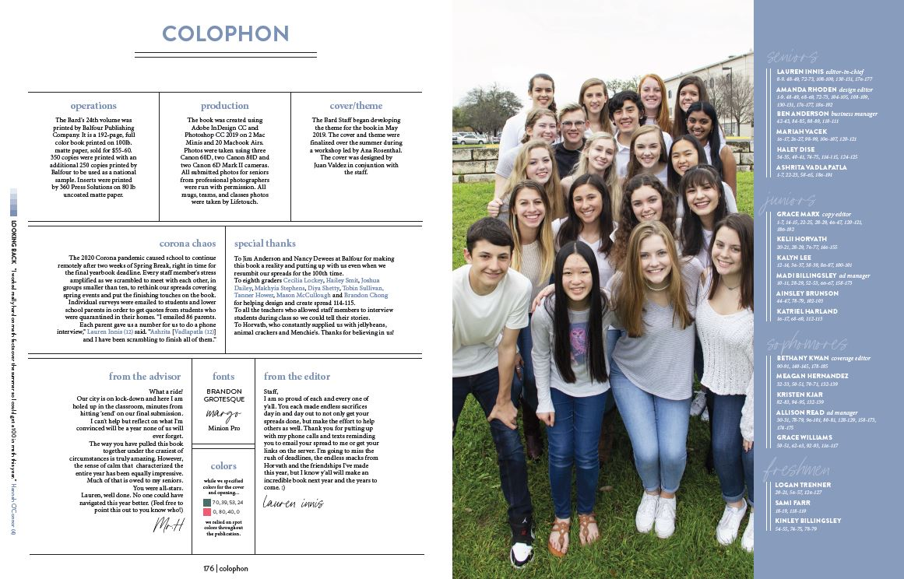
COLOPHON

Slide 30
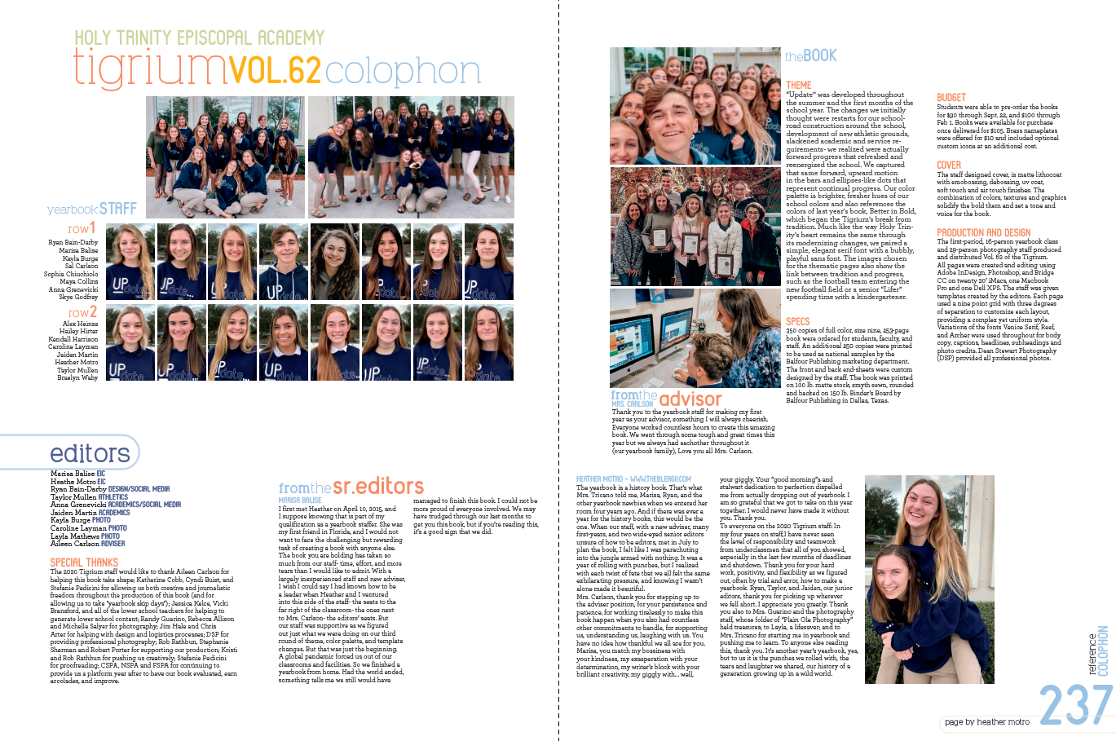
COLOPHON

Slide 31
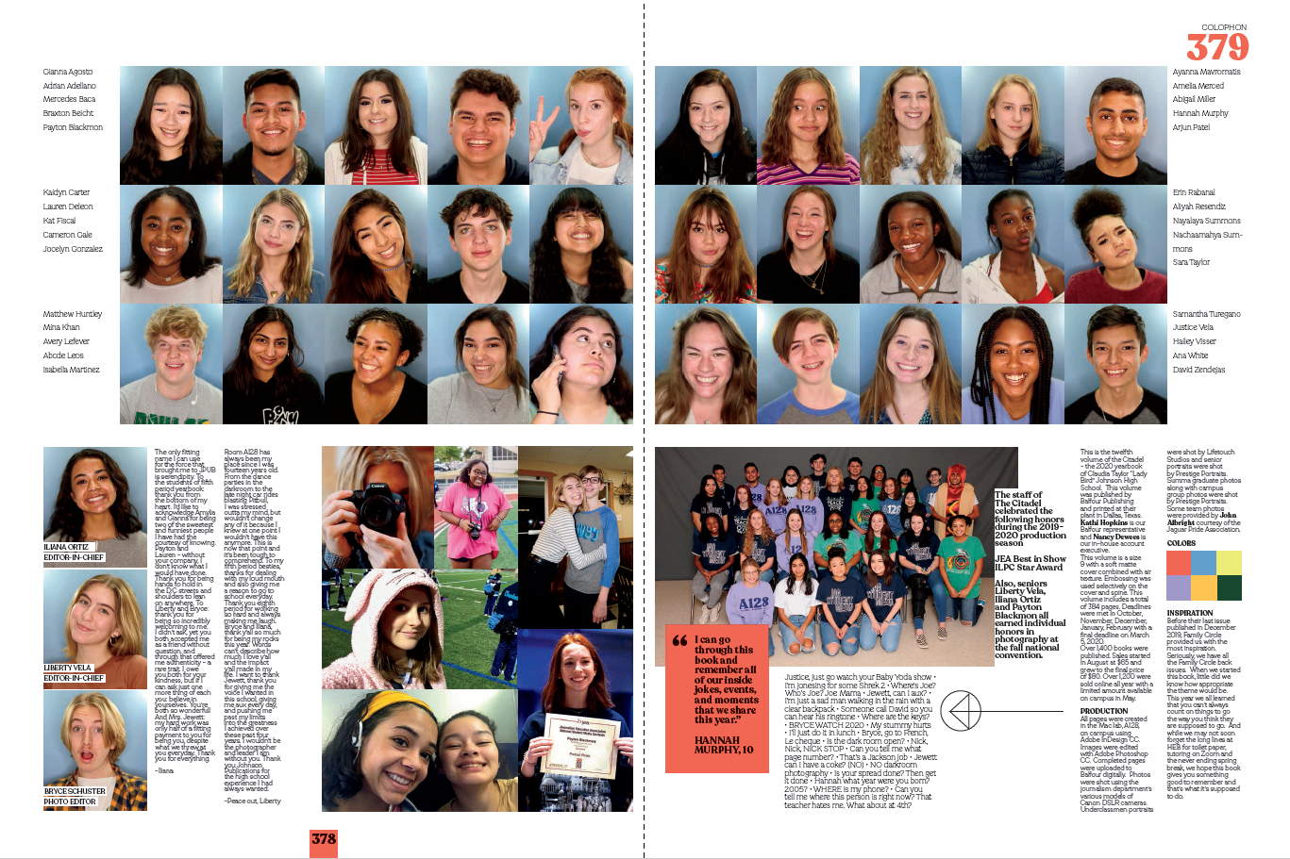
COLOPHON

Slide 32
COLOPHON

Slide 33
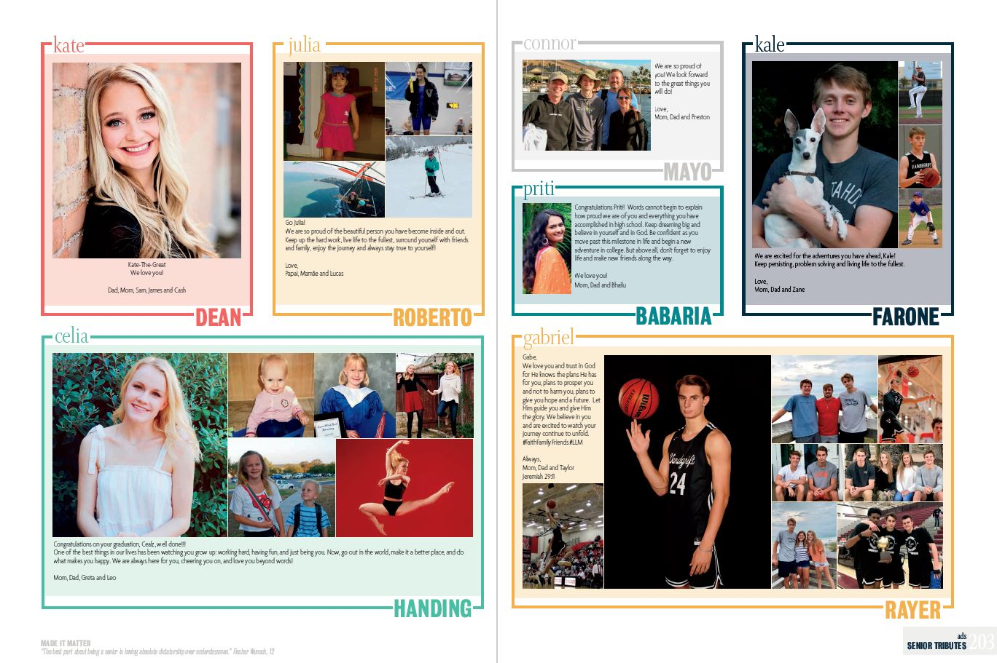
ADVERTISING/SENIOR ADS

Slide 34
ADVERTISING/SENIOR ADS

Slide 35
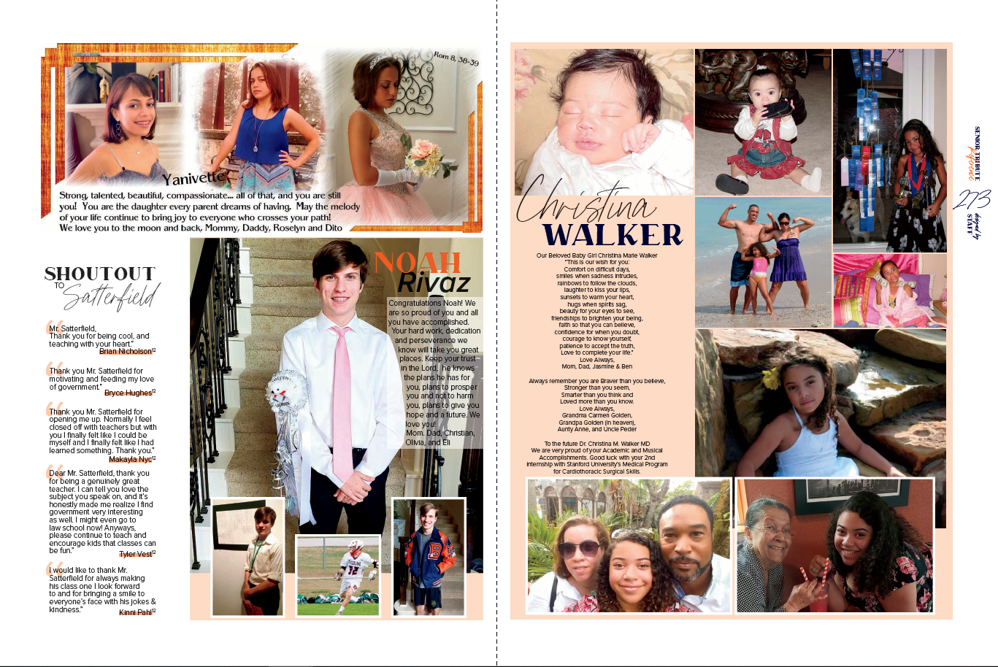
ADVERTISING/SENIOR ADS

Slide 36
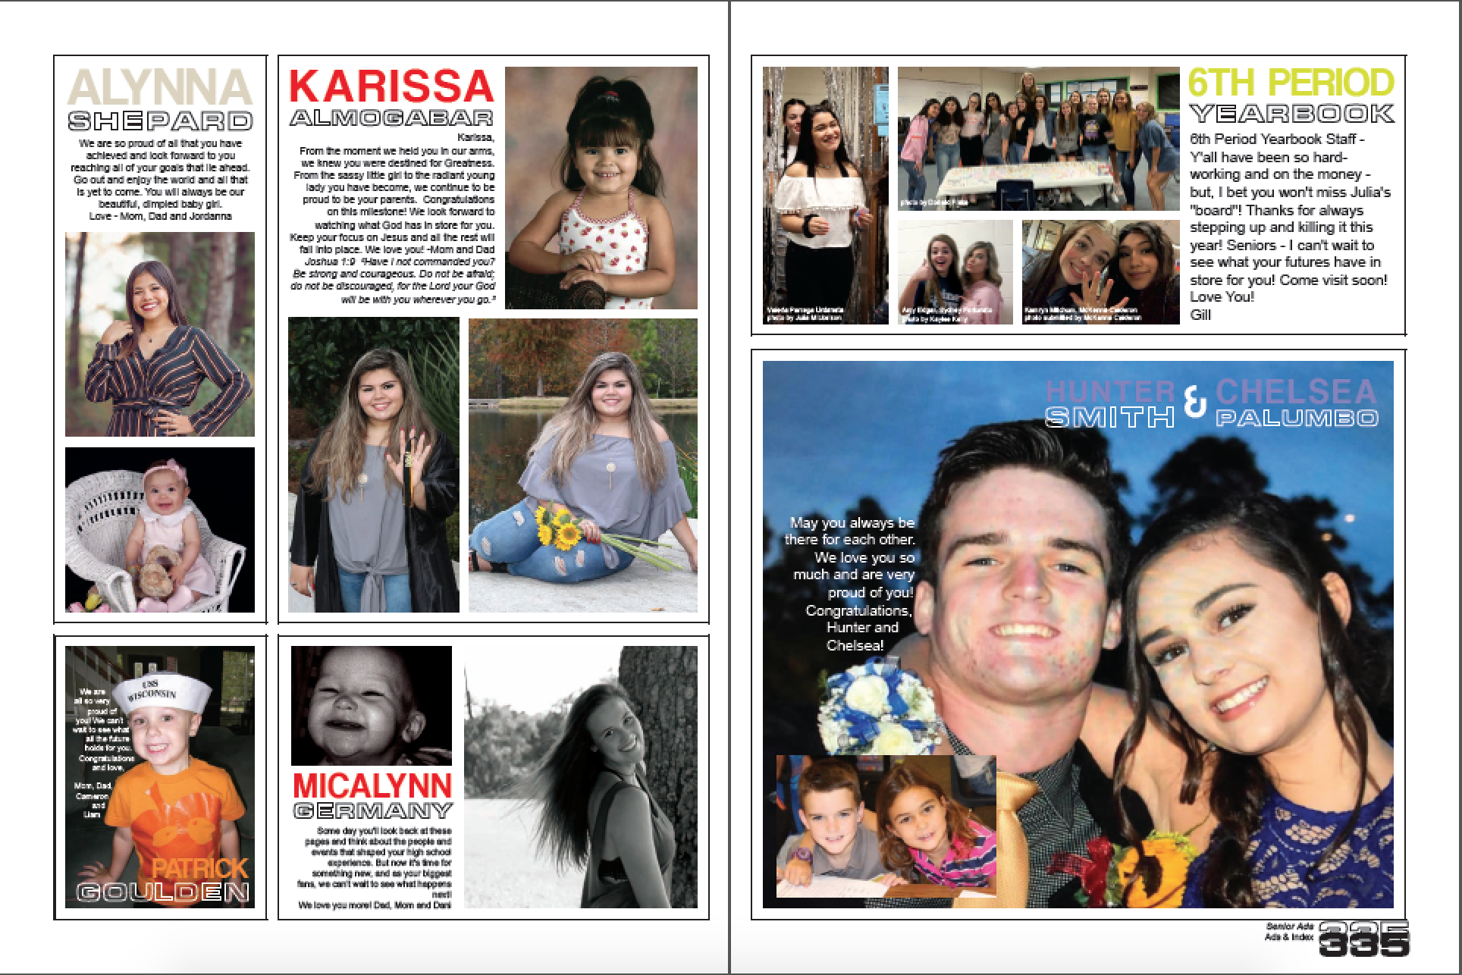
ADVERTISING/SENIOR ADS
Increase revenue with 1/9ths

Slide 37
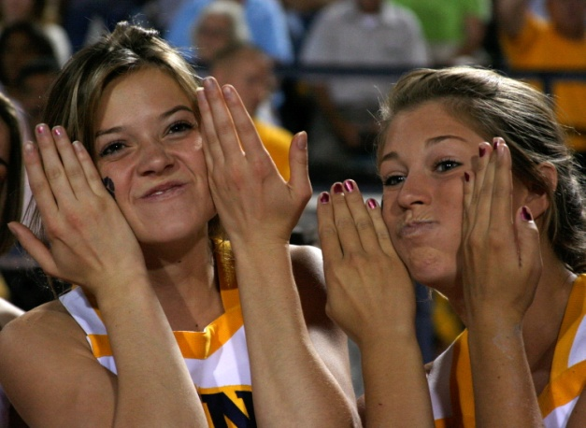
Photo Credits
Choose one style
photo by Justin Black
photo by Justin Black
With a time-out on their hands, senior cheerleaders Jessica Rehms and Carrie Smythe make fish faces. The team was ahead in the fourth quarter. “This was our tradition to taunt the freshmen,” Smythe said. “Luckily, no one in the stands could see or hear us.”
photo by Justin Black

Slide 38
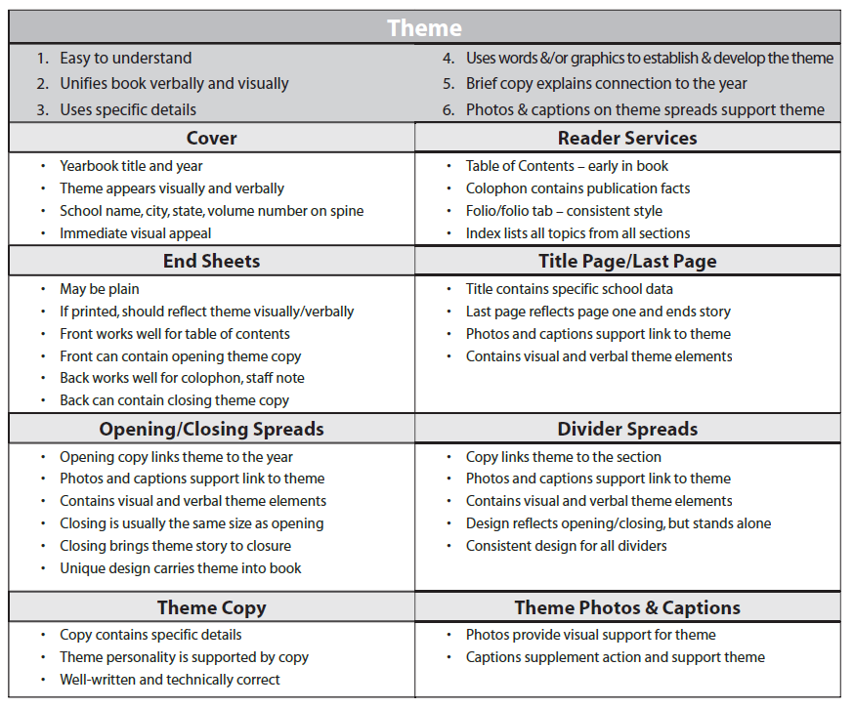
Critiques/Awards
Critical Rating Services handout from the Evaluation section of the Balfour Curriculum

Slide 39
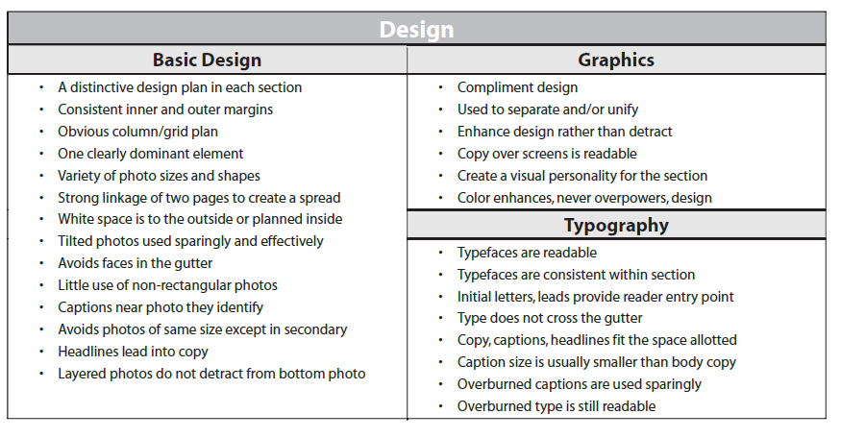
Critiques/Awards
Critical Rating Services handout from the Evaluation section of the Balfour Curriculum

Slide 40
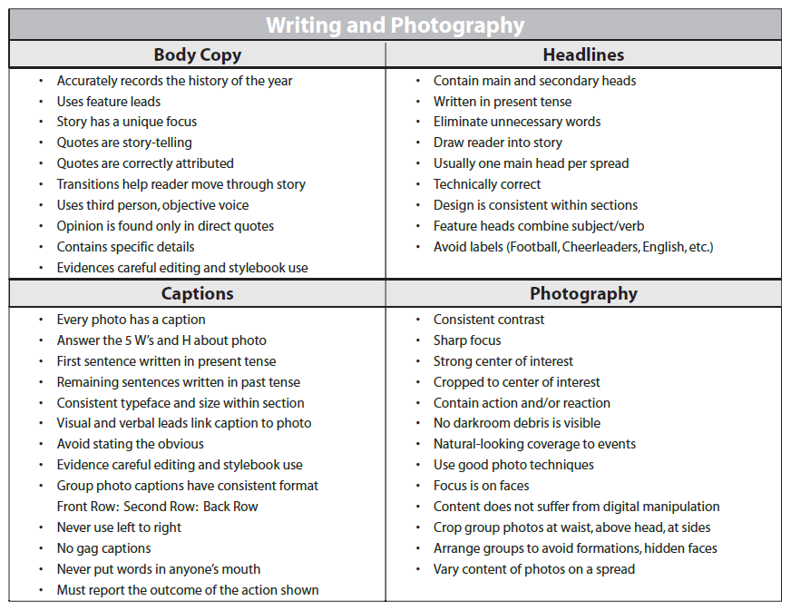
Critiques/Awards
Critical Rating Services handout from the Evaluation section of the Balfour Curriculum

