Slide 1
Showstoppers

Slide 2
Make readers
STOP
in their tracks.

Slide 3
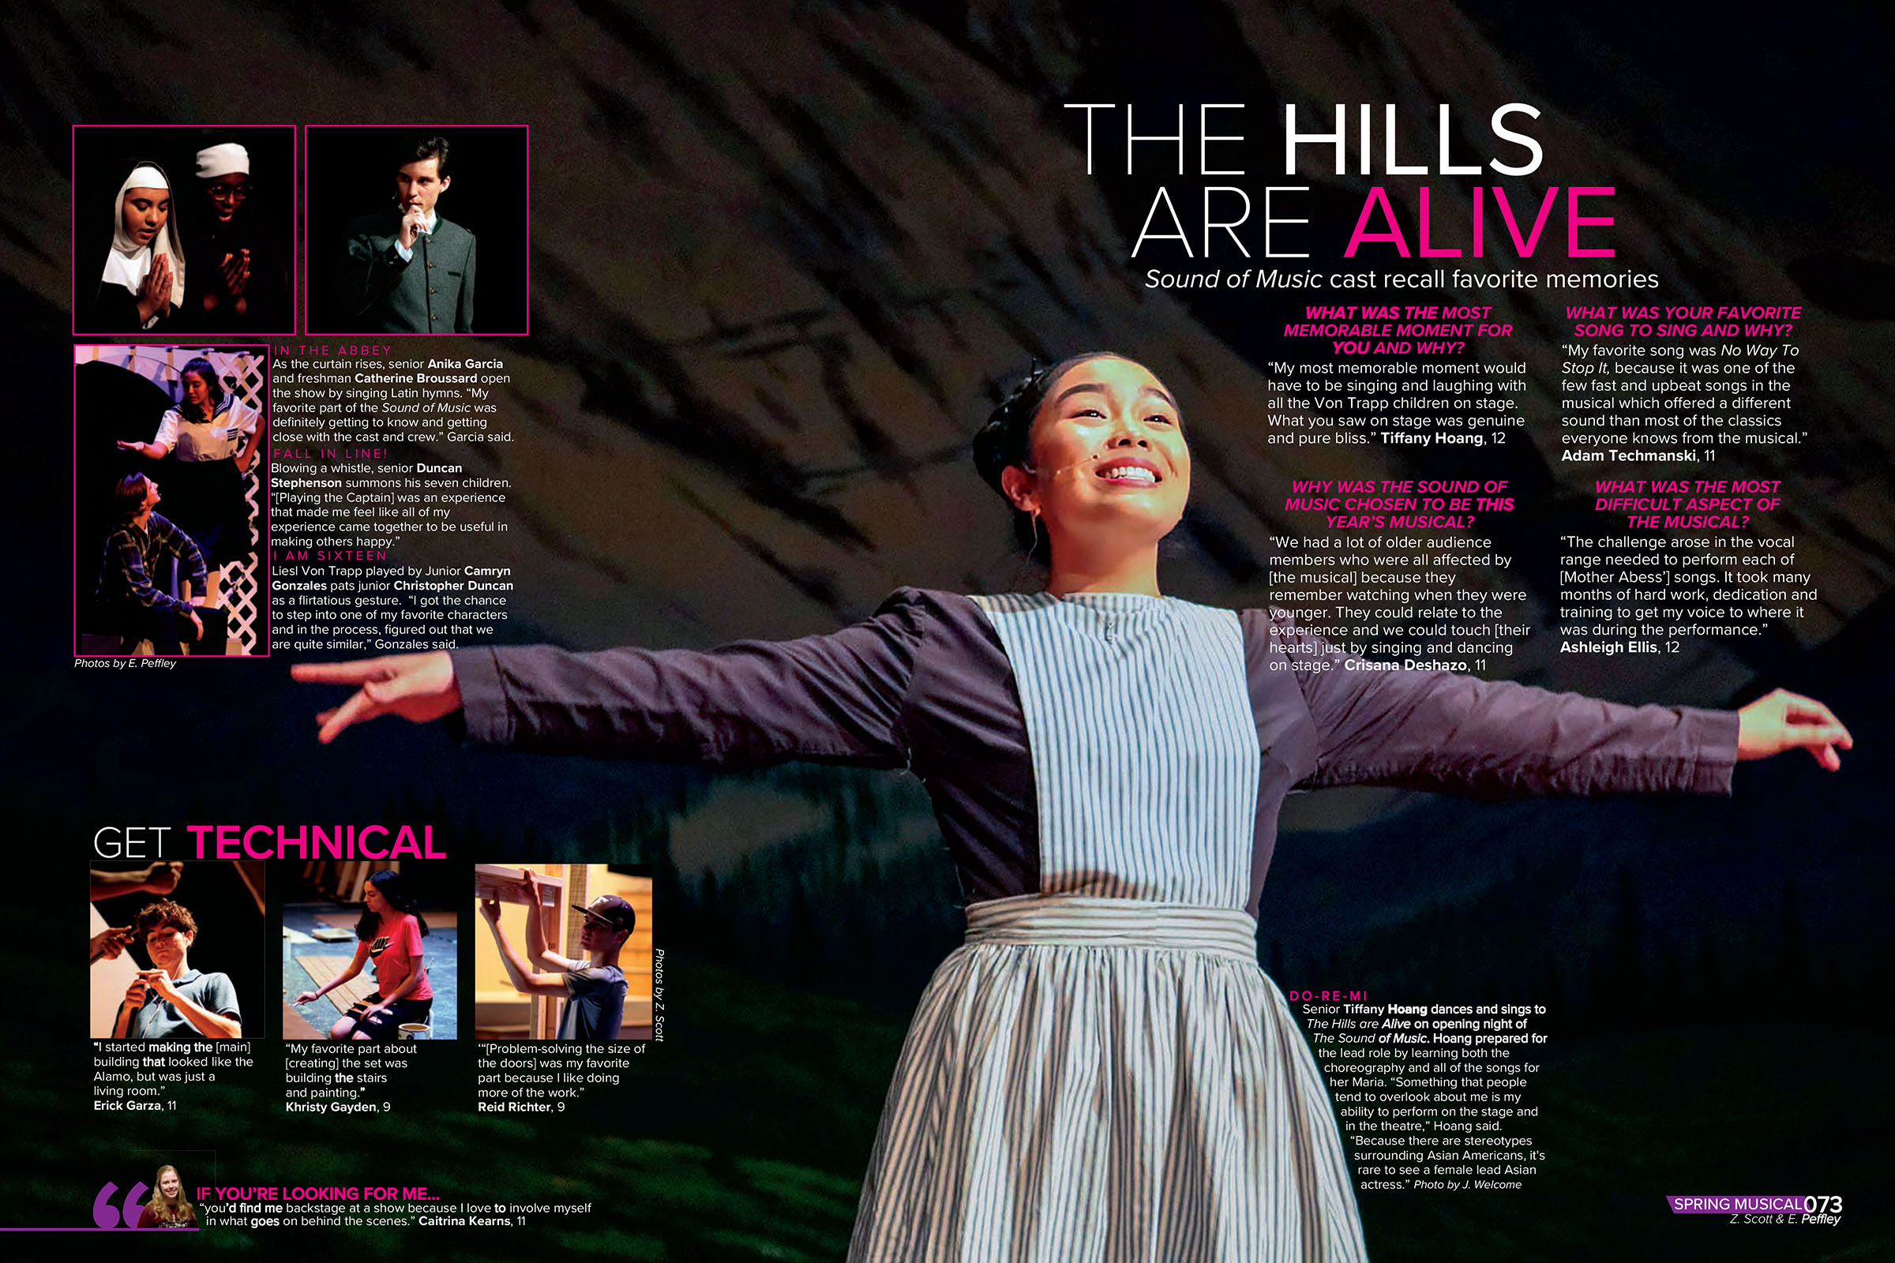
Foster HS

Slide 4
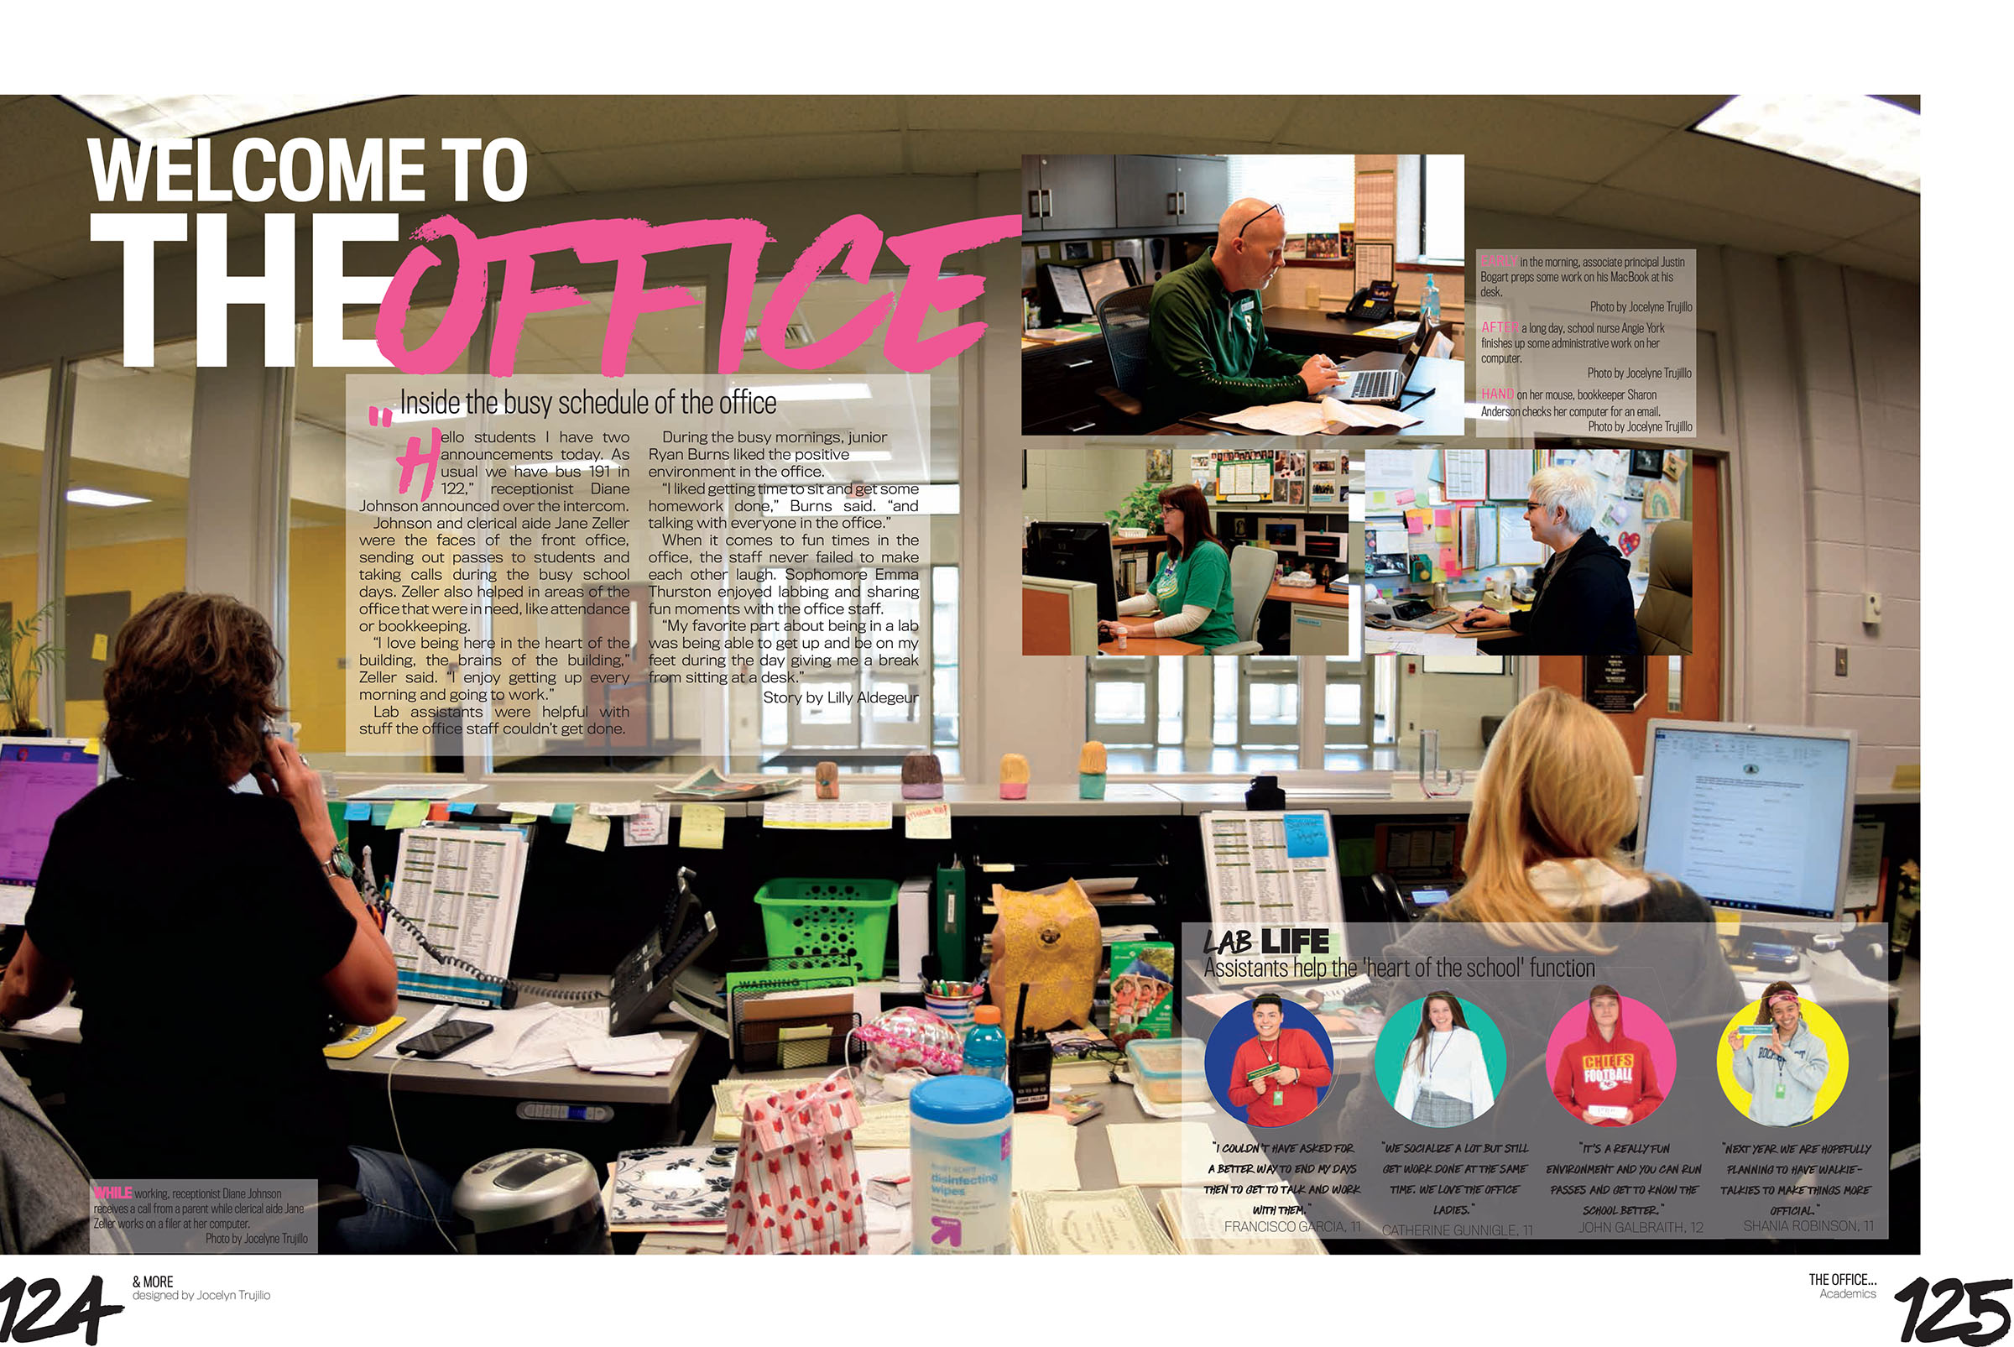
Shawnee Mission South HS

Slide 5
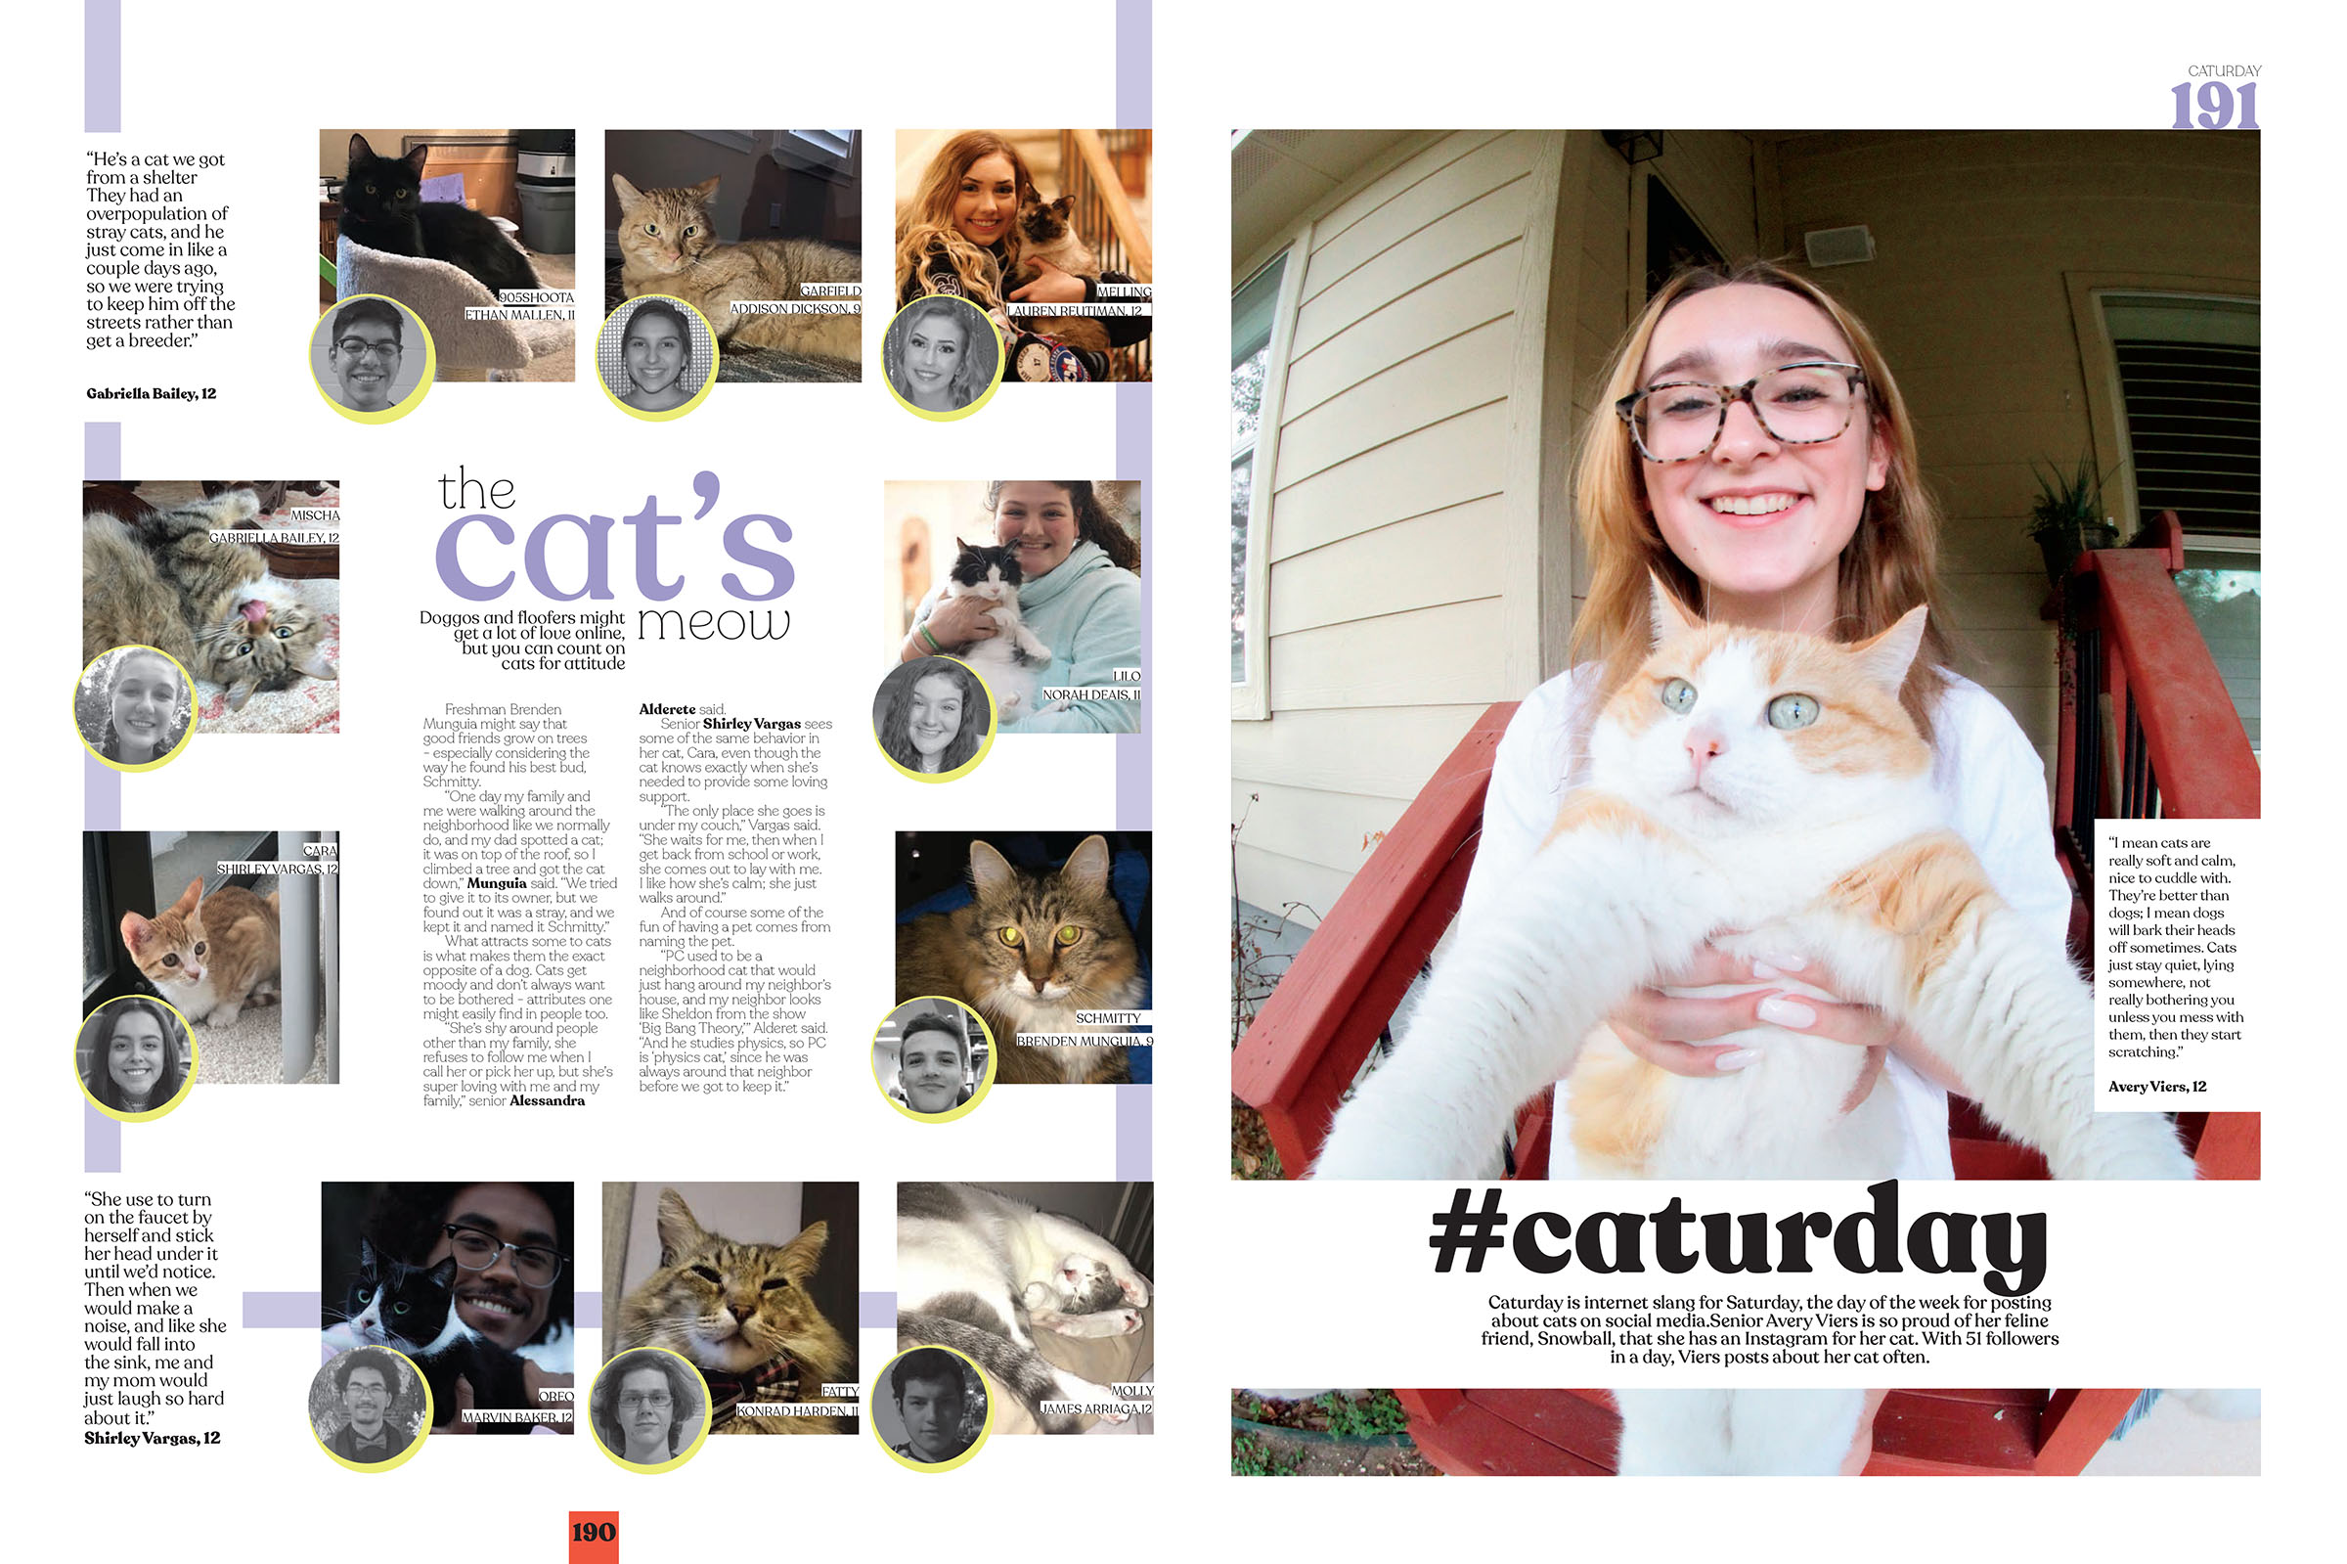
Claudia Taylor Johnson HS

Slide 6
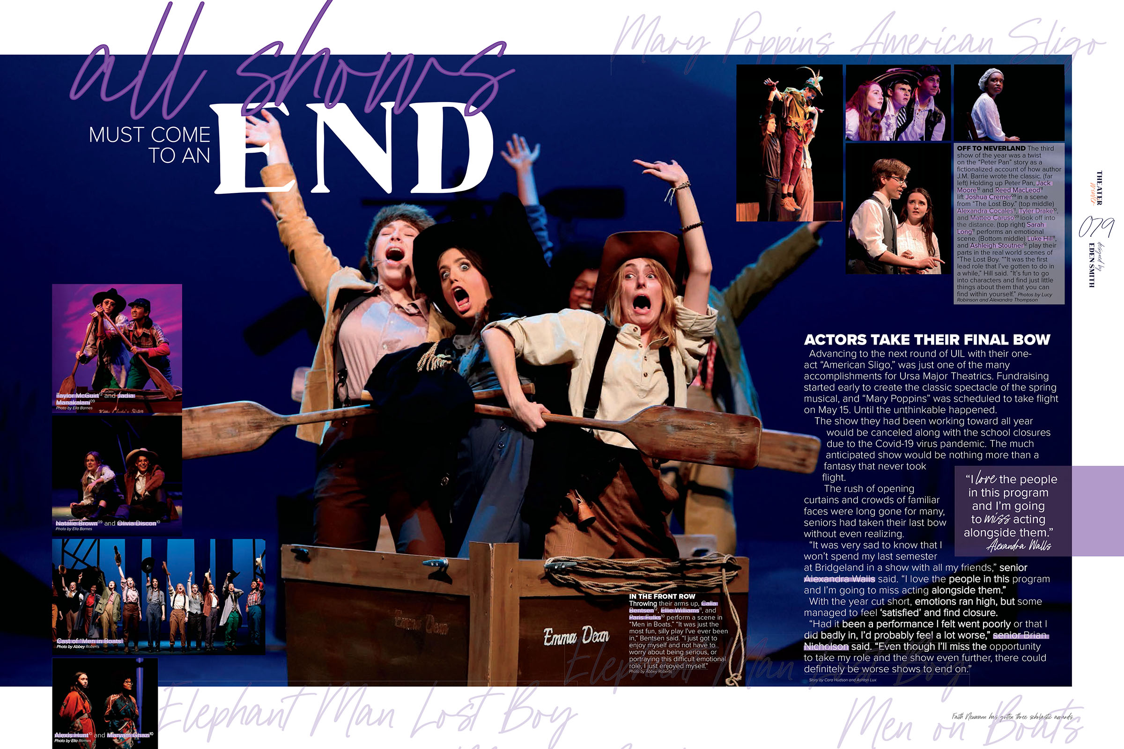
Bridgeland HS

Slide 7
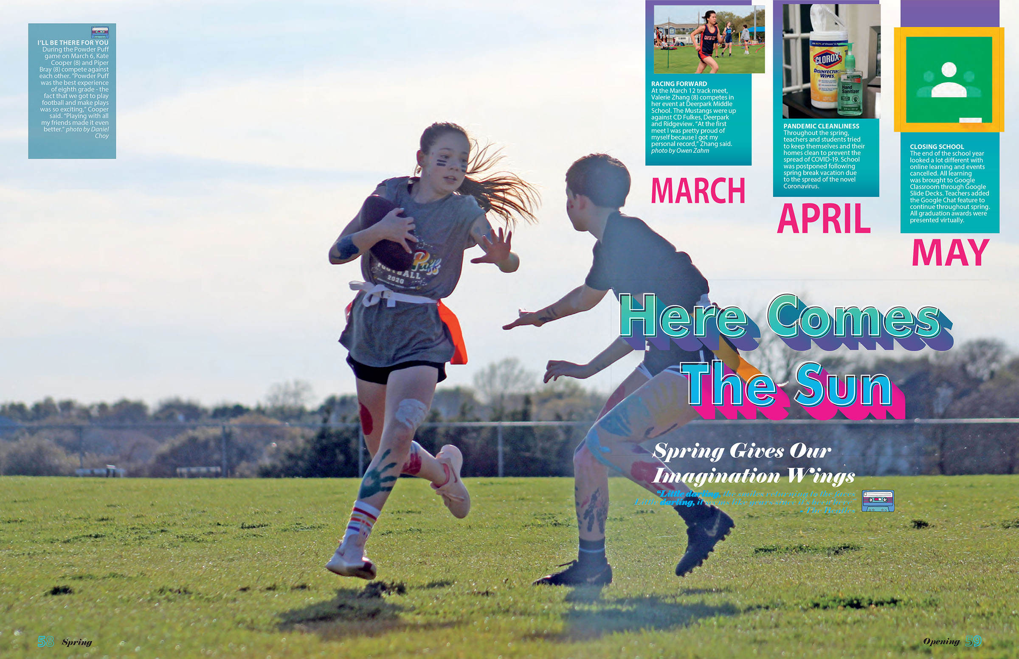
Showstoppers
Also referred to as:
wow spreads
breaker spreads
disruptors
interrupters
Canyon Vista MS
Showstoppers are layouts that differ from traditionally designed spreads.
They’re intended to “break” or “disrupt” the typical, consistent design.

Slide 8
Showstoppers
Wow pages provide content with a fresh look and a creative approach.
Bridgeland HS
They should “wow” the reader.

Slide 9
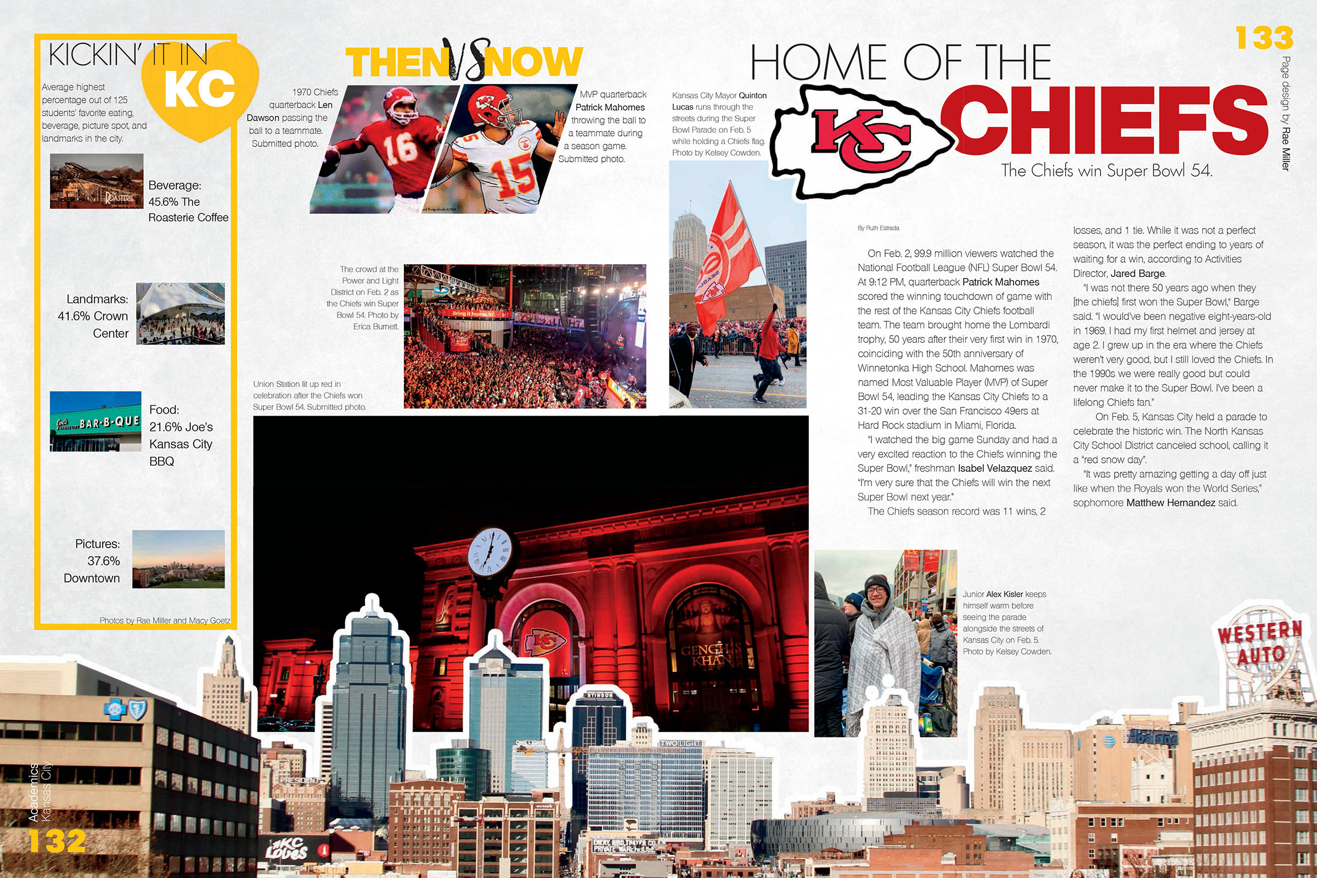
Showstoppers
Showstoppers don’t follow traditional design rules.
They might utilize a full bleed photo or numerous small images.
Winnetonka HS

Slide 10
Showstoppers
They often use typography, graphics or color to emphasize content.
Suncoast HS

Slide 11
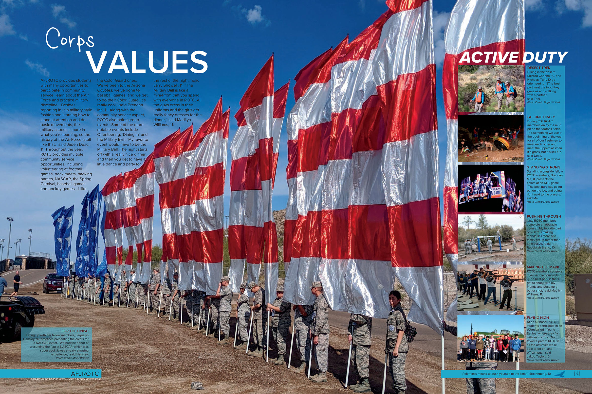
Showstoppers
Student life topics transform easily into showstoppers or wow pages.
But traditional coverage (events, sports) can also create compelling pages.
Deer Valley HS

Slide 12
Let’s
STOP
the show.

Slide 13
STUDENT
profiles

Slide 14
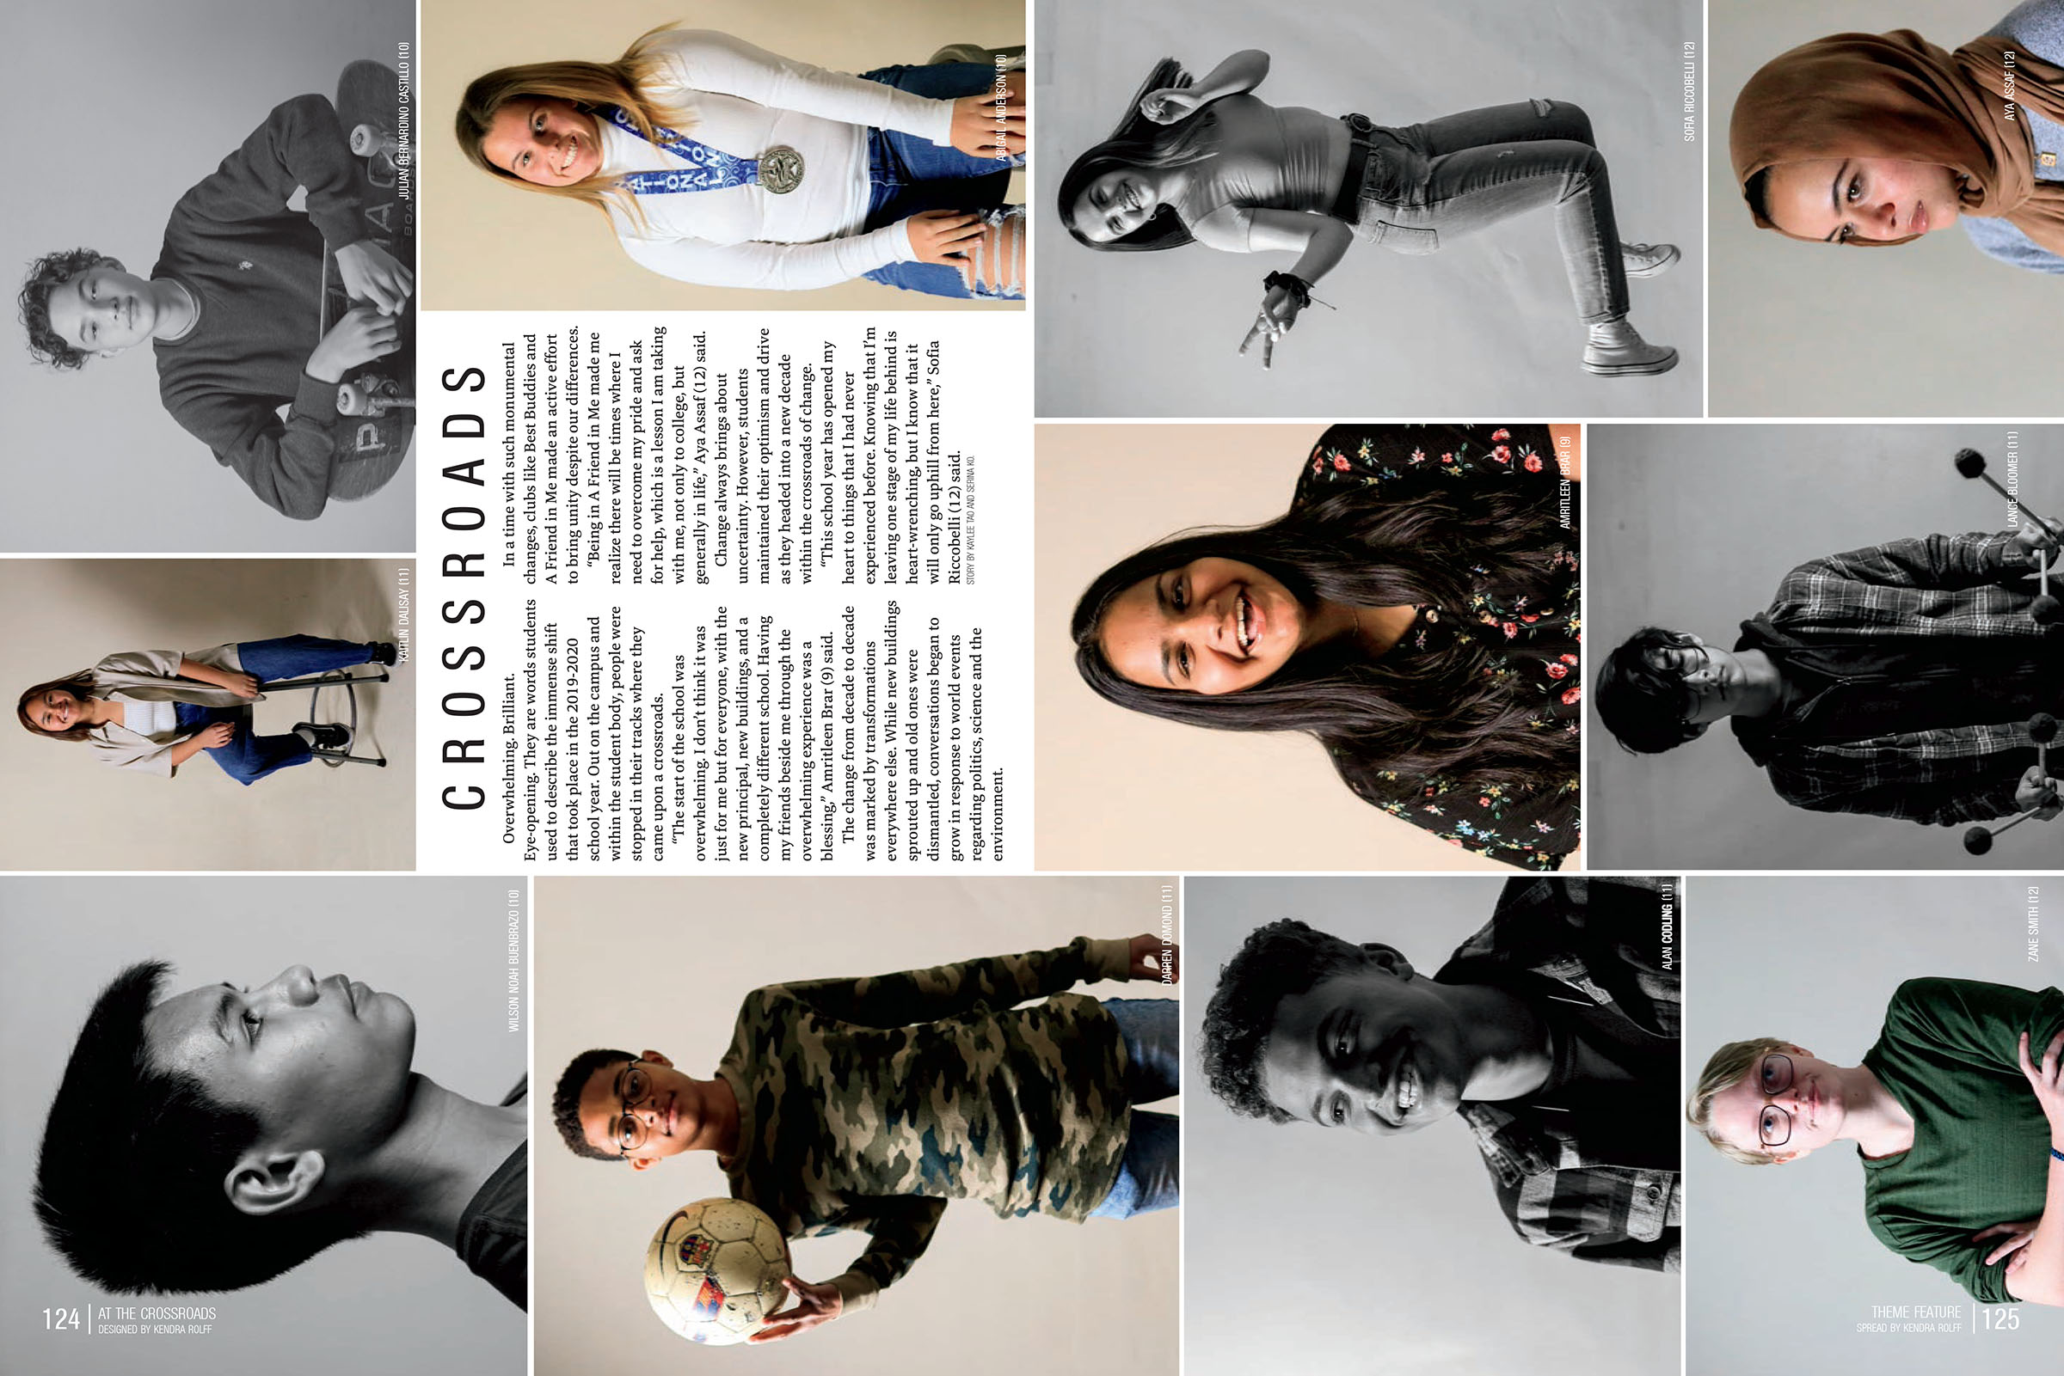
Etiwanda HS

Slide 15
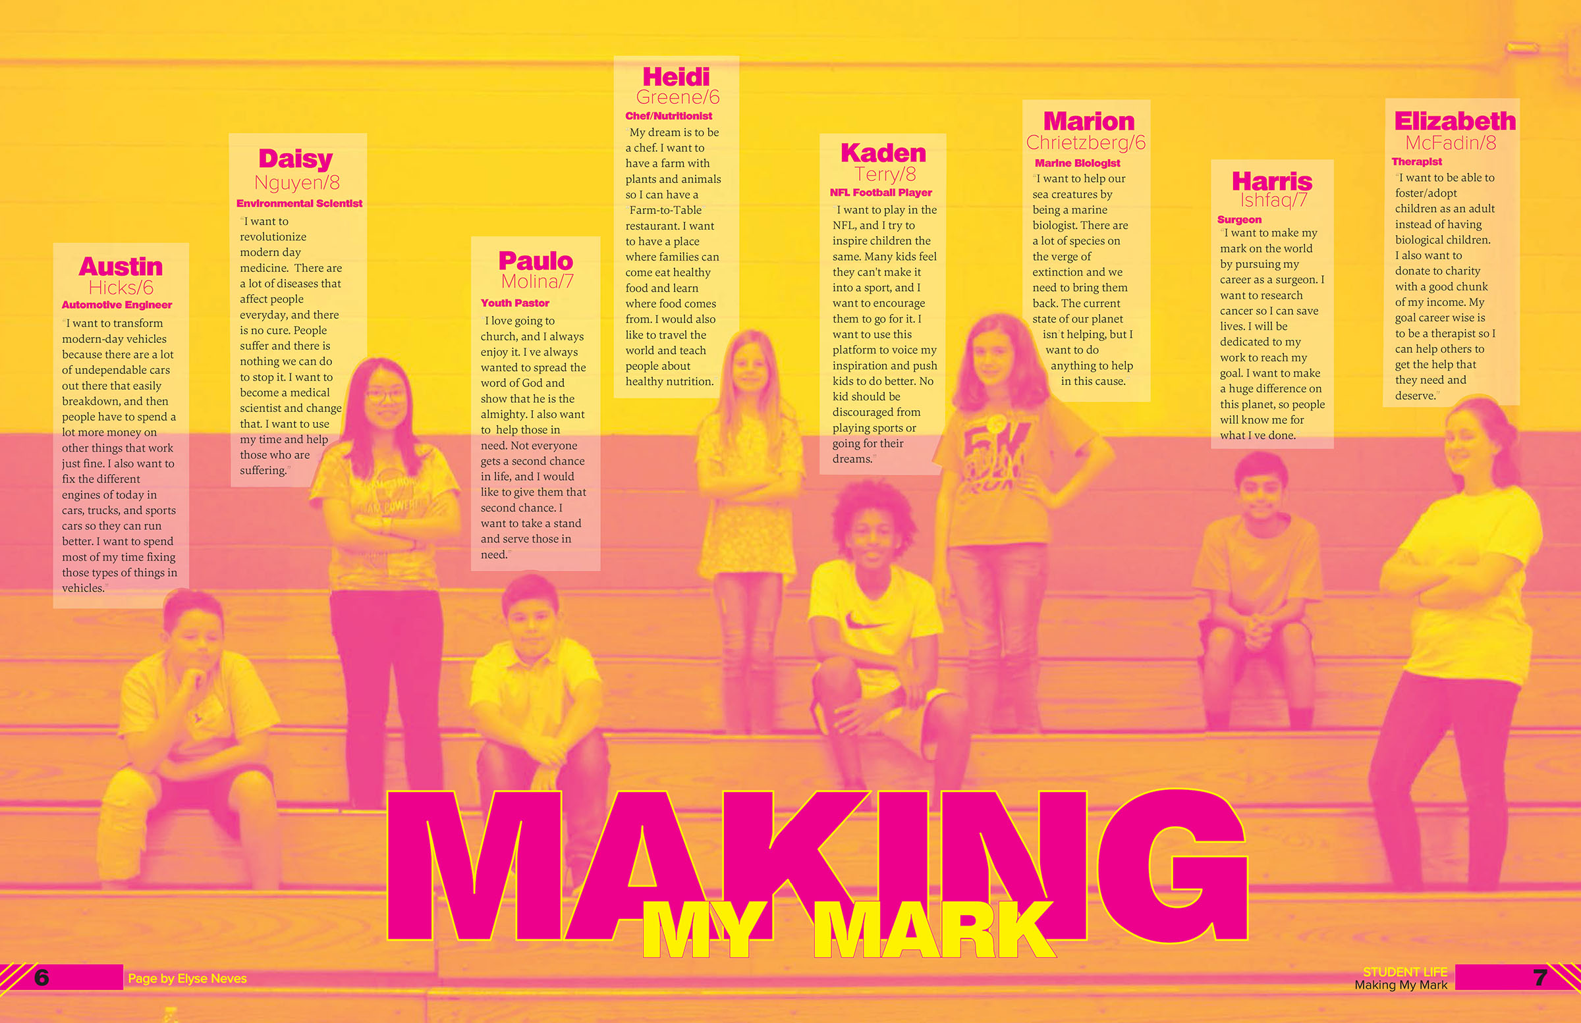
Katy JHS

Slide 16
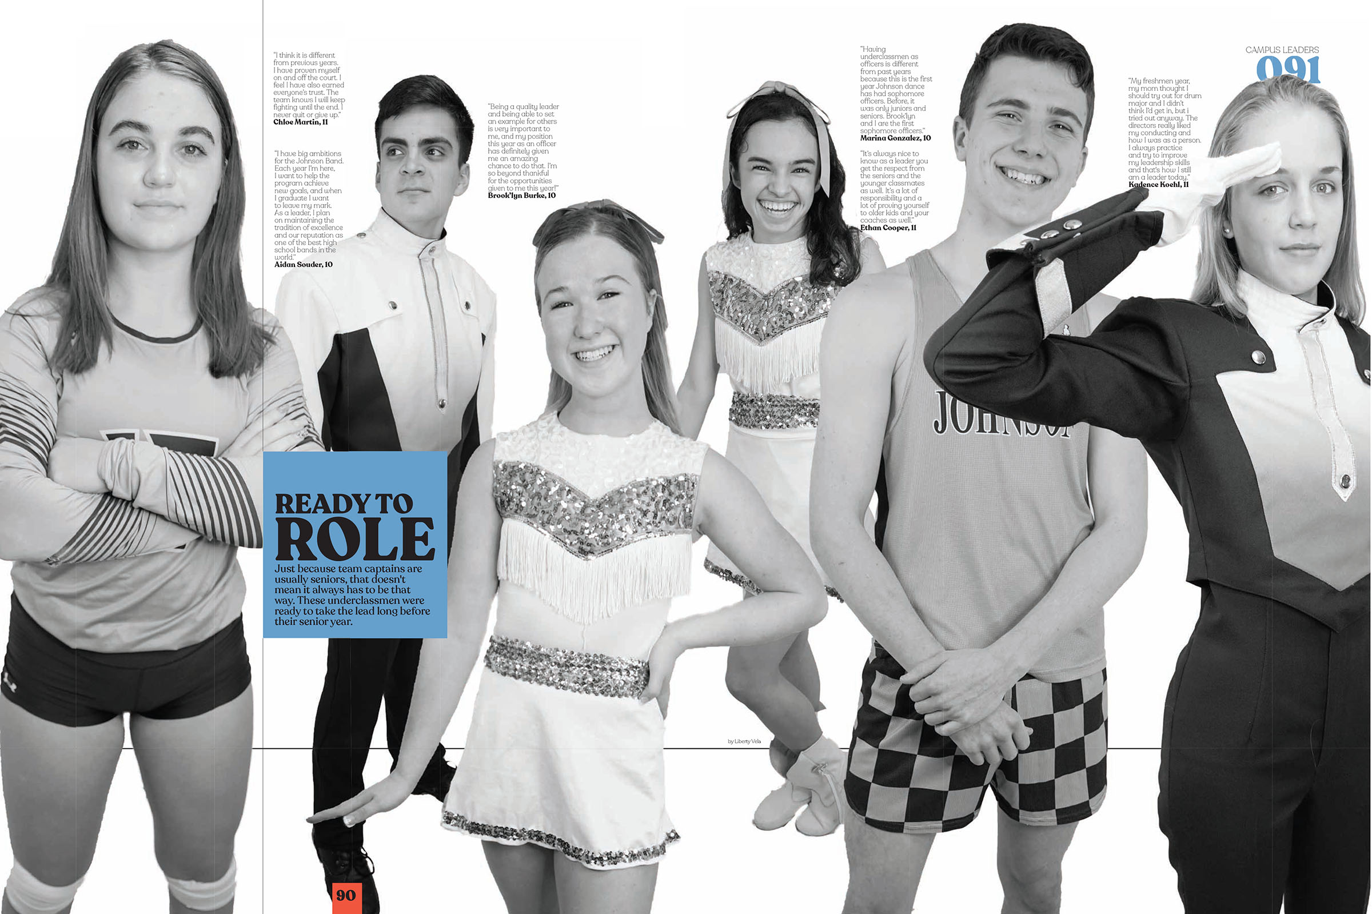
Claudia Taylor Johnson HS

Slide 17
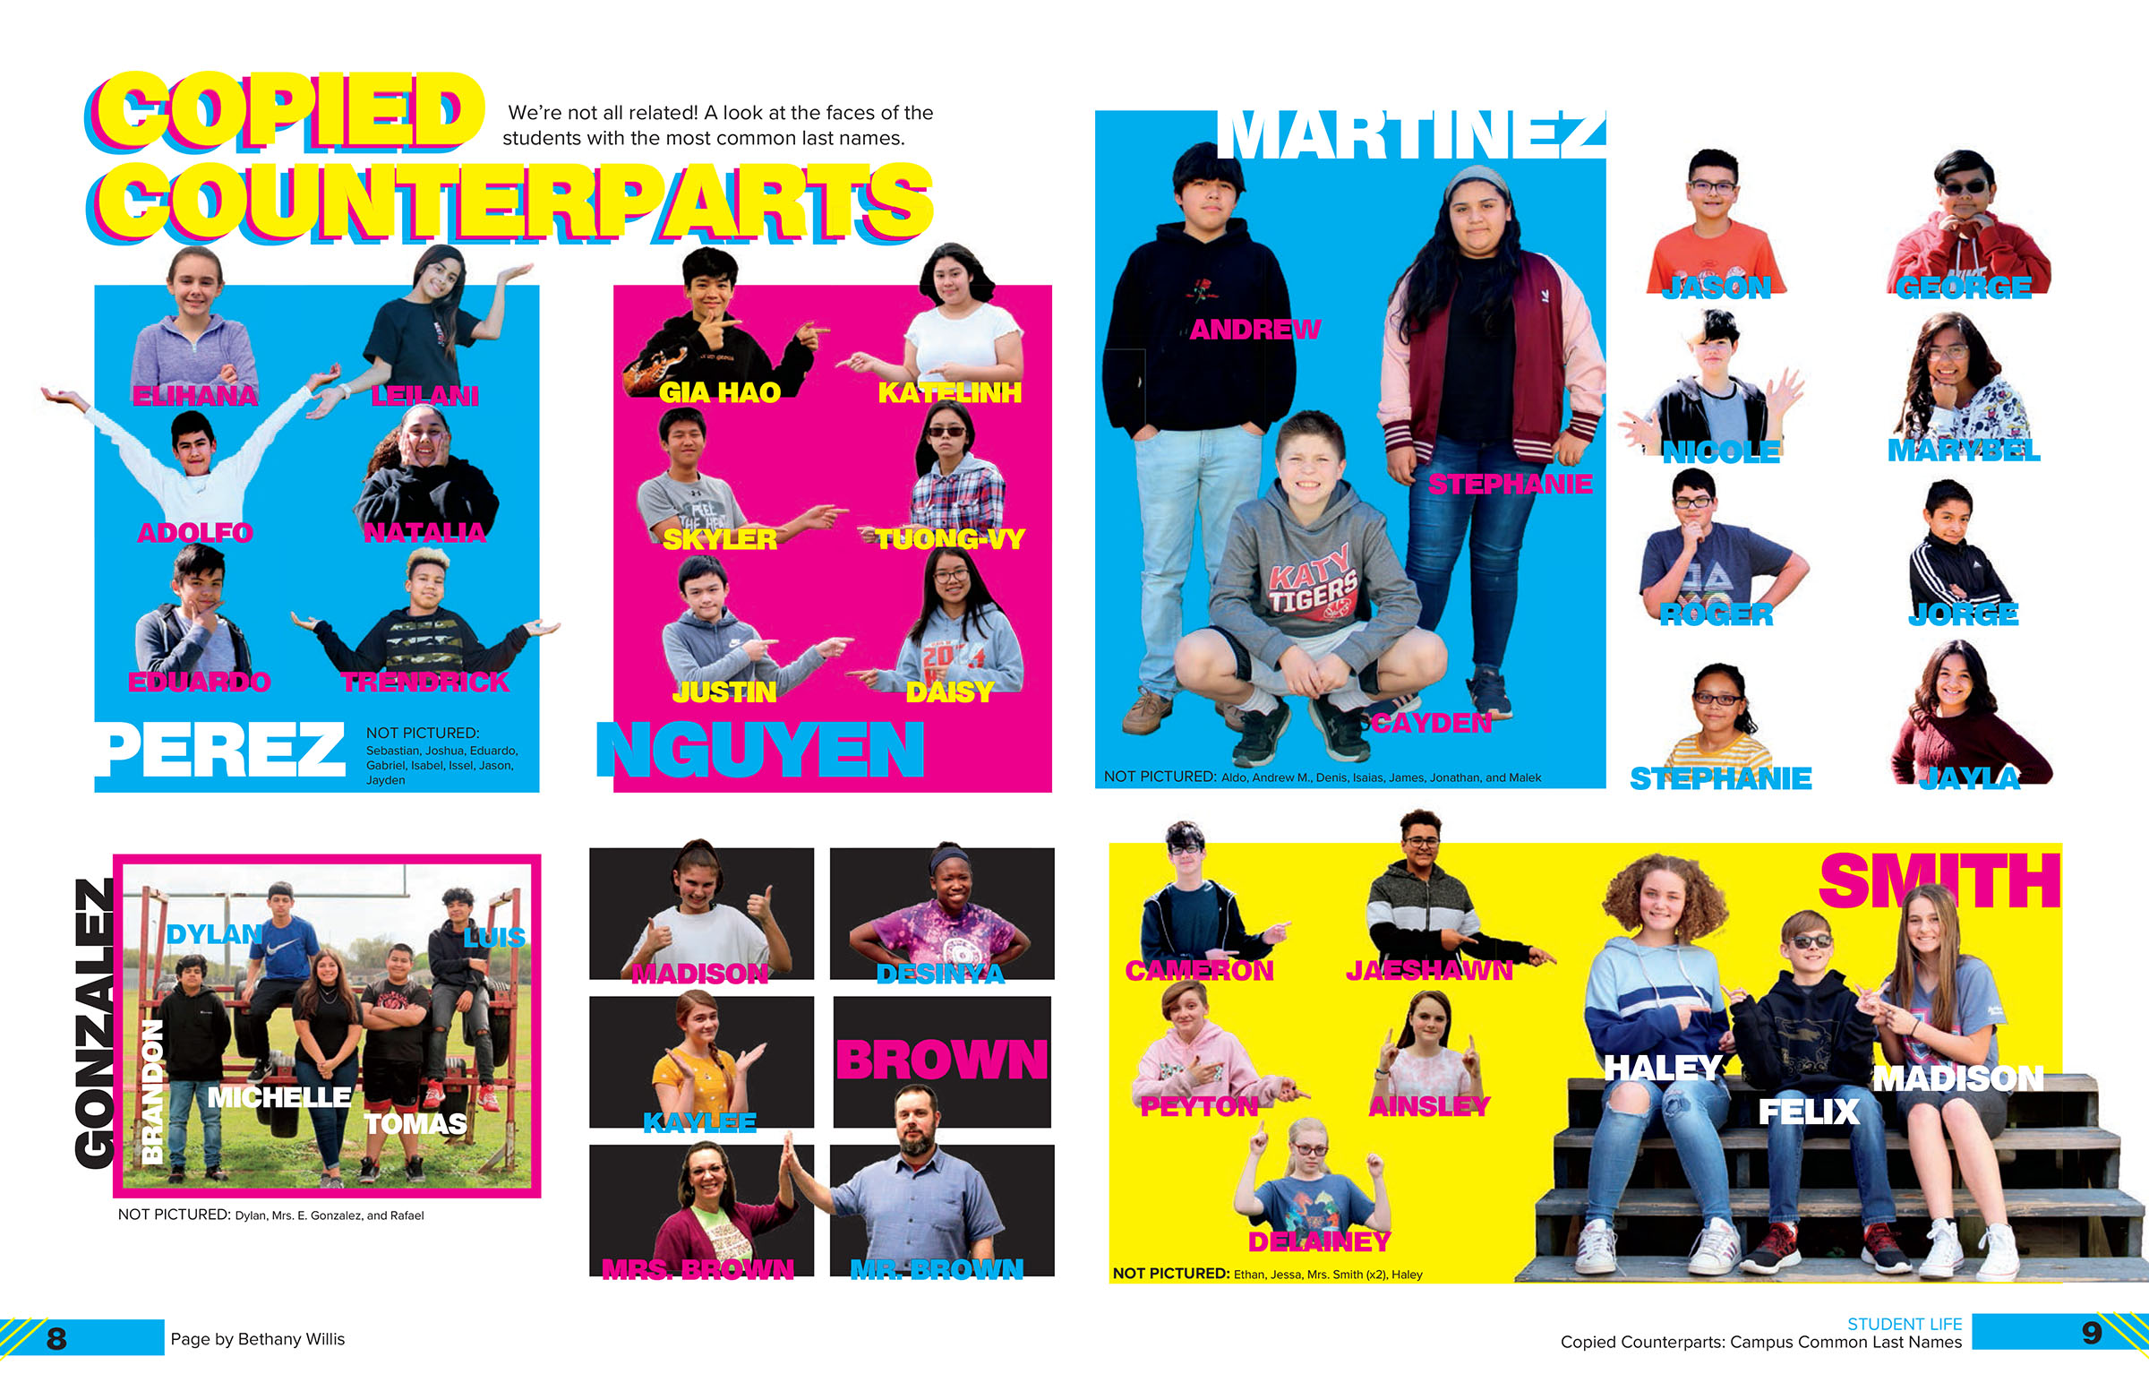
Katy JHS

Slide 18
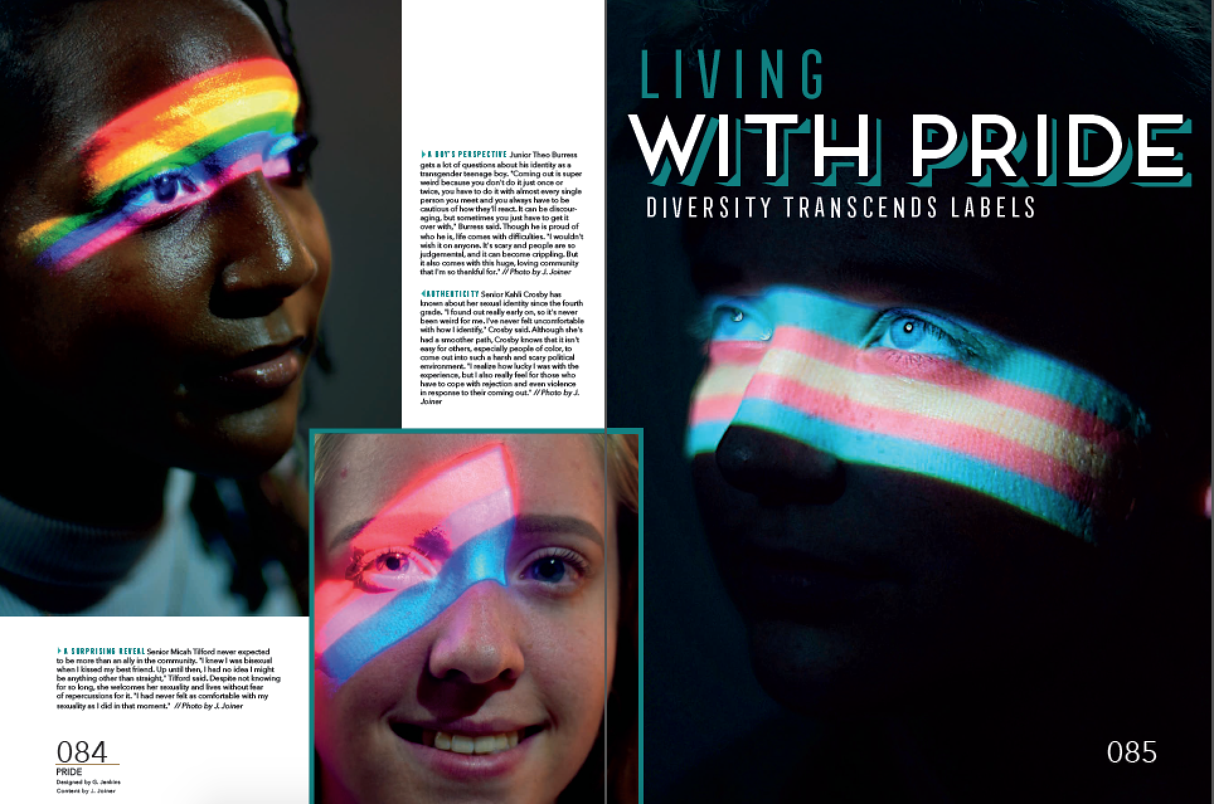
Little Rock Central HS

Slide 19
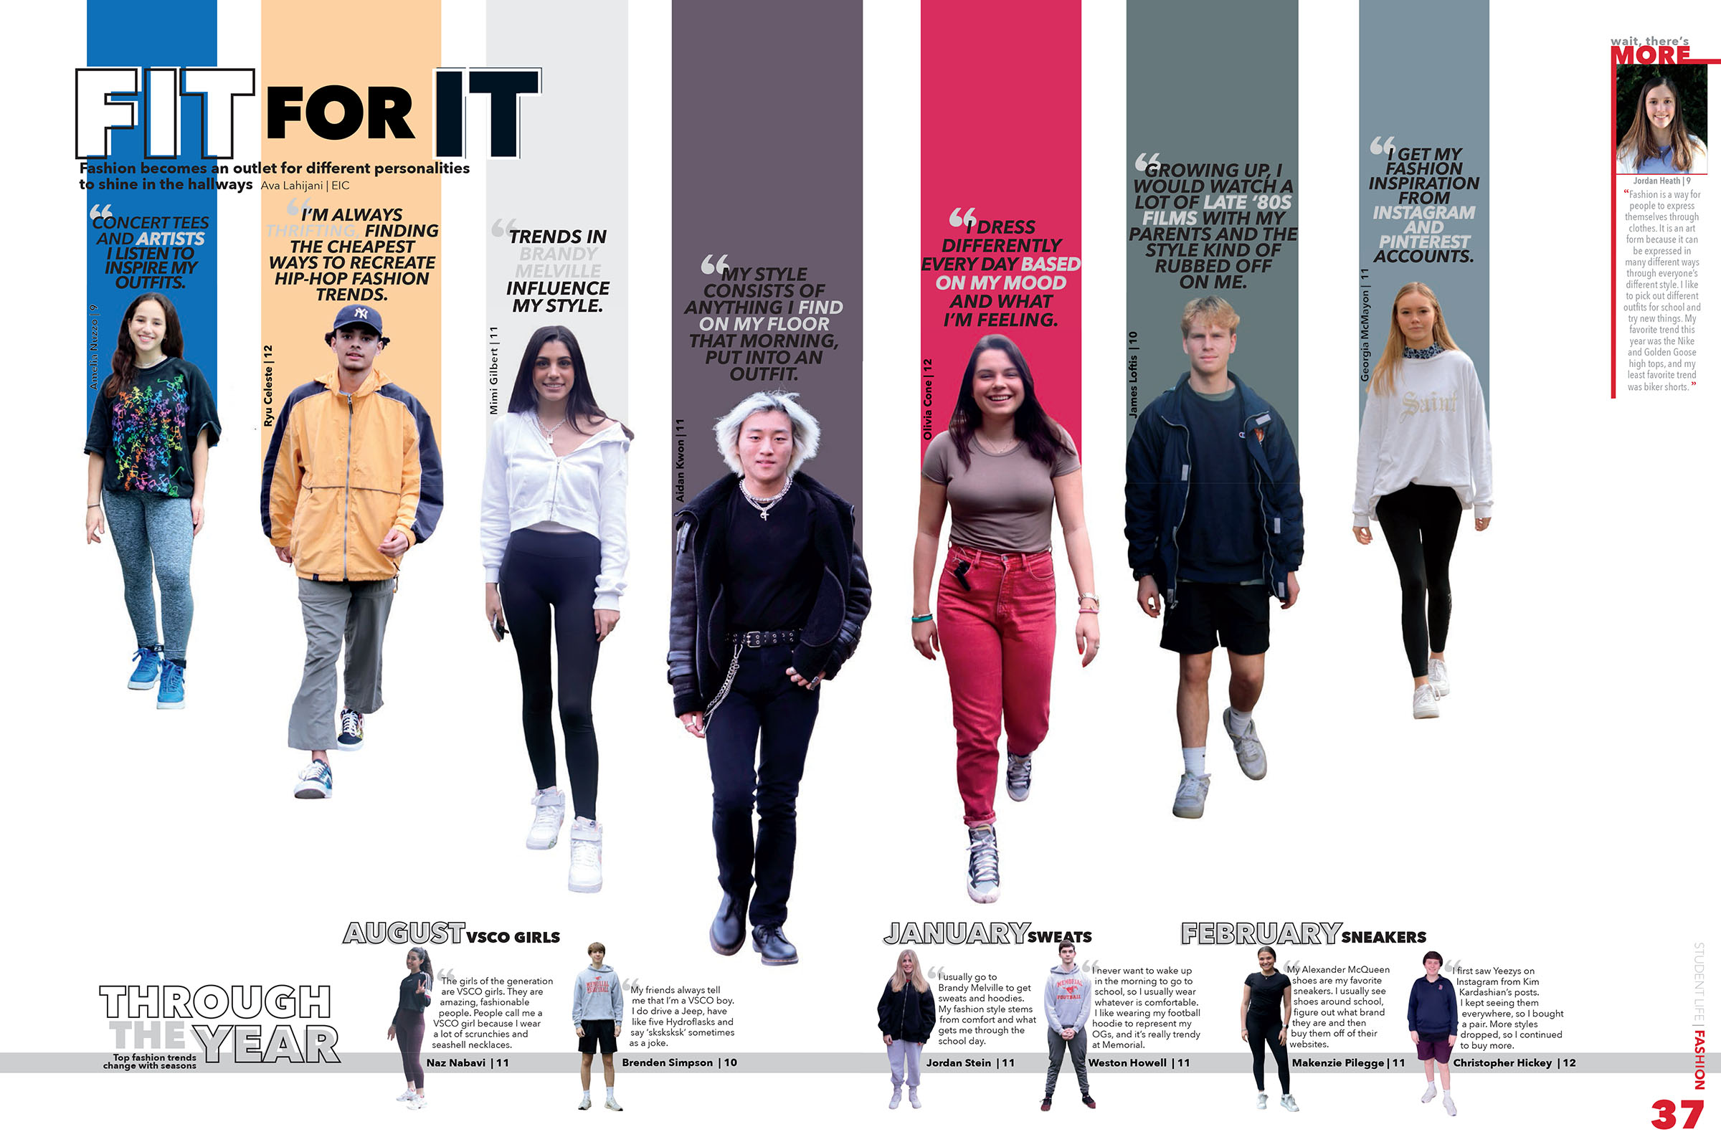
Memorial HS

Slide 20
Venice HS

Slide 21
ART, COLOR &
graphics

Slide 22
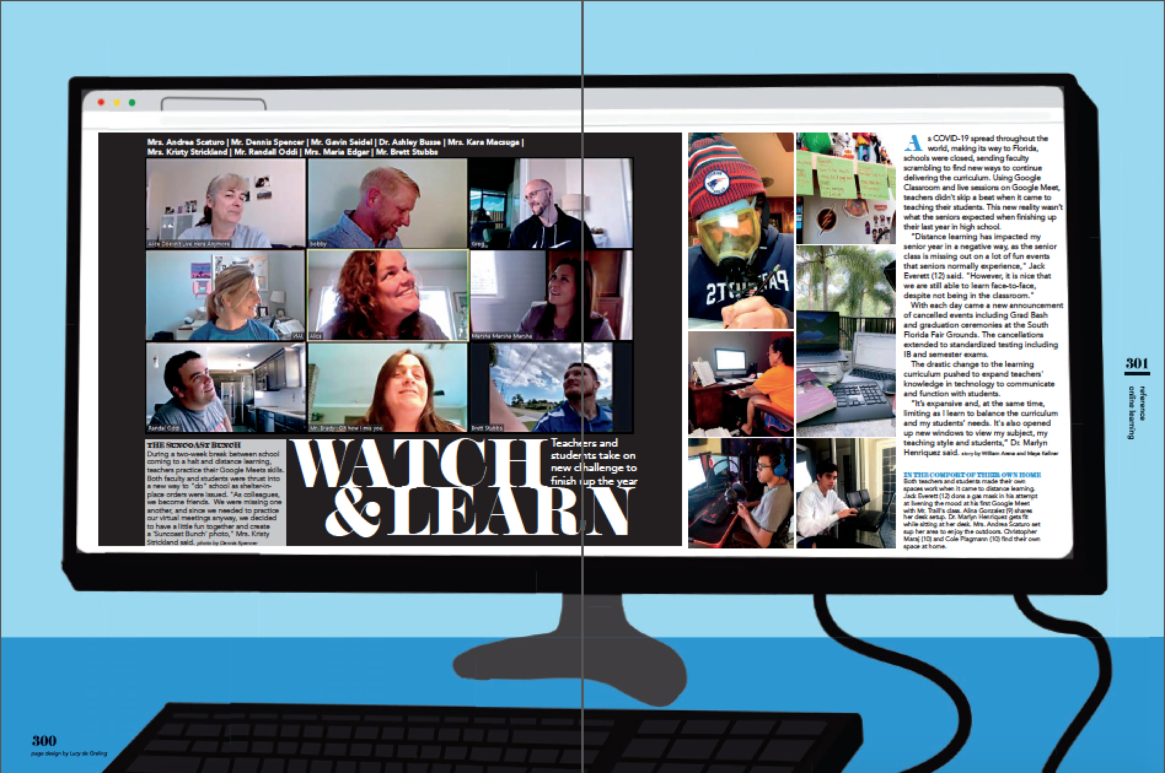
Suncoast HS

Slide 23
Staley HS

Slide 24
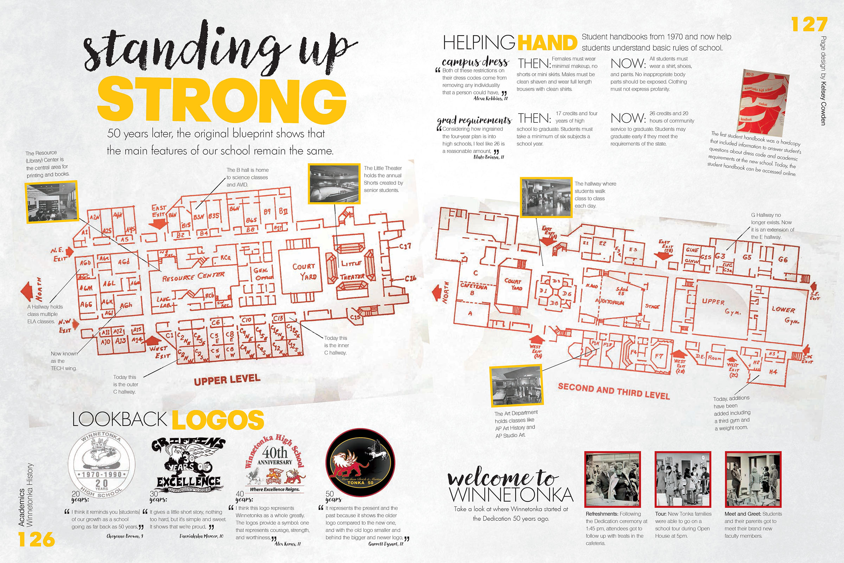
Winnetonka HS

Slide 25
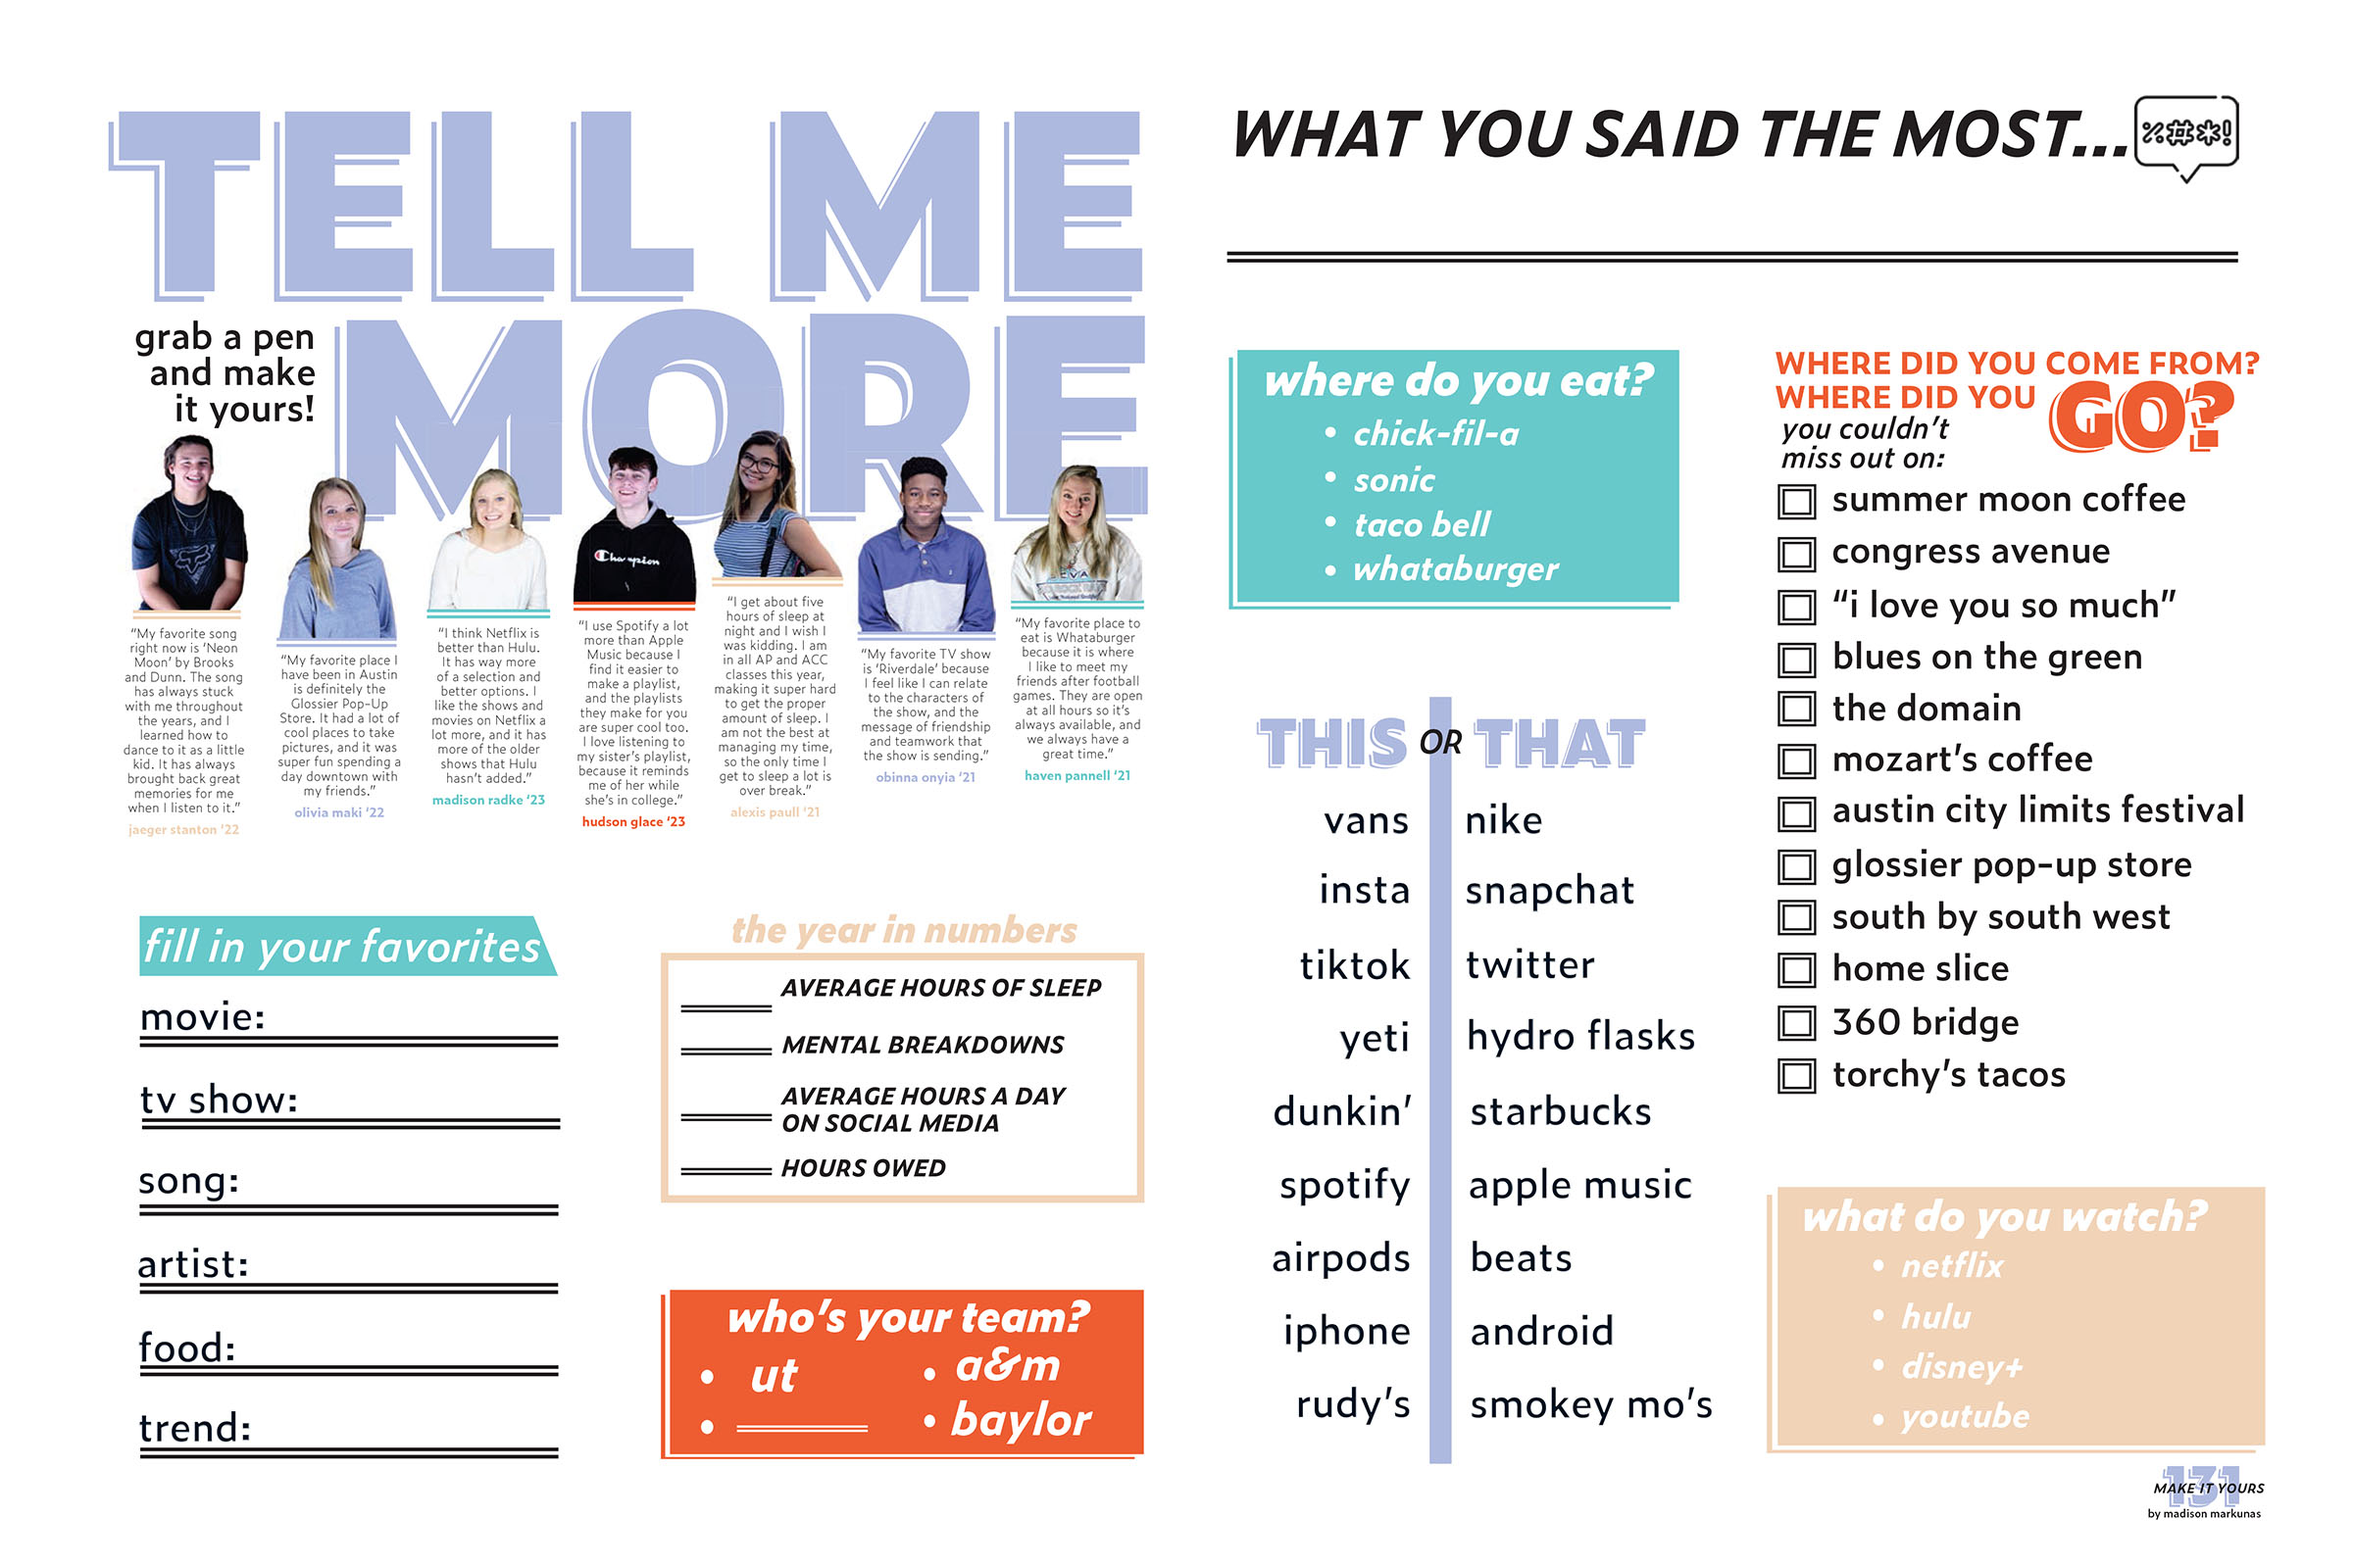
Cedar Park HS

Slide 26
Peterson MS

Slide 27
Holy Trinity Episcopal Academy

Slide 28
Suncoast HS

Slide 29
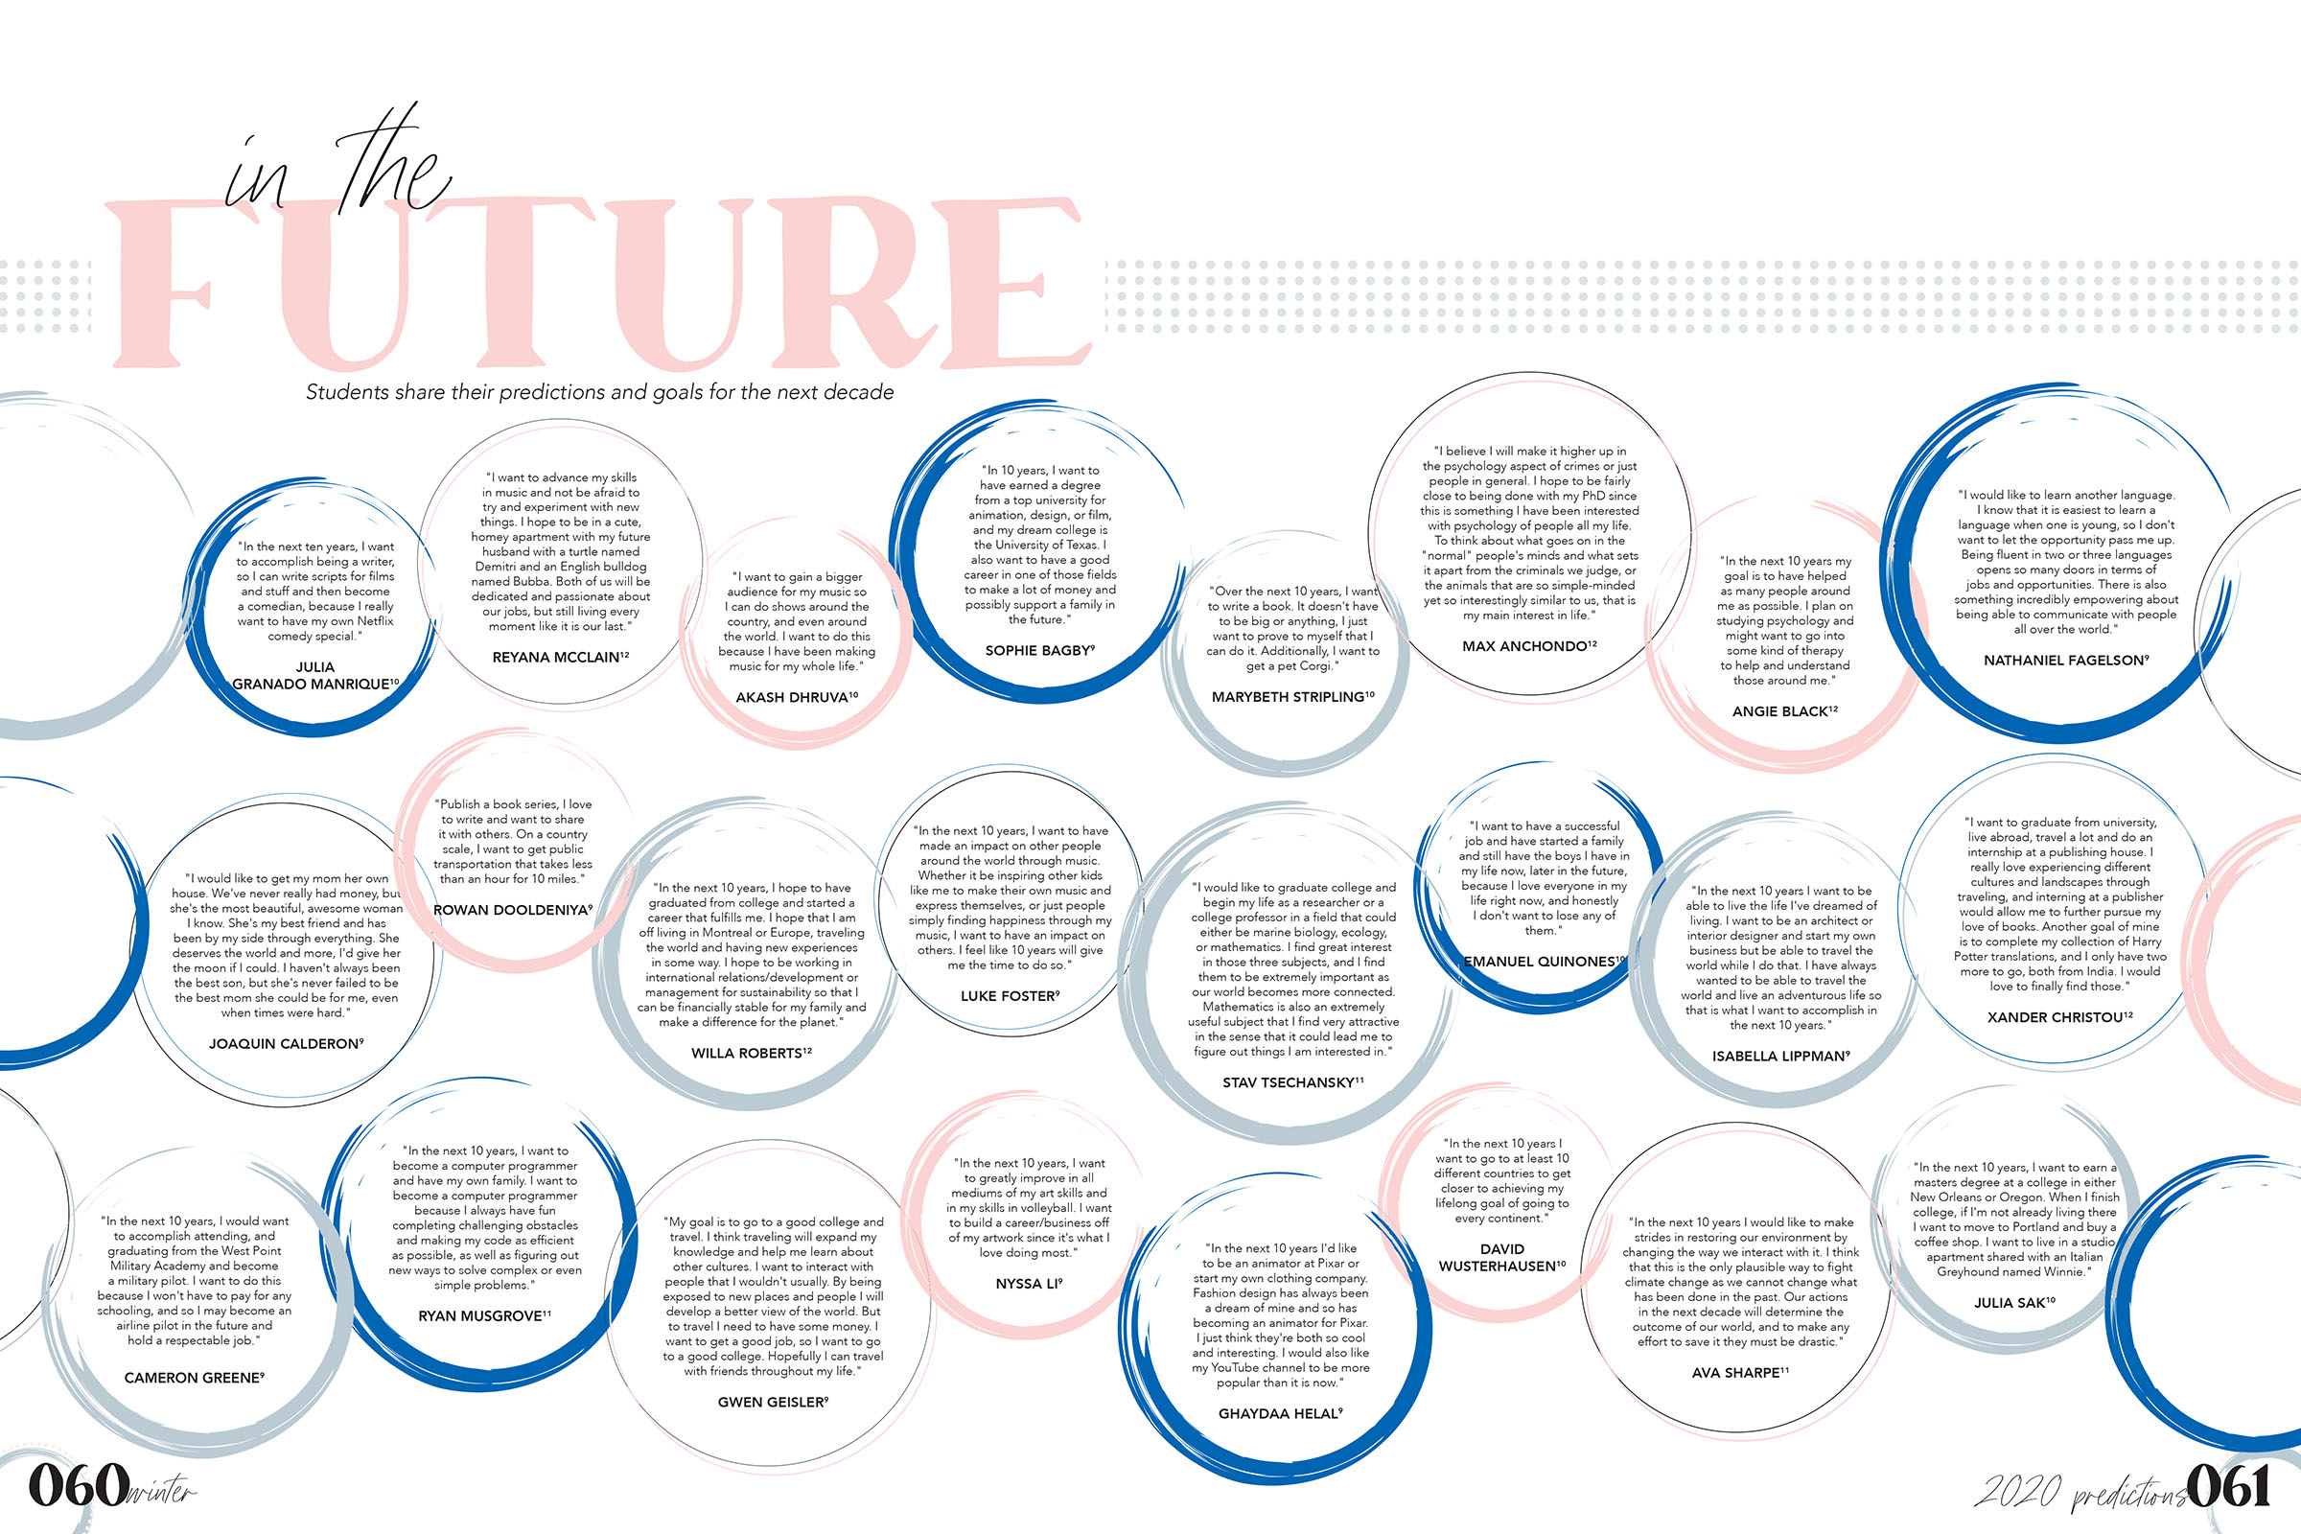
Austin HS

Slide 30
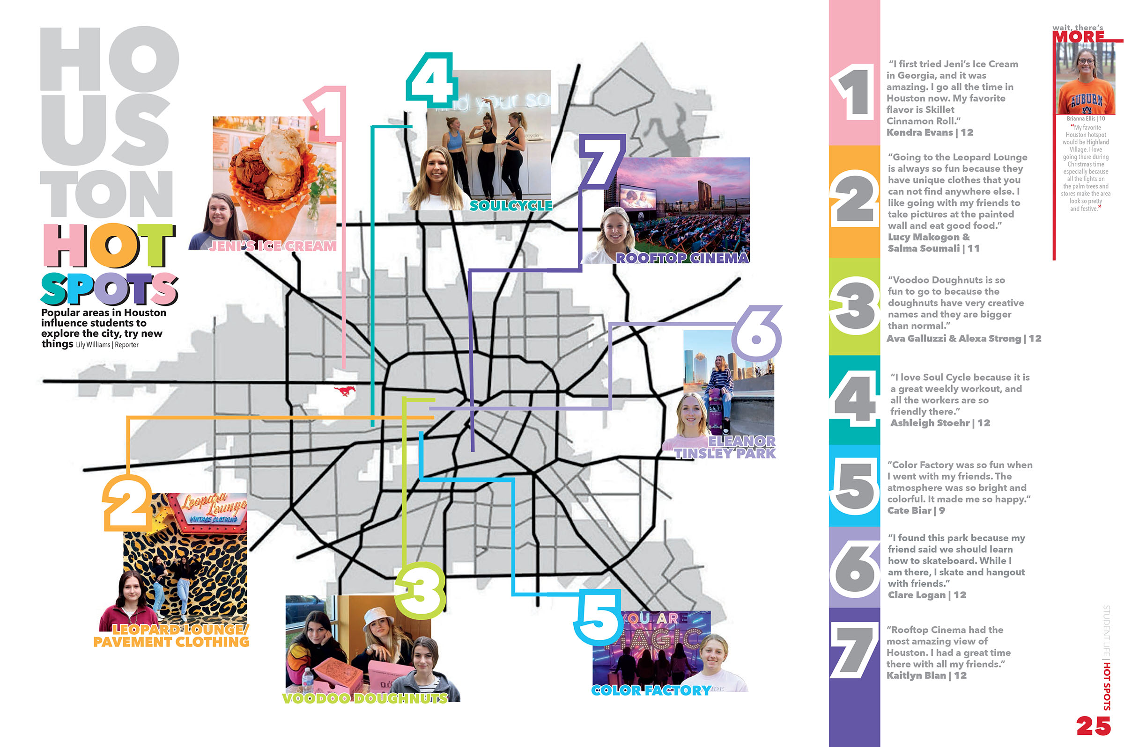
Memorial HS

Slide 31
USE OF
cutouts

Slide 32
West Monroe HS

Slide 33
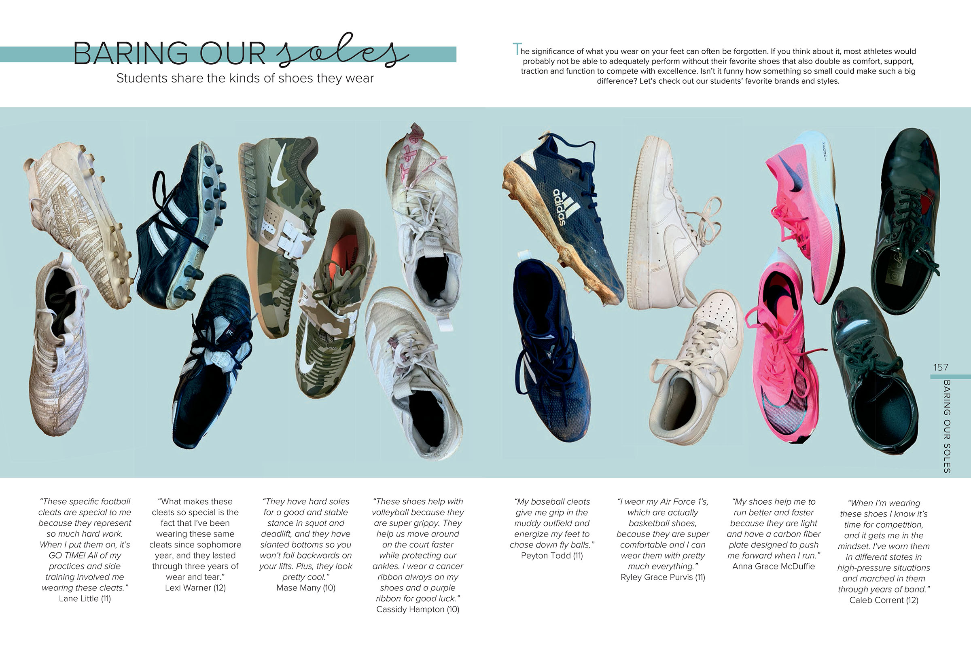
West Monroe HS

Slide 34
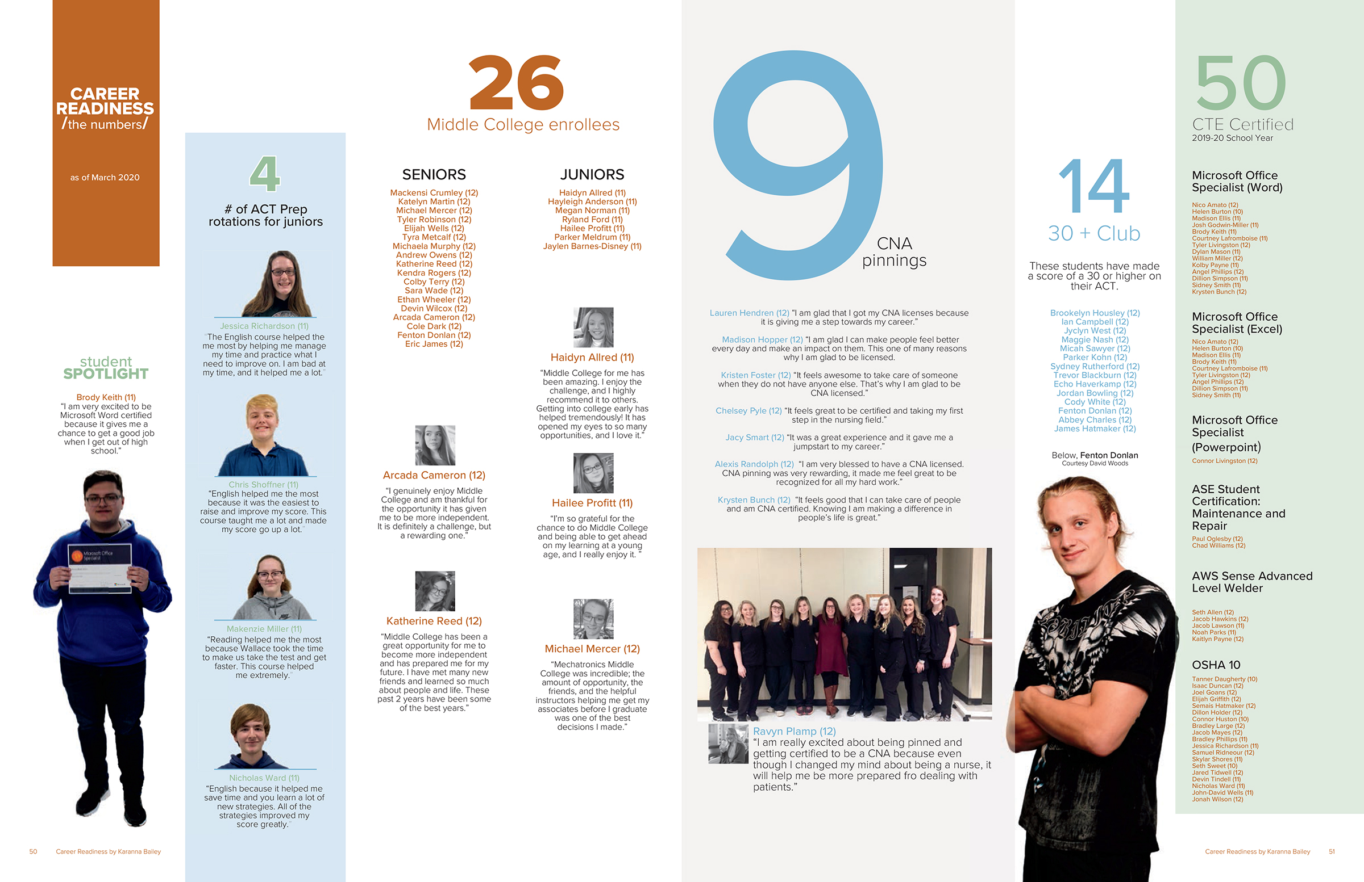
Anderson County HS

Slide 35
Cedar Park HS

Slide 36
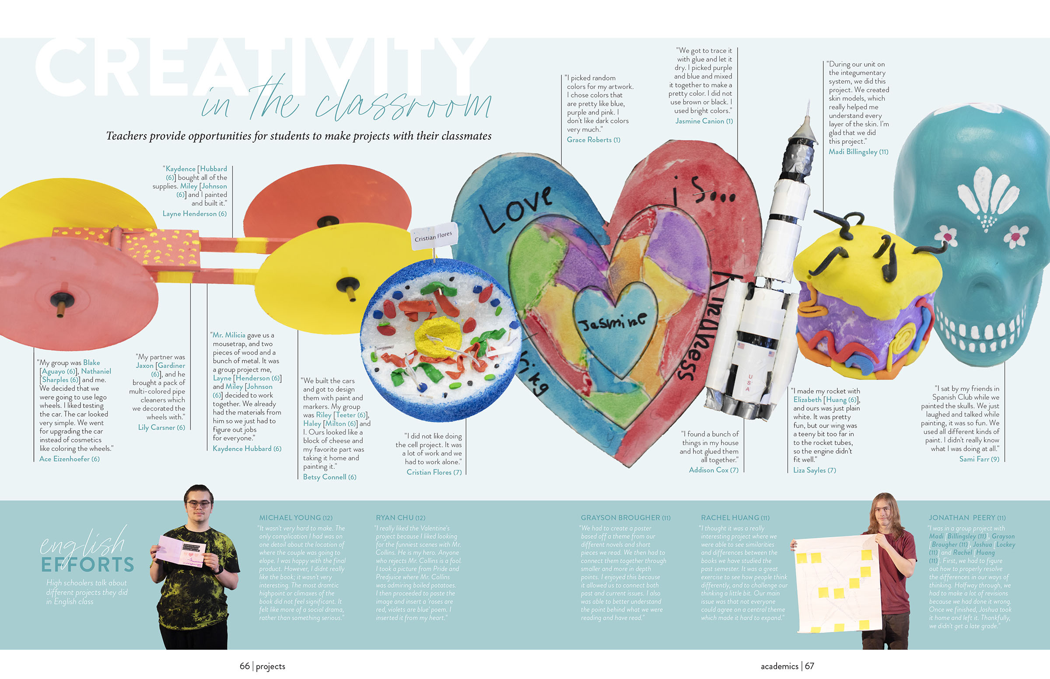
Hill Country Christian School

Slide 37
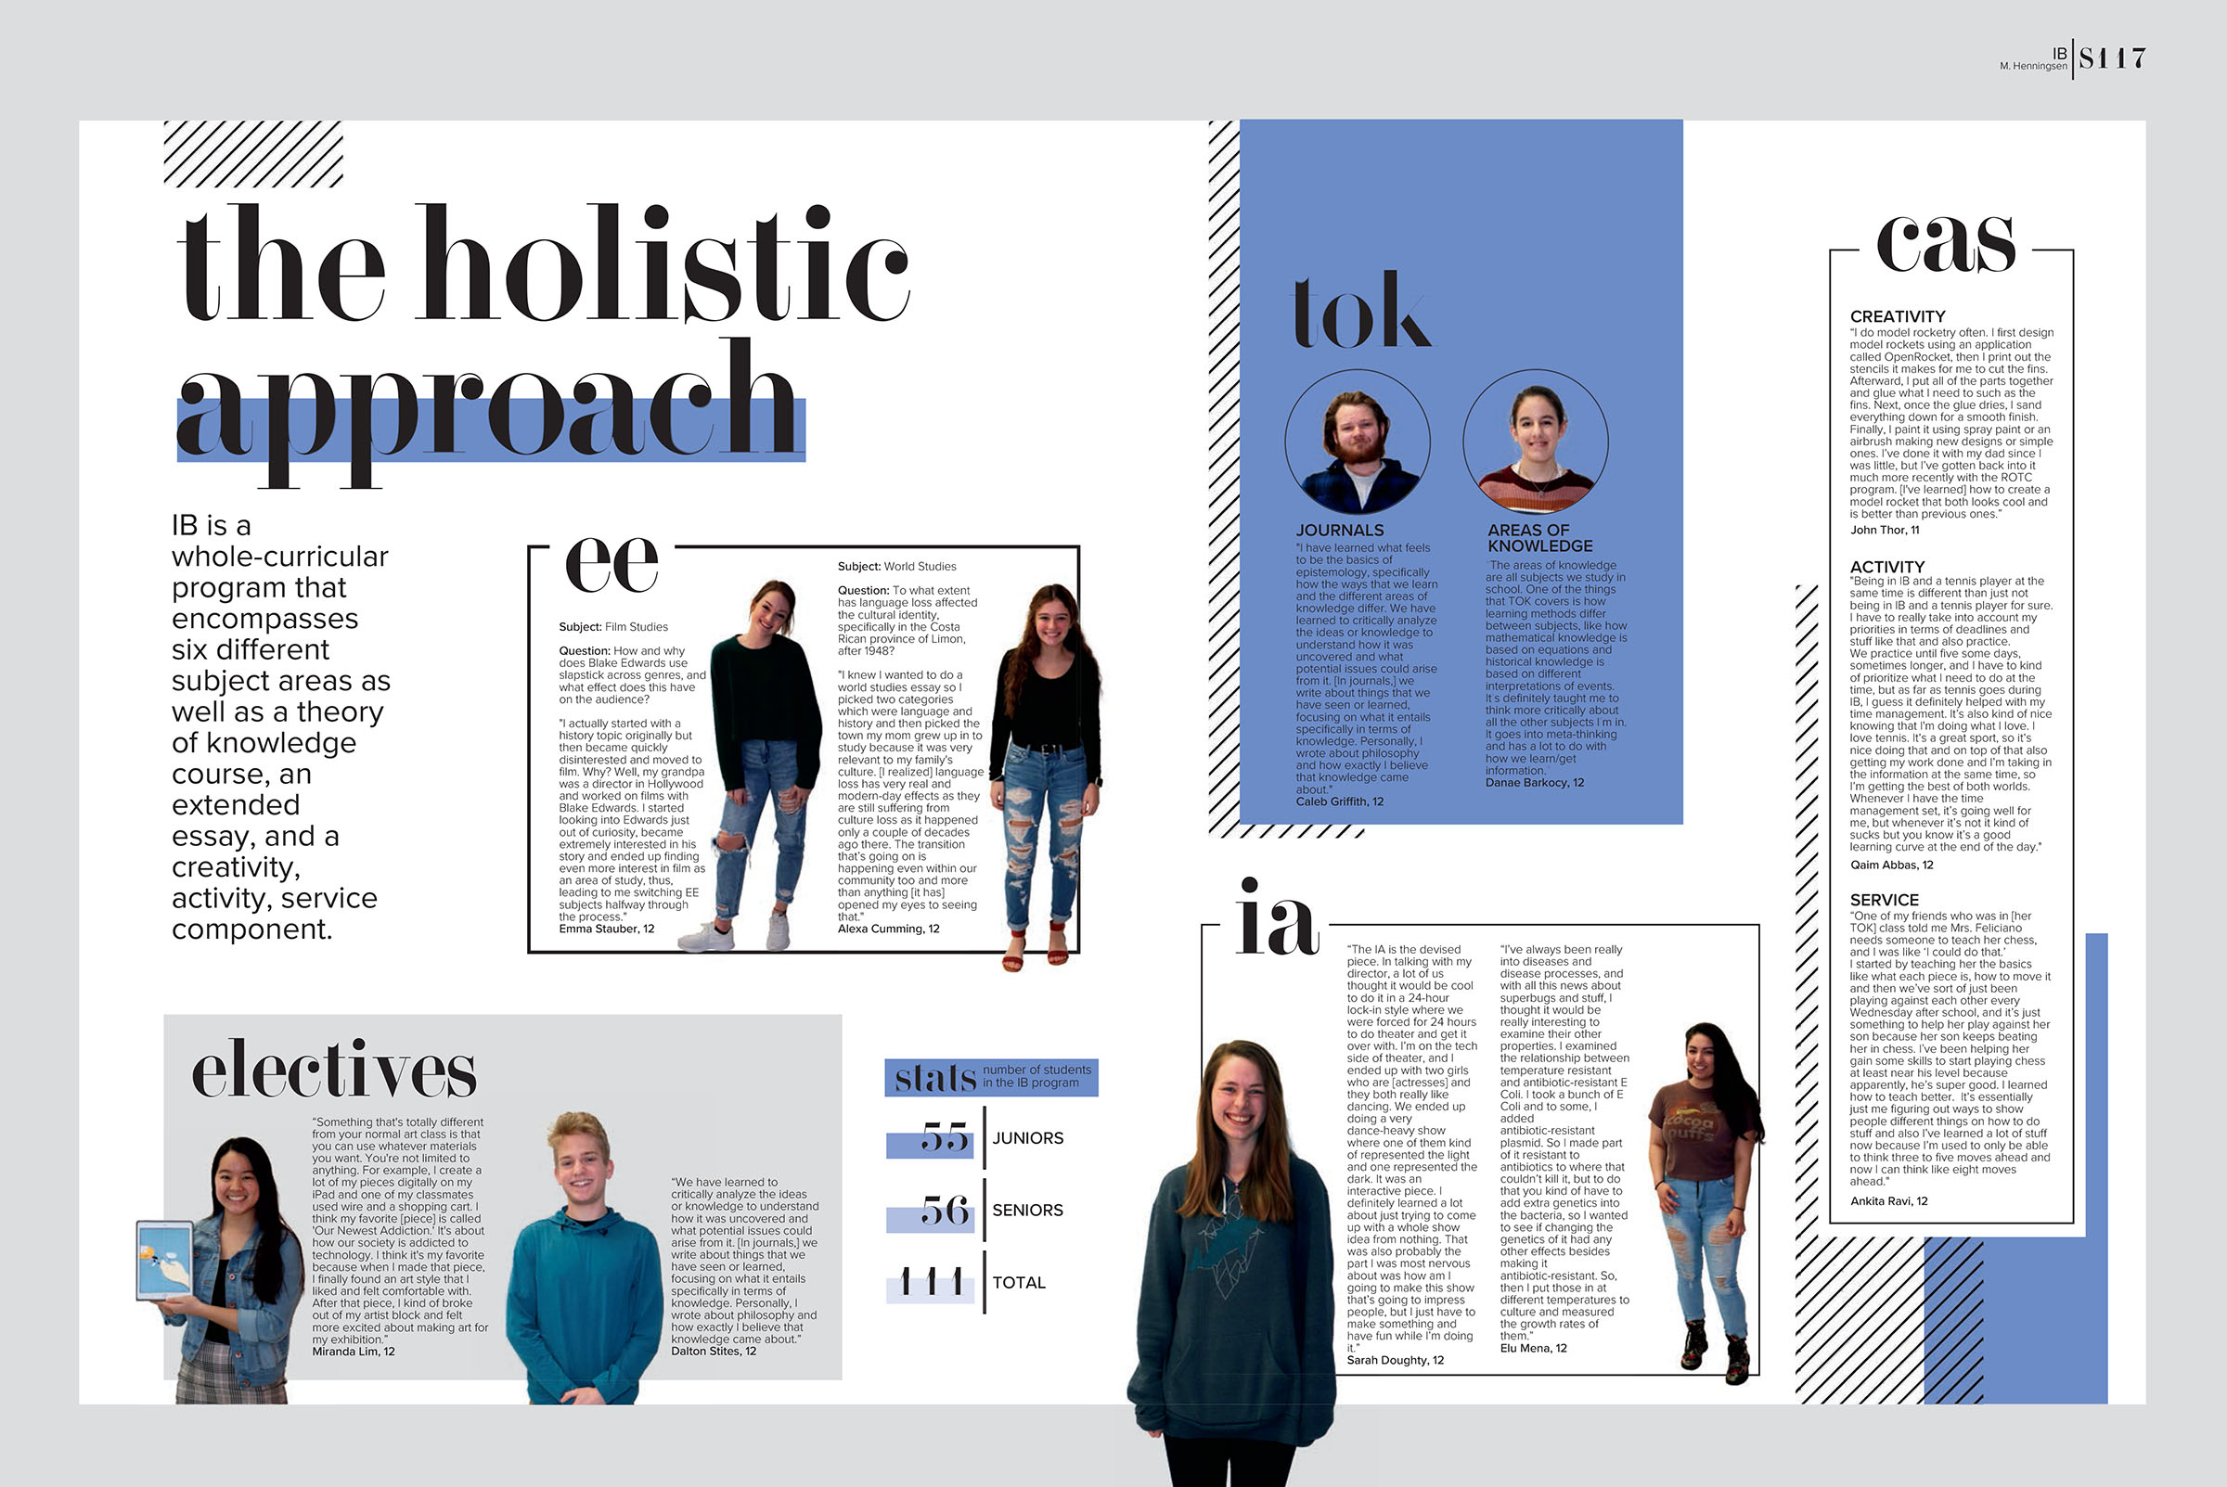
Leander HS

Slide 38
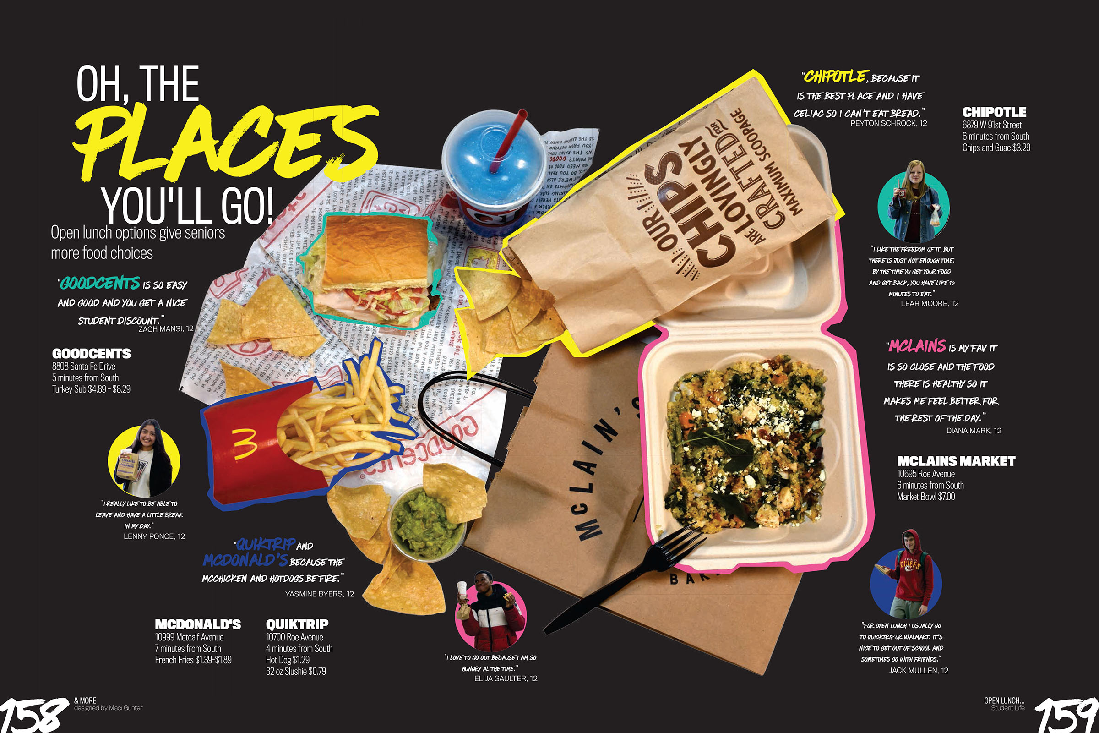
Shawnee Mission South HS

Slide 39
Hill Country Christian School

Slide 40
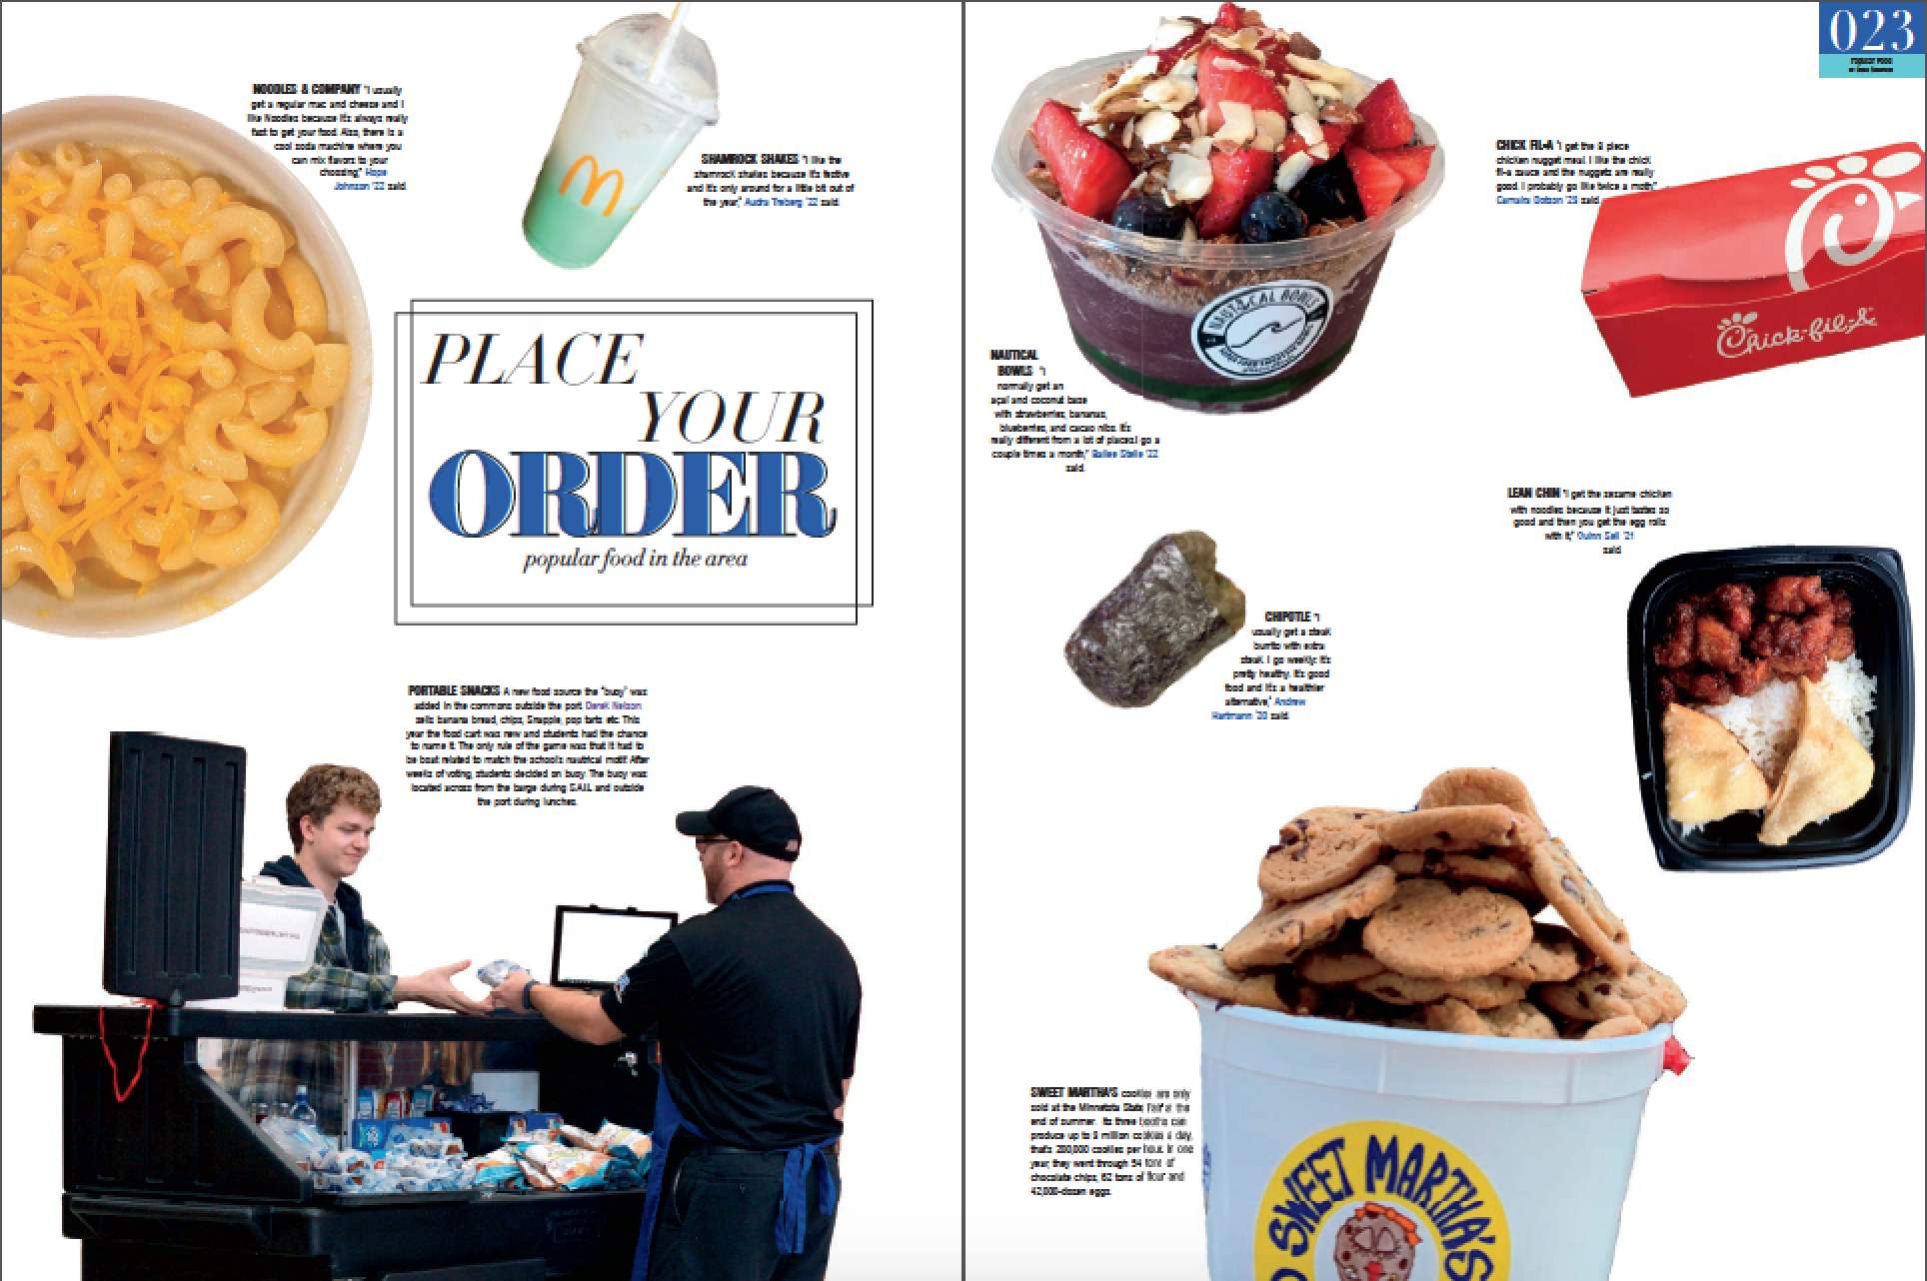
Minnetonka HS

Slide 41
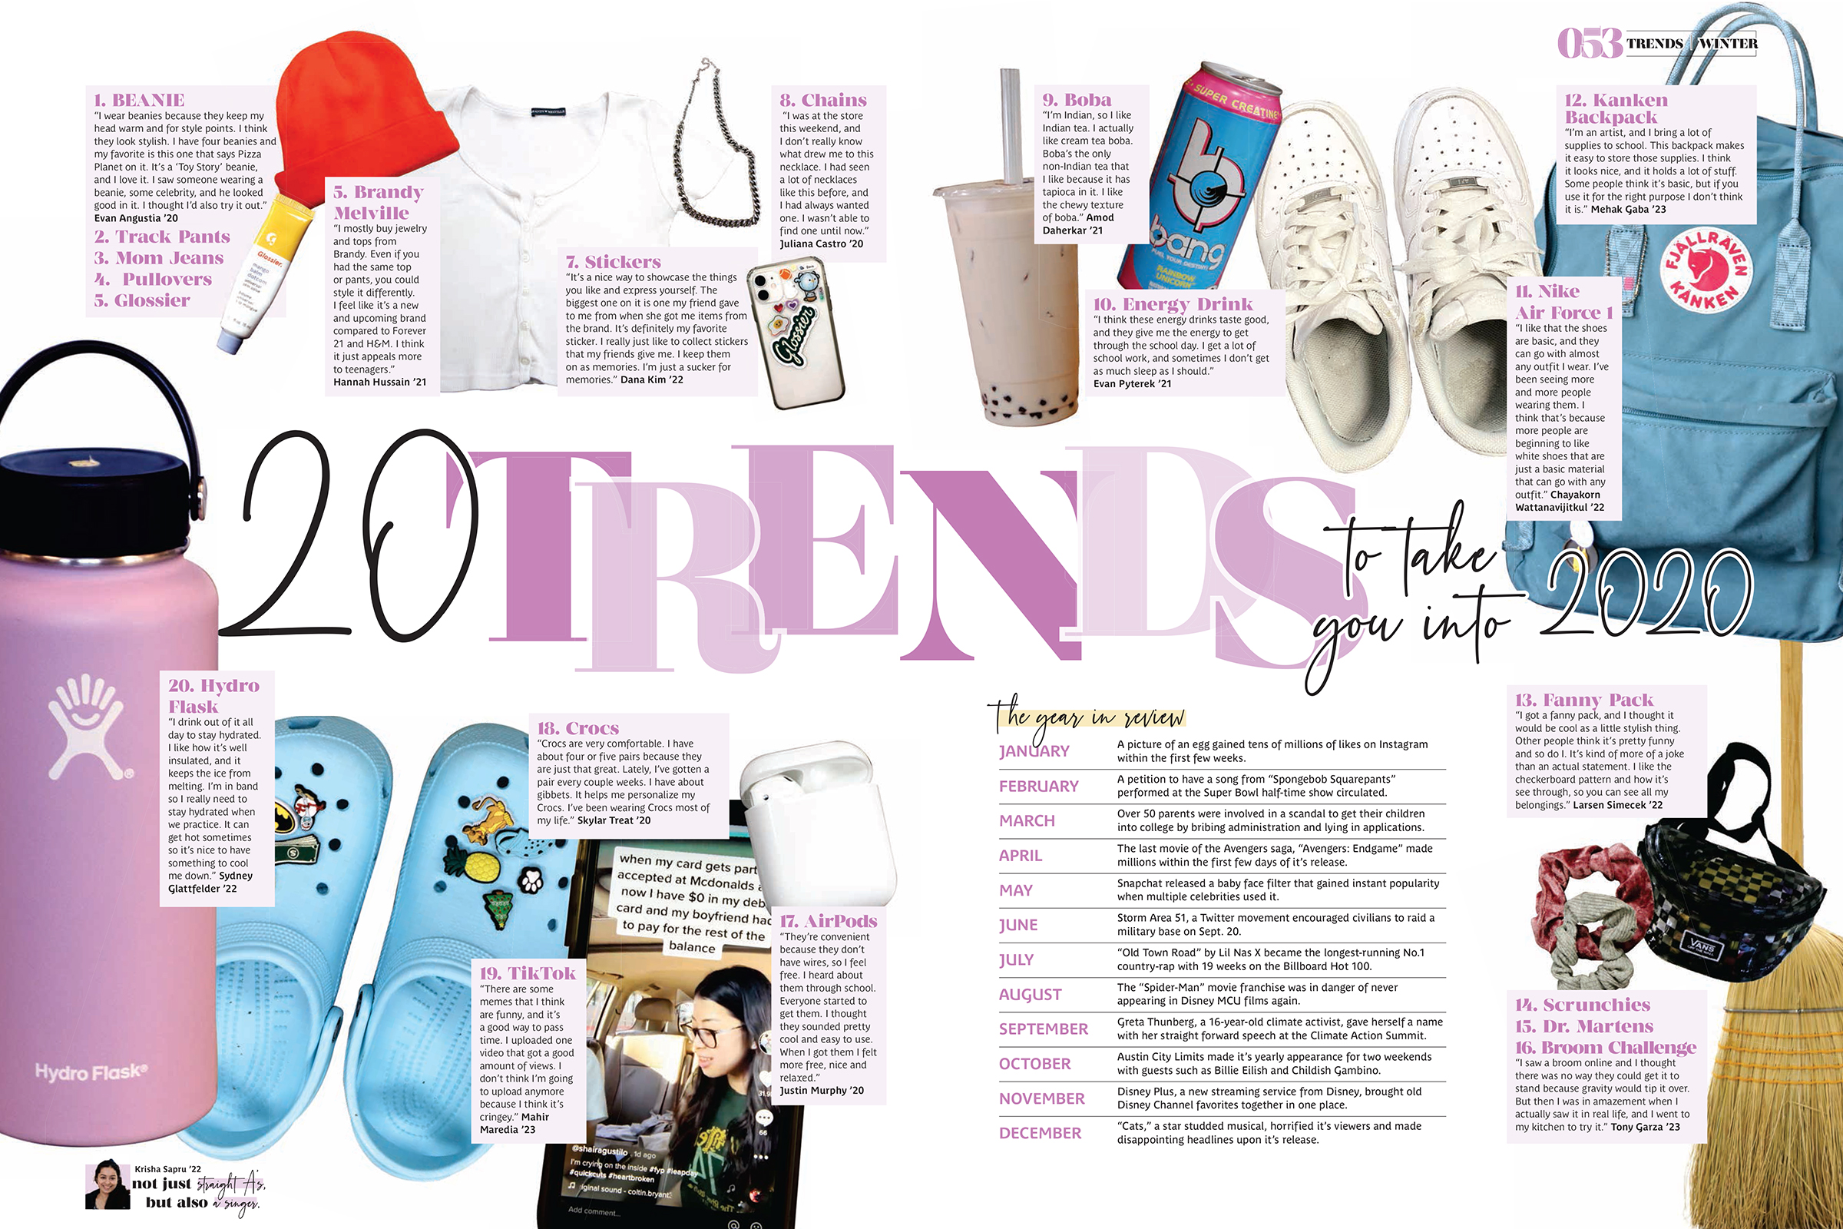
Vista Ridge HS

Slide 42
photos
SMALL
NO DOMINANT

Slide 43
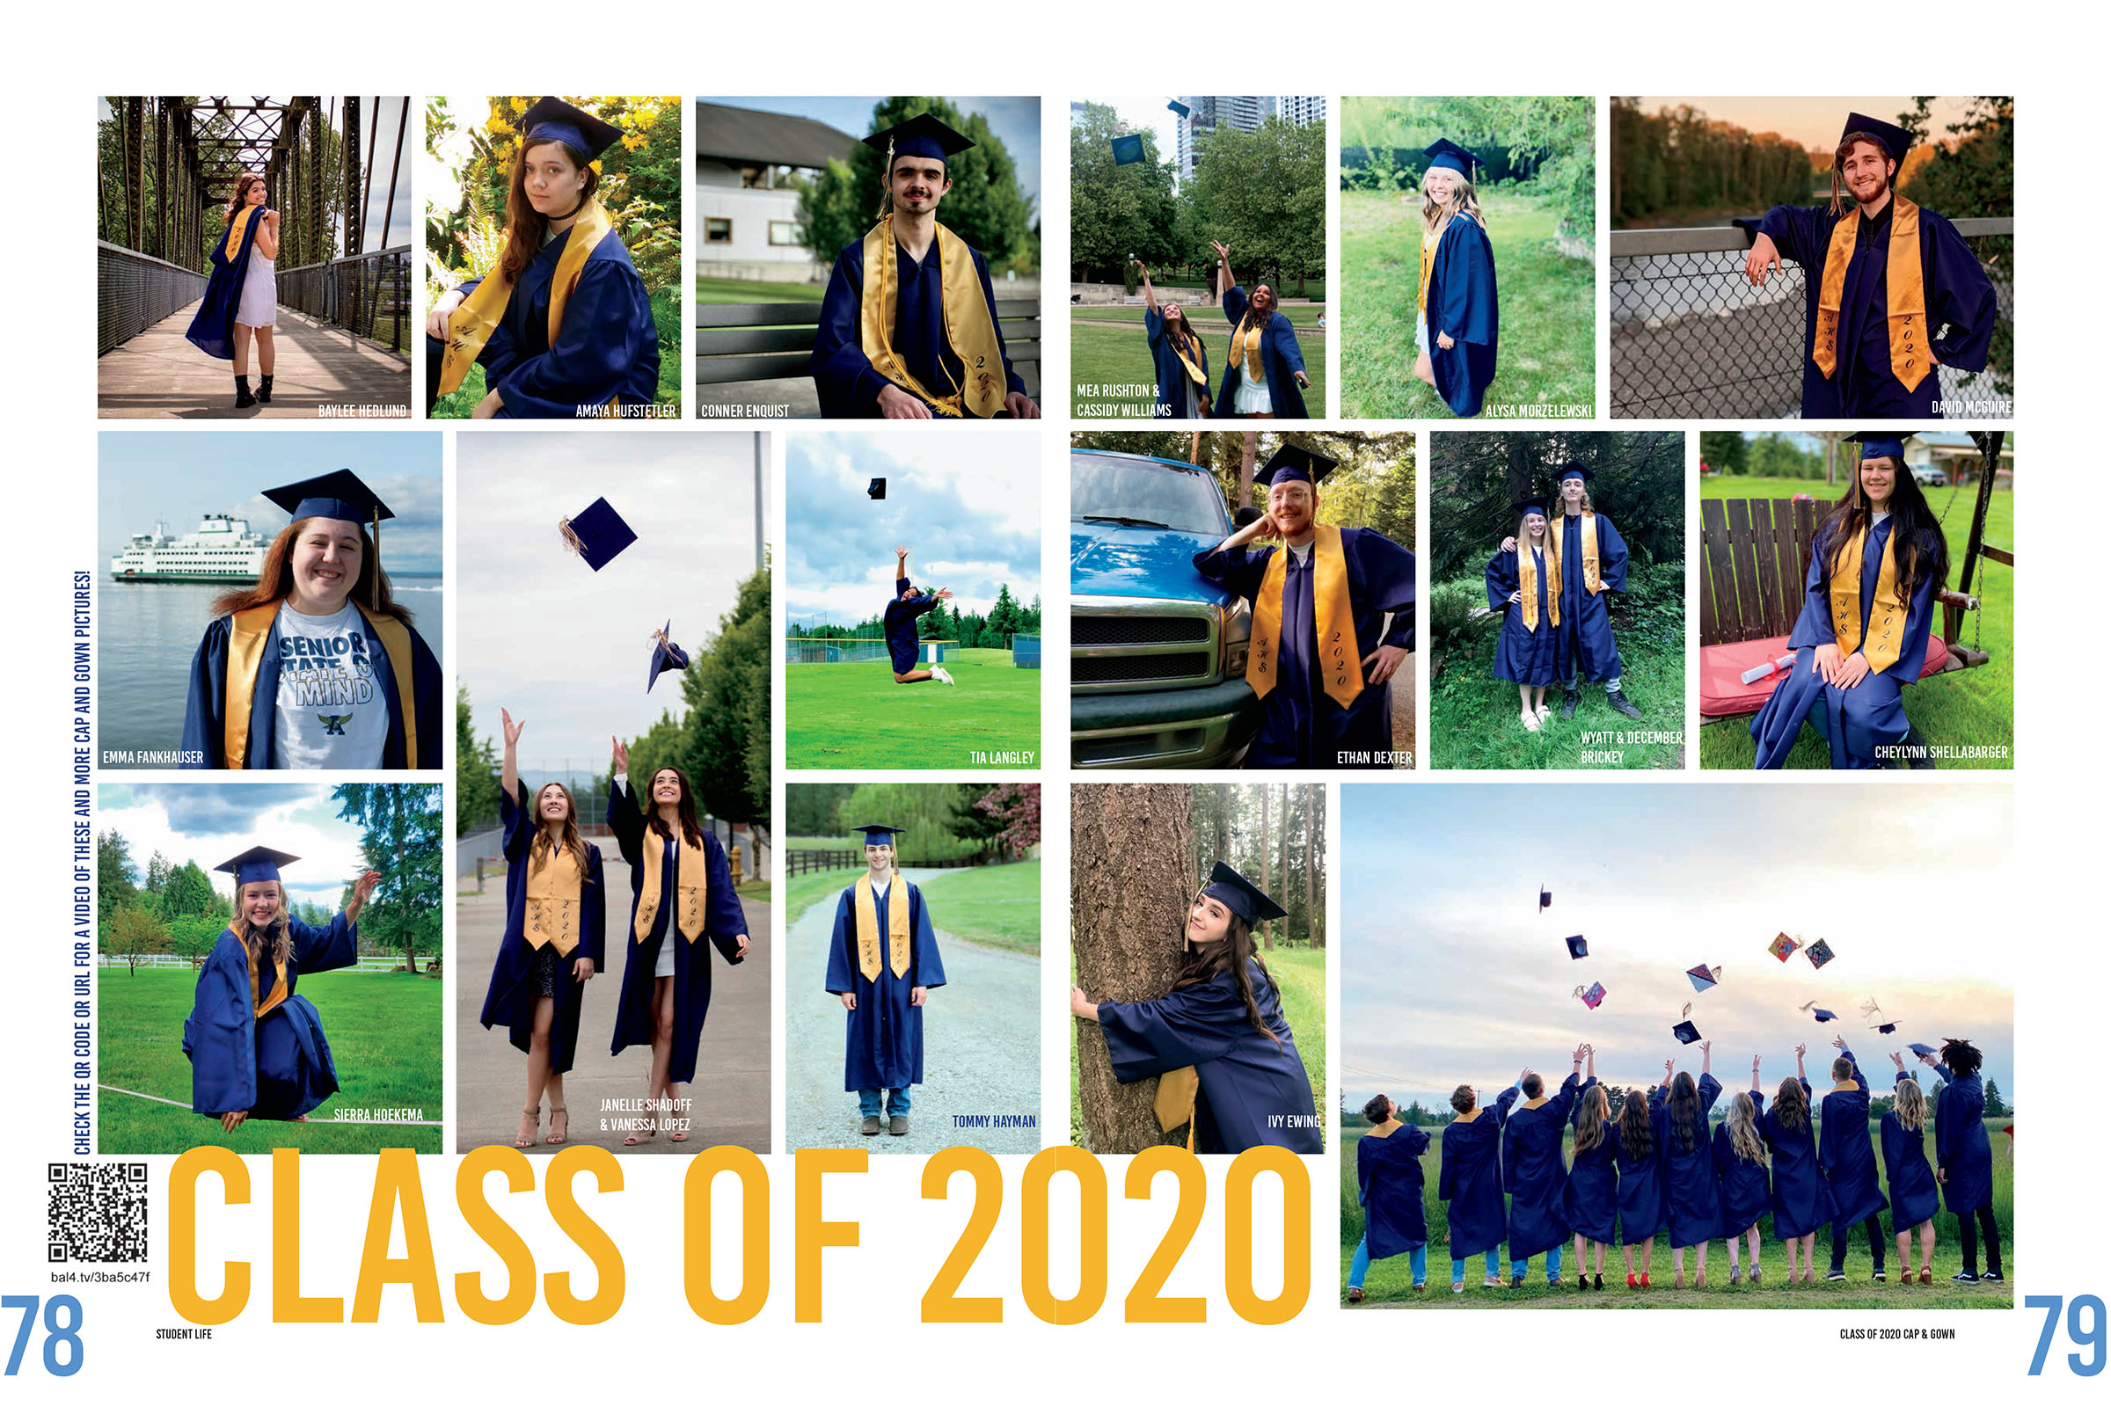
Arlington HS

Slide 44
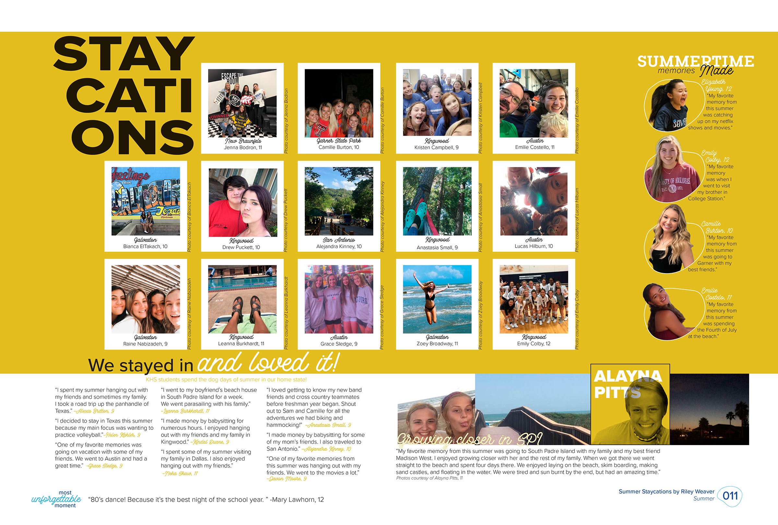
Kingwood HS

Slide 45
Claudia Taylor Johnson HS

Slide 46
Shawnee Mission South HS

Slide 47
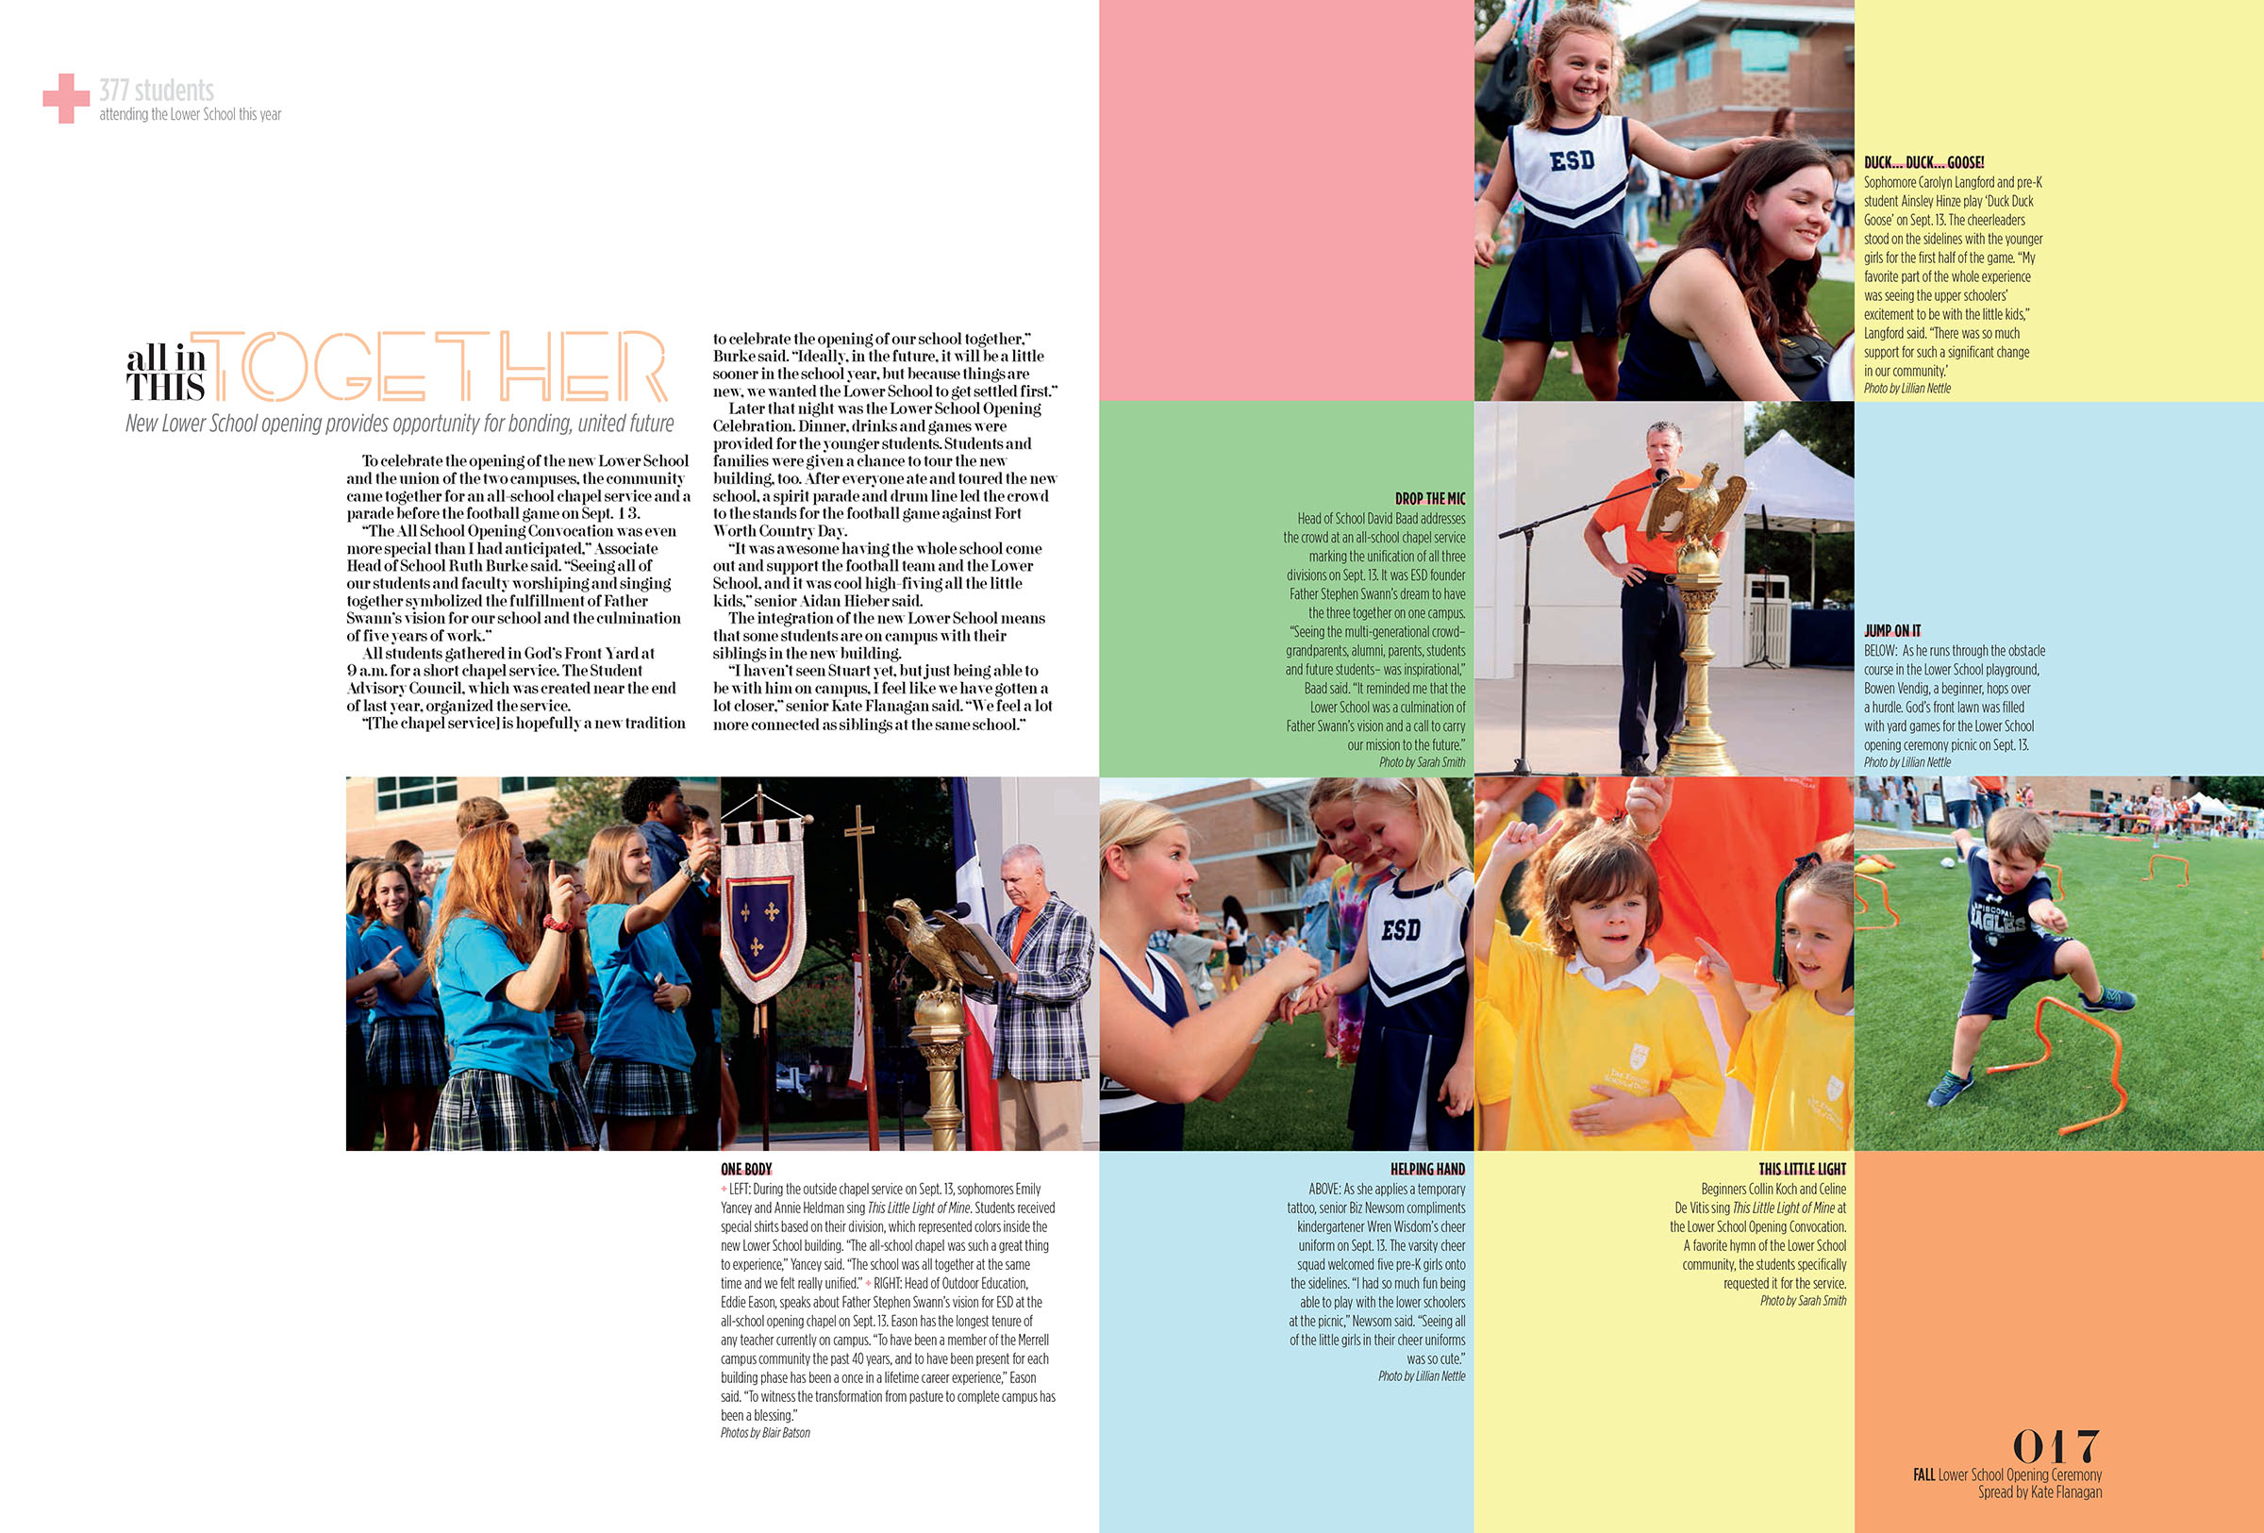
Episcopal School of Dallas

Slide 48
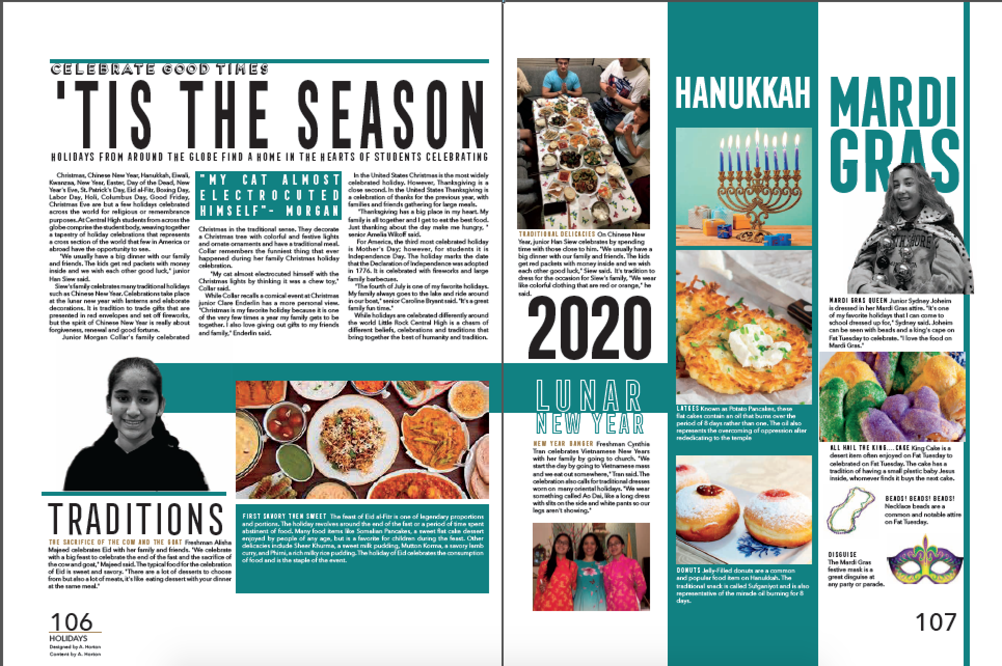
Little Rock Central HS

Slide 49
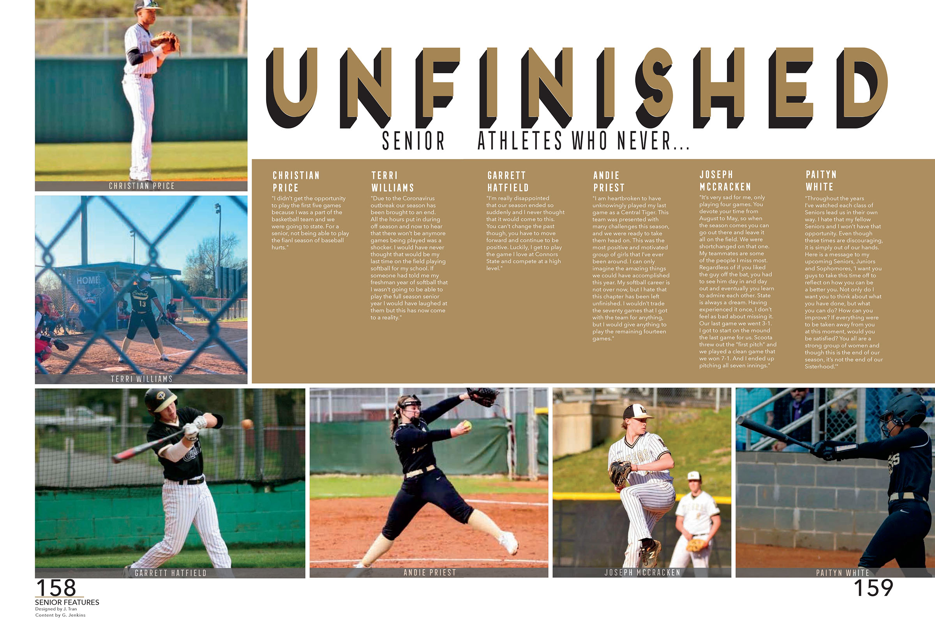
Little Rock Central HS

Slide 50
TRADITIONAL
coverage
TOPICS

Slide 51
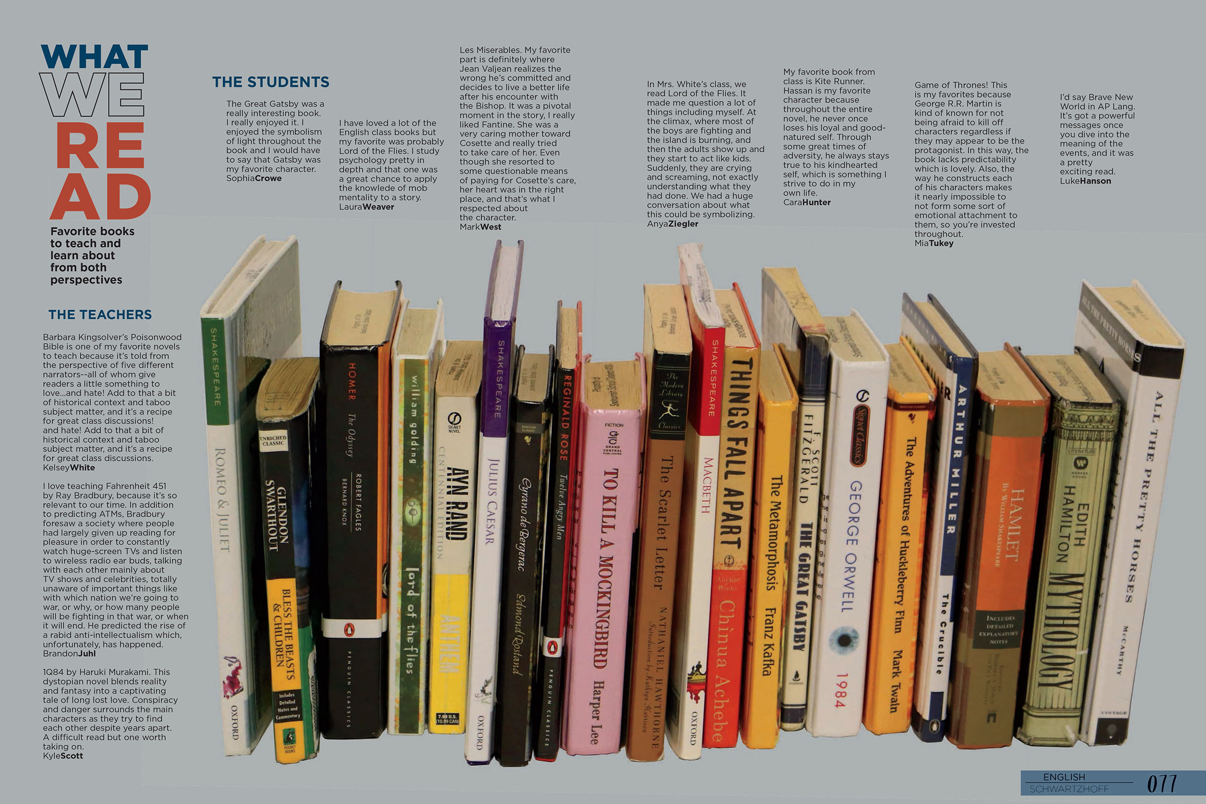
Glacier Peak HS

Slide 52
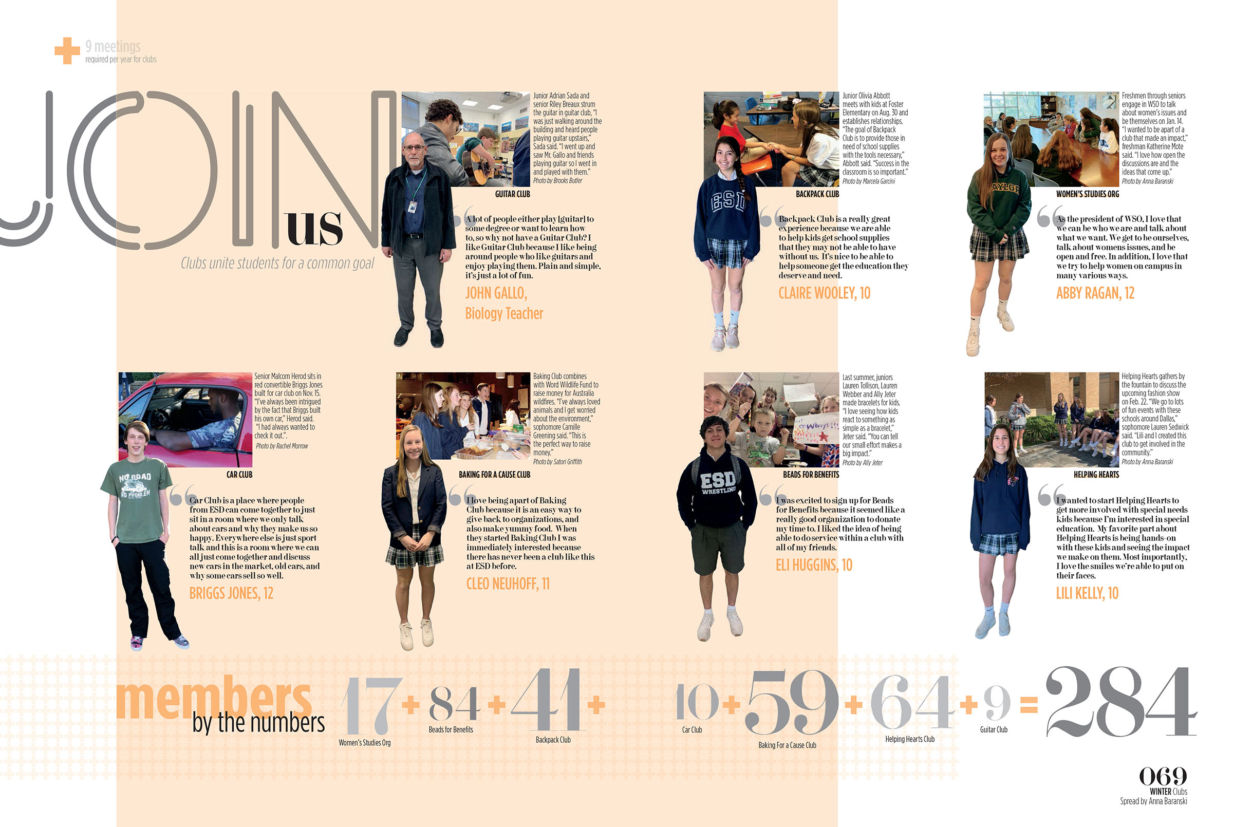
Episcopal School of Dallas

Slide 53
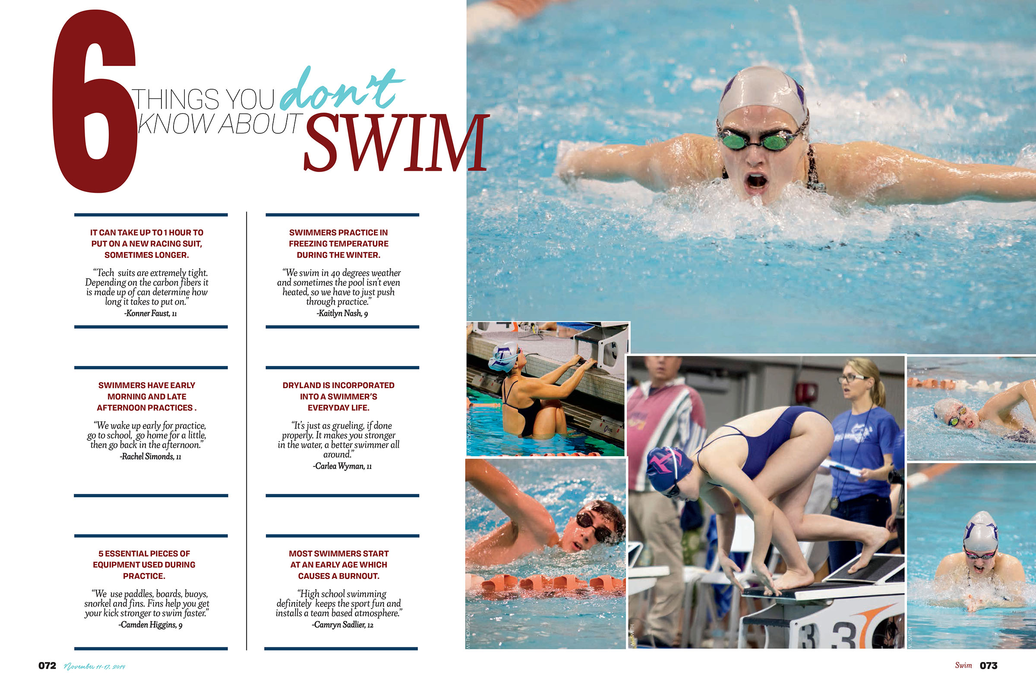
Hendrickson HS

Slide 54
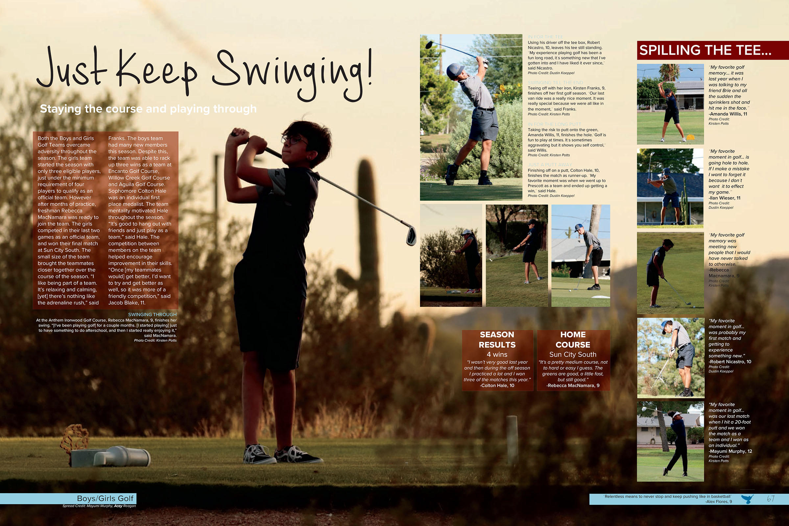
Deer Valley HS

Slide 55
Episcopal School of Dallas

Slide 56
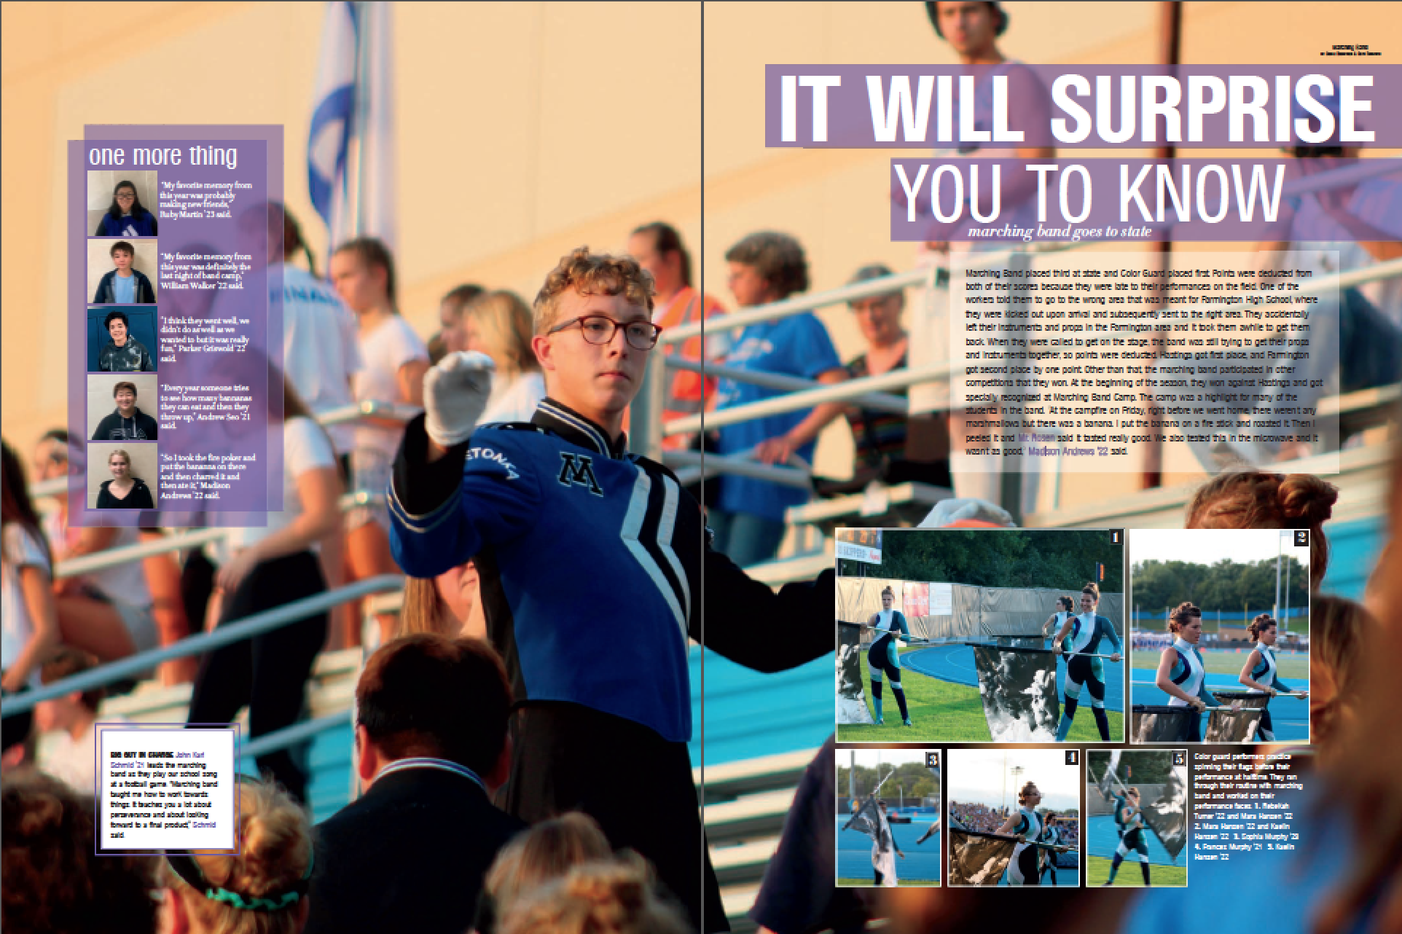
Minnetonka HS

Slide 57
Glacier Peak HS

Slide 58
photo
FULL-BLEED
AS BACKGROUND

Slide 59
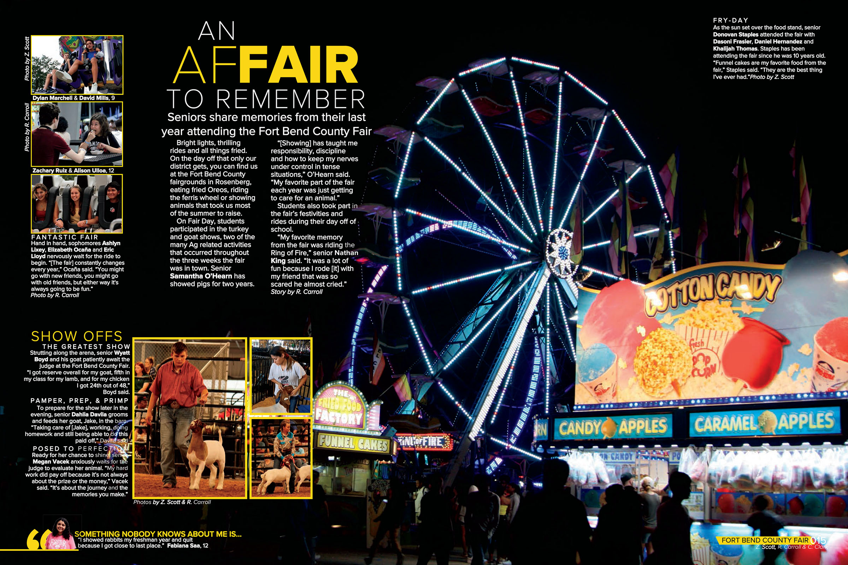
Foster HS

Slide 60
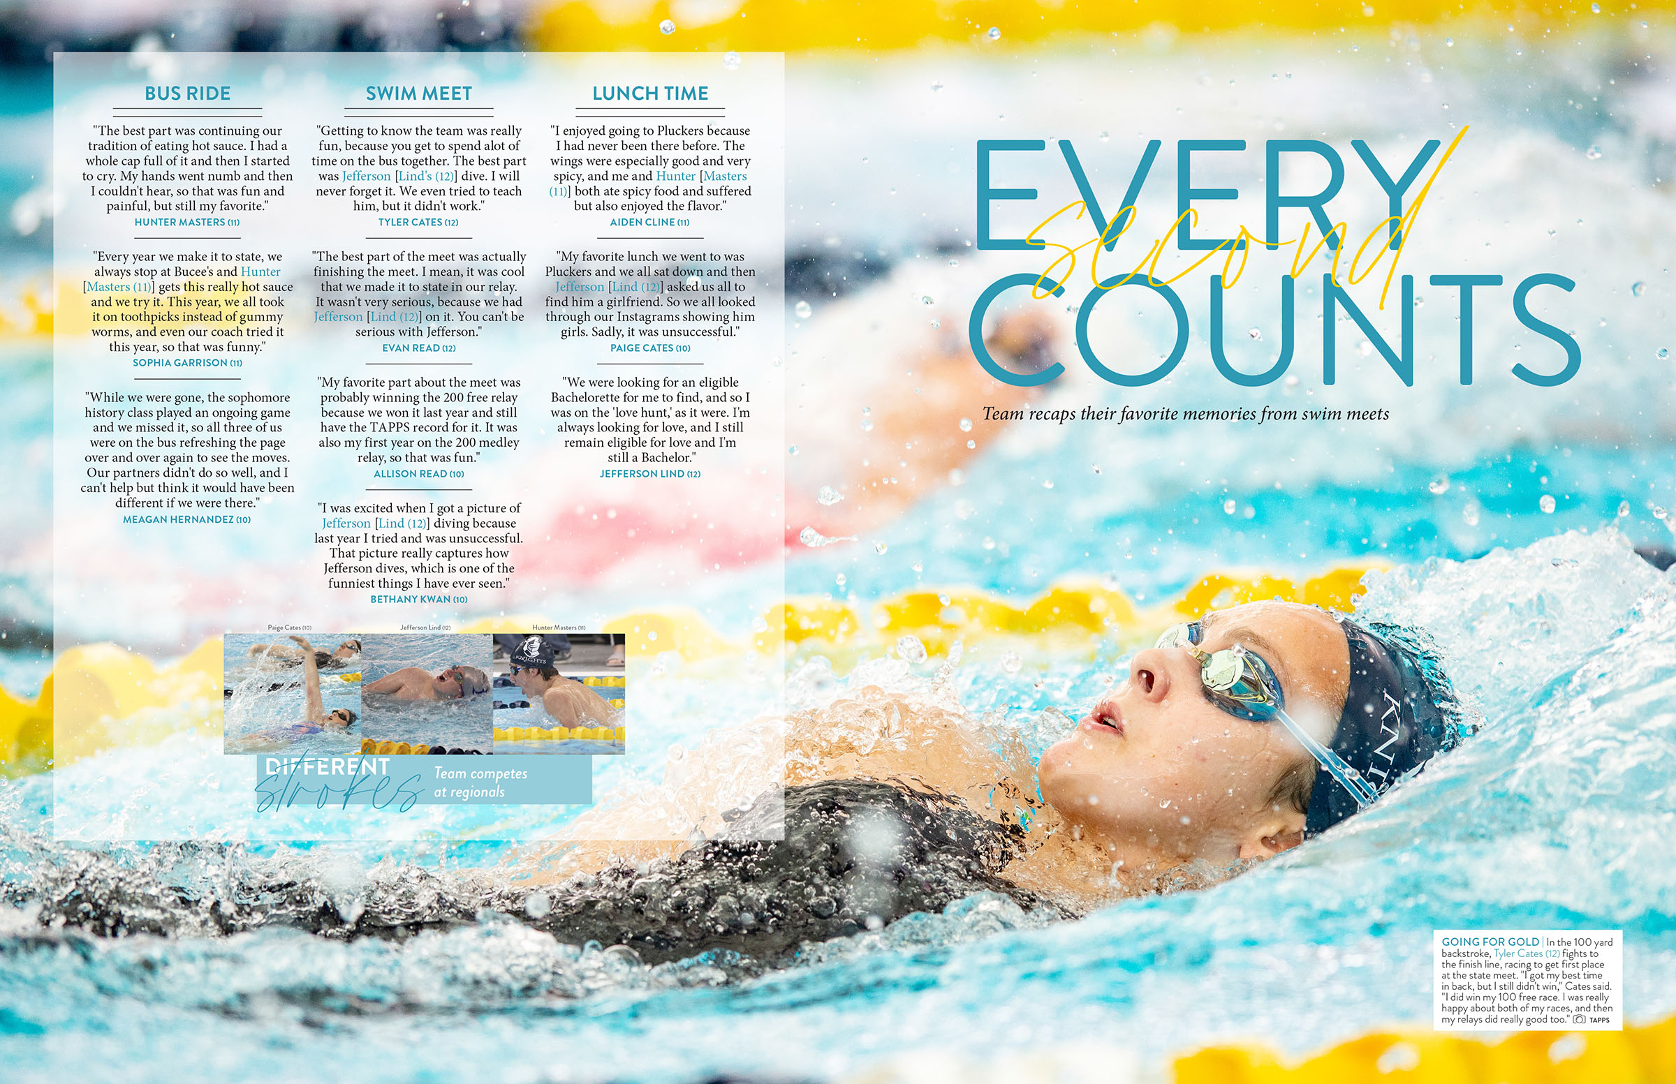
Hill Country Christian School

Slide 61
Klein Oak HS

Slide 62
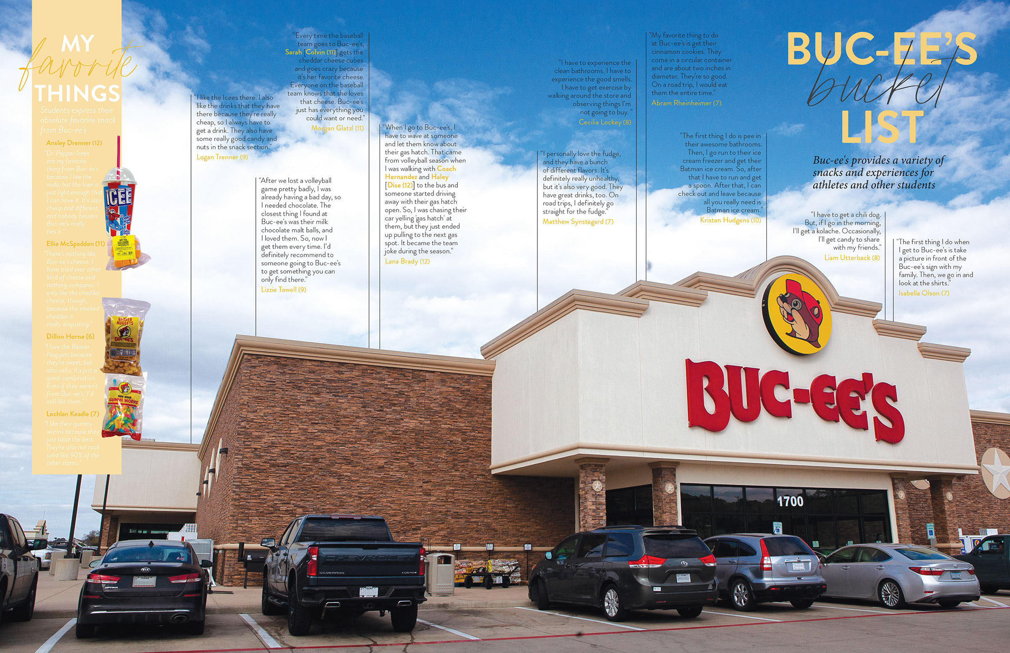
Hill Country Christian School

Slide 63
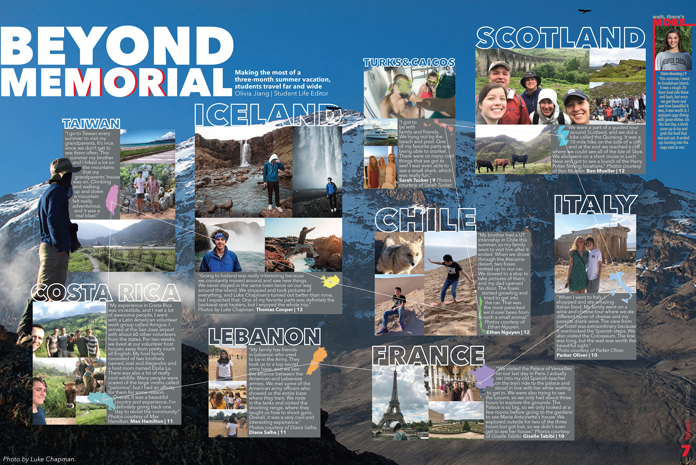
Memorial HS

Slide 64
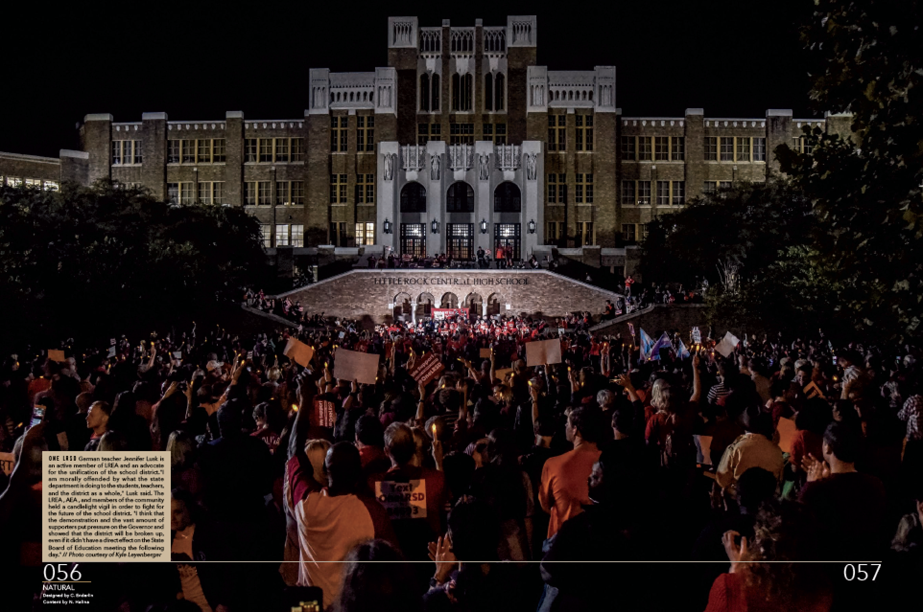
Little Rock Central HS

Slide 65
Leander HS

Slide 66
CREATIVE.
UNCONVENTIONAL.
inspiring.

