Slide 1
Copyright
AND FAIR USE

Slide 2

Is it okay to use superheroes or movie images in the yearbook?
Are photos posted on Facebook or Instagram copyrighted?
Who owns student photos published in the yearbook?
To answer these questions and more, we need to understand copyright and fair use.

Slide 3
copyright
basics

Slide 4
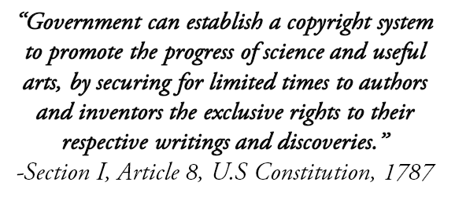
The Founders believed copyright protection would encourage innovation and benefit society.

Slide 5
Copyright
Copyright law provides authors and artists exclusive rights to their original, creative works for a limited amount of time.

Slide 6
Copyright
To qualify for copyright, the work must be:
original
creative expression fixed in a tangible medium

Slide 7

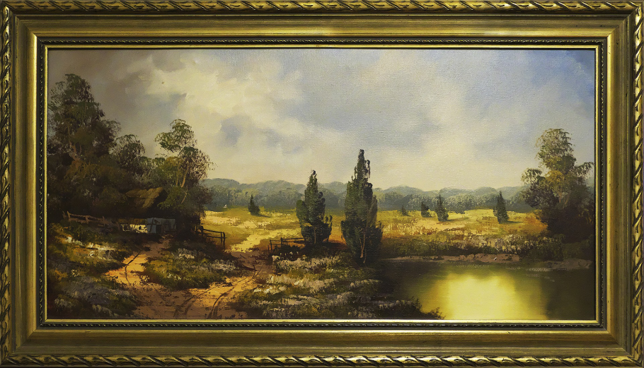
Copyright
Copyright protects architecture, art, computer software, literary works, music and photography.
Notes:
Once you create an original work and fix it in a medium (paper, paint, computer) it is copyrighted. The minute you draw on paper or snap a picture, the work is copyrighted. You don’t have to file with the copyright office.
Copyright even protects advertising and wallpaper.

Slide 8

Copyright
Not all forms of expression are protected by copyright.
Names, slogans, titles, words and short phrases, instructions, ingredient lists and familiar symbols or designs typically lack the needed originality.
Facts and ideas are not copyrighted.
Notes:
You can’t copyright facts or ideas, but what you create from that idea or fact is copyrighted.

Slide 9
Copyright
Copyright protects owners from unauthorized use of their work.
You can’t copy the work unless:
    You have permission from the owner
    You pay the owner a fee
    You claim fair use
Notes:
You can’t copyright facts or ideas, but what you create from that idea or fact is copyrighted.

Slide 10
?
What is
fair use

Slide 11
Fair use
Fair use is an exception to copyright infringement.
It gives people the use of copyrighted material for a limited and transformative purpose without consent or payment.

Slide 12
Fair use
Section 107 of the U.S. Copyright Act, 1976:
Allows the use of copyrighted material for criticism, comment, news reporting, teaching, scholarship or research purposes.
Notes:
The fair use doctrine is a statutory exception to copyright infringement and stipulated in the 1976 US Copyright Act.

Slide 13
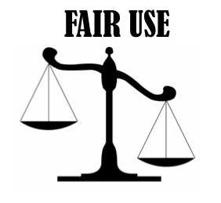
Fair use
Section 107 provides four factors the courts use to determine if the fair use exception applies.
Fair use is a balancing test of the four factors.

Slide 14
Fair use factors
The four factors:
The purpose and character of the use.
The nature of the copyrighted work.
How much of the original work is used.
The effect of the use on the commercial value of the work.
Notes:
The courts use the four factors on a case-by-case basis. They evaluate, apply and weigh each of the factors. The relative importance of the factors is not always the same.

Slide 15
Fair use factors
1. The purpose and character of the use.
Non-commercial use for purposes like news reporting, criticism and commentary are likely be fair.
The more the work is “transformed” (adding new meaning, information or aesthetics) the more likely it is a fair use.
Notes:
Educational vs. Entertainment/commercial
Nonprofit vs. For Profit
Transformative v. Iterative (the exact purpose for what it was created)
*transformative uses heavily favored (parodies, collages)
*education/research uses often iterative, can still be fair use

Slide 16
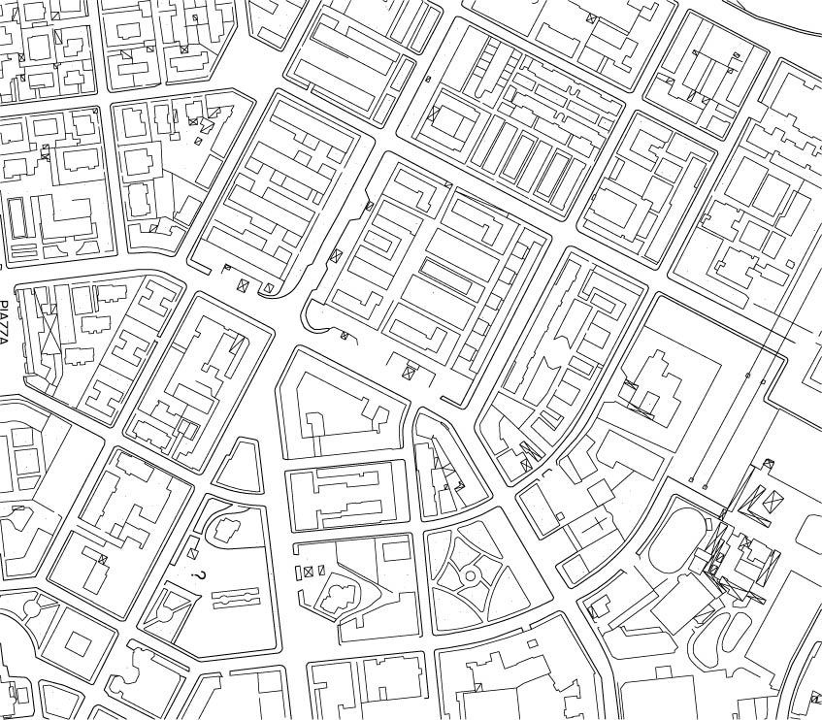
Fair use factors
2. The nature of the copyrighted work.
Using works containing mostly factual material, like maps or biographies, is more likely to be fair than using highly creative and original works like novels and cartoons.
Notes:
Published vs. unpublished
Factual vs. fictional or highly creative

Slide 17
Fair use factors
3. How much of the original work is used.
No more of the work than what is necessary may be used fairly.
The test is both quantitative (how many words of a 200,000 word book are reproduced?) and qualitative.
    Using the core or “heart” of a work, no matter how small, is less likely to be a fair use.
Notes:
Amount and substantiality of use
Less is always better in a fair use analysis
Did you use just the appropriate amount in order to make your point when you incorporated someone else’s copyrighted work?
Transformative uses have been allowed that use an entire work
Better if you do not use “heart of the work”
Parody – may be essential to use the heart or all, but protected
Revealing key details of a book in a review would be an issue

Slide 18
Fair use factors
4. The effect of the use on the commercial value of the copyrighted work.
If consumers are likely to buy what has been used as substitute for the original, it probably will not qualify as a fair use.
Notes:
Impact on the Market
Would it affect the original copyright owner’s ability to make money or derivatives of the work? Is the work still on the market?
If you transform something, you’re not really competing with the original. Transforming it gives it a new purpose, a new intent.

Slide 19
fair use
examples

Slide 20
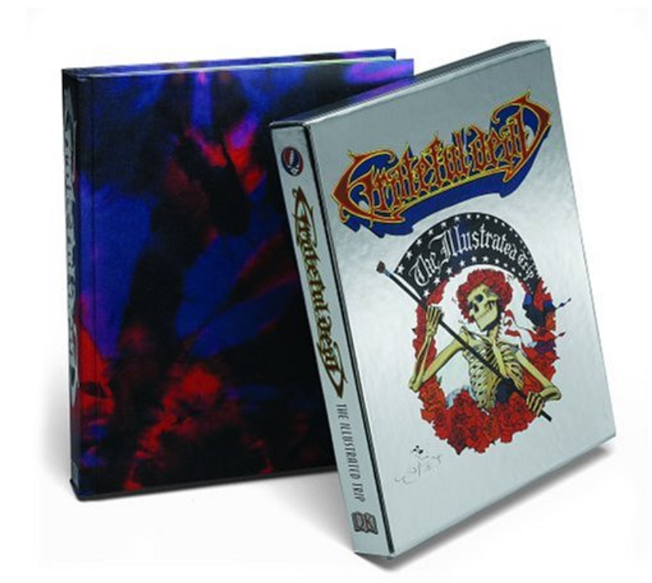
Fair use factors
Bill Graham Archives v. Dorling Kindersley, 2006
In 2003, Dorling Kindersley published ”Grateful Dead: The Illustrated Trip,” a 480-page coffee table book on the history of the rock group.

Slide 21
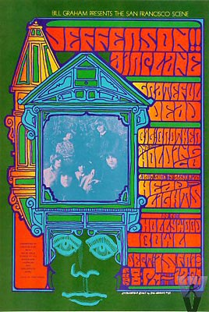
Fair use cases
DK tried to license images used on concert posters and tickets, but couldn’t come to an agreement with BGA.
They published the images anyway and BGA sued for copyright infringement.

Slide 22
Fair use cases
The district court found the usage was fair and the Second Circuit affirmed.
The usage was “transformatively different” because the images were used in a biographical timeline.
They were printed smaller and scattered among other items
Only 7 of 2000+ images, a marginal affect on the commercial book value
Notes:
The courts noted biographies are a recognized form of scholarship and criticism and DK’s purpose was different from the promotional purpose the posters were created for.

Slide 23
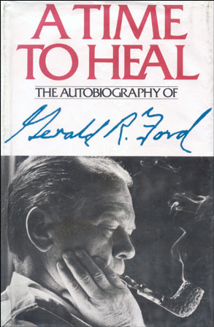
Fair use cases
Harper & Row v. Nation Enterprises, 1985
In 1979, Time paid $12,500 to run an exclusive excerpt of president Ford’s upcoming memoir about pardoning Nixon.

Slide 24
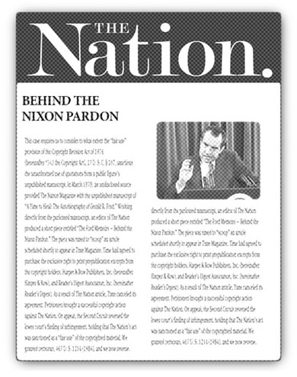
Fair use cases
The Nation magazine obtained an unauthorized copy and printed an article several weeks before the Time excerpts.
The article paraphrased passages and used 300 words directly.

Slide 25
Fair use cases
Time canceled the article and refused to pay.
Harper & Row sued The Nation for copyright infringement.
The Supreme Court ruled in 1985 the Nation infringed on the copyright.

Slide 26
Fair use cases
The book had not been published yet, taking away the “valuable right of first publication.”
Although only 300 words were used verbatim, the quotes were the “dramatic focal points.”
    This is the “heart” of the work criteria in third fair use factor: the amount of work used.

Slide 27
Fair use cases
While the courts weigh all four factors, the first factor is the most essential: the purpose and character of the use.
The more transformative the use, the more likely it will be considered fair use.
You see examples of fair use every day.

Slide 28
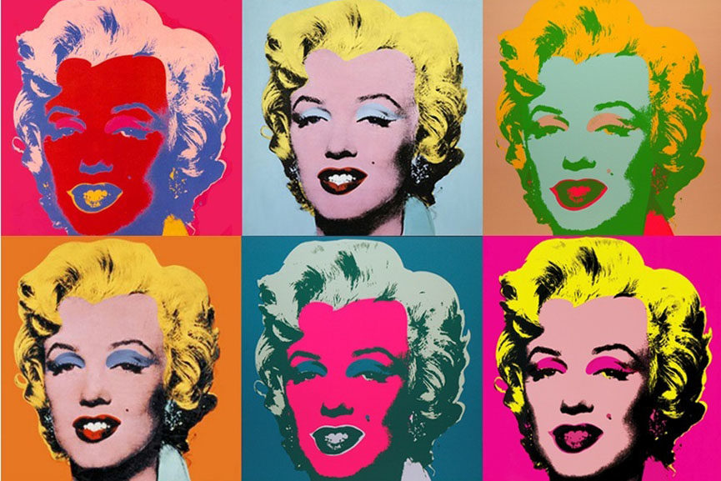
Fair use is everywhere.
Andy Warhol using old art to create new art.

Slide 29
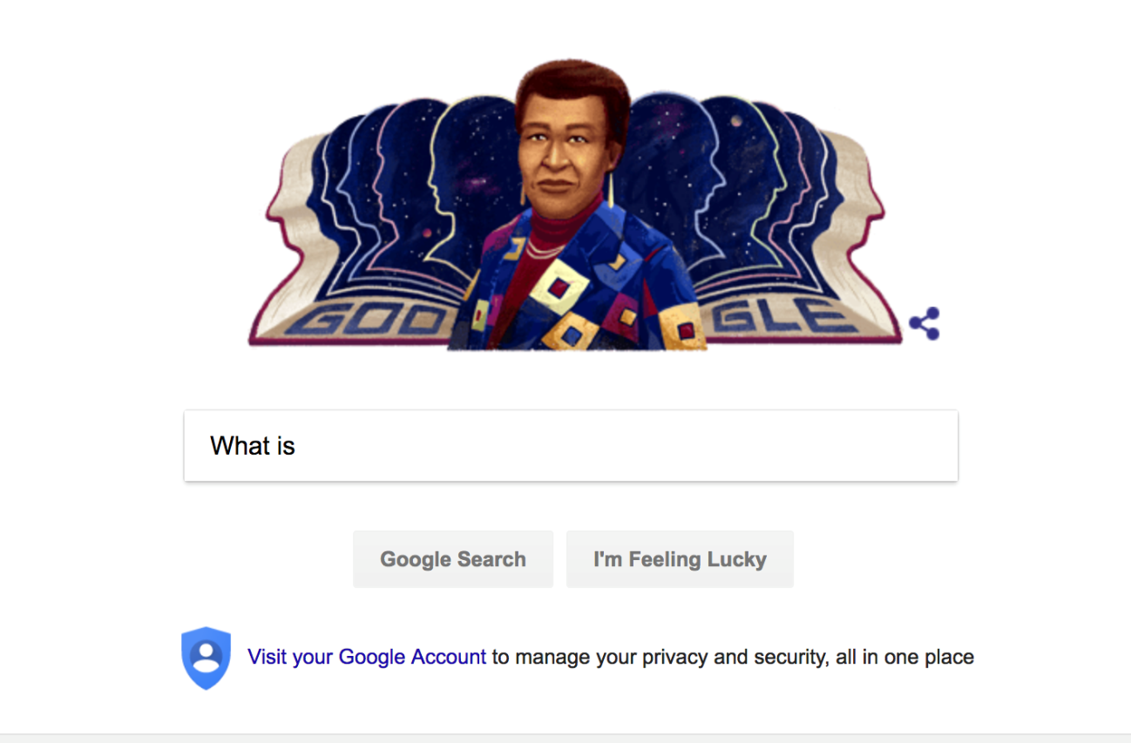
Fair use is everywhere.
Creating databases like Google to make images searchable.

Slide 30
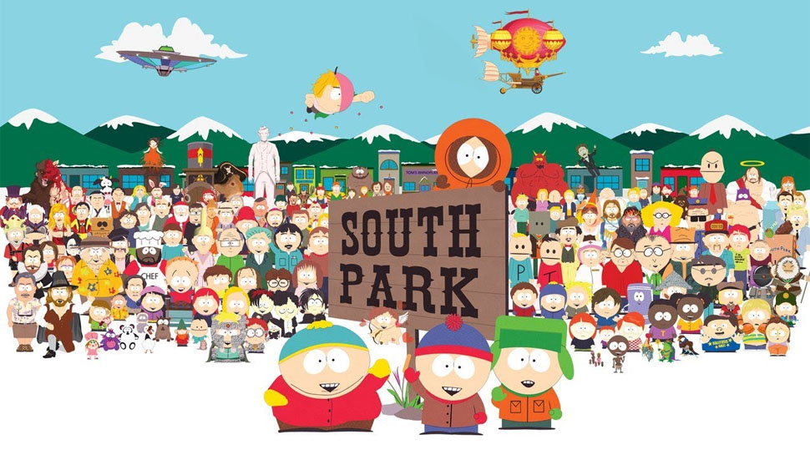
Fair use is everywhere.
South Park’s making fun of culture is fair use.

Slide 31
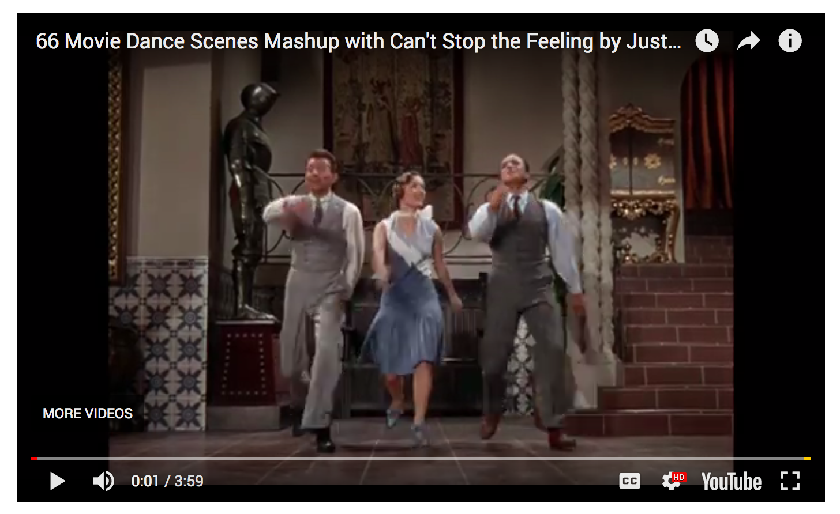
Fair use is everywhere.
Mashup videos and fan fictions are examples of fair use.

Slide 32
copyright
questions

Slide 33
Q:
Can we use media photos from a national event without permission?

Slide 34
A:
No.
Although your purpose is news reporting, it would not qualify as a fair use of the copyrighted images.
On the other hand, critiquing the media’s coverage of the news event would allow you to use photos or the full page (reduced in size).
Notes:
The smaller size helps with the “transformative” aspect which makes it more likely fair use.

Slide 35
A:
Contact the media outlet, which may allow you to buy the desired images or give you permission to use them.
Smaller outlets, like a local newspaper, often allow usage with proper attribution. Larger ones charge a fee.
The Tribune News Service is a wire agency that provides national news coverage for an annual fee.
Notes:
Tribune News Service offers a price for newspapers and yearbooks. The yearbook price depends on the size of the student population.

Slide 36
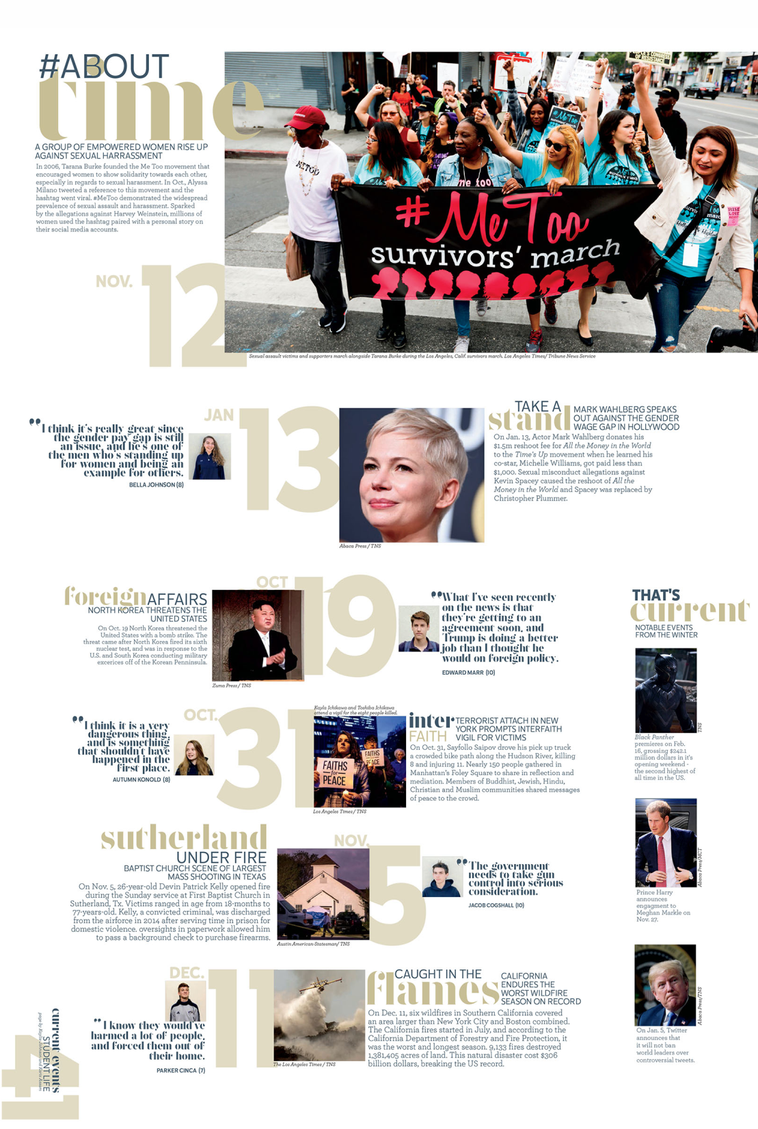
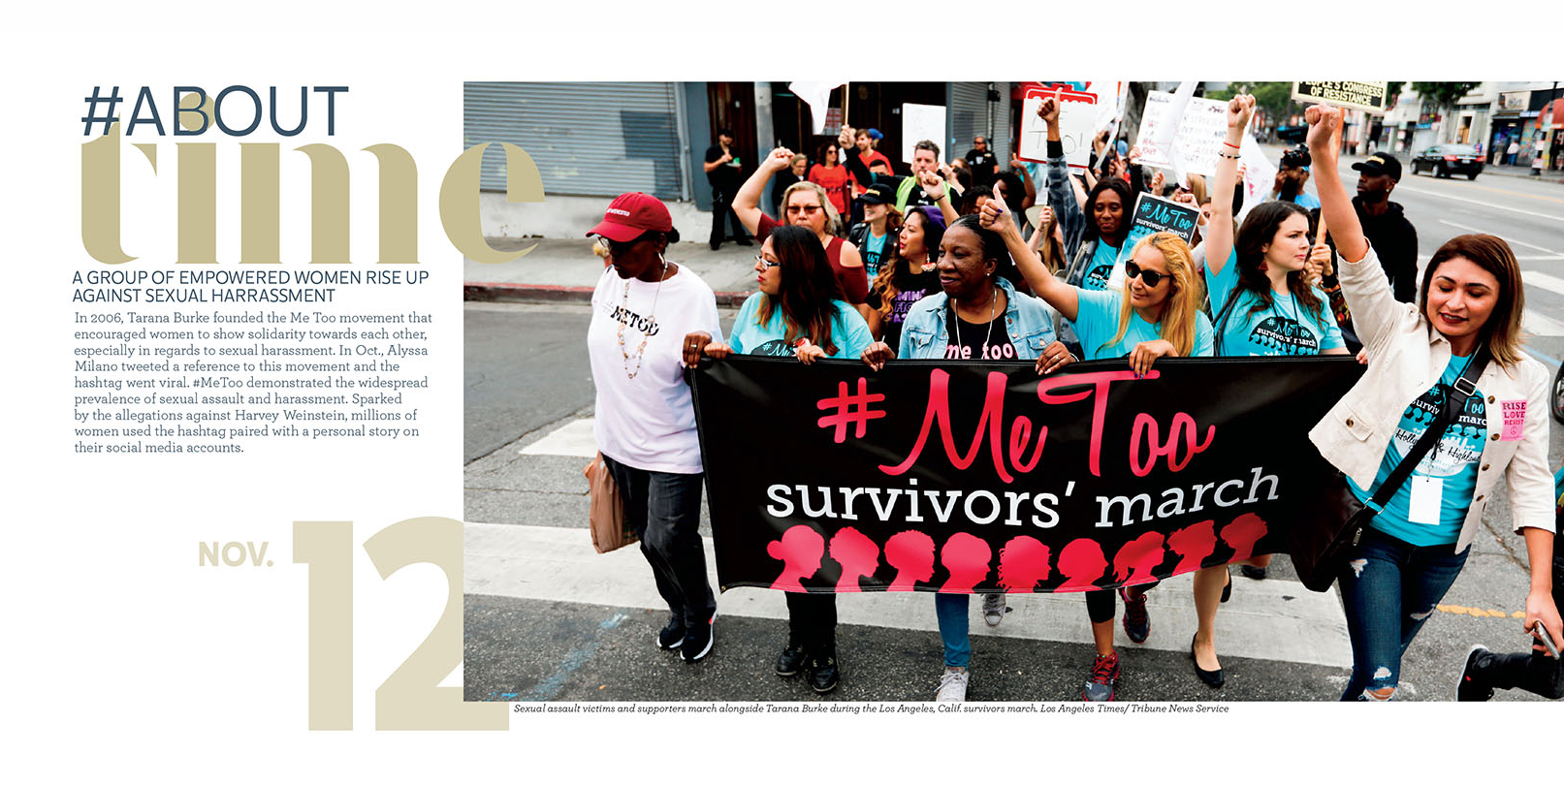
Holy Trinity
Notes:
Tribune News Service offers a price for newspapers and yearbooks. The yearbook price depends on the size of the student population.

Slide 37
Q:
Can we use book covers, CD covers or movie stills for reviews?

Slide 38
A:
Yes.
You’re providing commentary and criticism which is considered a fair use.
The fair use argument is stronger by reducing the image’s size.
It’s preferable to photograph CDs and books instead of pulling online images.
Download movie stills from studio sites.
Notes:
The smaller size helps with the “transformative” aspect which makes it more likely fair use.

Slide 39
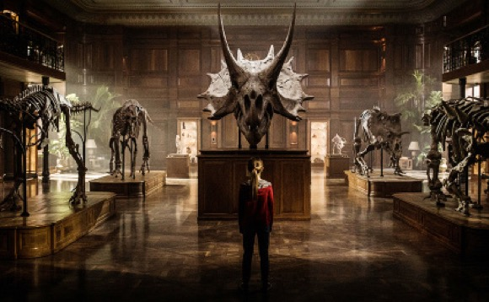
A review of the movie Jurassic World could use stills from the film. Similarly, quotes from students about the best movies of the year or their favorite book-to-movie adaptations would also qualify as fair use. Universal Pictures

Slide 40
Q:
Can we use cartoon characters, superheroes, books or movies?

Slide 41
A:
Yes, if they are used with commentary (quotes or a survey).
Surveys should measure student interest and how many sampled.
Using smaller images helps validate the fair usage.
Copyrighted images used to decorate the book or on the cover would NOT be a fair use.

Slide 42
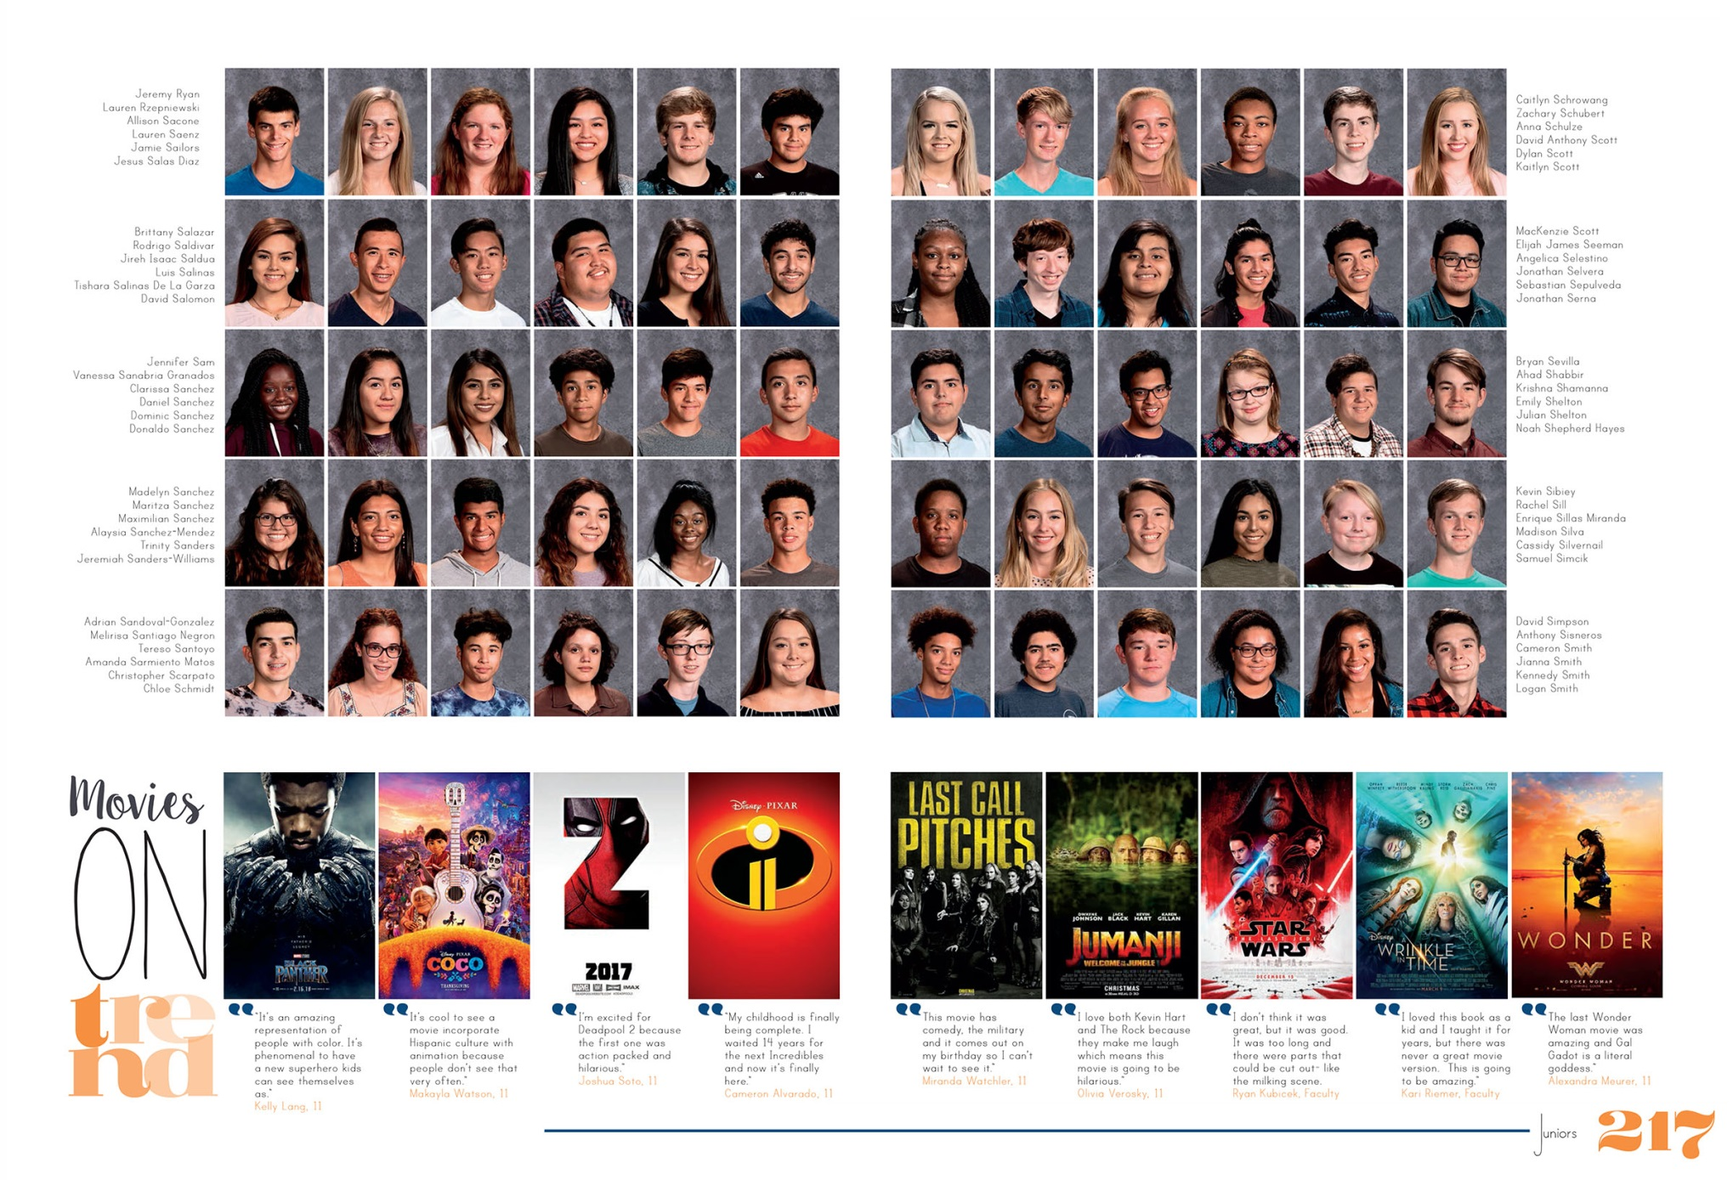
Hendrickson

Slide 43
Q:
Can we use company logos or app icons without permission?

Slide 44
A:
Yes, if it is connected with a news story, feature story or survey about the company.
However, you can’t use the logos or apps for marketing purposes, like a logo on the yearbook cover to sell more books.

Slide 45
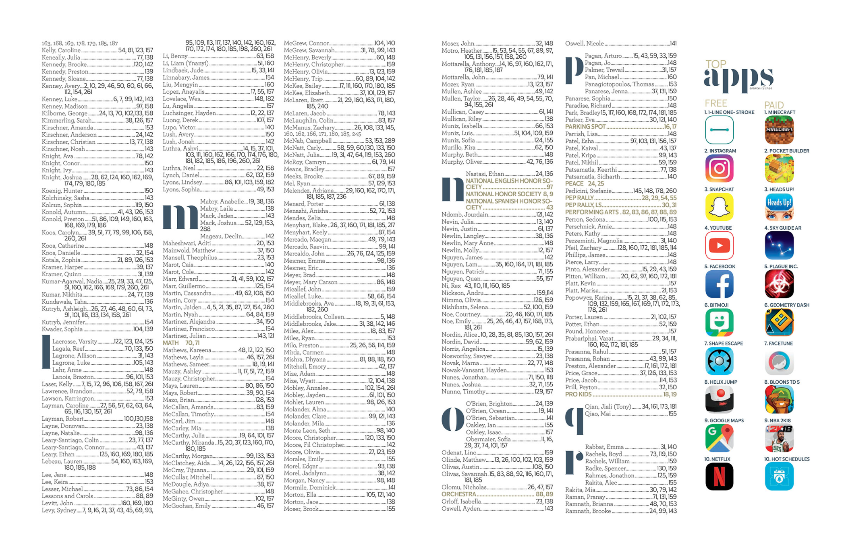
Holy Trinity

Slide 46
Q:
Are online photos and videos copyrighted?

Slide 47
A:
Yes.
Although the internet makes it easy to find material, it doesn’t mean it is free to use.
Online images, videos, stories and music are copyrighted.
The best practice is to get consent or create an alternative.

Slide 48
Q:
Is it okay to use copyrighted images if we give credit?

Slide 49
A:
No.
While providing attribution is important, it does not grant permission for its use.
You must still ask the owner for permission unless is qualifies under the fair use.
Also, “photo by Google” is NOT correct.
Notes:
Google is a search engine and does not own the photo.

Slide 50
Q:
How do we get permission to use copyrighted material?

Slide 51
A:
Contact the company or person who owns the copyright.
Provide details of how it will be used (user, intended audience and copies published).
Give ample time for a response.
Smaller outlets may allow use, larger ones may charge a fee.

Slide 52
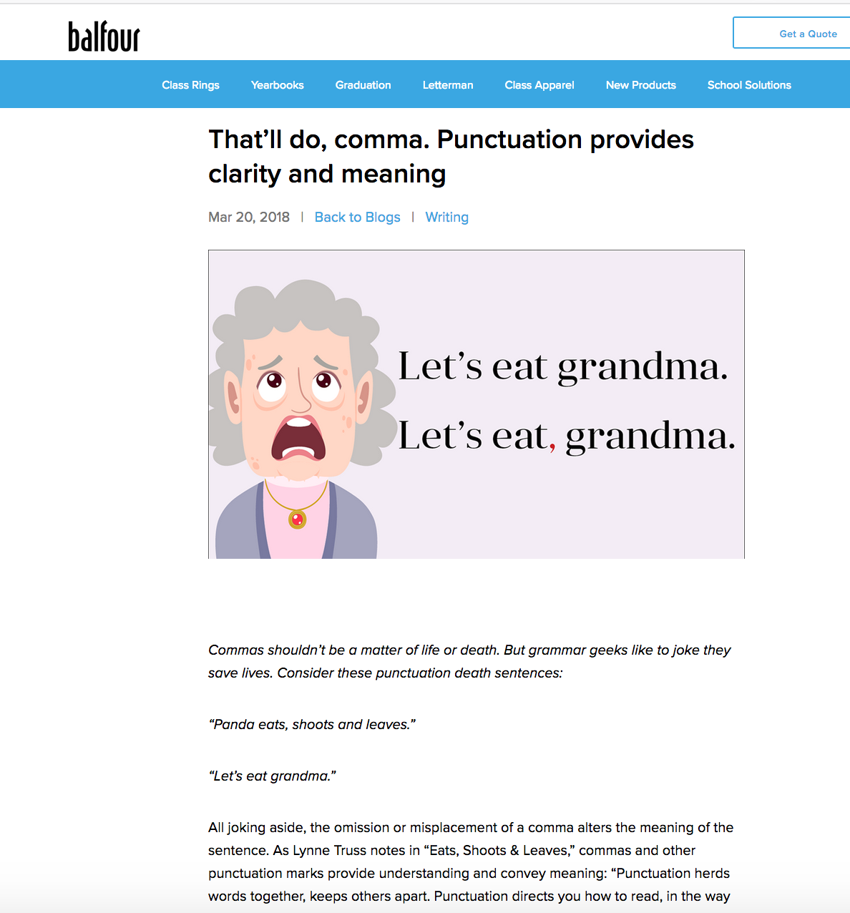
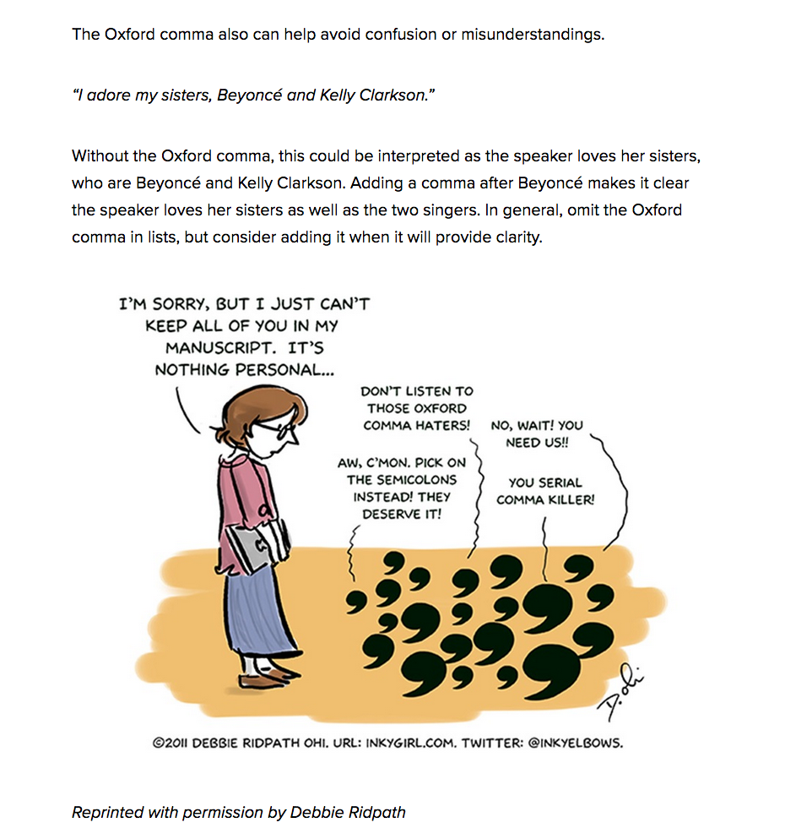
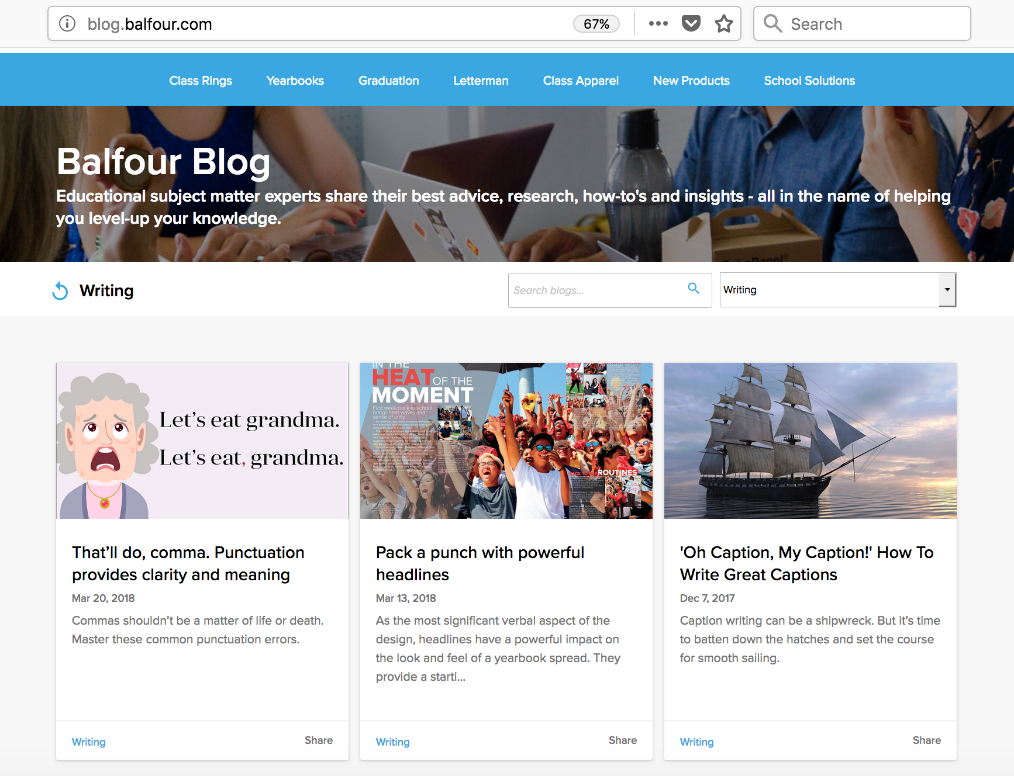
For a recent Tuesday Tip post about punctuation, there was a cartoon we wanted to use about Oxford commas. We contacted the owner who gave us written permission to reproduce the art.

Slide 53
Q:
Where can we find photos and videos that can be used without permission?

Slide 54
A:
Start with federal government sites.
White House, FEMA, National Park Service and other .gov sites
Content created by federal employees in the line of work is not protected by copyright and can be freely reused.

Slide 55
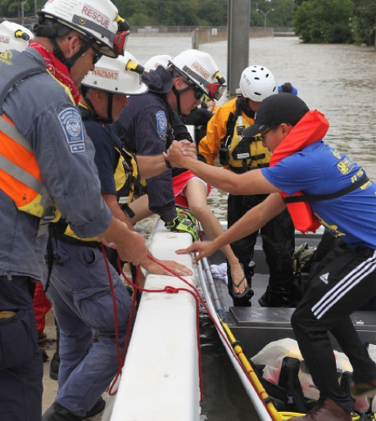
Members of FEMA’s Urban Search and Rescue Nebraska Task Force One (NE-TF1) remove an survivor from floodwaters in a neighborhood impacted by flooding from Hurricane Harvey. FEMA News Photo

Slide 56
A:
Look for materials with a Creative Commons (CC) license.
CC is a voluntary alternative to copyright.
Materials can be used for nonprofit publications as long as proper attribution is given.
An advanced Google or Creative Commons search can locate images.

Slide 57
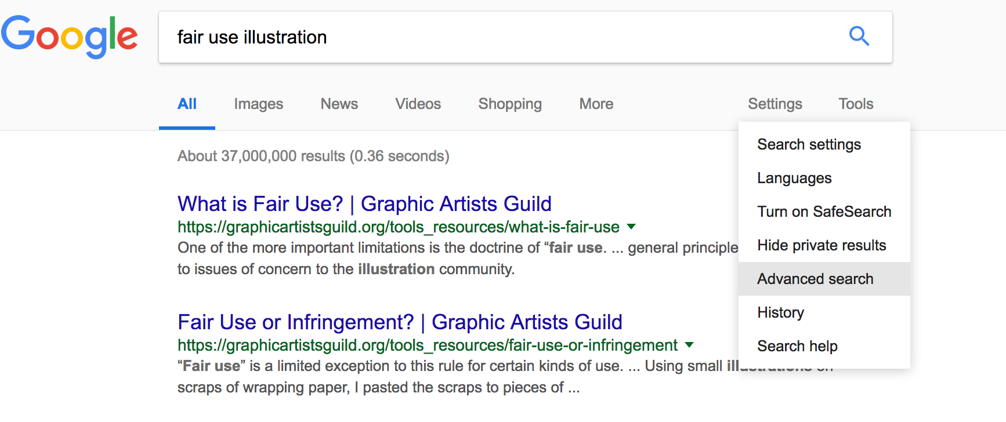
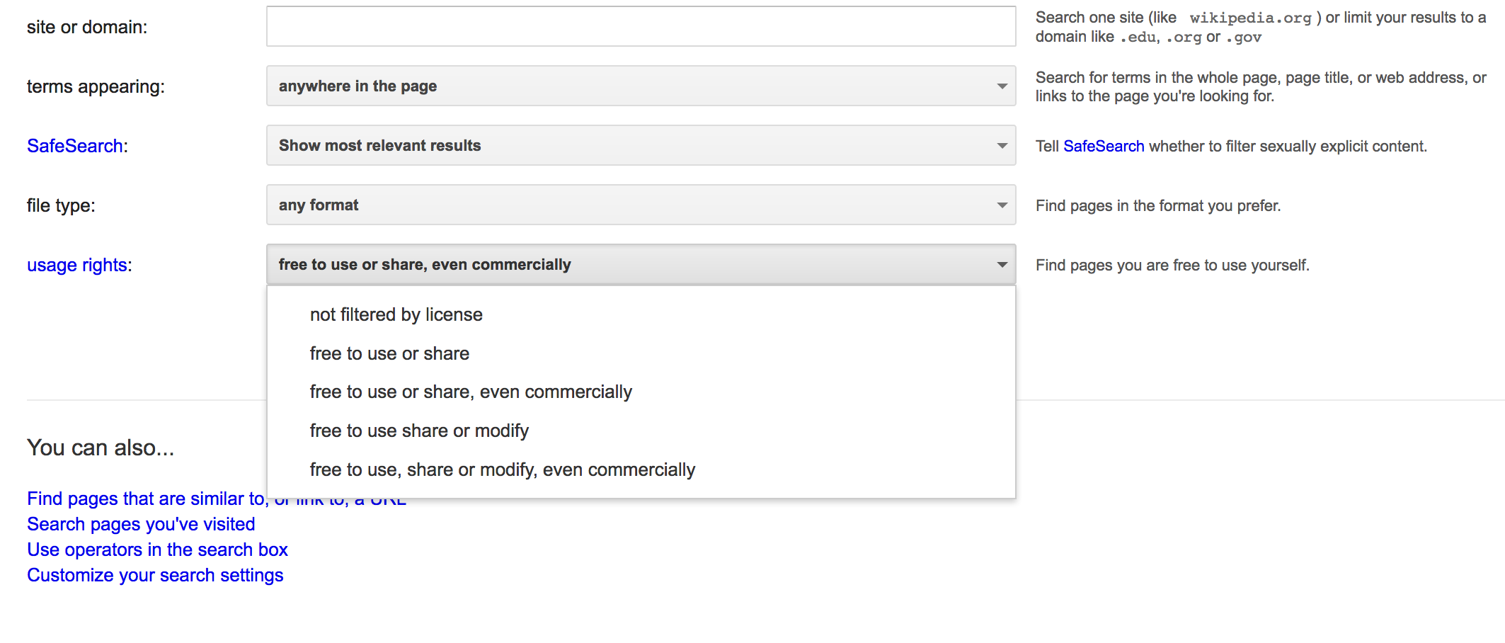

Slide 58
Q:
Can we use photos from Facebook, Instagram and other social media?

Slide 59
A:
Not without permission.
While images and videos published online are widely available, it does not remove their copyright.
You still need permission to use the material.

Slide 60
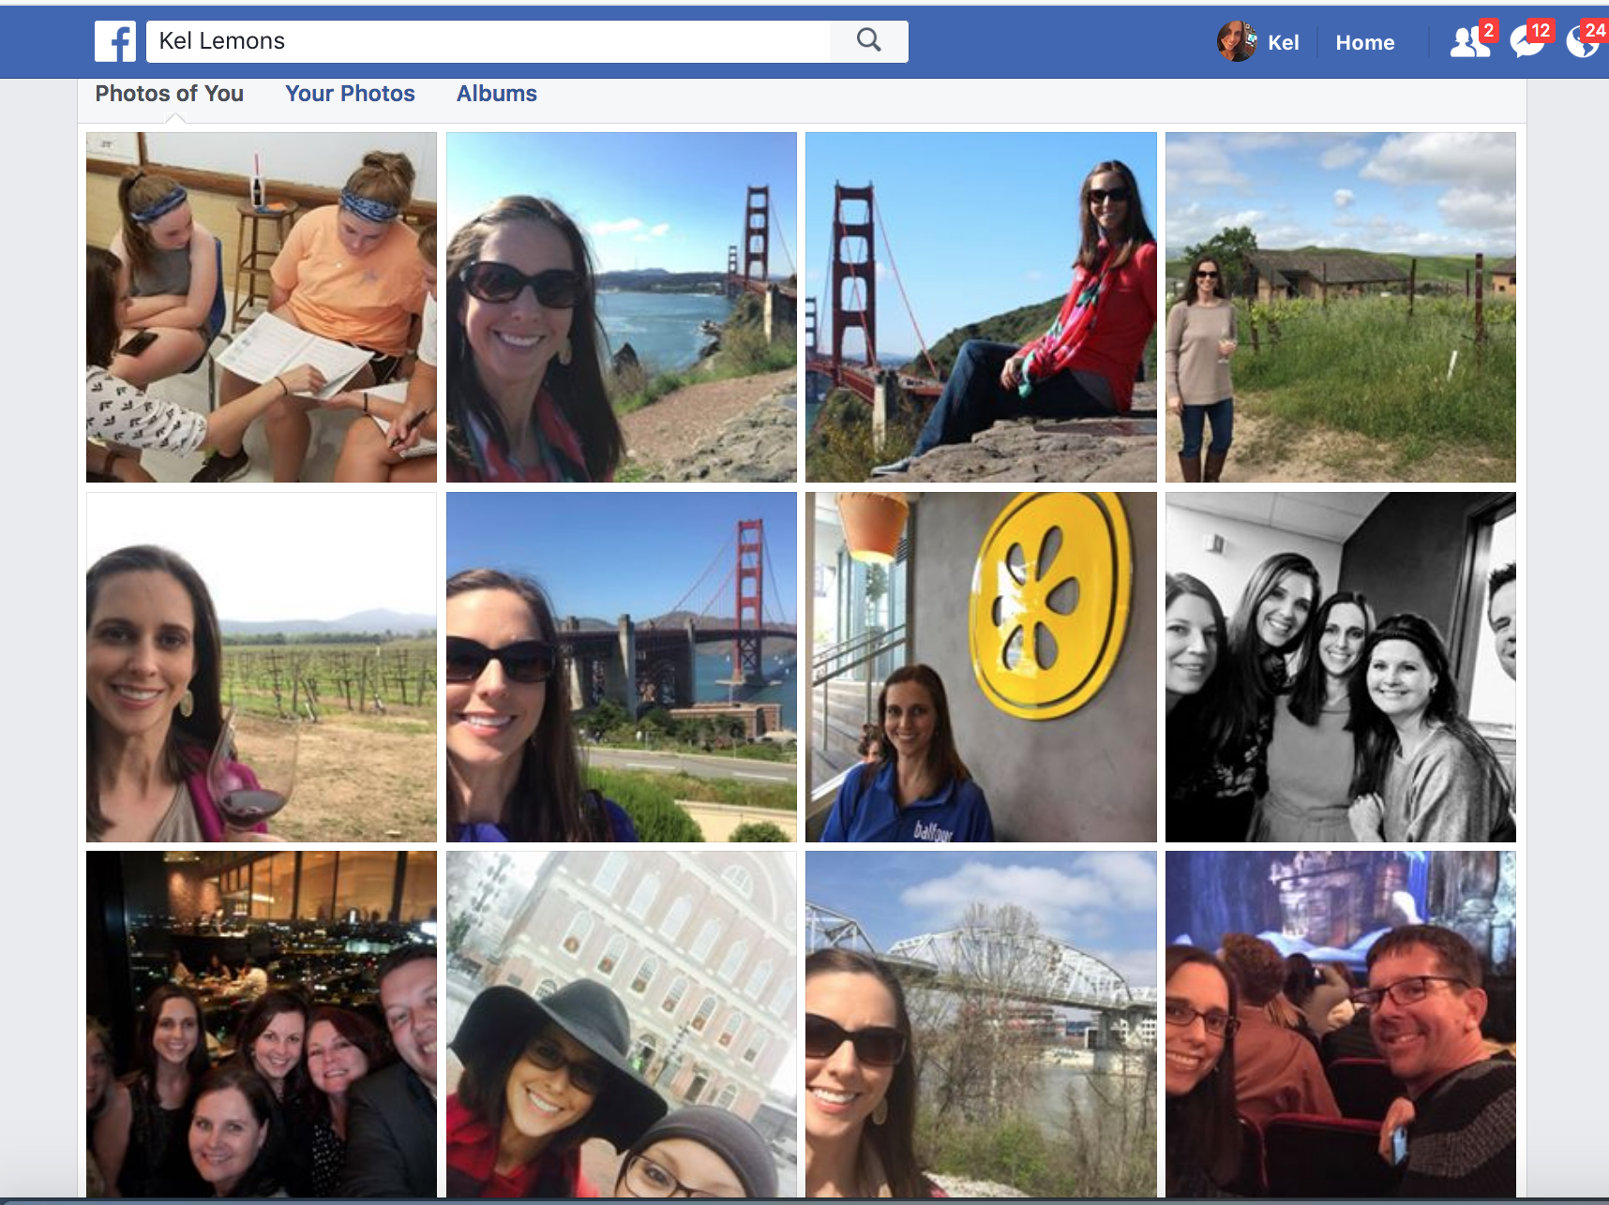

Slide 61
Q:
Can staffers post their photos and videos on social media?

Slide 62
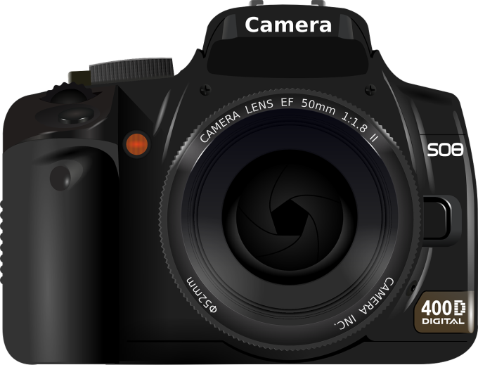
A:
Unless staffers signed an employment or work-for-hire contract, the photographer owns the copyright to his or her images.
This is true even for photos and videos taken on school equipment for school assignments.

Slide 63
A:
Research the school or district’s policy on intellectual property and technology use policies which can support or conflict with copyright rights.
To avoid issues, have a contract that details ownership and permissions before and after publication, including images not used.
Notes:
The SPLC has a sample contract

Slide 64
Notes:
The SPLC has a sample contract.

Slide 65
Q:
Can we use famous quotes or movie dialogue in the yearbook?

Slide 66
A:
Yes and no.
Quotes from famous people are not copyrighted. Copyright law doesn’t protect short phrases–they don’t meet the “original” or “creative” criteria.
But we encourage you to avoid famous quotes and publish original content in your book from current students.
Notes:
It’s better to hear the perspective of students who went to your school.

Slide 67
A:
Movie script dialogue is copyrighted.
You’ll need permission to quote movie lines.
The quote usage could be transformative depending on how creative the use is.

Slide 68
Q:
Can song lyrics or poems be included in a yearbook ad?

Slide 69
A:
No.
This doesn’t fall into traditionally recognized fair use categories such as news reporting, commentary, critique or research.
Since the ad helps finance the yearbook, the commercial purpose also weighs against the use.
Notes:
The SPLC has a sample contract

Slide 70
A:
You can encourage parents to use their own words or obtain (and provide) written permission from the copyright owner to use the work.
Be sure to credit the author in the ad.
EXCEPTION: Works published before 1924 are in the public domain (songs, poetry, books, Shakespeare, the Bible).
Notes:
Works published before 1923 are in the public domain and can be included and reproduced.

Slide 71
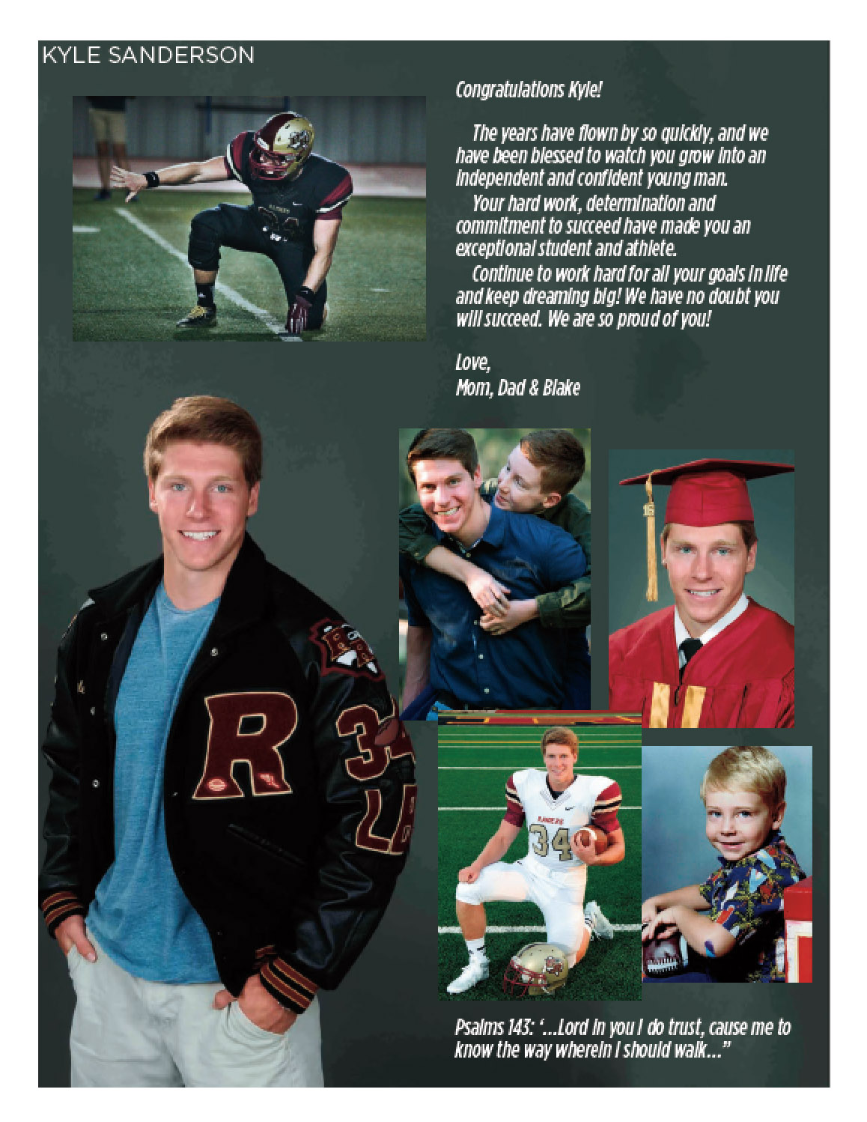

Slide 72
available
resources

Slide 73
Photos & Video
    Adobe Stock*
    Creative Commons
    Defense Department
    FEMA
    Free Images
    ImageSource*
    NASA
    National Park Service
    Pixabay
    Shutterstock*
    Stock Vault
    Unsplash
*royalty-free pay sites

Slide 74
Music & Audio
    Audio Nautix
    ccMixter
    Creative Commons
    Free Music Archive
    Free Music Public Domain
    Free Play Music
    Free Stock Music
    Legit Torrents
    Music in Cloud
    Opsound
    Public Domain Information Project
    The Internet Archive
    Vuze

Slide 75
Read licensing agreements and FAQs closely. Some websites have a minor fee or restrictions on commercial use, stand-alone usage or modifications.
Always include the proper credit with the material reused.

Slide 76
SPLC guides
    “Copyrighted Music in High School News Broadcasts”
    “Know Your Rights: Copyright and Fair Use”
    “Guide to Music Licensing for Broadcasting and Webcasting”
    “SPLC Guide to Fair use”
    “Student Media Guide to Copyright Law”
    “Copyright Safe Materials Available for Republication in Student Media”

Slide 77
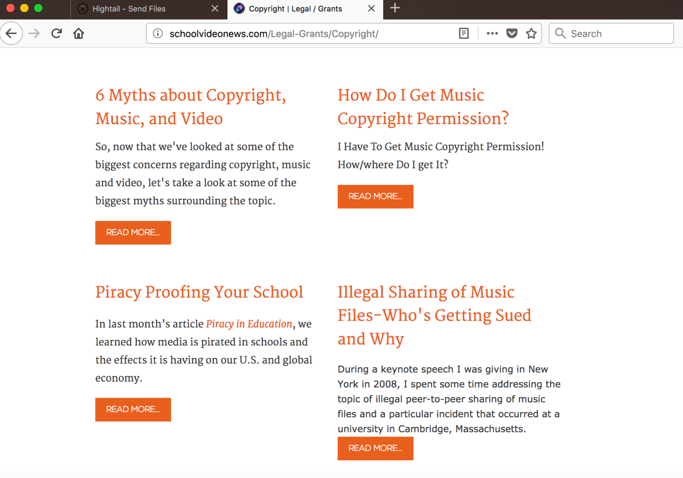
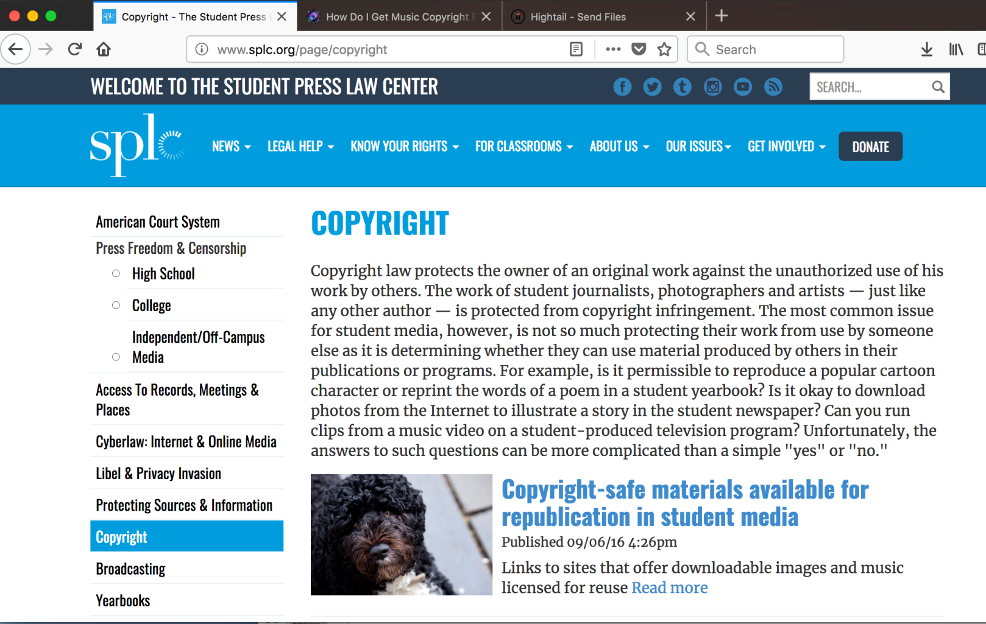

Slide 78
?
Questions

Slide 79
Works cited
Aufderheide, Patricia and Jaszi, Peter. Reclaiming Fair Use. The University of Chicago Press, 2011.
Britt, Barry S. “Copyright issues when using Music in Videos.” http://schoolvideonews.com/Copyright/Copyright-issues-when-using-music-in-videos. School Video News. Accessed Feb. 19, 2018.
Fishman, J.D., Stephen. The Copyright Handbook. Nolo, 2017.
Harris, Phillip L. “How Do I Get Music Copyright Permission?” School Video News. http://schoolvideonews.com/Copyright/How-Do-I-Get-Music-Copyright-Permission. Accessed Feb. 19, 2018.
Hobbs, Renee. Copyright Clarity. Corwin, 2010.
Student Press Law Center. “Copyrighted Music in High School News Broadcasts.” https://www.studenttelevision.com/data/images/pdf/SPLC_Music_Guidelines.pdf. Accessed Jan. 21, 2018.
Student Press Law Center. “Know Your Rights: Copyright and Fair Use.” https://s3.amazonaws.com/media.spl/1061_faq_copyrighto.pdf. Accessed Feb. 19, 2018.
Student Press Law Center. “Guide to Music Licensing for Broadcasting and Webcasting.” http://www.splc.org/article/2011/01/splc-guide-to-music-licensing-for-broadcasting-and-webcasting?id=112. Accessed Feb. 19, 2018.
Student Press Law Center. “SPLC Guide to Fair Use.” http://www.splc.org/article/2011/04/splc-guide-to-fair-use. Accessed Feb. 19, 2018.
Student Press Law Center. “Student Media Guide to Copyright Law.” August 2015. http://www.splc.org/article/2015/08/student-media-guide-to-copyright-law. Accessed Dec. 20, 2017.
Student Press Law Center. “Copyright Safe Materials Available for Republication in Student Media.” http://www.splc.org/article/2016/09/copyright-free-sites. Accessed Feb. 19, 2018.

