Slide 1
Caption
WRITING

Slide 2
THINGS TO REMEMBER
A well-written caption provides the context for a picture by answering the who, what, when, where, why and how.
Caption writing involves interviewing, prewriting, drafting, rewriting and editing.

Slide 3
TYPES OF CAPTIONS
BASIC – Identifies the moment captured in the picture and written in present tense
EXPANDED – Answers 5 Ws & H with background information and quote to personalize information
IDENTIFICATION – Uses person’s first and last name and grade

Slide 4
TYPES OF CAPTIONS
COLLECTION – Describes the total package and is accompanied by identifications
GROUPED – Photos are numbered and captions are grouped with corresponding numbers
GROUP IDENTS – Should have a title (group name) and name rows in different type so they’re easy to find

Slide 5
TYPES OF
CAPTIONS
BASIC
Sentence captions identify people (up to five) and describe the action in the photo in present tense. They are often used when space is limited or when there are a number of photos on the spread which are closely related.

Slide 6
TYPES OF
CAPTIONS
EXPANDED
Expanded captions add one or two sentences to the basic sentence caption to tell a more complete story. The sentence that describes the action is followed by a sentence that expands on the moment captured in the photo. This sentence is written in past tense.

Slide 7
TYPES OF CAPTIONS
IDENTIFICATION

Slide 8
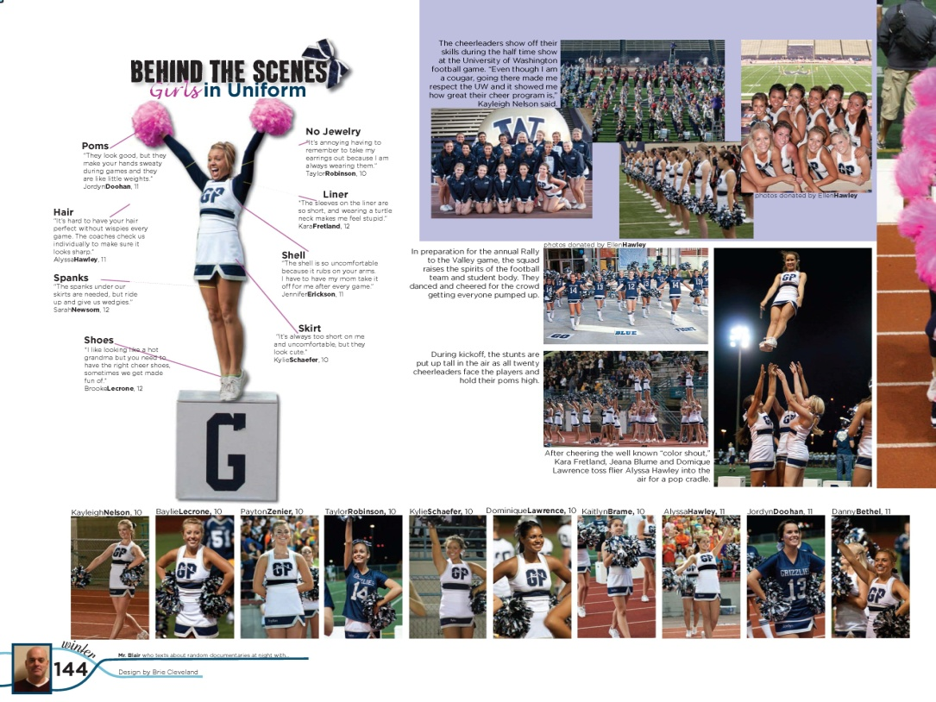
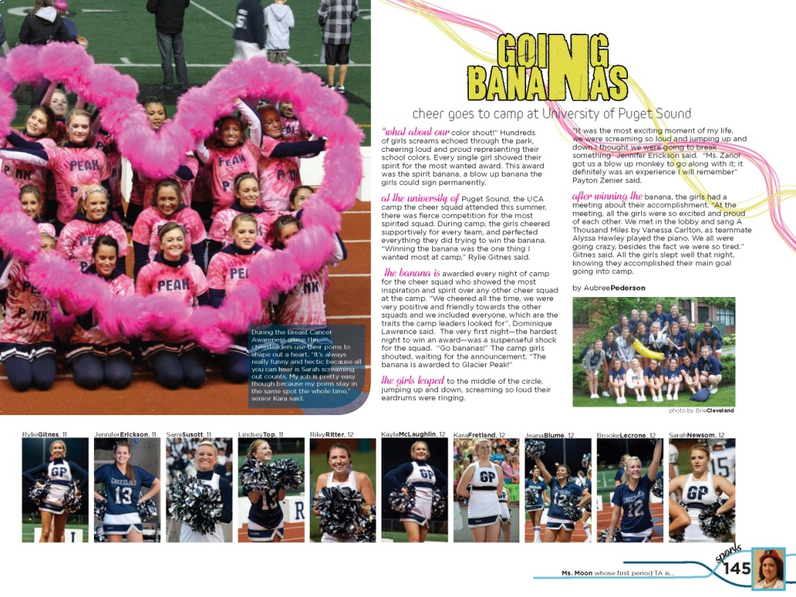
TYPES OF CAPTIONS
IDENTIFICATION
Identify up to five people in a photo.
After five, identify the group, i.e. cheerleaders, drum line.
Idents include first and last names. They may also include class, and/or position (quarterback, Key Club officer, etc. They are usually used with a photo collection (1st degree of separation).

Slide 9
TYPES OF CAPTIONS
IDENT+PERSONALITY
Need to include more people in your book?
Consider running candid portraits through the book with simple identifications.

Slide 10
TYPES OF CAPTIONS
IDENT+QUOTE
Cover current events with a one-sentence explanation and a quote

Slide 11
TYPES OF CAPTIONS
IDENT+QUOTE
Use numbers to link students to their quotes

Slide 12
TYPES OF CAPTIONS
When captions are grouped, a number is placed on the photo to link the picture to the correct caption.
Captions are generally the basic “who, what, where” variety.

Slide 13
TYPES OF CAPTIONS
COLLECTION
Collection captions describe the total package and are accompanied by idents.
Photos must have a common theme for this type of caption to be effective.
2006 Pioneer Conference Champions
Dance team juniors

Slide 14
TYPES OF CAPTIONS
COLLECTION
1.Picture collection focuses on one aspect of the event
2. Five-six sentence story, including two quotes
3. Numbered pics with basic captions & names highlighted

Slide 15
AS EASY AS A, B, C, D
A — Action Lead-In
B — Basic Information
C — Complementary Information
D — Direct Quote

Slide 16
BASIC INFORMATION
Just the facts
RESEARCH. Find out the who, what, where and when.
.

Slide 17
B — BASIC INFORMATION
Facts from interview
WHO: sophomores Noe Garcia and Hannah Moltz, junior Adam Nelson
WHAT: students get their heads shaved to raise money for cancer
WHERE: gymnasium
WHEN: Pep rally hosted by the Neglected Sports Cheer Club

Slide 18
A — ACTION LEAD-IN
List words or phrases that come to mind when
looking at the picture.
___________
___________
___________
___________
___________
___________

Slide 19
A — ACTION LEAD-IN
Write an attention-getting word or phrase that links the caption to the picture.
Close Shave
Hair-razing experience
Clipping for Cancer
Shear Madness
Shaving Lives

Slide 20
A — MORE ACTION LEAD-INS
Hair Today, Gone Tomorrow
A Hairy Situation
New Do
Win for a Trim
A Cut Above
The Mane Event
Good Hair
(or Bad Hair) Day

Slide 21
B — BASIC INFORMATION
Just the facts
Using first and last names, identify everyone in the photo (up to five).
Interview people in the picture as well as those associated with the activity.
Accurately describe the action in the photo.

Slide 22
B — BASIC INFORMATION
Write now
As he hears the razor come closer, junior Noe Garcia waits to get his head shaved by sophomore Hannah Moltz with junior Adam Nelson lending a hand.

Slide 23
B — BEYOND BASIC
Keep on writing
Write another sentence that contains key information, the WHY & HOW.
Write it in PAST tense.

Slide 24
C — COMPLEMENTARY INFORMATION
Wrap it up
Expand coverage by going behind the scenes.
Dig deeper. Get the inside scoop and appeal to the intelligent, curious reader.
Write additional sentences in past tense.

Slide 25
C — COMPLEMENTARY INFORMATION
Wrap it up
Students were given the opportunity to bid on more than 30 students who volunteered to have their heads shaved for charity.

Slide 26
D — ADD A QUOTE
Write now
“Even though I didn’t trust Hannah with a shaving mechanism,” Noe said. “It was worth it because I raised a good chunk of money.”

Slide 27
Final Caption
SHAVING LIVES As he hears the razor come closer, junior Noe Garcia waits to get his head shaved by sophomore Hannah Moltz with junior Adam Nelson lending a hand. Students were given the opportunity to bid on more than 30 guys who volunteered to have their heads shaved for charity. “Even though I didn’t trust Hannah with a shaving mechanism,” Noe said. “It was worth it because I raised a good chunk of money.”
Notes:
27

Slide 28
CHECK DETAILS
Are names spelled correctly? Noe, Noah or Noel? Hannah or Hanna?
Is grade classification included?
Have you made sure the caption does not begin with a name?
Is there a widow?

Slide 29
CREATE A COLLECTION CAPTION
Senior participants
1. Half-shaved, Austin Dunson (12) and Trevor Duggan (11) laugh together.
2. Cancer survivors: Mrs. Norrell, Mr. Lacy, Coach Blackman
3. Noe Garcia (10) braces for a haircut from Hannah Moltz (11) with Adam Nelson’s help. 4. Dylan Nguyen (11) assists Mrs. Hughes shave Mike Farmer’s (12) head.
Add simple identifications
Cancer survivors-Mrs. Janice Norrell, Mr. Justin Lacy, Coach Bruce Blackman
or basic captions
Noe Garcia (10), Hannah Moltz (11), Adam Nelson
1
2
4
With a headline, secondary head & a summary of the event
Mane Event
3
Noe Garcia (10), Hannah Moltz (11), Adam Nelson

Slide 30
SPORTS CAPTION WRITING TIPS
Do not editorialize.
Go, Team!
Congratulations, (insert group name here)
We love our players
Go out and support the (insert mascot here)
We have the best (insert group or team name here) ever
Avoid clichés or trite wording that describe actions with feelings, such as happily rejoices, jumps with joy, claps with glee, etc.

Slide 31
CAPTION WRITING TIPS
Sports captions
Check the type of caption that is used in your section (such as sentence or expanded)
Include the following:
The play’s outcome (when appropriate)
The names of all players from all teams in the photo
Uniform or jersey numbers in parentheses for all players
• If you do not have organized sports, cover sports clubs & individual sports.

Slide 32
CAPTION WRITING TIPS
Sports captions
UNDEFEATED.
On the attack in tournament play, Jordan White uses a crossing pass to get the ball to the center of the field. The HJ MacDonald defender, Emily DeFrank, tries to steal the ball. The 4-3 game against HJ MacDonald was the closest game of the season. “Nikki Robinson’s hat trick was phenomenal, but every member of the team contributed to this championship,” Dominique Martinez said.

Slide 33
CAPTION WRITING TIPS
Sports captions
In secondary information include:
Statistics about the team, the player, the season and previous games played against the opponent, etc.
Avoid relating the final score.

Slide 34
CAPTION TIPS
Group photo idents
Identify the group
Start from the front row and work left to right
Label each row as front row, second row,… back row
Identify people with special titles by placing the title in parenthesis after the person’s name
Example
Science Club: Front Row- Gina DeLaCruz (adviser), Matt James; Second Row- Ferra McKinzey, Tina Marks, J.J. Timmons; Back Row- Hannah Dims, Yolanda Gulickson.
Note the use of bold face for club name, italics for the row designations

Slide 35
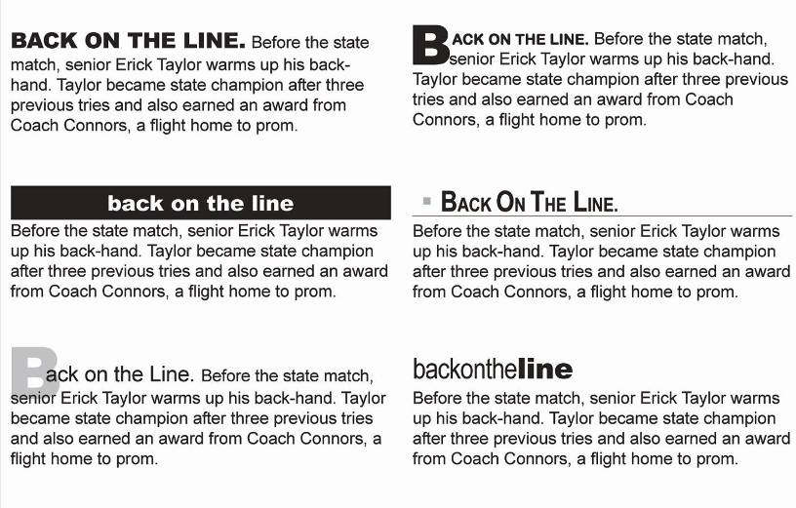
CAPTION DESIGN

Slide 36
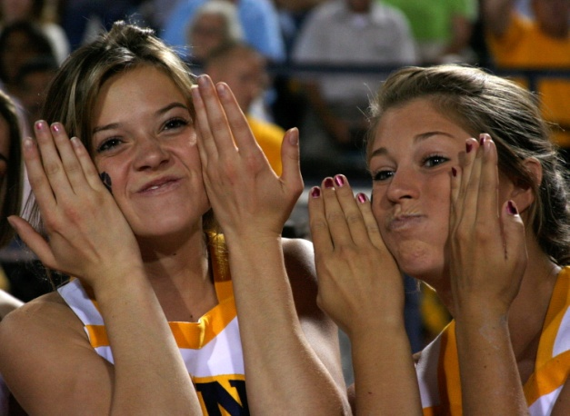
CAPTION DESIGN
Photo credit placement
photo by Justin Black
photo by Justin Black
With a time-out on their hands, cheerleaders Jessica Rehms and Carrie Smythe accompany their facial contortions with rude noises for the benefit of their squad. “Luckily, no one in the stands could see or hear us,” Smythe said.
photo by Justin Black
Consider photo credits.
Choose one style and stick with it!

Slide 37
CAPTION DESIGN
Photo credit placement
Placement styles:
On the right side of the photo flowing from the bottom edge of the photo up in italics
At the end of the caption in italics
Under the photo aligned with the right edge in italics
photo by Justin Black
photo by Justin Black
With a time-out on their hands, cheerleaders Jessica Rehms and Carrie Smythe accompany their facial contortions with rude noises for the benefit of their squad. “Luckily, no one in the stands could see or hear us,” Smythe said.
photo by Justin Black

Slide 38
seniors Grace Stephens
and Aidan Keating
seniors Grace Stephens
and Aidan Keating
YOUR TURN
CAPTION
HERE

Slide 39
WHO: seniors Grace Stephens (Lady of the Lake) Aidan Keating (King Arthur)
WHAT: sing “Always Look on the Bright Side of Life” in the finale of Spamalot.
WHERE: theater
WHEN: Final dress rehearsal, Jan. 31, 2018, play ran from Feb. 1-3

Slide 40
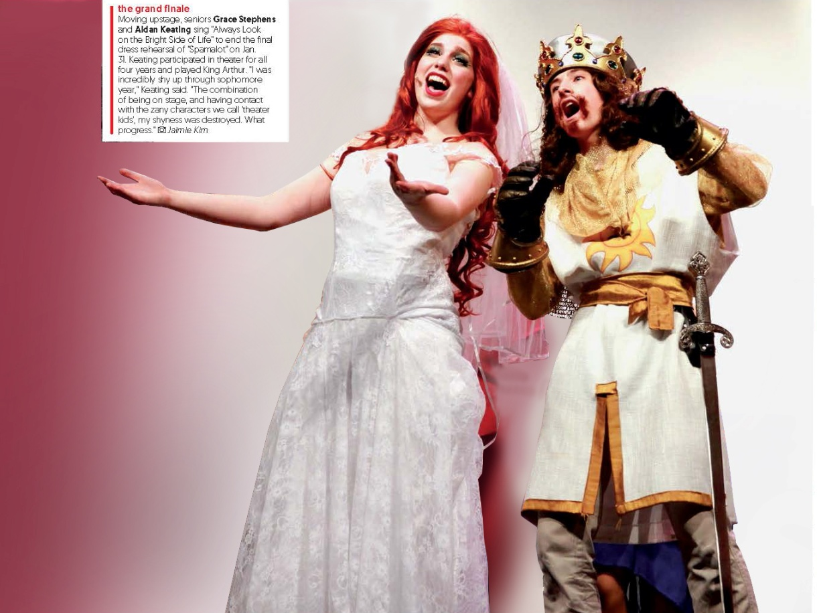
seniors Grace Stephens
and Aidan Keating
seniors Grace Stephens
and Aidan Keating
A — ACTION LEAD-IN
List words or phrases that come to mind when
looking at the picture.
___________
___________
___________
___________
___________
___________
CAPTION
HERE

Slide 41
seniors Grace Stephens
and Aidan Keating
seniors Grace Stephens
and Aidan Keating
B — BASIC INFORMATION
Just the facts
Using first and last names, identify everyone in the photo (up to five).
Interview people in the picture as well as those associated with the activity.
Accurately describe the action in the photo.
CAPTION
HERE

Slide 42
seniors Grace Stephens
and Aidan Keating
seniors Grace Stephens
and Aidan Keating
C — BASIC INFORMATION
Just the facts
Using first and last names, identify everyone in the photo (up to five).
Interview people in the picture as well as those associated with the activity.
Accurately describe the action in the photo.

Slide 43
B — BEYOND BASIC
Keep on writing
Write another sentence that contains key information, the WHY & HOW.
Write it in PAST tense.

Slide 44
C — COMPLEMENTARY INFORMATION
Wrap it up
Expand coverage by going behind the scenes.
Dig deeper. Get the inside scoop and appeal to the intelligent, curious reader.
Write additional sentences in past tense.

Slide 45
C — COMPLEMENTARY INFORMATION
Wrap it up
Carefully choose the information to be included in the caption. The second sentence should make expand on the moment.
Keep it relevant.

Slide 46
C — COMPLEMENTARY INFORMATION
Wrap it up
1,345 tickets were sold for four shows.
Keating participated in theater all four years of high school.
Stephens performed with an ensemble called The Laker Girls.
Stephens’ red wig was called “Gena-weave.”
Spamalot, along with productions throughout the year, served as theater fundraisers.

Slide 47
D — DIRECT QUOTE
Write now
“I was incredibly shy up through sophomore year,” Keating said. “The combination of being on stage, and having contact with the zany characters we call 'theater kids', my shyness was destroyed. What progress.”
“It’s this red sort of Ariel wig. We named her Gena-weave,” Stephens said. “Aidan Keating almost pulled the wig right off. It was hilarious.”
“One of my costumes was a skintight silver disco ball outfit,” Stephens said. “It had a bunch of sequin drapery and cool belts. I felt like a diva in this scene.”

Slide 48
seniors Grace Stephens
and Aidan Keating
seniors Grace Stephens
and Aidan Keating
FINAL CAPTION
ACTION LEAD
BASIC
COMPLEMENTARY
DIRECT QUOTE

Slide 49
If I say “Editing,” I can HEAR you think—
Here we go again!

Slide 50
I can SEE you roll your eyes.

Slide 51
6-1-5
Editing
Six people 1 suggestion/person 5 minutes

Slide 52
1st Step
Form a group of 6 with people who were not in your original group.
2nd Step
Place your captions in the middle of the table.
3rd Step
Grab a caption. (Not your own.) Based on the caption checklist, write suggestions on the paper. You have ONE minute.
4th Step
Repeat. Place caption in the center. Grab another.(Not your own or the one you just did.) Based on the caption checklist, write suggestions on the paper. You have ONE minute.
5th Step
Repeat until you have seen five captions. Pick up your caption, go back to your original group and compare suggestions. Again, look at the caption checklist..
6th Step
As a group, write one sensational caption.
Notes:
Run off a few caption checklists to accommodate anyone who may have problems seeing. Distribute to groups. Don’t ask. One person less or one person more in a group is OK. This method is anonymous for the most part. The students offering suggestions don’t feel uncomfortable. The students receiving the suggestions are also good with them. “I don’t know these people. Why should I care what they think?”

