Slide 1
BASIC
Design

Slide 2
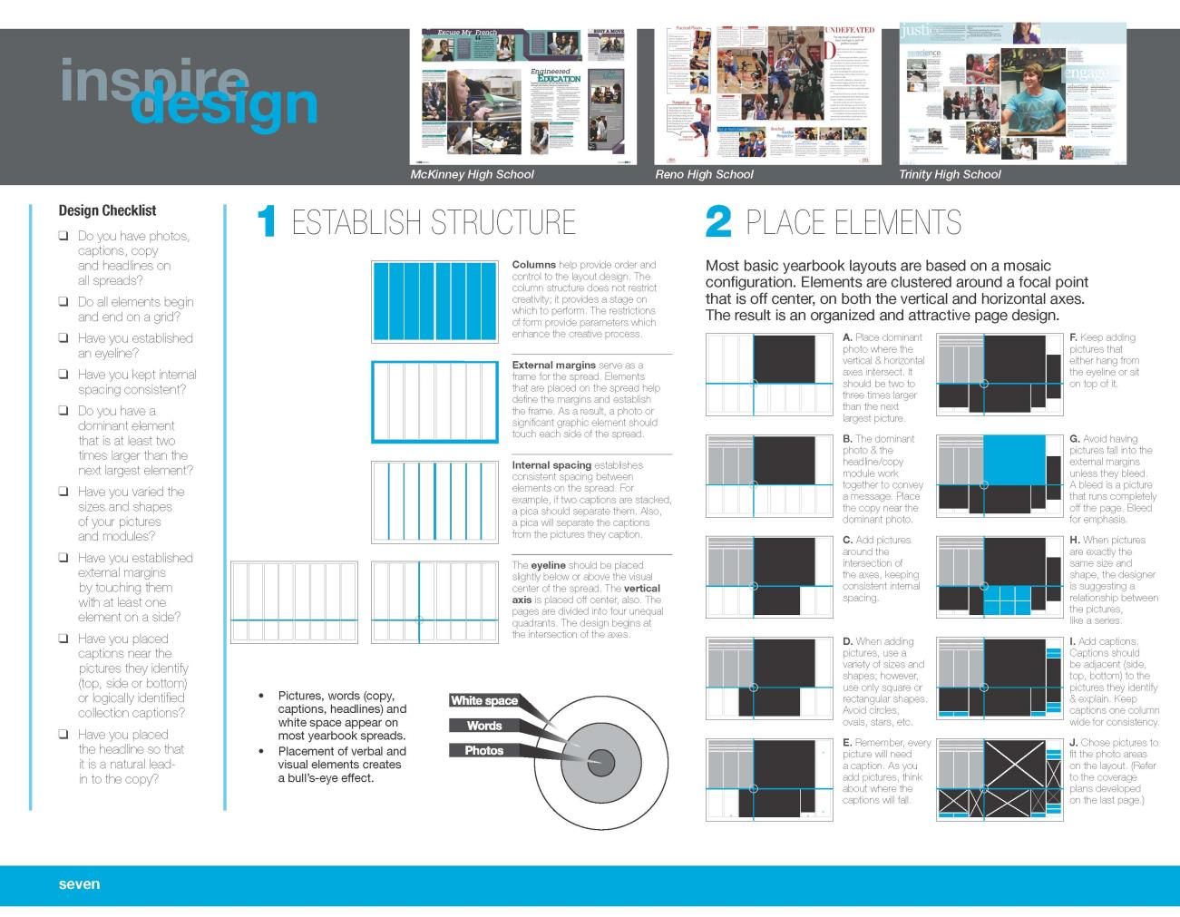

Slide 3
Basic Design
organized arrangement
of images & words to tell a story

Slide 4
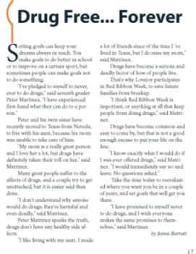
Elements of Design
photos
copy
►headline & story
►captions
■ white space
Don’t underestimate the importance and impact white space has on your spreads!

Slide 5
Elements of Design
Verbal and visual elements create a bull’s-eye effect.
White space
Words
Photos

Slide 6
Design Steps
#1
Determine foundational structure by dividing
layout into columns of equal sizes.

Slide 7
Design CAUTION
All elements must begin and end on a column.
2 columns
3 columns
1 col.
2 ½
3 ¾
1 ¼
All elements begin and end on a column

Slide 8
Design Steps
#2
Establish the external margins
The amount of white space that surrounds the spread

Slide 9
Design Steps
#3
Note the gutter and the internal spacing.

Slide 10
Design Steps
#4
Place an eyeline

Slide 11
Design CAUTION
Placement of the eyeline
(Place in upper or lower third, never in the middle)
But not
here

Slide 12
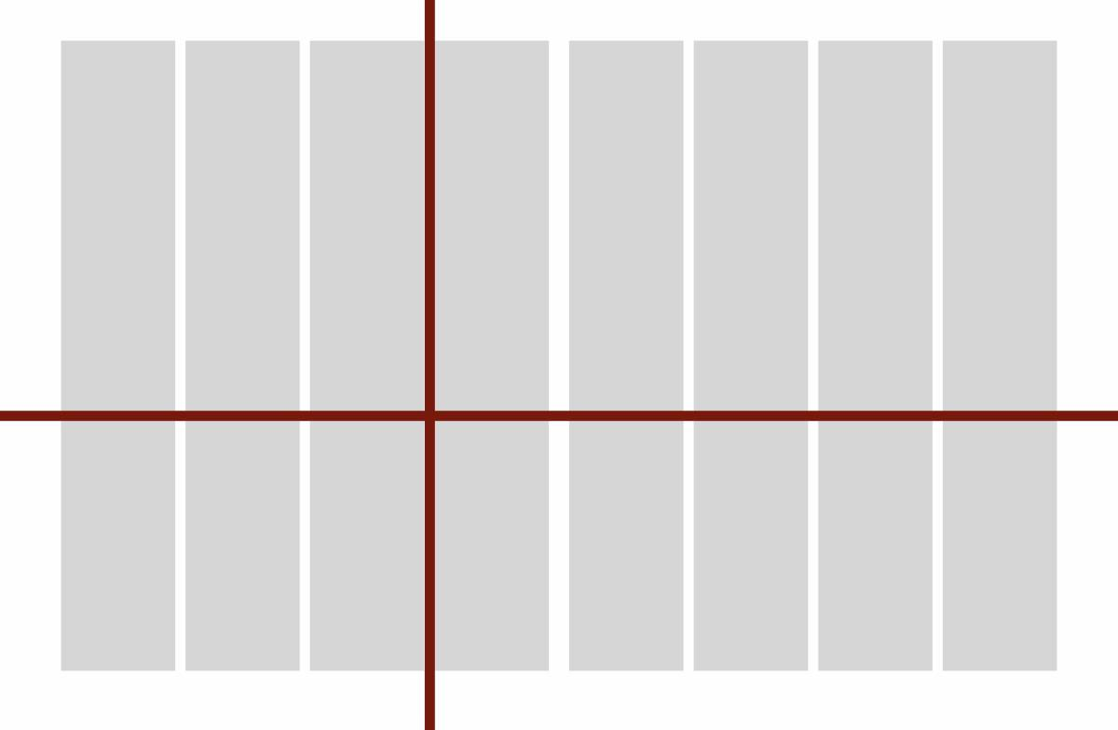
Design Steps
#5
Place a vertical axis that meets your eyeline
at what is called the axis point.

Slide 13
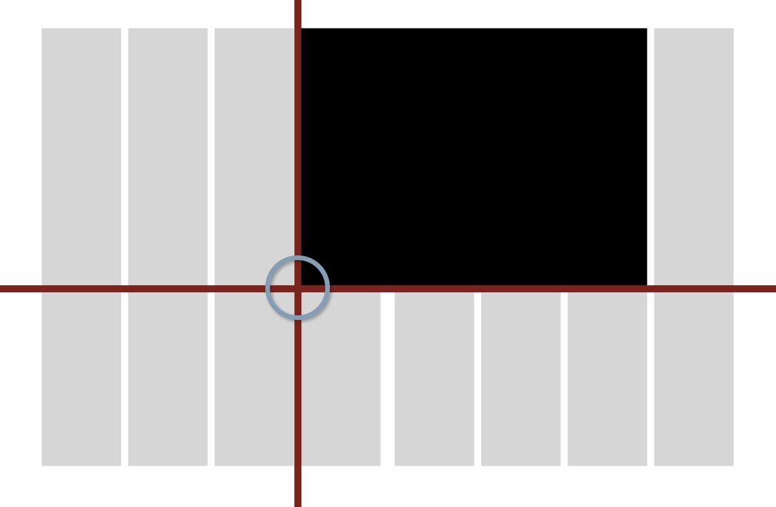
Design Steps
#6
Select and place dominant photo at axis point

Slide 14
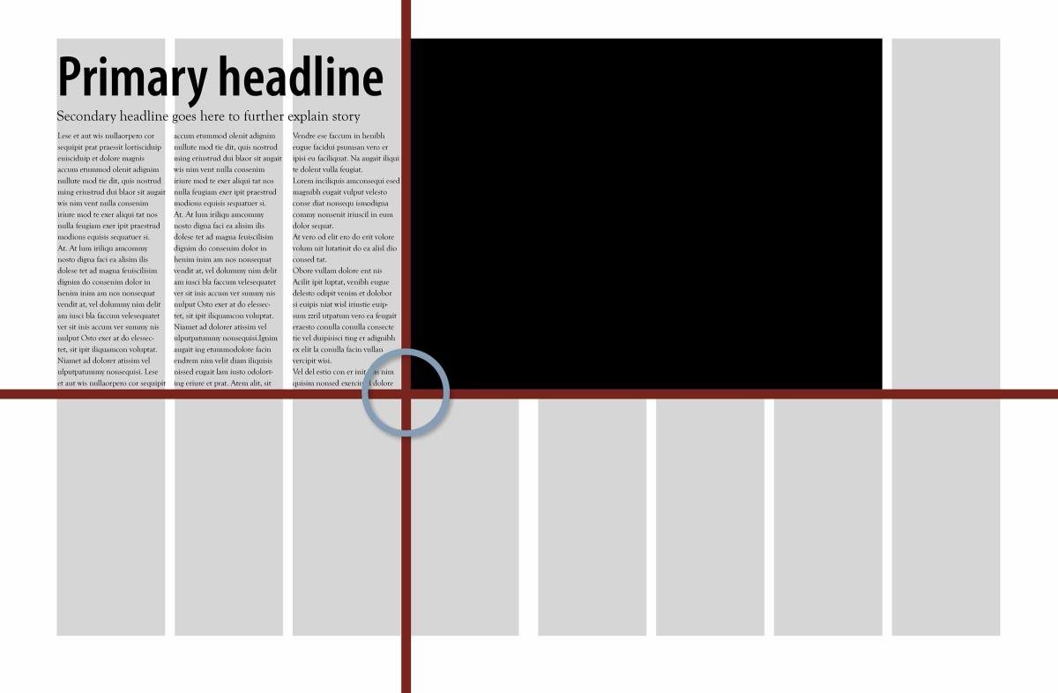
#7
Design Steps
Place headline/copy area near dominant
photo to reinforce message.

Slide 15
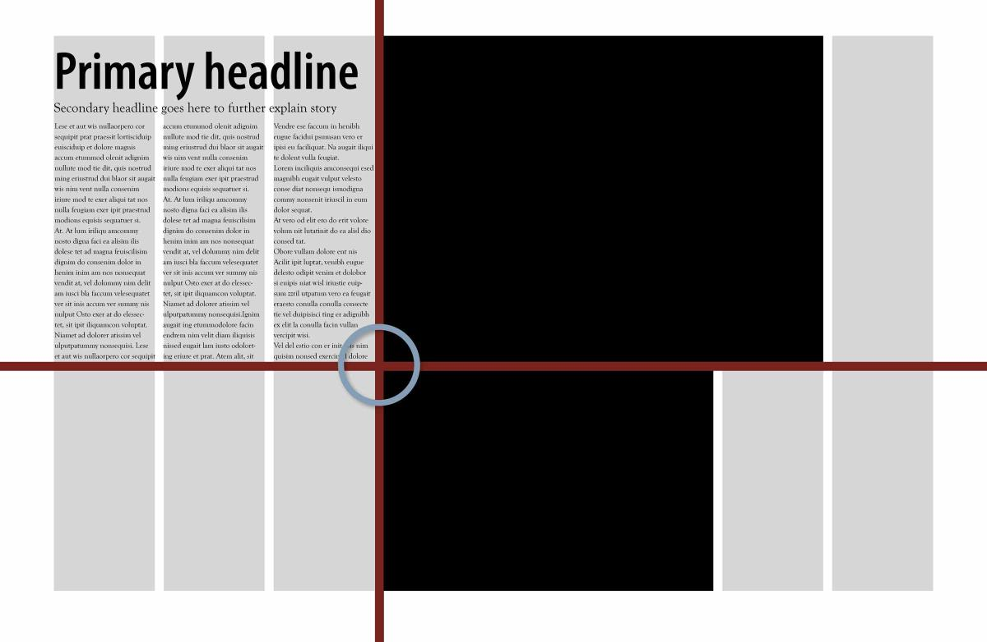
#8
Design Steps
Place next largest photo at axis point.

Slide 16
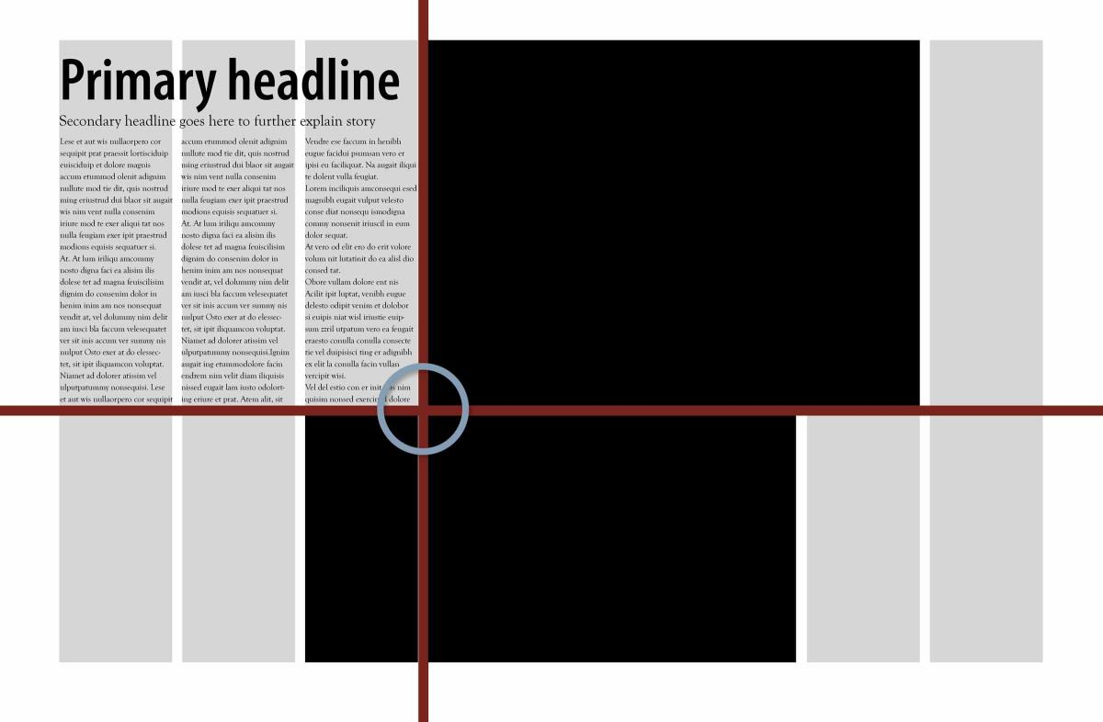
design steps
Design Steps
#9
Continuing to work from the axis point, place your next photo.

Slide 17
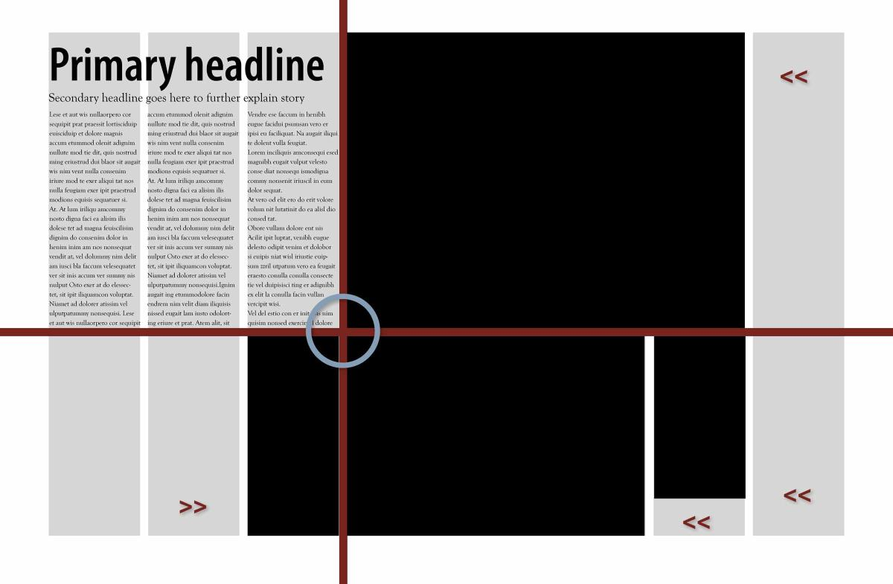
#10
Design Steps
Pause and consider caption placement.
(Avoid temptation to fill in the corners.)

Slide 18
Design IMPERATIVE
Vary the shape and size of rectangular photos.

Slide 19
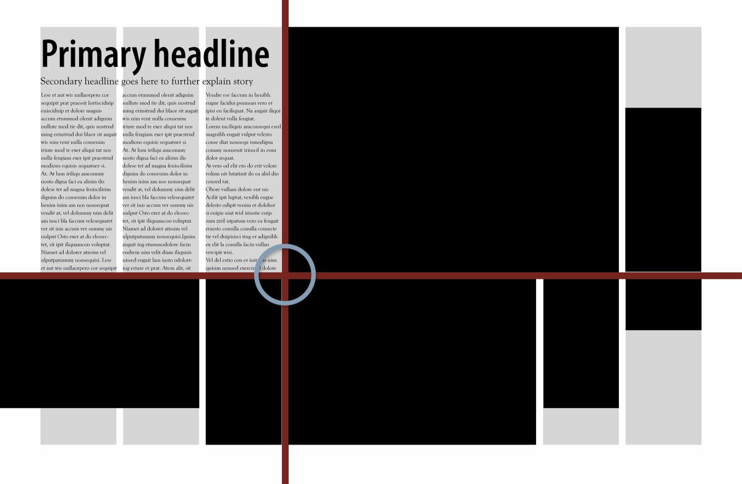
#11
Design Steps
Working from the eyeline, place the remaining photos.

Slide 20
Design Check
Photos should rest on or hang down from the eyeline.

Slide 21
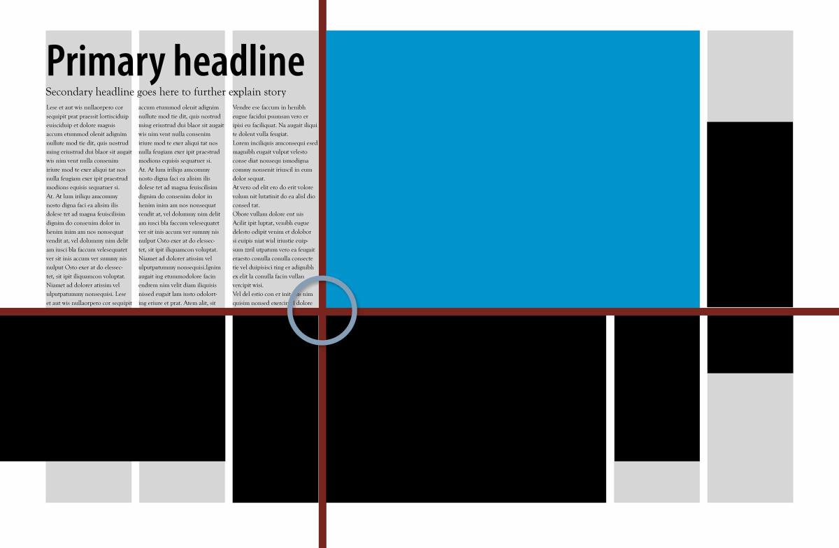
Design CAUTION
Avoid running pictures into the outside margins, unless they bleed.
Pictures that bleed run completely off the page.

Slide 22
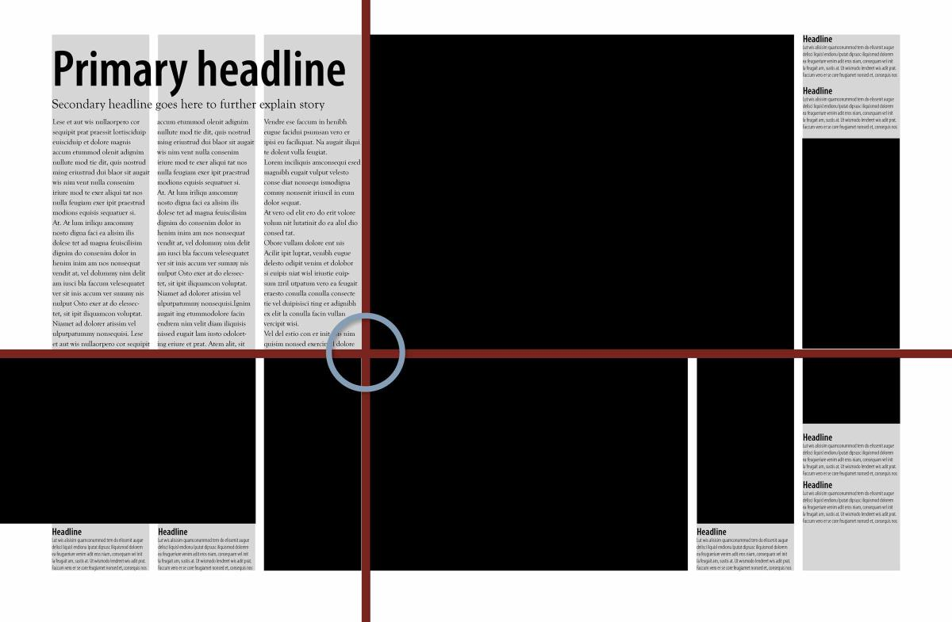
#12
Design Step
Place a caption for each photo.
(Captions may differ in length, but must be the same width.)

Slide 23
Design Check
Begin design check.

Slide 24
Design Check
Consistent external margin
Does a photo or copy element touch each margin?

Slide 25
Design Check
Consistent internal spacing
Is there a 1 pica separation between elements?

Slide 26
Design Check
Eyeline
Do the photo edges create a line of white space that spans across two facing pages?

Slide 27
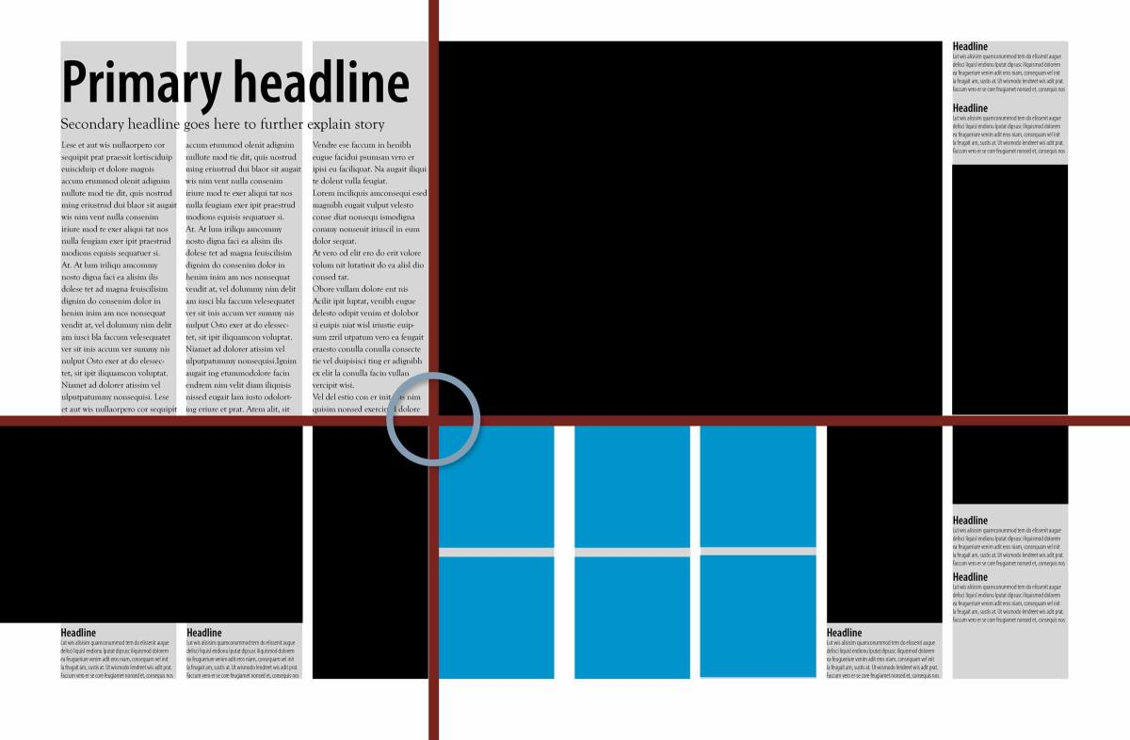
Design Check
Avoid placing pictures on the spread that are the
exact size & shape unless the content is related.

Slide 28
Design Check
Bull’s-eye effect
Do the layout of elements flow from the inside out,
from black to gray to white?

Slide 29
Design Check
Captioning
Do you have a caption block for every photo?

Slide 30
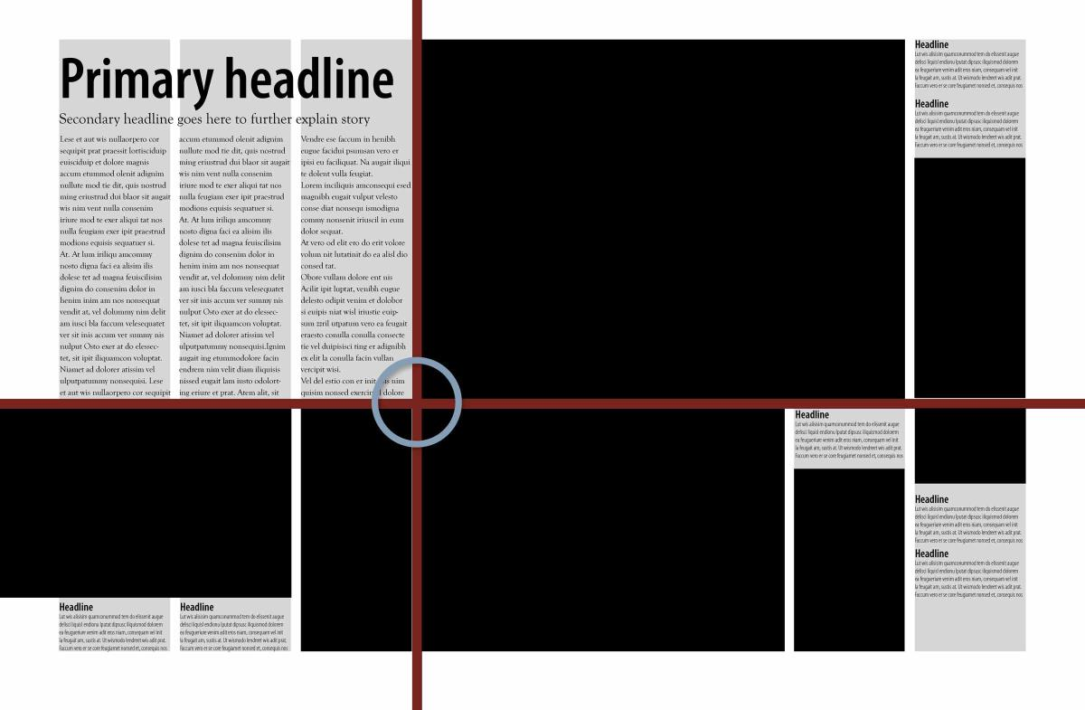
Design Check
White Space to Outside
Do you have white spaced trapped on the inside?
Example
of trapped
copy

Slide 31
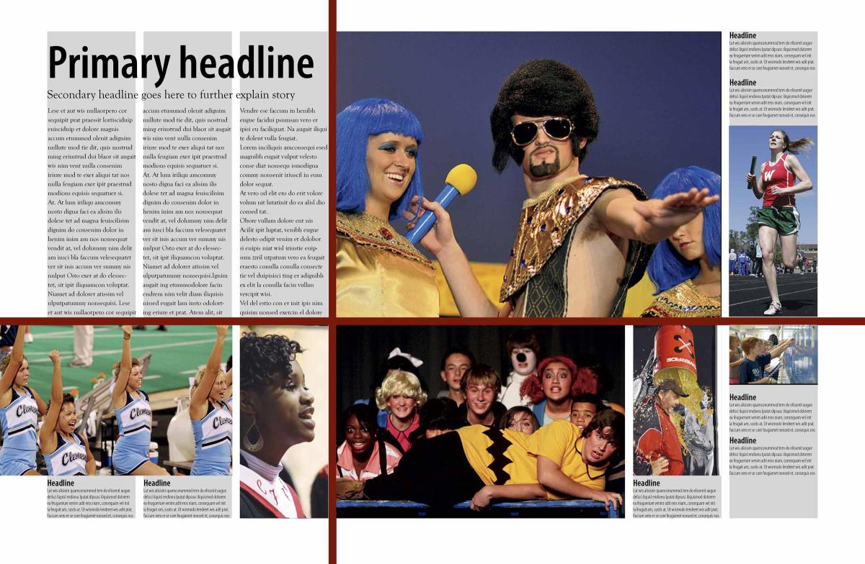
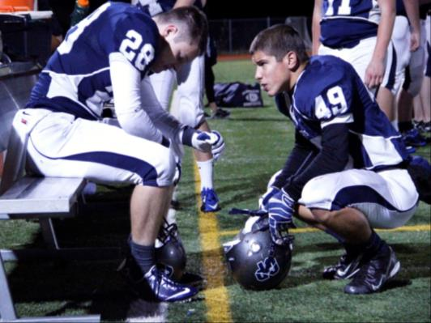
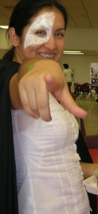
Design Check
Photo Cropping and Placement
Aim for a variety of content & balanced coverage.
PEP TALKS, YELLS

Slide 32
Design Check
Photo Cropping and Placement
Numbers: 1 person, 2 people, 3 people, small & large groups
Boys vs Girls: Do you have a balance?

Slide 33
Design Check
Replace photos or redesign as needed.
Primary headline

Slide 34
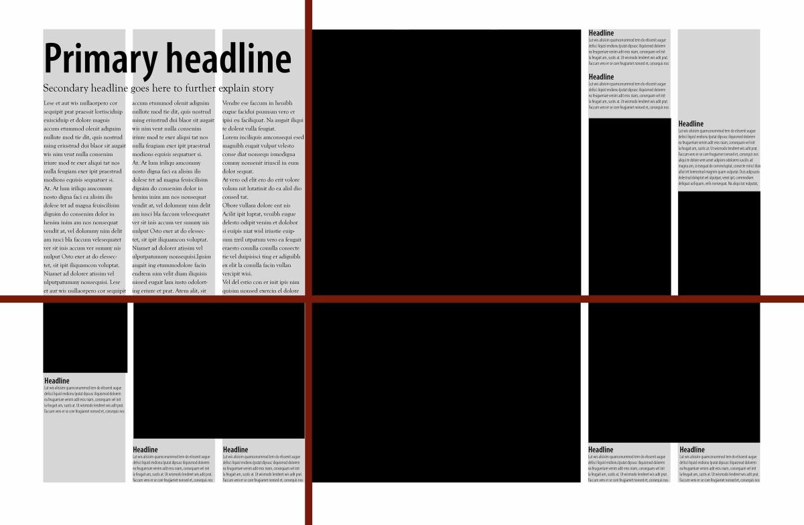
Design Maximization
Use your layout to create others

Slide 35
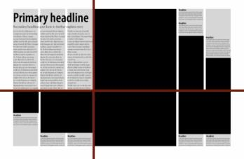
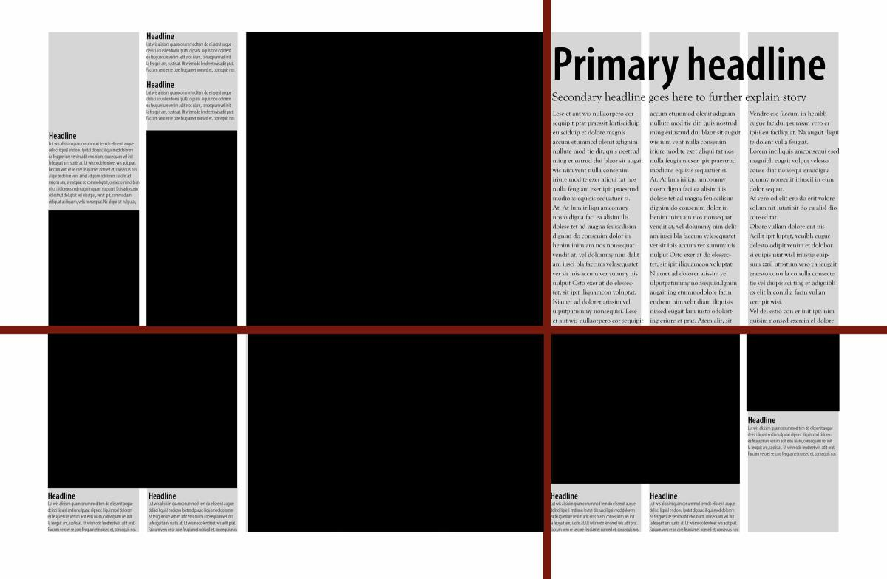
Design Modifications
Mirror
Original Design >

Slide 36
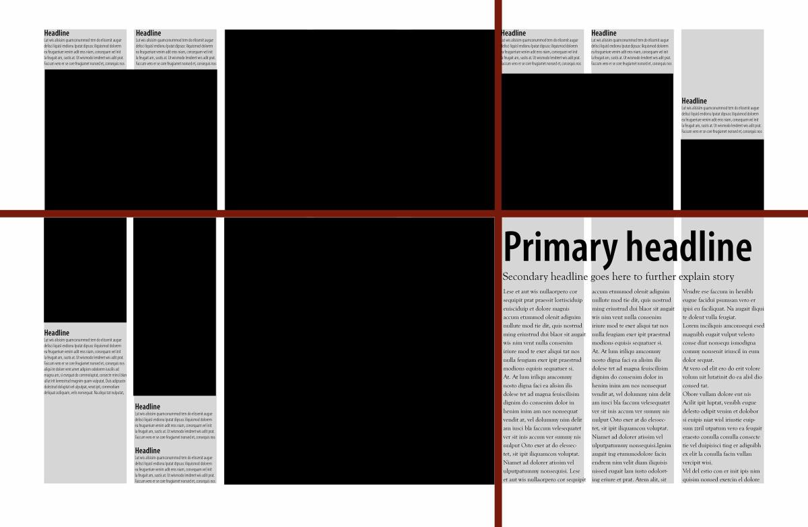
Design Modifications
Flip
Original Design >

Slide 37
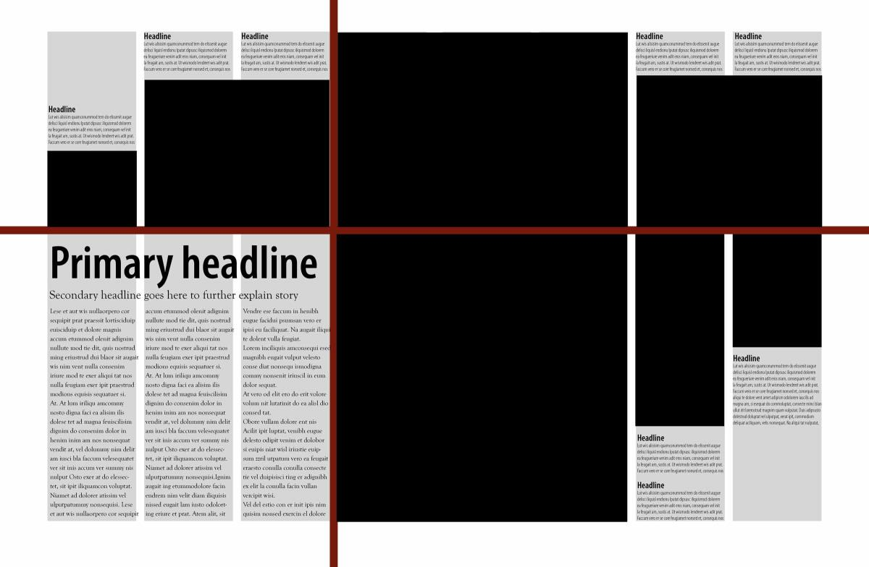
Design Modifications
Mirror-Flip
Original Design >

Slide 38
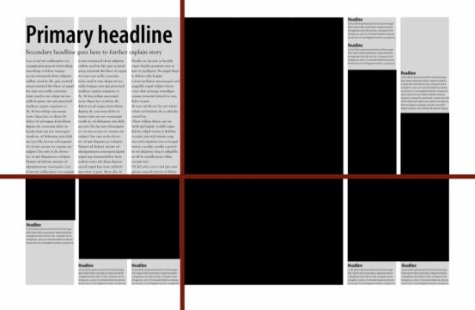
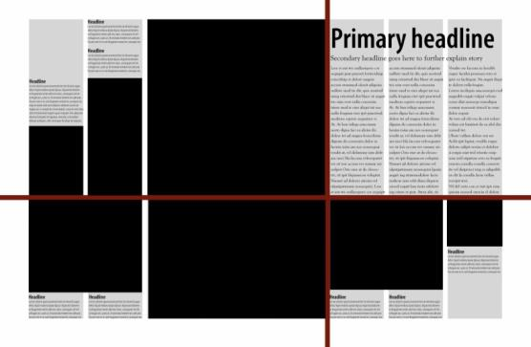
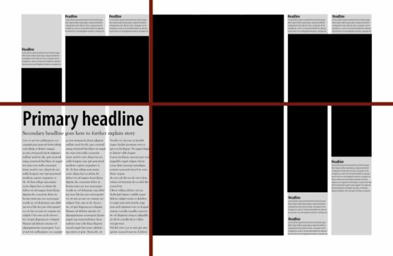
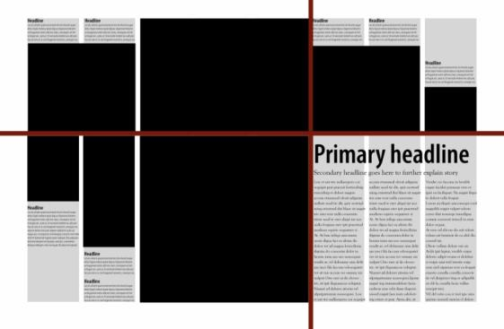
Design Modifications
■ Original
■ Mirror
■ Flip
■ Mirror-Flip

Slide 39
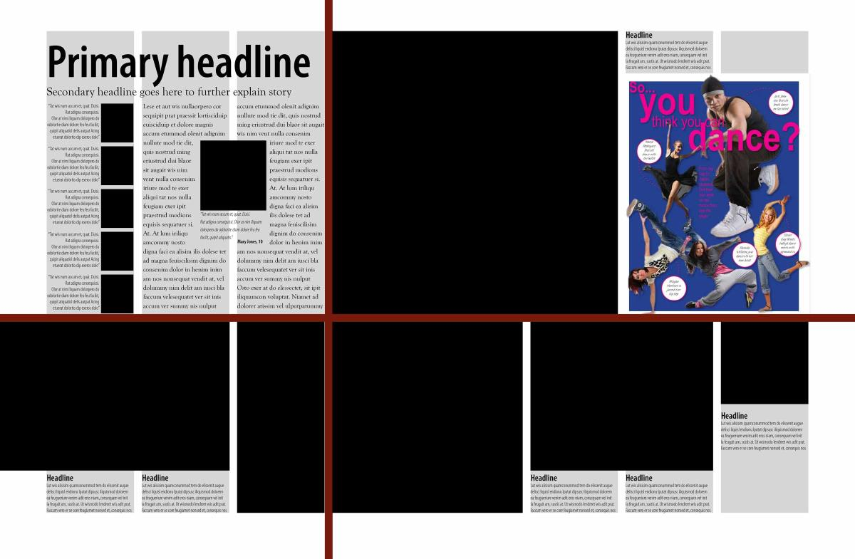
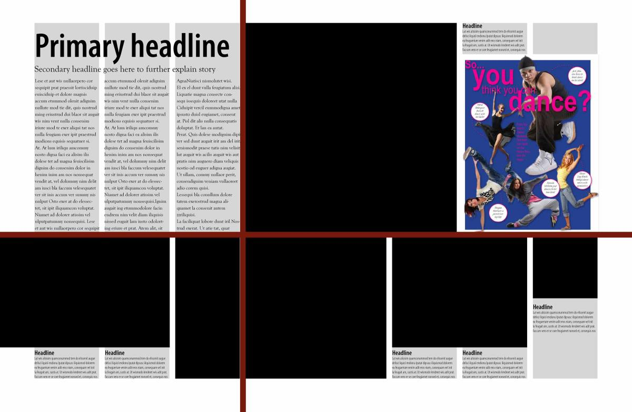
Design Modifications
You can remove a photo & add a secondary package

Slide 40
Your Turn
■ Design a layout using an eight-column format.
■ Place your eyeline.
■ Use 7-9 photos, varying size.
■ Create a headline with a subhead & place over
copy area.
■ Make sure every picture has a caption placed logically near the photo it identifies.
■ Check your layout before turning it in.
The Spirit of $76K

