Slide 1
Legal
ISSUES

Slide 2
Journalism
LEGAL ISSUES
If it’s yours, protect it.
If it’s someone else’s, respect it.

Slide 3
Yearbook Staff
LEGAL RESPONSIBILITIES
Your rights
Libel and privacy
Copyright material
Trademark material

Slide 4
Yearbook Staff
LEGAL BYTES FROM SPLC
Students are legally responsible for everything they publish. Being a minor is not an automatic shield from liability.
Material on the Internet is not free for the taking. The same copyright rules that protect printed material also protect images, graphics, sounds and text published online.

Slide 5
LEGAL BYTES FROM SPLC
Yearbook Staff
You may cross the line if in addition to words, you include references to the names, titles, short slogans, lists of ingredients and familiar symbols of brands or products. There are a few categories that cannot, by definition, be copyrighted. If you feel a need, you can, for example, use the words “The Days of Our Lives" or “Oh, the Places You'll Go" as the theme or a section header.

Slide 6
Your rights:
The Hazelwood Decision
The rights of public high school students are not necessarily the same as those of adults in other settings.
The Hazelwood decision gives the administrators the right to prior review of material for school sponsored publications, unless established as a public forum for student expression by established policy or tradition.

Slide 7
Your rights:
Hazelwood vs. Tinker standard

Slide 8
Under Hazelwood, administrators may edit materials that are:
Ungrammatical
Poorly written
Inadequately researched
Biased or prejudiced
Vulgar or profane
Unsuitable for immature audiences

Slide 9
Libel and privacy
THE DEFINITION:
Libel is defined as false, published words or pictures that attack a person’s good name or damage a person’s, company’s or organization’s reputation.

Slide 10
When in doubt, ask yourself:
?
If it were about me, would I want it printed or written in the yearbook?

Slide 11
Defending yourself:
!
In libel cases, the prosecution must prove the statement is false, published or written with intent to hurt someone.

Slide 12
TM
Trademark:
Trademarks are used to identify a product or service that’s for sale. You may not use a trademark logo, name or slogan if it will confuse the purchaser.

Slide 13
C
Copyright:
Copyright protects original works such as song lyrics, photos, CD covers, art, ad designs and cartoon characters.
Ideas or facts cannot be copyright protected, but the way they are expressed can be.
Fair use law:
A limited amount of copyright protected material can be used in news reporting, editorial comment, non-profit educational purposes or research.

Slide 14
*
When have you gone too far?
You could violate privacy laws if you—
Photograph a person in a private place and publish the picture.
Tape record a private conversation and publish the information.
Publish facts/pictures which aren’t appropriate for the publication.
Publish a made-up quote and attach someone’s name.

Slide 15
*
You have gone too far if you:
Use photos with unrelated copy.
Place hidden messages in yearbooks.
Put a damaging nickname under a picture.
Use someone’s likeness to endorse a product without his or her permission.

Slide 16
You be the JUDGE
Situation:
You need pictures from an event that your photographer couldn’t go to, but know that many students took pictures and have put them on Facebook, Twitter or Instagram.
Can you download them and legally use these pictures?
Notes:
No. Photos placed online or on social media are still copyrighted. Even though they’re easily accessed, you would still need permission from the photographer.

Slide 17
You be the JUDGE
Situation:
You need photos that deal with current events from this year (i.e. protests, pandemic, hurricane, celebrity happenings, etc).
Can you download them from Google images?
Notes:
It depends. If the photos have a Creative Commons license or are government photos, you may be able to use them. Do an advanced Google search to limit parameters to find photos that can be reproduced. Otherwise, you need permission from the photographer or need to purchase images from a news service.

Slide 18
You be the JUDGE
CAPTION:
At Best Buy’s checkout counter, Bob Forapples waits on a customer at his after school job. Forapples had to get a job to help support the family after his father was arrested for DUI in October.
Notes:
This is personal information that is not appropriate to run in the yearbook.

Slide 19
You be the JUDGE
Scenario:
The principal appears in a photograph in the senior section of the cafeteria with the sign behind him.
“Class of 2021”
The photo was cropped with the CL off the word CLASS.
Notes:
This is also inappropriate. This is in poor taste and reflects poorly on the principal who could sue for libel.

Slide 20
You be the JUDGE
Scenario:
Story on a spread is about how there are more girls on campus than boys and how difficult it is to get dates. A dominant photo appears of Susie Quetie standing and staring out the school window in math class.
Caption:
The window in math class provides a quiet place as Susie Quetie stares out and dreams of the dates she will never have.
Notes:
This is irresponsible and poor journalism writing. Susie could sue for libel.

Slide 21
You be the JUDGE
Scenario:
The superlative page has all the traditional titles: Best Looking, Most Likely to Succeed, etc. At the bottom of the page is a picture of a couple with the title:
Most Likely to Appear on Jerry Springer
Notes:
While this may seem funny and innocuous, the show has negative connotations that could be associated with the chosen couple. This could cause anger and potentially a lawsuit.

Slide 22
You be the JUDGE
Scenario:
The yearbook staff decides to use the cartoon character of Charlie Brown to introduce the theme of the book on the opening pages. A drawing of Charlie Brown, produced by a student on staff, appears on the opening pages and on the last page of the book.
Notes:
No. Charlie Brown images are copyrighted and cannot be used to “decorate” a page. Now, if there was a poll that ranked comic strip character, a Charlie Brown could be fairly used. This is an example of commentary and criticism which is considered fair use and the image can be used without permission or payment.

Slide 23
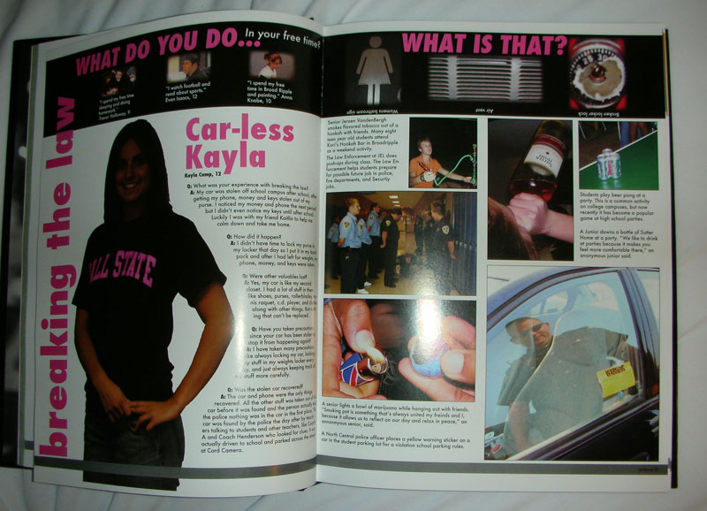
Would you run this spread in your yearbook?

Slide 24
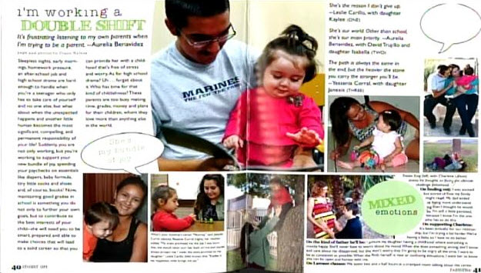
Would you run this spread in your yearbook?

Slide 25
What if you don’t know someone’s name in a picture?
What do you put in while waiting to find out their name?
Use an underline blank ___________.
If you use a “fake name” it might get printed in the book by accident.

Slide 26
Have a written policy in place for the following:
Photo publication policy (what you will/won’t accept in yearbook)
Obituary policy (so you don’t have to decide when emotions are high)
Have policies approved by your administration.

Slide 27
BOOK SALE POLICY (sample)
Yearbooks will be on sale each year from August through January. Price will vary and increase on a scheduled rate which will be published on the school’s website, the yearbook website and on printed forms.
Students who do not purchase a book in advance run the risk of not receiving one. Only a small number of extra books will be ordered. They will be available on a first-come, first-served basis for cash or money order only. (No checks will be accepted during distribution.)
Exchanges can be made for books with minor flaws if the book has no writing in it. If the book has been written in, the adviser will determine if an exchange is possible.

Slide 28
BOOK SALE POLICY (sample)
It’s the buyers responsibility to provide proof of purchase if the staff has no record. A valid receipt or canceled check that has been deposited into the yearbook account will constitute proof of purchase.
Any book not claimed within the calendar year it is produced will become the property of the yearbook program. The money paid for the book will be forfeited.
The staff and editorial board will determine the cost of an individual copy based on a balanced budget.

Slide 29
PORTRAIT POLICY (sample)
All students and school personnel must have their picture taken

Slide 31
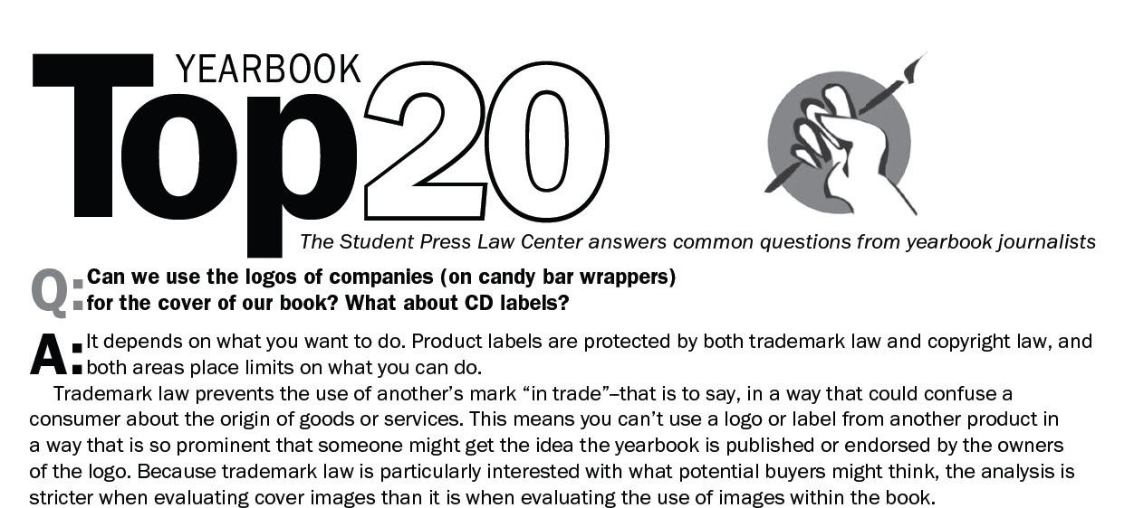
For more information

