Slide 1
Alternative
COPY

Slide 2
Why write
stories?
Most of your students can read.

Slide 3
Our students don’t read them.
Most of your students can read.
Most of them WILL read something that interests them.

Slide 4
become
storytellers
Most of your students can read.

Slide 5
Become storytellers
Focus on what’s new
Appeal to readers’emotions
Include facts & figures
Try alternative copy.

Slide 6
Alternative copy
Alternative copy is an alternative to traditional copy.
Also called quick reads.
Tells the complete story in layers with multiple perspectives.
Features numerous students and comes in a variety of formats.

Slide 7
Alternative copy
There are dozens of types of alternative copy.
Q & A
Quotes
Mugs & quotes
Highlights
Mini-stories
Timelines
Calendar
Interactive
How-to
Checklist
Notes:
Here’s just a few we’re going to talk about.

Slide 8
Types of alternative copy
Q & A
Find a person with a story to tell.
Frame questions so there is a beginning, a middle and an end to the story.
These are not random questions. The goal is to capture the person’s story and connect to the spread topic.

Slide 9
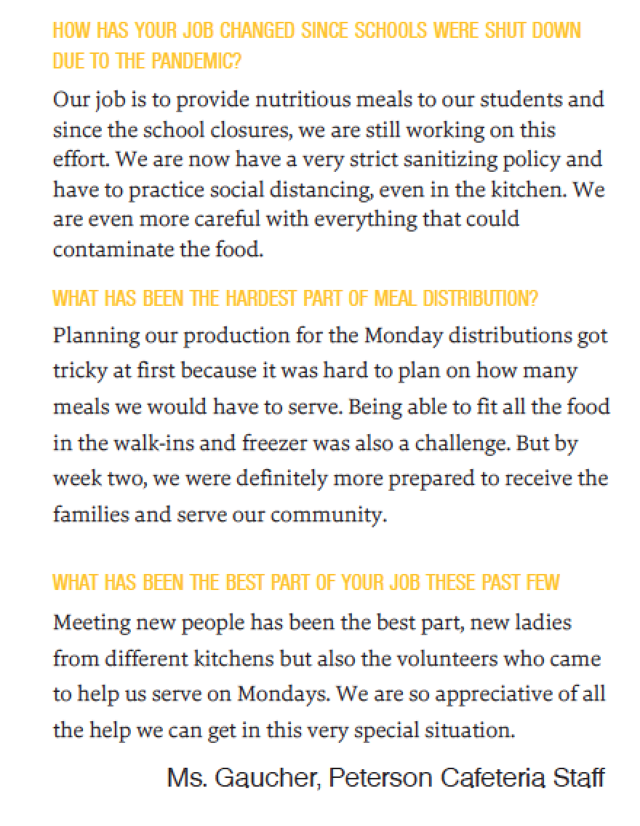
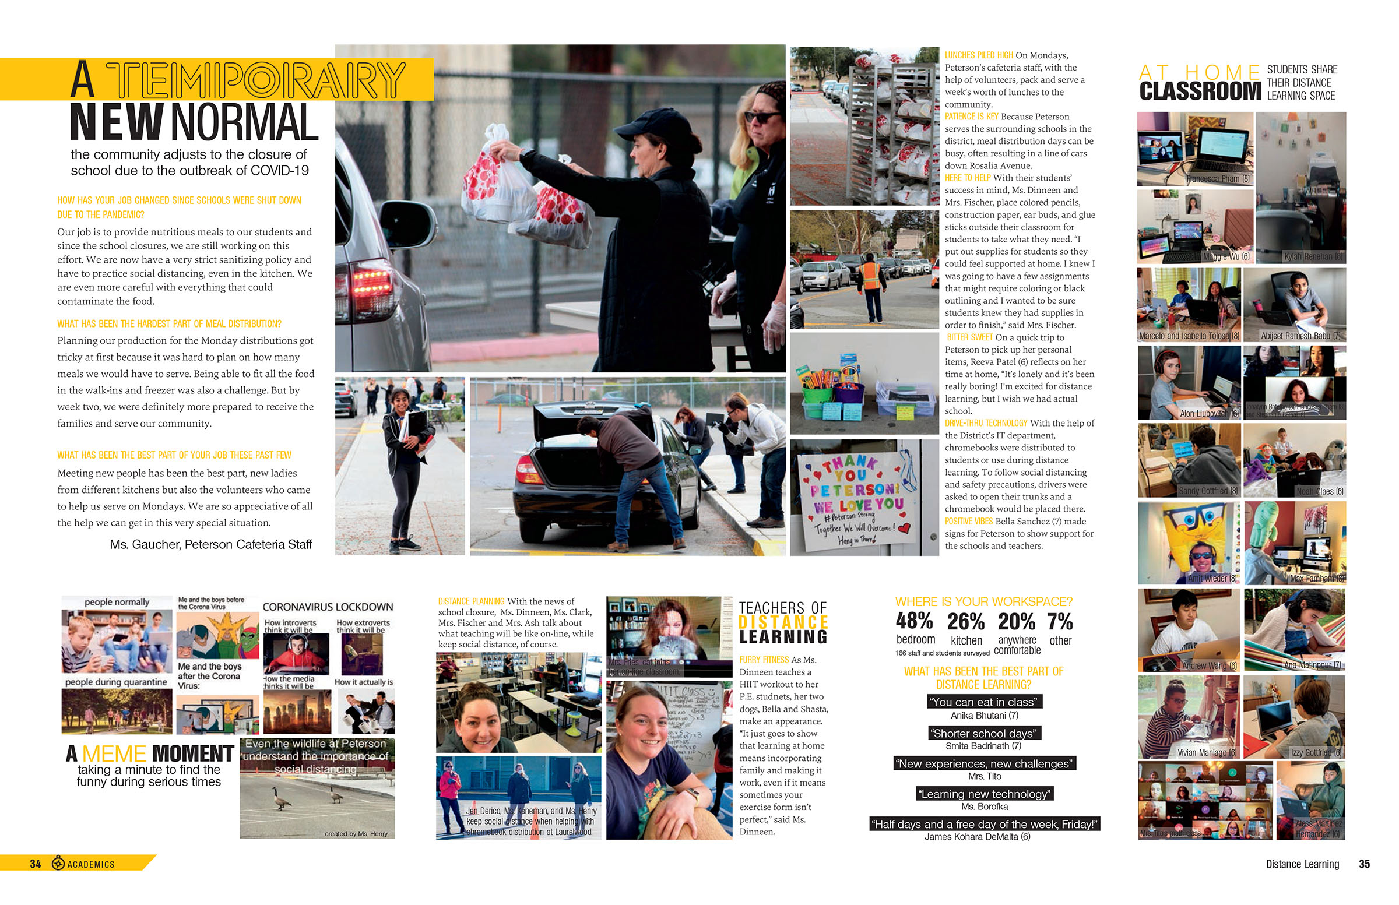
Q&A
Notes:
Q&A with one person

Slide 10
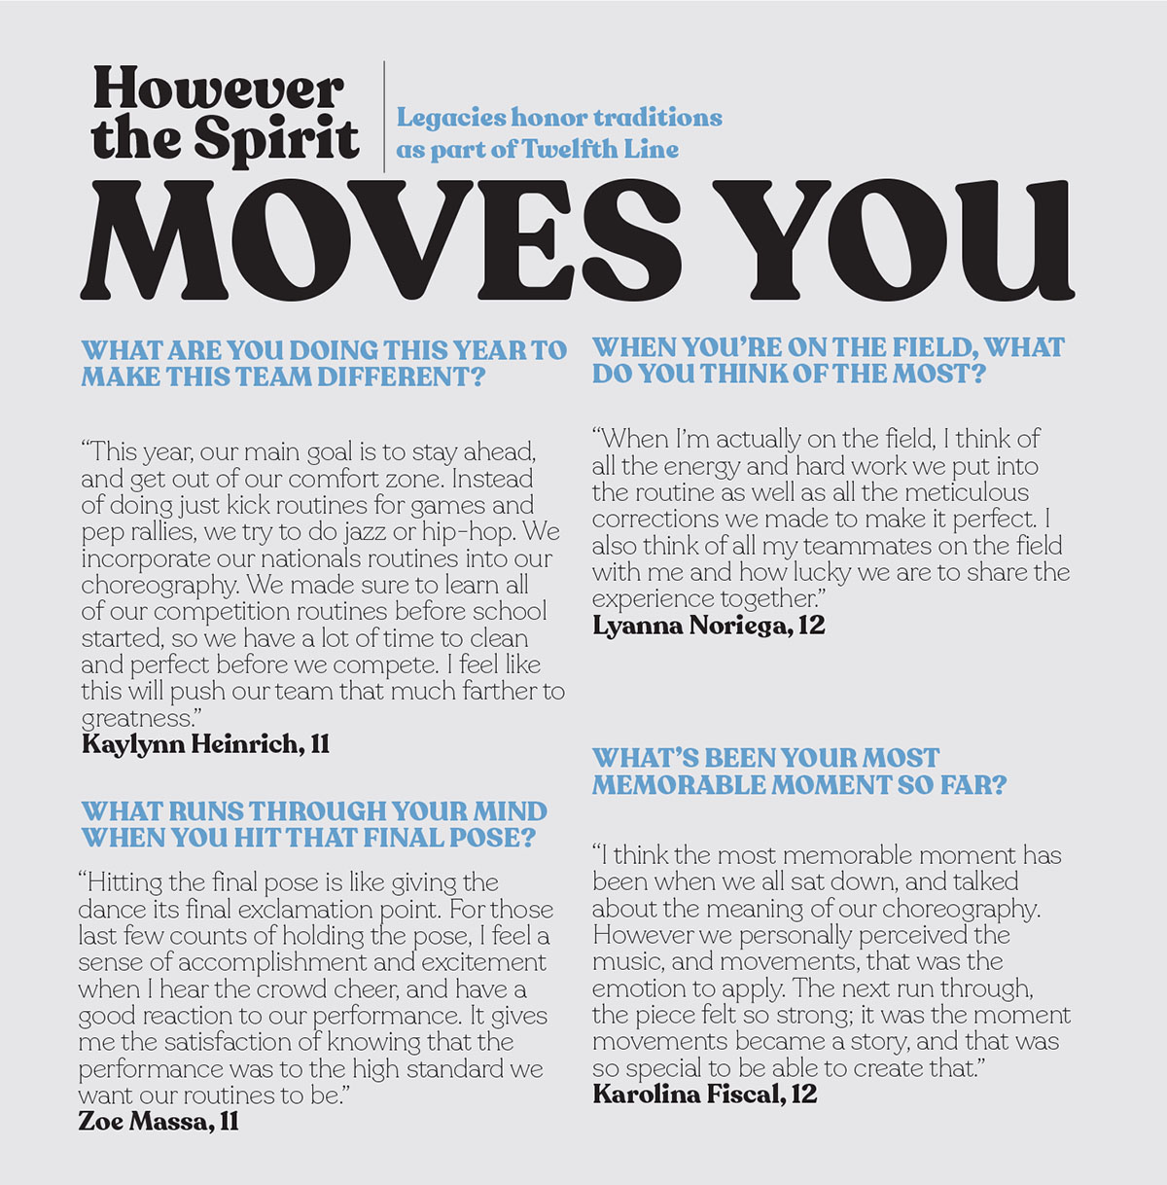
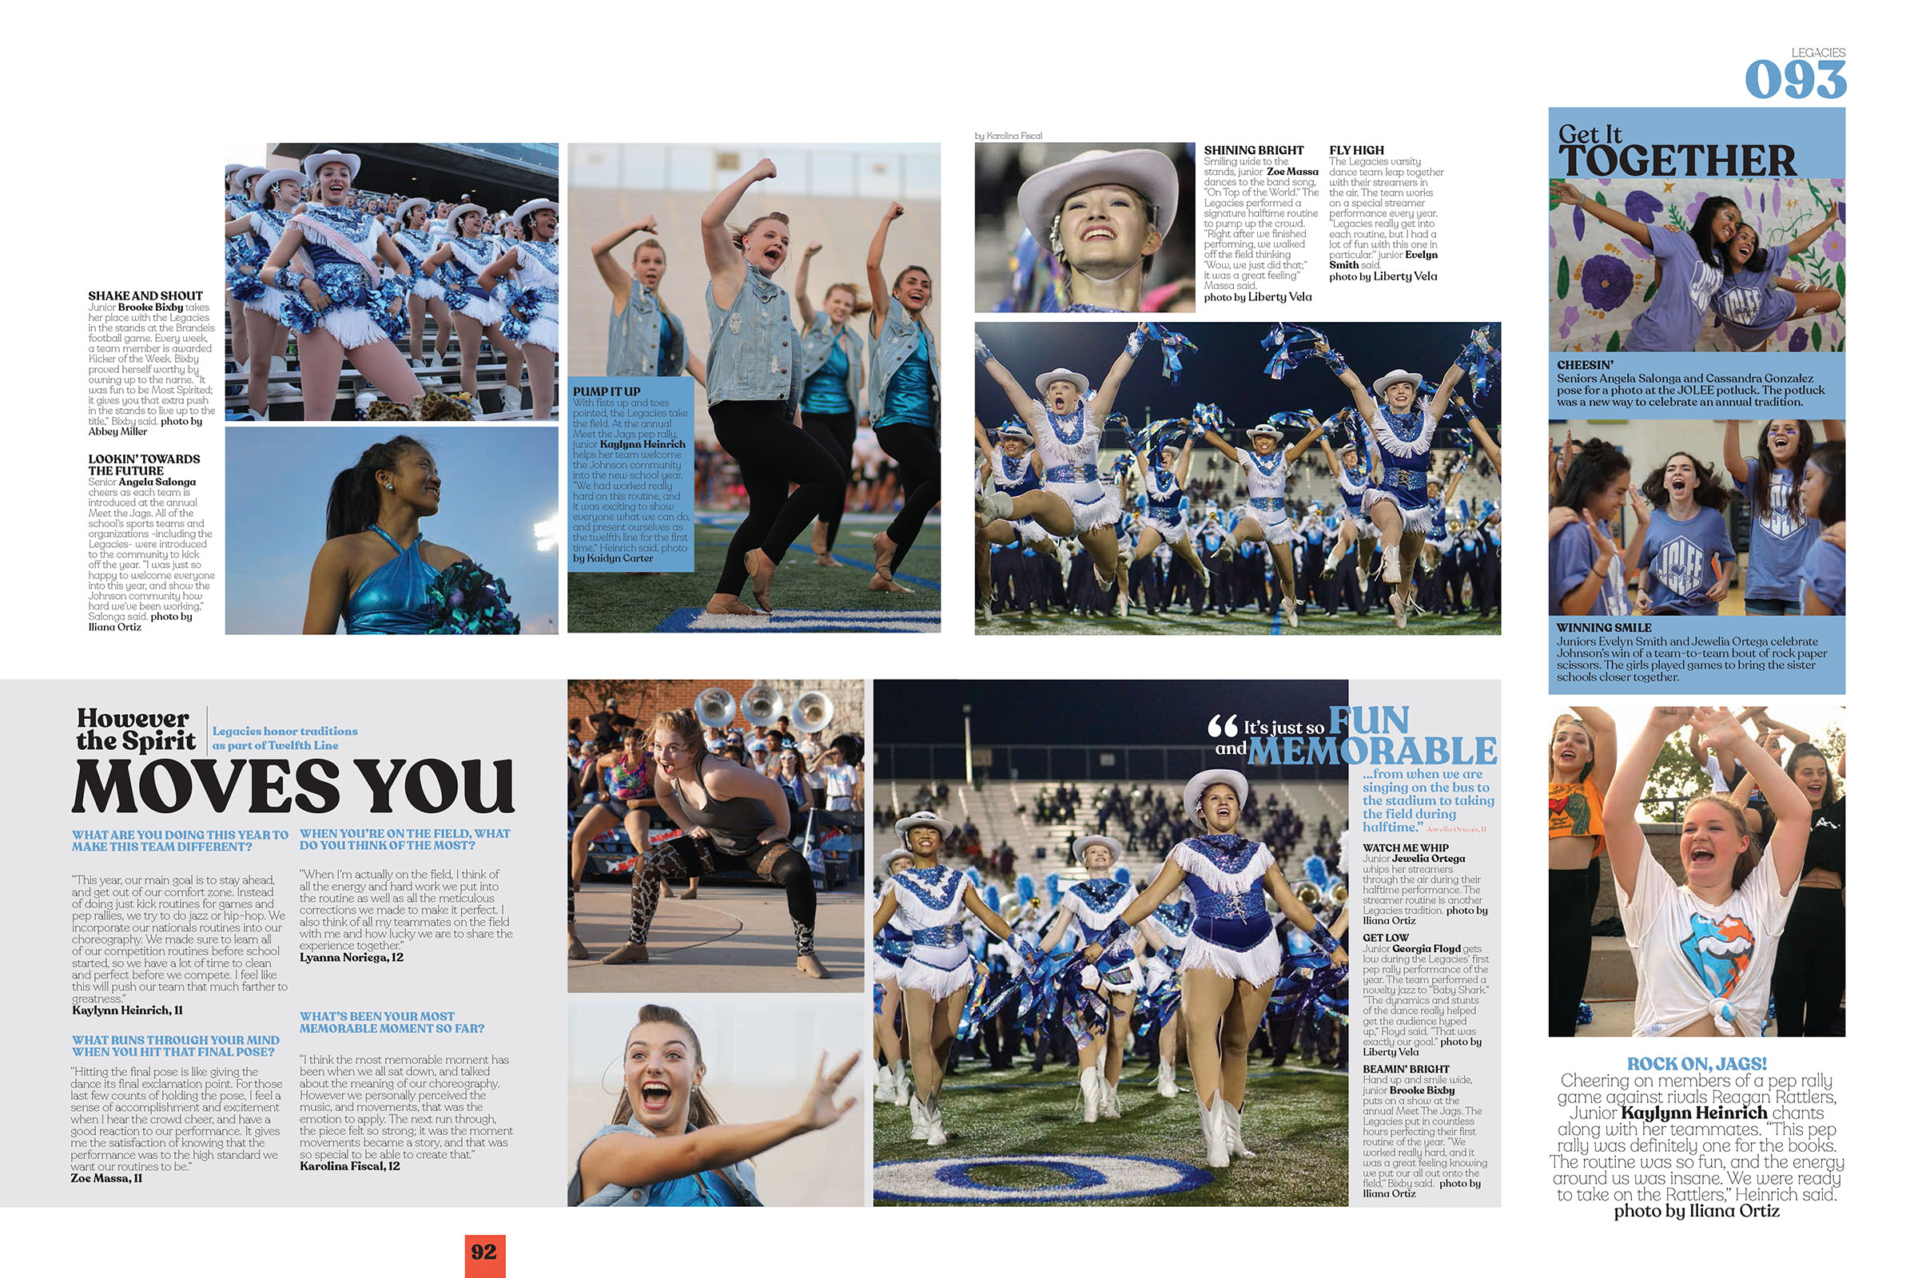
Q&A
Notes:
Q&A with four different people answering four different questions

Slide 11
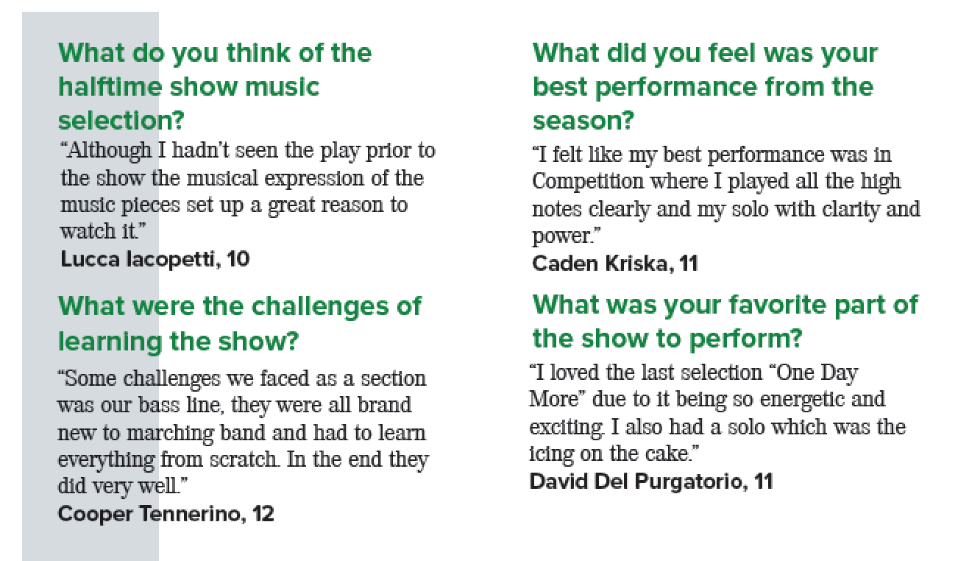
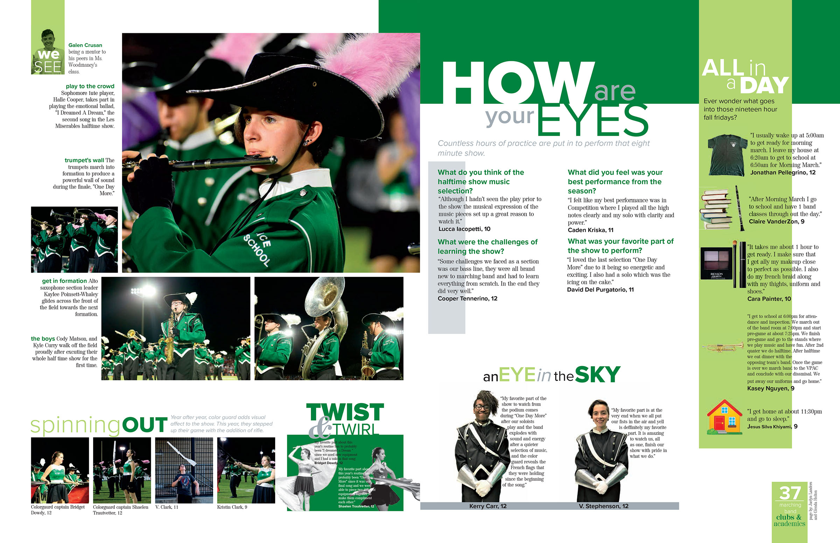
Q&A

Slide 12
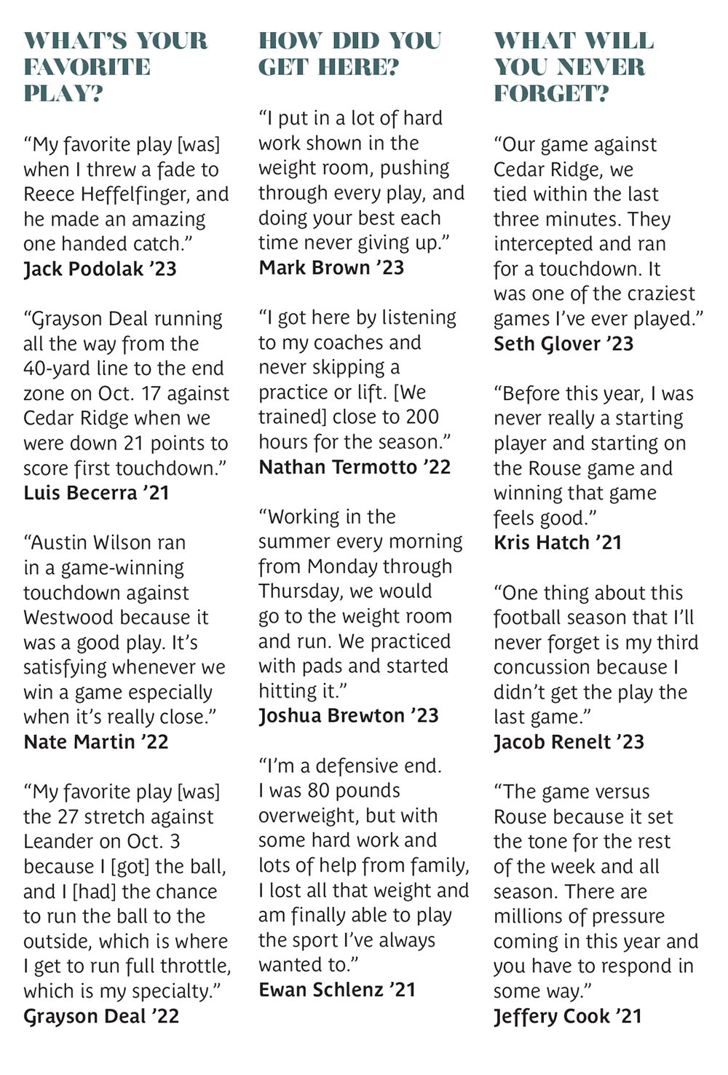
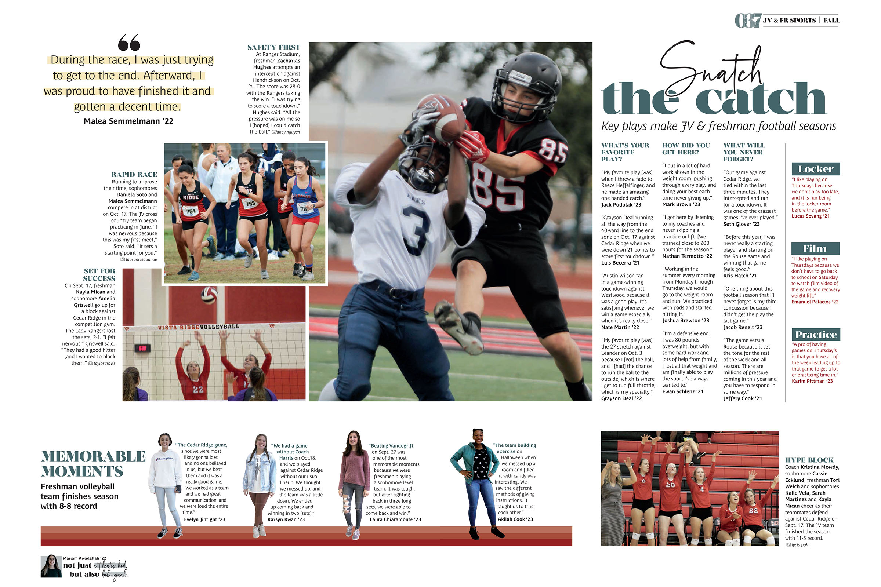
Q&A
Notes:
Q&A with 12 different athletes answer three questions. Smart way to utilize space and include players not on the spread in photos.

Slide 13
Types of alternative copy
Mini-stories
Instead of one long story, run one or more short feature stories (think 3-5 sentences).
Opportunity to feature several different aspects of a club, sport or event.
Ideal for clubs, classes and sports sharing space on one spread.
Notes:
Write a mini-story: 3-5 sentences for each one & include a GREAT quote. Great way to teach feature writing: Lead, quote, fact, quote. If they can learn that, then can teach how to do longer feature stories.
Mini-stories are great when there are too many groups to cover and not enough pages; and you run multiple groups, clubs or sports on one spread.

Slide 14
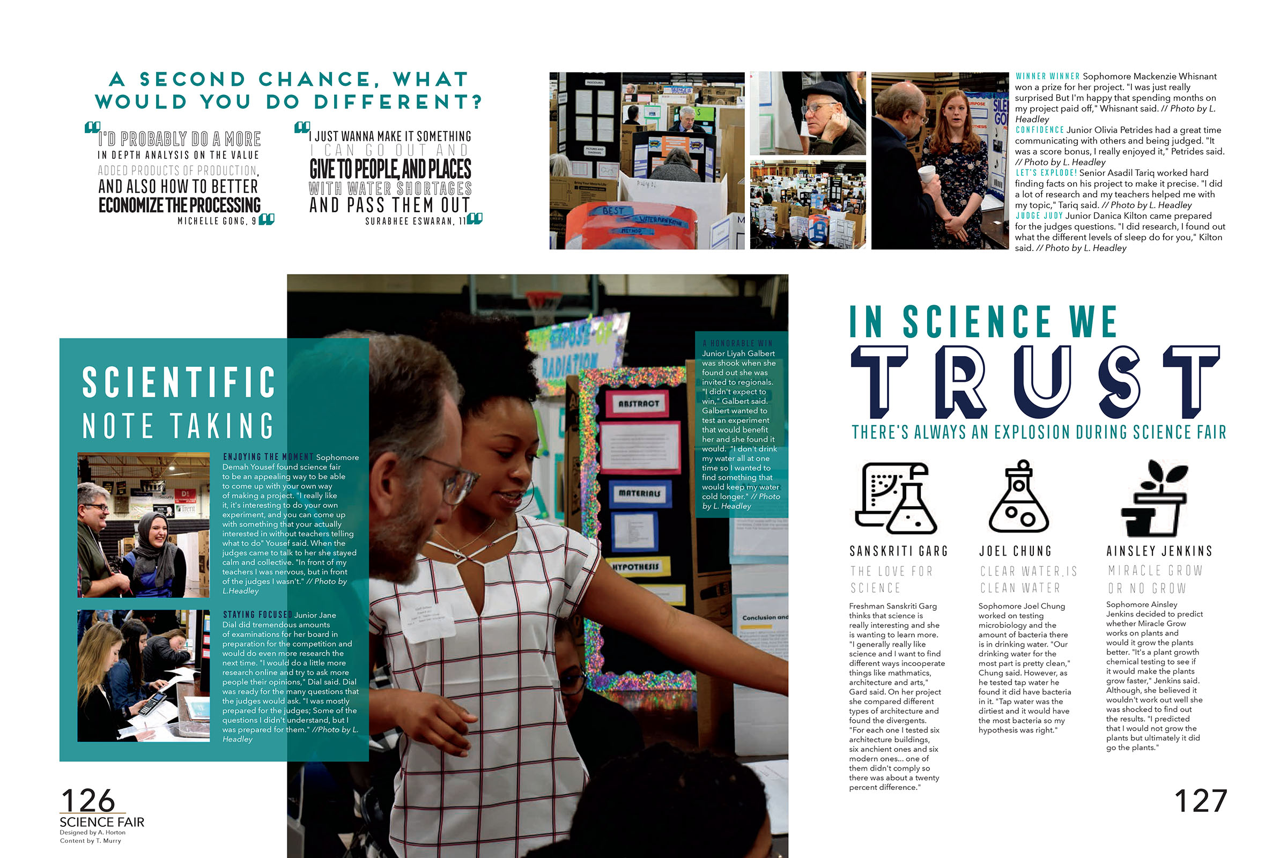
mini-stories

Slide 15
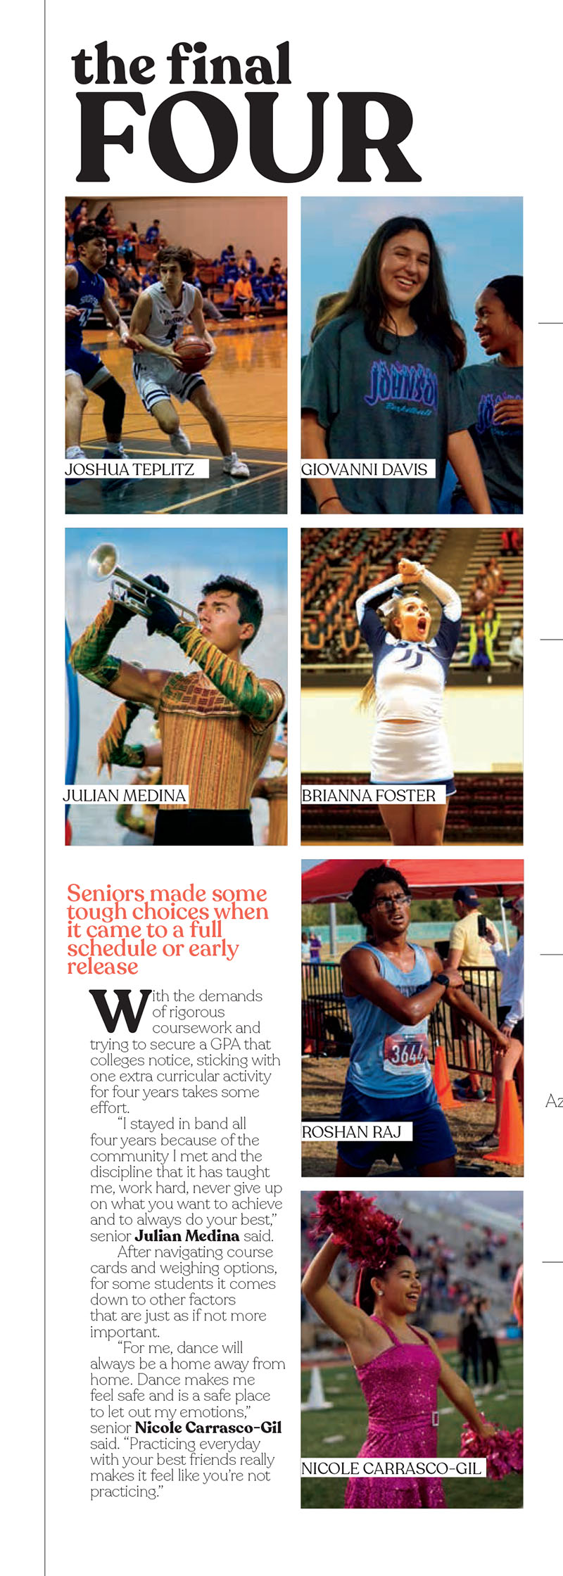
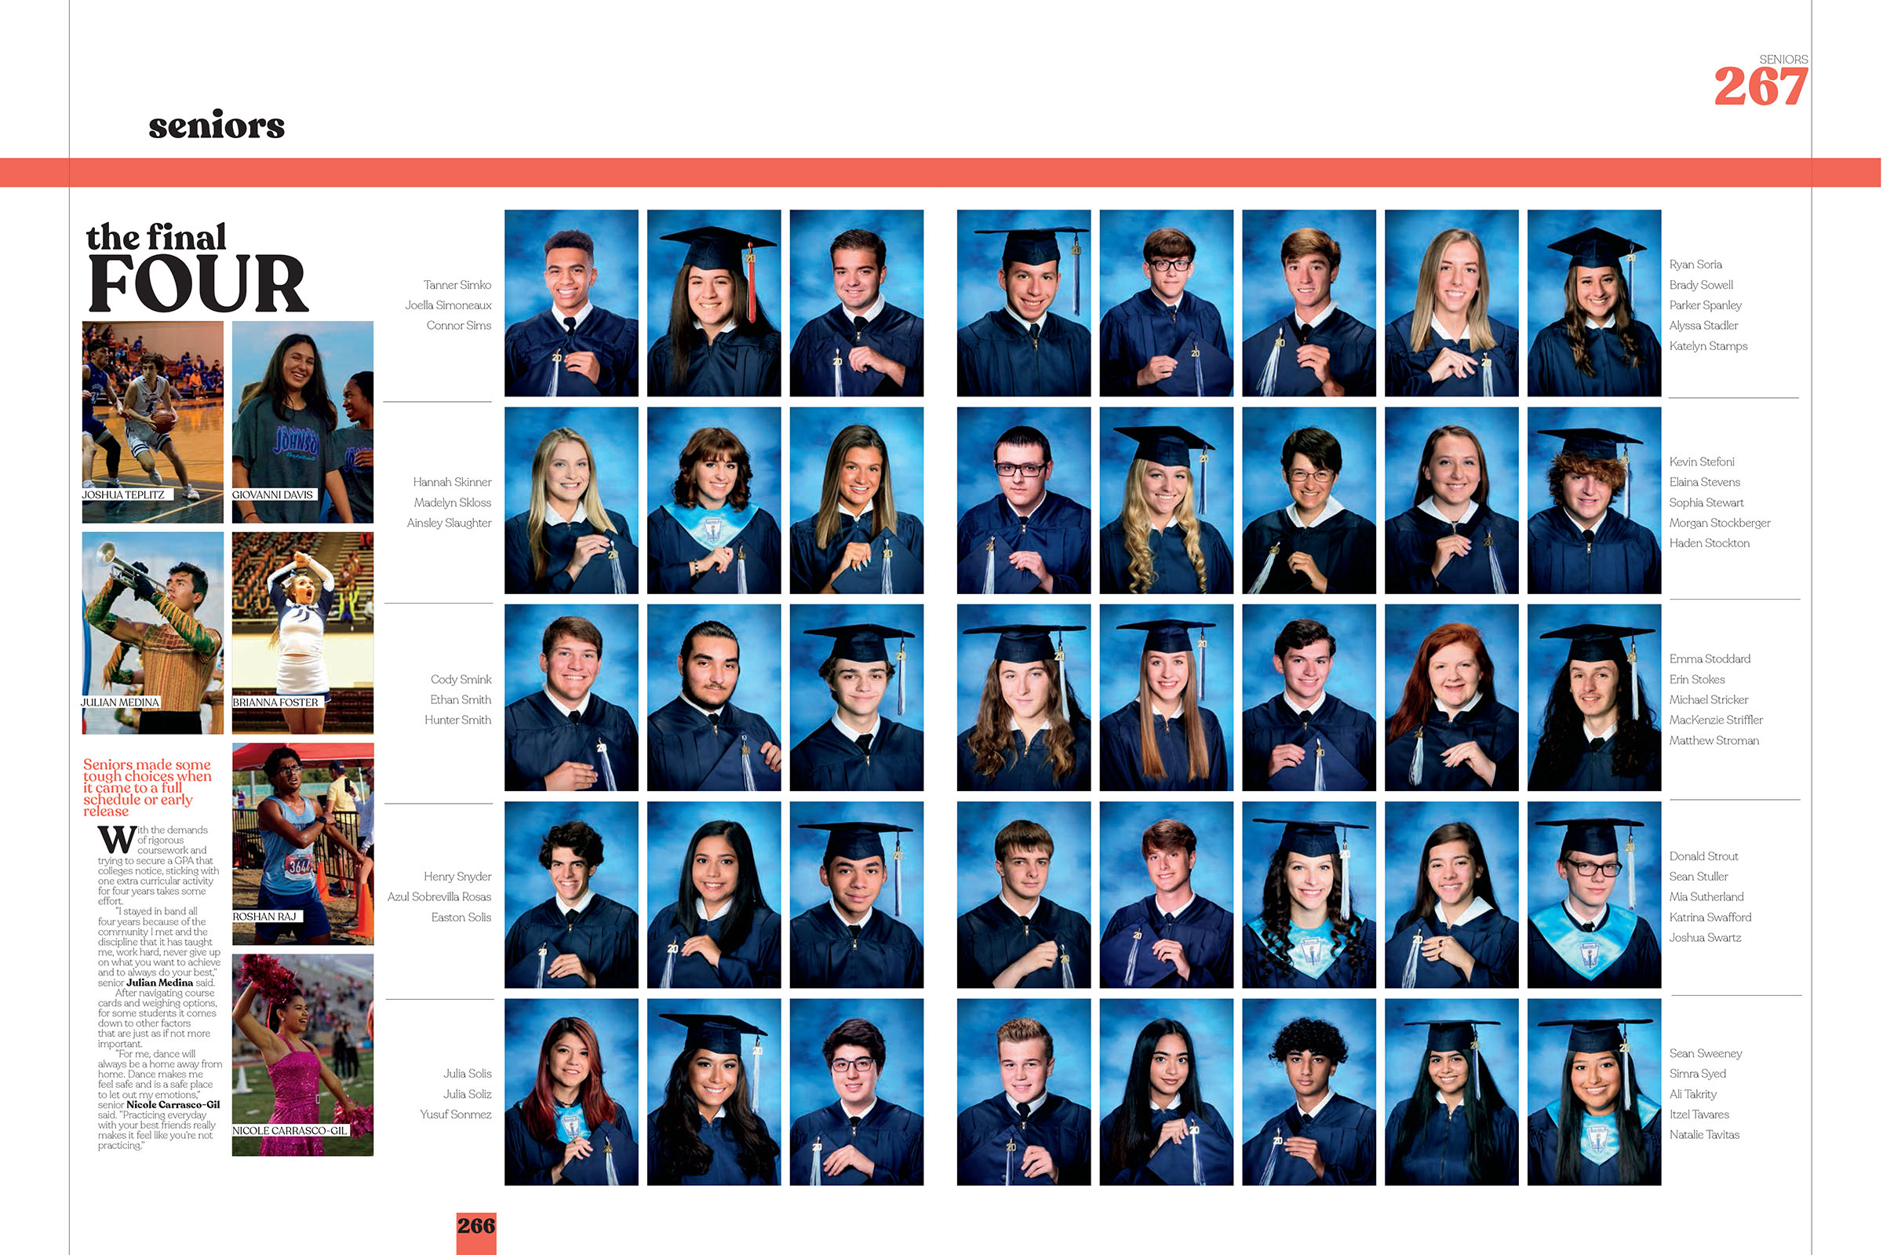
mini-stories

Slide 16
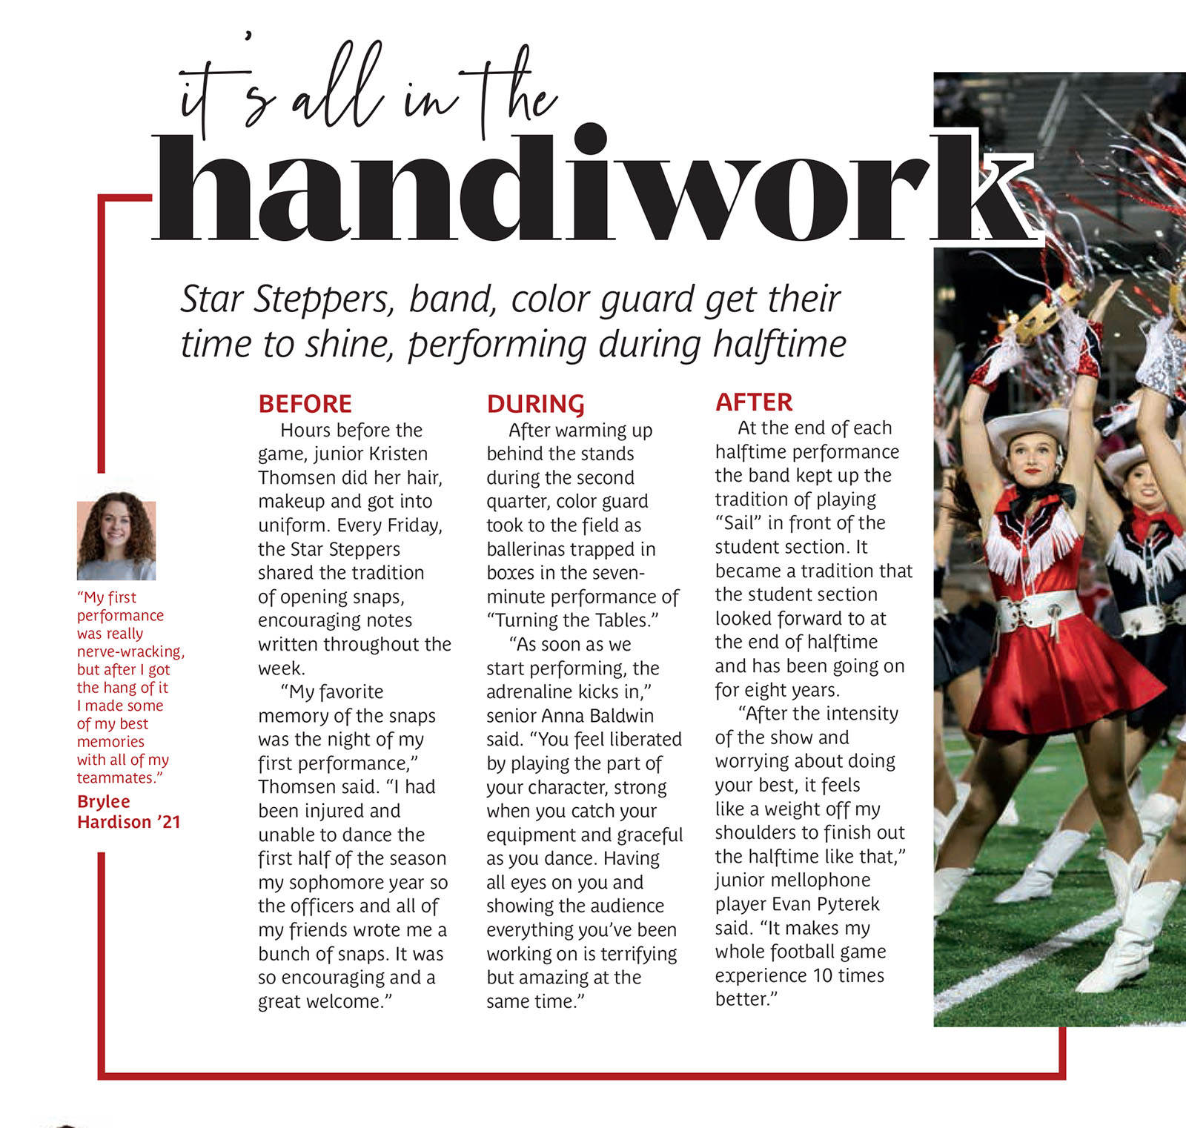
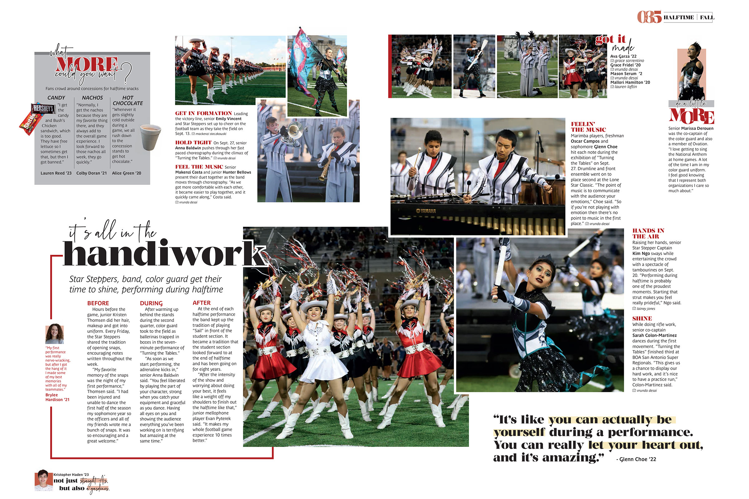
mini-stories

Slide 17
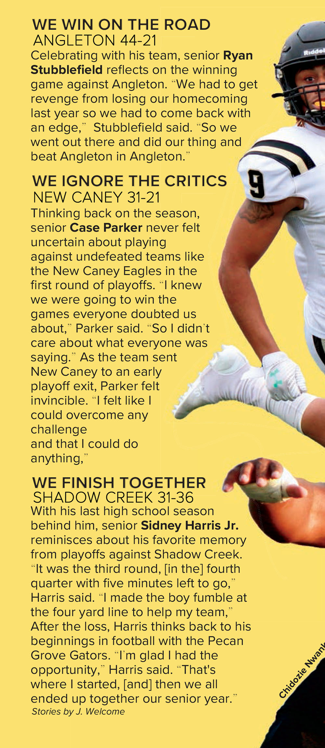
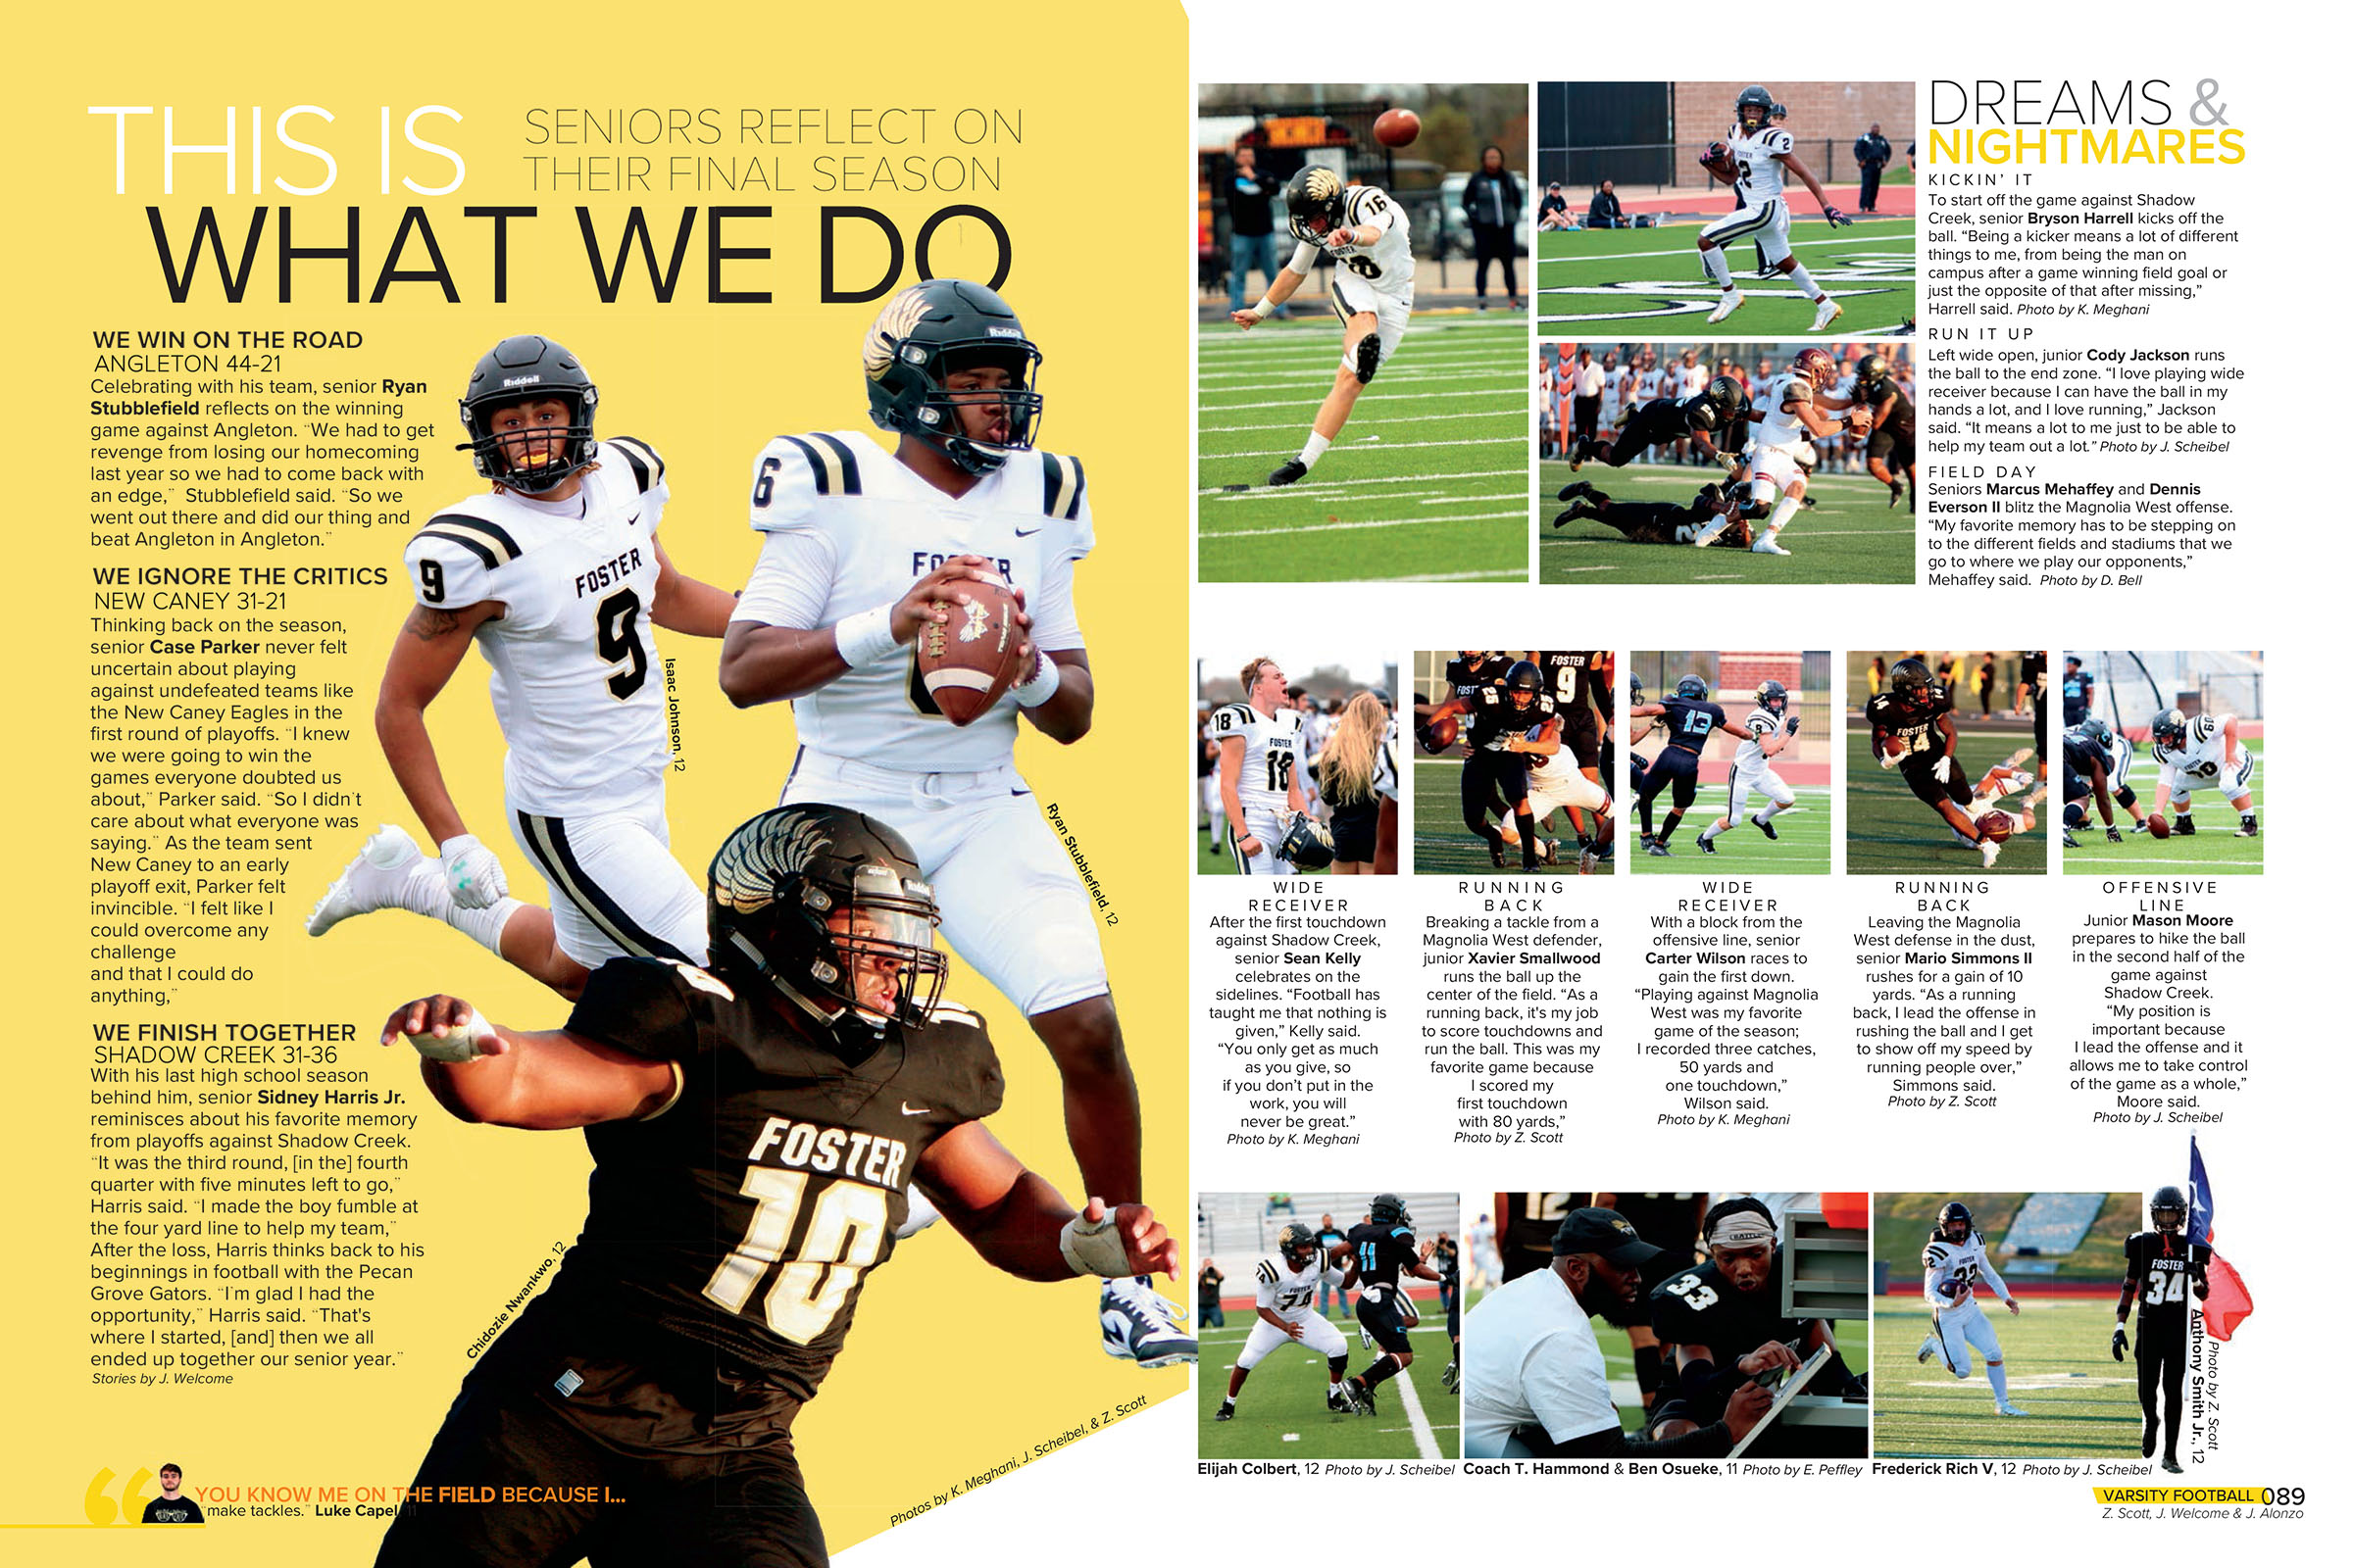
mini-stories

Slide 18
Types of alternative copy
Quotes
If 12 witnesses see the same event, each one will have a unique perspective.
Include a wide variety of students.
Feature students not already on the spread in photos.
Consider including cutouts or mugs.

Slide 19
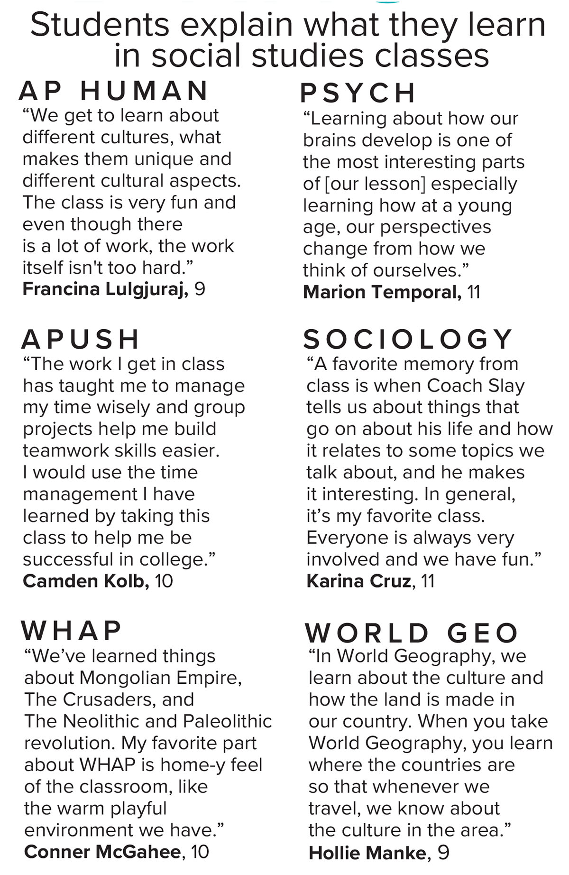
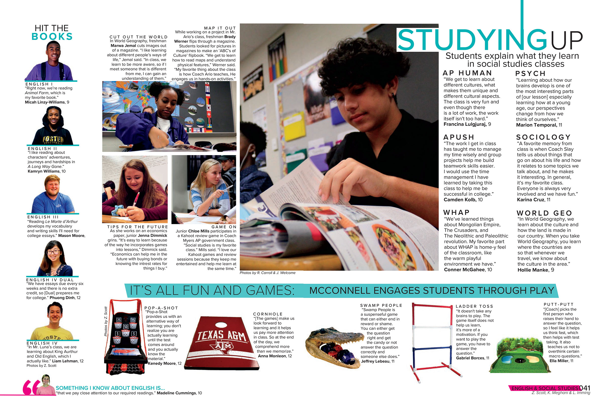
quotes
Notes:
Ten different athletes featured. Great way to cover big sports teams, and also freshman and JV teams, seventh grade teams.

Slide 20
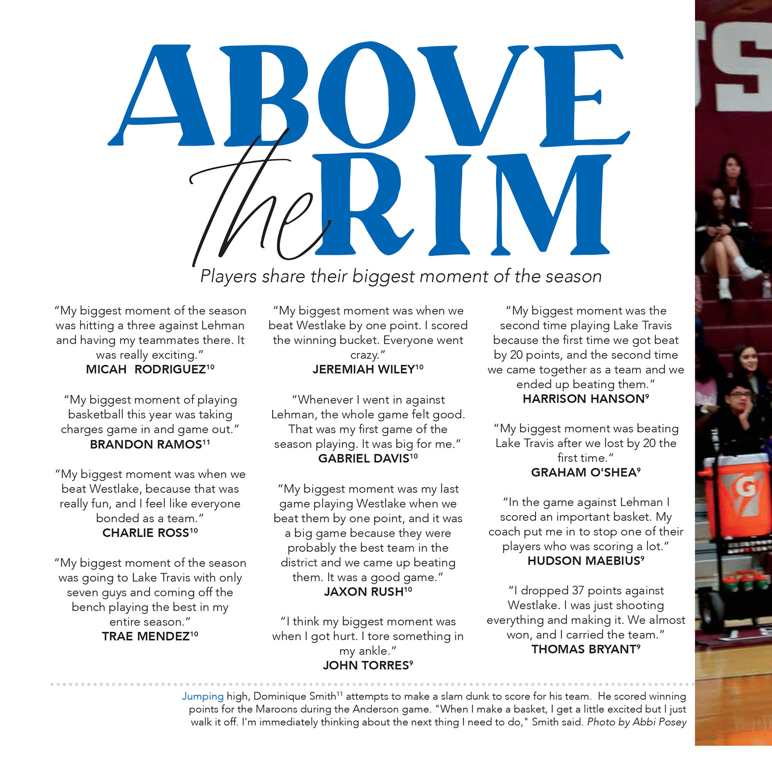
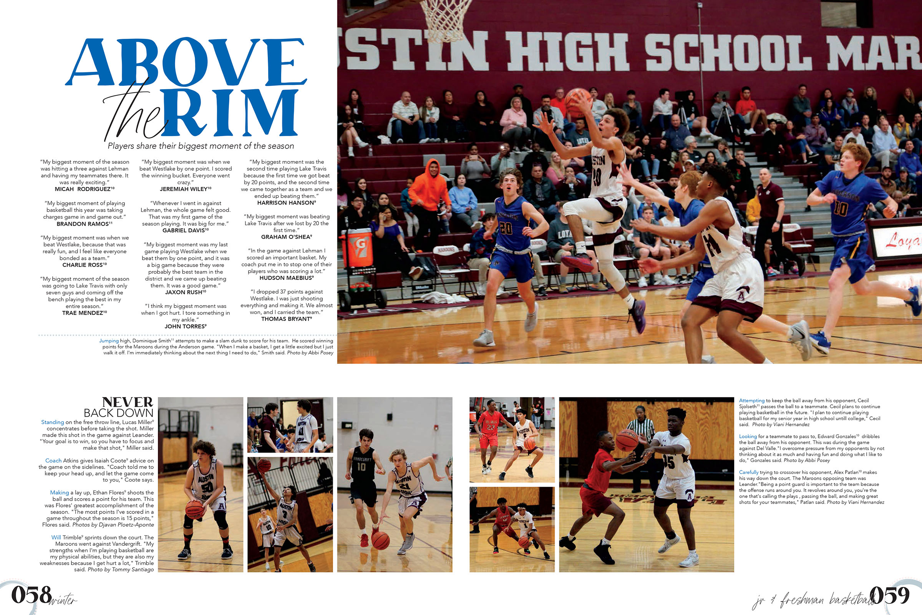
quotes
Notes:
Innovative way to cover Homecoming king and queen.

Slide 21
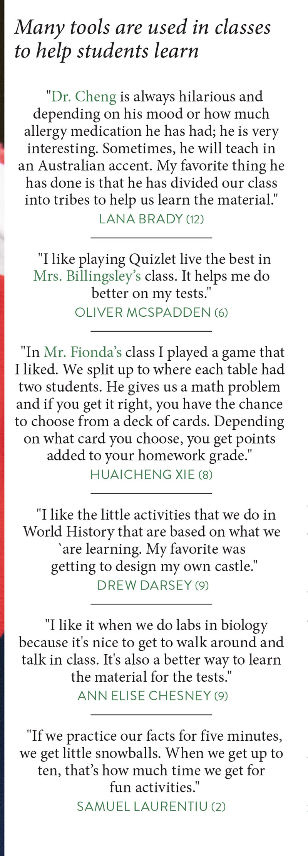
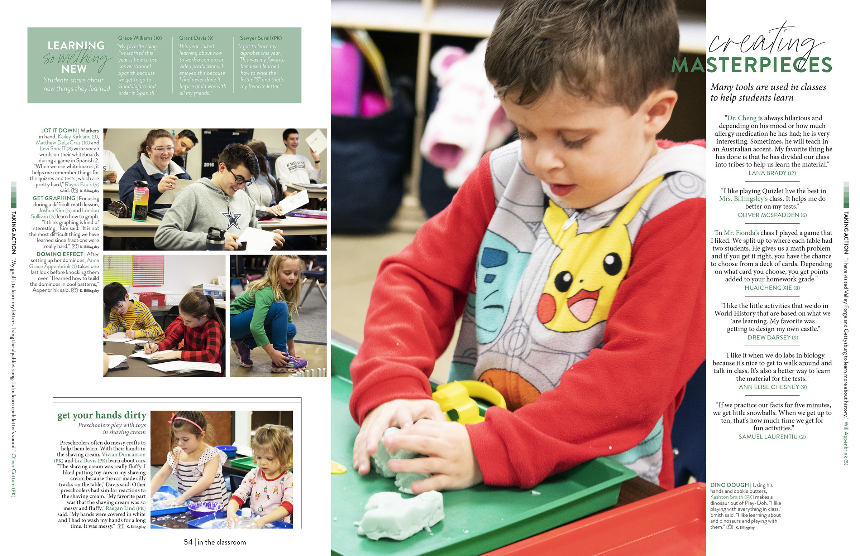
quotes
Notes:
Can include a candid photo instead of a mug

Slide 22
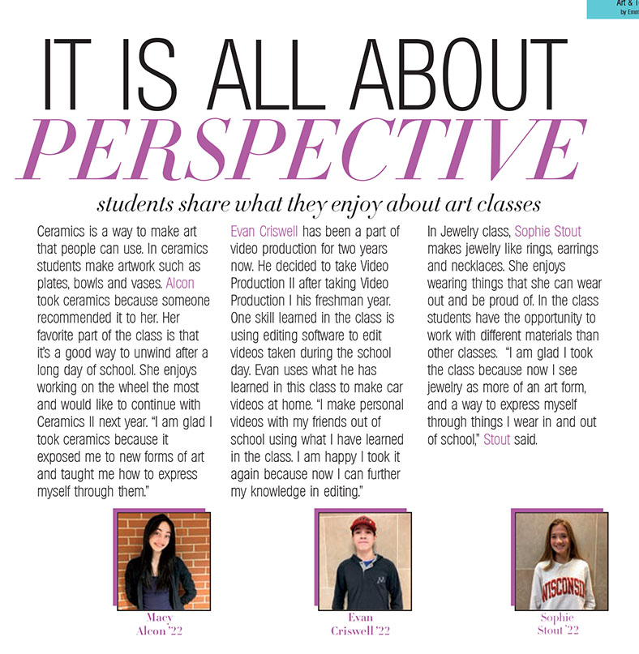
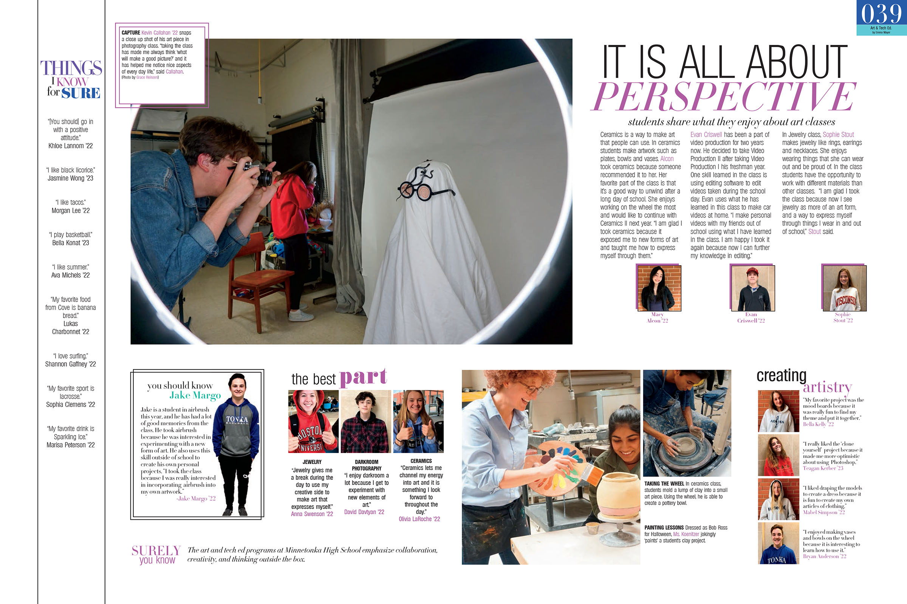
mugs & quotes
Notes:
Longer versions of quotes. Also, can use a candid photo or cutout instead of mug.

Slide 23
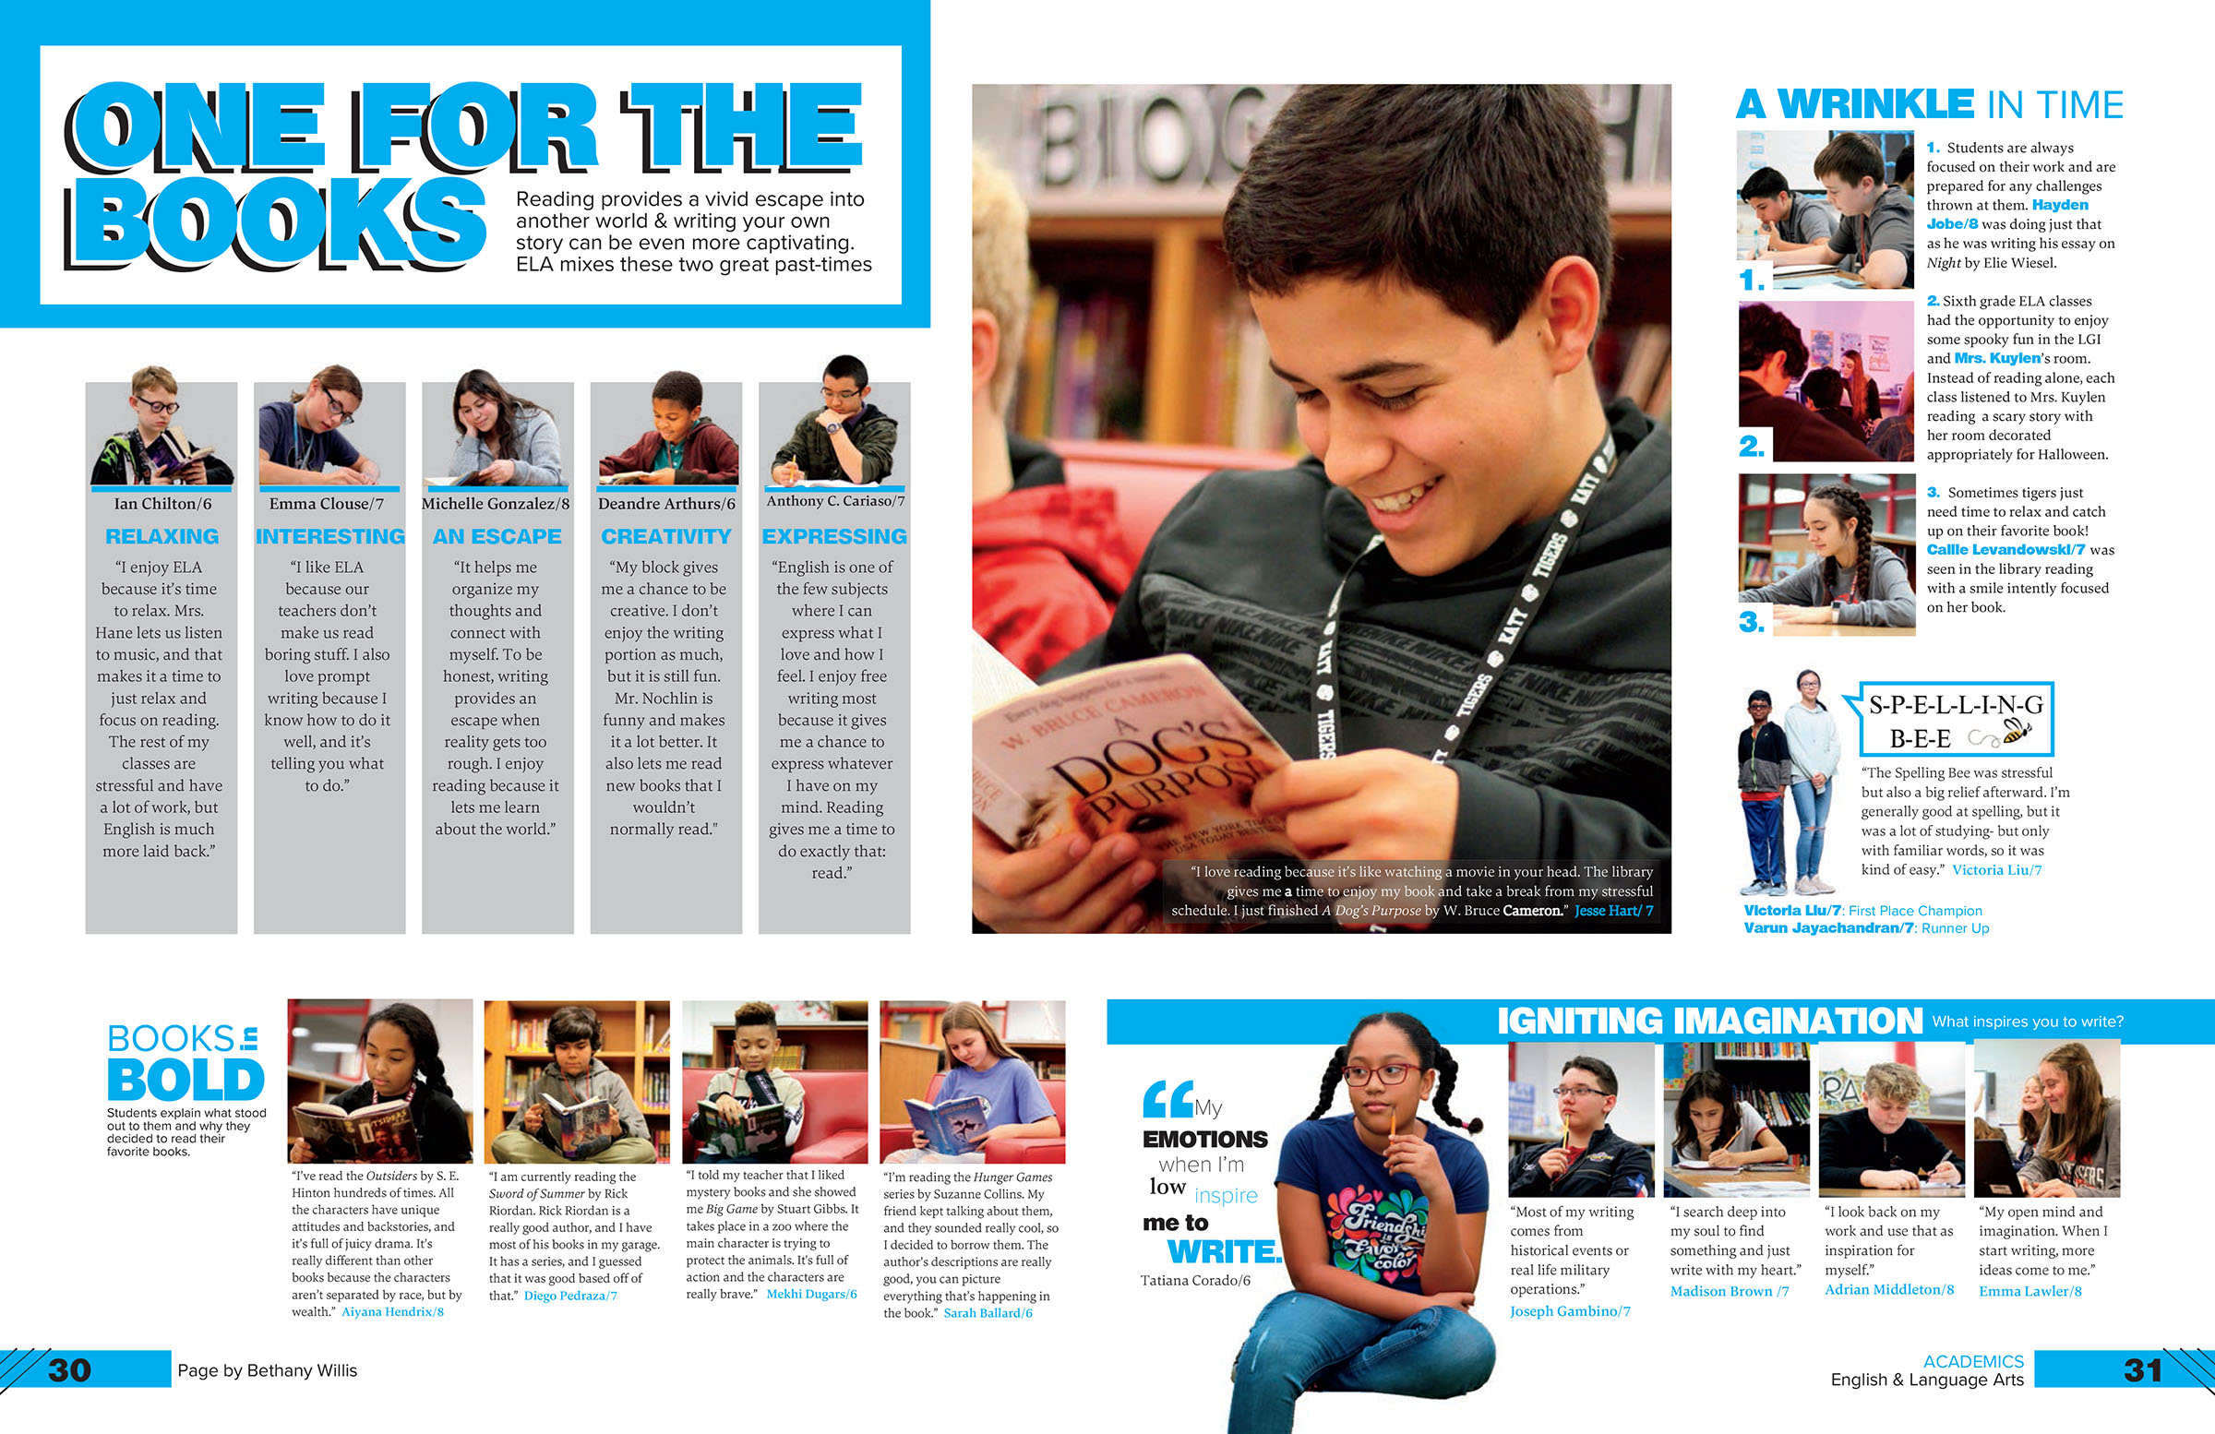
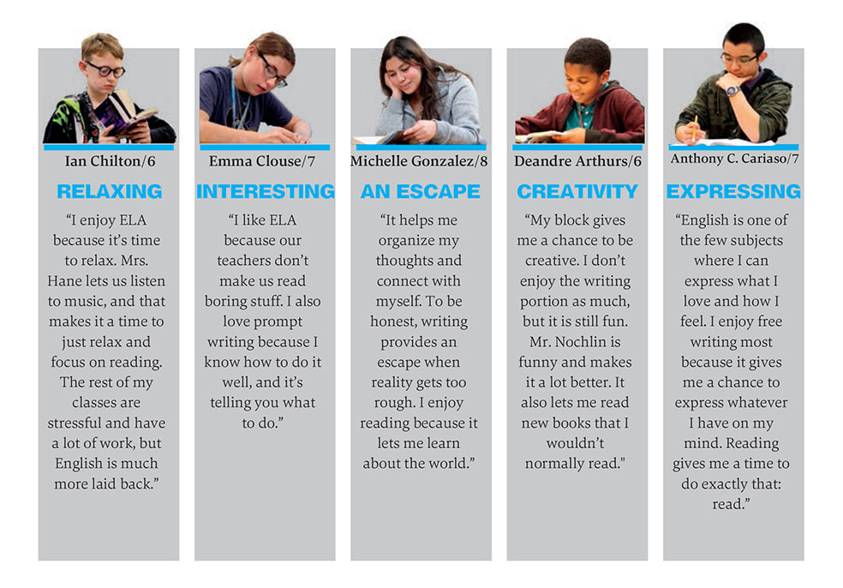
cutouts & quotes
Notes:
Can include a cutout with the quote. Even better if it’s a candid photo instead of a posed one.

Slide 24
Types of alternative copy
Linear Pull-outs with Quotes
Quick way to convey information.
Ideal for featuring multiple students and quotes.

Slide 25
linear pullouts

Slide 26
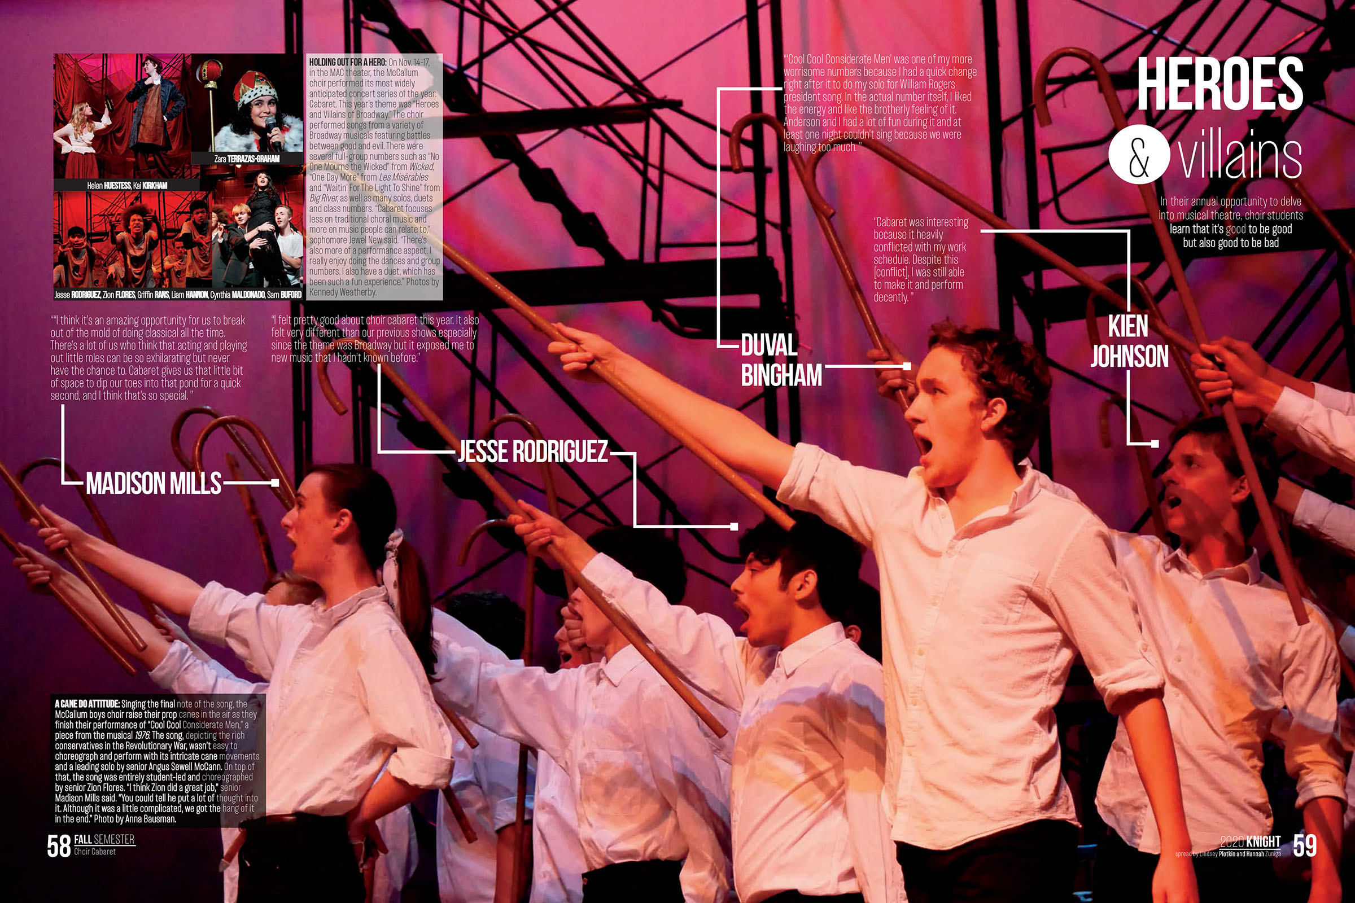
linear pullouts

Slide 27
linear pullouts

Slide 28
Types of alternative copy
Timeline
This format captures a sequence of events–by hour, day, month or year.
Include quotes from a wide variety of students.
The challenge is to fill the space with meaningful quotes and photos.
Avoid the temptation to simply list activities.

Slide 29
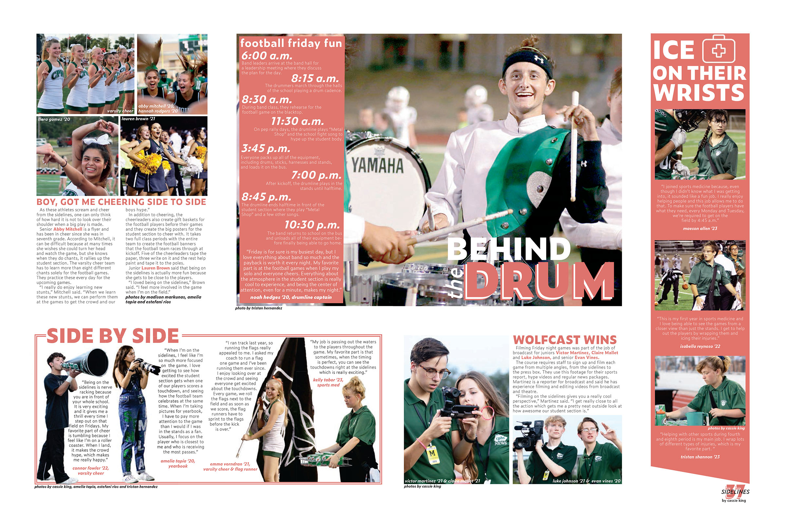
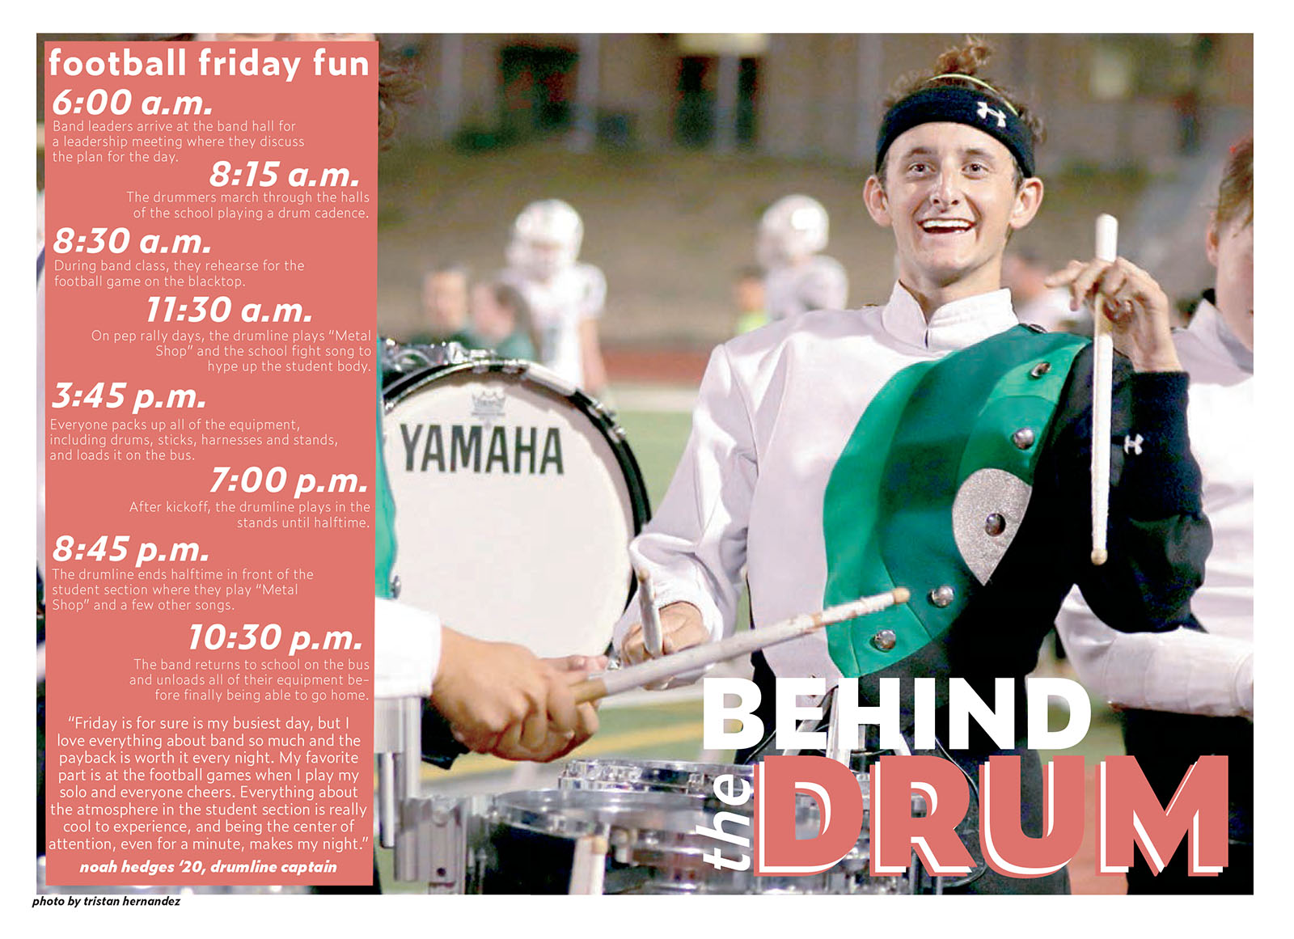
Timelines: hour-by-hour

Slide 30
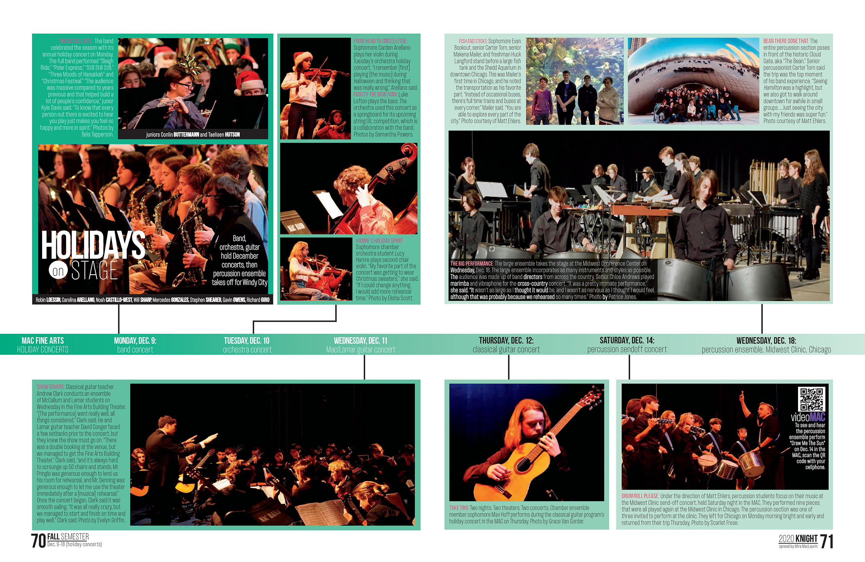
Timelines: day-by-day

Slide 31
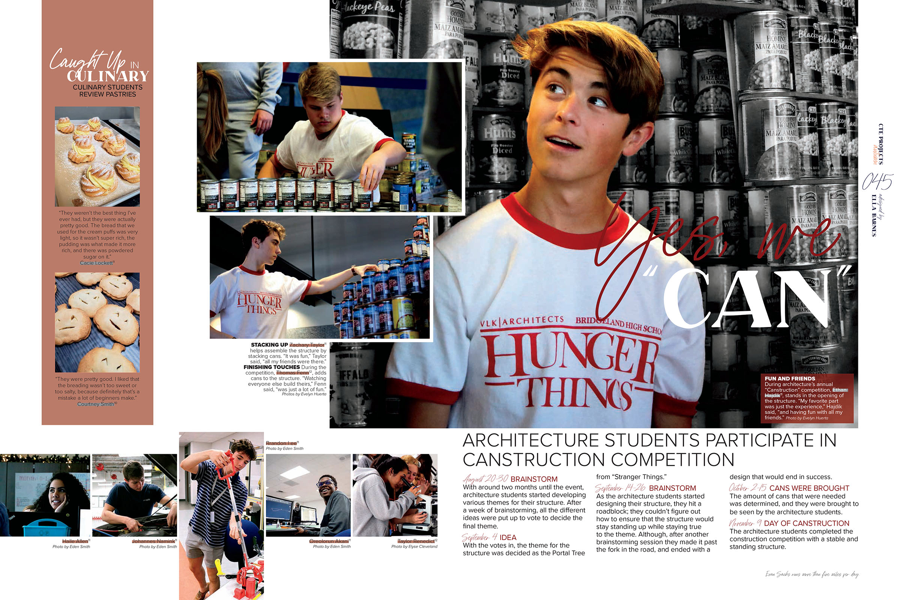
Timelines: day-by-day

Slide 32
Timelines: year-by-year

Slide 33
Types of alternative copy
Calendars
Calendars offer a meaningful overview of a month or a season.
Create a structure and then fill it with facts, figures, quotes and pictures.

Slide 34
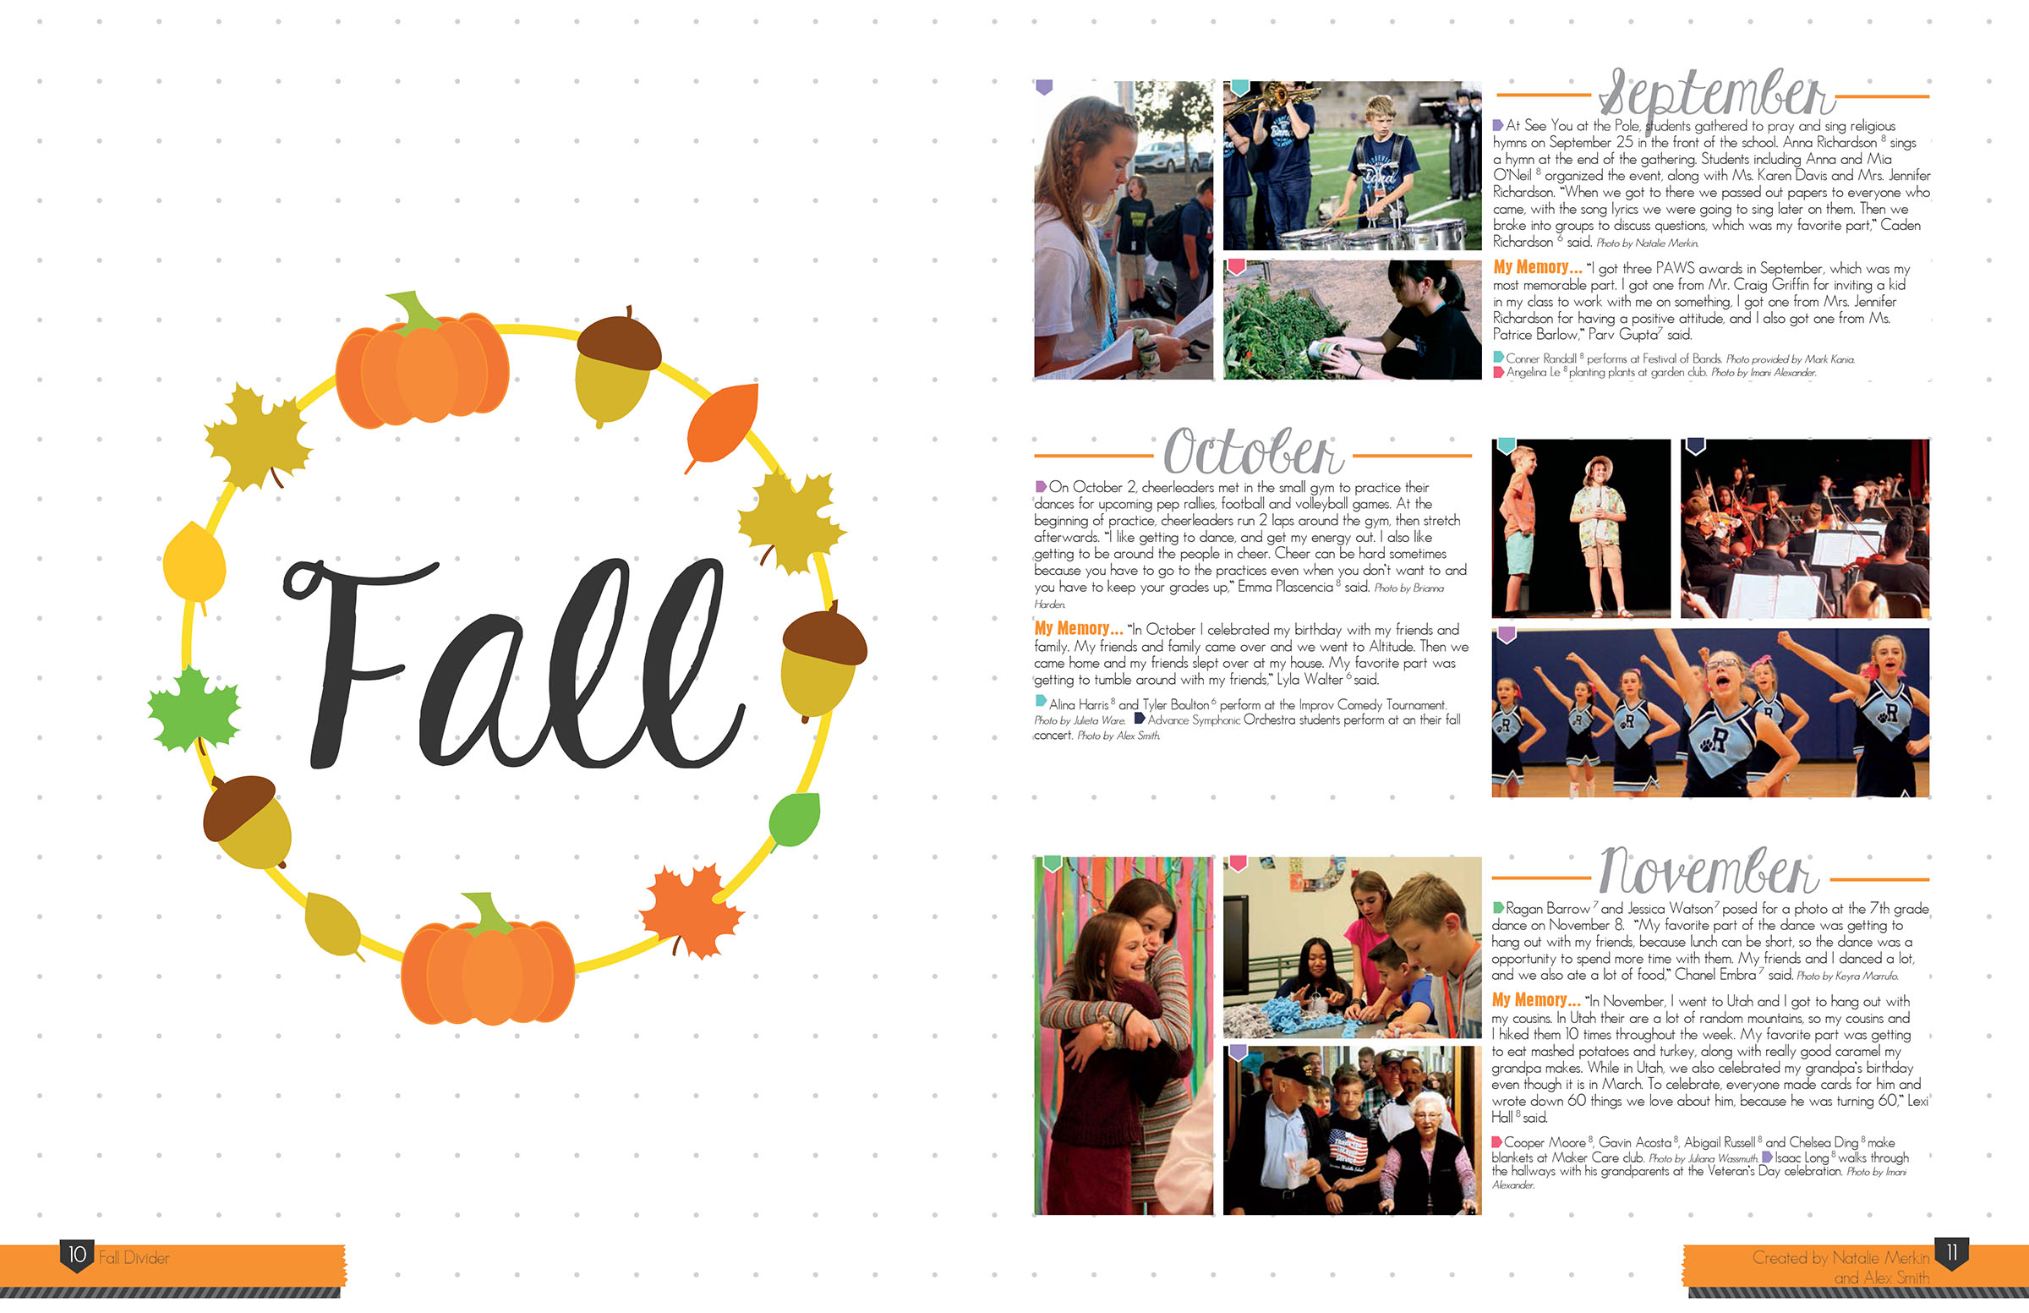
calendar

Slide 35
calendar

Slide 36
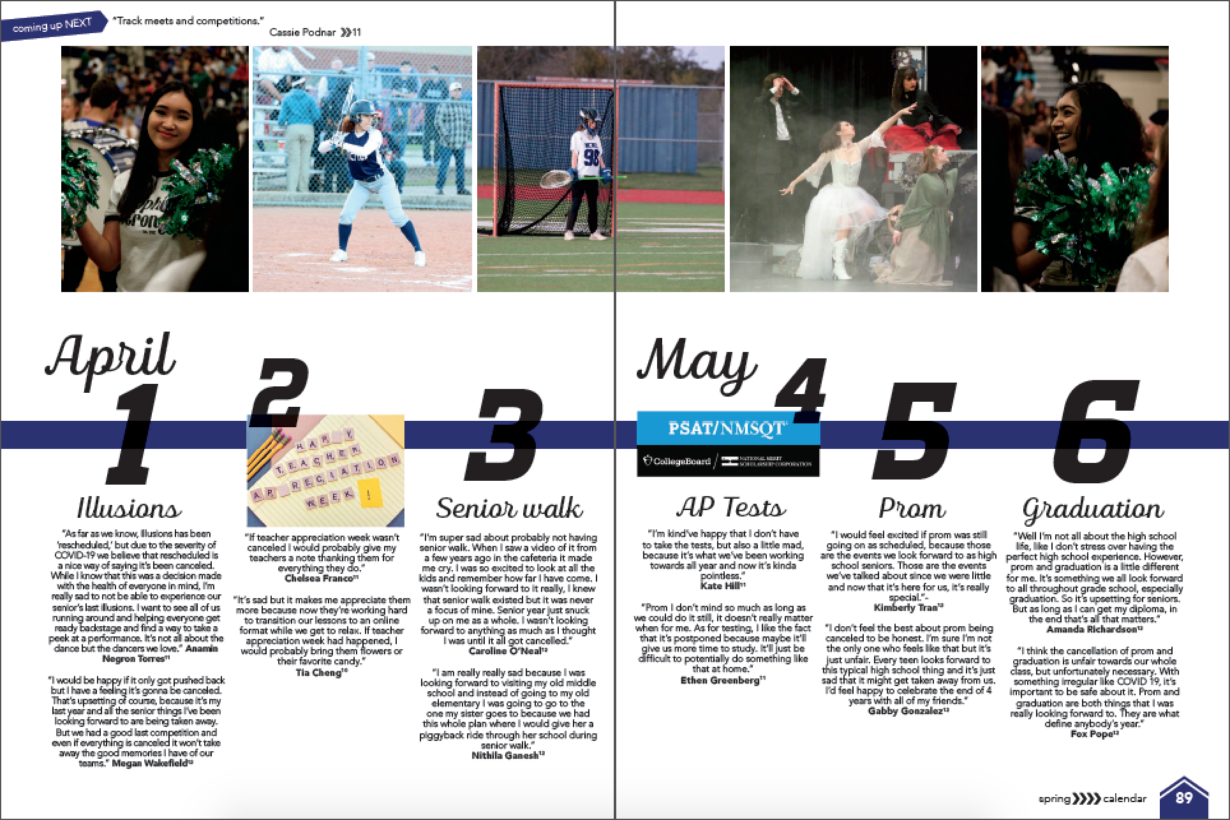
calendar

Slide 37
Types of alternative copy
Highlights
Emphasizes primary points.
Can include facts, details and quotes.
Allows for asides.

Slide 38
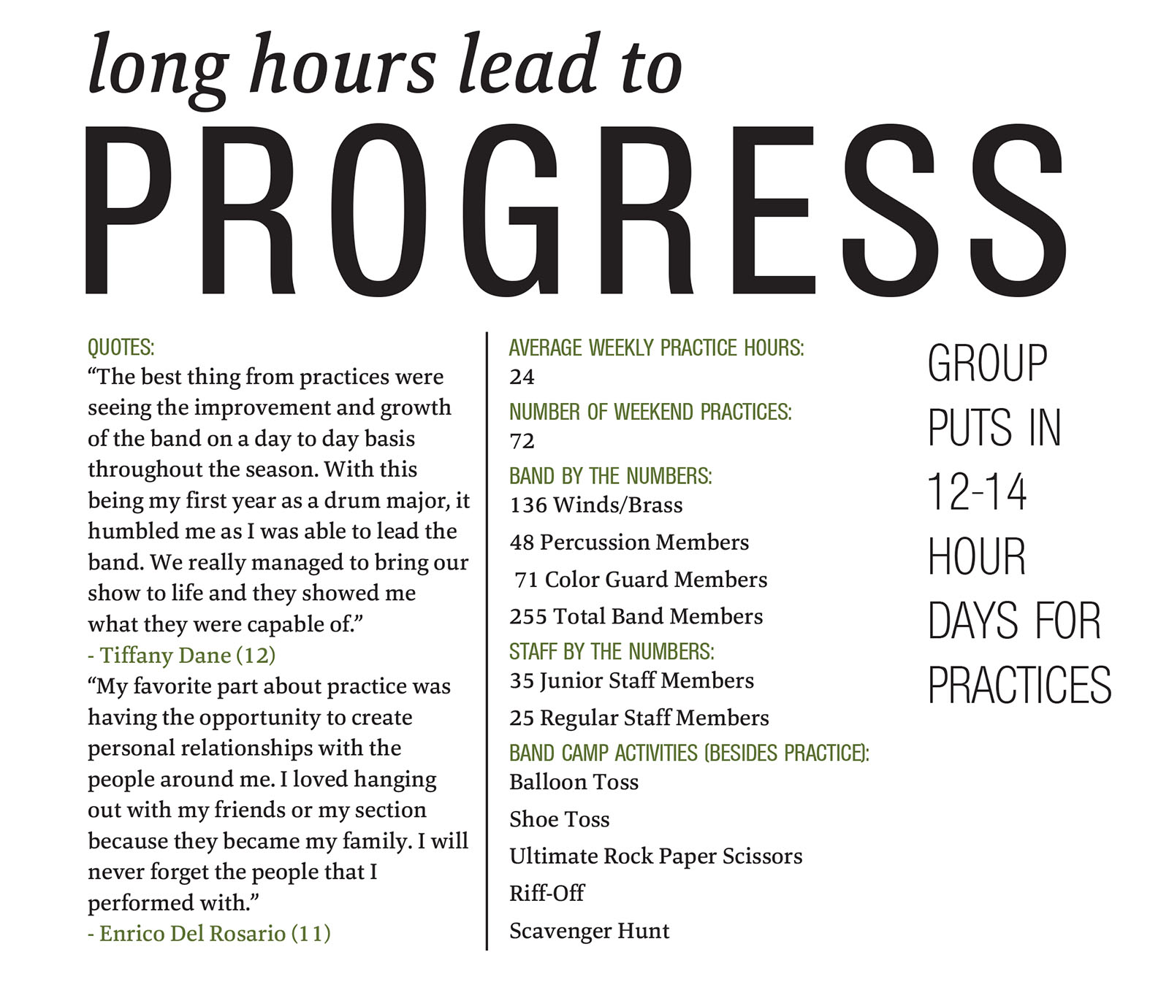
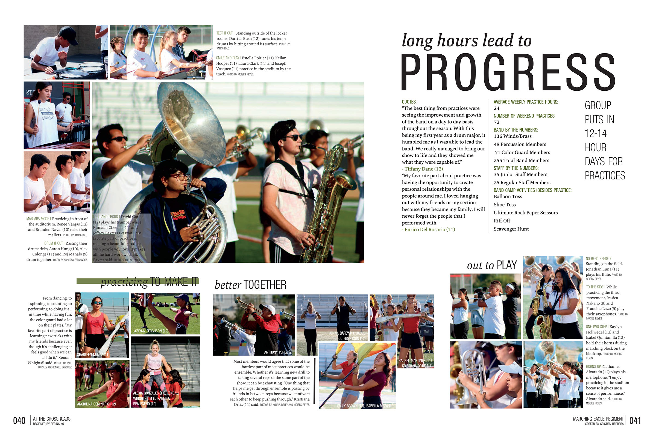
highlights

Slide 39
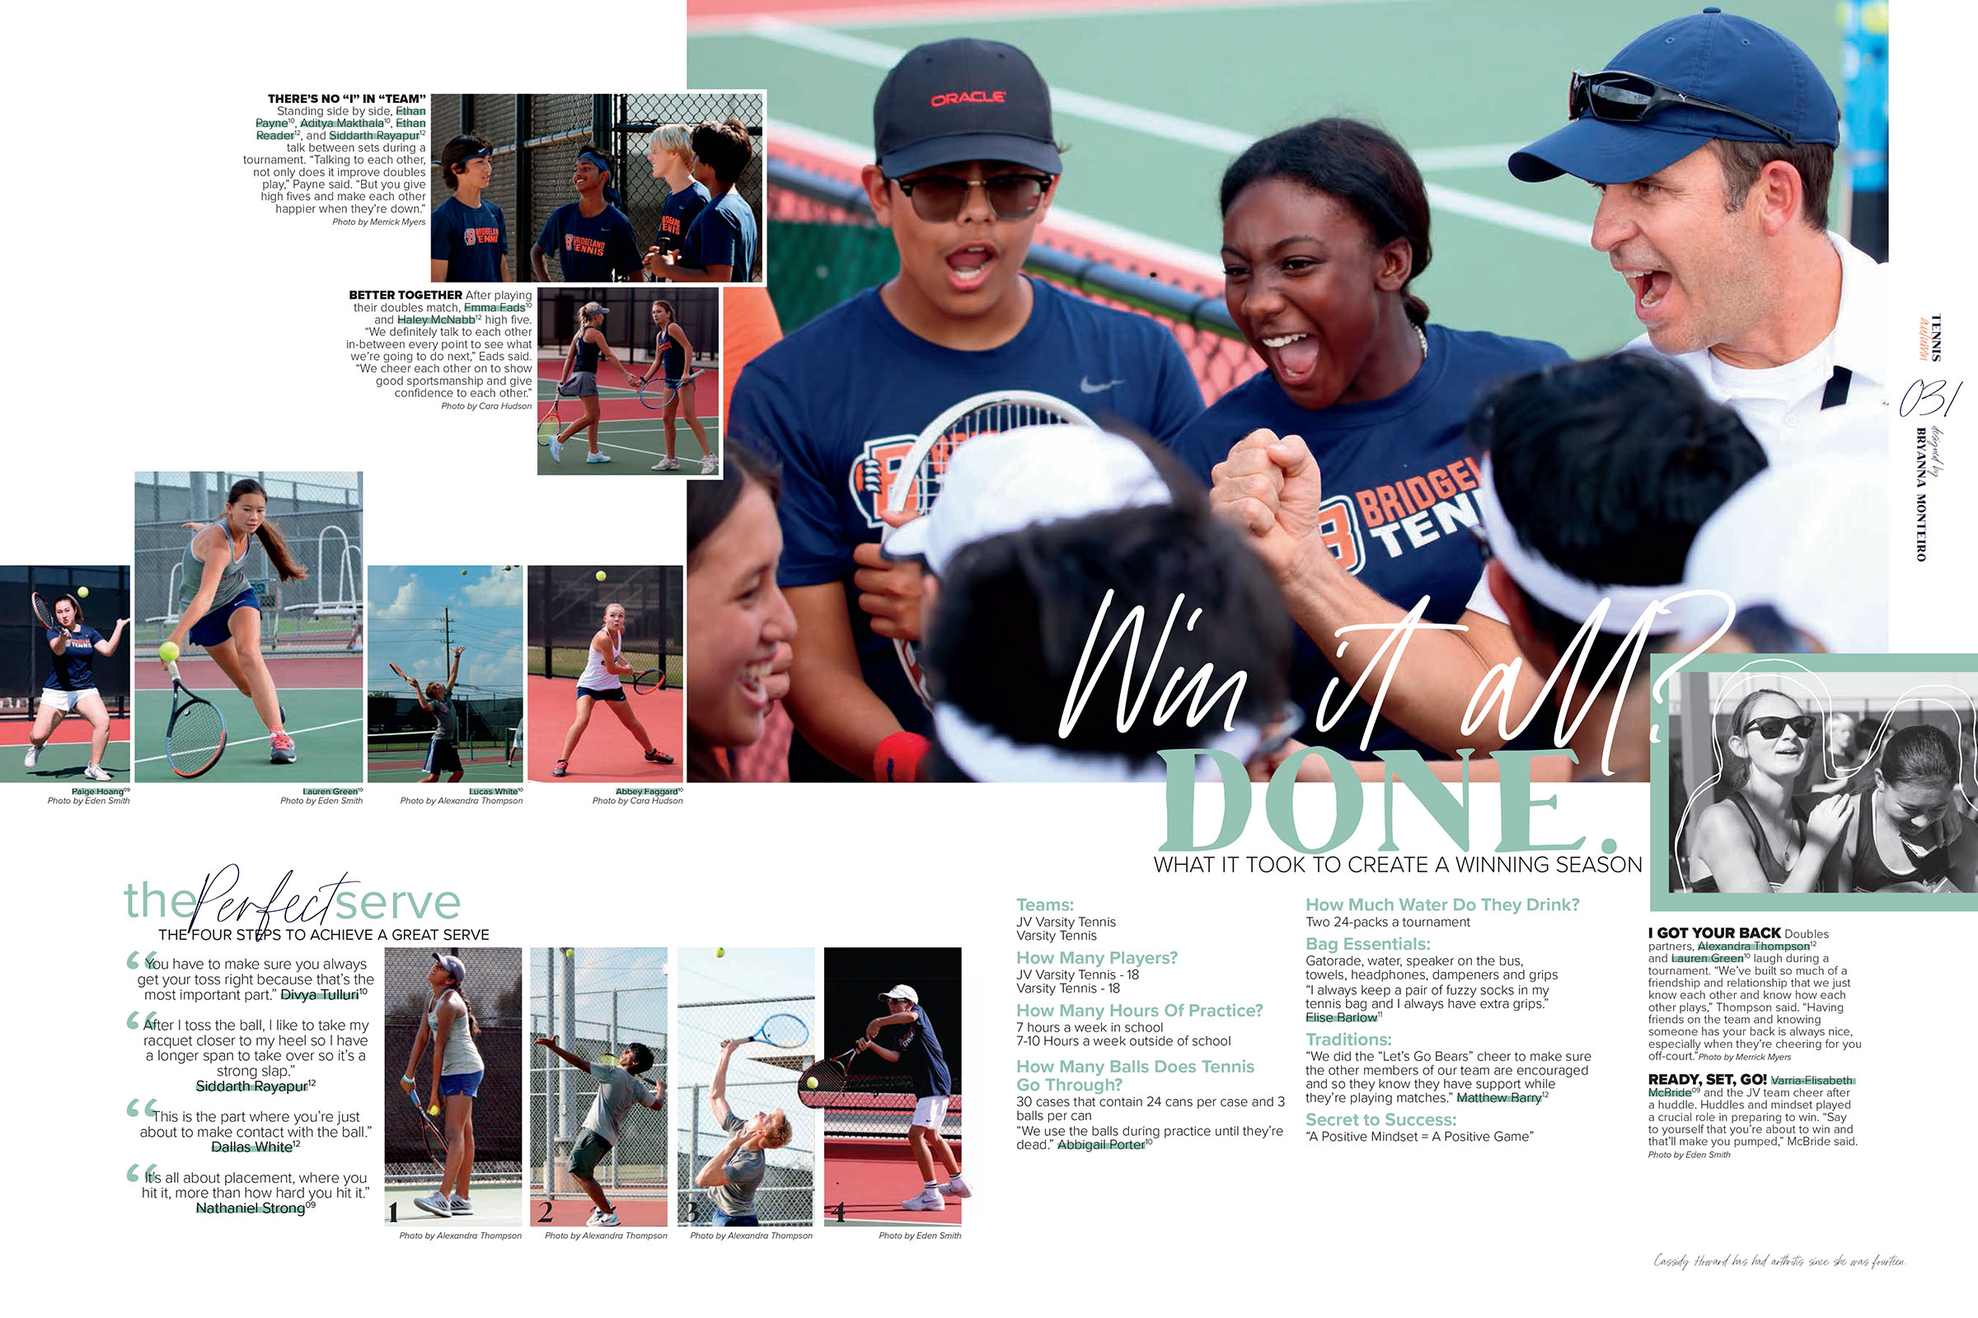
highlights

Slide 40
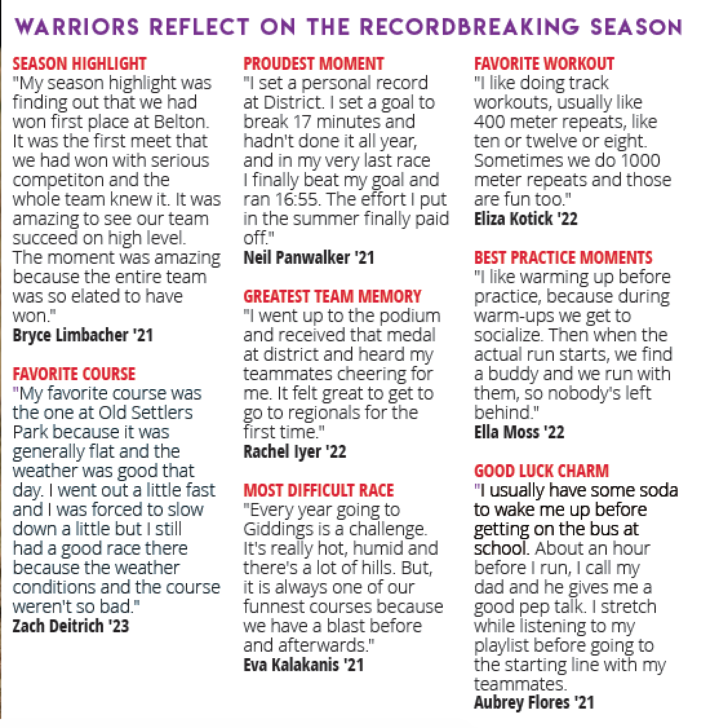
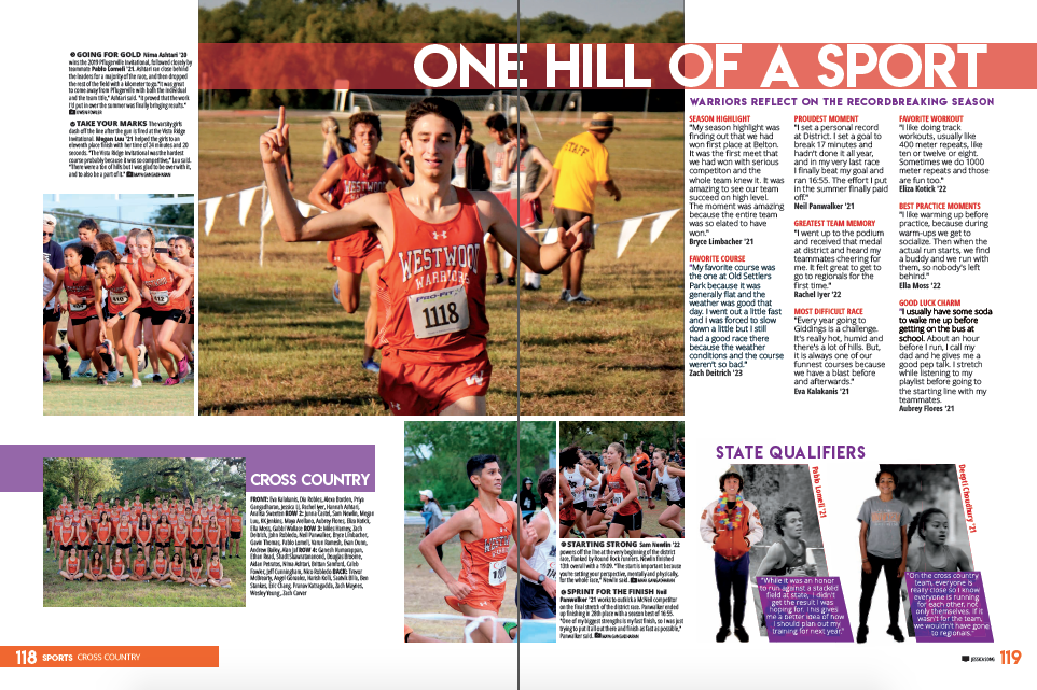
highlights

Slide 41
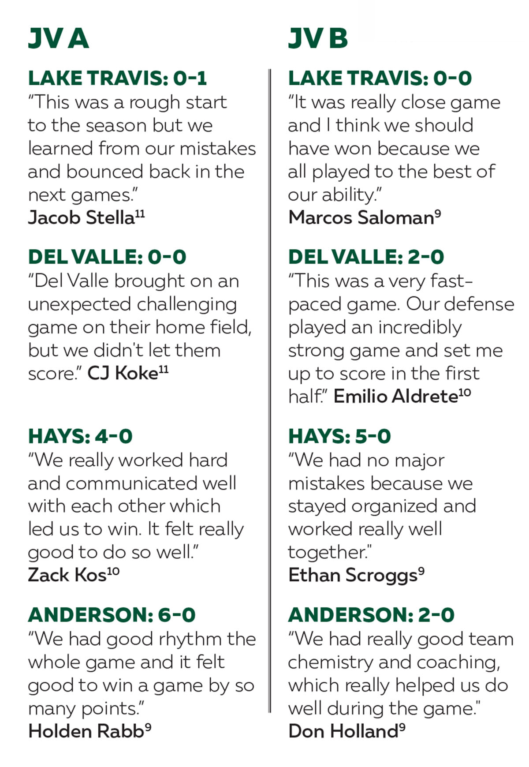
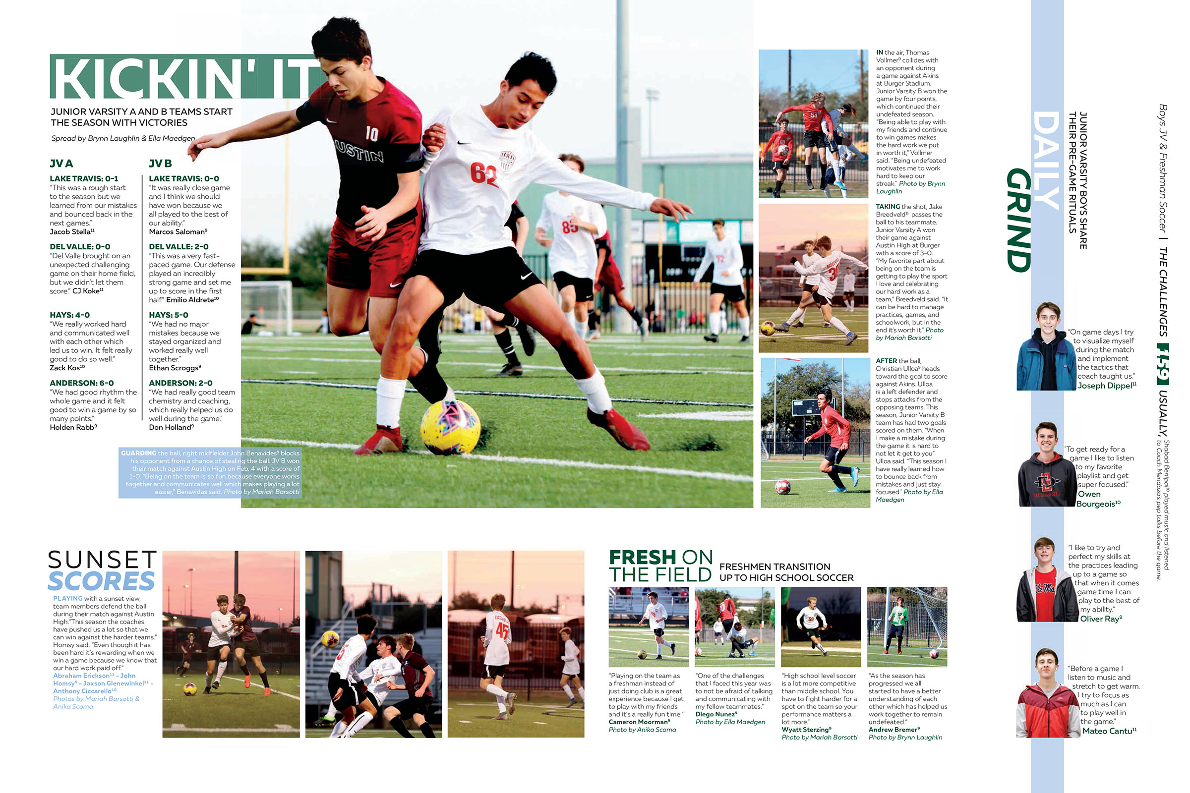
highlights

Slide 42
Types of alternative copy
Numbered Lists
Quick way to convey information.
Breaks up traditional design.

Slide 43
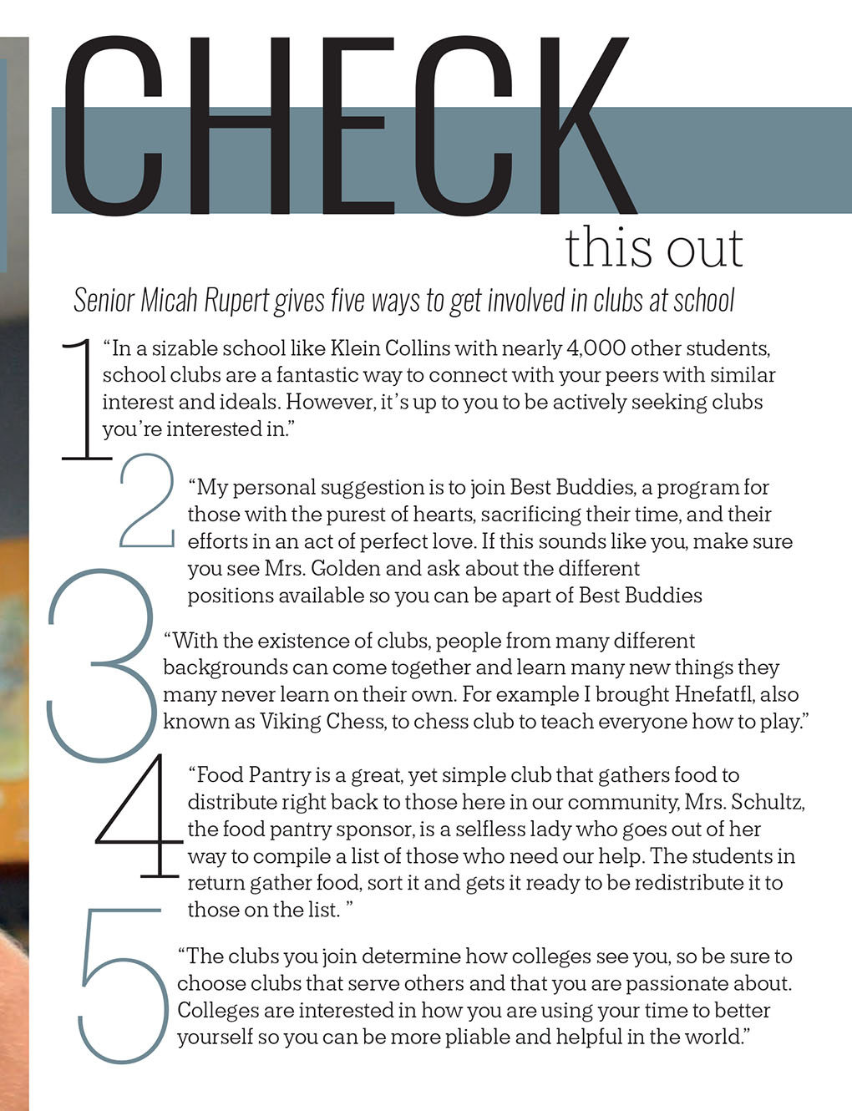
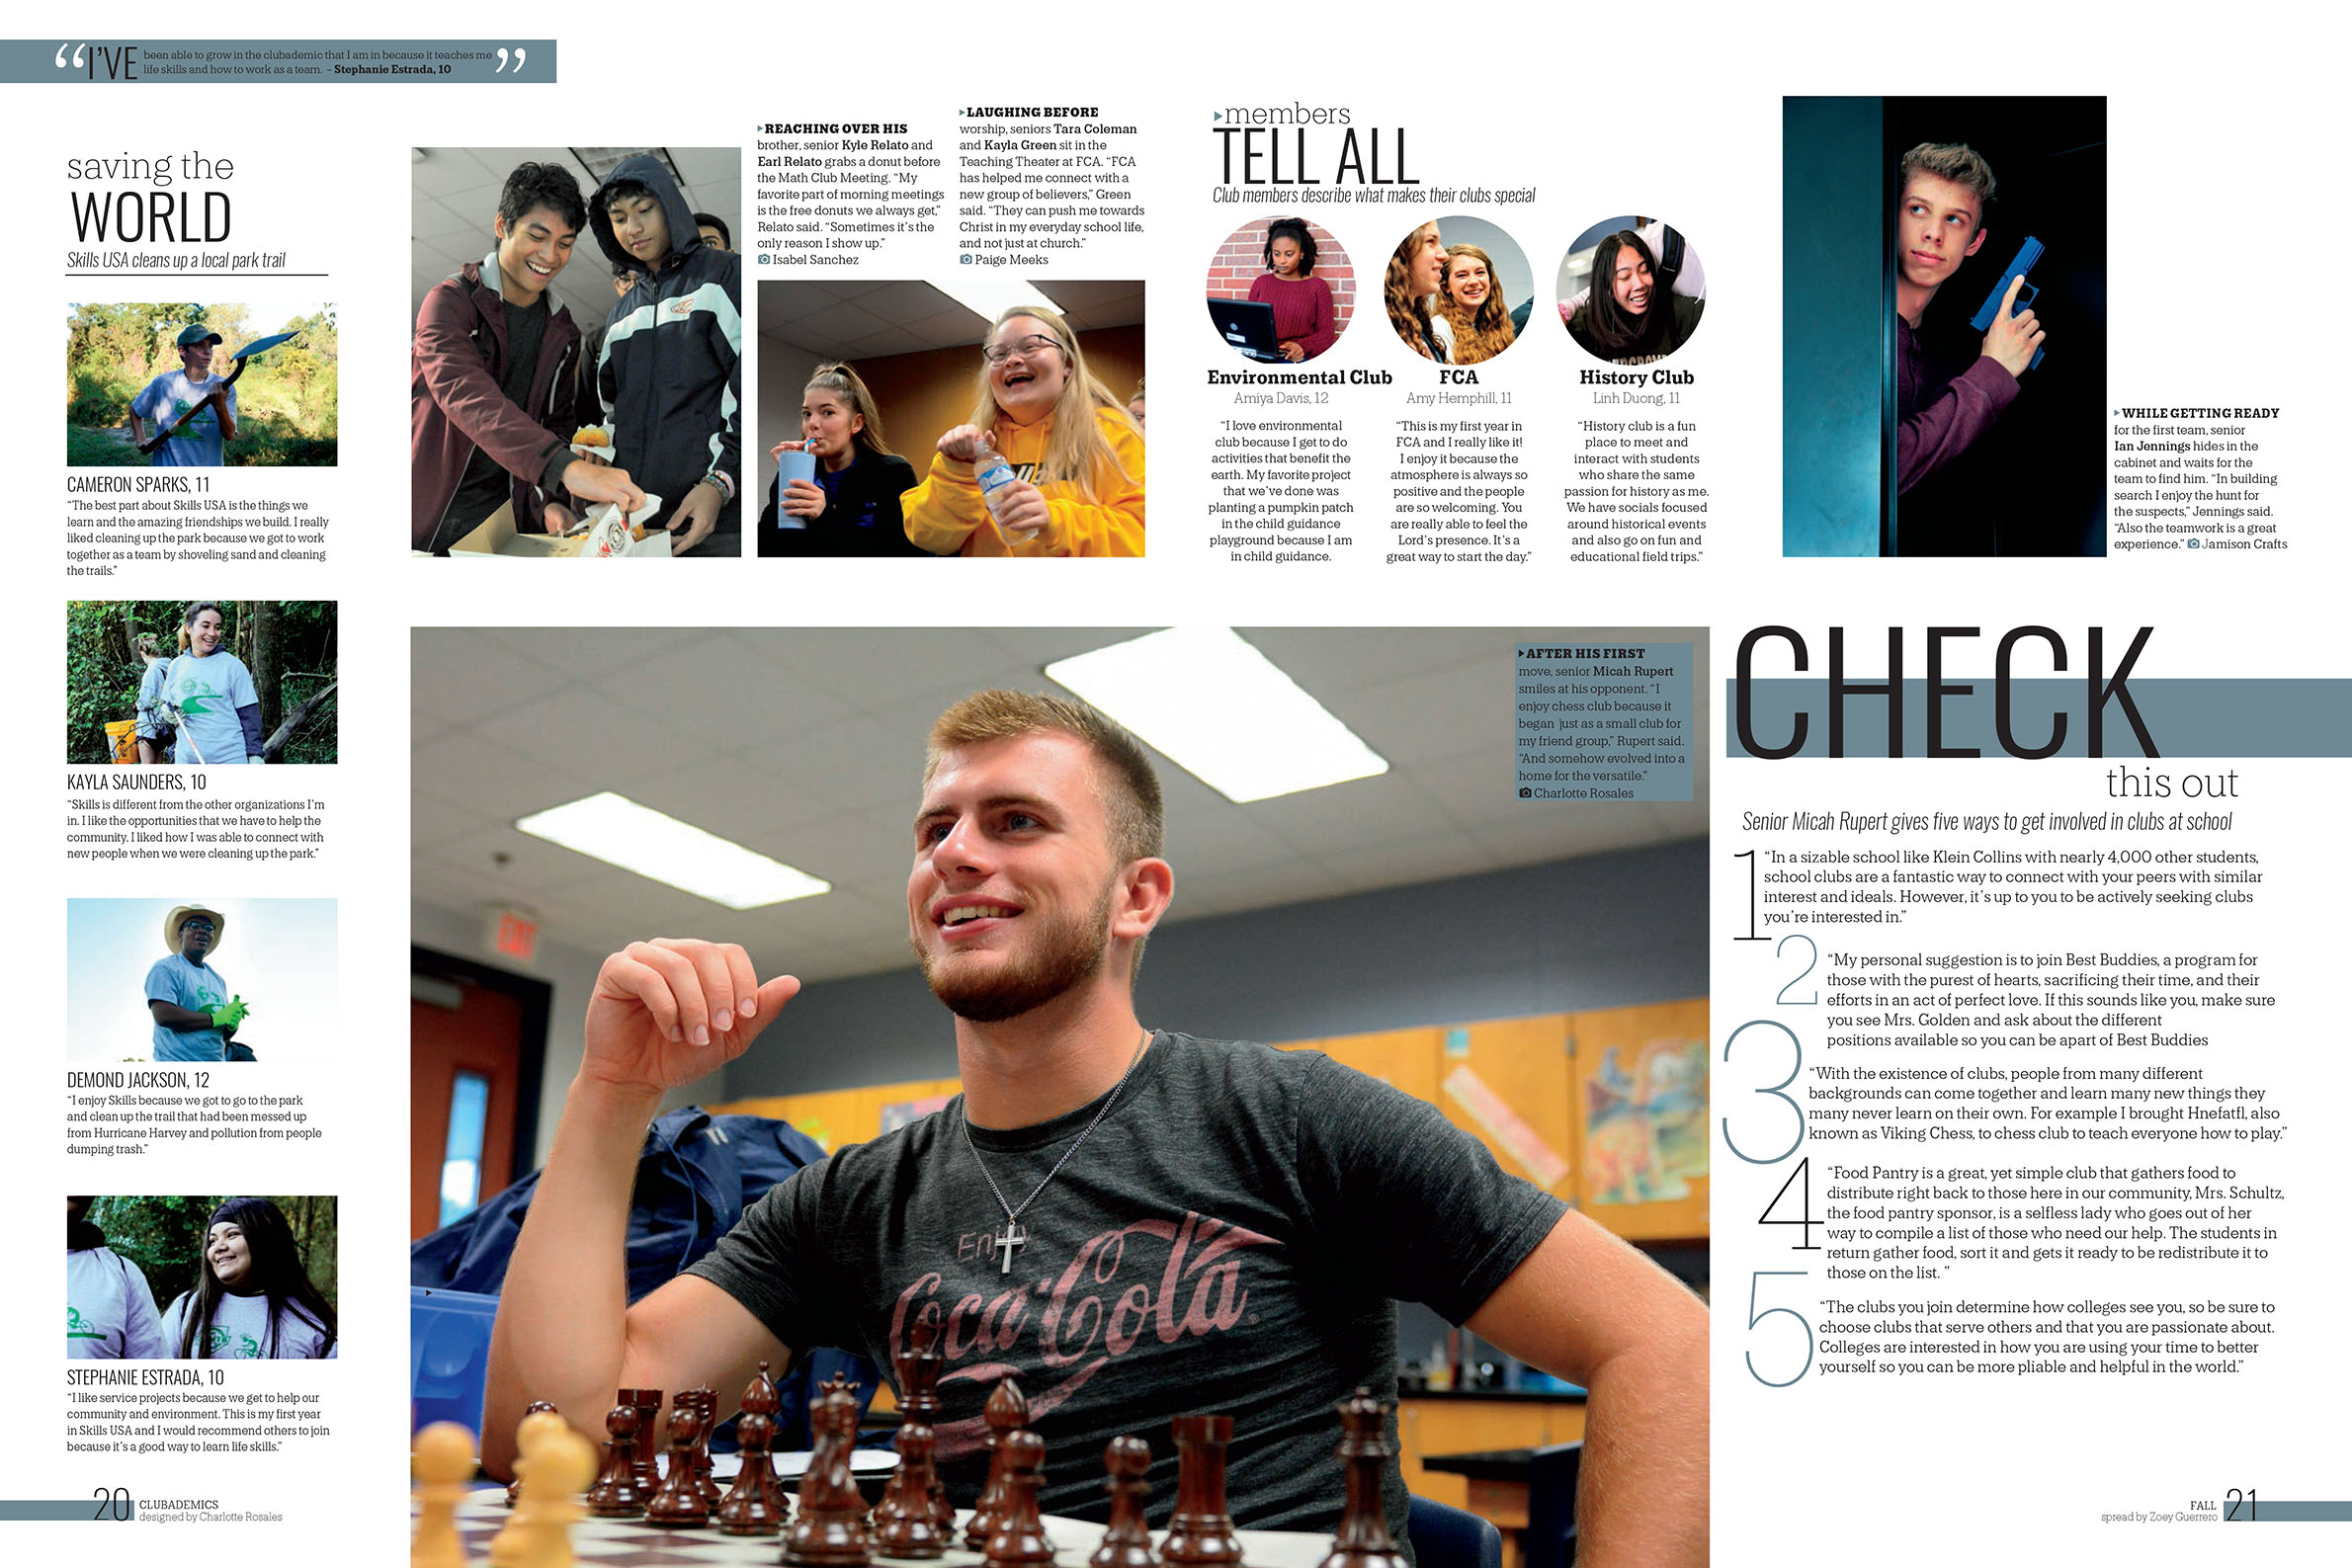
numbered lists

Slide 44
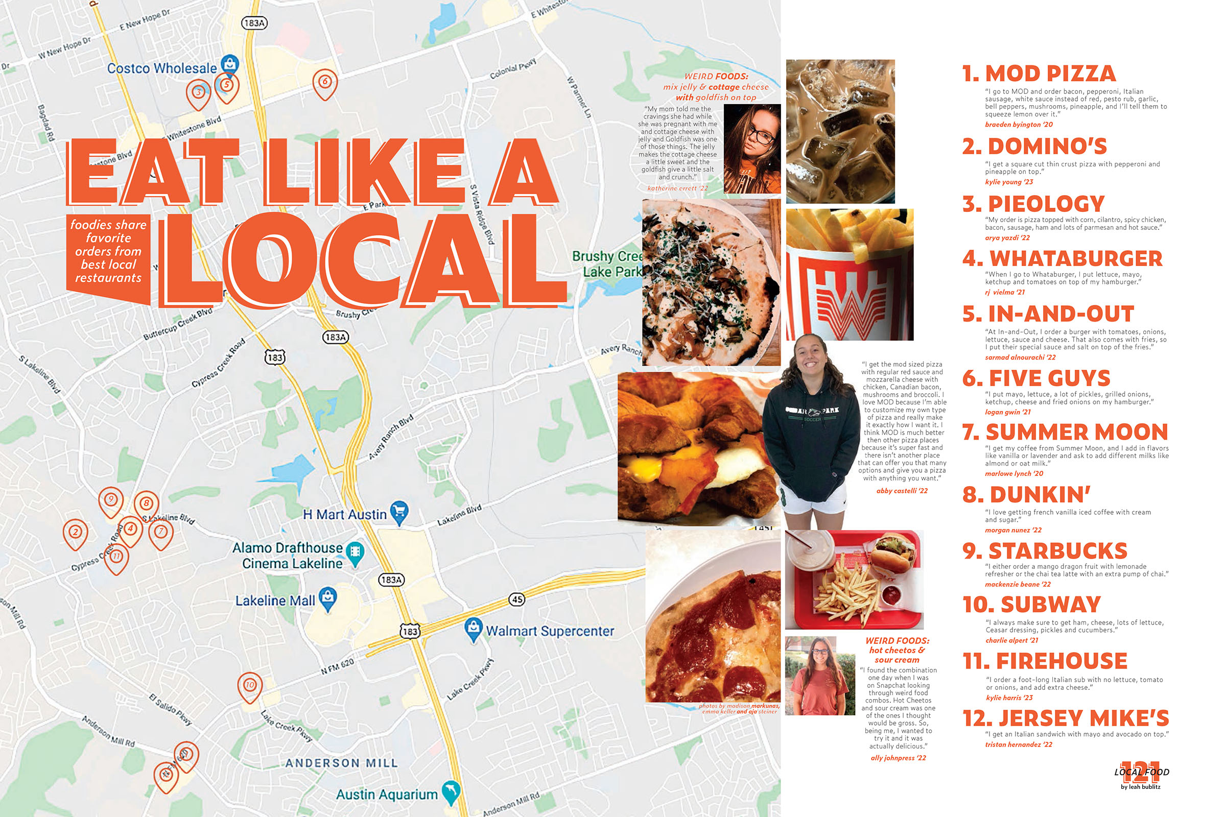
numbered lists

Slide 45
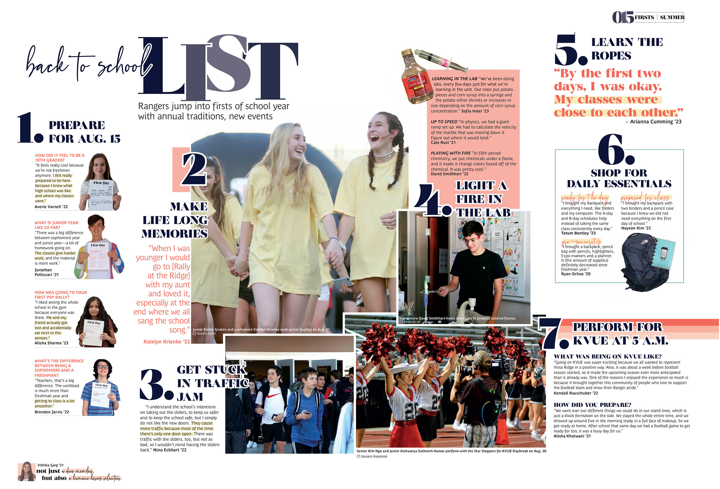
numbered lists

Slide 46
Types of alternative copy
A-Z
Cool twist on the list format.
Features information alphabetically.
Twenty-six opportunities to feature students, clubs, classes and sports.

Slide 47
A-Z

Slide 48
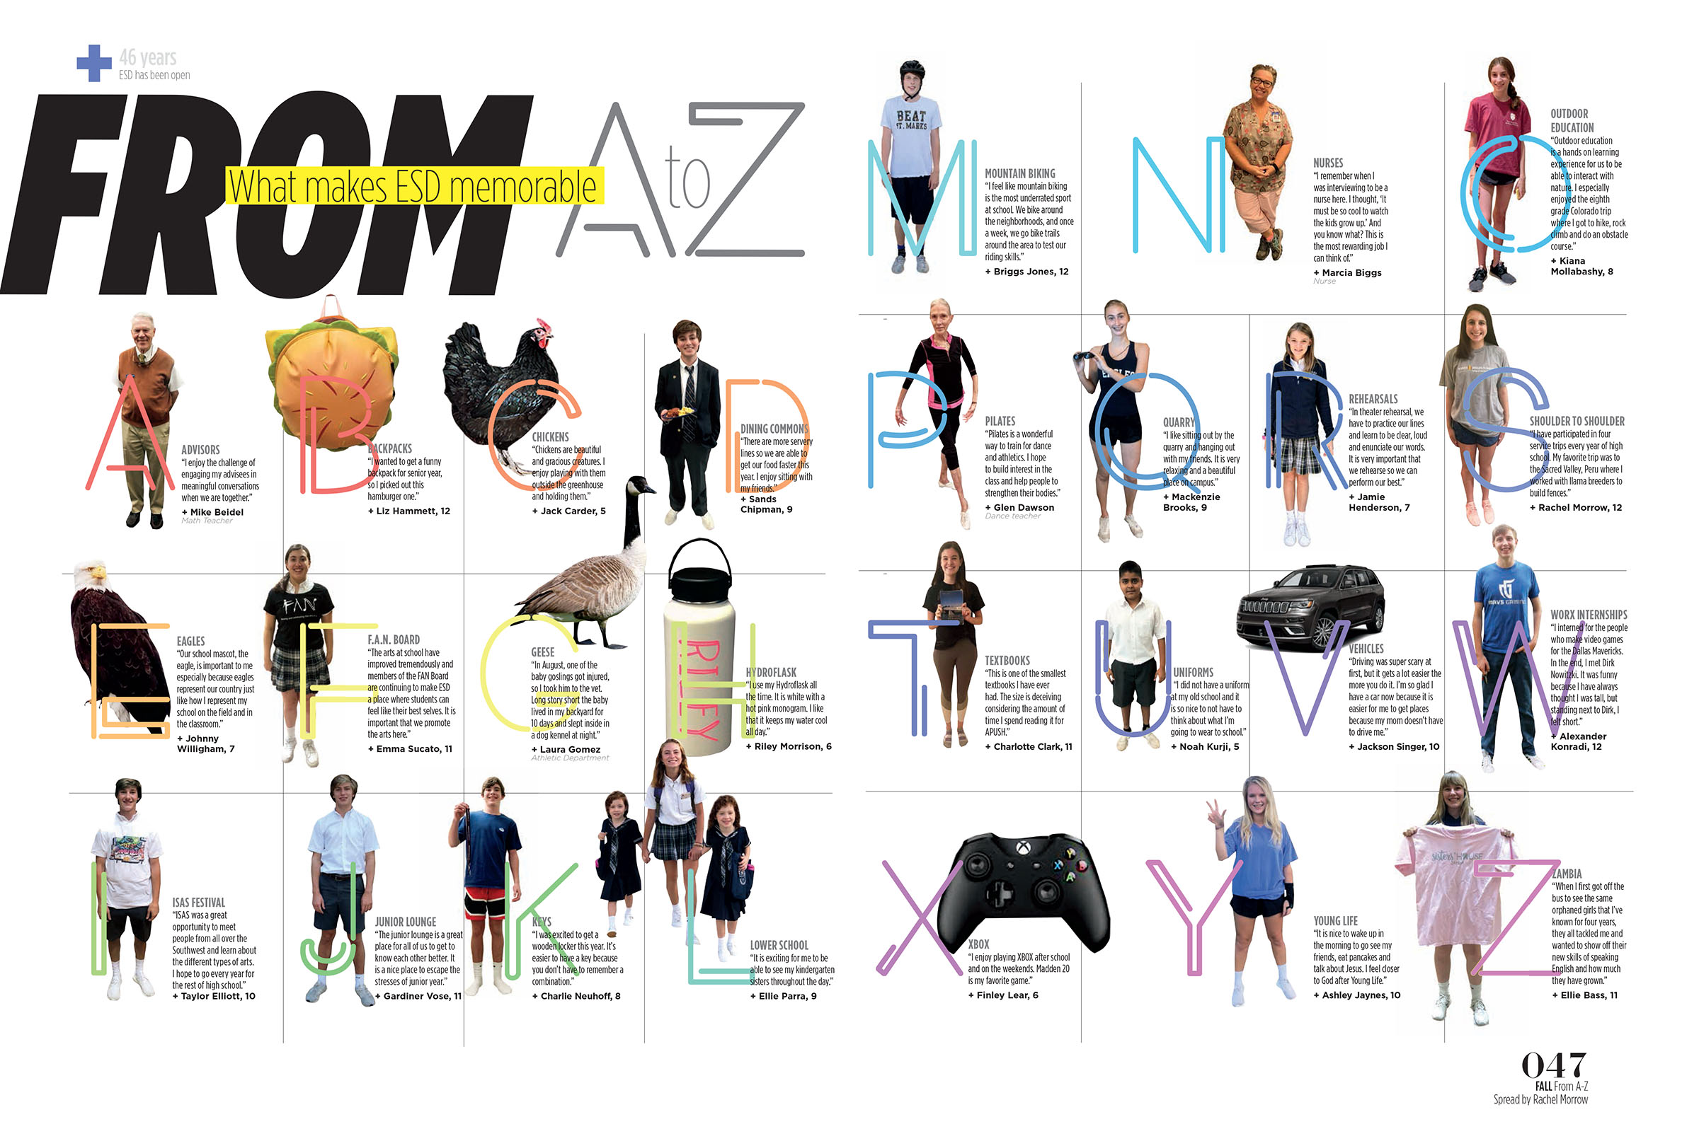
A-Z

Slide 49
A-Z
Notes:
49
A yearbook staff A-Z

Slide 50
Types of alternative copy
Interactive
Have readers interact with the book.
Magazines do it!
Let the subject matter and/or the theme direct your interactive strategy.

Slide 51
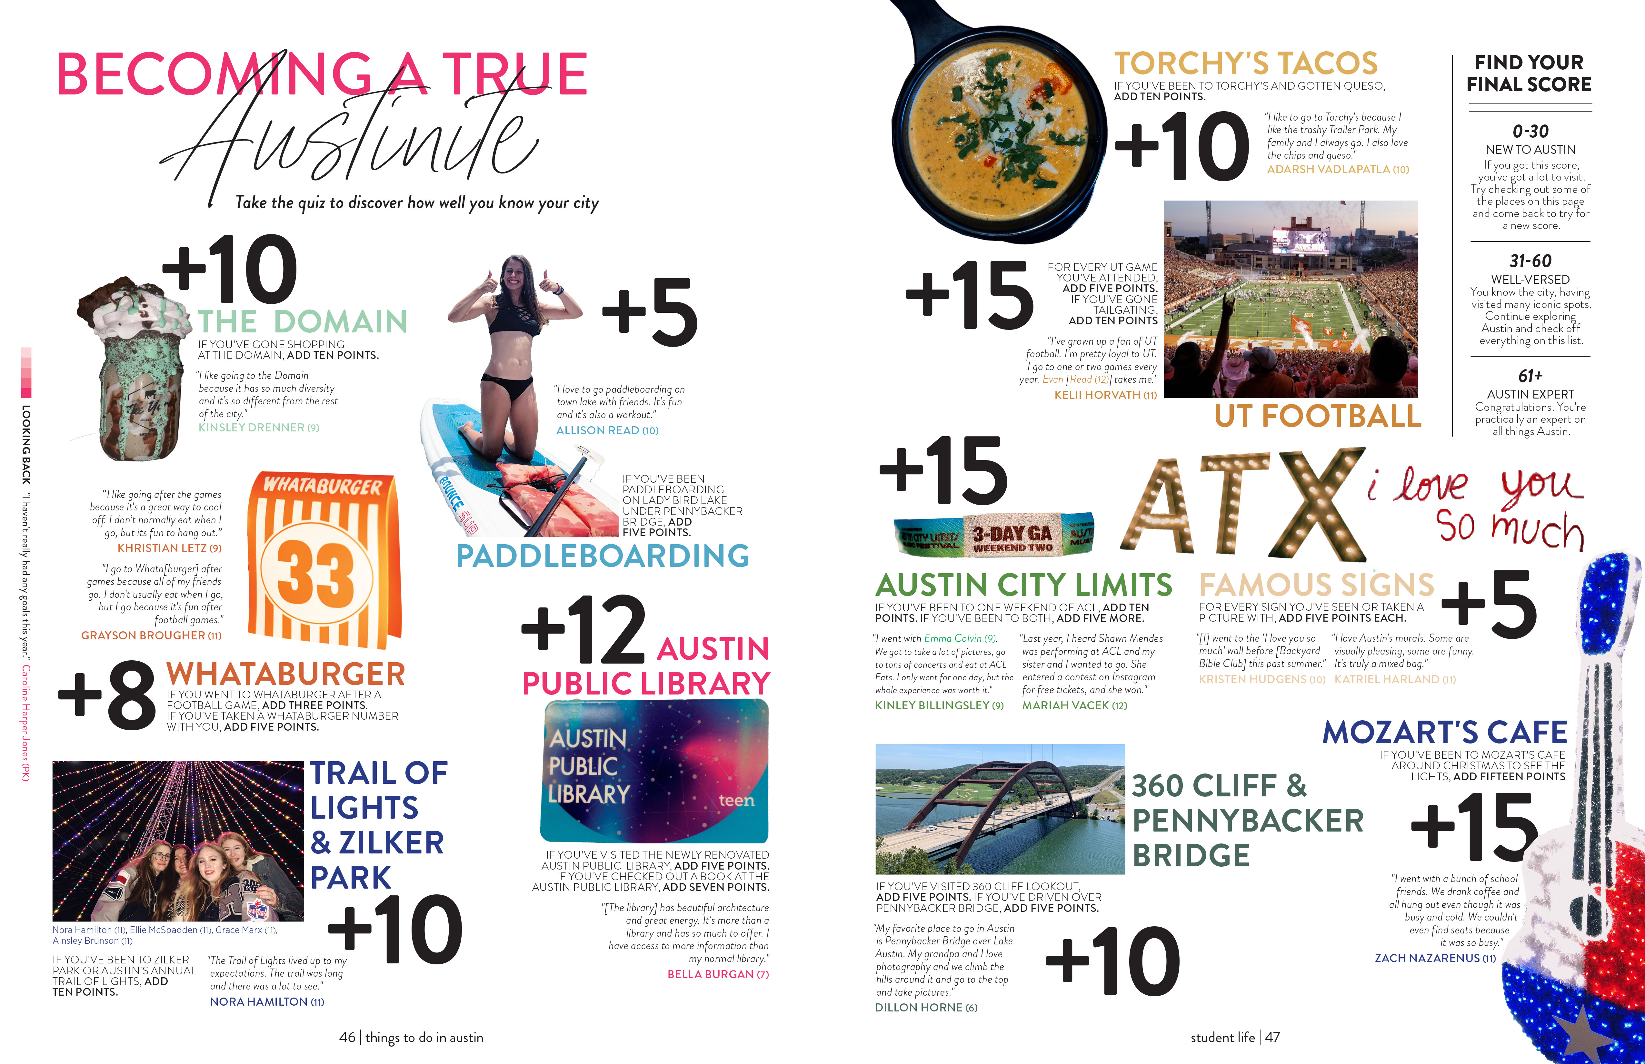
interactive

Slide 52
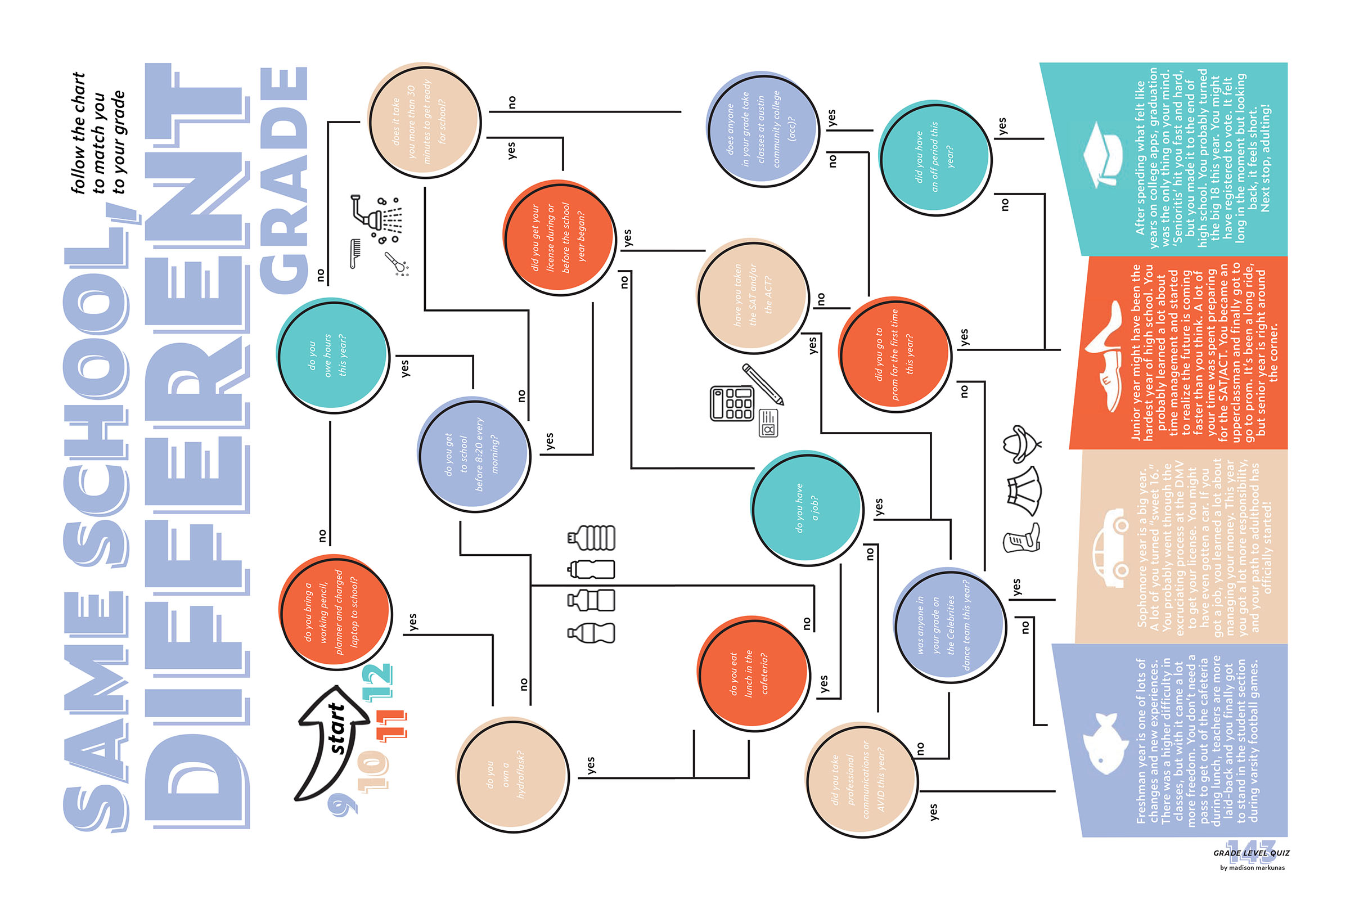
interactive

Slide 53
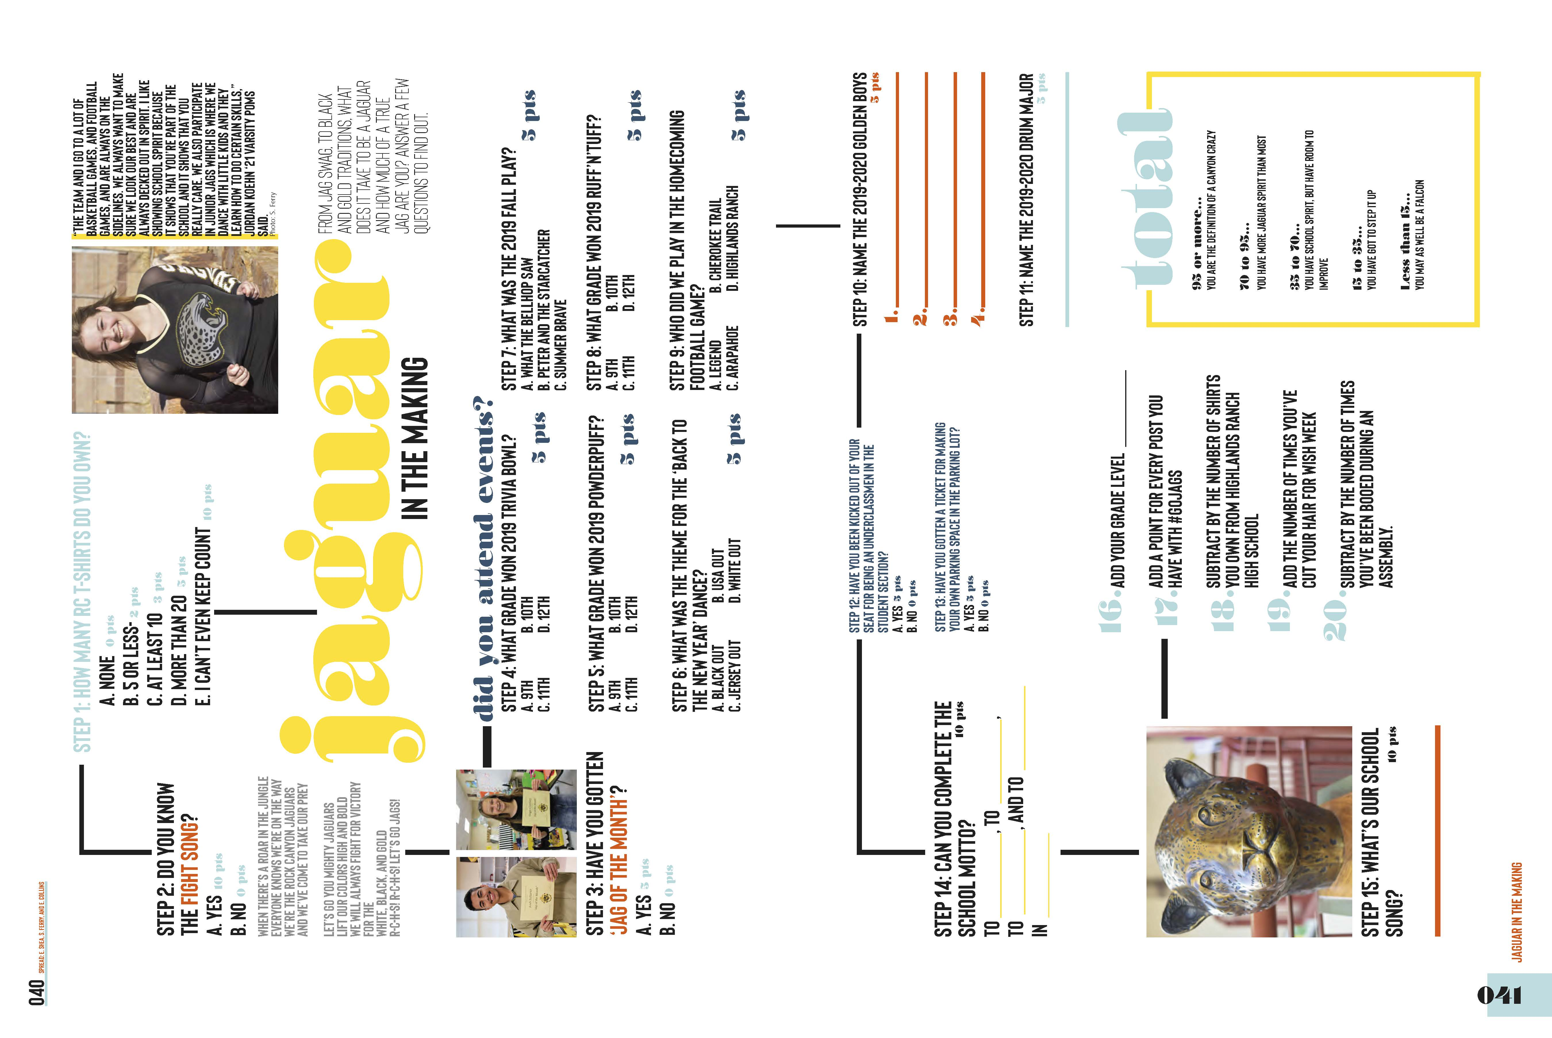
interactive

Slide 54
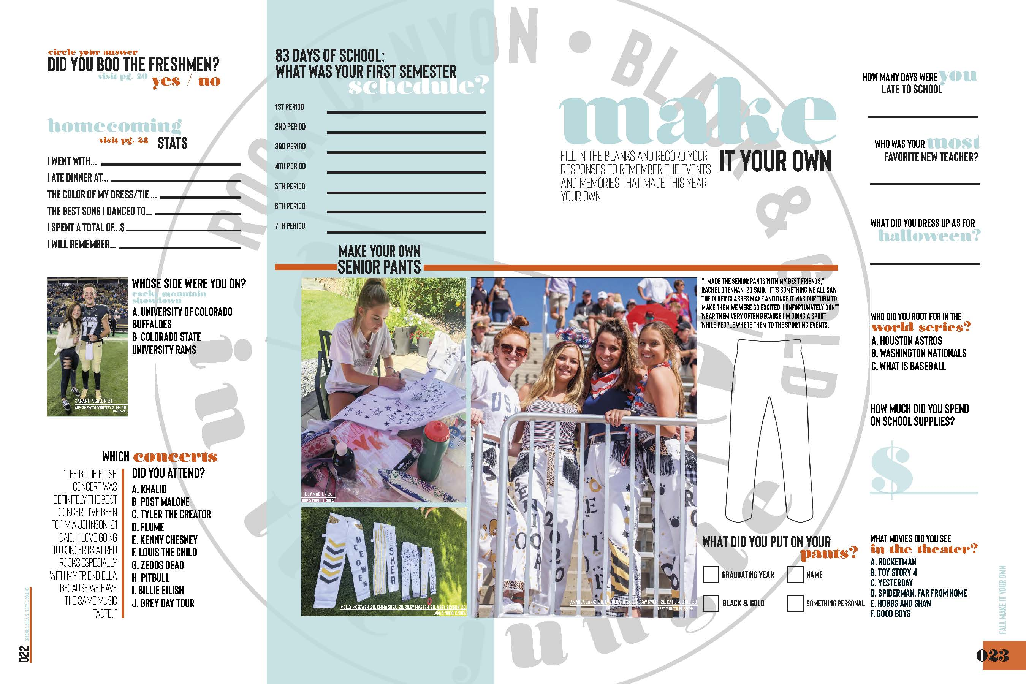
interactive

Slide 55
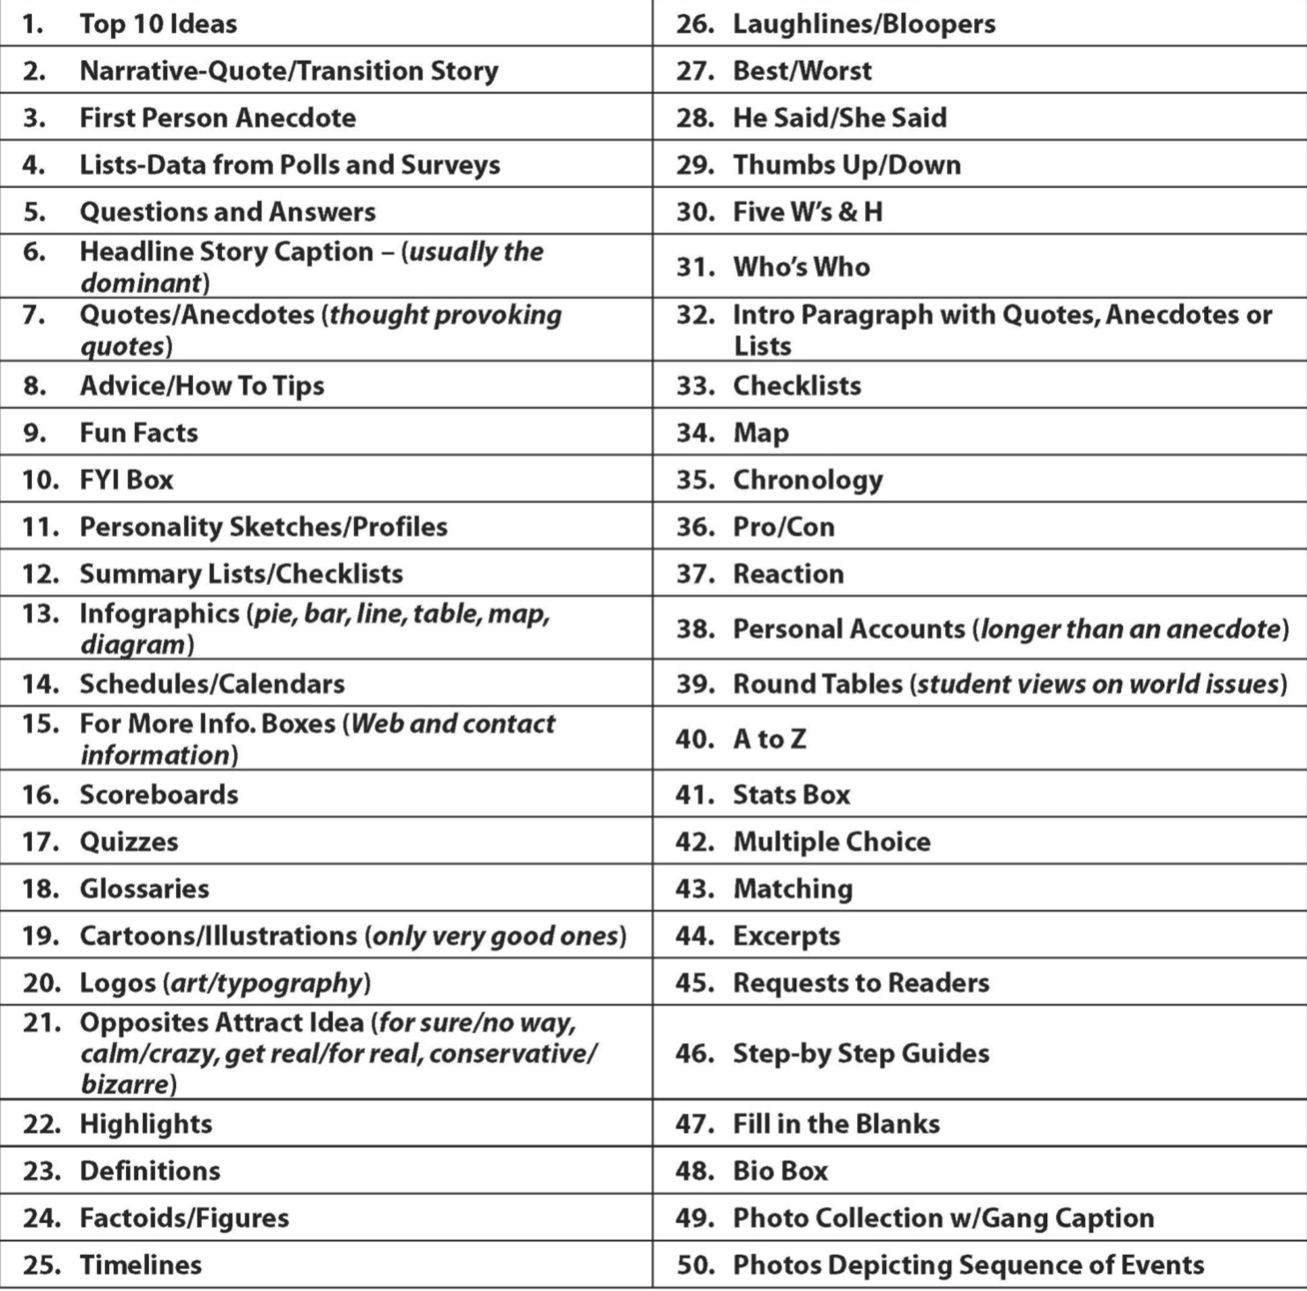
OTHER–Do whatever works

