Slide 1
ADVANCED DESIGN
Grids & White Space

Slide 2
You know the 8-column structure.
Increasing the number of columns offers more flexibility,
while keeping the foundation consistent throughout the entire book.
Twenty-Four Columns
Notes:
Note to trainer: This is a good time to mention that while there are multiple numbers of columns, all captions should be the same number of columns wide on the spread. In this example, the caption width for every caption would probably be three or four columns.

Slide 3
Create an even stronger foundation by adding horizontal rows to the column structure.

Slide 4
Add Rows to Create a Grid
The grid structure sets up a consistent strategy for using planned white space to show relationships.
Notes:
Note to trainer: The grid system sets up the second and third degrees of separation. The second degree is the white space between each box, in this scenario it is p9 (nine points). The third degree will equal one fill grid (the gray box) plus the white space above and below it (horizontally) or to the right and left (vertically). The staff would need to determine, what the first degree will be throughout the book. It is typically 0-3 points. Jeff like 3 points the best. ☺

Slide 5
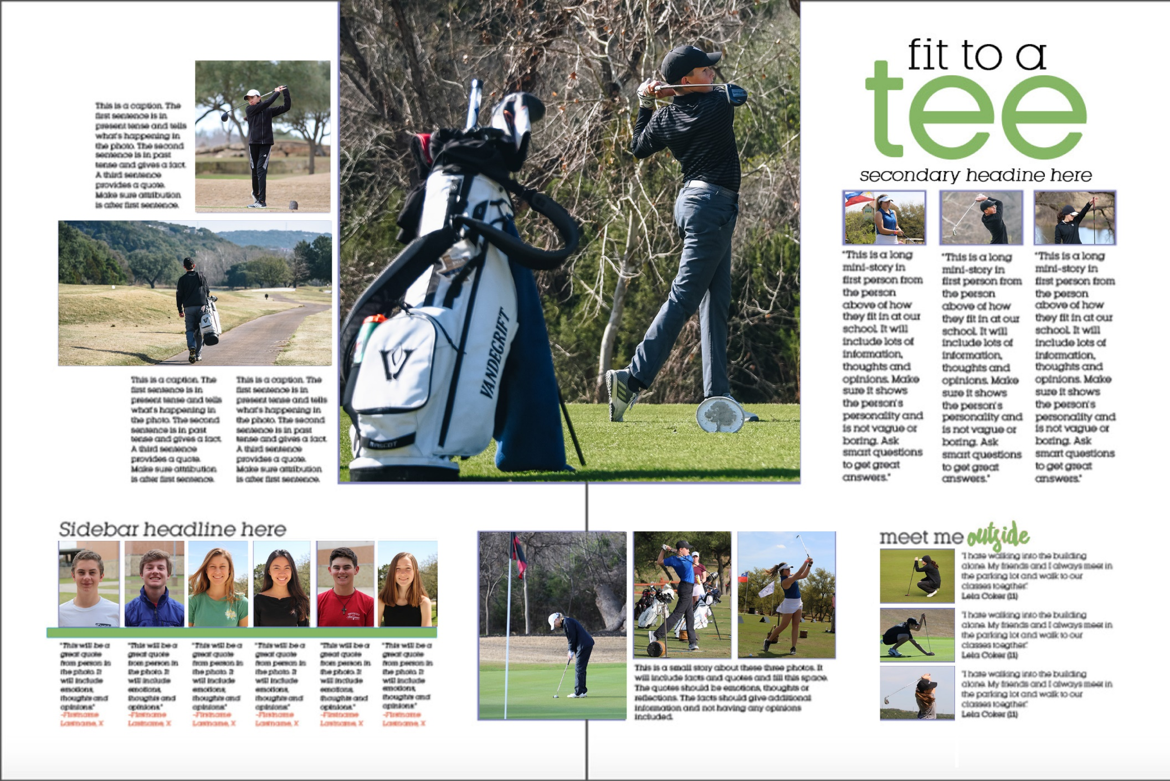
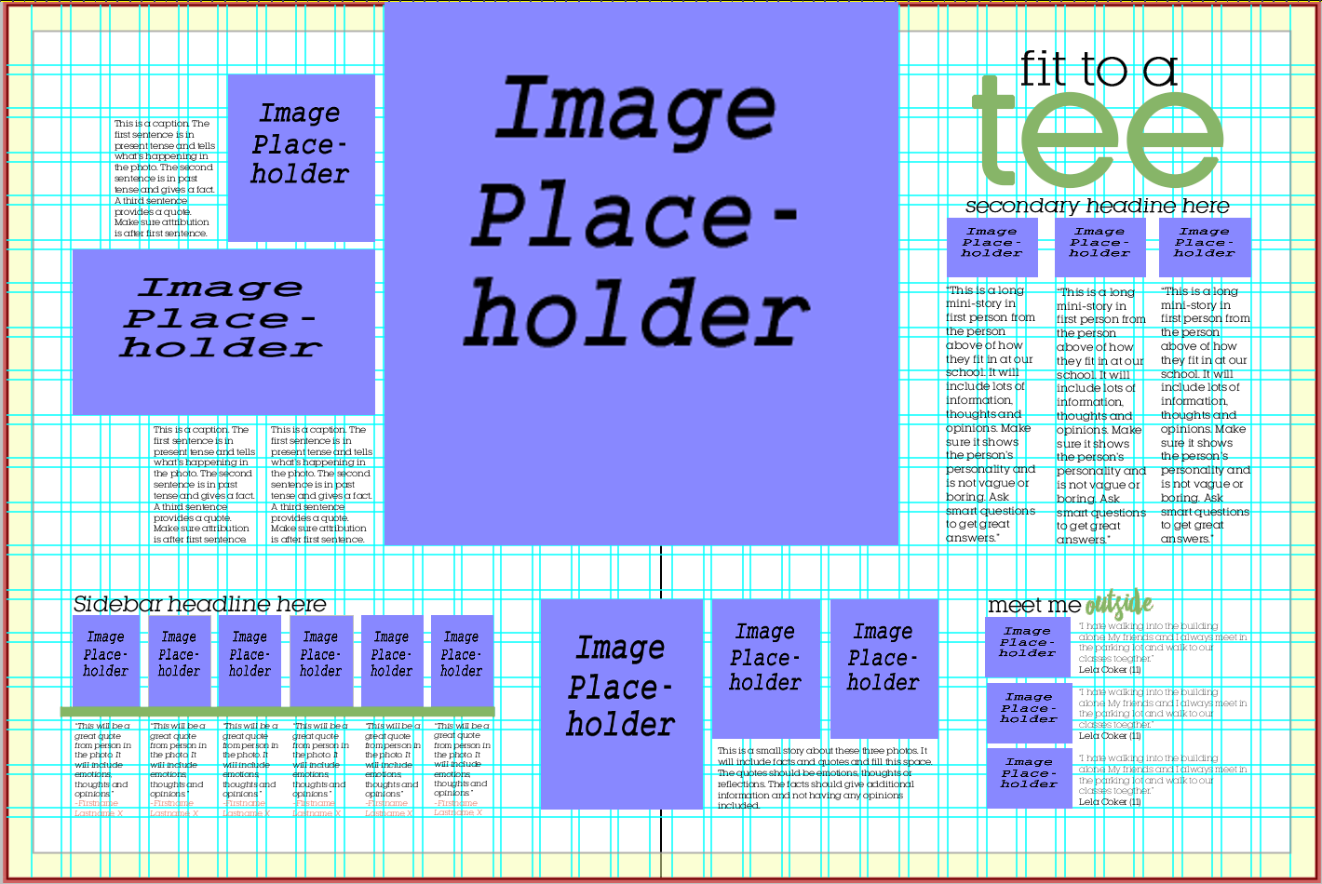
All elements begin and end on a grid.
Notes:
Note to trainer: The grid system sets up the second and third degrees of separation. The second degree is the white space between each box, in this scenario it is p9 (nine points). The third degree will equal one fill grid (the gray box) plus the white space above and below it (horizontally) or to the right and left (vertically). The staff would need to determine, what the first degree will be throughout the book. It is typically 0-3 points. Jeff like 3 points the best. ☺

Slide 6
WHITE SPACE
Creates relationships between elements

Slide 7
External Margins (3-5 picas)
Internal Spacing
macro – to emphasize & separate
(3-5 picas, use between modules)
micro – to connect (1-3 points separation,
use for elements within sidebars or modules)
conventional – for consistency
(9 points-1 pica, suggested for stories and
traditional photos & captions)
Some “unlearning”
Planned vs. Unplanned –
NOT trapped white space

Slide 8
External Margins
3-5 picas

Slide 9
External Margins
3-5 picas

Slide 10
MACRO
Used to
3-5 picas separation
EMPHASIZE & SEPARATE

Slide 11
MICRO
CONNECTION
1-3 points separation
Draws photos together

Slide 12
CONVENTIONAL
Standard separation between elements for CONSISTENCY
9 points or 1 pica

Slide 13
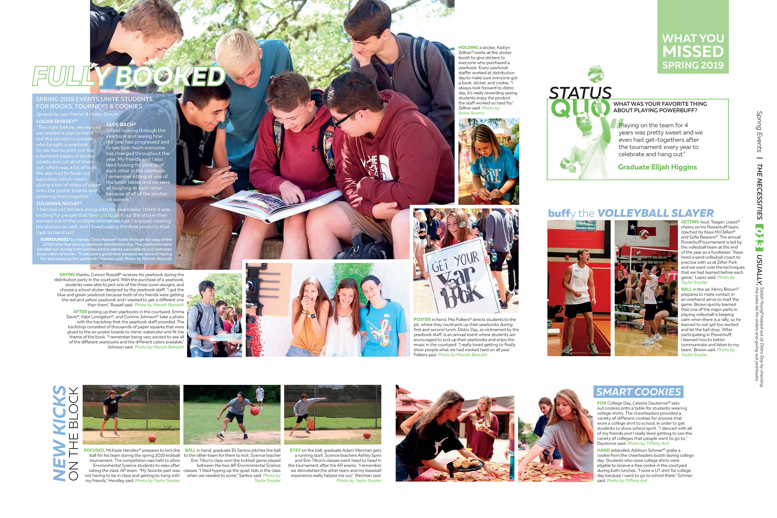
MACRO emphasis 1 grid (3-5 picas)

Slide 14
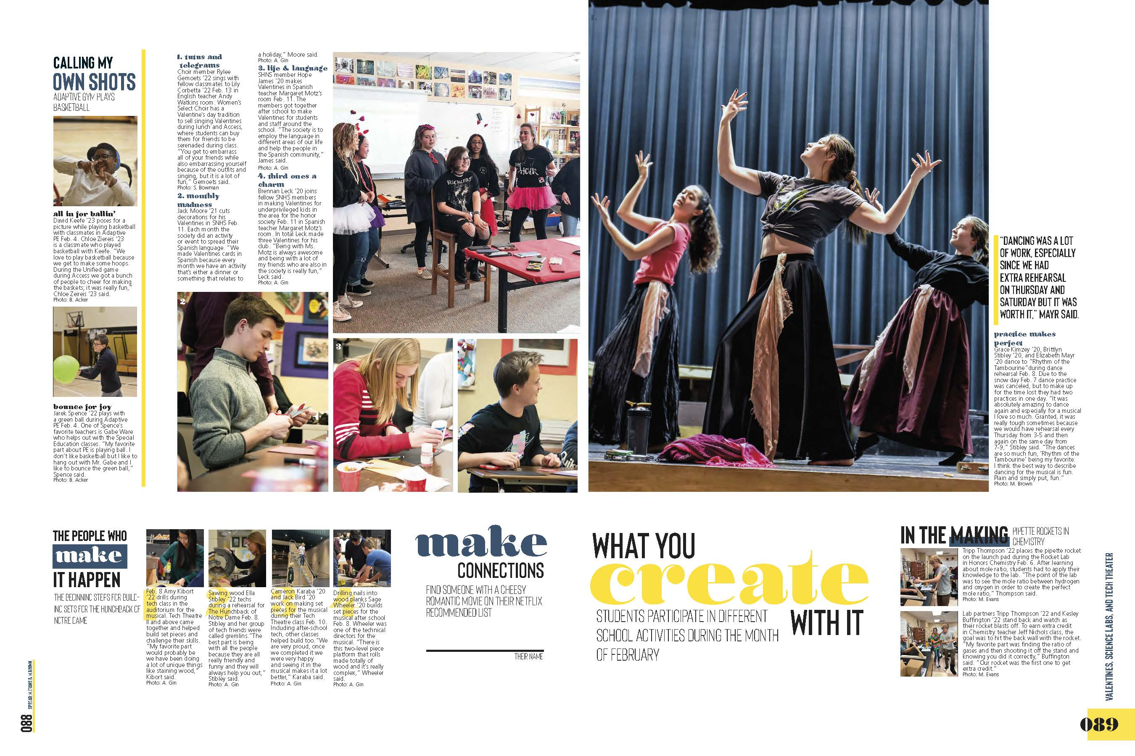
MACRO emphasis 1 grid (3-5 picas)

Slide 15
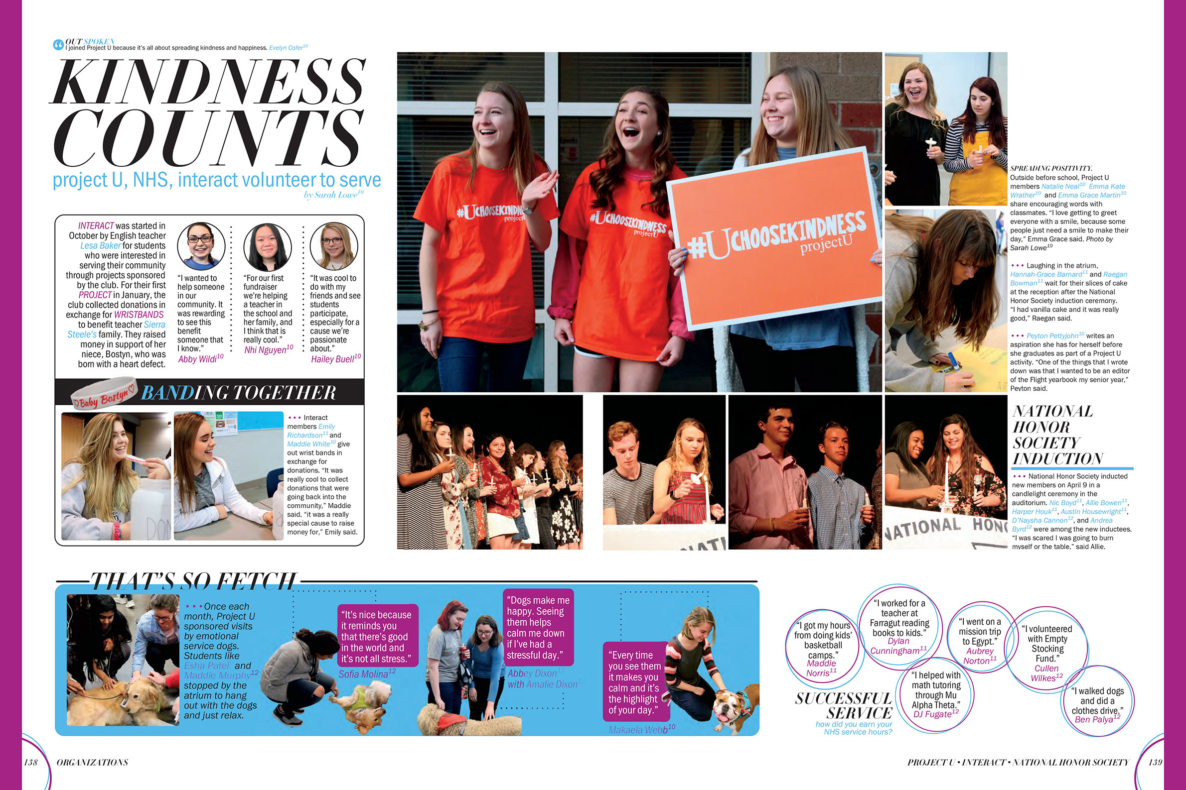
MICRO packaging
1-3 points separation

Slide 16
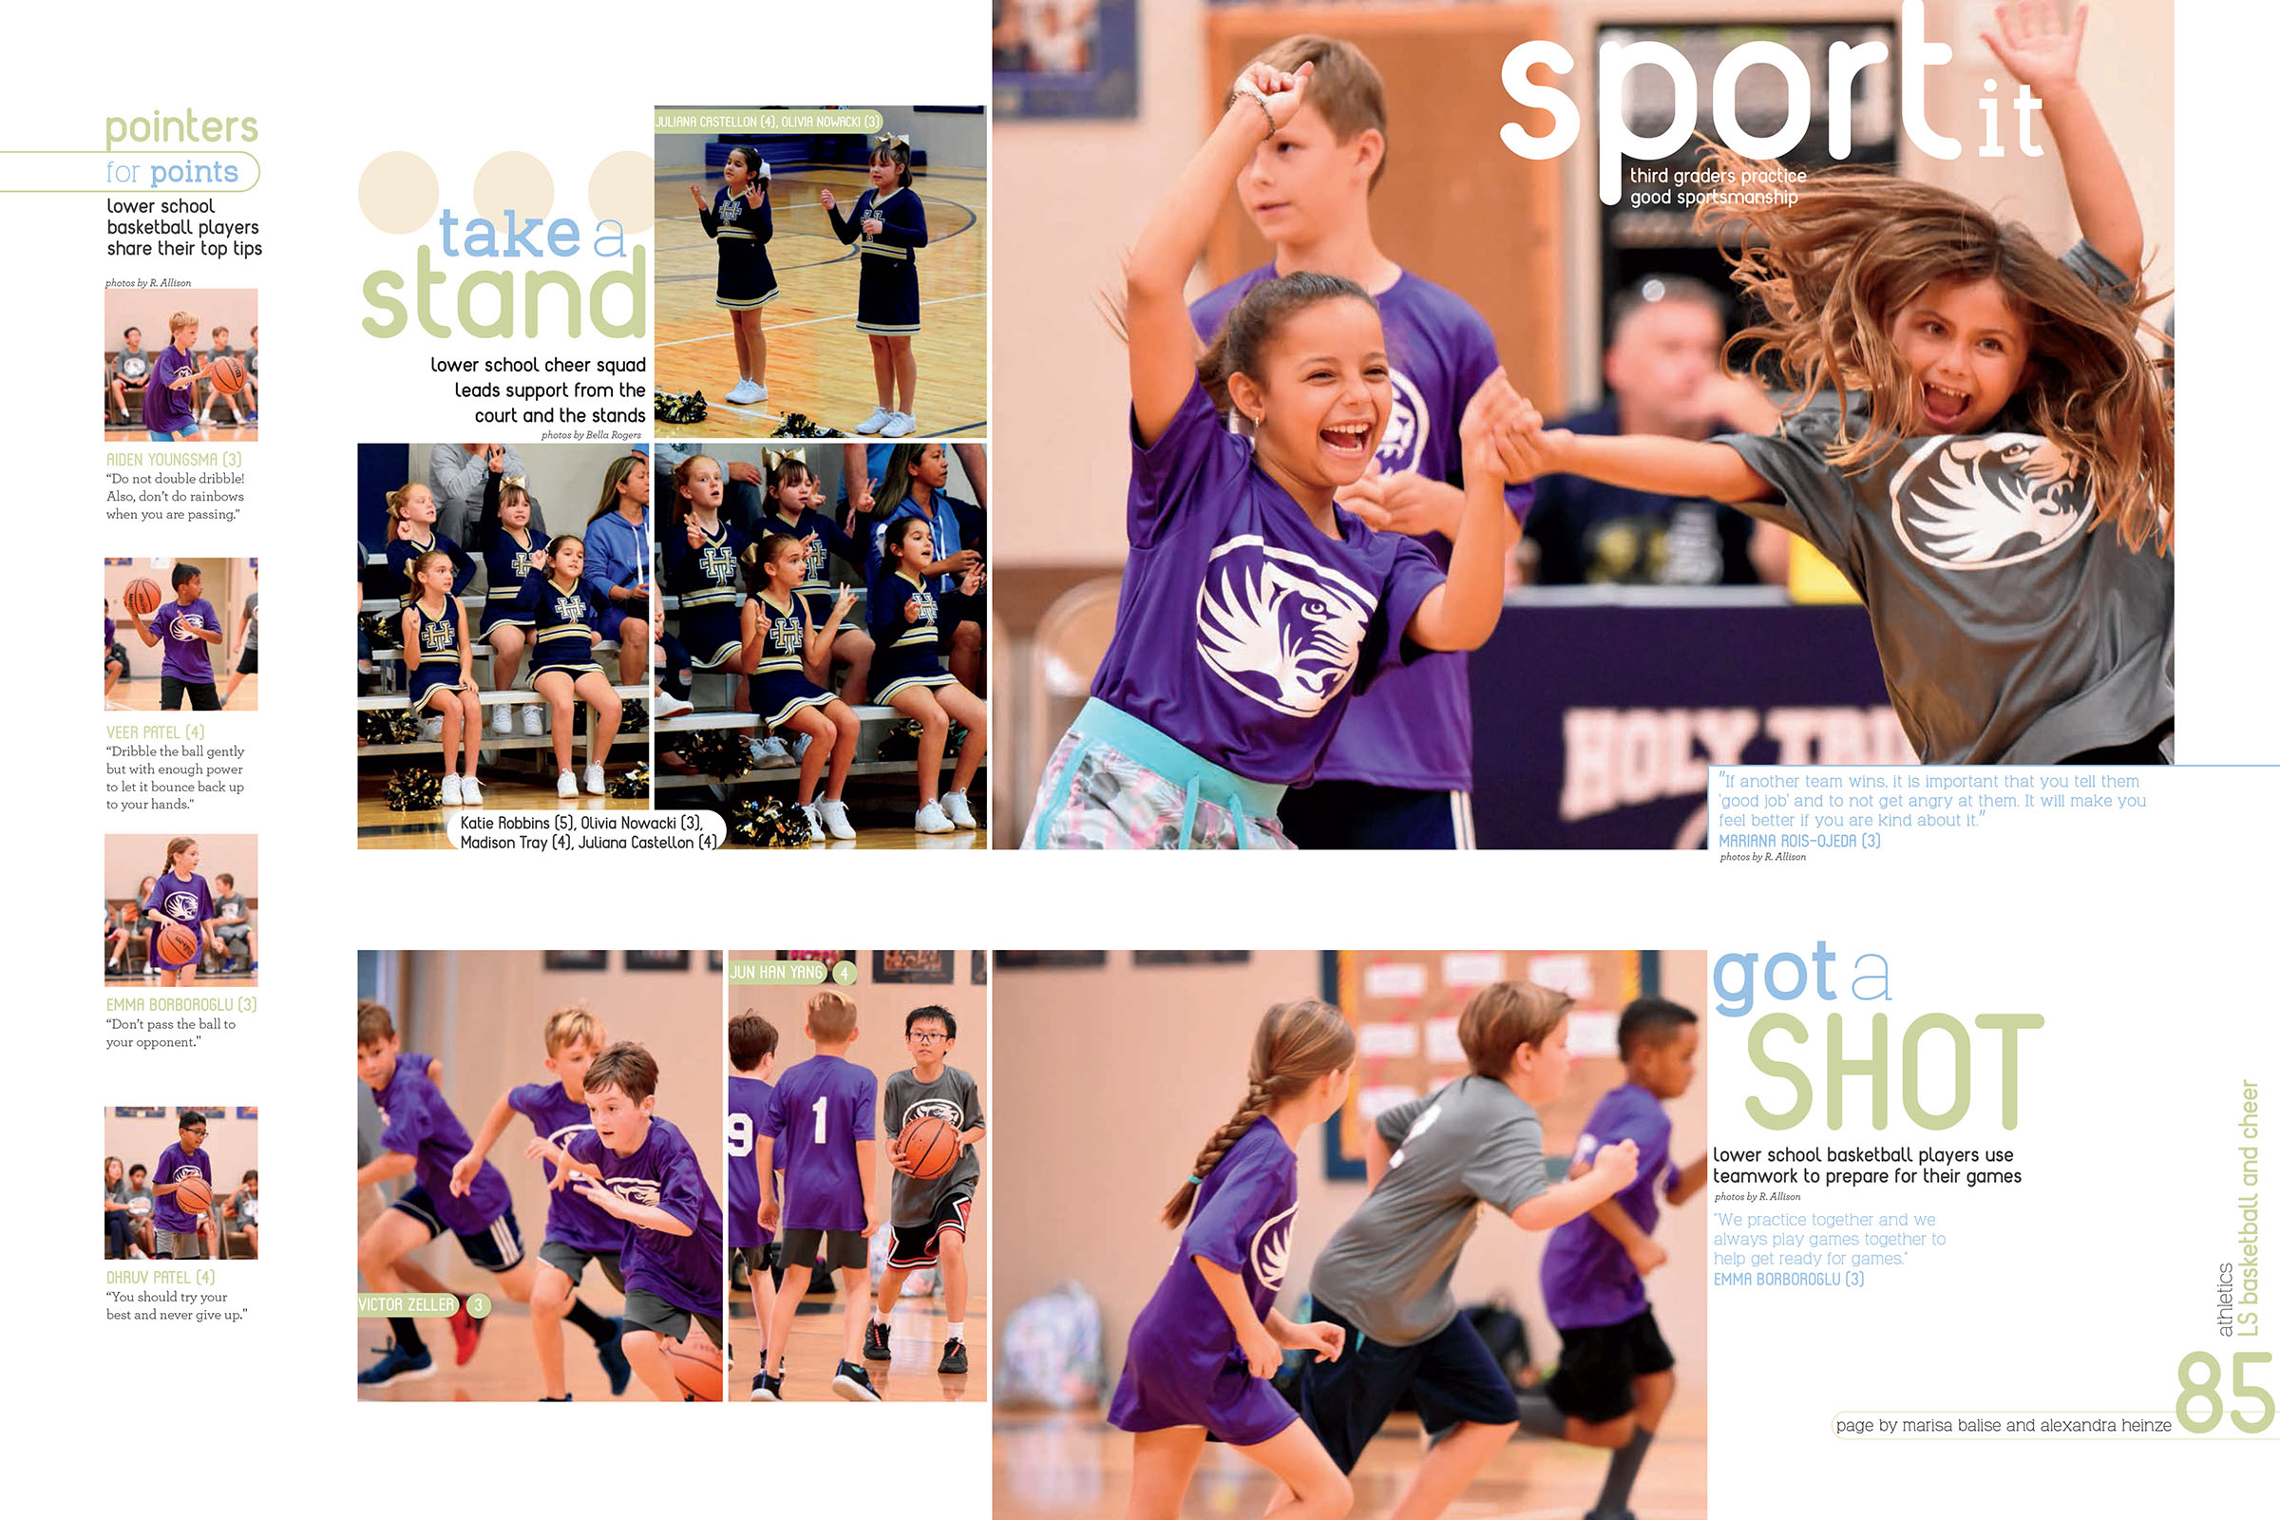
MICRO packaging
1-3 points separation
Photos with micro separation must be related & may be captioned with a group caption.

Slide 17
Conventional consistency
9 points - 1 pica separation

Slide 18
Conventional consistency 9 points – 1 pica separation

Slide 19
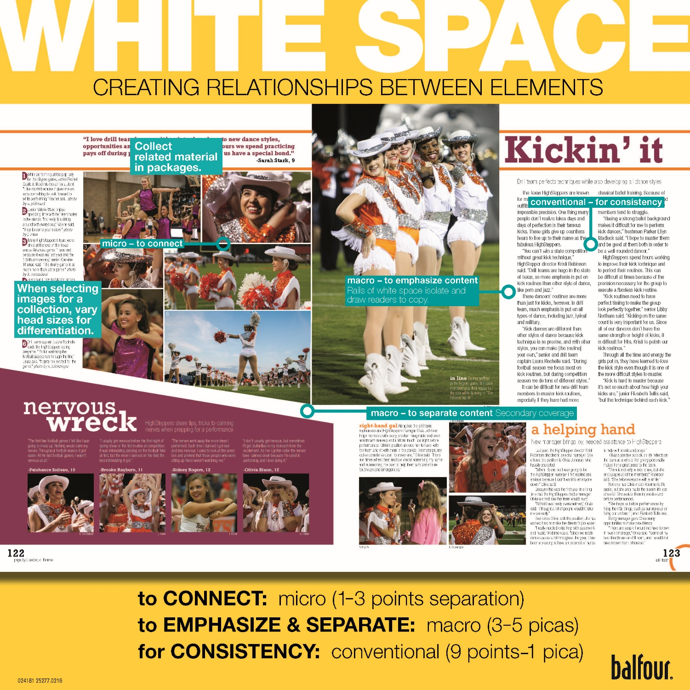
The WHITE SPACE square
provides a model
for staff members
Notes:
19

Slide 20
Your turn
Alter a basic layout by creating photo collections and secondary coverage packages.
Determine micro, macro and conventional spacing.
Use internal spacing to draw elements together (micro).
Use macro spacing to emphasize and separate content on the spread.
Check your layout before turning it in.

Slide 21
Notes:
21

