Slide 1
Selling to Technical People
Session 050
September 10th, 2021
Welcome – we’ll be starting soon.

Slide 2
Selling to Technical People
Session 050
September 10th, 2021

Slide 3
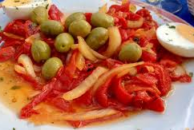

Slide 4
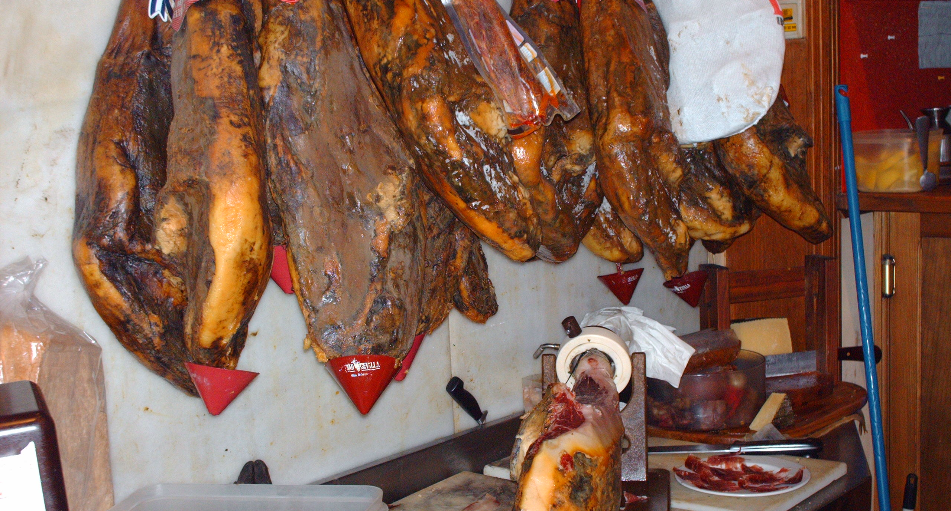

Slide 5
Compared to all the foods that I hated, jamon was amazing. For six days, I ate nothing else!

Slide 6
Compared to all the foods that I hated, jamon was amazing. For six days, I ate nothing else!

Slide 7
What technical people think about every salesperson…
You're going to run on and keep me from my tasks.
You're trying to be smarter than you are.
I know more about your stuff than you know.
You don't know about my industry.
You're going to overpromise and lie.
I don't like being with people, and especially don’t like extroverted people.

Slide 10
Compared to all the foods that I hated, jamon was amazing. For six days, I ate nothing else!

Slide 11
“I have an opportunity to become their favorite salesperson. When I do, they won’t want to work with anyone else!”

Slide 12
Prospecting
Sales Calls
General Best Practices

Slide 13
Lesson Plan

Slide 14
Poll Question

Slide 15
How frequently do you interface with technical people during a typical sales process – current customers or prospects?

Slide 16
How frequently do you interface with technical people during a typical sales process – current customers or prospects?
All the time.
More than 70%.
About half the time.
Not that often.
Hardly ever.

Slide 17
Prospecting

Slide 18
They hate surprises and interruptions, so how can I prospect to technical people?

Slide 19
Your goal is to show that you’re smarter than others. Not smarter than them, but other salespeople.

Slide 20
“You probably already know these points, but you might like this article about the hidden costs of cyber vulnerabilities.”

Slide 21
1. Brief 2. Bullet Points 3. Brief

Slide 22
Same Email – Different Format
Good afternoon, John.
I hope you’ve had a great week so far. I’ll be in your area in tomorrow early afternoon and would like to stop by to quickly demo our new system and show you the mobile application. I think you’ll appreciate the value it’ll bring to your organization and the ease of use that it offers the users – sparing your team of constantly training them.
Also, I’ve attached an article about prox cards that I think you’ll appreciate. Have a great rest of the week and weekend.
Hi John.
Three quick points:
I plan to stop by tomorrow at 1:30. If you’re free, I’ll provide a 10-minute demo of our new system.
I think you’ll appreciate the mobile app.
Check out the article attached on prox cards – I think you’ll like it.
Talk soon.

Slide 23
Phone or Voicemail
Brief.
Tell them exactly why you’re calling immediately.
Use phone to let them know what you’ll be doing.

Slide 24
In-Person Calls
Do not be aggressive in seeing them.
Let them know ahead of time that you’ll be dropping off material at “3:00 Thursday, but it’s ok if you can’t see me – I know you’re busy ”.
Make in-person calls at :50-:55 of the hour.

Slide 25
Brief
Bullet Points
Brief
Personal Sticky Note

Slide 26
Sales Calls

Slide 27
Make sure they are prepared for you.
Send an agenda a few days ahead of time.
Confirm the sales call / meeting.
Send helpful info like a glossary of terms, survey, or other thought-provoking material.

Slide 28
Protect their Time
Do as much homework ahead of time as possible to avoid asking unnecessary questions.
Let them know the scheduled stop time and set an alarm on your phone at the 10-minute mark.
Follow the agenda.
Finish early.

Slide 29
The Meat
Get to the point.
Tell stories.
Use data and examples to back up your stories.
Let leave-behind or follow-up material provide specifications and details.
Don’t tell them how great you are but lead them to forming that opinion.
Never outshine the master.

Slide 30
General Best Practices

Slide 31
Competence is More Important than Friendship
Make friends anyway.
Master your world: industry, solution, etc.
Know their industry enough to lead a discussion.

Slide 32
Know their Communication Style
Give them time to respond, especially when using Super Questions – maybe up to 20 seconds.
When challenging them, use a third party. “I read in an article that mobile credentials were going to take off this year. Do you disagree?”
Use north / south / east / west instead of right / left.
Be curious and care about the details.

Slide 33
Things They Judge
Not doing what you say at the exact time you were supposed to.
EDT when it’s EST and vice versa.
Inconsistencies in formatting
Redundant phrases (ATM machine, Monday morning at 8:30 am).
Inexact tiny quantities (…three or four times).

Slide 35
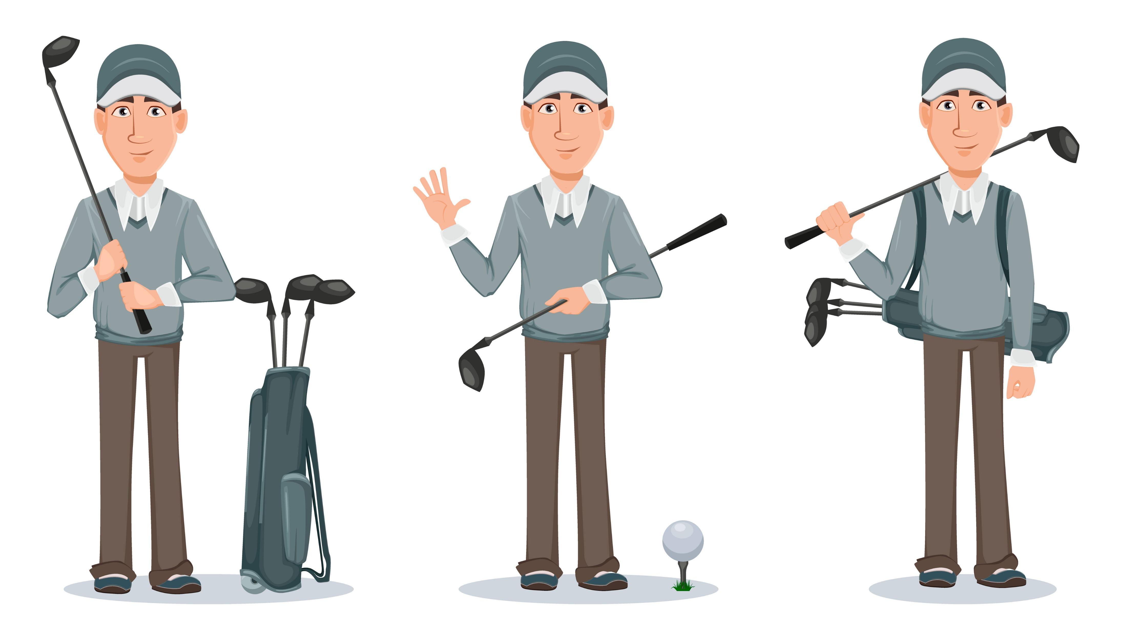

Slide 36
Creating Your Database
October’s Topic

Slide 38
Refresher Calls
Jamie will conduct an orientation / refresher session every month at 11:00 am Eastern Time on the first Friday of the month.
Next one is October 1st.

Slide 39
Questions and Discussion

