Slide 1
Three Keys to Building a Blueprint for Reopening
March 11, 2021
Property of Teachstone® 2021
Notes:
Gloria to start webinar

Slide 2
Before we begin:
We’re recording and you’ll receive a link to the recording tomorrow.
You’ll also receive a certificate of attendance and links to any resources mentioned.
Use the Q&A box to ask any questions you may have.
Property of Teachstone® 2021
Notes:
Gloria to share housekeeping

Slide 3
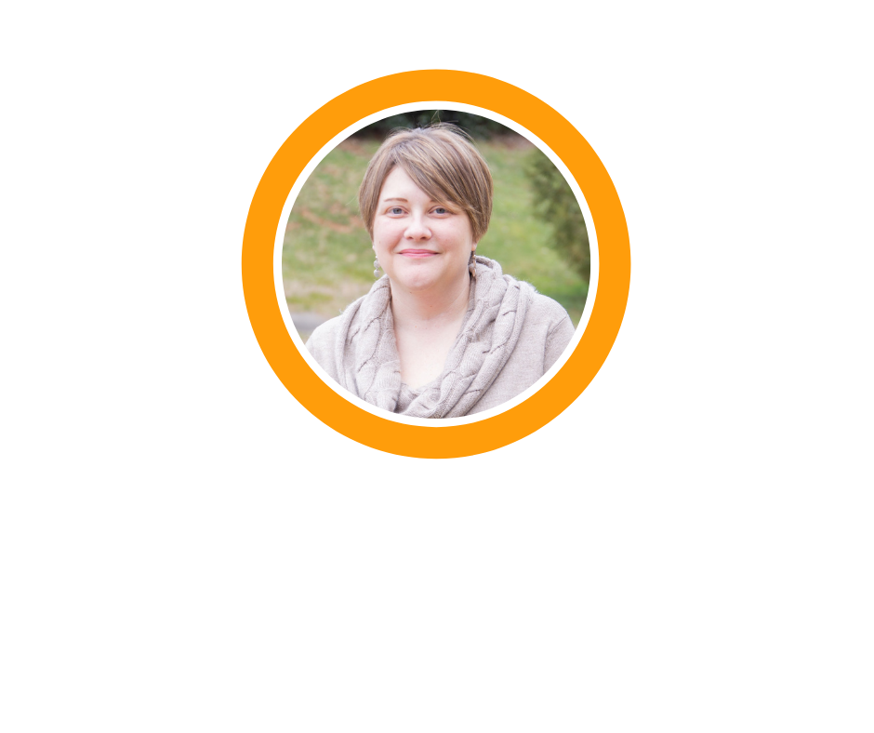
Today’s Discussion
Beja Williams
Regional Director,
Teachstone
Sara Diamond
Director of Partnership Development, Teachstone
Property of Teachstone® 2021
Notes:
Sara to introduce herself
Beja to introduce herself

Slide 4
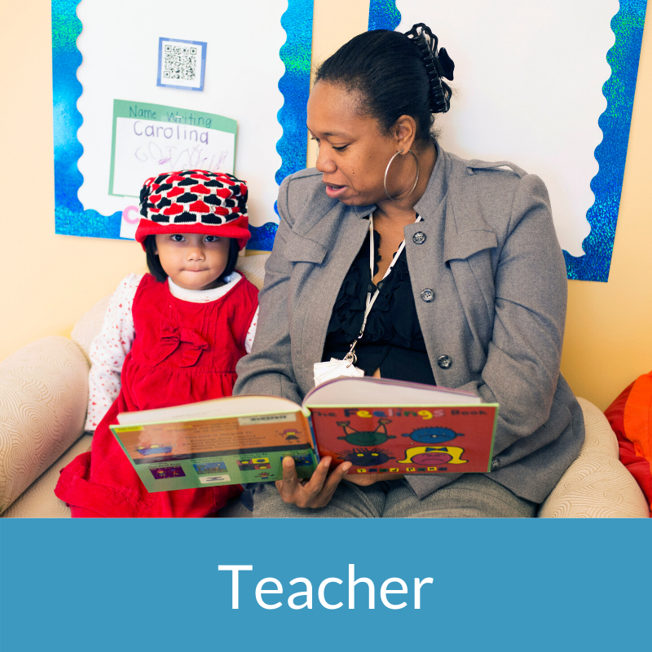
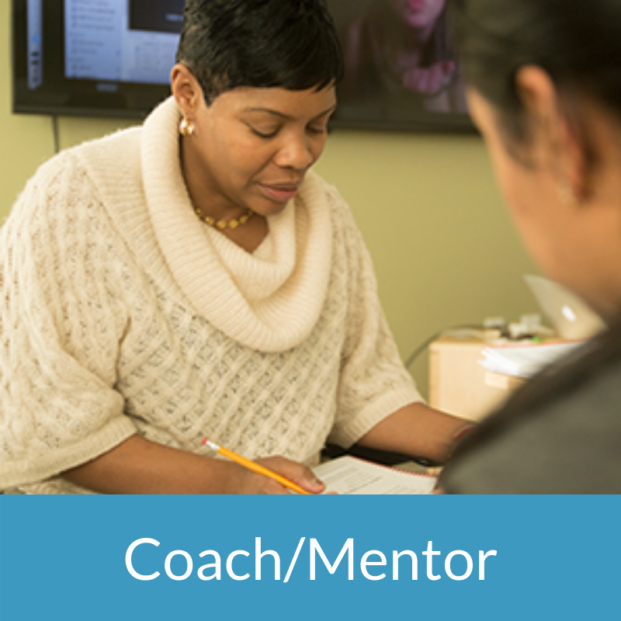
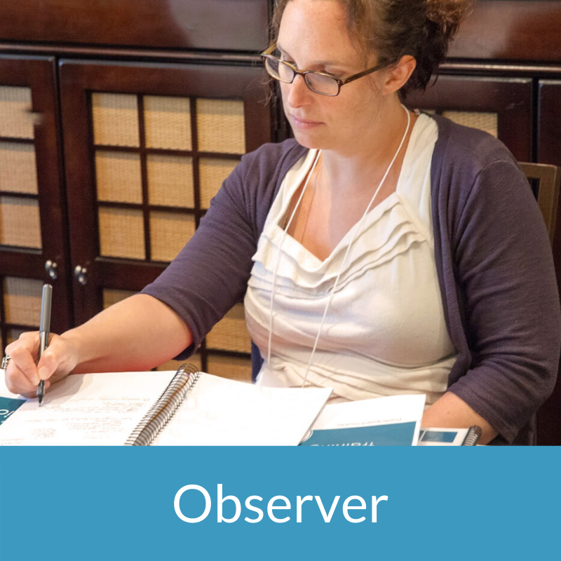
What is your role?
Property of Teachstone® 2021
Notes:
Beja to talk; To get started we’d love to know more about who is joining us today with a series of polls, so for our first question- what is your primary roll? … we will give it another 10 sec to answer… “ we have a majority of___ which will help us to frame our conversation today. “ Gloria to launch the poll
Gloria to share poll results and Beja to highlight

Slide 5
Quick Check-In
Is your program currently:
100% remote
Hybrid
Mostly or completely in-person
Property of Teachstone® 2021
Notes:
Launch Poll: Gloria
We recognize that schools are in various stages of reopening….
during our time together, we will discuss considerations as you continue to build and refine your reopening plans. Share out results

Slide 6
Quick Check-In
Your program plans to reopen mostly or completely for in-person learning by:
Already 100% in-person
As soon as possible
Fall 2021 / Next School Year
Still unsure
Property of Teachstone® 2021
Notes:
Launch Poll: Gloria
From your current perspective when do are/ you planning to return to completely in-person learning?
Share out results and connect findings to today’s topic [i.e. Majority are of you appear to be aiming for as soon as possible, or by this fall -- which only strengthens the need to establish a reopening plan that will support that timeline.
Transition Statement: Now that we better understand who’s joining us today, we’re excited to share with you 3 considerations in creating a blueprint for reopening. What does reopenoing mean as it pertains to your staff, parents and students in your program that are in need of emotional support. Let’s establish the 3 key for building a blueprint and creating a pathway to a successfi
to in-person instruction.
Sara takes it from here…

Slide 7
A Leader’s Role in Reopening
Instructional support cannot be thought about without first establishing strong emotional supports and an environment that promotes social-emotional development.
Reopening plans must include support for everyone - families, children, teachers, and staff.
It’s more critical than ever that we are attending to the needs of the whole-child, and not focusing solely on the academic or instructional implications.
Notes:
SARA
To frame our conversation today, I’d like to share about a panel discussion we recently hosted. We brought together a few educational leaders from the field to hear their experiences in writing reopening plans, and reopening their classrooms for in-person learning, and the key considerations that are continuing to drive their work.
From this discussion, a few common themes emerged that have helped to frame our 3 key considerations we’re sharing together
Review points on slide
A link to the recording of this webinar will be sent to you by email when we share the recording from today’s session.

Slide 8
In a time where there is still so much unknown, let’s focus on what we do know.
Notes:
Sara
Even with the insight from leaders who have already or are in the midst of reopening, there is still so much unknown. The needs and implications of reopening during a pandemic are constantly evolving.
Beja, In times where there is so much uncertainty, how can we remain grounde?

Slide 9
Interactions matter
… now more than ever
Children of all ages, birth - twelfth grade demonstrated positive outcomes in classrooms with higher interactions.
Stronger interactions showed greater gains in literacy, math and social-emotional learning.
Notes:
BEJA
We are not the experts in reopening, but we are the experts in Interactions and What we know is that interactions matter.
And now, after children have spent a year away from the classroom they matter more now than ever.
Research has shown that children in classrooms (birth through 12th grade) with more effective student-teacher interactions, as measured by CLASS, make gains in areas critical for success in school and in life. Let’s think about this on a deeper level….
How can education programs return to in-person learning in ways that will drive high quality interactions through literacy, math and social- emotional learning?
How do you build a plan that focuses on what matters most - meaningful, supportive interactions that create a nurturing environment for students
Share link: https://wwwcdn.teachstone.com/content/uploads/2020/08/CLASS-Research-Summary_2020.pdf

Slide 10
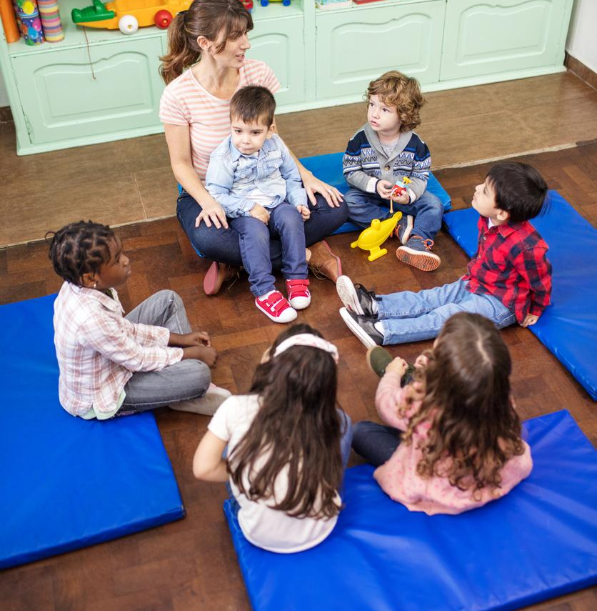
Build warm classroom environments and support social-emotional development.
Consideration 1
Notes:
Beja
As children return to the physical classroom is ensuring they’re being welcomed into a warm environment that allows them to feel safe, secure, and that fosters their social-emotional learning and development.
Children who are frightened, anxious or grieving are not able to learn until their emotional needs are met, so this is an important consideration.
We know many of you have been thinking about how best to support your teachers and children who have experienced trauma, and so have we.

Slide 11
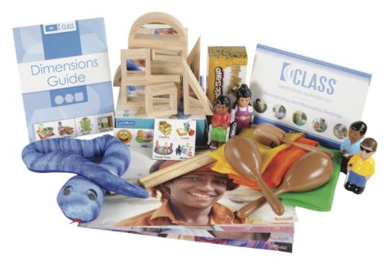
Provide trauma-informed professional development with Interactions at the Heart of Healing
Promote positive social-emotional development with a research-based Emotional Support Kit
Notes:
Beja
One of the ways we’ve responded to this need is by developing our Trauma Informed professional development series, Interactions at the Heart of Healing.
knowing that we are not the experts in trauma, we reached out to experts in the field to learn more. Not only did they dialogue with us, but this led to the development of an online course that is now available.
This trauma-informed virtual learning experience shares best practices and tools on how to support and recognize:
the importance of cultivating and understanding what it means to be a trauma-informed educator.
strategies to interact with families and help them better understand children's experience and position them to support healing
The importance to prioritize self-care so that educators can continue to show up as their best selves for children and families.
Overall, Trauma Informed pd series addresses all components in one; educators, children, families and positive learning environments.
To accompany Interactions at the heart of Healing, our research-based CLASS Emotional Support Kit, provides your teachers with the manipulatives and guidance to help children label and express feelings and help educators plan effectively for intentional interactions that promote positive behavior support.
.Some of our partners in the field have truly benefited from Trauma Informed professional development.
_______ with ______ incorporated (product) and shared “ _ insert quote”
Transition Statement: we understand that trauma can be a difficult topic to discuss. There is no one-size-fits-all answer to the challenges educators face in supporting children who have experienced a change in their lives over the past year. This learning experience aims to create a training environment that is especially supportive of participants and their particular needs.

Slide 12
Build a high-quality workforce dedicated to positive interactions.
Consideration 2
Notes:
Sara
For many, reopening plans include the need to rebuild a workforce. Even if you did not lose any of your workforce, it’s also an opportunity to further strengthen the qualifications and professional development opportunities to ensure your staff and teachers have the strategies and best practices to promote and support positive interactions.
So how might you do that?

Slide 13
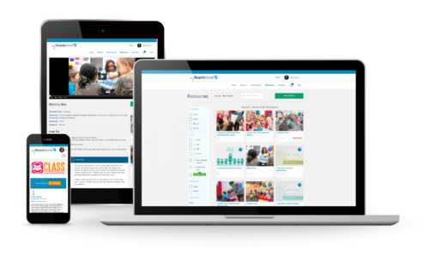
Re-focus on teacher-child interactions with CLASS® Foundations
Drive continuous improvement anytime, anywhere with myTeachstone
Strengthen your teacher quality with CDA with CLASS®
Notes:
SARA
refocusing staff on interactions is a great starting place. And there are tools that enable teachers to build a strong
CLASS Foundations for Teachers, your staff can
gain better understanding of the importance of interactions in supporting children’s development and learning
begin to explore the CLASS domains and build an understanding of best practices that drive to effective emotional support, classroom organization, and instructional support practices
To align your entire program’s improvement and professional development opportunities, myTeachstone gives you the tools to:
provide data-driven and individualized professional development learning opportunities to your teachers
support your teachers’ growth with ongoing, research-based observation and coaching practices
pair teachers with a certified CLASS coach to provide intentional and facilitated coaching sessions
If you are rebuilding your workforce, consider our CDA with CLASS offerings that:
gives your staff access to the only CDA offering that connects key learning to CLASS concepts and supports positive interactions
allows the choice of high-quality on-demand or facilitated programs that are mobile-friendly, engaging, and can provide CEUs or college credits upon completion
Any of these professional development opportunities could be easily incorporated into reopening plans, align with existing coach models within your programs, and provide the support that your teachers need as you promote their knowledge and skills around positive interactions.

Slide 14
Build capacity to ensure equity of interactions in every classroom.
Consideration 3
Notes:
Beja
As we enter 2021 Teachstone is laser-focused on fulfilling our mission by doing more to support the most important learning and developmental outcomes for every child.
with concerns of widening of the achievement gap, our third consideration is to reflect how you can build capacity to support and ensure equity of these interactions for every child you serve.
Research shows that African American and Hispanic/Latino children enter Kindergarten 7-12 months behind in reading skills, 9-12 months behind in math skills and even larger gaps existing for low income students.
Strong quality interactions with only a subset of children in a classroom shines light on the need to have a system to provide visibility for all.
Transition Statement: In one recent study conducted in Dallas, students who had CLASS proficient teaching in preschool-1st grade were almost 3 times as likely to be on track in their academic performance by the end of 1st grade as compared to student with less effective teaching experiences. At Teachstone, one of our goals is to ensure that CLASS and aligned implementation or improvement enhance the development and learning of every child and can be used equitably across all education landscapes.

Slide 15
Maximize the potential for every child by focusing on quality interactions with CLASS®
Notes:
Sara
consistency of interactions across the day as well
Our Classroom Assessment Scoring System® (CLASS), the leading quality improvement system for teaching, helps you focus, measure and improve classroom interactions — a key factor proven to drive children’s academic and life-long success.
With CLASS you can:
get insights into the quality of interactions within every classroom, across your program
maintain accountability for equity standards by measuring the quality of interactions
make data-driven improvement decisions to support program quality and further promote positive interactions -- the key to maximizing the potential for every child.

Slide 16
Let us support the reopening of your classrooms.
Notes:
Sara
As we near the close of our time together,
let’s review the three considerations we’ve shared …
and reiterate our commitment to being your partner in reopening.
POLL: If you’d like to learn more, we’d love to connect with you an executive who can partner with you to discuss returning to in-person learning, your goals, and identify solutions to support you, your program, and ultimately the children in your care.

Slide 17
https://teachstone.com/interact-class-summit/
Notes:
Gloria
We also invite you to join us at our upcoming live virtual InterAct Summit

Slide 18
Questions?
Notes:
We have about XX minutes left together, and we’d love to address any outstanding questions you may have. We’ll stay on the line to answer any questions submitted through the Q/A box for a few minutes.
Potential Questions to start the q/a portion (if none are submitted) and to extend session based on time.
How have other programs incorporated supports into their reopening plans?
From your experiences in supporting your partners, what have been on top of minds?
I’m interested in hearing more about Interactions at the heart of healing, what topics are covered in that content?

Slide 19
Thank You!
@teachstone
www.teachstone.com
Notes:
Gloria to thank everyone for attending, share that the recording and resources will be shared by email and end webinar

