Slide 1
Blue Yonder Partner Sales Battlecard
Brach is a leader in the financial wellness and payments space that helps businesses accelerate payments to employees. Companies use the Branch Employer Payments Platform to reduce costs and provide additional employee benefits that increase the bottom line.
Partner Type Technology What BY Solutions Workforce Management Industries All Industries with hourly workers Region USA Contact information Partner Contact: Tony Rappa, Strategic Aliiances Manager tony.rappa@branchapp.com 651-341-5522 | Technology Partners - Solution / Integration overview: Branch integrates with BY to get the employer roster and pay rate of employees, so as to effectively pay employees their Earned Wages, provide paycard replacement, ease 1099 payments, automate disbursements, and eliminate costs of paper driven processes in a digitized, contactless fashion.
 | Joint Value Statement Branch & Blue Yonder Increase Financial Wellness and flexibility for businesses and their employees Safe, Touch-Free Pay alternative for Employees Eliminate Manual Payouts for Payroll, Tips, Mileage & Employee Reimbursements that reduce payroll costs Optimize Labor with Increased Shift Coverage and reduction in overtime Increase loyalty of 1099 workers Attract top talent, and increase employee retention by 15% No Cost, No Commitment, No Minimums, & No Obligations
 | Helpful Facts - User Stories https://www.g2.com/products/branch/reviews
 | Partner highlights: Interesting facts about partner: # of customers, notable awards other unique highlights about your company that sets you apart. Over 1 Million End-Users 2020 Webby Award Winner for Best Financial Services/Banking App Finalist for Finovate Awards: Excellence in Financial Inclusion Star Tribune | Top 150 Workplaces in Minnesota Plaid Integration for real-time updates on Account Activity with other Plaid integrated applications

Slide 2
Branch Technology Offering Overview
Branch Employer Payments Platform
2021

Slide 3
Introducing Branch
Partner Type: Technology
Markets/Industry: Employer Payments & Financial Wellness
Partner Sales Contact: Tony Rappa, tony.rappa@branchapp.com
Offer Overview: The Branch Employer Payments Platform offers a full suite of solutions for business looking to accelerate payments to working Americans all at no cost. The employee digital wallet acts as an on-demand hub that helps them meet their everyday financial needs.
Existing Live Customers: Domino’s, Continuum Global Solutions, Henry Ford Health Systems, Banfield Pet Hospital
Partner Sales Model: Mobile First Application that is Fee-Free
Model with BY: Field Sales Referral Eligible
Technology Platform: Mobile First, Free- Employer Payments Platform
Competitive Position: DailyPay, PayActiv, Wisely, Rapid Pay, Even
Note: Portions can be from Battlecard - Summary

Slide 4
When to Engage Branch
When to Engage:
Example: If clients are interested in paying employees faster with digital solutions, while extending employee financial wellness benefits across the business at no cost, position Branch.
If any company is looking to enable direct deposit for all employees, has an initiative to utilize a paycard, enable digital contactless payments for tips, mileage, or other reimbursements, or is looking to enable same-day-pay, all No Cost to the business or the employee, then bring Branch in.
If BY Competitor is competing and we must defensively position together with Branch.
Branch and BY Fit:
[Joint positioning proposition/statement] We are positioning Branch’s Employer Payments Platform, and financial wellness with BY to enable employees engagement with their employer, while driving holistic savings for both the business and its employees.
Target Buyer/User Persona: HR, Benefits, Payroll, Total Rewards, CFO, and sometimes IT
Note: Portions can be from Battlecard - Summary

Slide 5
How to Engage your Branch Partners
Integration to BY Status: Application integrates with Blue Yonder
Demos: Demonstrations are readily available when working with the Branch team. Just submit a lead for Branch in the Branch | Blue Yonder - Resource Center, and the Branch team will align with the BY team to meet the client’s needs.
Value Assessment: Branch Savings Calculator: https://www.branchapp.com/savings-calculator
For a more in depth analysis of how Branch delivers value, reference the stats in the sales presentation, or reach out to Branch team for more information.
Pilots: Pilot’s with Branch are not needed as Branch is Fee-Free for employers and its employees with No Cost, No Commitment, No Minimums, & No Obligations. Employers can sign up with Branch at No Risk, and start providing the Branch benefit to its employees right away, and realize value immediately.

Slide 6
Branch Sales Messaging
Branch Employer Payments Platform
2021

Slide 7
Emerging leader in employee-centric fintech & financial wellness
Awards
2020 Webby Award Winner Apps - Financial Service Banking
2020 Lendit Fintech Award Winner Excellence in Financial Inclusion
G2 Leader - Winter 2021 4.7 Stars
Branch is working on big ideas to help solve the financial challenges faced by America’s 80 million hourly workers by partnering with the companies they work for to streamline payments.
Wellness Partnerships
Notes:
Talking Points //
“Where fintech meets financial wellness, our mission at Branch is to:
Offer transparent and equitable financial services
Encourage financial literacy through work
Positively impact both employee and employer

Slide 8
Workers need faster access to wages, now more than ever before.
COVID-19 has hit lower-income workers most
Movement away from cash has created gaps
Growth in gig employment has set new expectations
Traditional payment methods haven’t caught up.

Slide 9
Branch + Blue Yonder helps solve real business + payroll problems:
Providing EWA for All Employees
Save Money by Reducing Paper checks or Replacing Paycards
Automate Payouts - Tips, Miles, Last Pay
Help Attract and Retain Quality Talent
Drive Loyalty with 1099 Workforce
Offer Financially-Inclusive Wellness
Simplify Payroll Save Time + Money
Competitive-edge
Attracting Talent
Pay Employees Faster

Slide 10
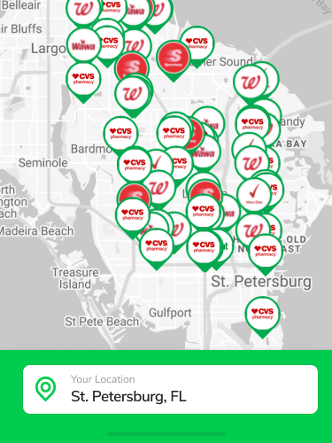
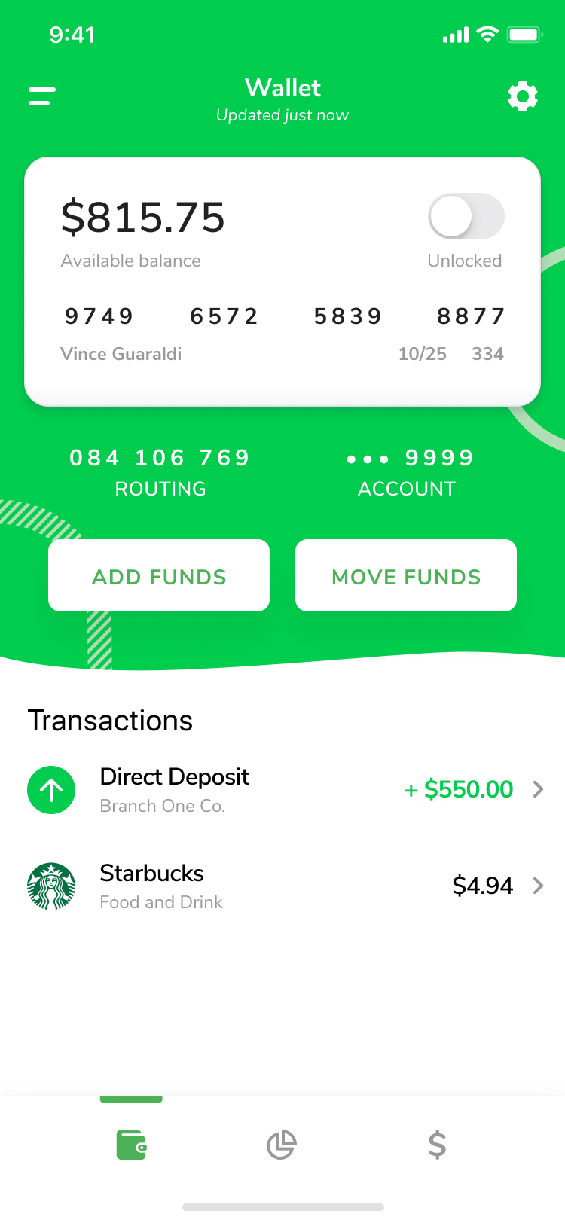
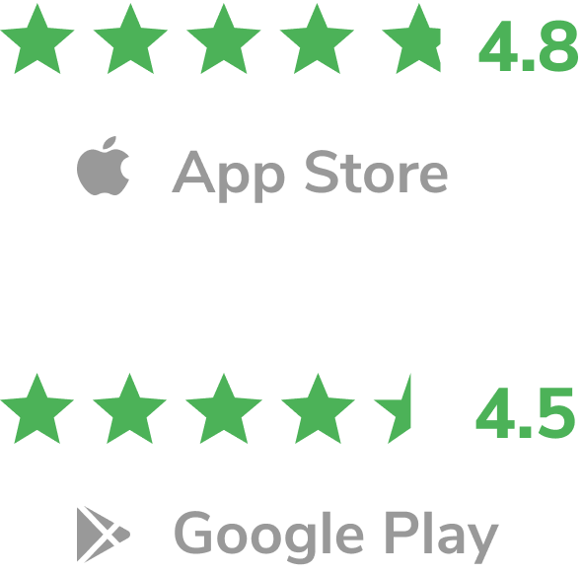
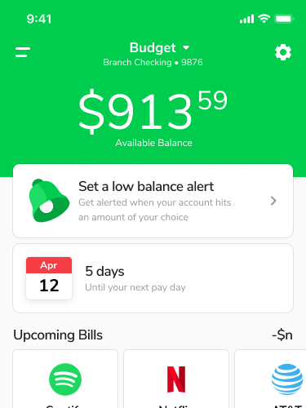
Branch Employer Payments Platform
The only employee-first digital wallet, helping working Americans meet their everyday financial needs.
Fee-Free Financial Services
FDIC-Insured Checking Acct + Debit Card
Up to 2-Day Early Direct Deposit
Free Built-in EWA
Budgeting + Financial Education Tools
Notes:
Talking Points //
“XXX

Slide 11
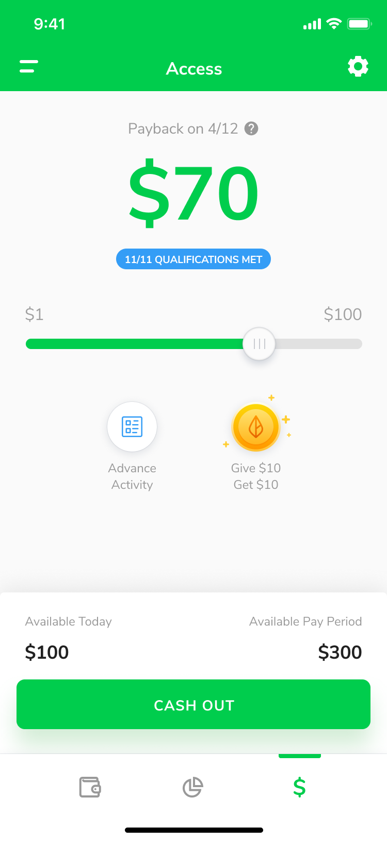
Instant Pay
Grant employees access to money they’ve already earned - free!
Free,
flexible spending
Earned Wage Access Up to 50 % wages before payday
Digital Tips + Disbursements Instantly after each shift
1099 + Gig Payouts Full payout after each gig completion
Branch Debit
–
Virtual Card
–
45,000+ ATMs
–
Transfer Out*
No changes to payroll or pay cycles
No pre-funding or escrow
Notes:
Talking Points //
“

Slide 12
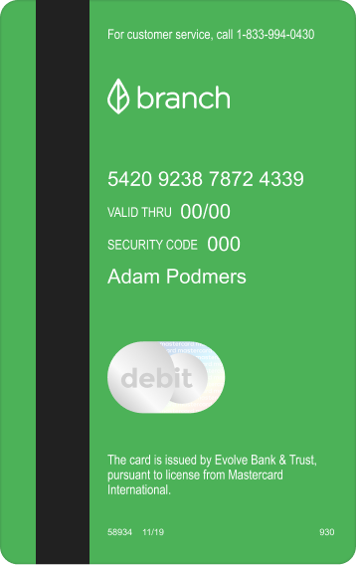
The Employee-First
Debit Card
Branch card is a modern banking card solution.
Features
No Overdraft, Minimum or Access Fees
Instant access to Apple Pay & Google Pay
45,000+ Free ATMs
Cash Reload at 100,000+ Locations
No Additional Setup or Payroll Integrations
Dedicated Support & Instant Onboarding
Copyright © 2020 Blue Yonder, Inc.

Slide 13
Beyond a Paycard
 | Branch | Standard Paycard | Traditional Bank
Free, built in EWA | ✓ | ✗ | ✗
Automated digital disbursements | ✓ | ✗ | ✗
Instant access to Apple Pay & Google Pay | ✓ | ✗ | ✗
Zero ATM fees at Allpoint Network | ✓ | Always $2.50 | $2.00 - $5.00
Zero monthly fees | ✓ | up to $10.00 | up to $30.00
Zero inactivity fees | ✓ | up to $10.00 | $5.00 - $20.00
Up to 2-days Early Direct Deposit | ✓ | ✗
P2P payments | ✓ | ✗
Transfer funds to a third party | ✓ | ✗
U.S. Based customer support | ✓ | ✗
Copyright © 2020 Blue Yonder, Inc.

Slide 14
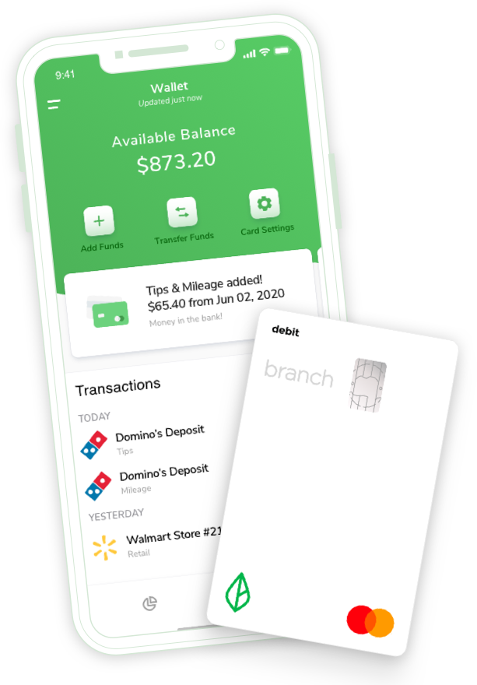
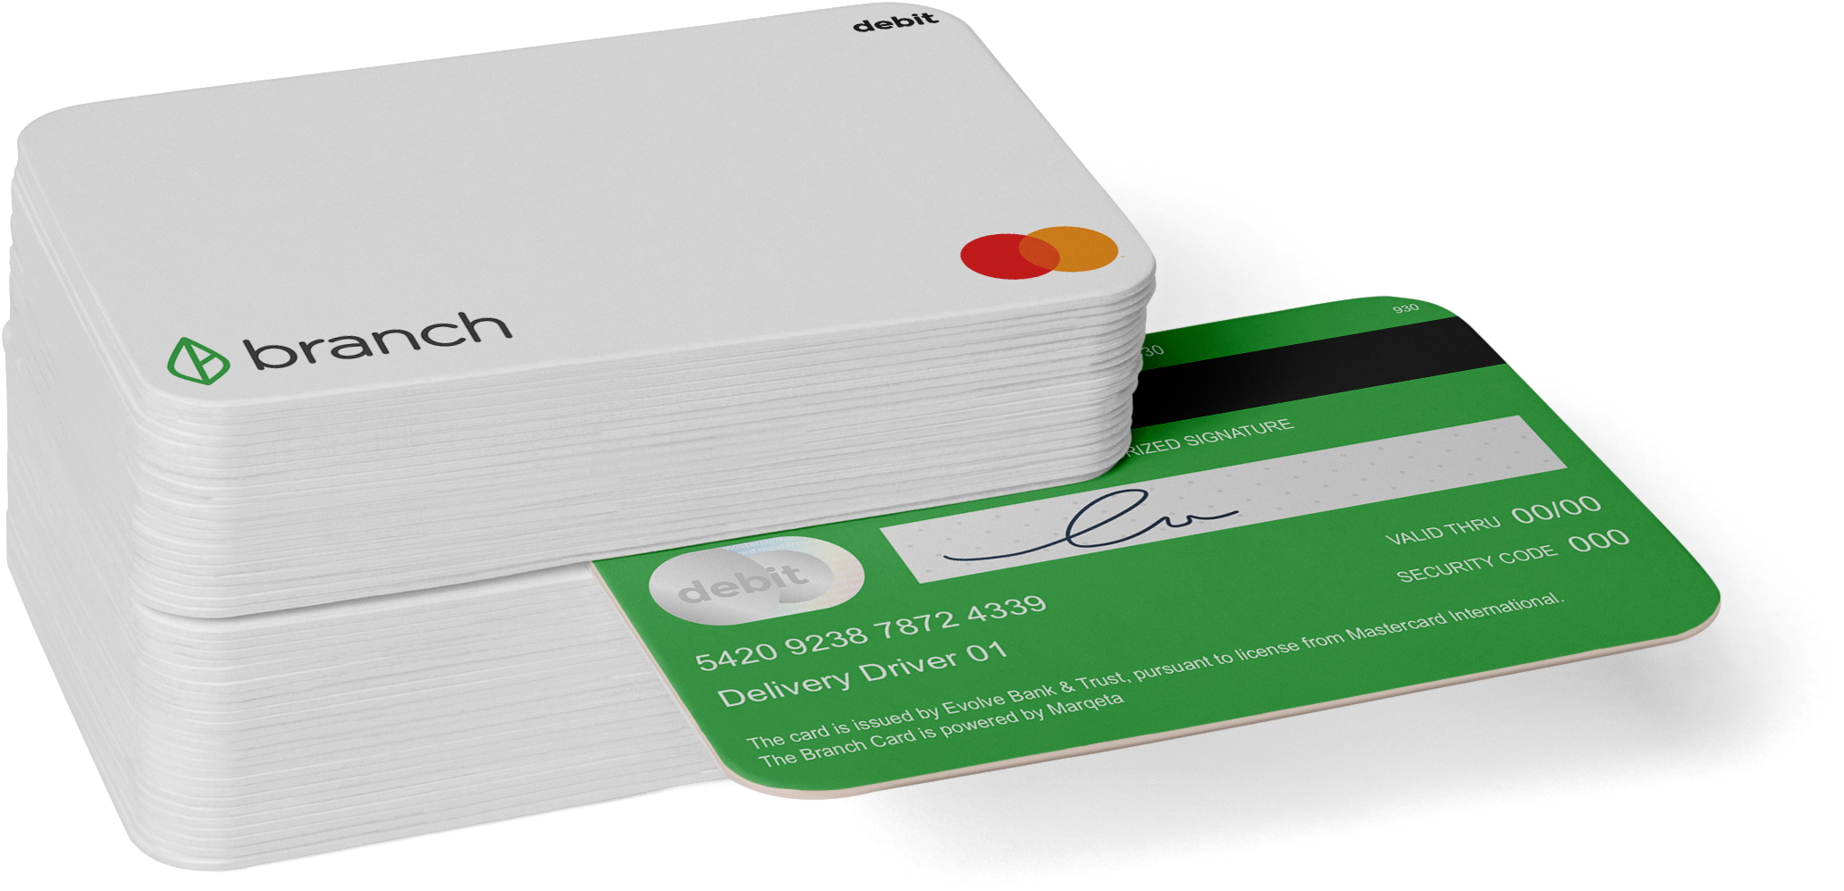
Disbursements
One-off payments sent to employees instantly
e.g: Tips, Mileage, Bonuses, Per Diem, Reimbursements
No trips to the bank or cash delays
No additional payroll steps
Easy payouts of tips, bonuses, mileage and other one-off payments
Cash access available through free ATM network

Slide 15
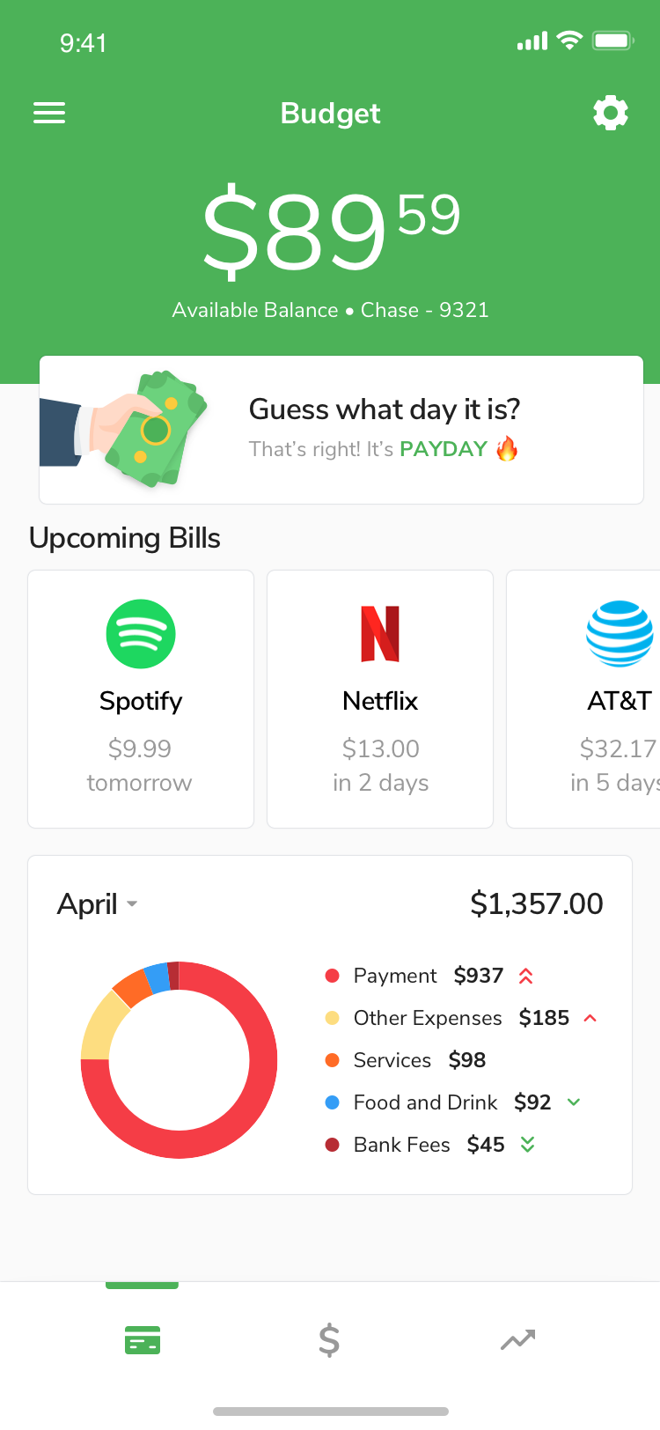
Mobile cash flow management
AUTO-BUDGET
Give employees data and insights at-a-glance to help them gain financial stability.
Eliminate overdrafts and fees
Track upcoming bills
Highlights spending trends
Alerts for high expenses and low balances
Determine when a wage advance makes sense

Slide 16
Replace Paycards +
Paper Checks
Reduce time & costs related to cutting paper checks or managing paycards
Provide fee-free digital banking and debit card to all employees
No-hassle, no-cost way to pay people faster, even on day one
Branch handles all support needs
Built in EWA & 2-Day early DD
1 in 3
Low-income workers are underbanked or unbanked
Save $2,000/year per 10 employees

Slide 17
Earned Wage Access
Free for you & your employees
No pre-funding, escrow, or third-party risk
No extra steps or changes to payroll
Prevents overdraft and maintenance fees, which perpetuates the cycle of debt
Improve retention and employee morale
Aligned with CFPB Advisory Guidelines
2x
Workers more likely to apply if EWA is offered

Slide 18
Digital Tips + Disbursements
Instantly send digital tips, mileage reimbursements or other one-off payments
No additional payroll steps
No manual data entry required; we automate the process for you
Eliminates cash-on-hand needs
Better cash flow: no escrow or pre-funding
“
What Branch offers is stylists to get their wages faster, and owners to control cash flow.”
Raj Mahajan President ProPoint Solutions

Slide 19
1099 + Gig Payouts
Workers can get their wages paid out instantly after job completion (and even multiple times a day) for Free!
Flexible integration options
Save by eliminating ACH + Instant fees
Tax-withholding and 1099 form generation options
90 second onboarding and immediate access to Apple Pay or Google Pay card
$2/daily
Instant or Express Pay fees
on average gig platforms

Slide 20
Case Studies, Value Metrics, Other Solution Proof Points

Slide 21
Background: Leading Customer Care Provider for Fortune 500s
Industry: Customer Service/Call Centers
US Employee Count: 7,000+
Challenge
In search of a financial wellness tool that could support underbanked employees living paycheck to paycheck
Cost and heavy lifting required for changing the bi-weekly pay cycle
“[Branch] struck a great balance for me, giving people control of money when they needed it or wanted it without creating any undue burden for me or the company from either a processing perspective or a cash-flow perspective.”
- Continuum Global Solutions CHRO Elaine Davis via
Solution
Mobile-first EWA via Branch
Free, fast options for employees
Financial education component with Auto-Budget

Slide 22
Background: Leading Taco Bell Franchisee
Industry: QSR/Fast Food
Employee Count: 5000+
36%
Reduction of paper check usage in first 30 days
Challenge
70% employees on paper checks
Admins needed to have couriers deliver the batches of checks to 200+ restaurant locations each pay cycle
Excessive administrative, paper check costs
83%
Increase in Direct Deposit adoption
Solution
$5,500
Saved per pay cycle
Branch Digital Wallet + Card
Fee-free Direct Deposit option
Financial wellness tools

Slide 23
Background: Leading provider of contract cleaning professionals in the Midwest
Industry: Industrial Cleaning & Maintenance
Employee Count: 1,000+
Challenge
6%
Reduction in turnover within 1st month
71%
More incentivized to go to work
94%
Better able to pay bills on time
Attracting & retaining talent in a competitive industry with high turnover
Searching for a solution that offered more than just instant pay
Solution
Selected Branch to provide EWA
Attracted new and current employees with same-day pay
Filled open shifts by broadcasting to employees in various districts and regions

Slide 24
Background: Partnership with Servant Systems
Industry: QSR/Fast Food
Location Count: Available to 2000+ US Locations
Challenge
98%
Avg. adoption per location for employees who receive tips
Decreasing use of cash /limited quantities of cash on-site
Numerous trips to the bank required
Potential liabilities
Solution
71%
Users spending with Branch
Instant digital payments of tips, mileage after each shift via Branch Digital Wallet + Card
Contactless payment options + onboarding

Slide 25
Blue Yonder and Branch partner to provide great financial wellness tools.
No pre-funding,
escrow or capital req.
Branch covers all
wage access and recovery.
Adding Branch unlocks fee-free banking and wage access that is better than a paycard.
Apple Pay/Google Pay debit card available day 1
EWA enabled on Day 1. Clock out, Cash out!
Offer higher than 50% for EWA
Realtime tip payout for tips with integration
Receive full paycheck up to 2 days early
24/7 US-based
Customer Support
Branch handles all card, banking and wage access customer service.

Slide 26
Results You’ll (Actually) Care About
10-15%
Decreased Turnover
With Branch, enterprise customers improve retention by 10-15% annually.
Improved Recruiting
On average, people are 1.5x more likely to apply for a job offering instant access to pay.
Increased Shift Coverage
Branch customers see shift coverage rates increase by 20% post-launch.
Increased Engagement
100% - financially secure workers come to work motivated and engaged.
1.5x
20%
100%

Slide 27
Pricing
Transaction | Cost
Instant Transfer (Branch Account) | Free
ACH Transfer (3rd Party Bank) | Free
Instant Transfer (3rd Party Bank) | $2.99- $4.99
In-Network ATM Withdrawal | Free
Financial Services | Cost
Branch Wallet + Card | Free
Smart Budget | Free
Implementation | Cost
Communication Material | Free
System Setup | Free
Enterprise Support | Free

Slide 28
When Employees Win,
We Win.
HOW DOES BRANCH MAKE MONEY?
Card
Holder
Merchant
Every time employees spend using a Branch card, the merchant pays a fee (called interchange) to Mastercard and the issuing bank.
This fee is shared with us – by Mastercard – so we can continue to offer our product for free.
We will never sell any personal data.
Interchange
Fee
Mastercard
Branch

Slide 29
Blue Yonder + Branch
Modern Digital Payments
Improved Cashflow
Switch to contactless, cashless payments — no pre-funding.
Quick Setup
Flexible integration options, get running in as little as a week.
Great Support
Our US-based team is here to help, you & your employees.
Compliant
Our employer-based offering is SOC-2 and CFPB-adherent.

Slide 30
Branch + Blue Yonder
BRANCH
Blue Yonder
In Store POS
Blue Yonder
Roster, T&A, Payout Files
Branch
Mobile Wallet
Manager enters payouts
Daily file sent
Ingest file
Employee
Receive Payout
Payroll Administrator Portal
View Employee Information
Manage Transactions
Create Manual Transactions
Order Instant Cards

Slide 31
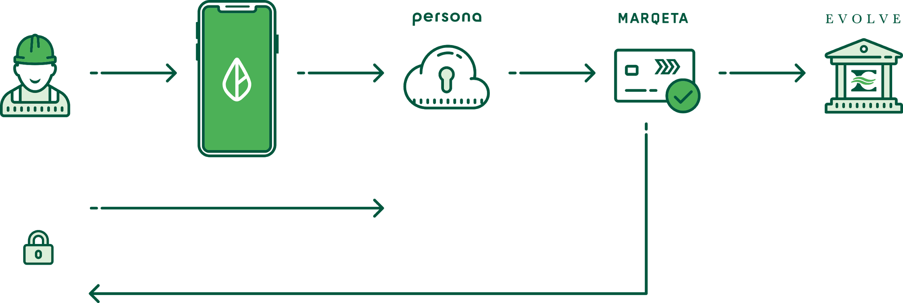
EMPLOYEE DATA, SECURITY FLOW & Solution Architecture with Blue Yonder
User
Branch Mobile App
Identity Verification
Issuer Processor
Issuing Bank
API
API
SFTP
Employee Login
Employee Login
Name
Email
Phone
SSN
DOB
Address
Name
Email
Phone
SSN
DOB
Address
KYC
OFAC
iFRAME
SSN, DOB, Address
Government ID (if SSN fails)
WIDGET
Debit Card #
Branch uses 2FA & Biometrics in app to protect any secure info.
Persona is iframed into the Branch app. Branch does not store or see SSN, DOB or Address.
Card number is never stored with Branch. It is shown in app via a PCI compliant widget.
Account & Routing number is stored encrypted with Branch.
Branch has an AML policy and process done by Branch’s Fraud team.

Slide 32
Getting Started with Branch is Easy!
1
Sign with Branch
No minimums, No fees
Your dedicated Branch Success Team will:
Review and align on your companies priorities
Help provide guidance + requirements on data exchange and setup
Create custom communication materials
Provide multi-level leadership training
2
Verify employee data route
3
Train leaders & distribute
marketing materials
4
Go live!

