Slide 1
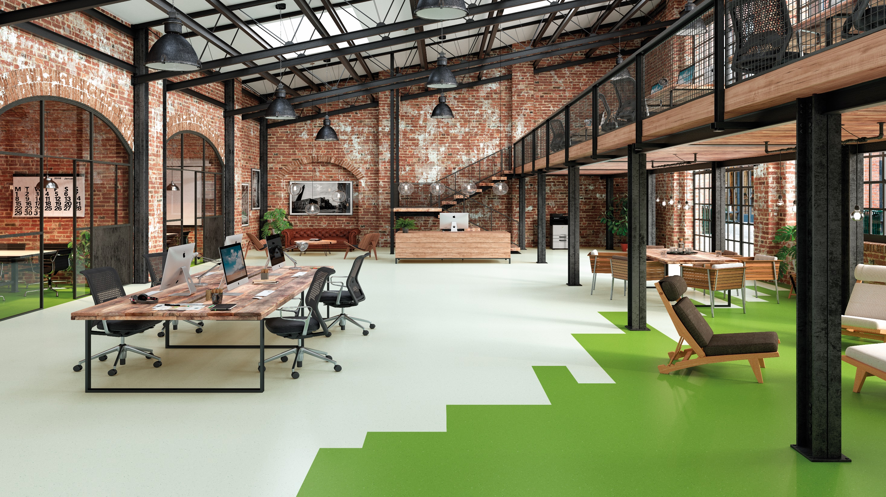
Why Vinyl?
Impervious surface
Hygienic
Flexible
Durable
Waterproof
Reduces noise and stress
Significantly reduces slips, trips and falls
Low VOC emissions ensures best indoor air quality
Ease of maintenance
Natural thermal insulator
Electro static dissipative options
Range to suit most requirements
Beautiful design versatility
Comfort
100% Recyclable
Although a vinyl installation requires very specific preparation
and installation technique, the benefits far outweigh the time and cost.
Notes:
Although a vinyl installation requires very specific preparation and installation technique, the benefits far outweigh the time and cost.

