Slide 1
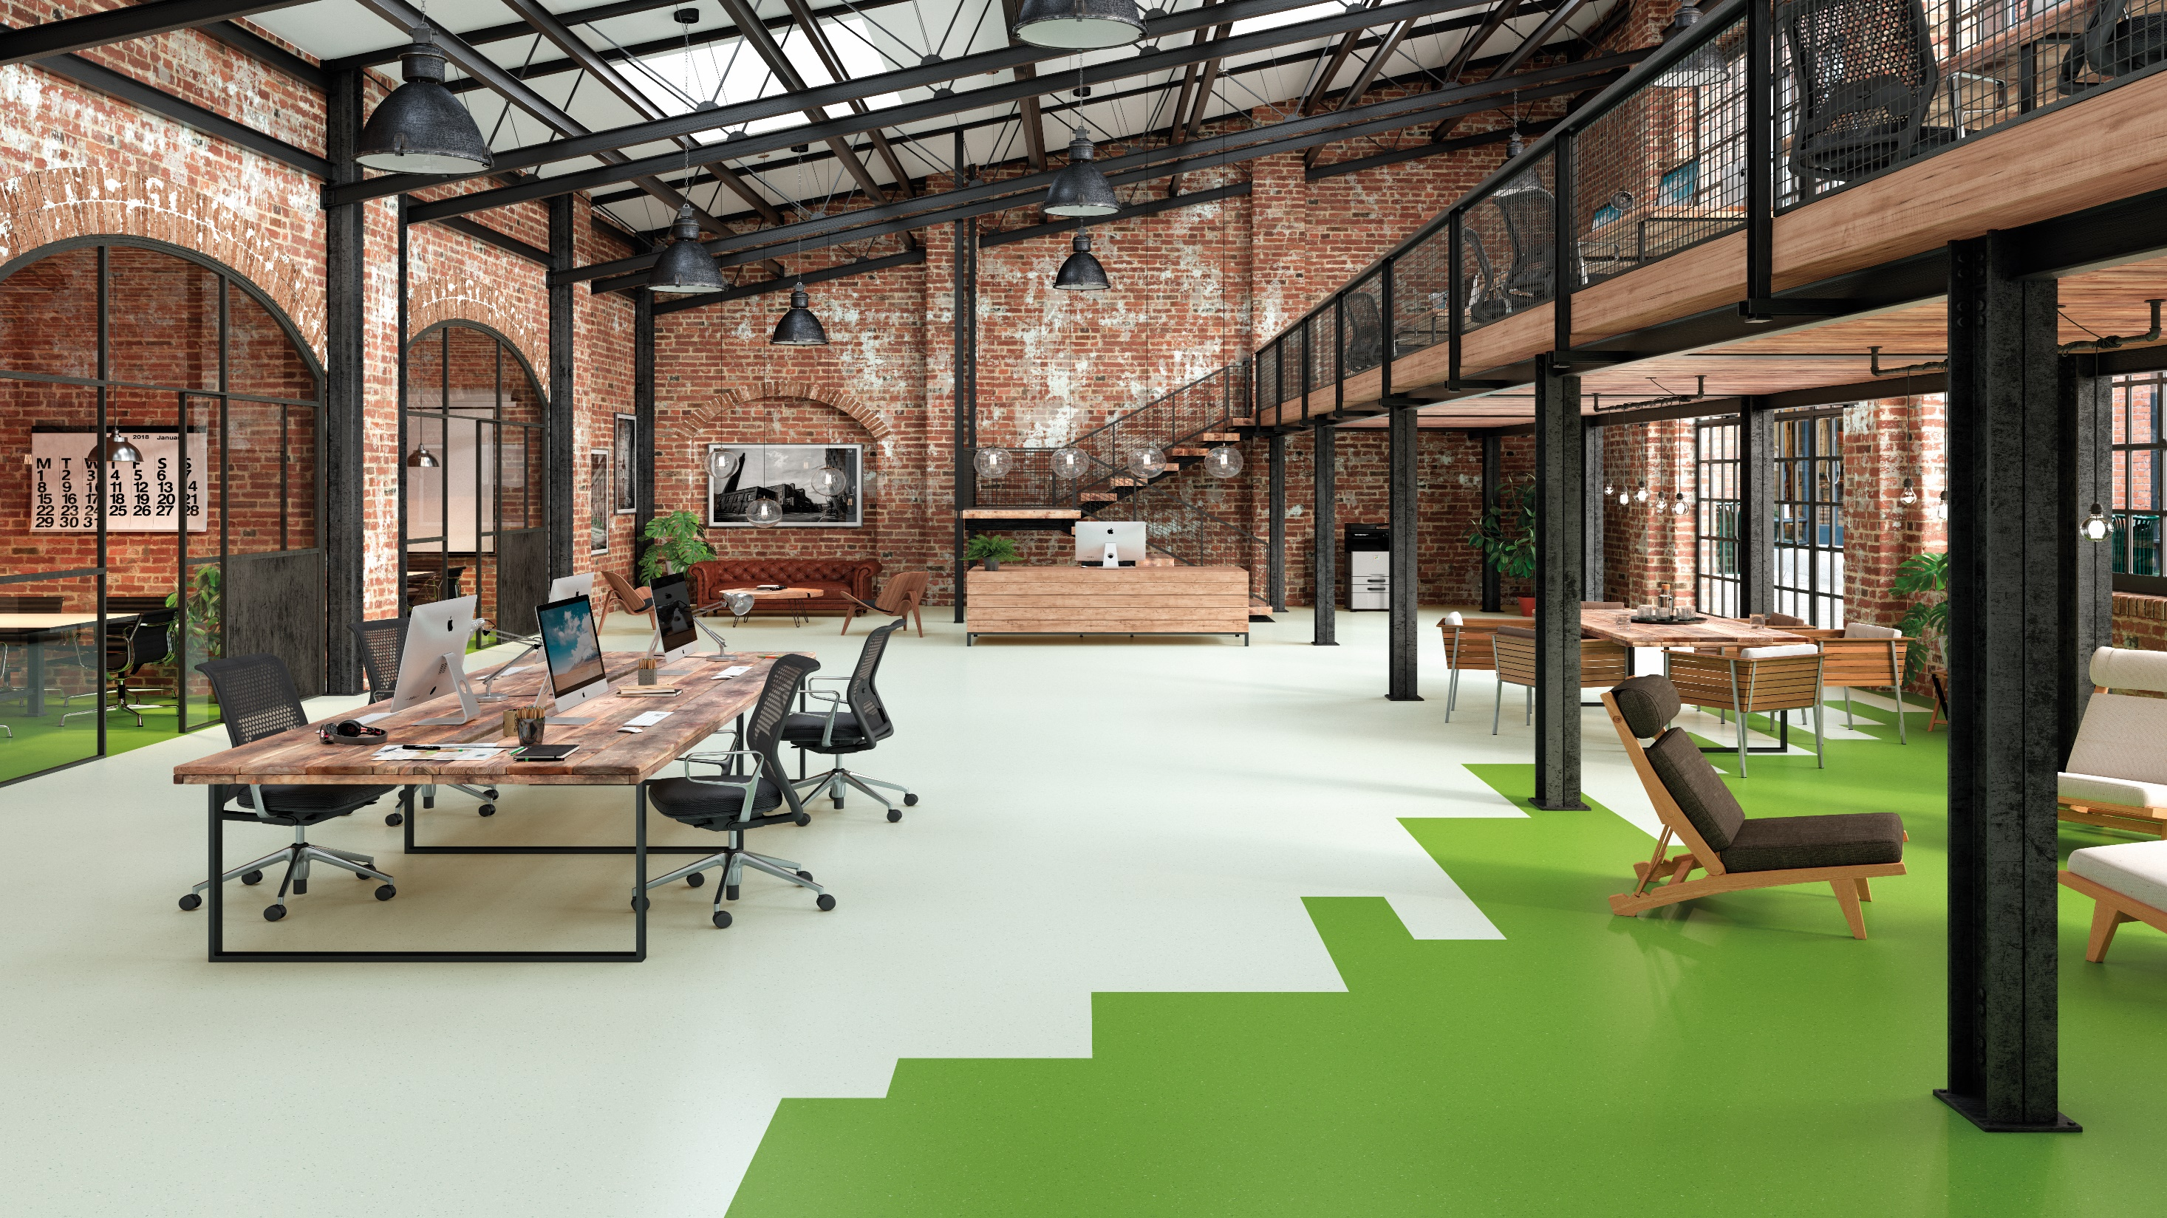
Student Village Accommodation

Slide 2
The starting point for any student accommodation is to view the area as a holistic learning space that needs to be healthy and supportive. To support learning, spaces need to be physically safe and comfortable, and students need to feel at home within a community.
Due to its water-resistant nature, durability, ease of cleaning, aesthetics, acoustic properties, slip resistance and comfort, vinyl is often the product of choice for many of student residences today.
Solutions for specialisation areas include:
Common spaces
Study areas
Bedrooms
Kitchens
Bathrooms
Lounges
Laundries
Gyms

Slide 3
Why Vinyl?
Impervious surface
Hygienic
Flexible
Durable
Waterproof
Reduces noise and stress
Significantly reduces slips, trips and falls
Low VOC emissions ensures best indoor air quality
Ease of maintenance
Natural thermal insulator
Range to suit most requirements
Beautiful design versatility
Comfort
100% Recyclable
Although a vinyl installation requires very specific preparation
and installation technique, the benefits far outweigh the time and cost.
Notes:
Although a vinyl installation requires very specific preparation and installation technique, the benefits far outweigh the time and cost.

Slide 4
Design considerations
Ability to personalise the space
Durability
Design versatility
The ability to transition seamlessly from one space to the next
Ease of maintenance
Special requirements – slip resistance, hygiene, acoustics, special needs etc.
Specifying materials with low environmental impact

Slide 5
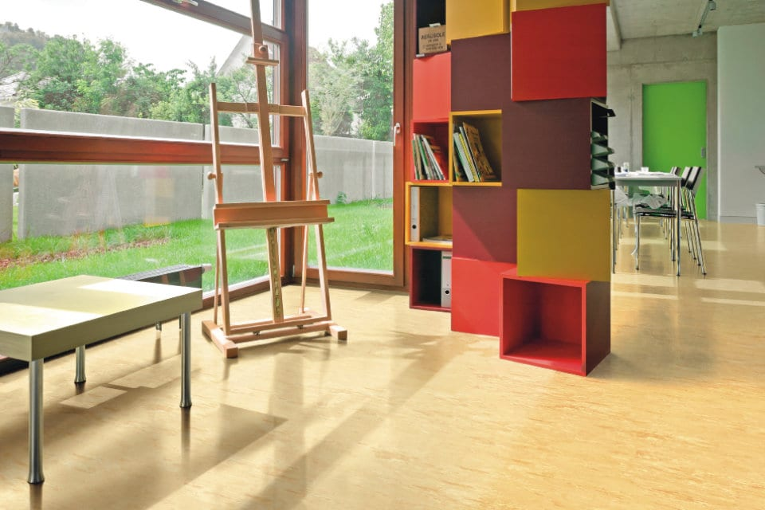
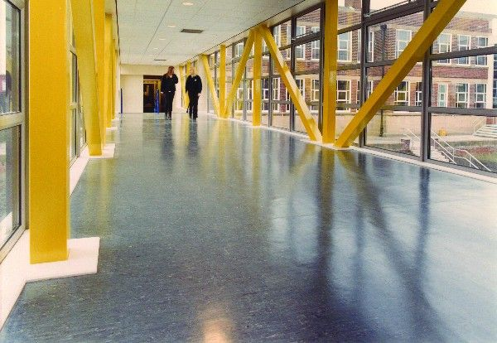
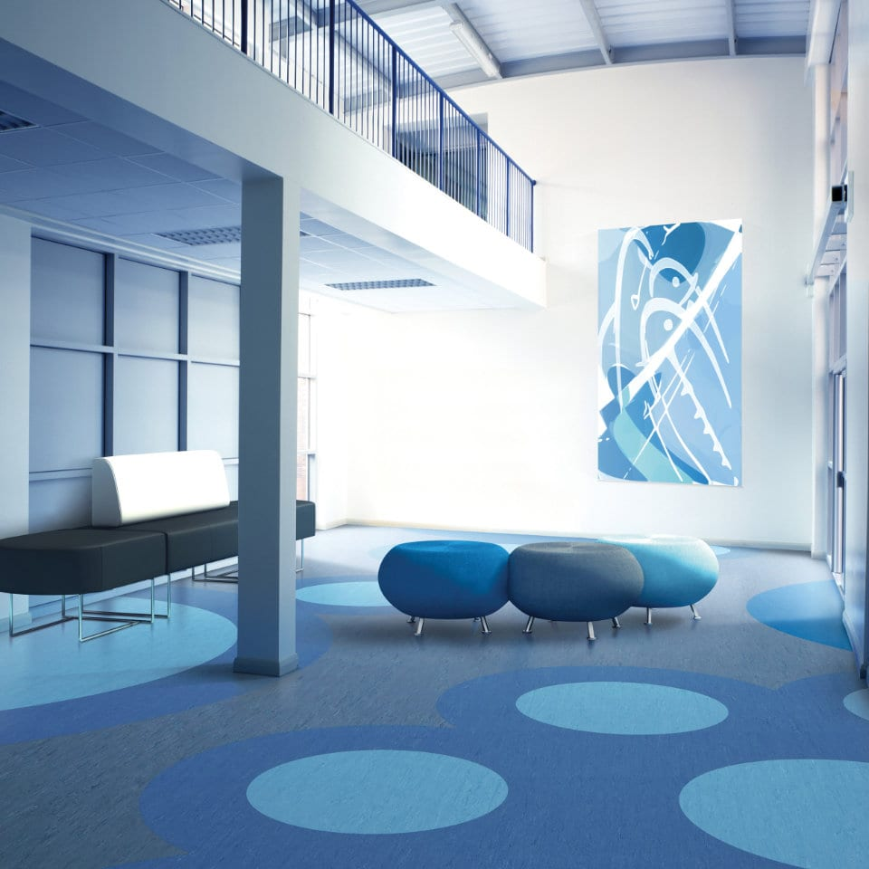
Suitable Products | Directional sheeting
XL PU & STANDARD XL (Annual maintenance required)
2000 PUR (Low maintenance)

Slide 6
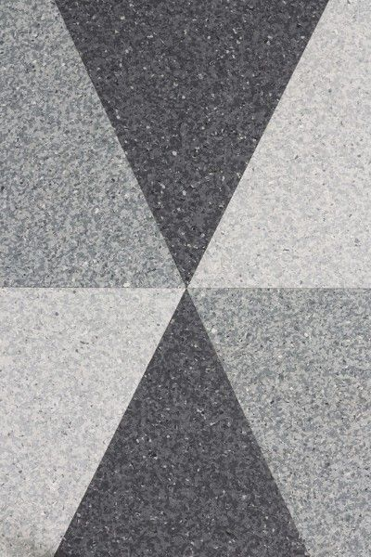
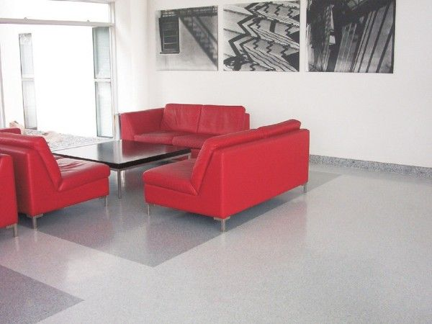
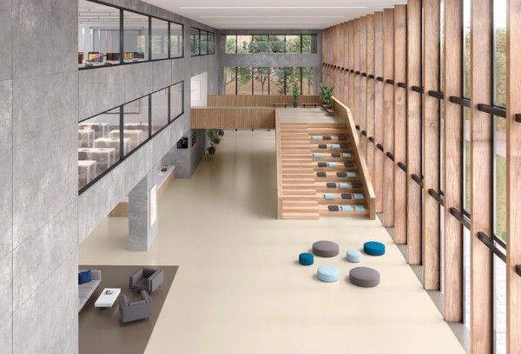
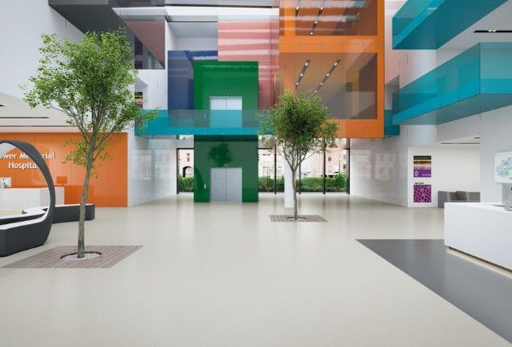
Suitable Products | Non-Directional sheeting
Classic Mystique PUR (Low maintenance)
Palettone PUR (Low maintenance)

Slide 7
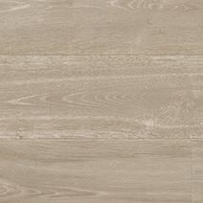
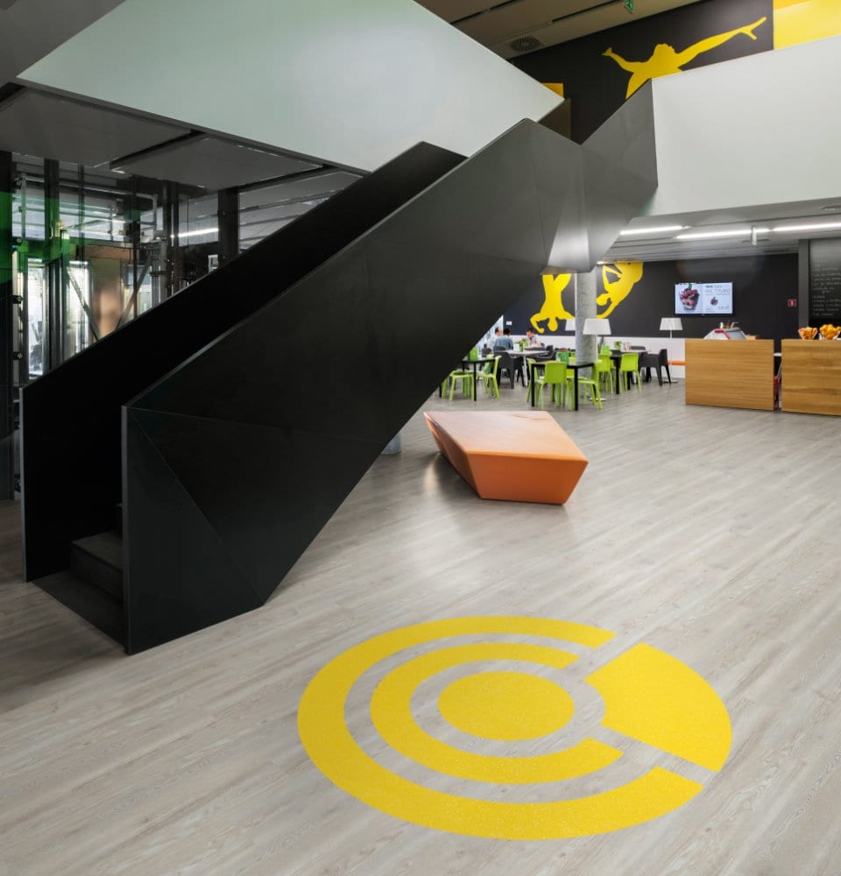
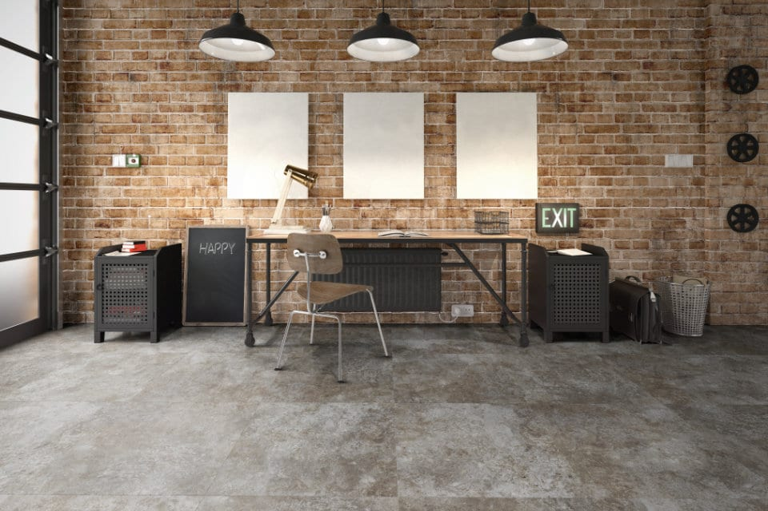
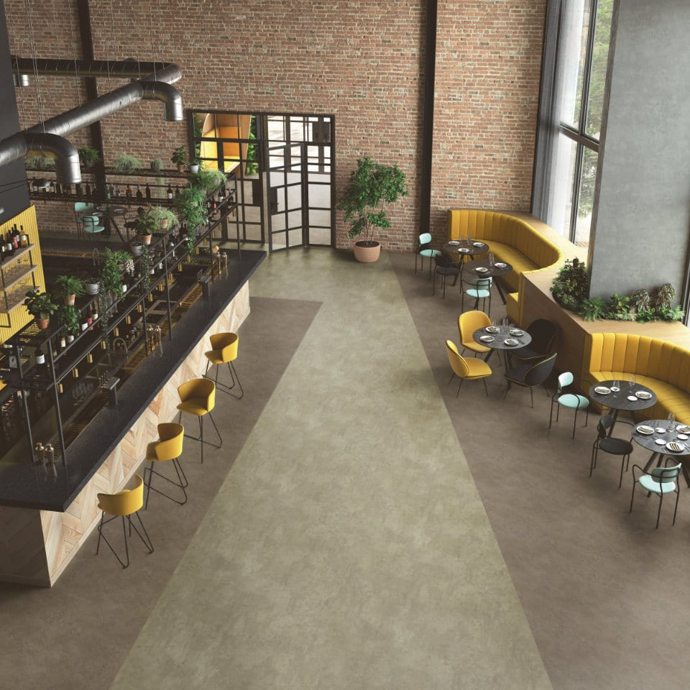
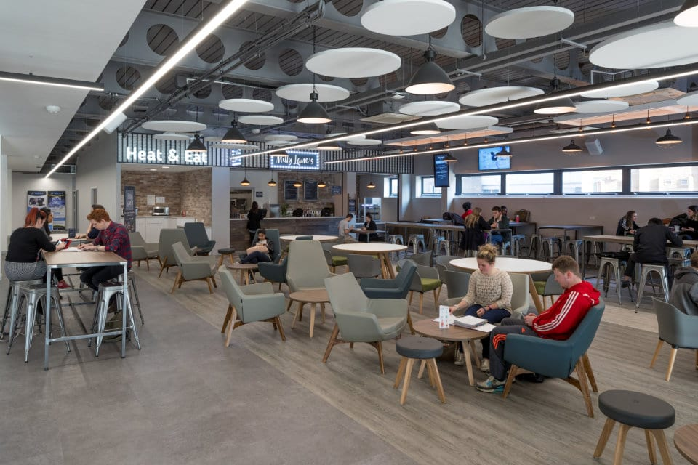
Luxury Vinyl Tiles
Tiles & Planks | Camaro PUR, Expona Commercial PUR, Affinity255 PUR
Sheet | Expona Flow PUR

Slide 8
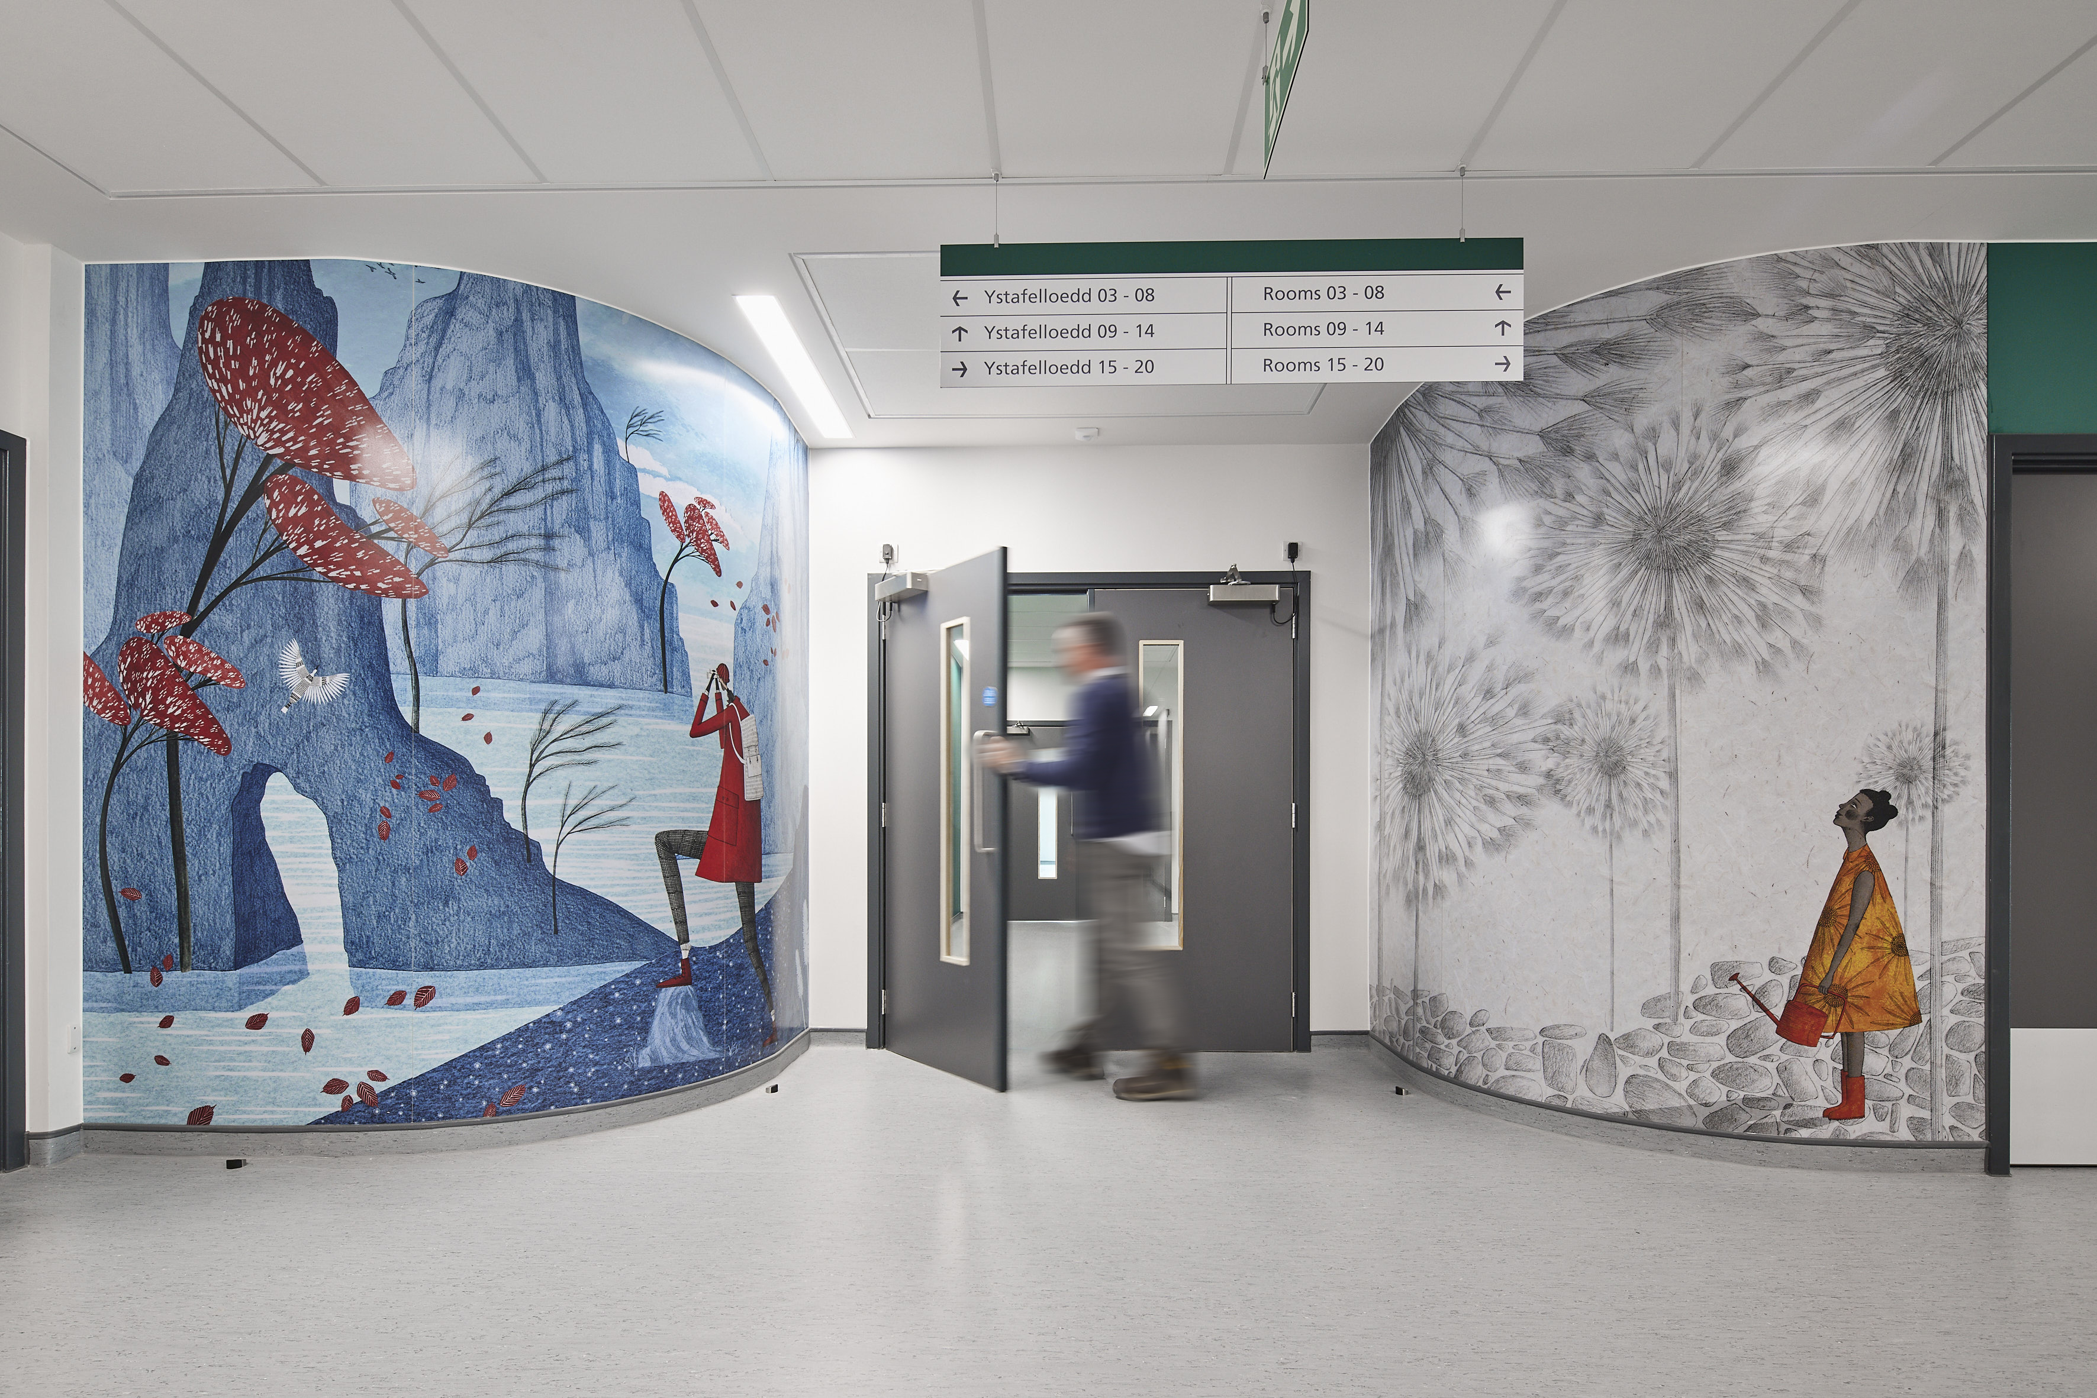
Why Wall Protection?
Reduce maintenance costs
Resistance to impact damage
Improve the overall appearance of an interior
The hygienic wall cladding system offers excellent surface protection
Easy to clean surface
Wayfinding
Notes:
- Cheaper alternative to continuous plastering and painting of walls
- Absorbs and dissipate impact from wheeled traffic –and
- Modern designed profiles contribute to the interior look
Easy to clean
Wayfinding

Slide 9
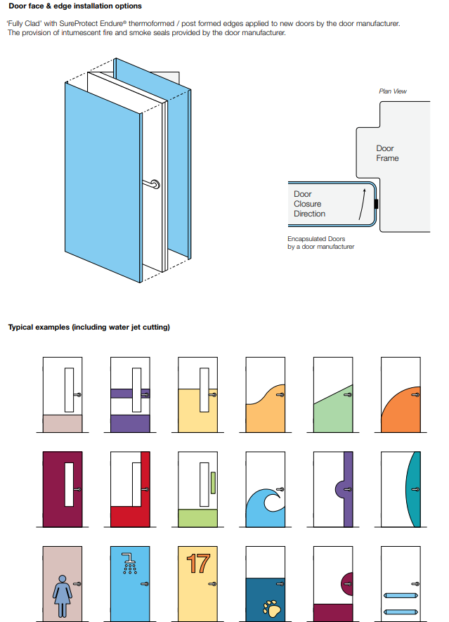
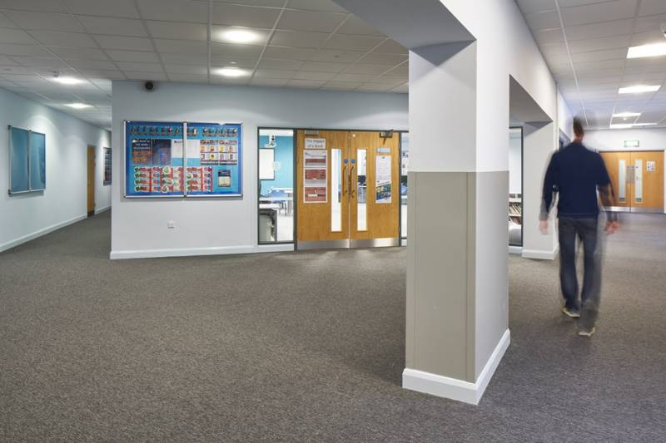
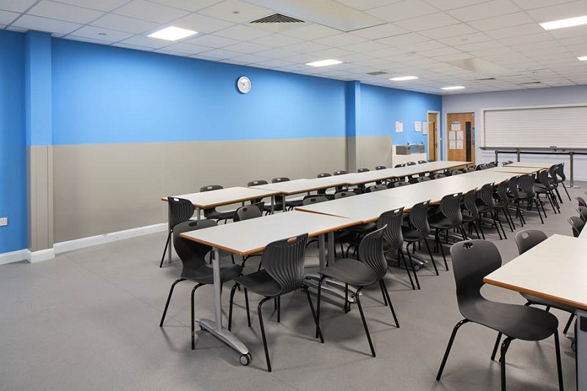
Notes:
- Cheaper alternative to continuous plastering and painting of walls
- Absorbs and dissipate impact from wheeled traffic –and
- Modern designed profiles contribute to the interior look
Easy to clean
Wayfinding

Slide 10
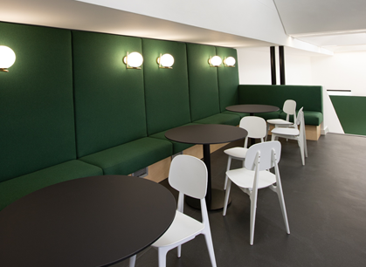
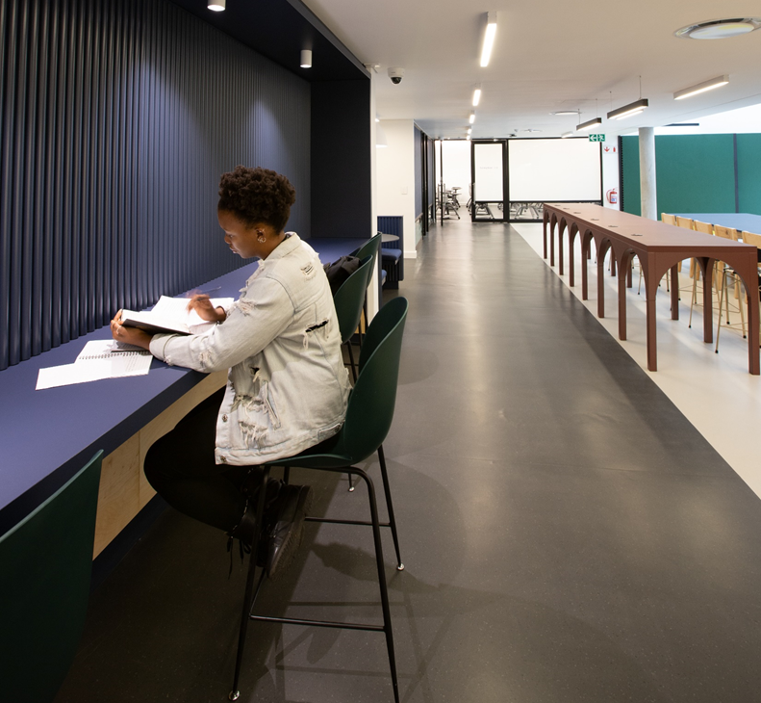
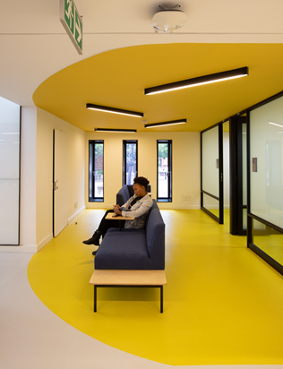
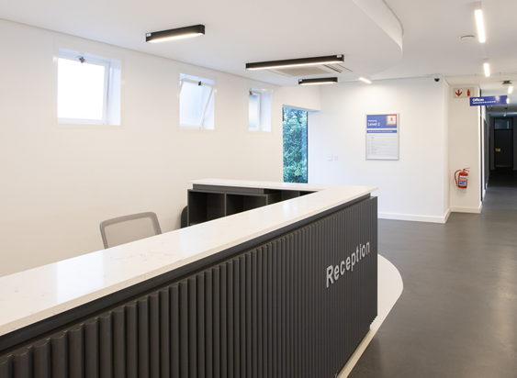
University of Pretoria Akanyang Student Residence
Products used : Silentflor PUR
Palettone PUR
Standard XL
XL PU
Architect : Two Five Five Architects

Slide 11
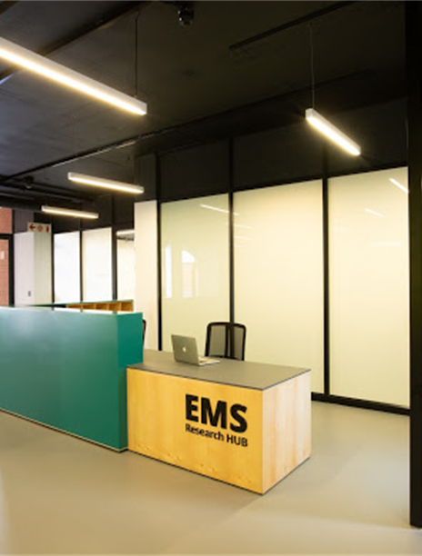
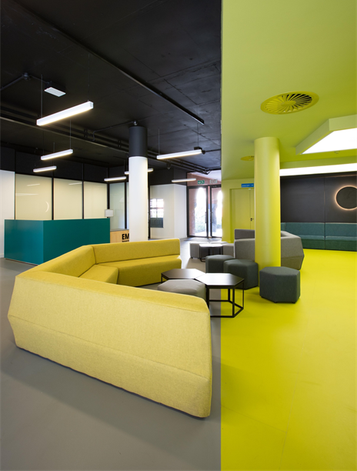
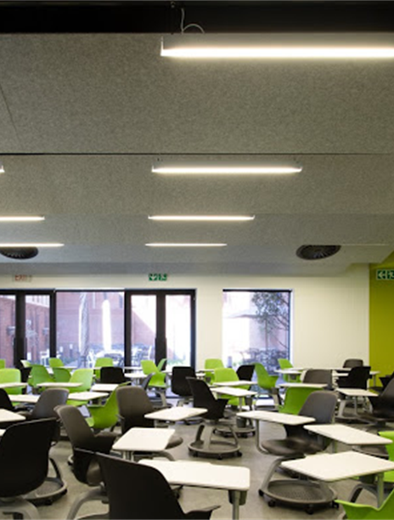
University of Pretoria EMS Research Hub
Products used : Bloc PUR
Silentflor PUR
Architect : Two Five Five Architects

Slide 12
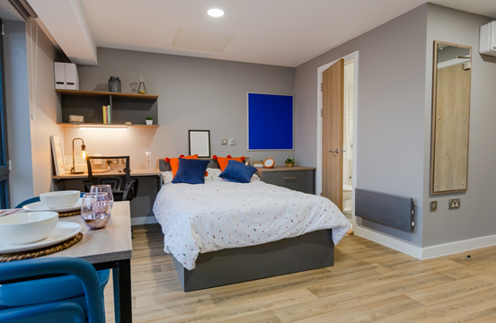
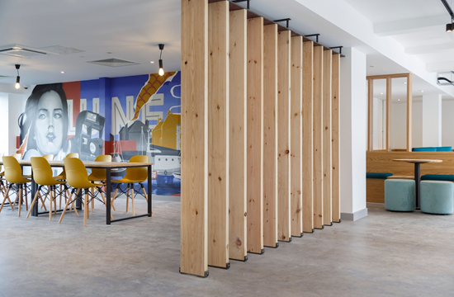
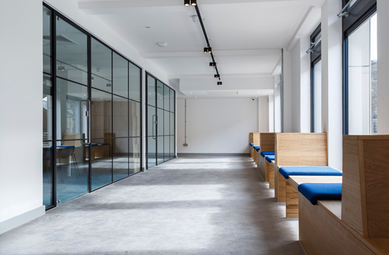
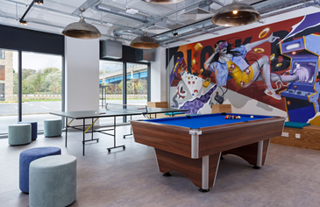
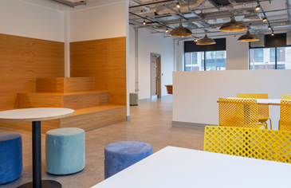
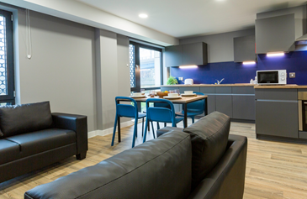
Luneside Student Accommodation
Product used : Standard PUR
Expona Flow PUR
Architect : Just H Architects
Link : https://youtu.be/4BckIg3_yY8

Slide 13
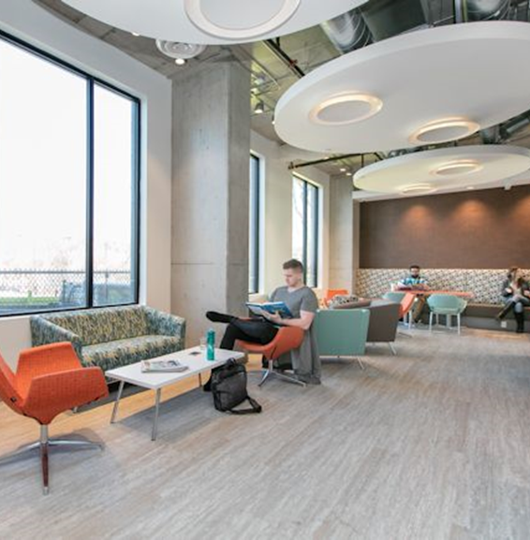
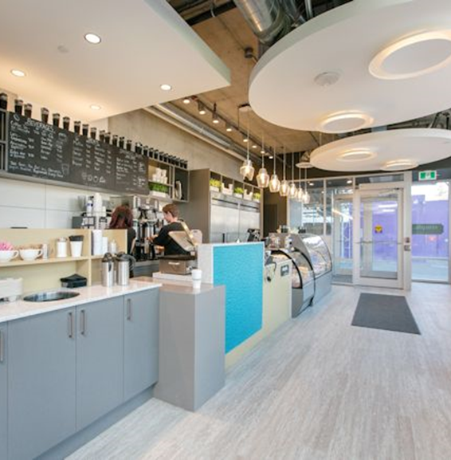
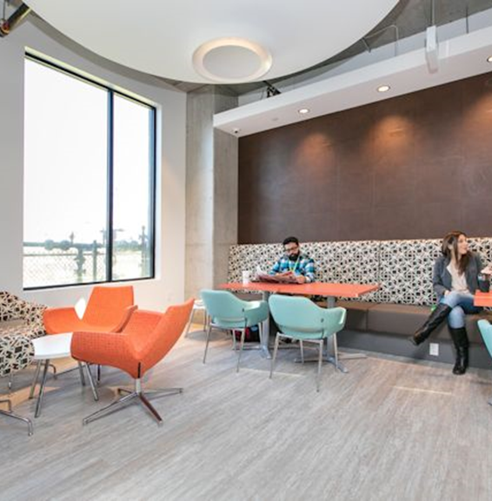
Envie Student Apartments
Product used : Expona Commercial PUR
Architect : Creative Friction

Slide 14
Subscribe to our blog
for valuable insights and advice
from our team of experts
http://info.polyflor.co.za/news

