Slide 1
Notes:
Polyflor is the leading supplier of quality vinyl flooring and wall protection solutions to the South African and African market, with particular focus on the Healthcare, Education and Commercial sectors.

Slide 2
Polyflor’s Portfolio in Higher Education

Slide 3
Higher Education List of completed projects
NWU Potchefstroom
Ferdinand Postma Library
J. Chris Coetzee Building - Lecture Rooms and Media Services
Biological Complex
Life Sciences
Biochemistry
NWU Mahikeng
New Psychosocial Health High Performance Building
Physical Science Building
Building A2 – Base Building
University of Pretoria
Javett Art Centre
Faculty of Veterinary Science Upgrade
Department of Architecture Building
Faculty of Health Sciences - The Skills Laboratory
School of Dentistry
Faculty of Economic and Management Sciences Building
School of Healthcare HW Snyman Building Upgrades
Akanyang (Huis-en-Haard) Residence
UCT
Anatomy Building
Department of Pathology – Histology Lab
Toxicology Lab
Chemical Store
Jagger Library
John Day Zoology Building - Processing Lab
Chris Barnard Building - Lab
Liesbeeck Gardens and Forest Hills Residences
Menzies Building – Engineering Lab
Computer Science Building

Slide 4
Higher Education List continued
WITS
Umthombo Building Lecture Hall
School of Geosciences
Humphrey Raikes Building School of Chemistry
Education Campus Marang Block
Geography, Archaeology and Environmental Studies Laboratory
Medical School
Oppenheimer Life Sciences Building
Library
School of Physics Building
Solomon Mahlangu House West Wing
Central Animal Services Upgrades
Stellenbosch
Tygerberg Campus
J C Smuts Building
Van Der Stel Sports Stadium
Department of Mechanical and Mechatronic Engineering
Revamp Electrical and Electronic Engineering Building
Revamp Industrial Engineering Department
Jan Mouton Learning Centre
Mike De Vries Building - Lab
Engineering Building
UFS
Thakaneng Bridge
Equitas Building Visual Media Hub
Annex
Department of Architecture Building
B1 Labs
Faculty of Natural and Agricultural Sciences
Mabaleng Building Renovations
Sensory Lab
Chemistry Building
George du Toit Administration Building
Flippie Groenewoud Building
Examination Rooms Building
Natural Sciences Boardroom
Muller Potgieter Building

Slide 5
Higher Education List continued
UKZN
Caprisa Laboratory
Westville Campus – Lecture Halls
Nelson Mandela University, Port Elizabeth
School of Engineering
Ocean Sciences Campus
Other institutions:
CUT – Free State Campus
CUT –Welkom Campus Cafeteria
TUT - PTA Campus Renovations
CPUT - Wellington Agricultural Campus
DUT – Laboratories
DUT - Music Department
MUT - Student Accommodation, Lecture Hall
FET College Daveyton
FET College Nkandla
FET College Lovedale
TVET College Tshwane South
TVET College KSD Libode – Hall and additions
TVET College Esayi
TVET College Northern Cape Urban
TVET College KwaNongoma
TVET College Flavius Mareka
Sol Plaatje University – Administration Block
Mpumalanga University – Laboratories, Library, Halls, Lecture Rooms
University of Johannesburg – APK Library
University of Port Elizabeth
Rhodes University
Walter Sisulu University
University Of Polokwane
University of Namibia - School of Medicine (PH3)
East London Student Collaboratory - Library
Port Elizabeth EMS College
Port Elizabeth Lilitha College of Nursing
Stellenbosch College

Slide 6
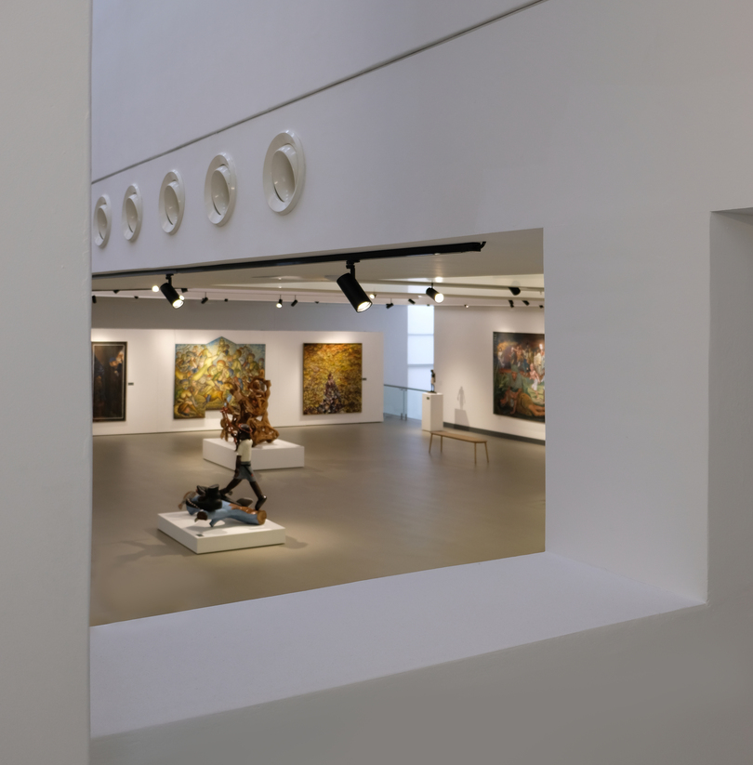
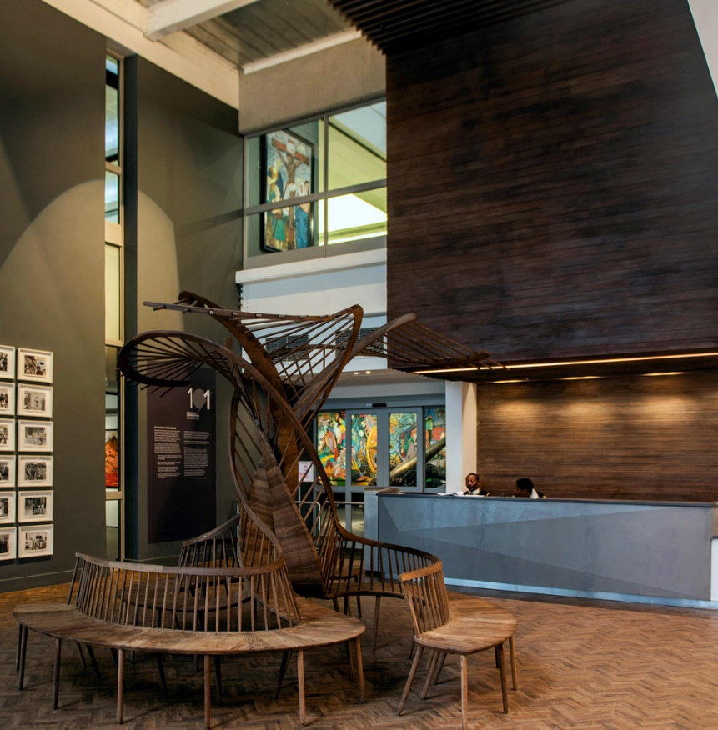
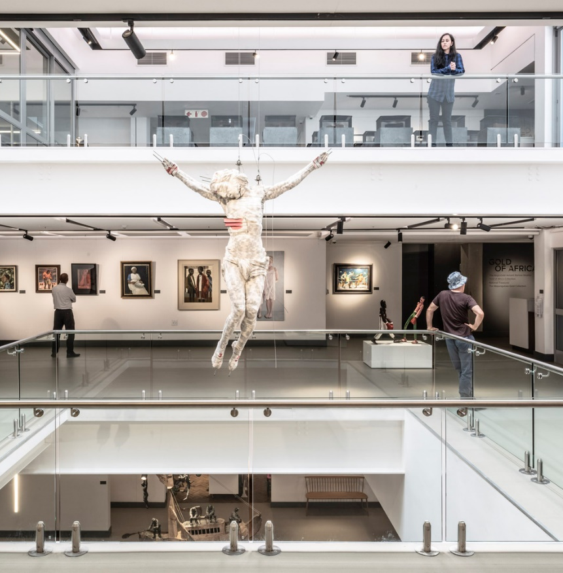
University of Pretoria Javett Art Centre
Product used : Polyflor Expona Flow PUR
Polyflor Camaro PUR
Polyflor Silentflor PUR
Architect : Mathews + Associates Architects

Slide 7
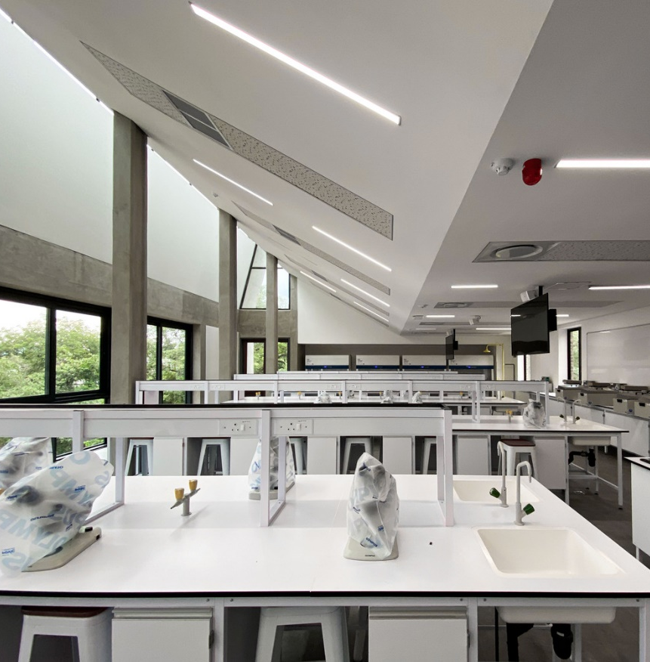
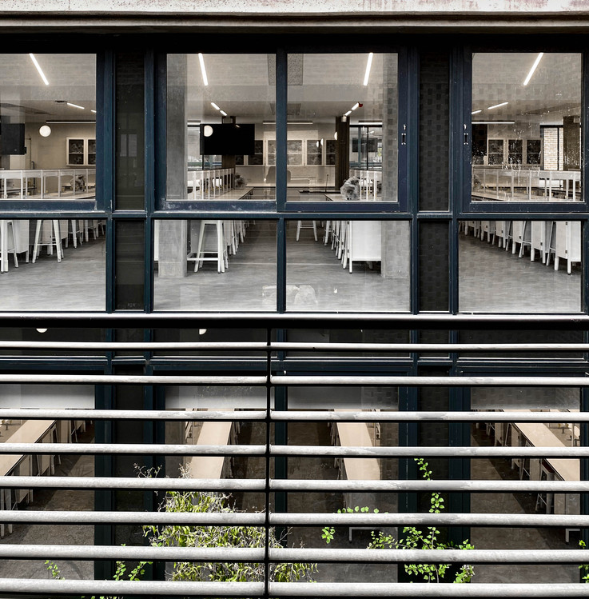
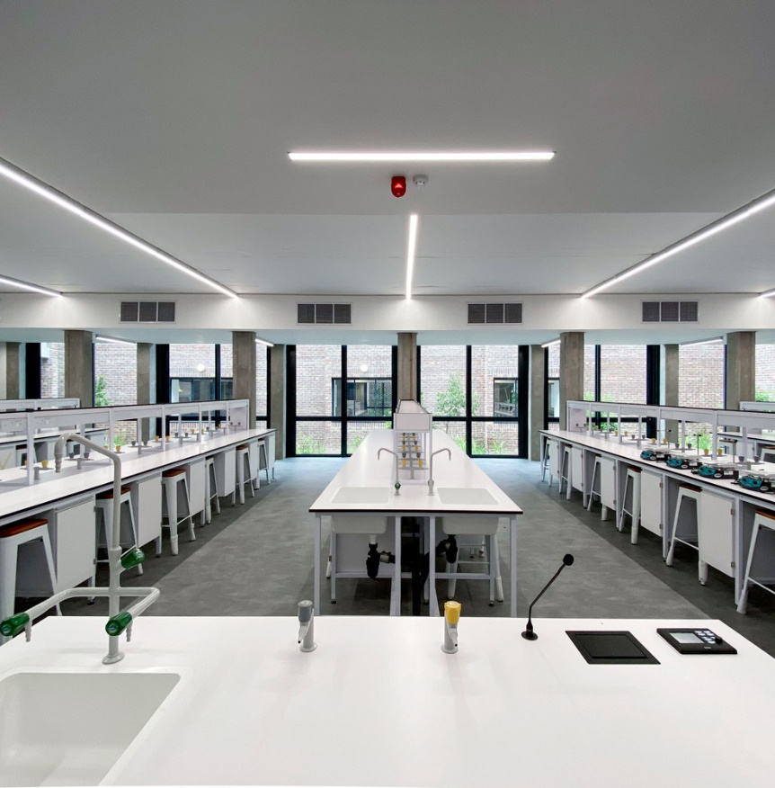
University of Mpumalanga Science Research Facility
Product used : Polyflor Silentflor PUR
Architect : Ludwig Hansen Architects + Urban Designers
Specifying architect : Gunther Wagner

Slide 8
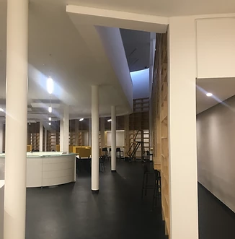
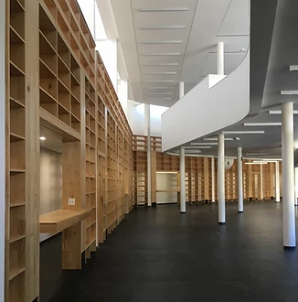
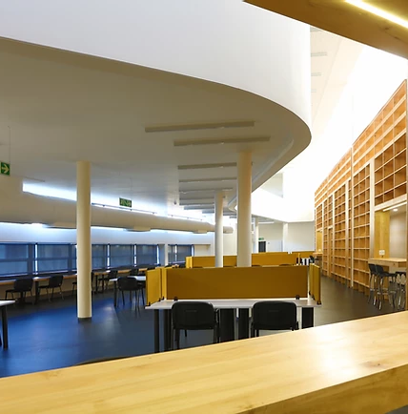
University of Mpumalanga Library
Product used : Ecore Rubber
Architect : Cohen and Garsen Architects
Specifying architect : Nina Cohen

Slide 9
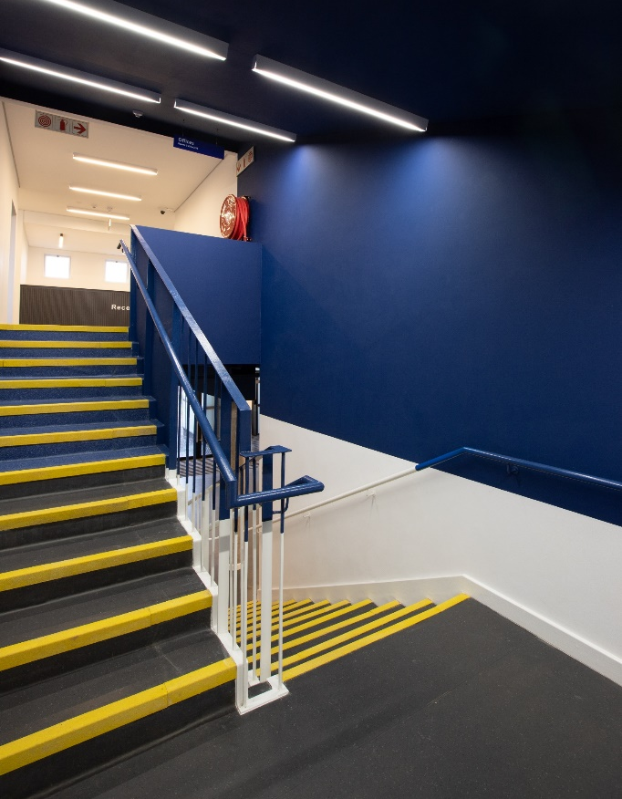
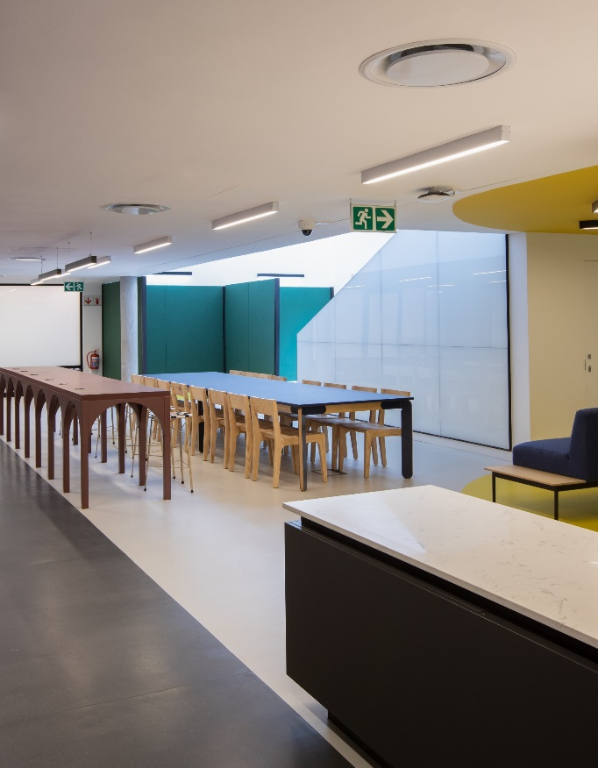
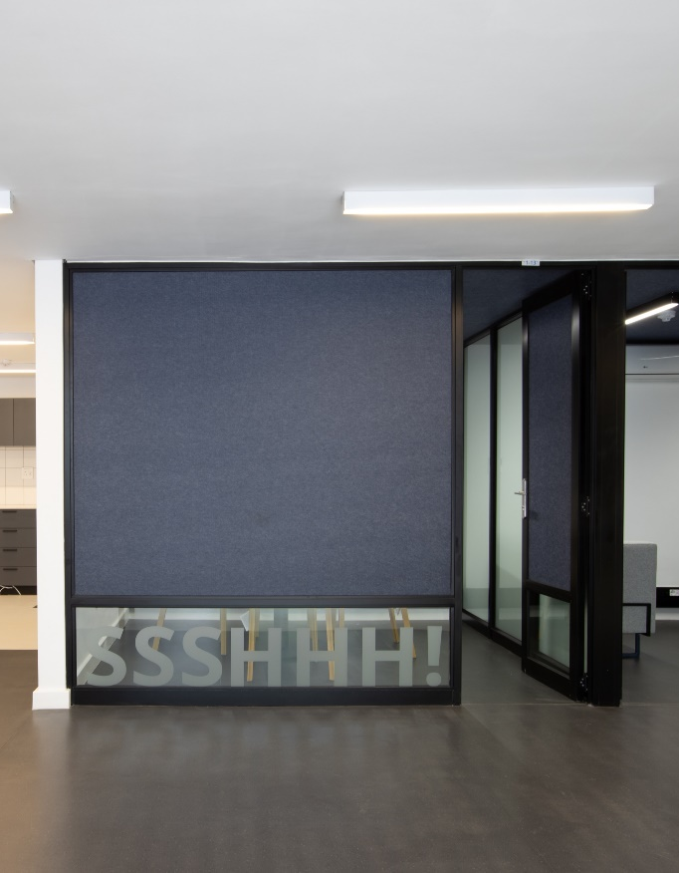
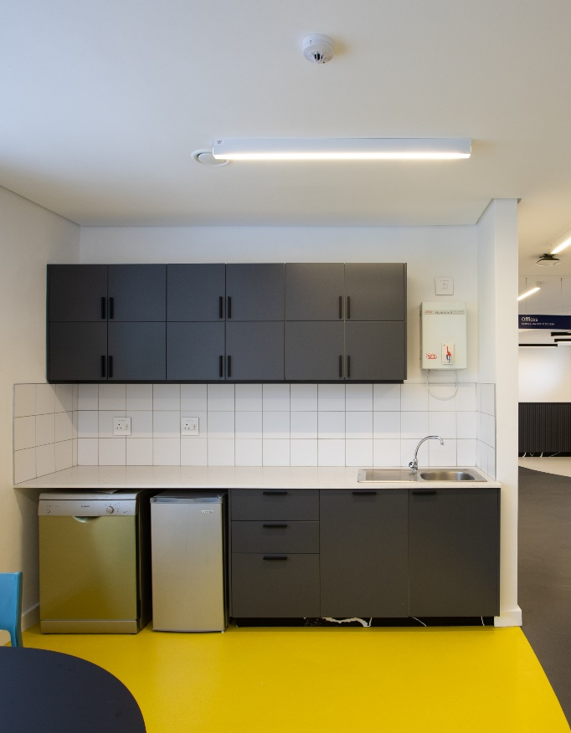
University of Pretoria Akanyang Residence
Product used : Polyflor Silentflor PUR
Polyflor Palletone PUR
Polyflor ESD Flooring
Architect : Two Five Five Architects
Specifying architect : Andre Krige

Slide 10
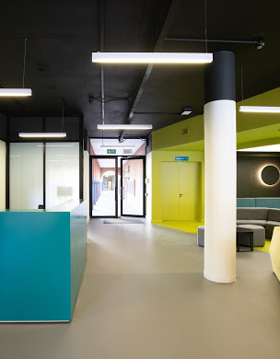
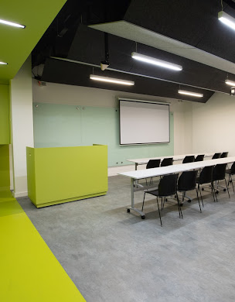
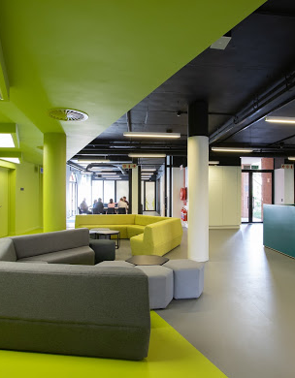
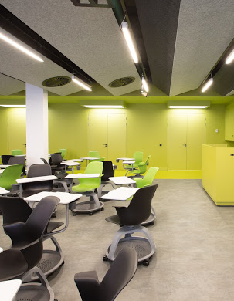
University of Pretoria Faculty of Economic and Management Sciences
Product used : Polyflor Silentflor PUR
Polyflor Bloc PUR
Architect : Two Five Five Architects
Specifying architect : Andre Krige

