Slide 1
POLYFLOR PUR Cleaning Regime
DAILY/WEEKLY/MONTHLY CLEAN
EQUIPMENT | METHOD
Rotary floor machine 160rpm – periodic deep clean Burnisher 1000 + rpm - weekly Wet & Dry Vacuum V-Sweeper Dry dusting lamella tool with Quik-Stik disposable cloths 3M Clean & Shine Pad 3M Pink Eraser Pad Scrub XS chemical Filmop sprinter spot mopping tool Filmop Twice Bucket flat mopping system Entrance matting *Entrance Matting recommended for all Entrances – to be measured per site* Trapping dirt before it enters the building will ensure that you get the maximum life out of the Polyflor PUR floors and will ultimately reduce the cleaning required. | INITIAL (Post laying of floor) All adhesive to be removed Dry vacuum or mop sweep Rotary machine floor scrub Microfibre damp mop with Scrub XS where necessary DAILY Sweep using the V-Sweeper 3 x daily to remove dust and debris Sweep high traffic areas with the lamella tool and quik-stik disposable cloths as much as possible Spot mop high traffic areas with Filmop Sprinter unit with plain water – use diluted Scrub XS if necessary for stubborn marks (rinse well) WEEKLY Wash floor with Filmop Twice bucket system and diluted Scrub XS (250ml-10L). Rinse floor with plain water Assess whether rotary machine and 3M Clean & Shine pad should be used in high traffic areas Dry buff with burnishing unit and 3M Pink Eraser pad to remove black scuff marks MONTHLY/PERIODIC DEEP CLEAN Scrub floor with rotary machine and 3M Clean & Shine pad with diluted Scrub XS (250ml-10L). Vacuum solution up with Wet & Dry vac. Rinse with plain water to remove chemical residue

Slide 2
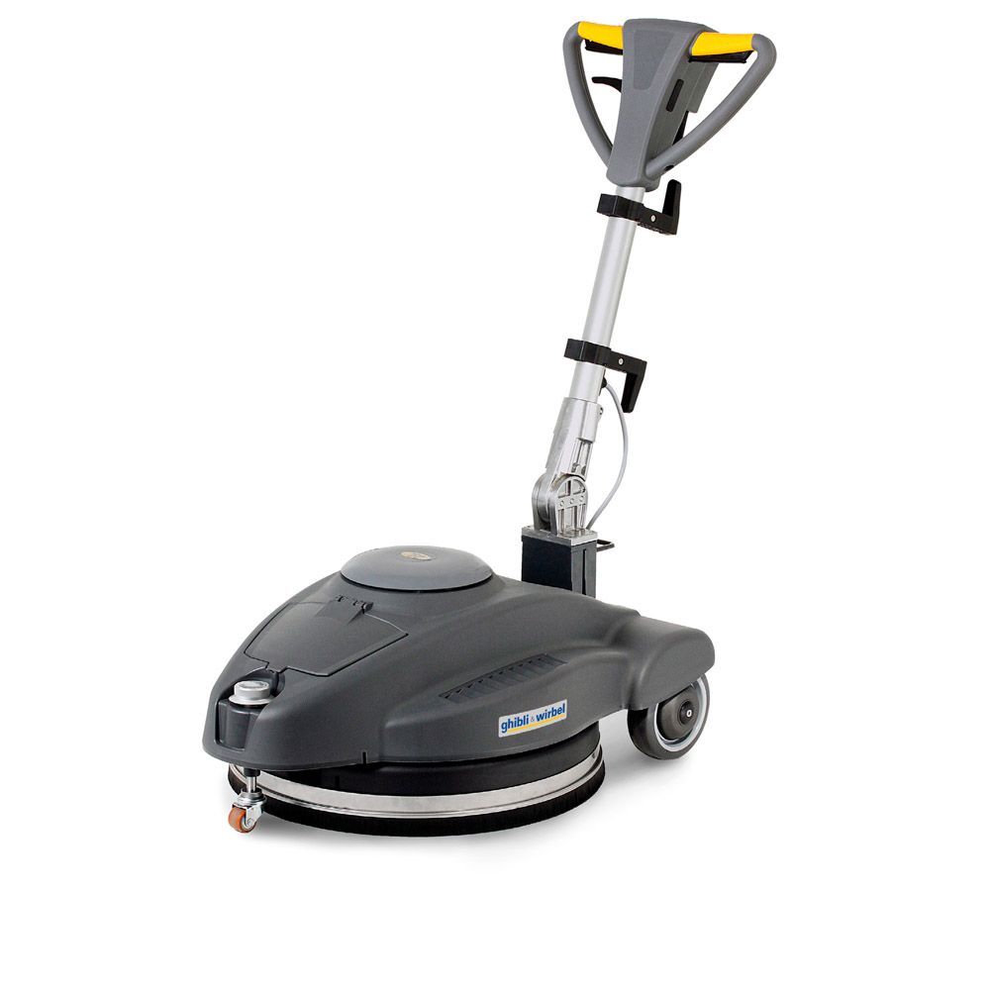
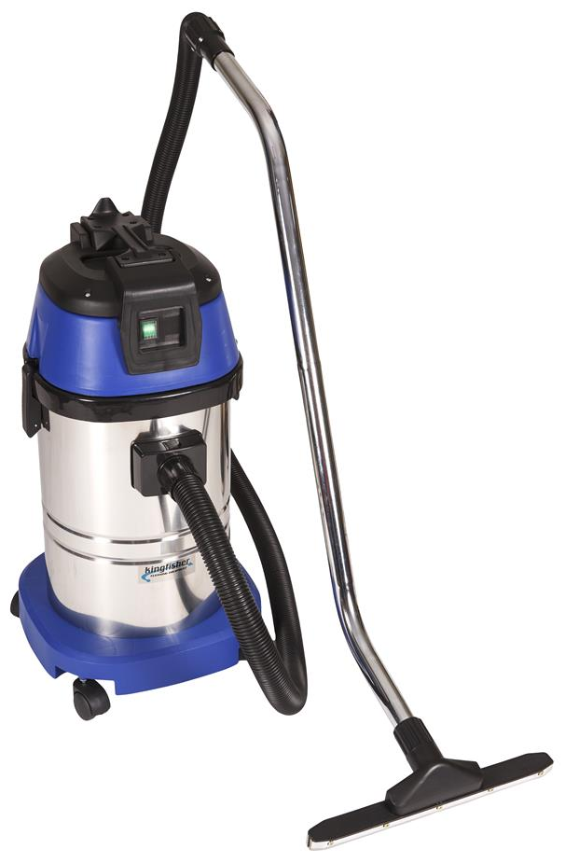
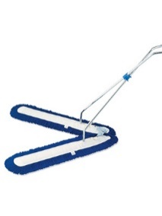
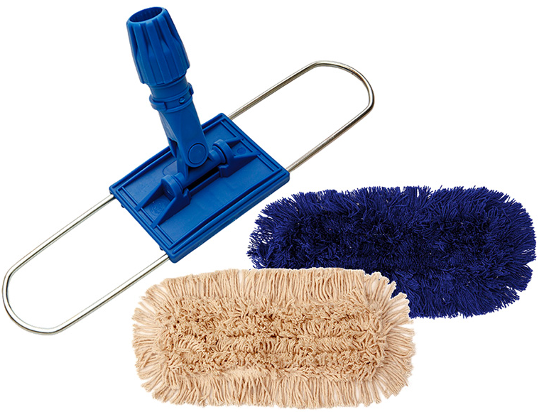
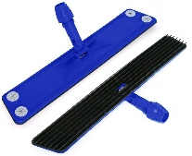
HOMOGENEOUS PUR Cleaning Methodology
 | PRODUCT | DESCRIPTION
 | SINGLE DISC ROTARY UNIT | Low speed rotary machine with pad drive - 165rpm
 | BURNISHER | Burnishing machine with interlock - 1300rpm
 | WET & DRY VACUUM | Stainless steel wet & dry vacuum 30L minimum, single motor
 | V-SWEEPER OR DUST MOP SWEEPER | V-Sweeper for large area sweeping, up to 1.9m width. Dust mop sweeper 80cm minimum. Acrylic sleeves – attracts dust through static
 | LAMELLA TOOL | Fine dry dusting tool with tactile sleeves for fine dust collection – high traffic zones

Slide 3
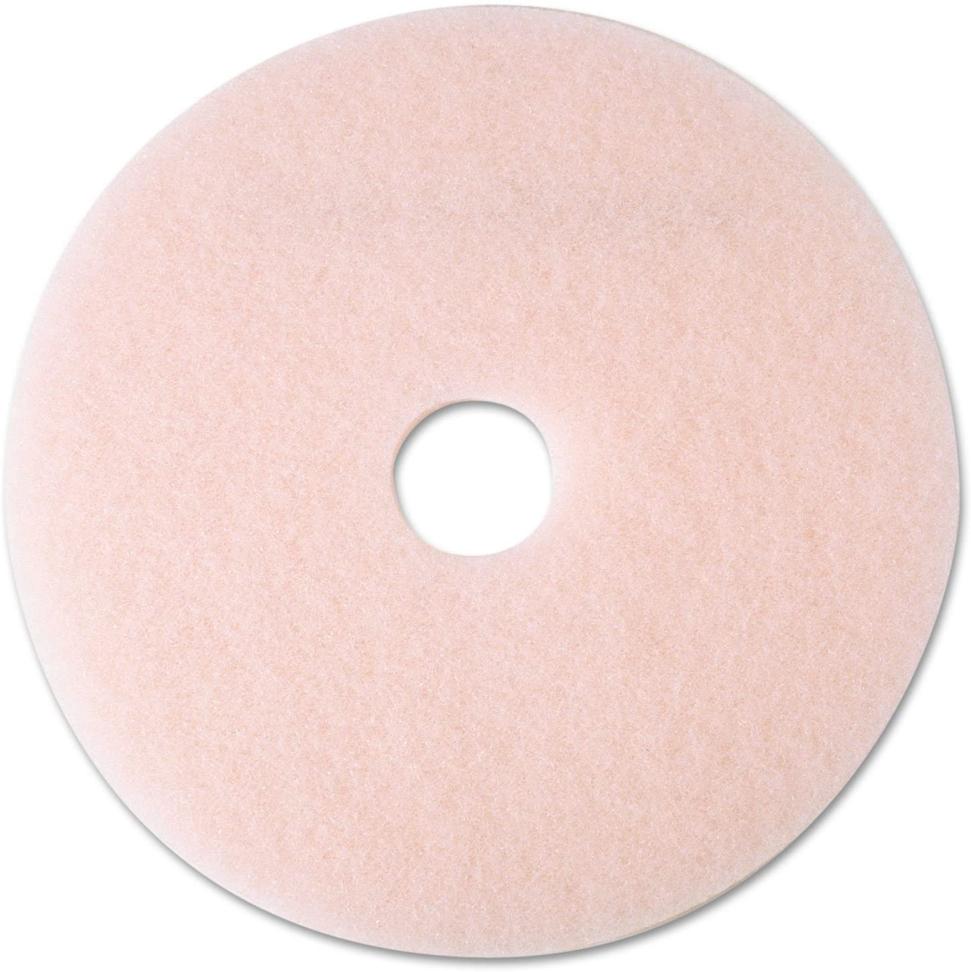
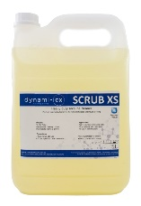
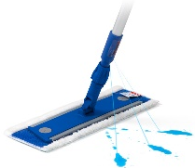
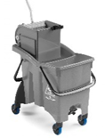
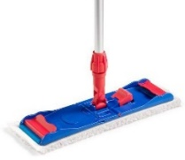
HOMOGENEOUS PUR Cleaning Methodology
 | PRODUCT | DESCRIPTION
 | 3M CLEAN & SHINE PAD 425mm 3M PINK BURNISHER PAD 500mm | Clean & shine – high performance pad for cleaning and sheen maintenance Pink burnisher pad – removes black marks
 | SCRUB XS | High performance cleaner to remove stubborn soiling and stains
 | FILMOP SPOT MOPPING TOOL | Damp microfiber spot mopping unit for high traffic areas to remove light soiling and dust
 | FILMOP TWICE BUCKET | Heavy duty large area damp microfiber mopping trolley with separate clean/dirty water
 | MICROFIBRE BREAK MOP TOOL | Microfibre mopping tool with middle break mechanism for use with Filmop Twice Bucket

