Slide 1
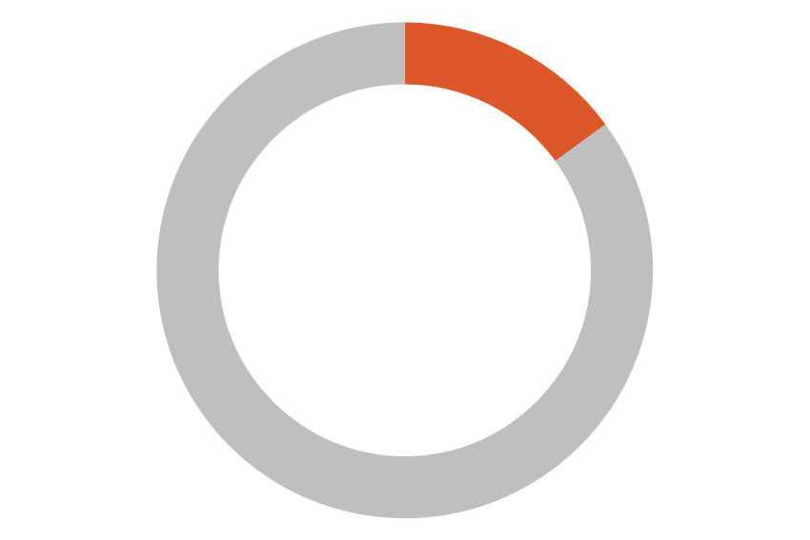
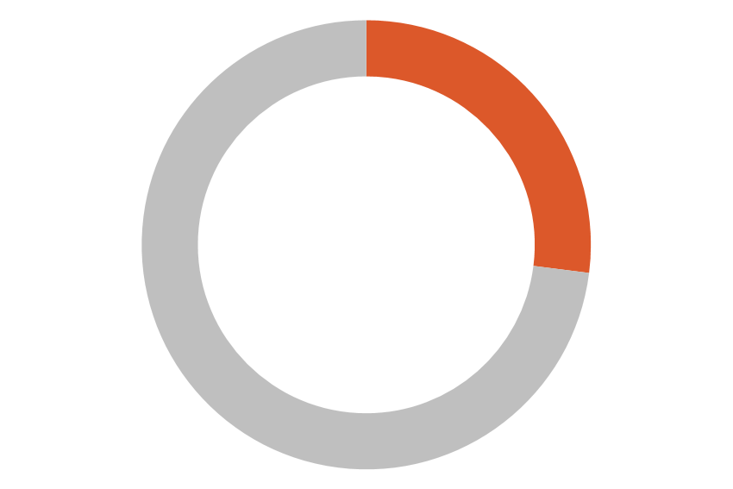
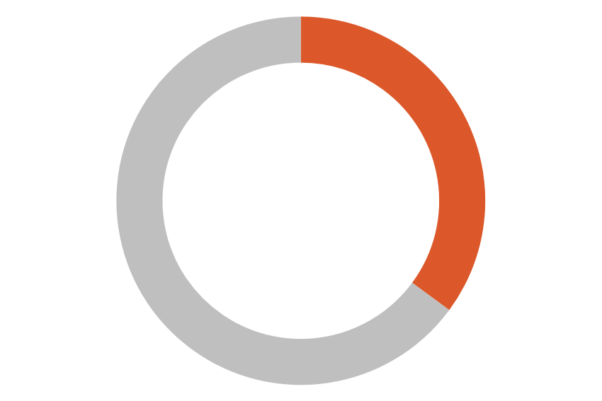
[YOUR COMPANY NAME HERE]
When Mental Health is a Family Affair
As emerging research suggests the pandemic will have a lasting impact on the mental wellbeing of young people, and we know you may be struggling with more than your own personal resilience.
Emerging research suggests the COVID-19 pandemic will have a lasting impact on the mental wellbeing of young people. Uncertainty about the duration of the pandemic, concerns about vulnerability to infection, continued physical distancing measures, and social and economic upheaval is driving increased anxiety and emotional stress for children and young adults. The research shows particular increases in clinginess, irritability, and fear in younger children—along with depression, anxiety, suicidal thoughts, and substance use in adolescents.
UNICEF REPORT: COVID-19 AFFECT ON YOUTH
15%
27%
46%
Reported anxiety in the last seven days
Reported depression in the last 7 days
Reported less motivation to do activities they enjoyed
73% have felt the need to ask for help concerning their physical and mental well-being. Despite this, 40% did not ask for help.
43% young females feel pessimistic about the future
31% young males feel pessimistic about the future
Source: https://www.unicef.org/lac/en/impact-covid-19-mental-health-adolescents-and-youth
A Closer Look at the Mental Health of Youth & Adolescents
The breadth of the emotional impact of COVID-19 and its various effects spans geographies, ethnicities, and social status. Parents, teachers, and professionals across the country report the following observations and concerns:
Isolation Is Damaging. Youth are experiencing prolonged social isolation and various traumas associated with not being in school. While students would typically spend 30+ hours each week interacting with peers in-person, many kids now spend all of that time physically alone.
Loneliness Is a Major Concern. Prior to COVID-19, 75% of school aged children took part in a sport, club, or other activity—many of which have been suspended. This means children are missing opportunities for social connections and exercise.
Safe Spaces Are Diminished. School, along with friends’ houses, previously afforded some youth time in safer places. Issues are compounded for children who live in unsafe environments—as they are now isolated within these conditions.
Poverty Presents Challenges. Before the pandemic, 20 million students received free or reduced-price lunches—and access has been disrupted for many. Poverty and the challenges related to unemployed parents and caregivers have increased the prevalence of both hunger and homelessness. ¹

Slide 2
A Closer Look at the Mental Health of Youth & Adolescents Continued:
Access to Services Are Impaired. 6.3 million children across 10,600 public schools access support resources through school-based health clinics, many of which have now been closed in order to contain the disease. Health, community, and social services access is now impaired by limited time at school.¹
It is More Than COVID-19. Since the start of the pandemic, many youth are experiencing additional traumas that compound their stress and anxiety— including racism and natural disasters like wildfires.
Support for Your Family
The past year highlighted the need for increased focus on the well-being of you and your family, including the physical, financial, and emotional well-being. Here are resources available through our benefits program to help you navigate mental health in a family setting.
Try Virtual Care Options. Our health plan offers $X virtual visits through [provider]. Use this virtual service for [include common uses such as: cold and flu, prescription refills, allergies, headaches, skin conditions, men's health, women's health, and more]. Start now at [website] or [mobile app].
Use Our Employee Assistance Program (EAP). Our EAP can offer meaningful support to employees concerned for the emotional wellbeing of their children. These confidential and no-cost opportunities to be connected with mental health professionals, helpful resources in the community, and more can be a lifeline for a struggling parent. Learn more at [website or phone number].
Mental Health & Substance Abuse Coverage. Beyond the free or reduced-cost services provided by our EAP, your benefits plan also includes behavioral health treatment like psychotherapy and counseling, mental health inpatient services, and treatment for substance use disorder. Learn more at [website/phone number].
Time Off & Flexible Working Arrangements. During COVID, we launched [remote work/flexible schedules, etc.] to keep workers safer and provide flexibility. However, as the line between work and life at home has blurred, it is important to seek work/life balance, including time away. Please talk to your manager or HR if you need time to cope with family issues.
Internal Networking Groups. [List any new or existing internal networking groups. See the following as an example] Next month we are launching a Parents Groups that will meet monthly to provide an additional forum for you to connect with one another, share ideas, and receive peer-to-peer support— and help feel more connected to each other.
Additional Resources. In addition to our plans and programs, there are national resources that can provide just-in-time, critical support. Call the 24/7 National Suicide Prevention Lifeline (1-800-273-8255) or text the Crisis Text Line (741741) if you or someone you know needs support.
https://www.kff.org/coronavirus-covid-19/issue-brief/childrens-health-and-well-being-during-the-coronavirus-pandemic/

Slide 3
Tips for Families
There are several actions parents and other family members can take when dealing with the emotional impact of the pandemic on youth:
Be present and available to the child. Acknowledge and validate their concerns and challenges, and offer support.
Appreciate young peoples’ ability to ask for help. Refer individuals in need to local or virtual resources if they express concern to you. Help them find pediatricians, therapists, and EAP counselors.
Consider alternative treatments. There are many treatment options, such as meditation apps and on-line therapy grounded in evidenced-based guidelines. Examples include Talkspace, BetterHelp, and Calm. (The notOK app was created by teenagers to help people when they are feeling vulnerable.)
Look for warning signs. Increased irritability, sudden changes in behavior or appearance, and comments such as “I’m a burden” or “I’m creating stress for this family” should not be ignored.
Lean on your village. Parents and doctors should work closely with everyone involved in the child’s treatment—teachers, coaches, therapists, and other family members, as appropriate.
There is Reason to be Optimistic
While the research can be concerning, we know that childhood mental health issues and disorders can be treated and managed. Early diagnosis and the connection to appropriate services are essential. While the most important thing is for parents and doctors to work closely together in support of a child, employer support also can have a meaningful impact in the mental health of youth and adolescents.
Please be advised that any and all information, comments, analysis, and/or recommendations set forth above relative to the possible impact of COVID-19 on potential insurance coverage or other policy implications are intended solely for informational purposes and should not be relied upon as legal or medical advice. As an insurance broker, we have no authority to make coverage decisions as that ability rests solely with the issuing carrier. Therefore, all claims should be submitted to the carrier for evaluation. The positions expressed herein are opinions only and are not to be construed as any form of guarantee or warranty. Finally, given the extremely dynamic and rapidly evolving COVID-19 situation, comments above do not take into account any applicable pending or future legislation introduced with the intent to override, alter or amend current policy language.
QUESTIONS? WE’RE HERE TO HELP.
(replace with company logo)
Website.com/help 000.000.0000 info@email.com

