Slide 1
This is a template for a presentation that you can use to introduce your team to Harvest. You can customize the content of the slides. You’ll want to pay special attention to highlighted areas and fill in info relevant to your team. Check out the presenter notes on each slide for more specific instructions.

Slide 2
Welcome to Harvest—a super simple time tracking tool that helps teams analyze their work and get paid.

Slide 3
1
Why we are tracking time

Slide 4
To accurately bill clients.
To keep projects on track.
To improve how we price projects.
To create more accurate estimates.
To work together better as a team.
Why are we tracking time?
Notes:
[Harvest Notes]: Understanding the larger context can motivate people to track time. That’s why it’s a good idea to start with the reasons your company is tracking time. On this slide is a list of common reasons. Remove the ones that don’t apply to you and add others that do.

Slide 5
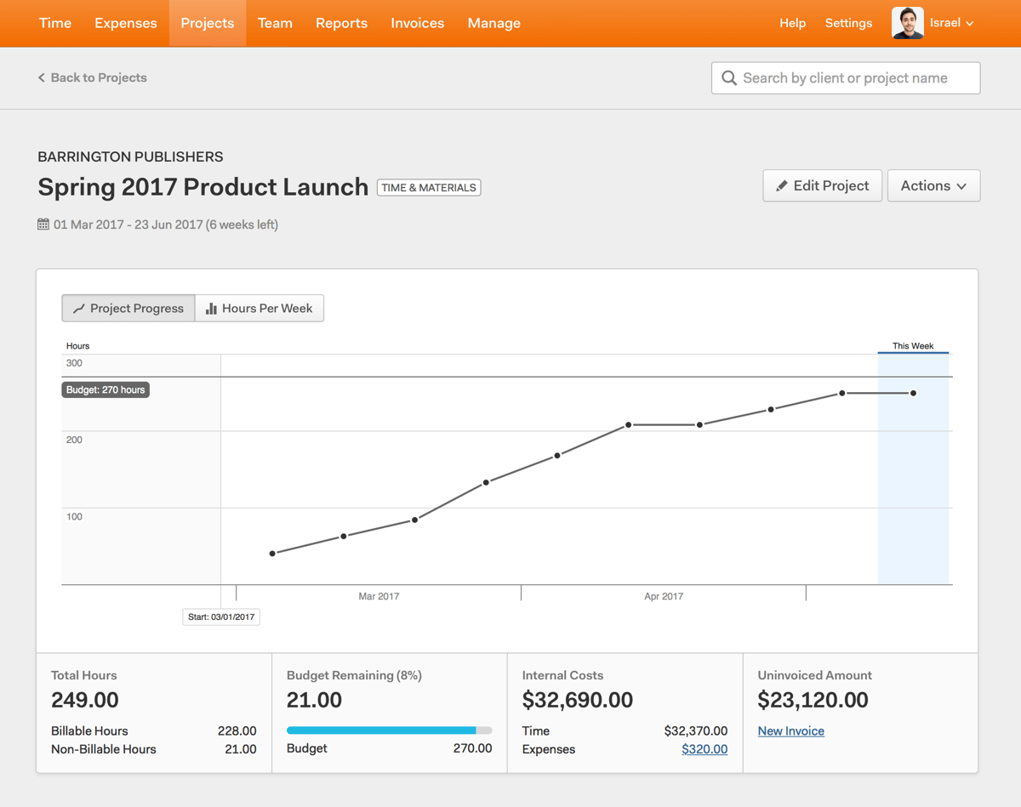
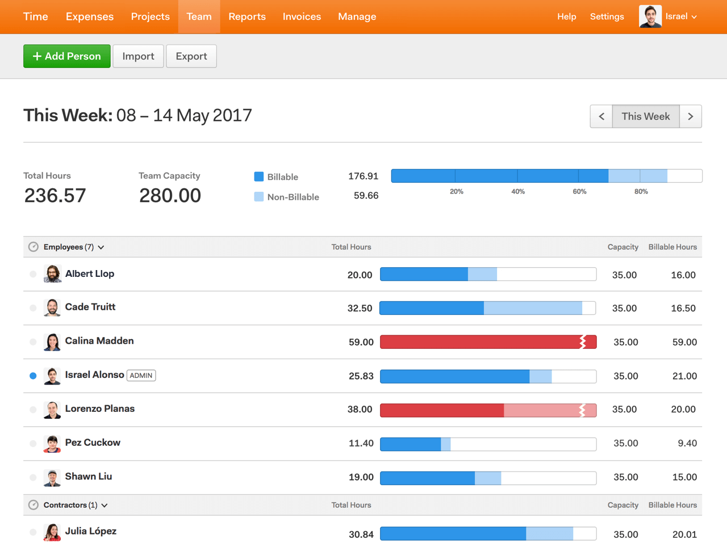
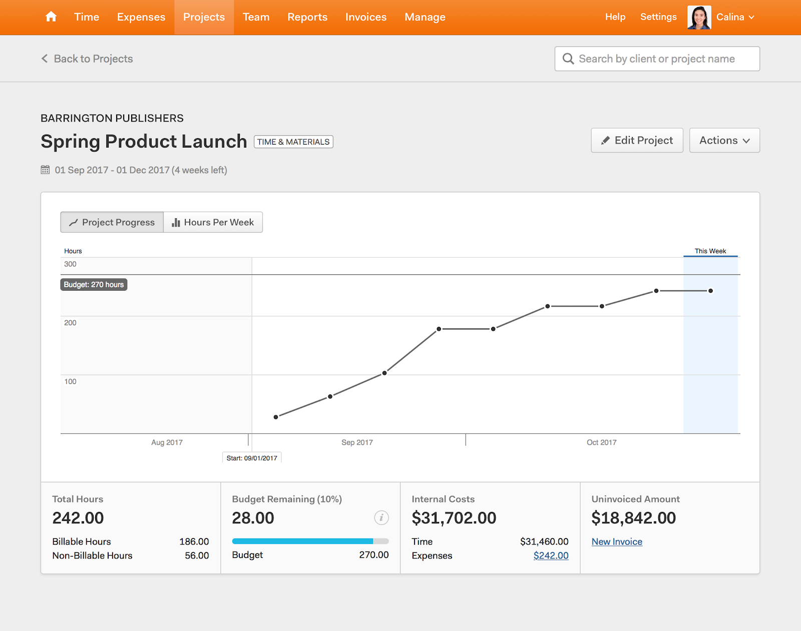
Sample report about our projects
Notes:
[Harvest Notes]: It helps to show your team examples of the reports you’ll generate using timesheet data. This is an example of the insight you can get into your projects using Harvest. It can help you track project progress against a budget, calculate costs, and figure out how much to invoice clients. Note that, depending on their permissions, not everyone will be able to see this information. However, even people who can’t see it can still track time to the project.

Slide 6
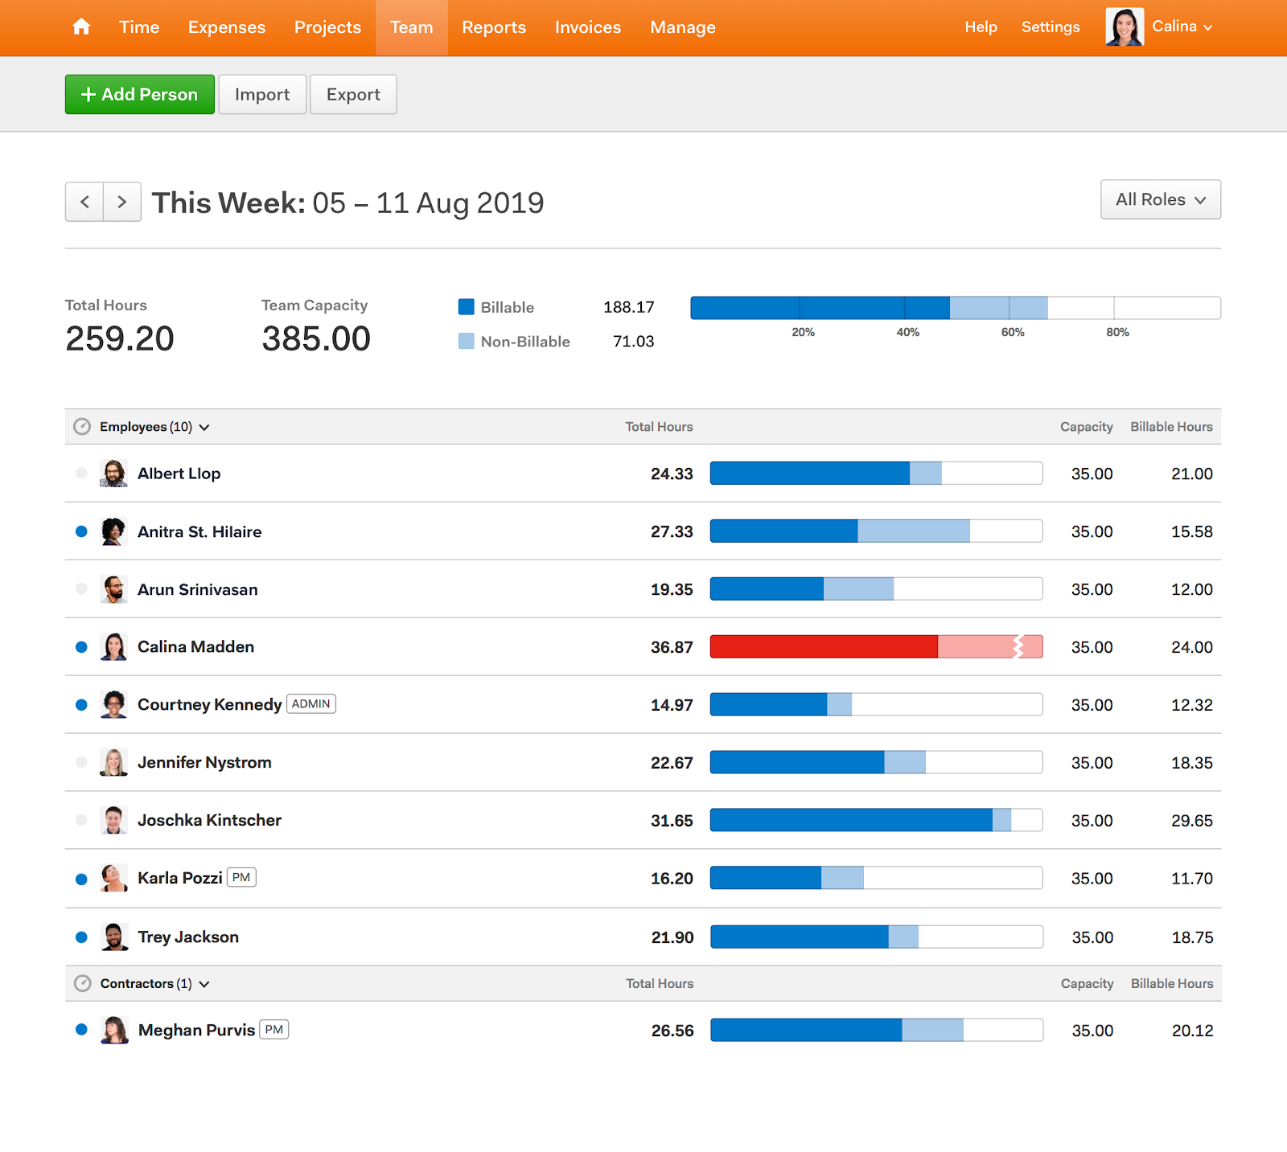
Sample report about our team’s time
Notes:
[Harvest Notes]: This is an example of the insight Harvest gives you into your team’s time. It can help you figure out who’s in danger of burning out and who can take on new projects. Make it clear that the purpose of collecting this information is not to spy on your team or judge them, but to improve the way you run projects. It’s also helpful to note that only admins in Harvest will have access to this information.

Slide 7
2
What’s expected of you

Slide 8
What time do people need to track? Do they need to track everything they do at work or only certain projects? Does it need to be exact or will an estimate do?
Time you need to track
Notes:
[Harvest Notes]: Some companies want their team to track every minute they spend at work. Others only care about client projects. Some are okay with general estimates, whereas others want more exact time entries. Edit the highlighted area above to let your team know exactly what they need to track.

Slide 9
Make sure your time for the week has been entered into Harvest by 5:00 pm Friday.
Your timesheet will be reviewed and approved by your project manager. Make sure you submit your timesheet for approval before the deadline. Once it’s been approved, those time entries will be locked.
Deadlines
Notes:
[Harvest Notes]: Make it clear when your team needs to have their time in. Edit the top bullet point to let them know about any deadlines. If you’re using Harvest’s timesheet approval feature, use the second bullet point to let your team know they need to submit their timesheets, and who will be reviewing them. If you aren’t using timesheet approval, feel free to remove it entirely. Learn more about timesheet approval here: https://help.getharvest.com/harvest/timesheets/approving-timesheets/timesheet-approval/

Slide 10
3
An introduction to Harvest

Slide 11
Run a timer as you work.
Options for tracking time
Enter time for the day or
week all at once.
Notes:
[Harvest Notes]: Different people prefer different methods for tracking their time. Make sure your team is aware of all their options, so they can find what works best for them. They can either run a timer as they work, stopping it when they finish a task and starting a new timer when they move on to something else, or they can enter time into their timesheets for a longer stretch of time.

Slide 12
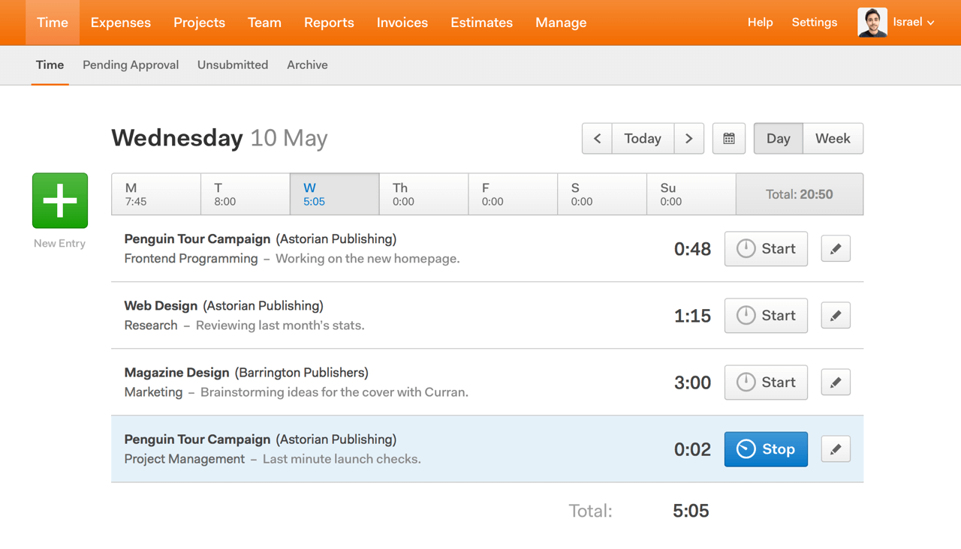
Run a timer as you work
Options for tracking time
The main Harvest web app.
Desktop apps.
Mobile apps.
Integrations. (if applicable)
Notes:
[Harvest Notes]: For people who prefer running a timer, there are lots of different places where they can start a timer. They can either sign in to Harvest’s main web app, or they can download a desktop or mobile app for faster access. If you’re integrating Harvest with another tool, don’t forget to mention that they might be able to track time in that tool as well. You can see the full range of apps and integrations available at http://getharvest.com/apps-and-integrations

Slide 13
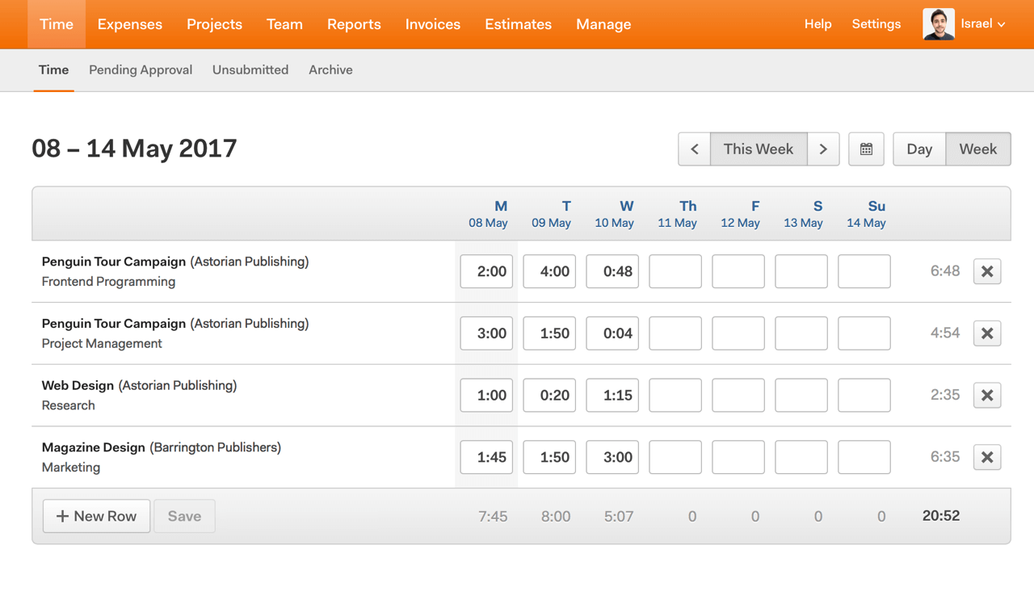
Enter your time for the week at once
Options for tracking time
The Time section of the main Harvest web app.
Notes:
[Harvest Notes]: People who prefer entering time into a timesheet will have to sign in to the main Harvest app in order to record their time.

Slide 14
Take screenshots of your computer.
Monitor chats or messages.
Track which websites or apps you’re using.
Track your location.
Track time automatically.
What Harvest does not do
Notes:
[Harvest Notes]: Some time tracking tools track employees in invasive ways. Harvest isn’t like that. Reassure your team that Harvest is not being used to spy on them.

Slide 15
See what you spend your time on.
Find areas to cut back.
Hold yourself accountable to your biggest priorities.
Personal insight
Notes:
[Harvest Notes]: Time tracking can provide individuals with valuable information. Point out to your team that this is an opportunity for them to examine and improve their personal work habits.

Slide 16
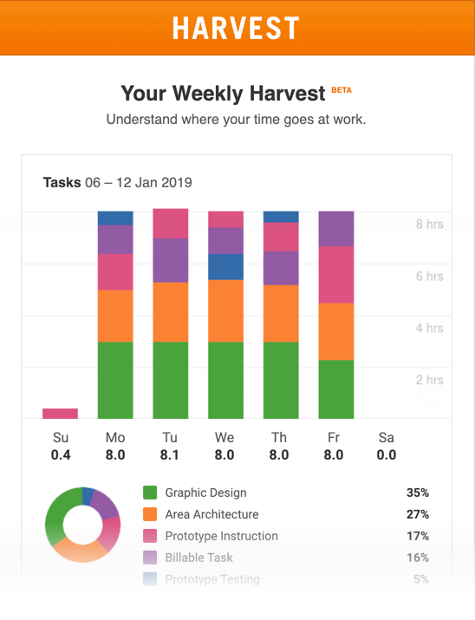
Personal insight
Notes:
[Harvest Notes]: Team members can opt to receive a weekly digest email that shows them how they spent their time for the week. An example is above. Learn more here: https://help.getharvest.com/harvest/reports/reports-faqs/personal-time-report/

Slide 17
4
Next steps

Slide 18
Look for an email invitation from Harvest. It will have instructions for signing in.
The first week to have a timesheet submitted in Harvest is [Month Day]. If you haven’t received your invitation by then, please contact [Contact Person].
Check out the Harvest welcome guide to learn more about how Harvest works.
Next steps
Notes:
[Harvest Notes]: Give your team an idea of what’s going to happen next and what they need to do. Don’t forget to add them as a user in Harvest and share the Harvest welcome guide with them!

Slide 19
getHarvest.com/welcome
Notes:
[Harvest Notes]: This is a good opportunity to ask your team if they have any initial questions. The link above is for the Harvest welcome guide. Encourage them to give it a look as they’re getting started in Harvest.

