Slide 1
Health First Colorado
Recovery Audit Contract
RAC Overview
2020

Slide 2
01
Introductions
02
Health First Colorado Recovery Audit Contract (RA) Summary
03
HMS Overview
04
Health First Colorado RAC Scope and Process
05
Resources
06
Q & A

Slide 3

Introductions

Slide 4
Health First Colorado RAC Summary

Slide 5

▪Medicare Modernization Act of 2003 created a
demonstration project to identify Medicare
Overpayments
• Operational from 2005 through 2007
• Made permanent in 2008
▪Section 6411(a) of the Affordable Care Act
expanded RAC to Medicaid.
• Identification of improper payments
• Coordination of audit efforts with state audit efforts
• Education to providers
▪Colorado Revised Statutes (CRS)
• CRS Section 25.5-4-301
▪Code of Colorado Regulations (CCR)
• 10 CCR 2505-10
• Section 8.015.8B
• Section 8.076.2-3
• Section 8.130.2A
Background on the Recovery Audit Contractor

Slide 6
HMS Overview

Slide 7

About HMS
HMS delivers healthcare technology, analytics and engagement solutions to help reduce costs, improve health outcomes and enhance consumer experiences.
Founded
1974
Customers
350+ health plans
40+ state Medicaid programs
160+ employers
Federal agencies (CMS,VA, CDC)
TPAs, PBMs, At-risk providers
HQ
Irving, Texas
Employees
~3,100, including international presence in India and Australia

Slide 8




Key Assets to Address Healthcare’s Cost Containment Needs
Broad solutions set - Coordination of Benefits, Payment Integrity, Population Risk Analytics, Care Management and Consumer Engagement
Market-leading data and technical ability to aggregate diverse data sets in normalized and common formats
Sophisticated and proprietary analytics developed over decades are paired with the latest technologies
Deep healthcare industry expertise
Expansive marquee client base enables access to best practices in the industry
Payment Accuracy
Coordination of Benefits
(COB)
Payment Integrity
(PI)
Population Health
Management (PHM)
Advisory Services

Slide 9

HMS Health First Colorado RAC Approach
Identify improper payments through
analysis of paid Health First Colorado
claims.
Deliver results grounded in quality,
integrity and accuracy to policy.
Partner with the Single State Agency to ensure a fair and consistence process.
Ensure clear, concise, and timely communication with providers.
Afford all providers their right to appeal.

Slide 10
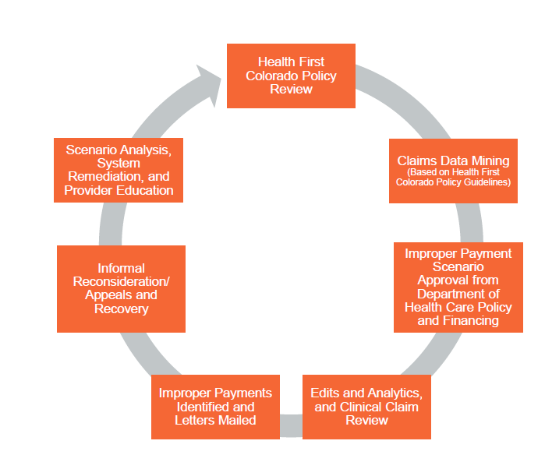
HMS Health First Colorado RAC Scenario Life Cycle

Slide 11
Health First Colorado RAC Scope and Process

Slide 12
Health First Colorado RAC
Scope and Type of Reviews
Scope
Automated Reviews
Complex Reviews
Lookback Period: Up to seven years from the claim paid date
Claim Types: All Claim and provider types are included
Automated Reviews are used when improper payments can be identified clearly and unambiguously using paid claims data
Examples:
Services rendered after date of death
Services rendered to recipients no longer eligible for Health First Colorado
Duplicate payments
Complex Reviews are required when data
analysis identifies a potential improper payment
that cannot be automatically validated so a review
of supporting documentation is required
Examples:
DRG Coding
Short-stay/Place of service reviews
Hospital readmissions

Slide 13

Automated Review Process
01
02
03
04
RAC Algorithms
Applied to Paid
Claims Data
Improper payment scenario submitted to HCPF
HCPF approval
Improper Payments Identified
InterChange review
Data validation
Notice of Adverse Action Issued
Certified mail
Serves as provider audit notification and communicates audit results. Providers do not receive notice prior to this notification for Automated review
Providers are given 30 calendar days from letter date to respond
Letter copies available on HMS Provider portal
IR, Appeal, Recovery
Informal Reconsiderations (IR): Additional documentation submitted and reviewed; final decision reached
Formal Appeal: Hearing held and final decision reach
Recovery: overpayment returned to HCPF

Slide 14
01
02
03
04
  Medical Records Requested
  Certified Mail
  Serves as provider’s notice of audit. Providers will not receive any audit plan or schedule in advance of this notice
  Provides are given 45 days from letter date to respond
  Providers may request an extension through HMS within 15 calendar days for additional time to return records
  Provider can submit their Medical records on paper, CD, or SFTP (to submit via SFTP contact HMS)
  Records Reviewed & Improper Payments Identified
  HMS Completes review
  Data validation
  Findings shared with HCPF
  Exit Conference held, as requested by provider
  Notice of Adverse Action Issued
  Certified Mail
  Providers are given 30 days from letter date to respond
  Letter copies available on HMS Provider Portal
  IR, Appeal, Recovery
  Informal reconsiderations: additional documentation submitted and reviewed; final decision reached
  Formal Appeal: Hearing held, and final decision reached
  Recovery: Overpayment returned to HCPF
Complex Review Process

Slide 15
• Exit conferences are optional and must be requested by the
Provider.
• Requested exit conferences are held once HMS has completed the review and before the Notice of Adverse Action is issued.
• Providers may request the Department be present at the
conference.
• HMS will host the conference and provide discussion on:
– Overpayment findings
– Documentation used to make the findings
– Missing documentation that might change the result
– Next steps in the review process
– Ways to avoid making same errors in the future
Exit Conference

Slide 16
Informal Reconsideration (IR)
▪ 30 Days: An Informal Reconsideration request must be
submitted in writing within 30 days of date of the Notice of
Adverse Action
▪ New additional documentation, not already provided, must
be submitted with the request.
▪ The specific overpayments being challenged must be
identified.
The reason for the request must be provided.
45 Days: HMS will complete the reconsideration and issue a
decision within 45 days.
Appeal
▪ 30 Days: An Appeal must be filed with the Office of Administrative Courts within 30 days of the date of the
original Notice of Adverse Action or Informal
Reconsideration response.
▪ Instructions for submitting a formal appeal are included on
the Notice of Adverse Action.
Claims submitted for IR or formal appeal will not
be recovered until after the IR or appeal is
finished.
Informal Reconsideration or Appeal

Slide 17



Automated Review | Complex Review
Agree- 30 days from the date of the Notice of Adverse Action of return overpayment to the Department | 45 days to submit medical records (submission options and instructions listed on Medical Record Request Letter)
Disagree– 30 days from date of the Notice of Adverse Action to submit Informal Reconsideration Request | 10 days to request Exit Conference from date medical records are submitted
Disagree– 30 days from date of the Notice of Adverse Action or Informal Reconsideration response to file appeal to Office of Administrative Courts | 60 days for HMS to complete review and notify provider via Notice of Adverse Action
 | Agree – 30 days from the date of the Demand Letter to return overpayment to the Department
 | Disagree– 30 days from date of the Notice of Adverse Action to submit Informal Reconsideration Request
 | Disagree– 30 days from date of the Notice of Adverse Action or Informal Reconsideration response to file appeal to Office of Administrative Courts
Review Timing

Slide 18
Resources

Slide 19

Provider
Portal
▪ Web-enabled, real-time, reliable, secure
▪ Leading technology designed for Provider
accessibility
▪ Streamlines access to information
▪ Update provider demographics
▪ Monitor review status
▪ Access electronic copies of letters
▪ Please visit https://ecenter.hmsy.com
▪ Instructions for New User Registration
▪ Once enrolled, it is important to update your
RAC-related contact information to ensure
proper routing of all RAC documents and
notifications
Notes:
Gary

Slide 20
▪ CO Provider-specific website:
http://hms.com/us/co-providers/home
▪ CO Provider-specific toll-free number:
(Monday – Friday, 8:00am – 5:00pm MT):
(877)- 640-3419
▪ CO Provider-specific email address:
CORAC@hms.com
CO RAC Dedicated Provider Contacts

Slide 21


Moving healthcare forward.
hms.com
© 2020 HMS. All rights reserved.
Kim Nguyen- HCPF Provider Payment Review Unit Supervisor
Alyssa Gilger- HCPF Contingency Based Contract Manager
Kim.Nguyen@state.co.us
303.866.6575
Alyssa.Gilger@state.co.us
303.866.2253
Joanna Coccaro- HMS
Program Director
Tara Wingo- HMS
Program Manager
Joanna.Coccaro@hms.com
203.428.1250
Tara.Wingo@hms.com
720.308.2082

